Slide 1
Hot Topics in General Relativity and Gravitation, Aug. 9-15, Quy Nhon, Vietnam
Holographic Superconductor Models
Rong-Gen Cai
Institute of Theoretical Physics
Chinese Academy of Sciences

Slide 2

2015: GR100
GR is nothing, but
a theory of spacetime!
KITPC program on
holographic duality for
condensed matter physics
(July 6-31,2015)

Slide 3
Outline:
1 Introduction
2 Holographic models of superconductors
s-wave, p-wave and d-wave, insulator/conductor
3 Holographic Josephson junction and SQUID
4 Competition and coexistence of superconductivity orders
5 Summary

Slide 4
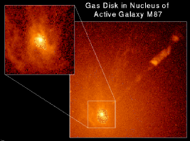
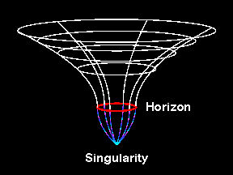
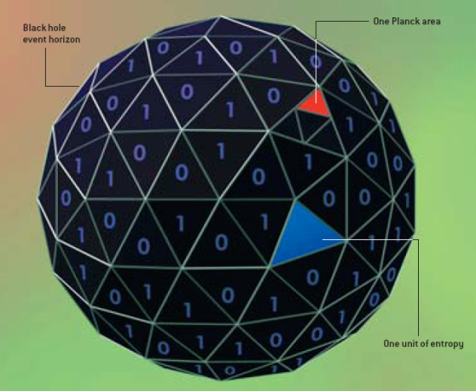
1 Introduction: holographic principle
Black hole is a window to quantum gravity
Thermodynamics of black hole
S.Hawking, 1974, J. Bekenstein, 1973

Slide 5

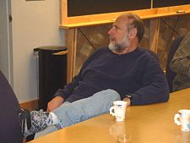


Holography of Gravity
Entropy in a system with surface area A:S<A/4G
(G. t’ Hooft)
(L. Susskind)
The world is a hologram？

Slide 6




Why GR?
The planar black hole with AdS radius L=1:
where:
Temperature of the black hole:
Energy of the black hole:
Entropy of the black hole:
The black hole behaves like a thermal gas
in 2+1 dimensions in thermodynamics!

Slide 7
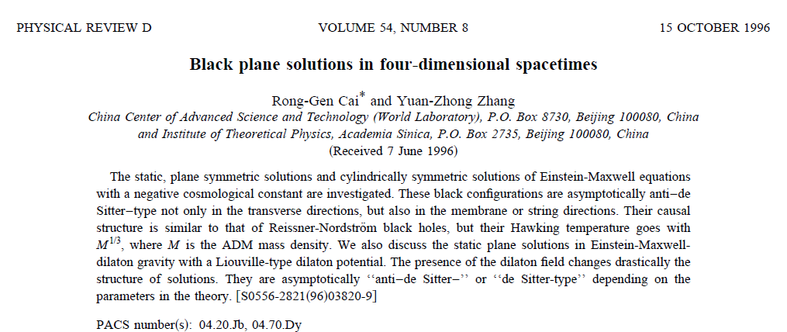


Topology theorem of black hole horizon:

Slide 8
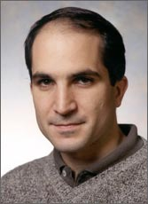
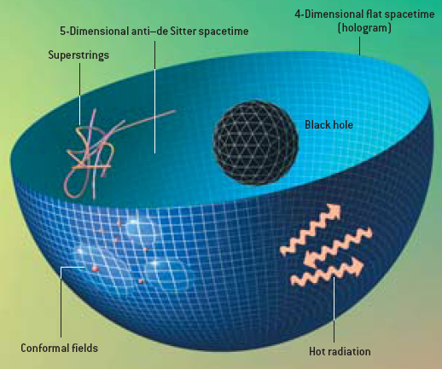
AdS/CFT correspondence
(J. Maldacena,1997)
IIB superstring theory on AdS5 x S⁵
N=4 SYM
“Real conceptual change
in our thinking about Gravity.”
(E. Witten, Science 285 (1999) 512

Slide 9

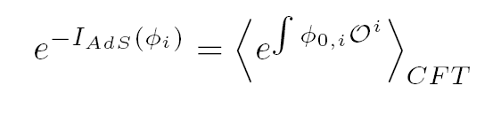

AdS/CFT dictionary :
Here
in the bulk:
the boundary value of the field propagating in the bulk
in the boundary theory:
the exterior source of the operator dual to the bulk field

Slide 10
Quantum field theory
in d-dimensions
operator Ο
boundary
quantum gravitational theory
in (d+1)-dimensions
dynamical field φ
bulk
(0909.3553, S. Hartnoll)

Slide 11
AdS/CFT correspondence：
gravity/gauge field
2) different spacetime dimension
3) weak/strong duality
4) classical/quantum
Applications in various fields:
low energy QCD, high temperature superconductor

Slide 12
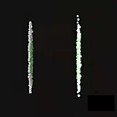
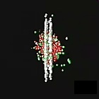
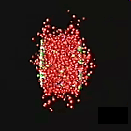
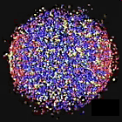

RHIC’s heavy Ion Collision
aurum
RHIC:
PRL98, 172301(2007), nucl-ex/0611018
PRL99, 172301(2007), nucl-ex/0706.1522
AdS/CFT:
Kovtun, Son and Starinet,PRL (05)
Gauss-Bonnet
black hole
(Brigante et al, PRL 2008)
Notes:
Au: Aurum

Slide 13
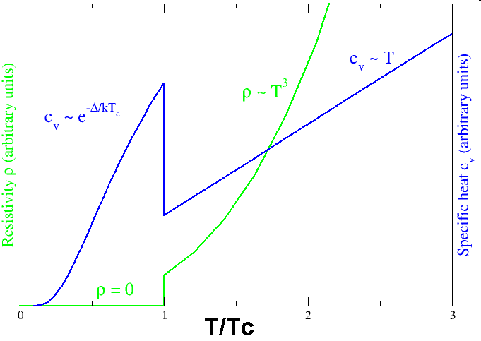
Superconductor：
Vanishing resistivity (H. Onnes, 1911)
Meissner effect (1933)
1950, Landau-Ginzburg theory
1957, BCS theory: interactions with phonons
1980’s: cuprate superconductor
2000’s: Fe-based superconductor

Slide 14
How to build a holographic superconductor model？
CFT AdS/CFT Gravity
global symmetry abelian gauge field
scalar operator scalar field
temperature black hole
phase transition high T/no hair；
low T/ hairy BH
G.T. Horowitz, 1002.1722

Slide 15
No-hair theorem?
S. Gubser, 0801.2977

Slide 16
2. Holographic superconductors: (1) S-wave
Building a holographic superconductor
S. Hartnoll, C.P. Herzog and G. Horowitz, arXiv: 0803.3295
PRL 101, 031601 (2008)
High Temperature（black hole without hair):

Slide 17
Consider the case of m^2L^2=-2，like a conformal scalar field.
In the probe limit and A_t= Phi
At the large r boundary:
Scalar operator condensate
O_i:

Slide 19


Conductivity
Maxwell equation with zero momentum :
Boundary conduction:
at the horizon: ingoing mode
at the infinity:
AdS/CFT
source:
current
Conductivity:

Slide 20

A universal energy gap: ~ 10%
BCS theory: 3.5
K. Gomes et al, Nature 447, 569 (2007)

Slide 21
Summary:
The CFT has a global abelian symmetry corresponding a
massless gauge field propagating in the bulk AdS space.
Also require an operator in the CFT that corresponds to a scalar
field that is charged with respect to this gauge field..
3. Adding a black hole to the AdS describes the CFT at finite
temperature.
Looks for cases where there are high temperature black hole
solutions with no charged scalar hair, but below some critical
temperature black hole solutions with charged scalar hair and
dominates the free energy.

Slide 22
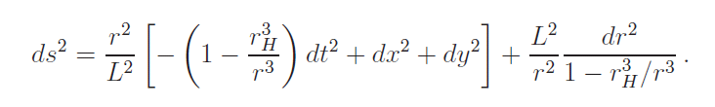

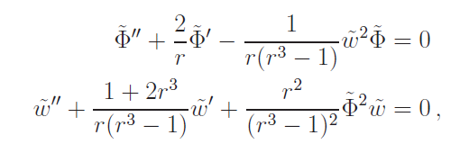
(2) P-wave superconductors
S. Gubser and S. Pufu, arXiv: 0805.2960
The order parameter is a vector! The model is

Slide 23
Vector operator
condensate
The ratio of the superconducting
charge density to the total charge density.

Slide 24
Back reaction in holographic p-wave superconductor
Consider the model:
The ansatz:

Slide 25

Equations of motion:
back reaction strength

Slide 27
Condensate of the vector operator
second order transition
first order transition

Slide 28
Free energy and entropy

Slide 29
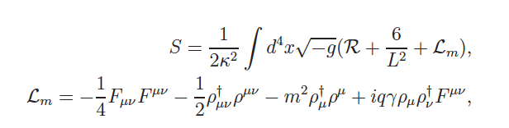
(2) Another P-wave:
Vector condensation and holographic p-wave superconductor
R.G. Cai et al, arXiv: 1309.2098, arXiv: 1309.4877,
arXiv: 1311.7578, arXiv: 1401.3974
Einstein-Maxwell-Vector Theory:
gyromagnetic ratio
rho meson condensation in strong magnetic field,
Holographic p-wave model
3）Conductivity induced by magnetic field

Slide 30

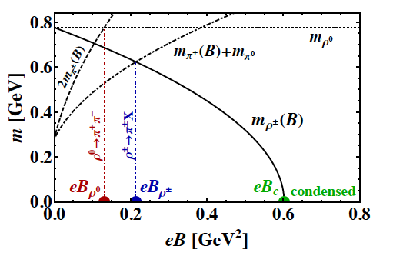
i) Condensation of rho meson in strong magnetic field
(M. Chernodub: 1008.1055)
Strong magnetic field could be created at RHIC and LHC
The QCD vacuum will
undergo a phase transition
to a new phase where
charged rho mesons are
condensed!!

Slide 31
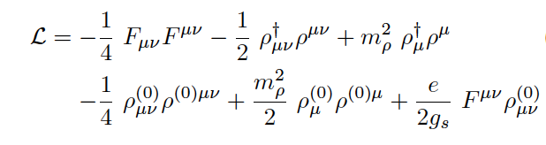
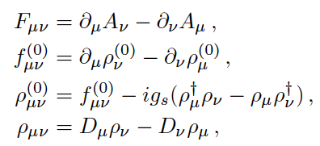
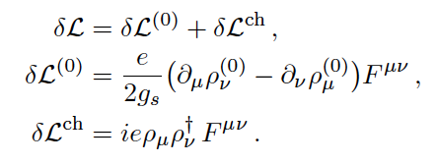
To describe the condensation of rho meson:
The DSGS model of rho meson’s electrodynamics:
(D.Djukanovic, M. Schindler, J. Gegelia and S. Scherer, PRL 95, 012001)

Slide 32
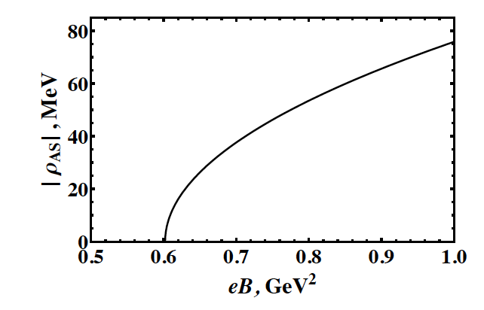
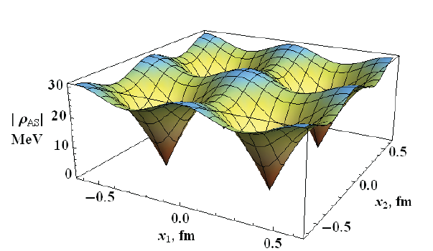
condensation as a function
of applied magnetic field.
rho meson vortex lattice

Slide 33
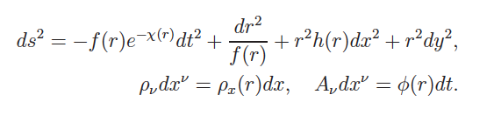
ii) A Holographic Model of p-wave Superconductor
Einstein-Maxwell-Vector Theory: generalization of DSGS
The ansatz:

Slide 34
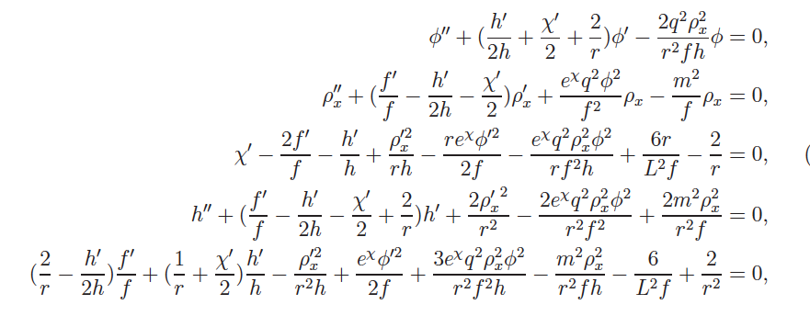

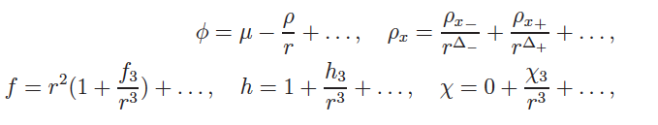
The equations of motion with back reaction:
The AdS boundary condition:

Slide 35
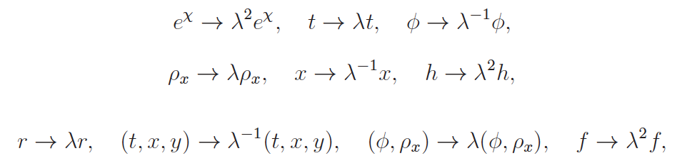


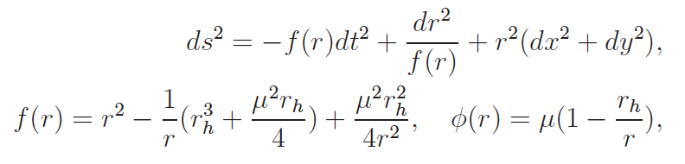
There exist three scaling symmetries in EOM:
by which we can set:
In addition, we have the RN-AdS solution:

Slide 36





To see which solution is thermodynamically favored,
Free energy of the black hole solutions:
We find that the system behaves qualitatively different when
and

Slide 37




i) The case :
=0
As an example, consider
Now the only parameter is the charge q of the vector field.
We find there exists a critical value of the charge:

Slide 38
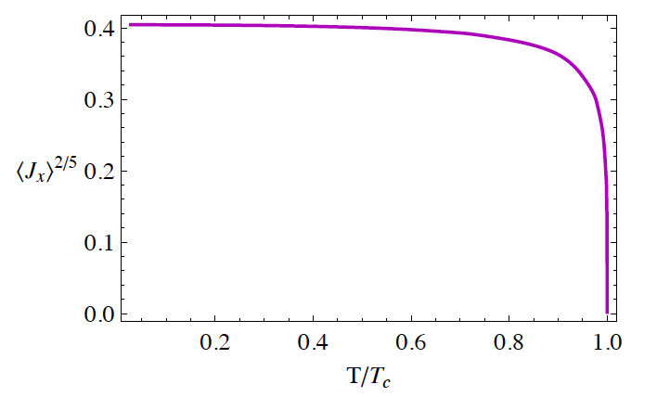

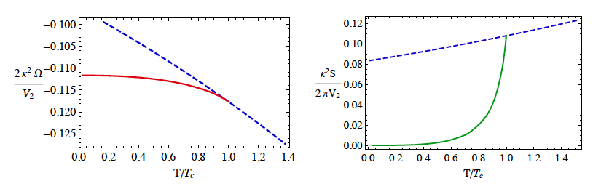
(1) when

Slide 39
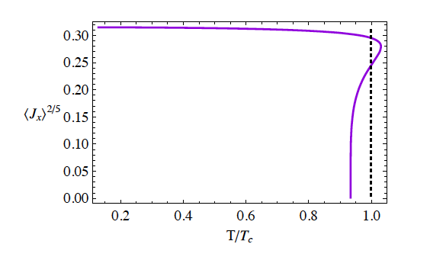

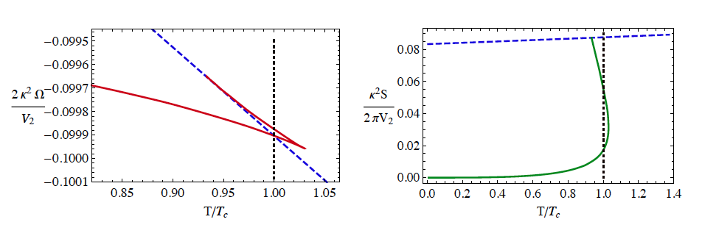
(2) when

Slide 40
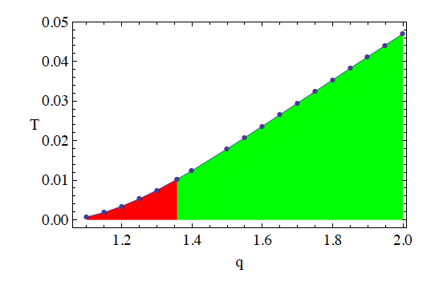

(3) Phase diagram:
Normal state
superconducting

Slide 41




ii) The case:
As an example, consider
In this case, we find that

Slide 42

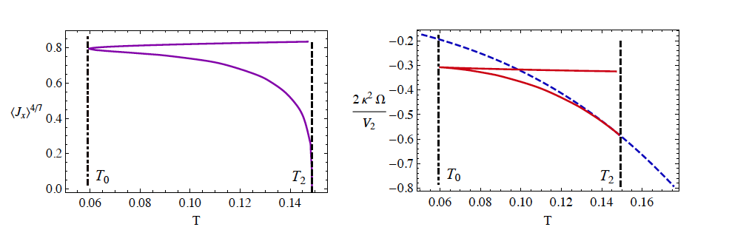
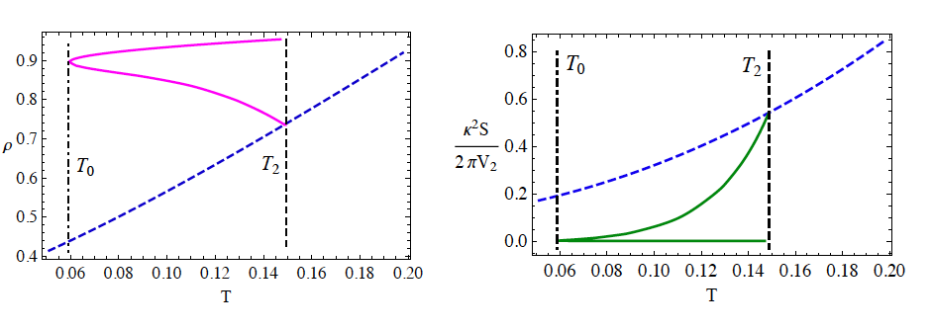
（1）The case
Two comments:
Zeroth order phase transition?
V.P. Maslov, “Zeroth-order Phase transition”,
Mathematical Notes 76, 697 (2004)
b) p-wave model with two-form field in gauged SUGRA
F. Aprile, D. Rodriguez-Gomez and J. Russo, 1011.2172

Slide 43

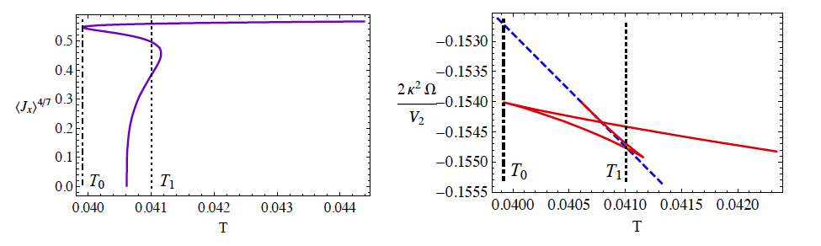
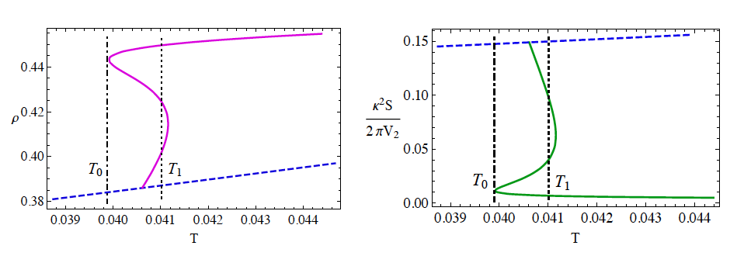
(2) The case

Slide 44
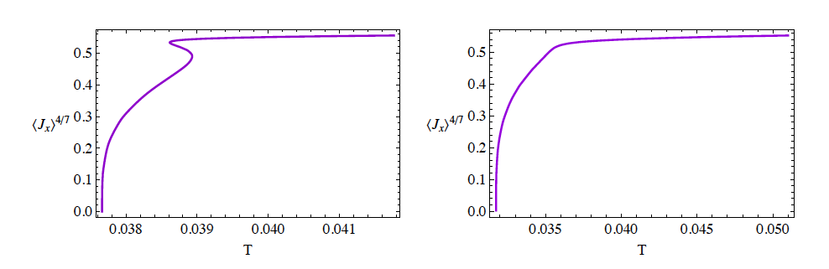


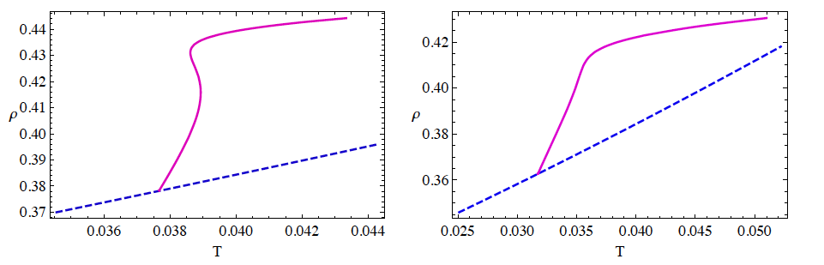
(3) The case

Slide 45
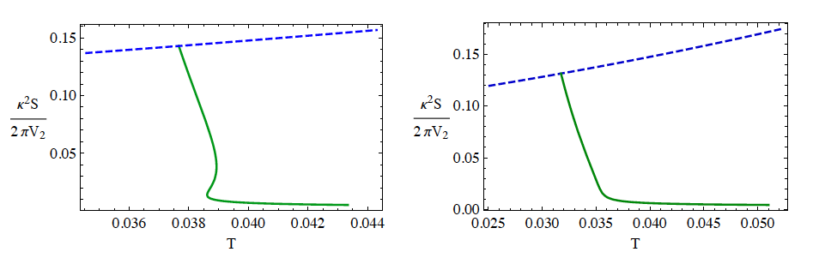
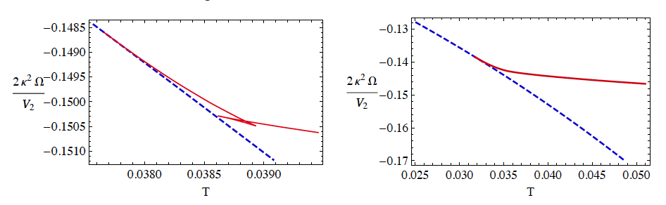
entropy and free energy
Two comments:
“ Retrograde condensation”: this was first introduced to
describe the behavior of a binary mixture during isothermal
compression above the critical temperature of the mixture.
J. P. Kuenen, “Measurements on the surface of Van der Waals for mixtures of carbonic acid and methyl chloride,”
Commun. Phys. Lab. Univ. Leiden, No 4 (1892).
b) A. Buchel and C. Pagnutti, “Exotic hairy black hole”,
0904.1716;
A. Donos and J. Gauntlett, 1104.4478;
F. Aprile, D. Roest and J. Russo, 1104.4473

Slide 46
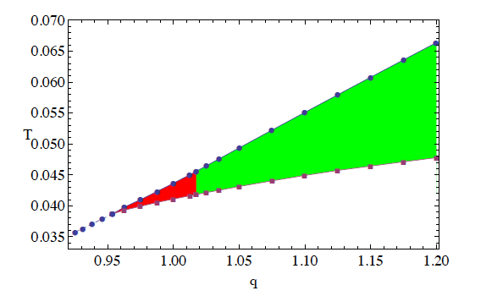

(4) Phase diagram
normal/superconducting/normal reentrant transition

Slide 47


Vector condensation induced by magnetic field
A) In AdS black hole background
We will work in the probe limit:

Slide 48



Now consider the LLL state, in this case, the effective mass of
the vector field:
There exist two different cases: (1) without charge density
(2) with charge density
(1) In the first case:

Slide 49
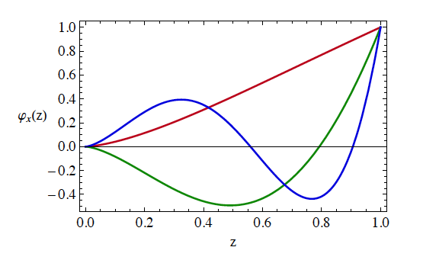



Slide 50

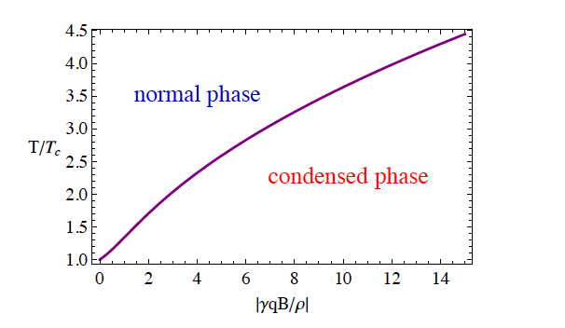

(2) The case with non-vanishing charge density

Slide 51

Vortex lattice solution:
This is enough to consider n=0 state solution:
Since the eigenvalue of E_n is independent of p, a linear
superposition of the solutions
with different p is also a solution of the model at the linear
order .

Slide 52
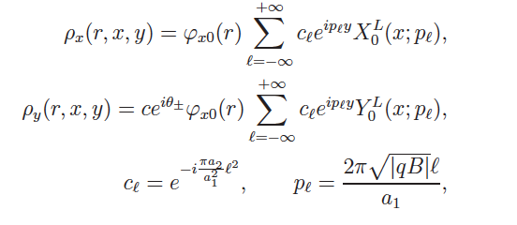

We define
K. Maeda, M. Natsuume and T. Okamura, “Vortex lattice for a holographic superconductor,”
Phys. Rev. D 81, 026002 (2010) [arXiv:0910.4475 ].

Slide 53
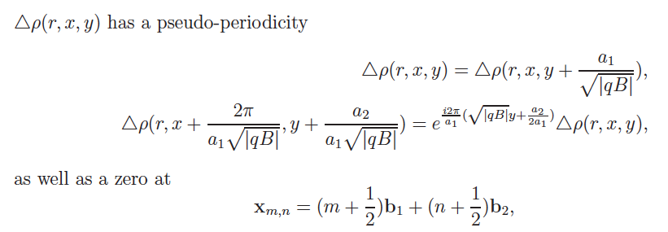

triangle lattice

Slide 54
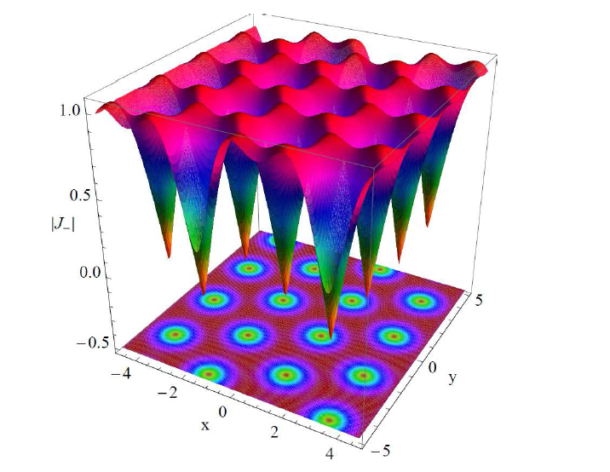

Vortex triangle lattice:

Slide 55


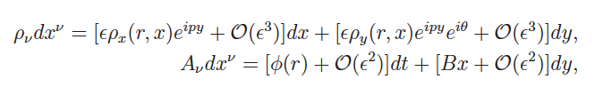

B) In AdS soliton background
The ansatz:

Slide 56
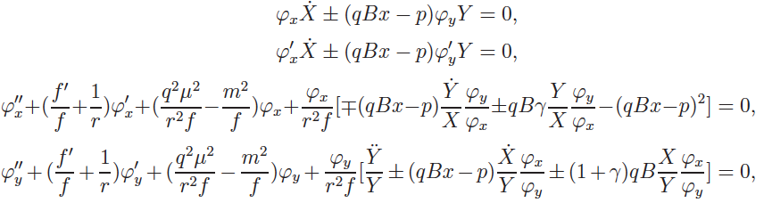

Equations of motion:
The eigenvalue:
The effective mass of the vector:

Slide 57


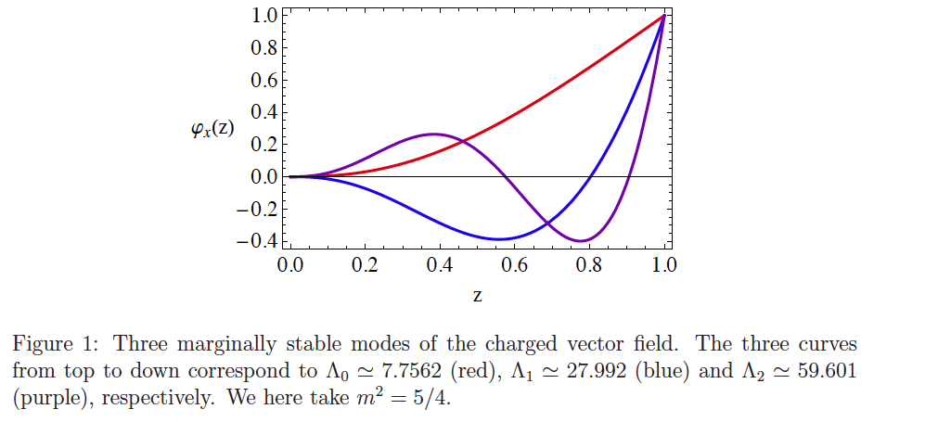
The radial equation:

Slide 58
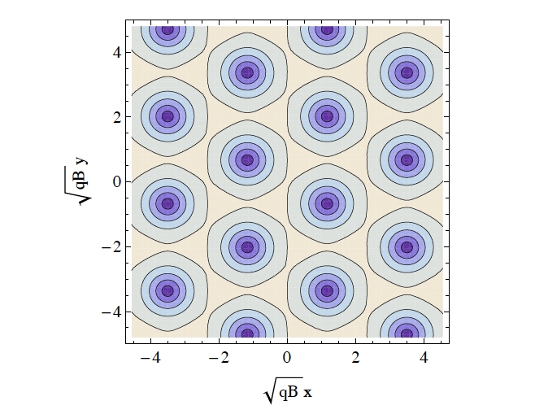
Questions: what is the difference from the SU(2) model?
gamma=1, m=0

Slide 59


(iii) D-wave superconductors
A) The CKMWY d-wave model
J.W.Chen et al, arXiv: 1003.2991
The ansatz:

Slide 60




at AdS boundary:
Condensation:

Slide 61


B) The BHRY d-wave model
F. Benini et al, arXiv:1007.1981

Slide 62




The ansatz:

Slide 63


Condensate and conductivity:

Slide 64

Holographic insulator/superconductor transition at zero tem.
The model:
T. Nishioka et al, JHEP 1003,131 (2010)
The AdS soliton solution

Slide 65

The ansatz:
The equations of motion:
The boundary:
both operators
normalizable if

Slide 66
soliton superconductor

Slide 67
Black hole superconductor

Slide 68
Phase diagram
without scalar hair
with scalar hair

Slide 69
Complete phase diagram (arXiv:1007.3714)
q=5
q=2
q=1.2
q=1.1
q=1

Slide 70
3. Holographic Josephson junction and SQUID
Holographic Superconductor-Insulator-Superconductor Josephson Junction
Wang,Liu,Cai, Takeuchi and Zhang,arXiv:1205.4406
G.T. Horowitz et al, arXiv: 1101.3326
supercond
supercond
insulator
The model:
AdS soliton:
Matter sector:

Slide 72
Phase differnce:

Slide 73
Choose the profile of the boundary chemical potential:

Slide 76





A Holographic Model of SQUID (superconducting quantum interference device) , Cai, Wang and Zhang, arXiv: 1308.5088
Our model:

Slide 77





Slide 78
4、Competition and coexistence of superconductivity orders
1）s+s orders
P. Basu et al arXiv:1007.3480 ,R.G. Cai et al, arXiv:1307.2768
s+p orders
Z.Y. Nie at al, arXiv: 1309.2204,1501.00004,
I. Amado et al, arXiv: 1309.5085
s+d orders
M. Nishida, arXiv: 1403.6070, L. F. Li et al, arXiv:1405.0382
4) P + (P+iP) orders
A. Donos et al, arXiv: 1310.5741
5) Superconductivity + magnetism
R.G. Cai et al, arXiv: 1410.5080,A. Amoretti et al, arXiv: 1309.5093

Slide 79




1) s+s orders: Cai, Li, Li and Wang, 1307.2768
Consider N=2, and by redefine

Slide 80




The ansatz:
Equations of motion:

Slide 81

This model has four parameters:
Take an example, consider:
We have three different superconductivity phases:
Both of them do not vanish!
Three kinds of coexisting phases!

Slide 82



Slide 83

The conductivity:

Slide 84

The phase diagram:

Slide 85



2）S+P orders: Nie, Cai, Gao and Zeng, 1309.2204,1501.00004
Consider a real scalar triplet charged in an SU(2) gauge field
The ansatz:

Slide 86

Condensation:

Slide 87

Phase diagram:
Much rich phase structure appears once the back reaction
is taken into account: see arXiv:1501.00004.

Slide 88



(3): s+d orders: Li,Cai, Li and Wang, arXiv:1405.0382
This model has four parameters:
In the probe limit, one can set

Slide 89


The ansatz:
There is a symmetry in the equations of motion
under which s-wave and d-wave interchange their roles.
Thus we can set:

Slide 90



Take the parameters as:

Slide 91

Free energy:

Slide 92

Charge density:

Slide 93

Conductivity:
There is an additional spike at a lower frequency, indicating
the existence of a bound state.

Slide 94
Thanks !

