Slide 1
The large D limit of General Relativity
Kentaro Tanabe (Kek)
based on collaboration work with R.Emparan, D.Grumiller, R.Suzuki, T.Shiromizu, T.Tanaka,
arXiv: 1302.6382, 1303.1995, 1506.06772

Slide 2
Large D limit
“Large D limit” = “1/D expansion of equations” (not only for GR)
Classical GR: e.g., Black Hole physics
- Quasinormal modes, Black hole solution, Gravitational collapses, Matter field dynamics around BHs, Dynamical evolution of BHs, …
[ Asnin-et.al. (2007), Emparan-Suzuki-KT (2013) ]
Quantum GR
- Analogy with Large N limit of SU(N) Yang-Mills
[Strominger (1981), Bjerrum-Bohr (2003), Hamber-Williams (2005), Canfora (2005) ]
Non GR: Condensed matter physics
- Dynamical mean field theory becomes an exact description of strongly correlated electron system at D=$∞$
[ Metzner-Vollhardt (1989), Georges-et.al. (1996),…]
$D=∞$ solution can explain$D=2$ or $D=3$ phenomena

Slide 3
Large D limit in GR
Large D limit in Classical GR
Einstein equation involves a spacetime dimension $D$
$$G_{μν}+Λg_{μν}=T_{μν}$$
Large D limit can simplify Einstein equation
Non-linear PDE system
Non-linear ODE system
Coupled equations for many variables
Decoupled equations for a few variables
Large D limit is a useful approximation method to solve Einstein equation
- In particular Black hole physics

Slide 4
summary of talk
Black Holes physics in the 1/D expansion
Almost no interactions between BHs, and strongly confined gravity
Black Hole has an effective description at $D=∞$
- Black hole physics as Membrane paradigm at large D
[ Minwalla-et.al. (2015), Emparan-et.al (2015), Suzuki-KT (2015) ]
$$G_{μν}+Λg_{μν}=0$$
$$∇^{a}T_{ab }=F_{b}$$
$$Σ$$
$$O(e^{−D})$$
- Black hole horizon becomes membrane-like object $Σ with$ effective fluid $T_{ab}$ satisfying simple dynamical equations derived from Einstein equation

Slide 5
contents
1. Black Holes at Large D
- Non-Decoupled mode / Decoupled mode excitation
2. One Application
- Evolution and endpoint of Gregory-Laflamme instability
3. Summary

Slide 6
contents
1. Black Holes at Large D
- Non-Decoupled mode / Decoupled mode excitation
2. One Application
- Evolution and endpoint of Gregory-Laflamme instability
3. Summary

Slide 7
Black holes
D dimensional Schwarzschild Black Hole metric
$$ds^{2}=−f\left(r\right)dt^{2}+f\left(r\right)dr^{2}+r^{2}dΩ_{D−2}^{2}$$
$$f\left(r\right)=1−{\left( \frac{r_{0}}{r} \right)}^{D−3}$$
BH’s gravitational potential has a Dimension-dependence
- Very steep behavior at $D=∞$
$$Φ=1−f$$
- Vanishing of potential far from BH
$$Φ={O(e}^{−D})$$
$$D→∞$$
- New characteristic scale appears
$${\left(ΔΦ\right)}^{−1}=r_{0}/D$$
$$∂_{r}=D/r_{0}$$
- Scale hierarchy (gradient expansion)
$$r_{0}≫r_{0}/D$$
$$r$$

Slide 8
potentials
Potential
$$V∼O(D^{2})$$
Probe field analysis
$$E=ω^{2}$$
$$1/r^{2}$$
$$□Ψ=0$$
$$\left(\frac{d^{2}}{dr_{∗}^{2}}−V(r)\right)Ψ=−ω^{2}Ψ$$
$$r=r_{0 }$$
$$(r_{∗}=−∞)$$
$$r−r_{0}=r_{0}/D$$
$$r=∞$$
$$(r_{∗}=∞)$$
BH gravity
No BH gravity
High energy mode (Non-decoupled mode): $ωr_{0}=O(D)$
- Probe the tip of the potential (centrifugal potential)
- No information of Black Holes (Universal mode = See BHs as a “hole”)
Low energy mode (Decoupled mode): $ωr_{0}=O(1)$
- Confined mode near the Black Hole
- Detail information of each BHs (e.g., instability, horizon deformation,..)

Slide 9
Non decoupled
$$V∼O(D^{2})$$
Non-decoupled mode
$$E=ω^{2}$$
$$E=ω^{2}=O(D^{2})$$
Universal mode
[Emaparan-Grumiller-KT (2013), Emaparan-KT (2014)]
- Various BHs have same feature
$$r=r_{0 }$$
$$(r_{∗}=−∞)$$
e.g., Quasinormal mode
$$r−r_{0}=r_{0}/D$$
$$r=∞$$
$$(r_{∗}=∞)$$
Coupled physics
- Far region dynamics and near region dynamics are coupled
BH gravity
No BH gravity
- Not only Radial dynamics
Non-decoupled mode view
$$∂_{r}=O\left(D\right)=∂_{t}$$
Applications
- Gravitational collapses, BH scattering or coalescence, Gravitational wave emissions

Slide 10
Decoupled
$$V∼O(D^{2})$$
Decoupled mode
$$E=ω^{2}=O(1)$$
$$E=ω^{2}$$
Non-universal mode
- Depends on each BHs
$$r=r_{0 }$$
$$(r_{∗}=−∞)$$
$$r−r_{0}=r_{0}/D$$
$$r=∞$$
$$(r_{∗}=∞)$$
e.g., stable/unstable
Decoupled physics
BH gravity
No BH gravity
- Only near region dynamics
Decoupled mode view
- Radial dynamics is dominant
$$∂_{r}$$
$$∂_{r}=O\left(D\right)≫∂_{t}=O(1)$$
Applications
- Construction of Black Hole solution, dynamics of isolated black hole

Slide 11
Membrane paradigm
Integration of decoupled mode in radial direction
$$∂_{r}$$
Integration of Einstein equation along r can be performed (ODE system w.r.t. $∂_{r}$)
$$∂_{r}=O\left(D\right)≫∂_{t}=O(1)$$
Physical d.o.f of BHs are associated on r-constant surface $Σ$ (BH = membrane)
$$(Σ,T_{ab})$$
- BH mass, (angular) momentum in $T_{ab}$ defined on $Σ$
EoM of BHs is derived from radial integration of Einstein equation (momentum constraint on $Σ$)
$$∇^{a}T_{ab }=F_{b}$$
- EoM depend on Black Hole which we consider (Schwarzschild, Kerr(Myers-Perry BH), black p-brane, black ring, …)
- Perturbation solution gives Qusinormal mode frequency

Slide 12
What We can do
Black Hole has two different physics
Non-decoupled mode physics
- Qusinormal mode is universal for non-extremal black holes
- Gravitational collapse (critical (Choptuik) exponent)
- Scalar field dynamics around AdS-BH (holographic superconductor)
[ Emaparan-KT (2013) ]
Decoupled mode physics (membrane paradigm)
- Black Hole solution construction
Black droplet (braneworld BH), Non-uniform Black String (NUBS), Black Ring, Bumpy Black Hole (deformed Myers-Perry BH),…
- Quasinormal mode
Find out of instability modes of Myers-Perry BH, Black p-brane, Black Ring solution
- Non-linear evolution/endpoint of dynamical instability of Black objects
Endpoint of Gregory-Laflamme instability, Critical dimension of NUBS

Slide 13
What We can do
Black Hole has two different physics
Non-decoupled mode physics
- Qusinormal mode is universal for non-extremal black holes
- Gravitational collapse (critical (Choptuik) exponent)
- Scalar field dynamics around AdS-BH (holographic superconductor)
[ Emaparan-KT (2013) ]
Decoupled mode physics (membrane paradigm)
- Black Hole solution construction
Black droplet (braneworld BH), Non-uniform Black String (NUBS), Black Ring, Bumpy Black Hole (deformed Myers-Perry BH),…
- Quasinormal mode
Find out of instability modes of Myers-Perry BH, Black p-brane, Black Ring solution
- Non-linear evolution/endpoint of dynamical instability of Black objects
Endpoint of Gregory-Laflamme instability, Critical dimension of NUBS
[ Emparan-Suzuki-KT (2015)]

Slide 14
contents
1. Black Holes at Large D
- Non-Decoupled mode / Decoupled mode excitation
2. One Application
- Evolution/endpoint of Gregory-Laflamme instability
3. Summary

Slide 15
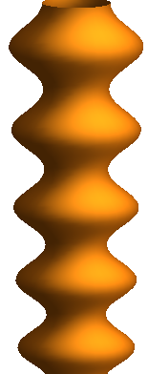
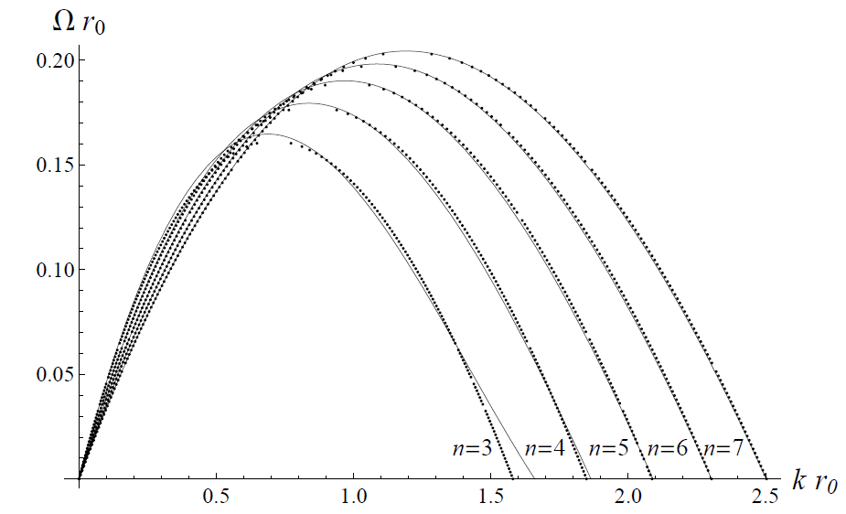
Gregory-Laflamme
Black string is unstable
[ Gregory-Laflamme (1994)]
Perturbation on black string grows exponentially in time
$${δg_{μν}∝e}^{Ωt+ikz}$$
$$Ω>0$$
Dispersion relation (linear result) is well reproduced by large D method
[ Asnin-et.al. (2007), Emaparan-Suzuki-KT (2013)]
- Gregory-Laflamme instability is a decoupled mode dynamics
$$∂_{t}∼Ω=O(1)$$
$$∂_{z}∼k=O(\sqrt{D})$$
- Up to $O(1{/D}^{4})$ solution

Slide 16
Dispersion relation
$$n=D−4$$

Slide 17
Gregory-Laflamme
Black string is unstable
[ Gregory-Laflamme (1994)]
Perturbation on black string grows exponentially in time
$${δg_{μν}∝e}^{Ωt+ikz}$$
$$Ω>0$$
Dispersion relation (linear result) is well reproduced by large D method
[ Asnin-et.al. (2007), Emaparan-Suzuki-KT (2013)]
- Gregory-Laflamme instability is a decoupled mode physics
$$∂_{t}∼Ω=O(1)$$
$$∂_{z}∼k=O(\sqrt{D})$$
- Up to $O(1{/D}^{4})$ solution

Slide 18
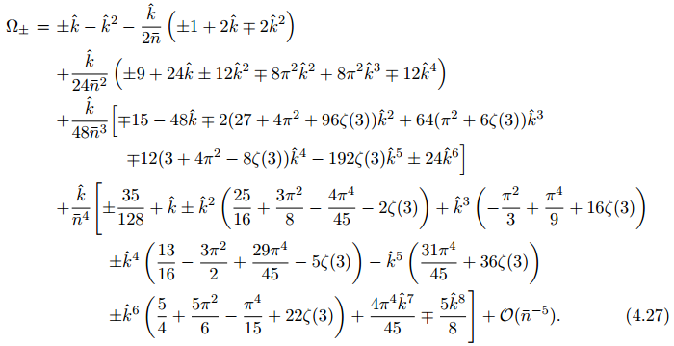
Gregory-Laflamme
Black brane is unstable
[ Gregory-Laflamme (1994)]
Perturbation on black string grows exponentially in time
$${δg_{μν}∝e}^{Ωt+ikz}$$
$$Ω>0$$
Dispersion relation (linear result) is well reproduced by large D method
[ Asnin-et.al. (2007), Emaparan-Suzuki-KT (2013)]
- Gregory-Laflamme instability is a decoupled mode dynamics
$$∂_{t}∼Ω=O(1)$$
$$∂_{z}∼k=O(\sqrt{D})$$
- Up to $O(1{/D}^{4})$ solution

Slide 19
Gregory-Laflamme
Black brane is unstable
[ Gregory-Laflamme (1994)]
Perturbation on black string grows exponentially in time
$${δg_{μν}∝e}^{Ωt+ikz}$$
$$Ω>0$$
Dispersion relation (linear result) is well reproduced by large D method
[ Asnin-et.al. (2007), Emaparan-Suzuki-KT (2013)]
- Gregory-Laflamme instability is a decoupled mode dynamics
$$∂_{t}∼Ω=O(1)$$
$$∂_{z}∼k=O(\sqrt{D})$$
- Up to $O(1{/D}^{4})$ solution

Slide 20
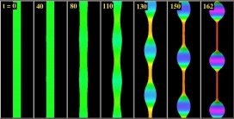
Endpoint of GL
What is the endpoint of the Gregory-Laflamme instability?
Non-trivial zero mode suggests the appearance of new static solution
- Non-Uniform Black String (NUBS)
NUBS might be unstable/stable in lower/higher dimension
[ Gubser (2001), Sorkin (2004) ]
- Critical dimension for NUBS $D≃13$
- Endpoint is NUBS $(D>13)$ / caged BHs? $(D<13)$
Some numerical analysis have been done
- Dynamical evolution of $5D$ black string
[ Lehner-Pretorius (2010) ]
- Construction of static NUBS
[ Wiseman (2002), Kudoh-Wiseman (2004), Kleihause-Kunz-Radu (2006), Headrick-Kitchen-Wiseman (2010), Figueras-Murata-Reall (2012)]

Slide 21
Large D method
Construction of “dynamical black string” at large D
Black String solution (exact solution)
$$ds^{2}=−\left(1−\frac{m}{r^{n}}\right)dv^{2}+2dvdr+dz^{2}+r^{2}dΩ_{D−3}^{2}$$
$$n=D−4$$
Leading order solution at large D
$$ds^{2}=−\left(1−\frac{m\left(v,z\right)}{r^{n}}\right)dv^{2}+2dvdr+\frac{dz^{2}}{n}$$
$$+\frac{2p_{z}\left(v,z\right)}{r^{n}}\frac{dvdz}{n\sqrt{n}}+r^{2}dΩ_{D−3}^{2}$$
- Rescale z-coordinate $z→z/\sqrt{n}$ because Gregory-Laflamme mode is $k_{GL}=O(\sqrt{n} )$
- We can introduce the v- and z- dependence to mass and momentum
- The radial dynamics is dominant ( v- and z- dynamics is subdominant, not leading order dynamics )
- No constraint on $m(v,z)$ and $p_{z}(v,z)$ at leading order of Einstein equation

Slide 22
Dynamical eq
Solving Einstein equation at Next-to-Leading order
$$ds^{2}=−\left(1−\frac{m\left(v,z\right)}{r^{n}}\right)dv^{2}+2dvdr+\frac{dz^{2}}{n}$$
$$+\frac{2p_{z}\left(v,z\right)}{r^{n}}\frac{dvdz}{n\sqrt{n}}+r^{2}dΩ_{D−3}^{2}$$
$$+\frac{1}{n}δg_{μν}dx^{μ}dx^{ν}$$
Momentum constraint gives dynamical evolution equations
$$∂_{v}p−∂_{z}^{2}p=∂_{z}\left[ m−\frac{p_{z}^{2}}{m} \right]$$
$$∂_{v}m−∂_{z}^{2}m=−p_{z}$$
- If these equations are satisfied, the metric becomes a solution of Einstein equation up to $O(1/n)$
- Contain Black string solution ($m\left(v,z\right)=m_{0},p_{z}\left(v,z\right)=0$), Non-Uniform black string ($m\left(v,z\right)=m(z),p_{z}\left(v,z\right)=0$)
- Non-linear equations (PDE(1+1) system with diffusion terms)

Slide 23
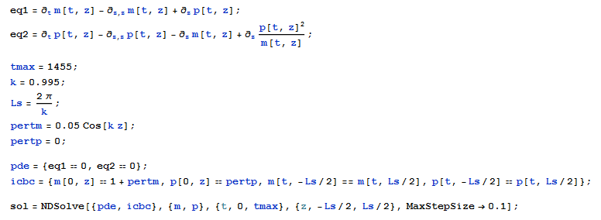
solving
Dynamical equations can be soled easily by Mathematica
$$∂_{v}p−∂_{z}^{2}p=∂_{z}\left[ m−\frac{p_{z}^{2}}{m} \right]$$
$$∂_{v}m−∂_{z}^{2}m=−p_{z}$$

Slide 24
solution
Plot of the numerical solutions
- Imposing periodic boundary conditions
$$m\left(v,z\right)=m(v,z+L_{s})$$
- Initial perturbations satisfy Gregory-Laflamme instability condition (“thin” black string)
$$r_{BS}<L_{s}=2πk^{−1}$$
$$δm{\left.​\right|}_{v=0}=m_{0}+δm e^{ikz}$$
- Plot Horizon position $r^{n}=m(v,z)$

Slide 25
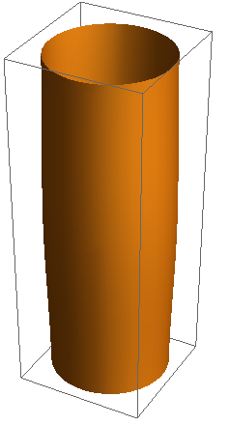
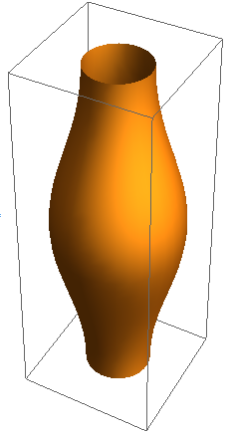
result
Numerical results say:
Endpoint of Gregory-Laflamme instability is Non-uniform black string solution (NUBS)
- Expected result : Leading order solution in 1/D expansion is a solution above critical dimension ( NUBS is expected to be stable )
Including 1/D corrections to dynamical equations, we can see different behaviors
- Equation has a dimensional dependence
- At $D>D_{∗}≃12$, final state is NUBS, at $D<D_{∗}≃12$ instability of black string would not stop
[ Emparan-Martinez-KT (to appear)]

Slide 26
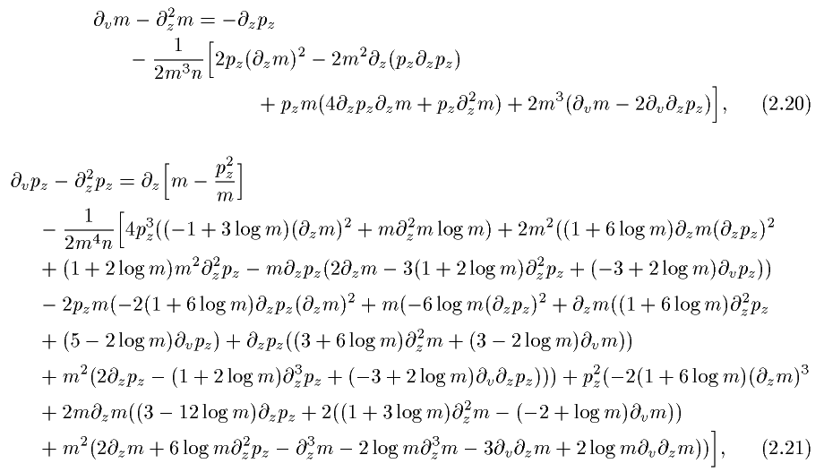
Nlo eq
$$n=D−4$$

Slide 27
result
Numerical results say:
Endpoint of Gregory-Laflamme instability is Non-uniform black string solution (NUBS)
- Expected result : Leading order solution in 1/D expansion is a solution above critical dimension ( NUBS is expected to be stable )
Including 1/D corrections to dynamical equations, we can see different behaviors
- Equation has a dimensional dependence
- At $D>D_{∗}≃12$, final state is NUBS, at $D<D_{∗}≃12$ instability of black string would not stop
[ Emparan-Martinez-KT (to appear)]

Slide 28
summary
Large D expansion method is useful and interesting
Very suitable to Black Hole physics
- Deformation of BHs are decoupled mode excitation
- Radial dynamics becomes dominant ⇒ PDE system reduces to ODE system
- Integrating radial dynamics out, we obtain dynamical equations of membrane-like object as EoM of BHs
$$g_{μν}$$
$$T_{ab}[ m(v,x^{i}),p_{i}(v,x^{i}) ]$$
Various extensions
- Dynamical deformation equation of black holes
Endpoints of instability of Myers-Perry black holes, black rings
- Inclusion of matter fields (Gauge fields, scalar fields, …)

