Slide 1

Cosmology with Peculiar Velocities:
Observational Effects
Per Andersen
w. Tamara Davis, Cullan Howlett

Slide 2
Bulk Flow
Discrepancy in measured bulk flows
Observational bias?
- Survey geometry (not full sky coverage)
- Undersampling (few data points)
Focus on type Ia SNe surveys
3/22

Slide 3
Plan of Attack – Use Simulation (Horizon Run 2)
Actual
All galaxies
Full 3d info
Averaged flow
Compare with
linear theory
Measured
Galaxy subsample
Line-of-sight info
Estimated flow:
Maximum Likelihood
Minimum Variance
4/22

Slide 4
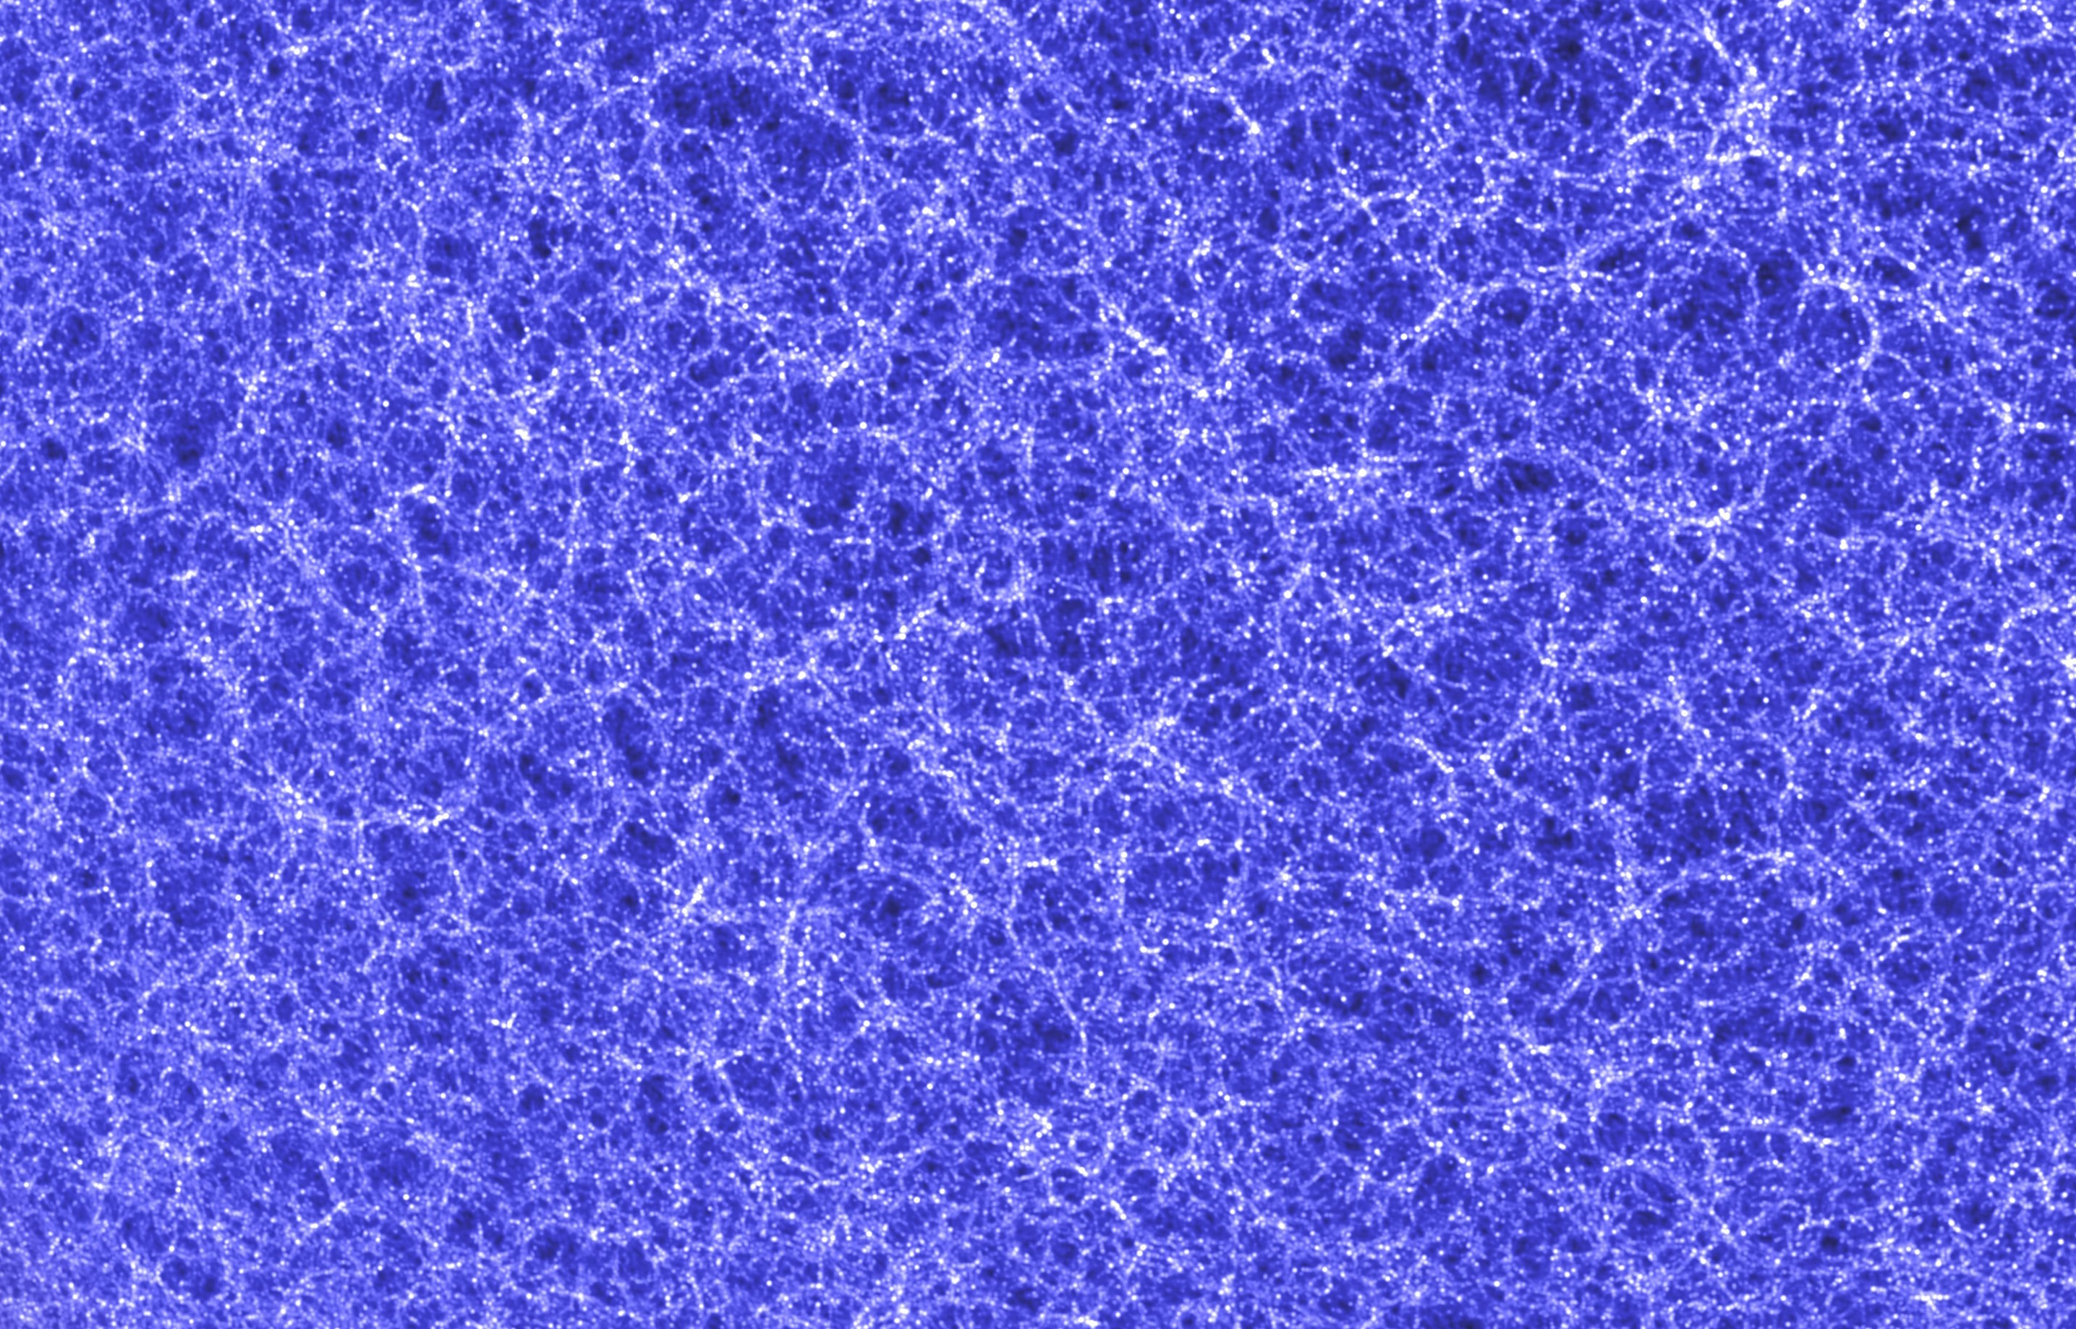
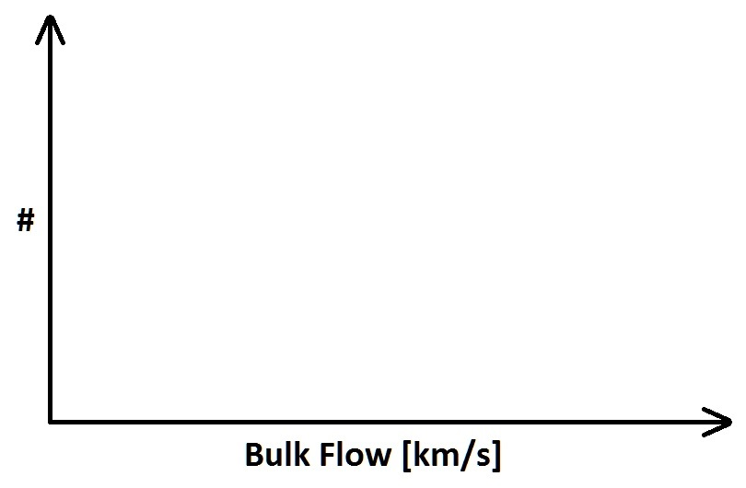
Measuring Bulk Flow from Simulation
5/22

Slide 5
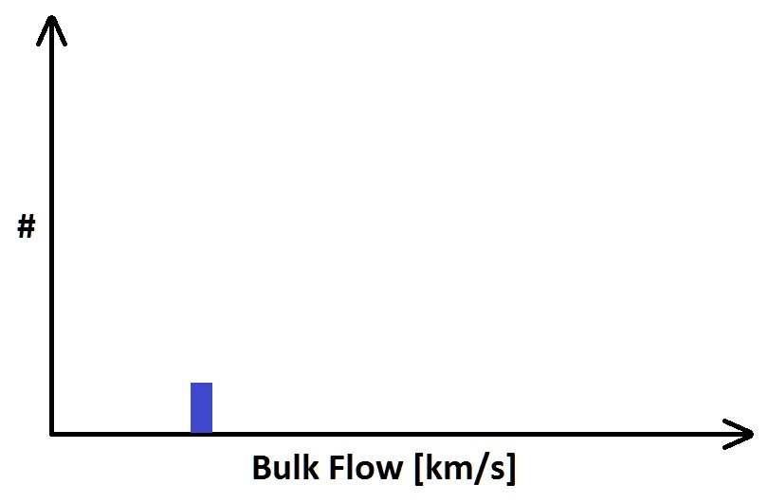
Measuring Bulk Flow from Simulation
6/22

Slide 6
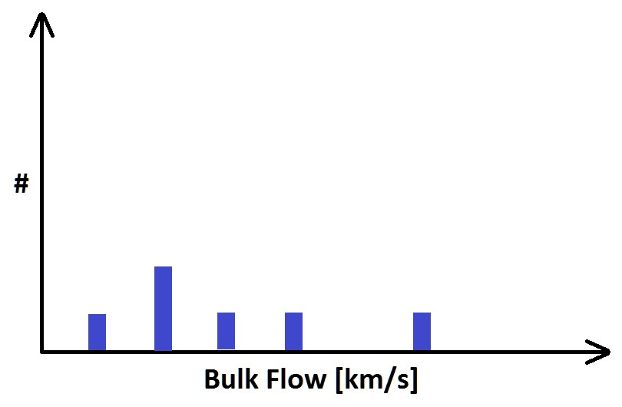
Measuring Bulk Flow from Simulation
7/22

Slide 7
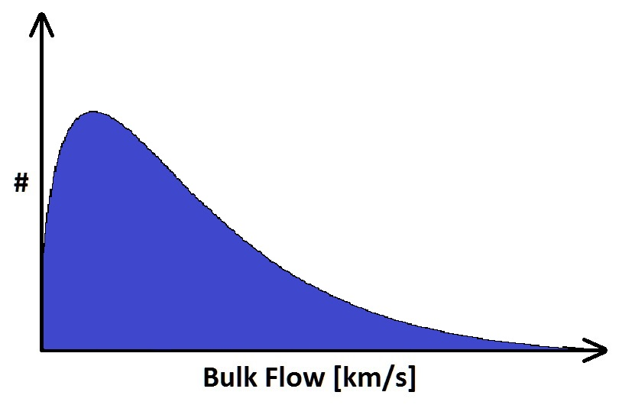
Measuring Bulk Flow from Simulation
8/22

Slide 8

Measuring Bulk Flow from Simulation
9/22

Slide 9

Measuring Bulk Flow from Simulation
10/22

Slide 10

Bulk Flow – Linear Theory
11/22

Slide 11
Bulk Flow – Linear Theory
From cosmology
12/22

Slide 12
Bulk Flow – Linear Theory
From cosmology
From survey geometry
13/22

Slide 13
Bulk Flow – Linear Theory
From cosmology
From survey geometry
14/22

Slide 14
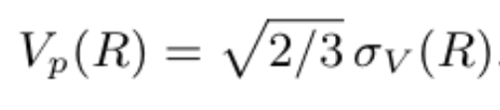
Bulk Flow – Linear Theory
From cosmology
From survey geometry
Most probable value
15/22

Slide 15
Bulk Flow – Estimator Performance
N ~ 50000
n = 500
16/22

Slide 16
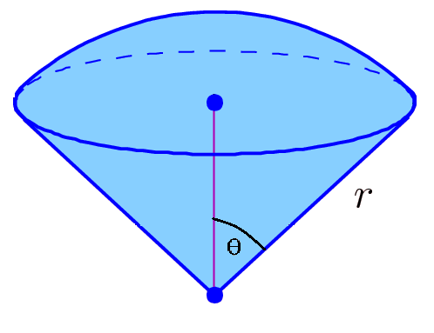
Idealised Survey– Spherical Cone Geometry
17/22

Slide 17
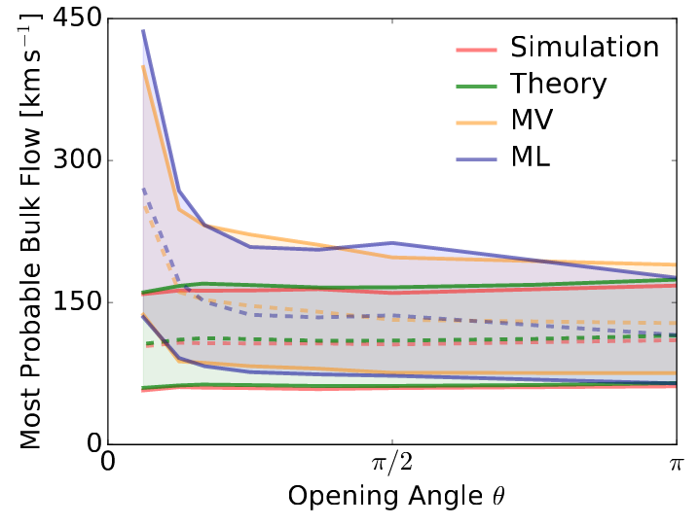
Bulk Flow - Results
n = 500
18/22

Slide 18
Bulk Flow - Results
n = 500
r ~ 1 Gpc
r ~ 200 Mpc
19/22

Slide 19
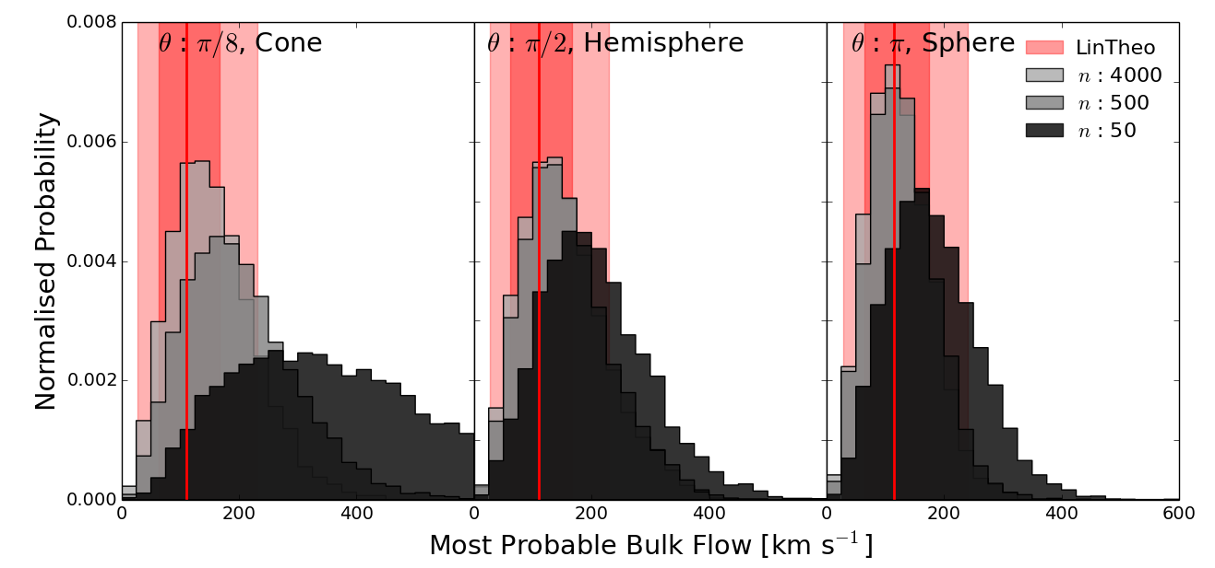
Bulk Flow - Results
Relative Likelihood
Bulk Flow [km/s]
20/22

Slide 20
Bulk Flow - Results
Relative Likelihood
21/22

Slide 21
Bulk Flow - Conclusion
Found: Significant bias in bulk flow measurement compared to theoretical prediction from both undersampling and non-spherical geometries
Solution: Use simulation rather than linear theory prediction to compare measured bulk flows with theory
22/22

Slide 22
Bulk Flow – Extra Slides

Slide 23
Bulk Flow – Extra Slides

Slide 24
Bulk Flow – Extra Slides

