Slide 1
Large Scale Structure- Cosmic Flows
This subject ended as an active field ~30 years ago, but the data has recently improved, justifying another look
Marc Davis Vietnam

Slide 2
A marvelous test of LSS
Goal: to explain the 640 km/s dipole velocity of CMBR.
For 40 years we have wondered about its origin
- Is the source of gravity the local distribution of mass?
- What fraction is locally induced?
- Or is it mostly generated by very distant effect?
Method:
- Use TF galaxies out to 10,000 km/s
- Do the test only on scales greater than 1000 km/s to ensure linear
theory is applicable
- Use the “Inverse Method” to minimize Malmquist bias
- Fit to expansion in Spherical Harmonics
Notes:
A question

Slide 3
‘Inverse’ TF Method
Virgocentric infall model
(Aaronson, Mould, Huchra, Schechter, Tully, 1982)
Minimize scatter in TF by adjusting peculiar velocity of 306 galaxies having
  cz<3000 km/s
  m_{H}
  21 cm linewidth
Flow model had 6 parameters:
  slope and zero point of TF relation
  amplitude of spherical flow toward Virgo
  2 components of peculiar velocity of the LG

Slide 4
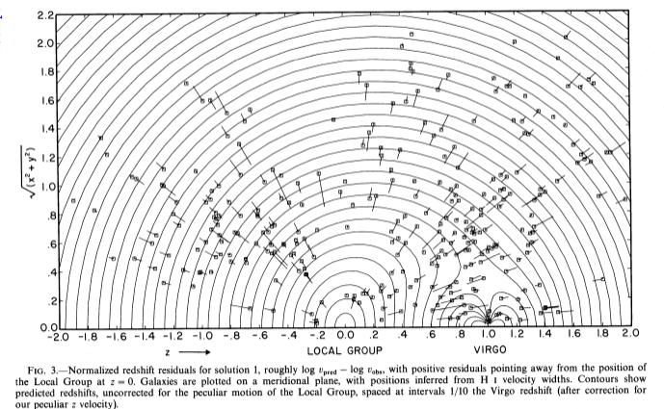
Residuals of Flow around Virgo cluster
Results are accurate today!
Notes:
late 70’s: What is our infall to the Virgo cluster?

Slide 5
Large Scale flows
MD, Nusser, Masters, Springob, Huchra, & Lemson (2011)
Goal is to explain the local (cz<10000 km/s) large scale motions
Adi & I redo problem we first studied, unsucessfully, 30 years ago!
  25 years ago, we gave up on solving the
  problem because , instead of 1.
Notes:
original papers used old Fortran code

Slide 6
Compare observed velocity field with gravity field as a function of
Velocity field is the SFI++ Tully-Fisher whole sky sample of 2830 galaxies (Masters etal 2006)
Gravity field is the whole sky redshift survey, 2MRS (Huchra etal 2005) based on K selected 2MASS galaxies. Catalog is 23,000 galaxies, recently extended to 43,500 galaxies. Limited at |b|>5⁰, 10⁰ near galactic center
In our lifetime, gravity field is unlikely to improve enough to bother, since it is not the limiting noise. For improvements, work on enlarging TF data
Notes:
Of course, both fields had enormous contribution from Australians

Slide 7
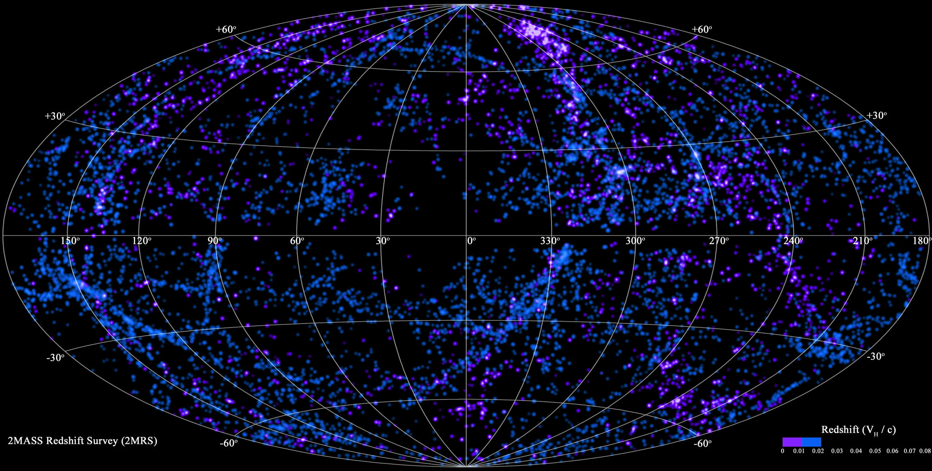
Constructing g field, using 2MRS
Huchra et al.
0 < cz < 6000 km/s

Slide 8
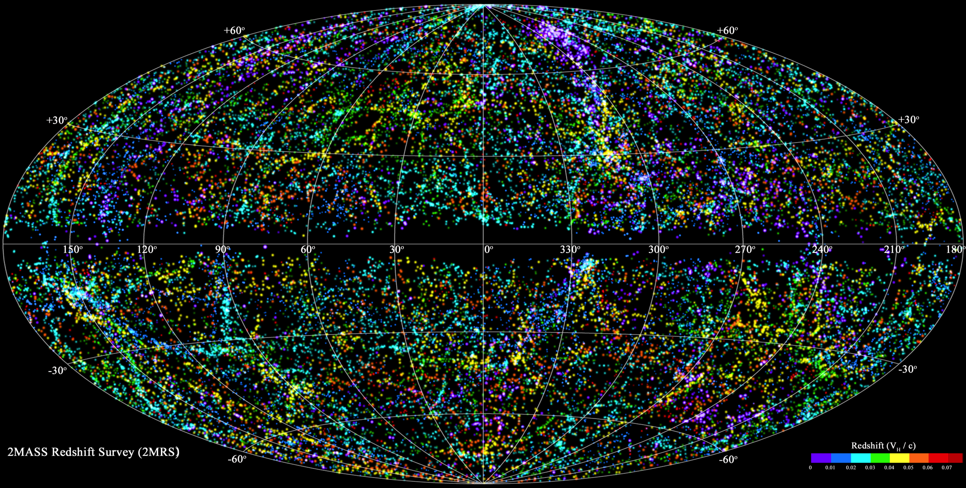
Constructing g field, using 2MRS
Huchra et al.
cz<18,000 km/s

Slide 9
Assume linear Tully-Fisher relation:
TF relation
How to find P?
Expand it into orthogonal functions and solve
for the individual amplitudes
Notes:
Eta-0 and s, 2 parameters to be fit, as well as coefficients of P, perhaps 20 or 70 coefficients

Slide 10
How the itf method operates
Use ~20-40 normal modes to describe peculiar motion v_{i} of 2830 galaxies out to 10,000 km/s.
typical scale of filter is =>1000 km/s where Linear theory is GOOD!
Boundary conditions (e.g. v=0 at r=0) set naturally.
Mode amplitudes plus 2 parameters of TF, slope and zero-point, are free parameters set by minimizing the TF scatter of the galaxies.
This an inverse TF method, where M_{i} is adjusted by adjusting the coefficients of P so as minimize describing scatter of
Finally, compare these amplitudes to the linear theory predictions of 2MRS redshift survey as a function of β=f(Ω)/b
Notes:
any number of modes could be used
Ylm’s are natural. Set BC automatically.
Very important to work in frame of ref with V_lg=0 – natural BC, after all, how much of flow is generated out to 2000 or 4000 km/s?
Working in cosmologiical frame therefore makes no sense

Slide 11
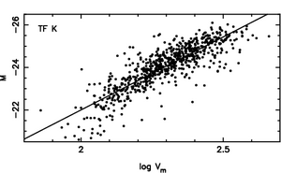
TF relation to estimate ‘peculiar’ velocity
Observables for each galaxy:
m_{i}
cz_{i}
l_{i} , b_{i}
Forward method has serious Malmquist bias
Inverse method has negligible Malmquist bias
Notes:
Malmquist effect, comes from fitting distribution in M, leads to nasty biases

Slide 12



Measuring peculiar velocities, v_{itf}
Start with Inverse TF relation: η_{i} = γM_{i} + η₀ (η_{i} = log ω_{i} -- ω_{i} is the rotation width)
How to get a handle on u_{i} ?: cz_{i} = Hr_{i} + u_{i} (u_{i} is radial peculiar velocity in LG frame)
Separate u by writing: M_{i} = M_{0i} + P_{i}
where: M_{0i} = m_{i} + 5log(z_{i}) -15
and: P_{i} = 5log(1 –u_{i}/z_{i})
Write P_{i} as a sum over j_{m} orthogonal basis functions:
Orthogonality conditions within SFI++ galaxies:
Best fit mode coefficients a^{j} found by minimizing χ² in sum over galaxies N_{g} for each a^{j}
Notes:
F is a normal mode of Y_lmn. DOF is 10 for expanssion to Q mode, How many radial oscilation?
chi^2 is the TF reduction

Slide 13

Choosing basis functions for P
Spherical Bessel functions with compressed radial coordinate, y,
to allow larger error with distance
For l =< 2, n=0,1, gives 18 modes
The effect of using y(x) is higher resolution in foreground, and lower resolution in background where the resolution is poorer
y(z) = z/z_{s} -- y small
y(z) = 2*ln(z/z_{s}) -- y large
This is hardly unique– there are many ways to expand an orthonormal set of functions
Notes:
y(z) is function to lower oscillations with distance z
automatically satisfies BC at 0 and \inf
Y gets radial oscilltions about right

Slide 14
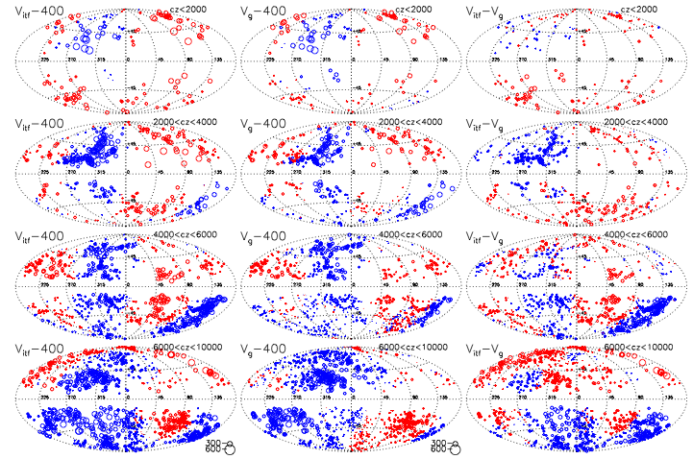
Observed v_{P} versus predicted v_{P}
400 km/s dipole subtracted, to aide visualization
ITF modes gravity residual
SFI++
Results of 20 Inverse Tully Fisher modes, sliced by redshift
To aide visualization, 400 km/s dipole, in direction of CMBR has been subtracted
cz<2000 km/s
2000<cz<4000
4000<cz<6000
6000<cz<
10000
Notes:
residual- 3rd column
note 400 km/s dipole is already removed from columns 1 & 2, to better see higher order behavior
size of circle proportional to v

Slide 15



Linear theory to estimate g using 2MRS
–(predicting peculiar velocities)
velocity is linear with gravity
gravity is the usual sum over fluctuations
density function, 2MRS in redshift space
--ϕ(s_{i}) is selection function
--w(L_{oi}) is galaxy’s weight
v_{g} is irrotational, so express velocity as divergence of gravitational potential
Notes:
all standard definitions, V_g = (Hubble time) * gravity

Slide 16

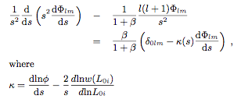
Solution in LG frame of reference
Expand Φ and δ₀(s) in natural basis functions
To lowest order, Φ nearly satisfies a Poisson equation, but in redshift space, s, there is a correction for generalized Kaiser rocket effect, κ(s)
Φ is expanded as spherical Bessel function times spherical harmonic Y_{lm}
remove fingers of god before solution
Solutions to monopole (l=0) and dipole (l=1) are uniquely determined by specifying Φ=0 at origin.
At redshift s, the radial velocity field when expanded to l≤1 is NOT influenced by exterior mass.
Notes:
not quite a Poisson equation, solve on a spherical grid. To expand up to quadrapole takes 10 parameter per radial mode.

Slide 17
Considerations in choosing P_{i}
Expand in LG frame – B.C. is natural at origin
Y_{l}^{m} for angular wavefunction
Derivative of spherical Bessel functions for radial function (correct B.C. at origin and outer boundary)
At end of calculation, ask how well does reflex dipole match CMB, but since we don’t know the size of U. comoving with us, why does it matter? (Comparison at end of analysis, not beginning)
With better, more precise, data can extend solution to higher l, m, n

Slide 18
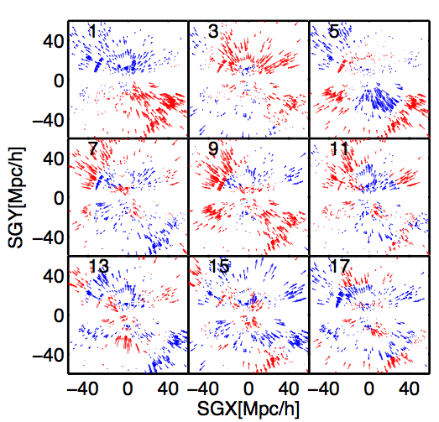
Modes are orthogonalized over SFI++ data
9 examples of modes taken from first 20 in amplitude, out of 70 modes to n=5, l=3
delete the n=1, l=0 mode as it can be confused with Hubble flow.
Notes:
nothing unique about these modes
don’t confuse analysis with Hubble flow

Slide 19
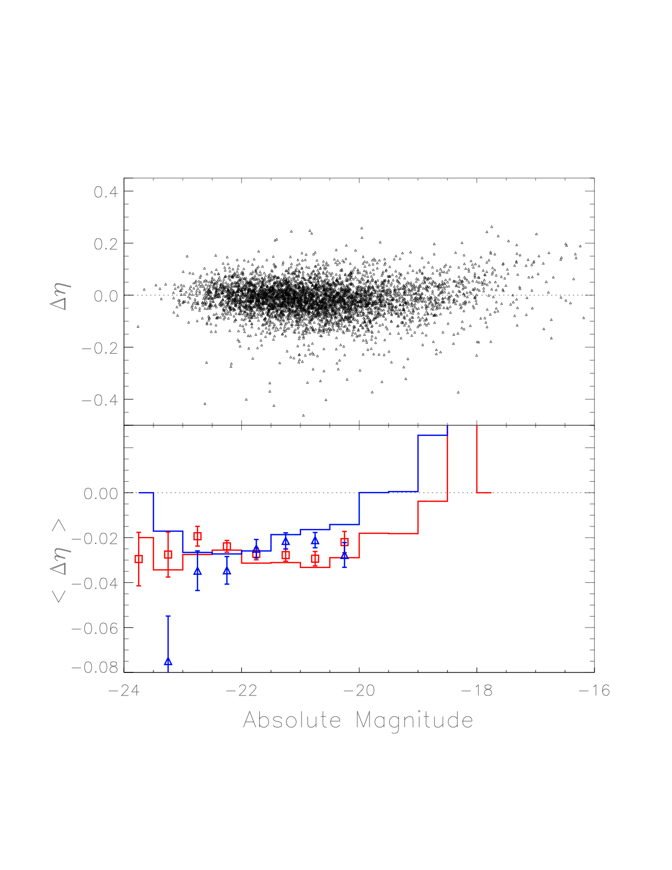
An inverse Tully-Fisher example
ω_{i} is linewidth
η_{i} = log(ω_{i} )
inverse Tully-Fisher relation (ITF):
η = γM + η₀ ,where M is magnitude
γ is slope (≈0.12)
500>v>10,000 km/s discarded
top plot shows residuals of η for 2830 galaxies from SFI++ catalog. seems OK for M<-20.
red is galaxies with cz>5000, blue is for cz<5000.
Histograms are RAW data, no flow. Red curve quite distinct from blue
the points are the mean Δη AFTER the fit. Note red and blue are now intermixed, as they should be.
Fit has reduced the ITF scatter.
Notes:
Illustrative example – not actual procedure
delta eta is residual from TF slope
bottom curve is illustration, velocity cut at 5000 km/s

Slide 20
Fitting mode coefficients
Instead of fitting 2800 peculiar velocities, one for each galaxy, we fit ~20 mode amplitudes a^{j}_{itf} that describe full sky field
For gravity, we fit a^{j}_{gravity} to linear theory amplitude, characterized by β=f(Ω)/b -- b is the 2MRS galaxy bias
Since they were derived independently, we can compare a^{j}_{itf} to a^{j}_{gravity} using another χ² analysis to determine β
Entire method can be fully simulated with nbody results
Notes:
2nd chi^2

Slide 21
Finding mode amplitudes
Mock catalogs
The method works and picks up the FULL velocity field.
Notes:
mock simulates SFI++ against truth

Slide 22
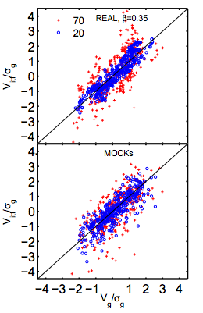
Mode amplitudes of selected galaxies
Real velocities,
v_{itf} versus v_{g}
(sigma_{g} = 230 km/s)
20 or 70 modes
Same analysis for mock catalog

Slide 23
Observed v_{P} versus predicted v_{P}
400 km/s dipole subtracted, to aide visualization
ITF modes gravity residual
Inverse Tully Fisher modes sliced by redshift
cz<2000 km/s
2000<cz<4000
4000<cz<6000
6000<cz<
10000
Notes:
residual- 3rd column
note 400 km/s dipole is already removed from columns 1 & 2, to better see higher order behavior
size of circle proportional to v

Slide 24
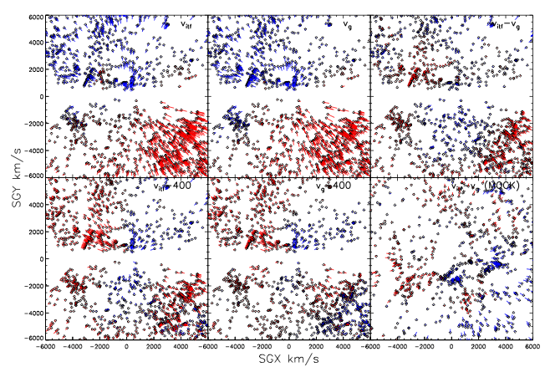
Supergalactic plane projections of derived flows
Blue is inward flowing
Red is outflowing
MW at center
v_{itf} v_{g} v_{itf} - v_{g}
Velocities---
Velocities--
with 400 km/s toward CMB subtracted
Notes:
SG coords. We are at center

Slide 25
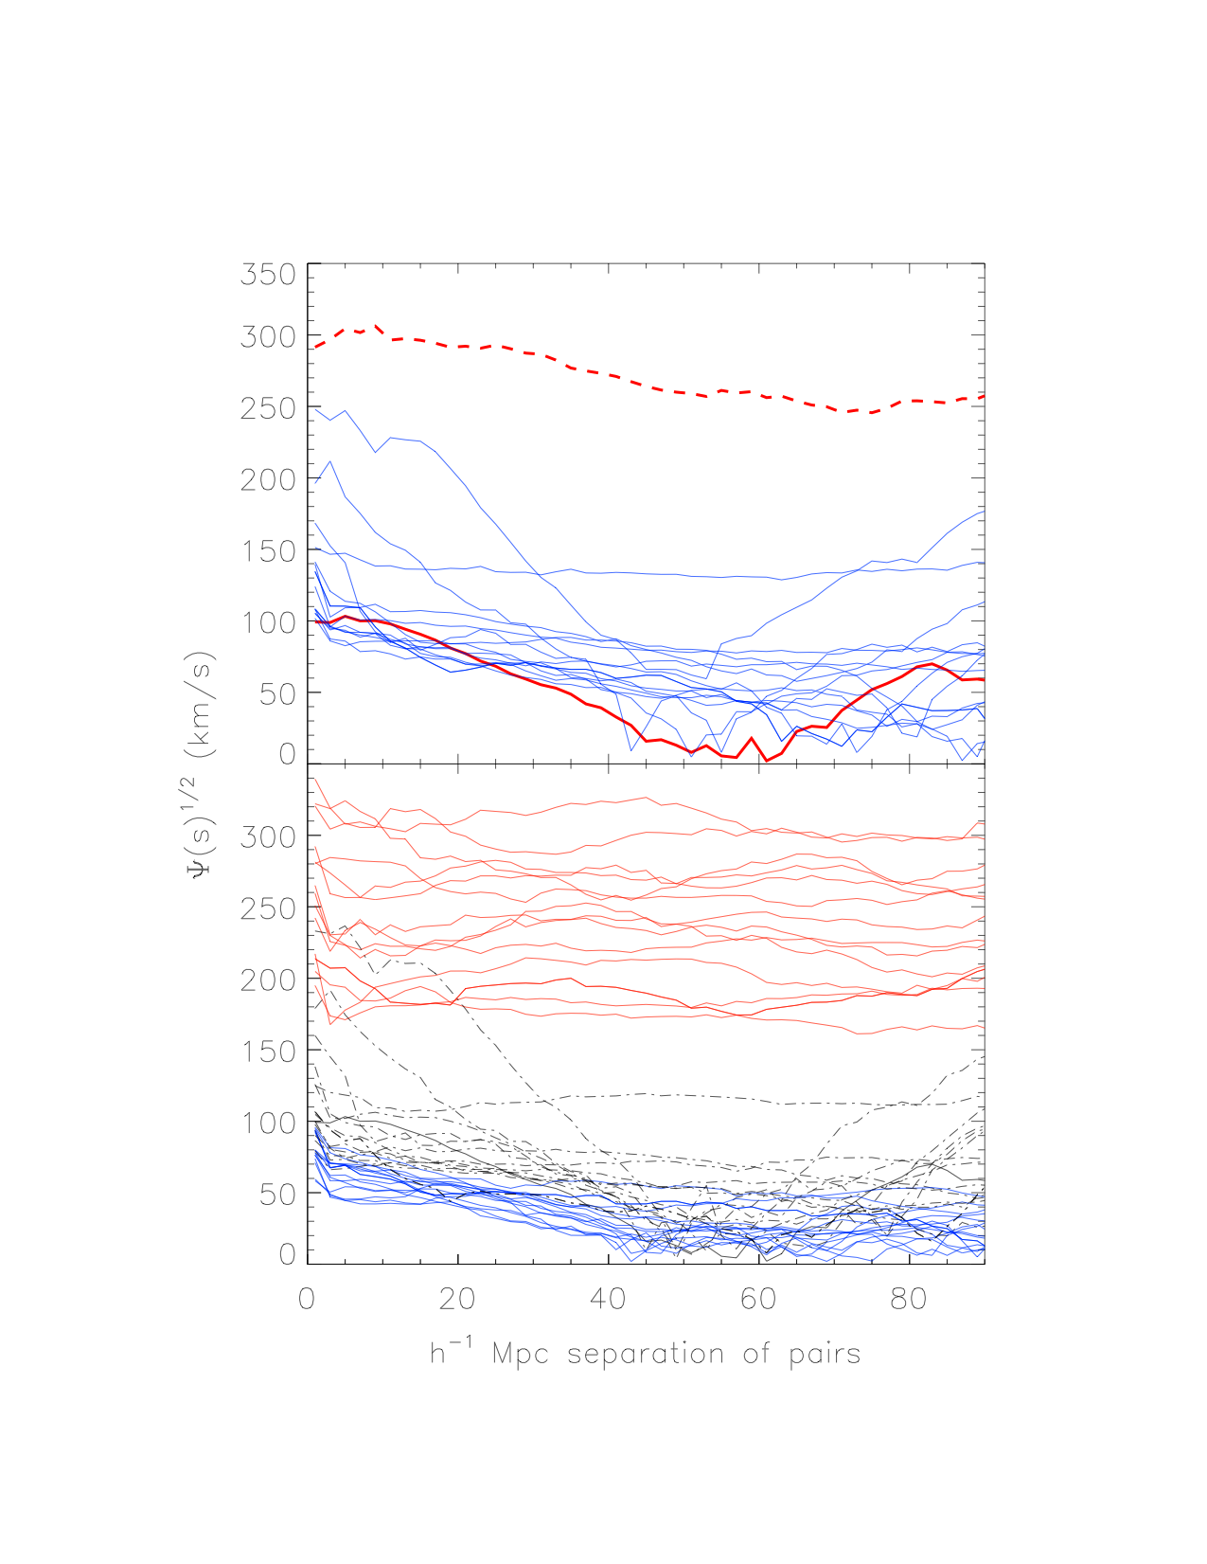
Residual velocity correlations
Top: the velocity correlation of the real data and 15 mock catalogues. The dashed red and solid red curves are, respectively, the correlations of v_{ITF} and v_{ITF} − v_{g} in the real data. The blue lines are each correlations of v_{ITF} − v_{g} for the mock catalogues.
Bottom: velocity correlations for 15 mock catalogues. The red curves are the velocity of vitf, the dot–dashed curves show the correlation of (v_{true} − v_{g}), and the blue curves correspond to v_{true} − v_{itf}. Both v_{true} and v_{g} are first smoothed with the 20 mode expansion before the auto-covariance is computed. Note that the correlation of v_{ITF} − v_{g} is only slightly worse than the correlation of v_{true} − v_{g}, showing that the velocity reconstruction dominates the errors. Note also that we are plotting the square root of the velocity correlation.
Notes:
Top: velocity correlations (dashed) and correlations of residual velocity (solid curve)

Slide 26
Amazing!
_{i}
The derivations of the gravity and velocity fields as constructed are not connected, They are independent!!
Their equality demonstrates that we understand where the CMB dipole, and low order Y_{lm} ‘s are derived
Y_{lm} is poor description of LSS, giving rise to correlated residuals, but still we get /dof = 1
(30 years ago, was )

Slide 27
Constraints on parameters
M ≈ L^{α}
β = f(Ω)/b ≈ Ω^{0.55}/b
Notes:
easy to do, but not informative

Slide 28
χ² behavior of a^{itf} vs a^{g}
χ² behavior clearly favors low values of β. Best value is β=0.33 ± 0.04
The noise is limited by the TF scatter, not the 2MRS reconstruction.
With β_{min}= 0.33 and f(Ω)=.483, we get a bias factor b=1.46 ± 0.20 between the dark matter and the 2MRS galaxy distribution. σ₈ = 0.66 ± 0.10 (1.5 σ from WMAP result)
Favor no correlation between M and mass.
We find no evidence for SUPER large-scale flows. We see no evidence that the dipole in the CMBR is produced by anything other than our motion in the universe.
Notes:
alpha=0 weights all galaxies in 2RMS equally.

Slide 29
Advantages over power spectral analysis
power spectrum of velocities throws away phases. We don’t.
PS analysis compares velocities to those expected in a randomly selected volume. How can this be better than comparing velocities to expectations with a known mass distribution?
in PS analysis, all the talk is on missing large scale power. We can do likewise, with real knowledge of power on smaller scales. PS analysis should start with known velocity of 400 km/s generated by mass within radius of ~8000 km/s.
Galaxies have small-scale but coherent bulk flows which are properly weighted in ITF method. In PS analysis through a window function, no account is taken of this coherence, leading to overly optimistic errors.
ITF method sensitive to bias of galaxies.
Notes:
ITF is far superior to PS analysis

Slide 30
Summary
The peculiar velocities of all galaxies within ~10000 km/s are completely described by the observed galaxy distribution in 2RMS out to 12,000 km/s
This motion accounts for all but ~150 km/s of the CMB motion--
  There is no need, or room, for a really large scale flow
LCDM can easily account for 100-200 km/s generated by distribution outside 10,000 km/s
The comparison of v_{p} and g is so precise as to be a stunning example of the power of linear theory!
Some HUGE source is unnecessary to generate the bulk of our motion relative to CMB.
This finishes the study of the local velocity field, and I have retired!
Notes:
very satisfying. I began this field in ~1980, and finally the data says chi2/dof = 1 (instead of 2, 15 years ago)
I shall retire next June, having completed this analysis!

