Slide 1
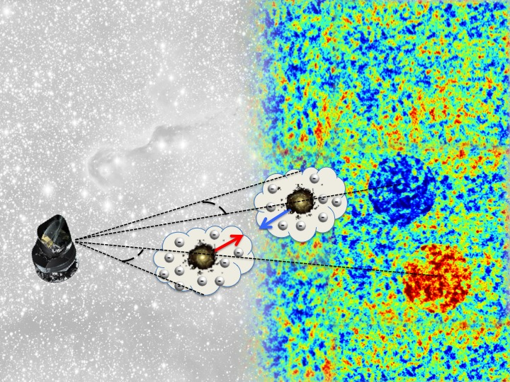
Constraints on bulk flows and the missing baryons through the kinetic Sunyaev-Zeldovich effect
Carlos Hernández-Monteagudo
Centro de Estudios de Física del Cosmos de Aragón
[CEFCA]
Planck Intermediate Results XII, XXXVIII,
Physical Review Letters 2015

Slide 2
Outline
The kinetic Sunyaev-Zel’dovich effect (kSZ) vs the thermal Sunyaev-Zeldovich effect (tSZ)
First trials and constraints from the kSZ
Measuring the kSZ pairwise momentum == correlation with a reconstruction of the peculiar velocity field: connection between both approaches
The Central Galaxy Catalogue (CGC) – other posterior exercises – implications for the missing baryons
The 3-point approach
Future prospects (mention and describe J-PAS, also prospects for Core+)
The delta-z – kSZ correlation (Jonás Chaves-Montero’s PhD thesis work)

Slide 3
The kSZ vs the tSZ effects

Slide 4
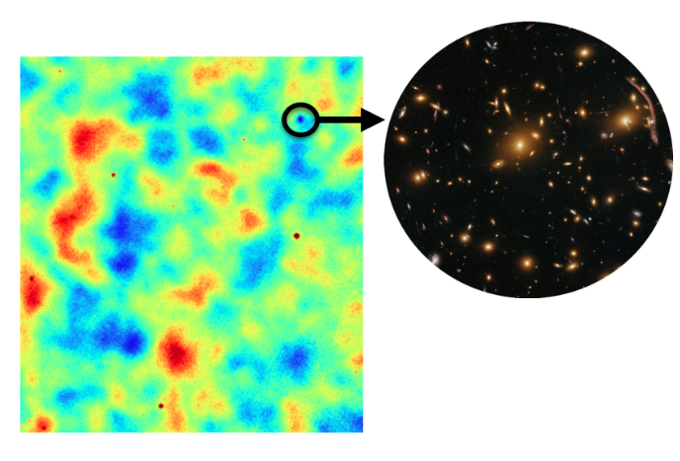
One image is more worth than one thousand words …
~1 deg
ACT CMB map at 143 GHz

Slide 5
One image is more worth than one thousand words …
CMB intrinsic spots, generated at z~1,100 …
~1 deg
ACT CMB map at 143 GHz

Slide 6
One image is more worth than one thousand words …
CMB intrinsic spots, generated at z~1,100 …
Dusty galaxies
~1 deg
ACT CMB map at 143 GHz

Slide 7
One image is more worth than one thousand words …
CMB intrinsic spots, generated at z~1,100 …
Dusty galaxies
~1 deg
Thermal Sunyaev-Zeldovich (tSZ) cluster
ACT CMB map at 143 GHz
If sources/clusters were big in angular size they would be confused with CMB …

Slide 8
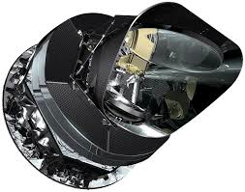
V
If electrons are not too hot, its Thomson scattering and there’s NO energy exchange at the electron’s frame …
Black body CMB spectrum is shifted but preserved!

Slide 9
Thomson scattering, Compton scattering and all that...
In a thermalized photon-baryon bath, in the electron’s frame, Thomson scattering does not transfer energy but simply changes the direction of CMB photons...
If the electron cloud is moving with respect to the CMB photon bath, there is however a net flux of momentum that affects all photons in the same way -> there is no distortion of the (frequency independent) brightness temperature.
However, due to its anisotropic nature, if there is a local quadrupole in the CMB intensity distribution, it will generate linear polarization
Kinetic Sunyaev-Zel'dovich effect (kSZ)‏

Slide 10
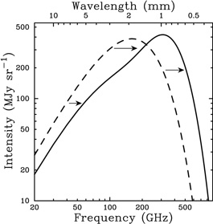
V, T_{e}
Black body CMB spectrum is distorted!

Slide 11
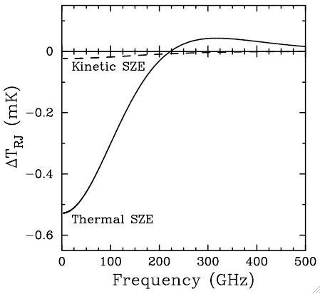
Thomson scattering, Compton scattering and all that... (II)‏
If however the CMB encounters a hot electron plasma, then there is a net transfer of energy from the hot electrons to the cold photons. As a result, we have fewer cold low energy photons and more hot high frequency photons. This results in a distortion of the black body CMB spectrum, i.e., in frequency dependent brightness temperature fluctuations.
Thermal Sunyaev-Zel'dovich effect (tSZ)‏
The symbol y is known as the Comptonization parameter

Slide 12
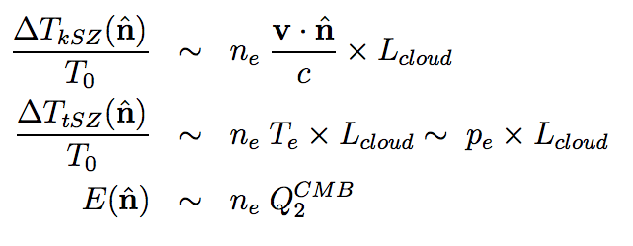
Therefore,
we have three channels of interaction between free electrons and CMB photons:
kSZ: Thomson scattering on temperature, sensitive to LOS integrated electron momentum
tSZ: Compton scattering on intensity, sensitive to LOS integrated electron pressure
Thomson scattering on polarization:
Intrinsic CMB anisotropies act as a very important source of noise for these signals!
The tSZ will more easily detectable in collapsed structures, whereas the kSZ will be detected in comoving gas, regardless it is collapsed or not.
The ratio of the two effects scales as:
kSZ/tSZ ~ (v.n/c) / (k_{B} T_{e}/m_{e} c²) ~ 0.01 – 0.1 for galaxy clusters

Slide 13
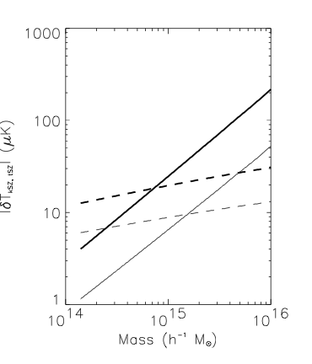
Dashed lines: kSZ
Solid lines: tSZ @ 222 GHz
(two different redshifts shown: z=0,1)

Slide 14
Chasing the kSZ effect …

Slide 15
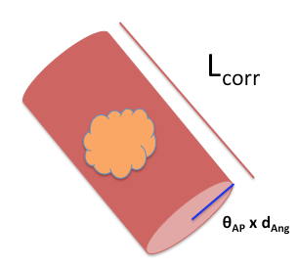
Let’s count the electrons one can detect with the kSZ …
τ _{T} = \int dl n_{e} σ_{T} ~ number of electrons
We are effectively observing through cylinders of depth L_{corr}

Slide 16
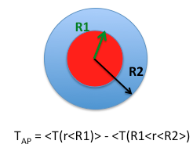
Measuring the kSZ pairwise momentum
APERTURE PHOTOMETRY
We do not assume any gas profile around sources, but try different apertures
We use R2=SQRT(2) R1 and vary R1
We set all galaxies within a redshift shell at the same zero level

Slide 17
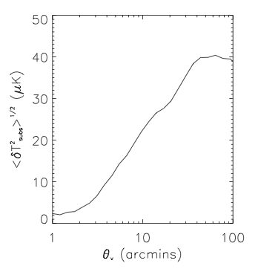
The larger the aperture radius is, the larger is the typical CMB residual amplitude …
Typical kSZ signal is ~ few μK for clusters of galaxies, ~ 0.1 μK for 1e13 M_sun halos …
= Θ_{AP} = aperture angle

Slide 18
Constraints from kSZ non detections!

Slide 19
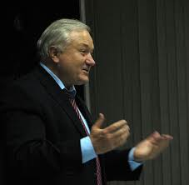
kSZ statistics @ 0th order. Mean or average of kSZ temperature (compatible with zero)
Planck Intermediate Results. XIII
Rashid Sunyaev to Sarah Church: “Sarah, look yourself, you have clusters at z~1 and yet they are at rest with the CMB!!”

Slide 20
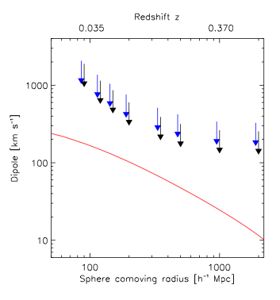
kSZ statistics @ 1st order. Dipole of kSZ temperature field (compatible with zero)
Planck Intermediate Results. XIII. Looking at the direction of ~1,500 X-ray galaxy clusters.
⬇
(CGs)
Strongest evidence for the Copernican Principle!
Planck Intermediate Results. XIII

Slide 21
kSZ statistics @ 2nd order.
Two different methodologies:
(i) the pairwise kSZ momentum, and
(ii) the kSZ x [reconstructed]velocity correlation

Slide 22
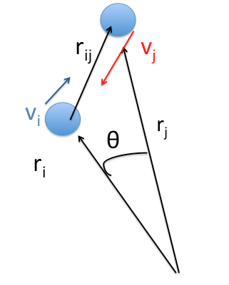
Method I : Measuring the kSZ pairwise momentum
Pairwise momentum expresses the mutual infall of two objects due to gravitational interaction
Groth et al. 1981, Juszkiewicz et al. 1998, Ferreira et al. 1999, Hand et al. 2012

Slide 23
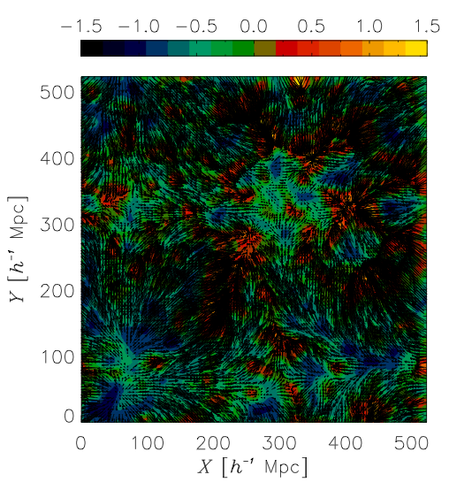
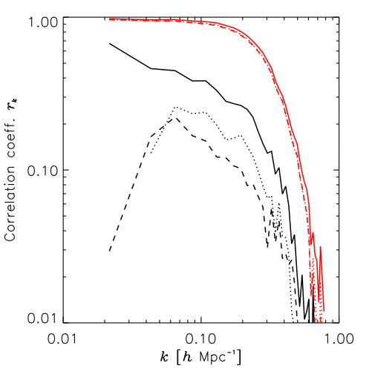
Method II: Inverting galaxy density into velocity
Dedeo et al.2005, Ho et al.2010
We invert the linear continuity equation to estimate the peculiar velocity field from the CG density field
Correlation coefficient: ORIG. VEL x RECOV.VEL
Three approaches: LINEAR, LOG-LINEAR, LOG-2LPT
Impact of mask: LINEAR method most promising after all
Without mask
With mask
Logarithmic linearisation

Slide 24
Inverting galaxy density into velocity
Velocity field recovered for a slice of the Central Galaxy Catalogue (containing ~260,000 galaxies of mass ~ 1e13 Msolar at z ~ 0.12

Slide 25
First kSZ evidence on real data …

Slide 26
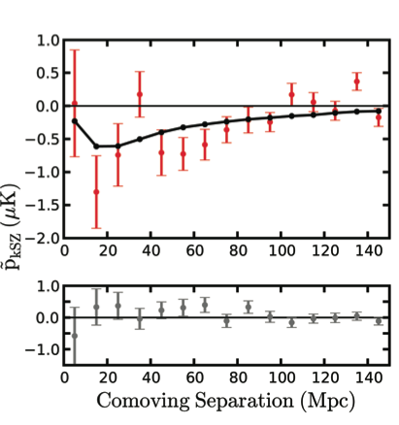
First kSZ detection from kSZ pairwise momentum and ACT CMB data
Hand et al. 2012
The Atacama Cosmology Telescope collaboration provided the first detection of the kSZ by stacking estimates of filtered maps at 145 GHz on the positions of ~5e13 M_sun LRGs identified by BOSS, of typical mass . ACT has FWHM~1.3 arcmin, where Planck’s best angular resolution is close to FHWM=5 arcmin.

Slide 27
Quickly followed by Planck data …

Slide 28
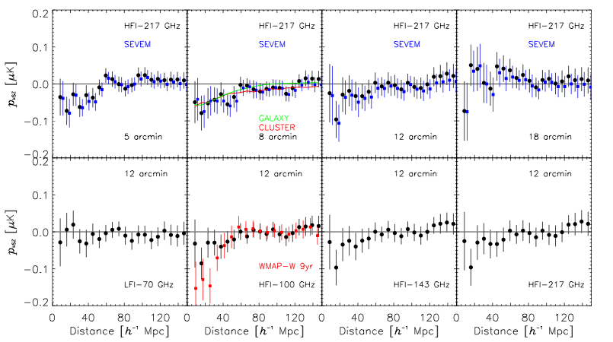
Second detection of the kSZ pairwise momentum
We found a colour-free decrement (up to 2.5 σ) for the cleaned SEVEM map and for apertures of 8 – 12 arcmin. For SEVEM @ 8 arcmin, a fit to the output of numerical simulations yields S/N ~ 2.2

Slide 29
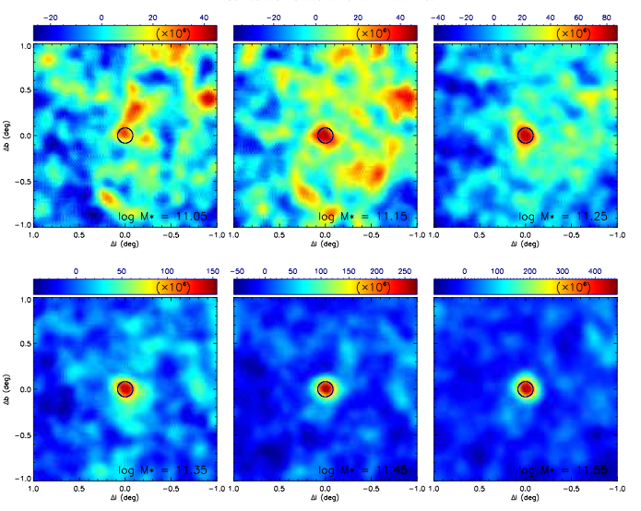
The Central Galaxy Catalogue (CGC)
Stacked thermal SZ maps in the direction of CGs for different stellar mass bins(Guo et al. 2011, Planck PIP-XI)
Based upon SDSS DR7 NYUAV galaxy catalogue after isolating brightest galaxies in 1 Mpc (transversal direction) and 1000 km/s (LOS)
It consists of 262 673 galaxies placed at z~0.12, of which ~83% should be true central galaxies.
Using the Millennium simulation, from M* we may estimate M_{halo}
When placing them in a grid, we retain only the 150,000 most nearby ones

Slide 30
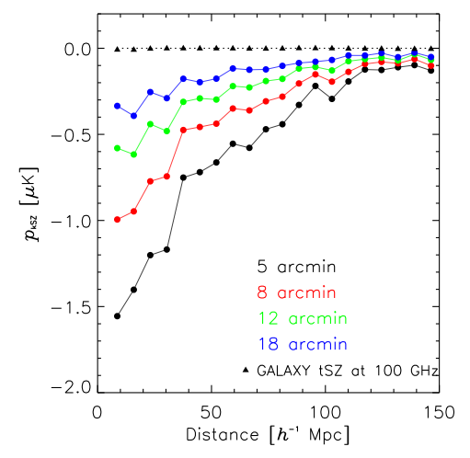
Measuring the kSZ pairwise momentum
Hand et al. 2012
Data suggest presence of bulk flows extending up to ~ 100 Mpc/h
The impact of tSZ seems to be negligible
Simulated clusters of Dolag & Sunyaev. 2013

Slide 31
Trying method II: Inverting galaxy density into velocity
Velocity field recovered for a slice of the CGC

Slide 32
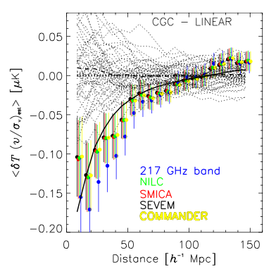
The first δT_{kSZ} – v_{los} correlation detection (with the CGC):
<T_{kSZ} . v/σ_{v} >: correlation between kSZ temperature anisotropies and recovered velocities (with RMS=1)
S/N up to 3.8

Slide 33
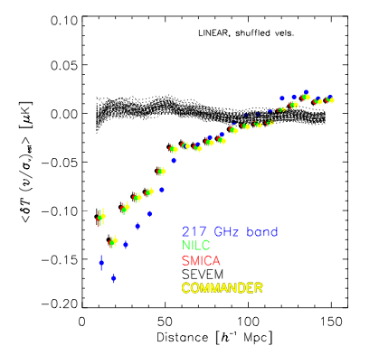
Consistency tests
We compute correlation after shuffling the recovered velocities among the CGs: the correlation is only recovered for the correct configuration
The coupling of intrinsic CMB large modes with large spatial modes of the recovered velocities constitutes the largest contribution to the variance: the low-k modes of the recovered velocities are suppressed after shuffling these

Slide 34
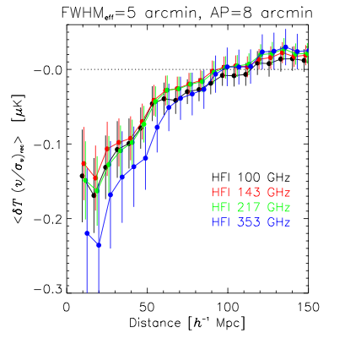
Consistency tests
We expect NO frequency dependence in the kSZ signal:
After de-convolving and convolving all HFI raw channels to the same FWHM=5 arcmin, we only find some signatures of dust at 353 GHz

Slide 35
Implications for the missing baryon problem …

Slide 36
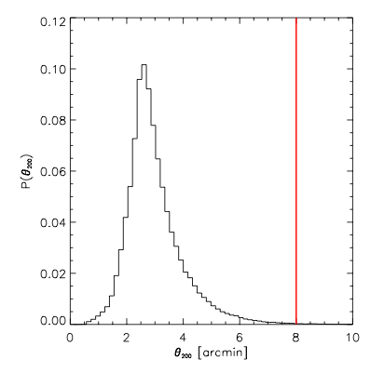
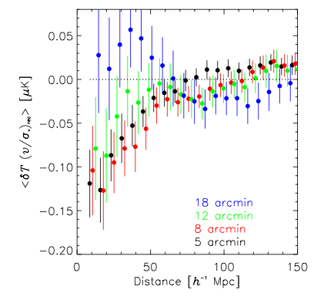
Hints for unbound gas ??
As for the peculiar kSZ pairwise momentum, we find more kSZ signal at apertures close to 8 arcmin (~0.8 Mpc at z~0.12) than at 5 arcmin, and it extends up to ~12 arcmin.
The typical CG virial radius is below 400 Kpc, or typically 5—6 arcmins.

Slide 37
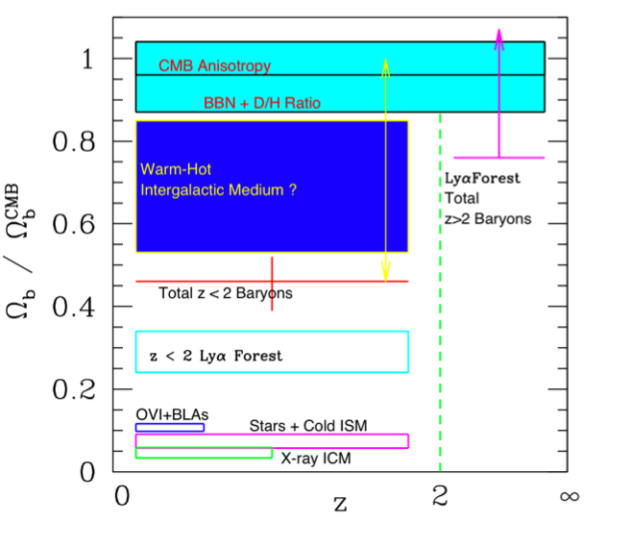
THE MISSING BARYON PROBLEM
Counting the amount of baryons in the local universe yields a result that falls a factor of 2-4 short when compared to observations at redshifts z~5-6 (Ly-alpha absorbers) and z~1,050 (CMB observations)‏
The Universe has grown bigger and transparent since then...
The hidden baryons should be found in a diffuse low density warm hot phase (WHIM) at T \in [1e5,1e7] K
Observations of diffuse X-ray emission around clusters (Zappacosta et al. 02) or absorption lines along bright high-z QSOs (Nicastro et al. 05) have yielded some evidence of diffuse baryons at low redshift.
Nicastro et al. (05)‏

Slide 38
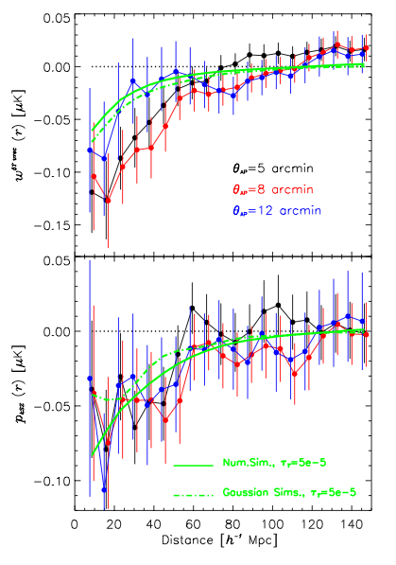
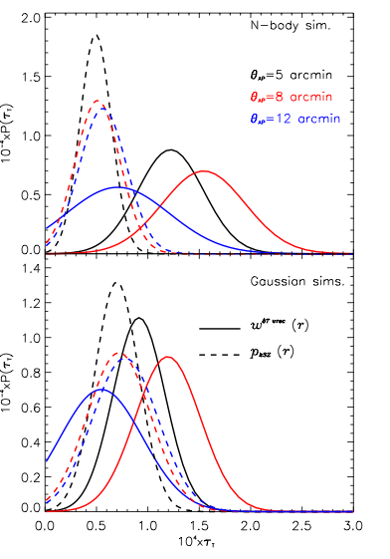
Let’s compare both measurements:
<dT dv>[r] vs r
P(τ_{T}) vs τ_{T}
<dT dv>_{sim}[r]=
τ_{T} <v_{i} v^{est}_{j}>_{sim}[r]
p_{kSZ}(r) vs r
<p_{kSZ}>_{sim}[r]=
τ_{T} <(v_{i –} v_{j}) c_{ij}>_{sim}[r]
τ _{T} ~ number of electrons

Slide 39
Let’s count the electrons one can detect with the kSZ …
τ _{T} = \int dl n_{e} σ_{T} ~ number of electrons
We are effectively observing through cylinders of depth L_{corr}

Slide 40
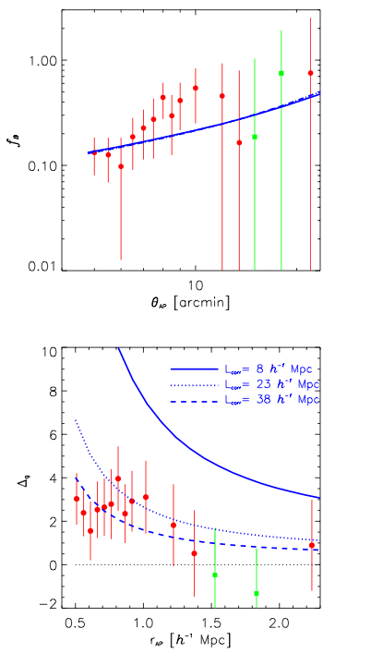
Fraction of electrons/baryons detected around CGs wrt all electrons/baryons existing at that z:
τ _{T} = \int dl n_{e} σ_{T} ~ number of electrons
~50%
DM predictions from N-body Millennium sim.
Average gas overdensity within cylinder of
a given depth L_{corr} :

Slide 41
See Yin-zhe Ma’s talk right after this one!!

Slide 42
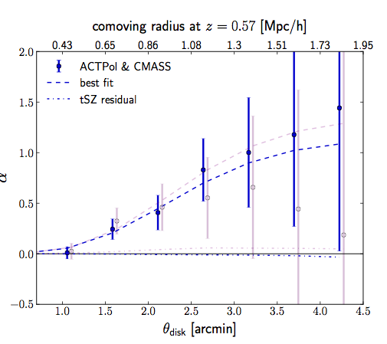
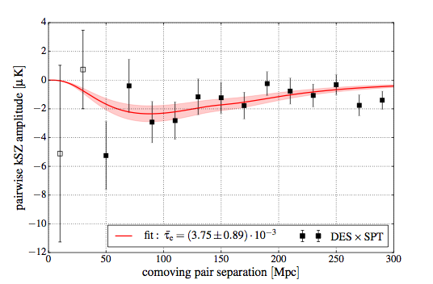
Latest results from high-resolution experiments like the South Pole Telescope (SPT) and the Atacama Cosmology Telescope Pol (ACTPol)
Schaan et al. 2016, for the ACTPol collab: α = <δT_{obs} / δT_{model} >
Soergel et al., 2016,
for the SPT collab.

Slide 43
New approaches to the kSZ …

Slide 44
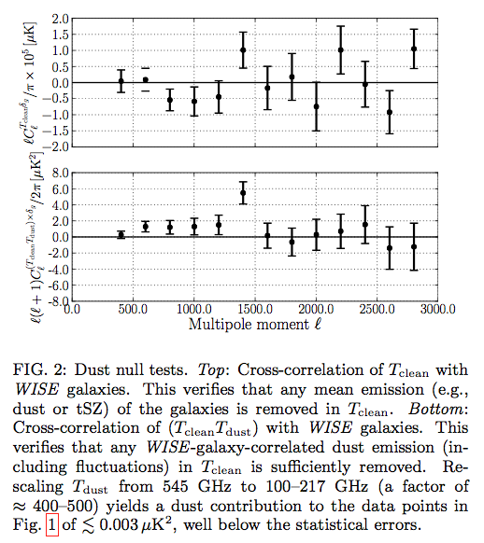
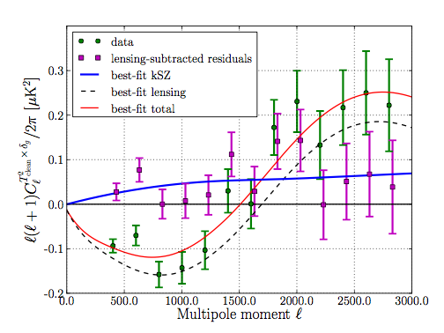
The 3-point approach
Hill et al. 2016
<(δT_{kSZ})^2 δ_{gal} > : it computes the correlation of the squared CMB temperature field with the galaxy density contrast. It is however contaminated by CMB lensing …. They claim to have detected ALL baryons with this approach!

Slide 45
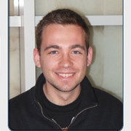
The δz – kSZ correlation
Mr. Jonás Chaves-Montero is a PhD student at CEFCA
z = z_{Hubble} + z_{pec}

Slide 46
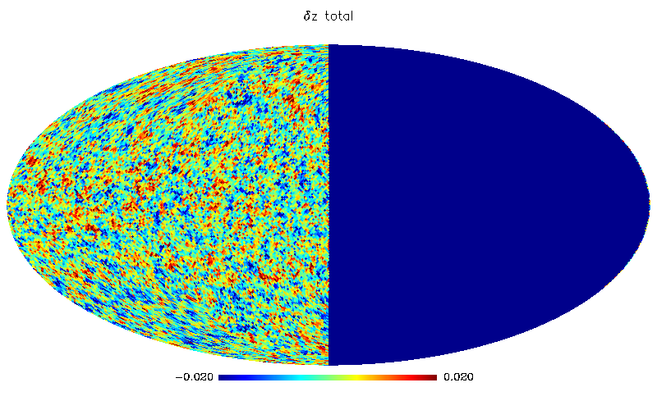
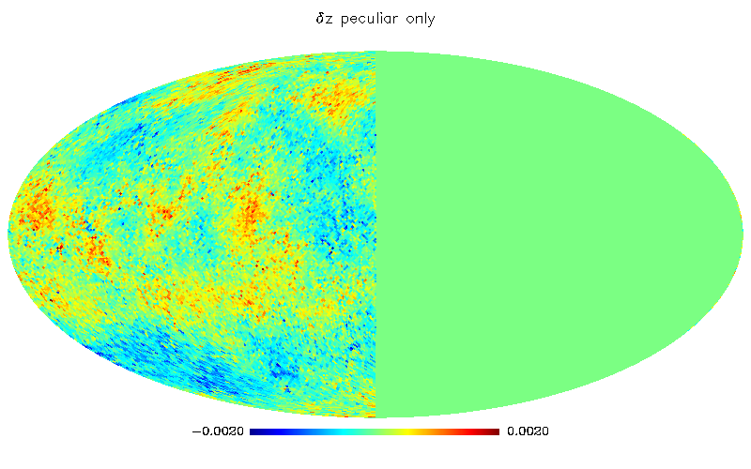
Mr. Jonás Chaves-Montero is a PhD student at CEFCA
z = z_{Hubble} + z_{pec}
From Garching Virtual Observatory (GAVO)
(z~0.2 and n_{g} ~1e-3 [h/Mpc]^3, \sigma_z~0.02)
z = z_{pec}

Slide 47
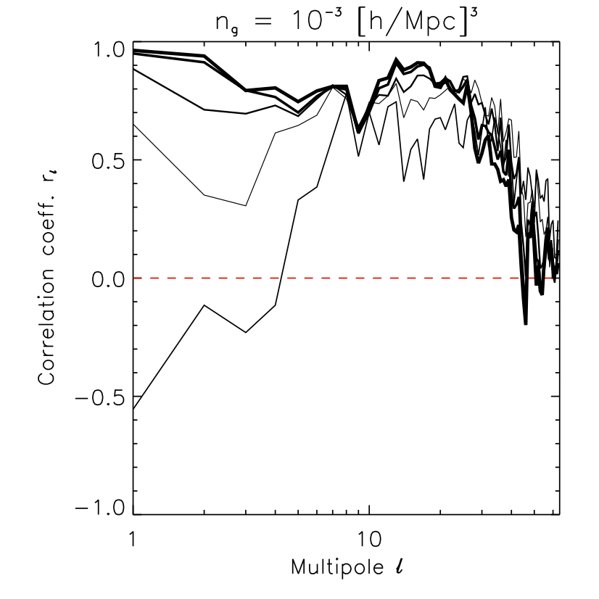
Mr. Jonás Chaves-Montero is a PhD student at CEFCA
Correlation coefficient between z_{vel}(n) and redshift fluctuations δz (n):
R(z_{vel} δz) =
<z_{vel} δz> / SQRT(<z_{vel} ²><δz²>),
Same as R(x,y) = <xy> / SQRT(<x²><y²>)
If R(x,y)=1, x,y are perfectly correlated
If R(x,y)=0, x,y are uncorrelated
1/θ
If confirmed to work OK, this should provide a new channel to study the interplay of densities and velocities on the large scales!

Slide 48
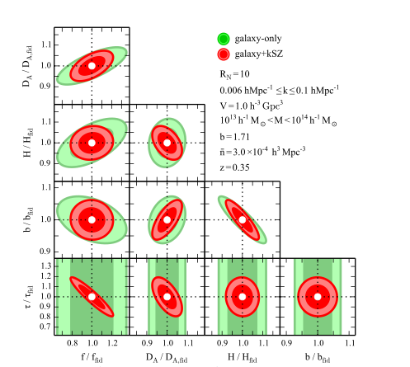
A look to the future
A forecast study by Sugiyama et al. 2016 assures that kSZ surveys will complement upcoming LSS surveys by shrinking error bars in parameters like b, fσ₈ , H₀ , and D_{A} .
We are very probably at the beginning of a very interesting kSZ-science era!

Slide 49
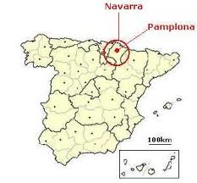
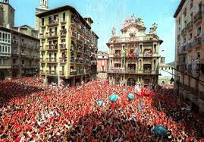
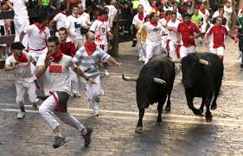
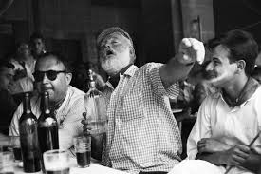
7 de Julio, San Fermín!! → July the 7th, San Fermin!!
Spain
Ernst Hemingway

Slide 50
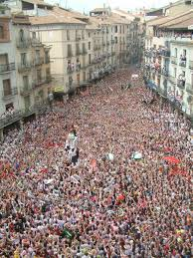
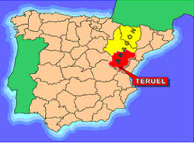
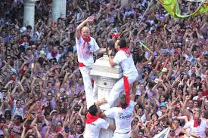
La Vaquilla, main Summer festivity in Teruel (Aragón, Spain), is taking place this Saturday!
Continental Spain

Slide 51
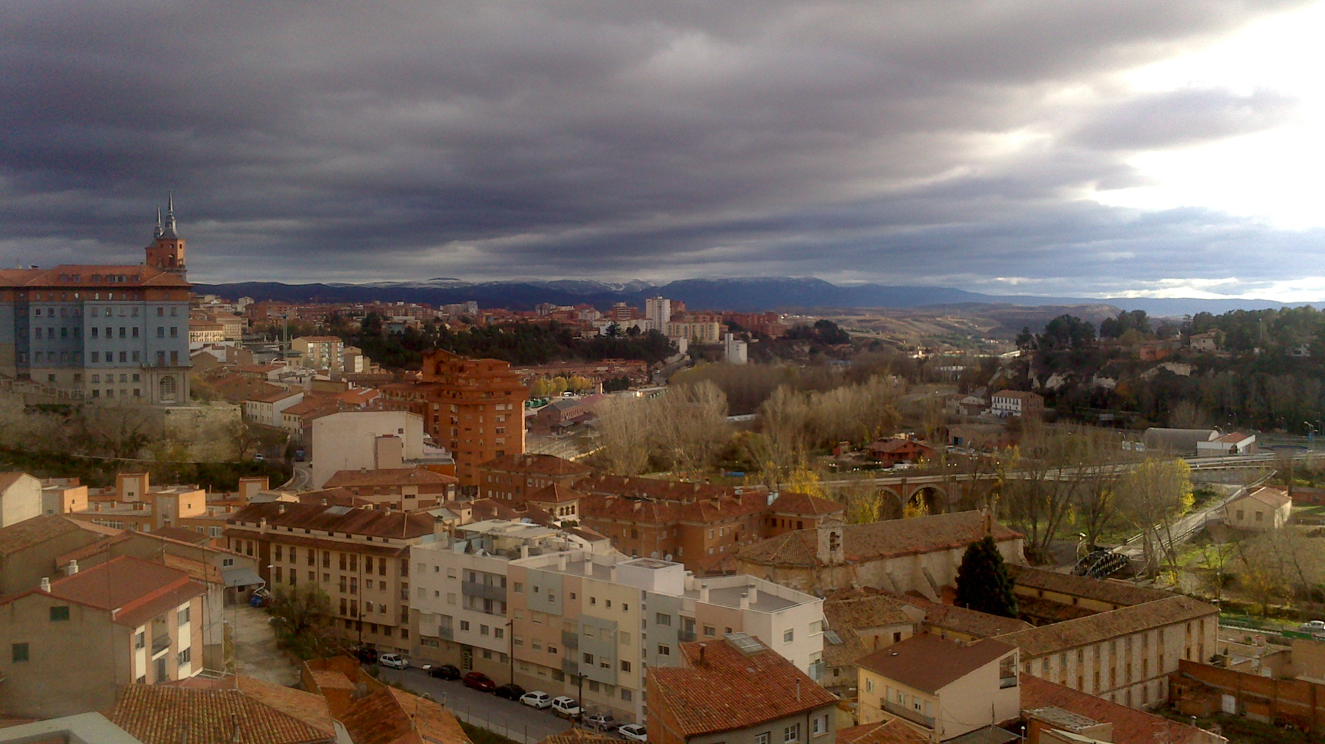
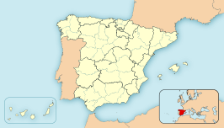
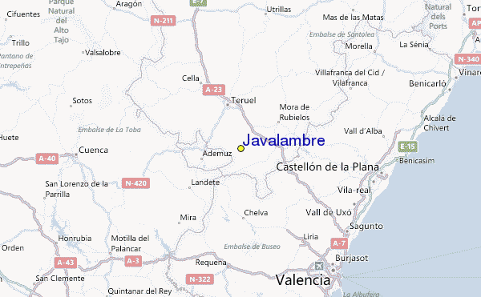
ARAGÓN
Teruel
Valencia
Teruel lies ~ 150 km NW from Valencia, not far from the Mediterranean sea …

Slide 52
Javalambre sierra as seen SE from my home in Teruel
Teruel

Slide 53
Javalambre sierra as seen SE from my home in Teruel

Slide 54
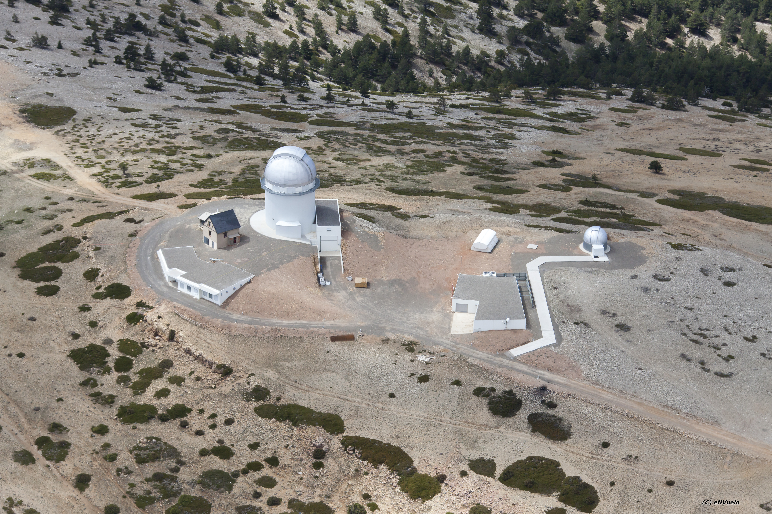
Observatorio
Astrofísico de
Javalambre, OAJ
Median seeing ~0.7” at Pico del Buitre
Elevation ~2,000 m

Slide 55
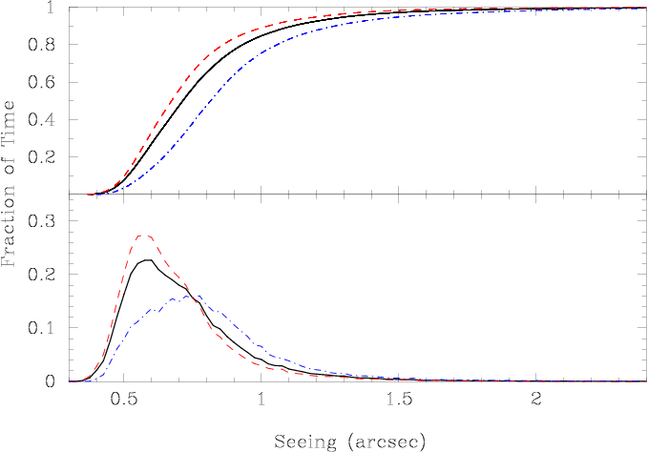
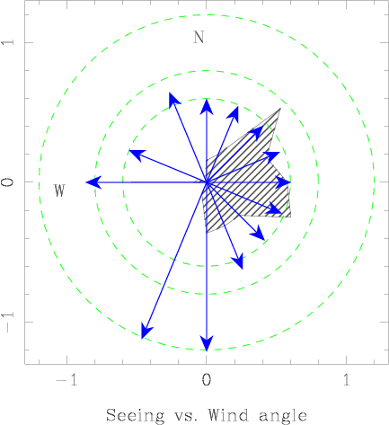
OAJ
Seeing conditions
Moles et al. 2009

Slide 56
J-PAS survey
J-PAS should yield a pseudo-spectrum (R~50) in every pixel of the sky down to m_{AB} ~ 22.5 – 23.5

Slide 57
J-PAS is an acronym of an acronym, and stands for Javalambre (Physics of the Accelerating Universe) Astrophysical Survey.
J-PAS, founded on the grounds of a MoU signed by three institutions (CEFCA, USP [University of Saõ-Paulo, Brazil] and ON [Observatorio Nacional, Brazil]), gathers now the efforts of more than 100 scientists from Spain, Brazil, Japan, Italy and the US, in order to cover 8,500 square degrees in the northern sky with 54 filters narrow band filters (~125 A) + 5 broad band filters, down to a depth of m_{AB} ~23.5 from the Observatorio Astrofísico de Javalambre (OAJ), in Teruel, Spain. This survey should start at the beginning of 2017 and finish by 2023
J-PAS will do BAO Cosmology, galaxy clusters, RSDs, lensing and a lot of Galaxy Evolution Science
J-PAS will provide ~ 20 million sources with Δz/1+z) ~ 3e-3
http://j-pas.org

Slide 58
C’am ‘On
(Thank you!)

