Slide 1
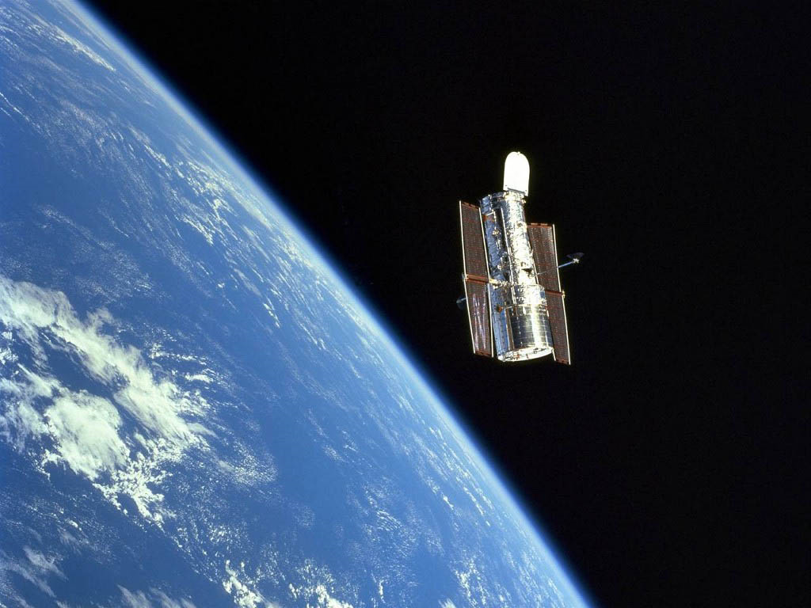
The Future of Infrared Surface Brightness Fluctuation Distance Measurements
Joseph Jensen, Utah Valley University
John Blakeslee, Herzberg Astrophysics
July 4, 2016

Slide 2
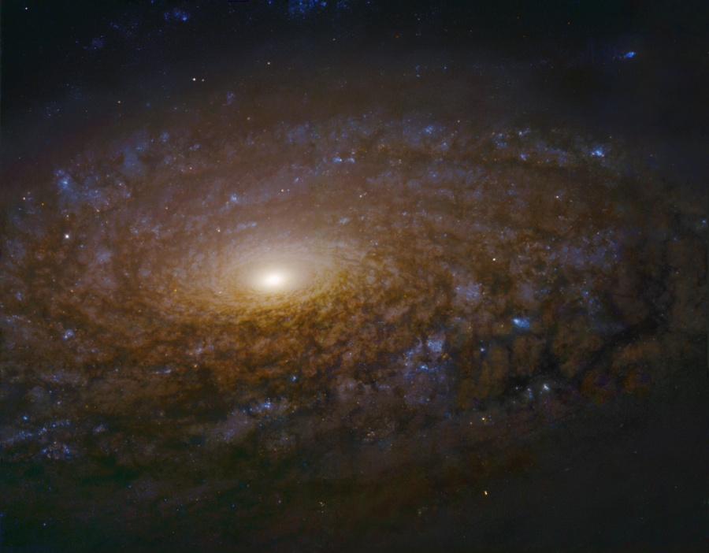
Why do we need to measure
accurate distances?
Understanding the systematic limitations of distance measurement techniques is key to solving many problems in cosmology and astrophysics.
  Measure supermassive black hole masses in early-type galaxies.
  Understand possible biases in the type Ia supernovae distance scale.
  Help resolve the tension between CMB model-based H_{o} and the locally-calibrated distance ladder.

Slide 3
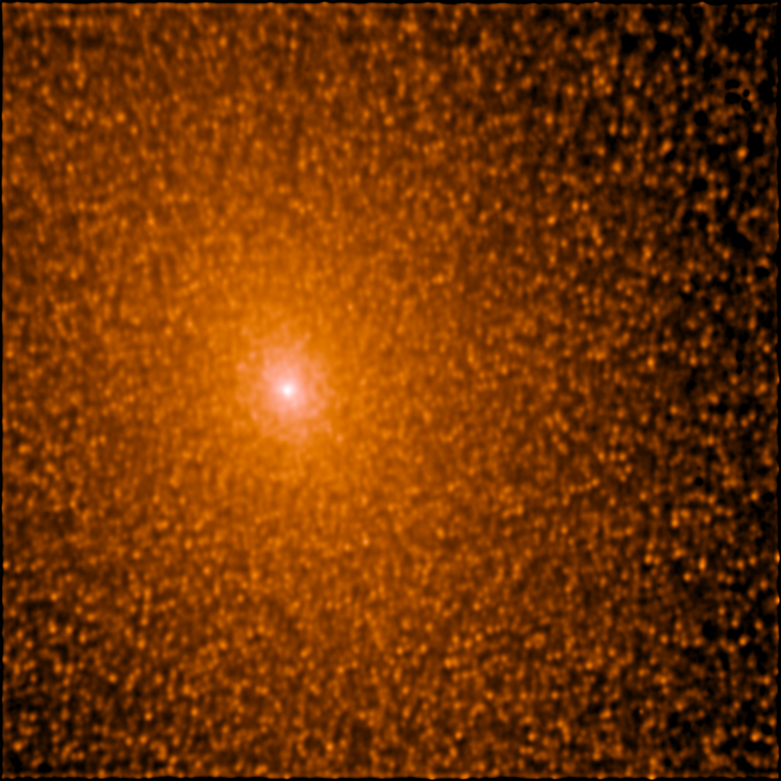
Surface Brightness Fluctuations

Slide 4
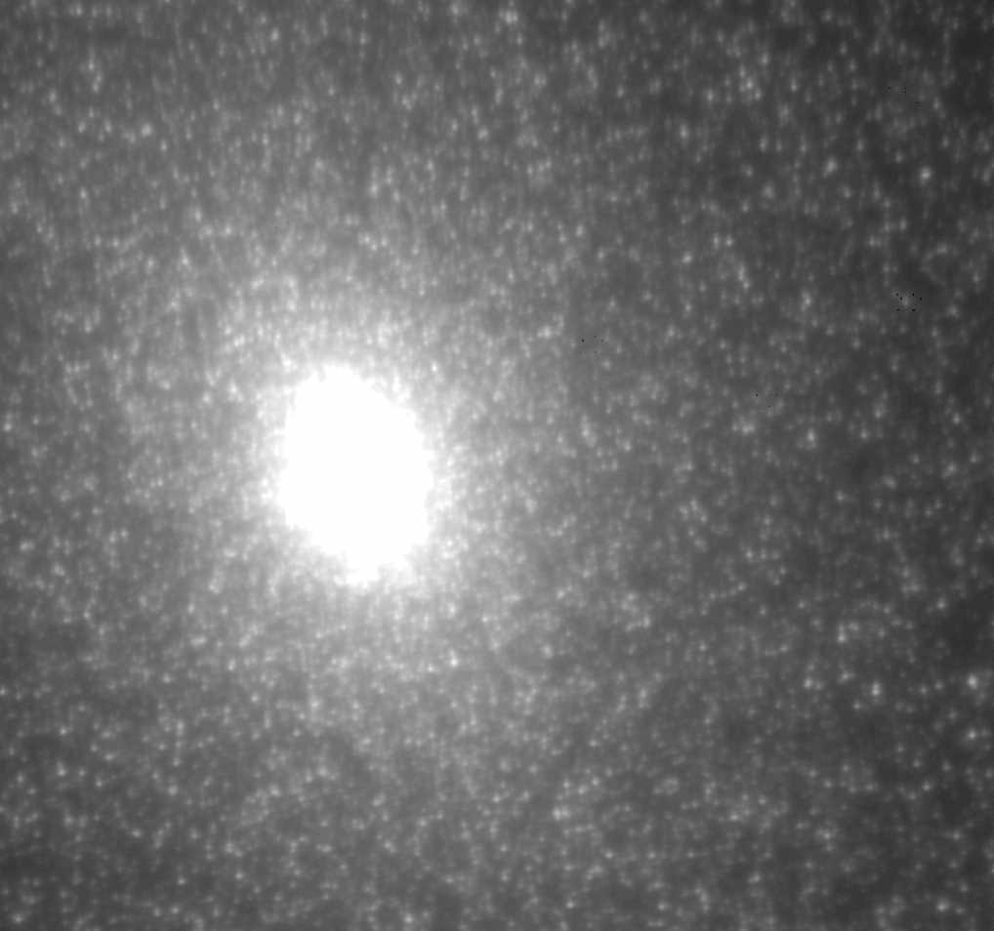
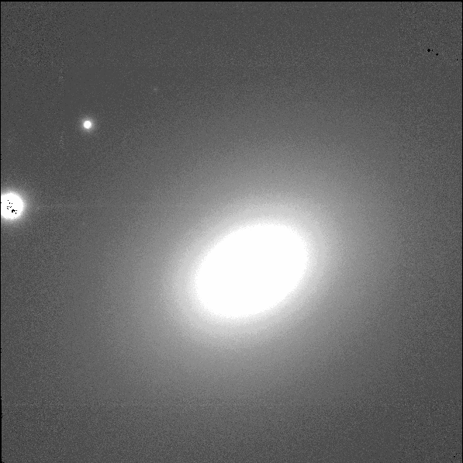
Distant galaxies appear smooth compared to nearby ones due to Poisson statistics.
5”
M 32 (0.77 Mpc)
NGC 7768 (120 Mpc)

Slide 5
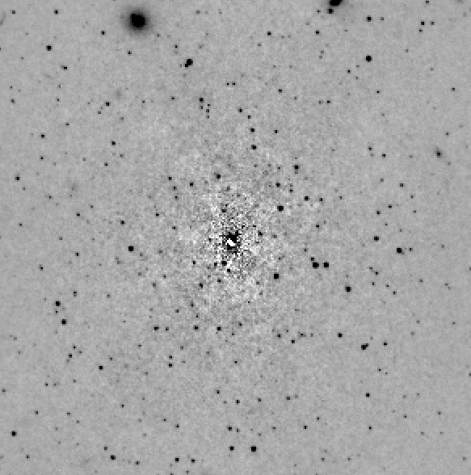
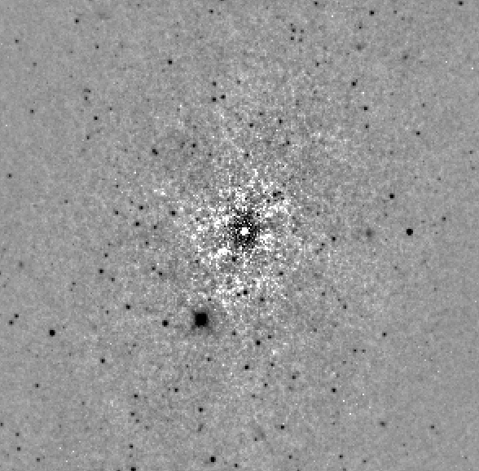
IR SBFs
Standard candle based on RGB stars accurate to ~5% in distance
Statistical method: individual stars need not be imaged; blending is not an issue
Independent of the bulk properties of the galaxies, unlike TF or FP; just the stars themselves (age and metallicity)
Completely different population from Ia SNe
Notes:
Emphasize more efficient than Cepheids or SN for targeted samples.

Slide 6
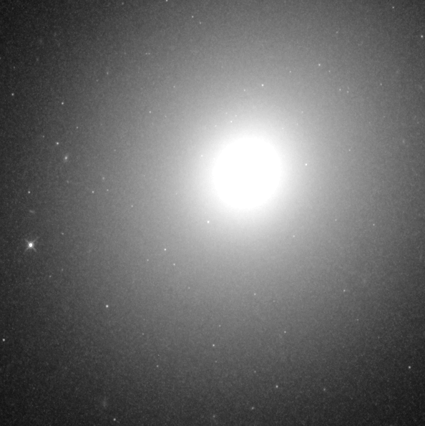
IC 2006
WFC3/IR
F110W
Fornax
20 Mpc

Slide 7
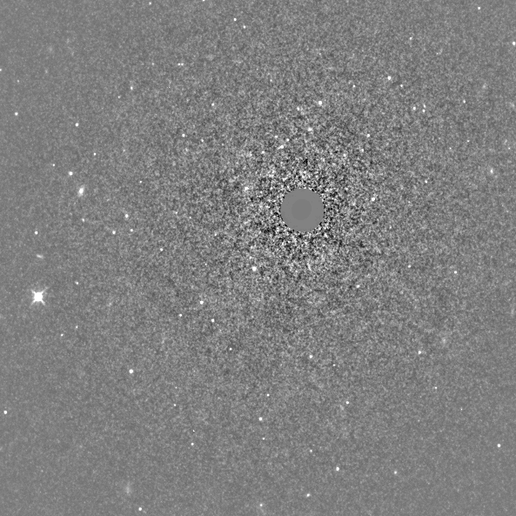
IC 2006
WFC3/IR
F110W
Fornax
20 Mpc

Slide 8
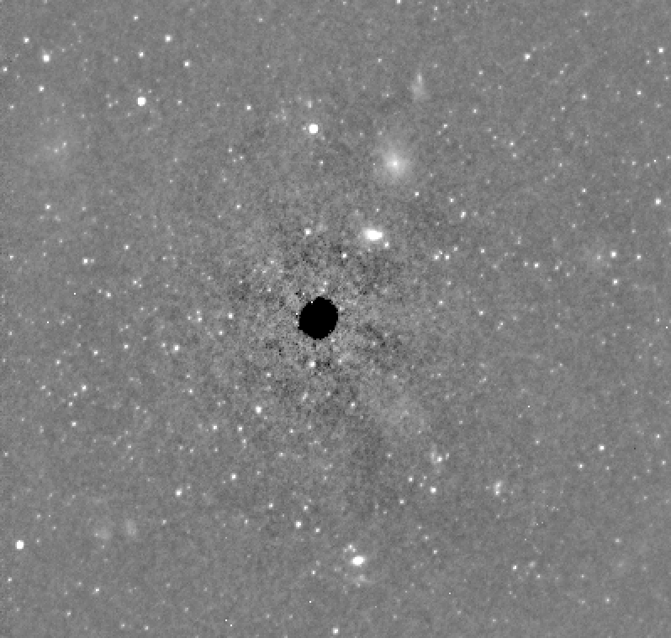
NGC 4874
WFC3/IR
F110W
Coma
96 Mpc
Limitation at ~100 Mpc is detecting globular clusters, not the SBF.
Notes:
Central square arcmin of N4874 with WFC3/IR, with the galaxy subtracted

Slide 9
Advantages of IR SBF Distances
SBFs are much more luminous in the NIR
  Dominated by luminous RGB stars
Increased contrast with contaminating globular clusters and background galaxies
Image quality is better in the near-IR
Dust extinction is much lower than in the optical
Comparable accuracy to Sne, but more efficient
BUT…
IR SBF are sensitive to young populations and AGB stars, so we avoid the bluest ones
Depends on the Cepheid calibration (for now)
Notes:
Many advantages for IR SBF with AO

Slide 10
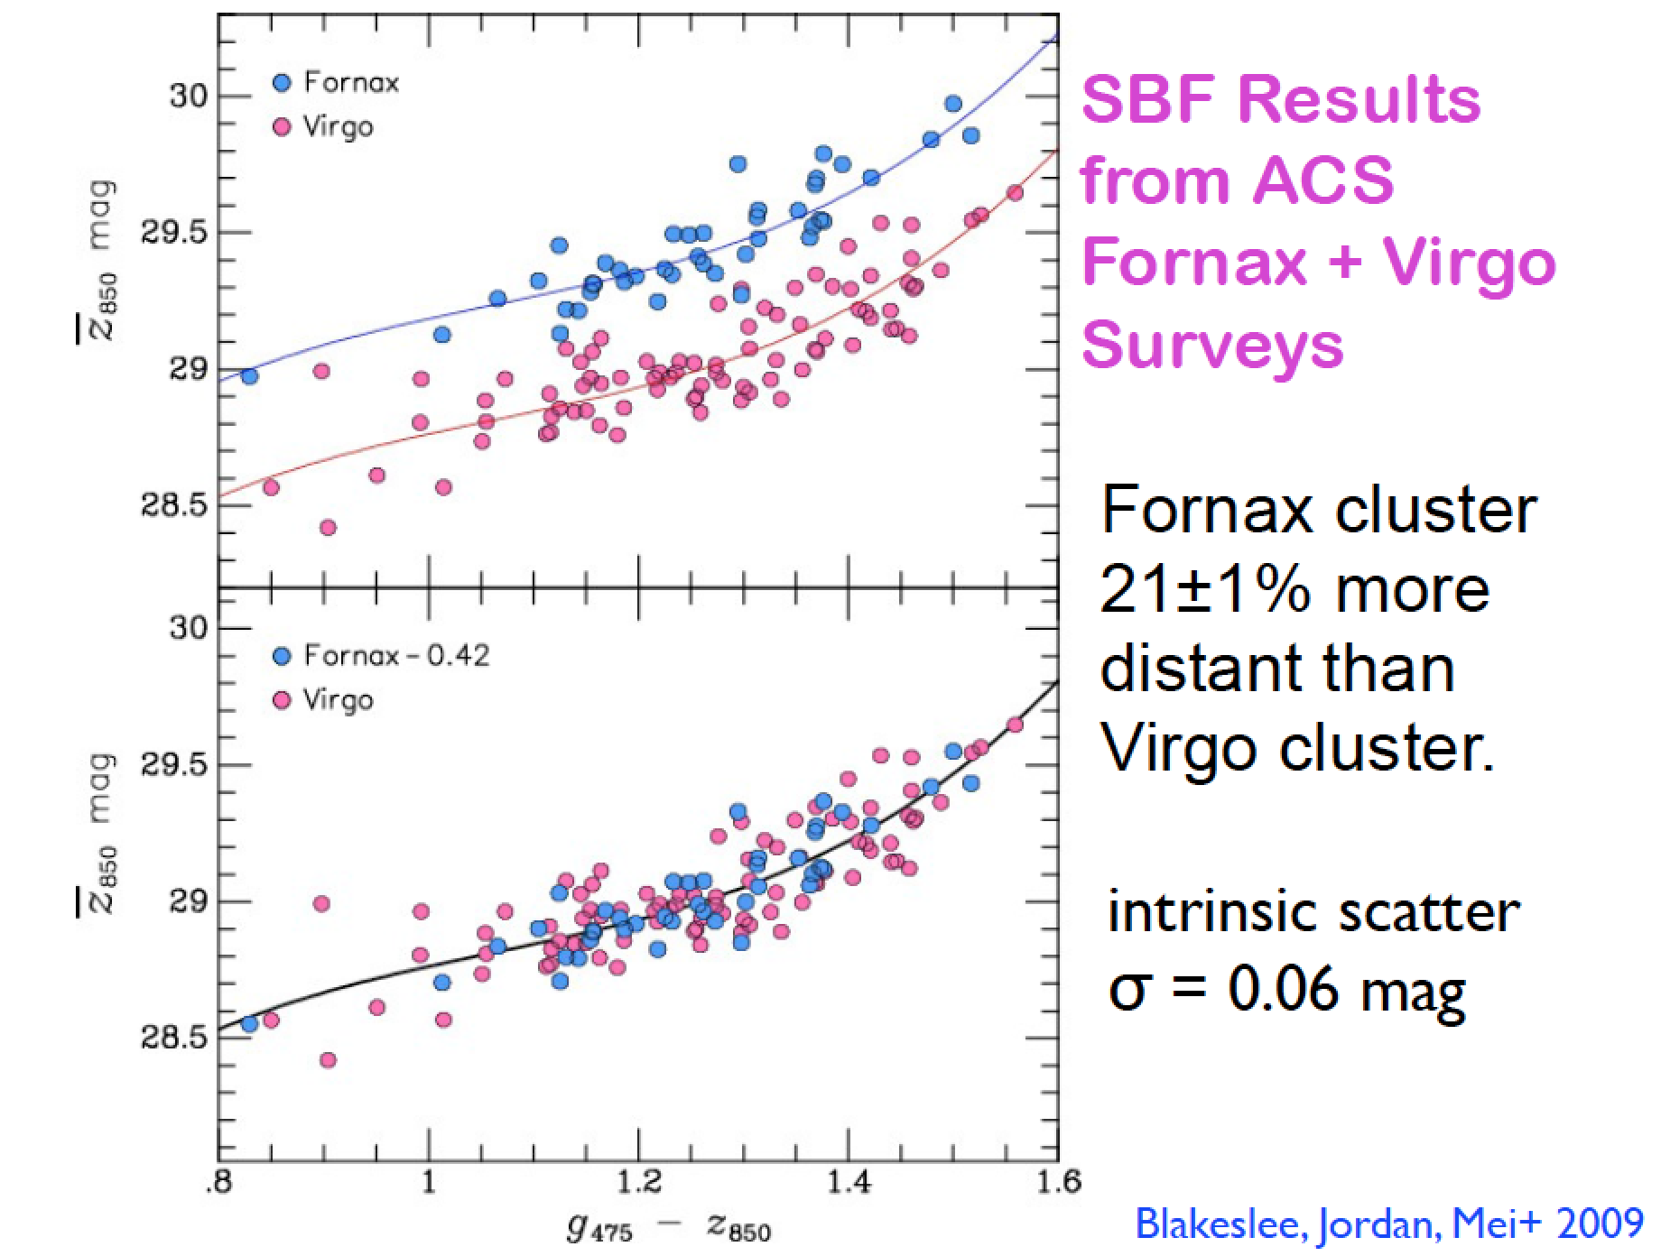

Slide 11
The IR SBF calibration has intrinsic scatter of 0.08 and 0.11 mag at J and H
~5% distances to early-type galaxies
Jensen, Blakeslee, et al. 2015, ApJ 808:91

Slide 12
Jensen, Blakeslee, et al. 2015, ApJ 808:91
Notes:
Padova isochrones include sophisticated handling of the TP-AGB
evolutionary phase. The Padova tracks use solar-scaled
metallicity abundance ratios and do not include α -element
enhancement.

Slide 13
Jensen, Blakeslee, et al. 2015, ApJ 808:91
Notes:
Teramo BaSTI models using a standard Salpeter initial mass function with a low-mass cutoff of
0.5 Msun ( Pietrinferni et al. 2004 , 2006 ; Cordier et al. 2007; Lee et al. 2010) . The solar-scaled
abundance ratio models without convective overshoot, and
the α -enhanced version of the models described by Lee et al.
(2010) . The latter models have a mean [α /Fe] of ∼ 0.4 dex, but
with physically-motivated variations in the abundance ratios
of the individual α elements ( i.e., O, Mg, Si, S, Ca, Ti) ; the
[ Fe/H] abundances in these models have been correspondingly
reduced to keep a fi xed [ Z/H] .

Slide 14
What the Models Tell Us…
Massive, luminous ellipticals in clusters are old and about solar metallicity.
Bluer ellipticals and lenticulars have younger (i.e., intermediate age AGB) populations.
The models can’t (yet) tell us if the dwarf galaxies are old or young.
The oldest populations are near the centers of ellipticals, but the dwarfs have younger populations near their centers.

Slide 15
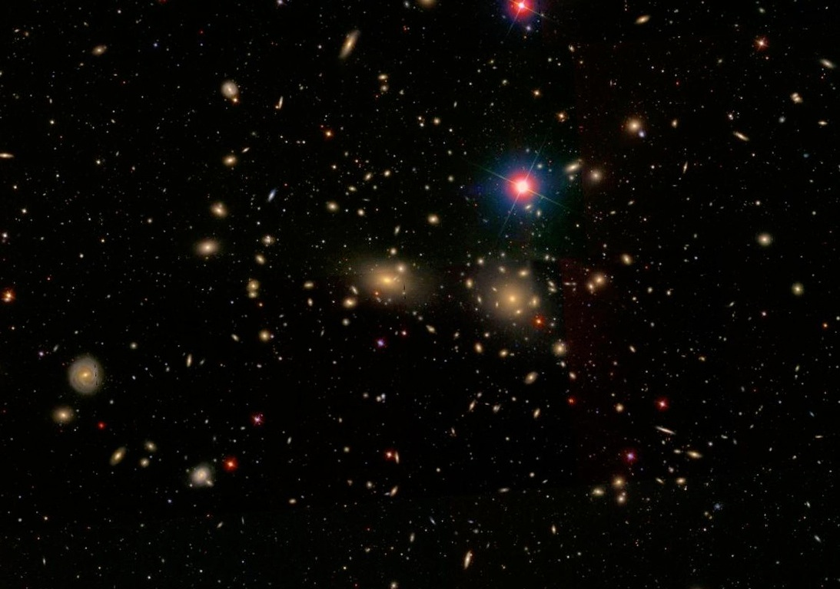
1. The MASSIVE Survey:
Supermassive Black Holes in the Centers of Elliptical Galaxies
Joseph Jensen (Utah Valley University)
John Blakeslee (Herzberg Astrophysics)
Chung-Pei Ma (UC Berkeley) Jenny Greene (Princeton)
Nicholas McConnell (U Hawaii) Jens Thomas (MPE)
Ryan Janish (UC Berkeley) Jeremy Murphy (Princeton)

Slide 16
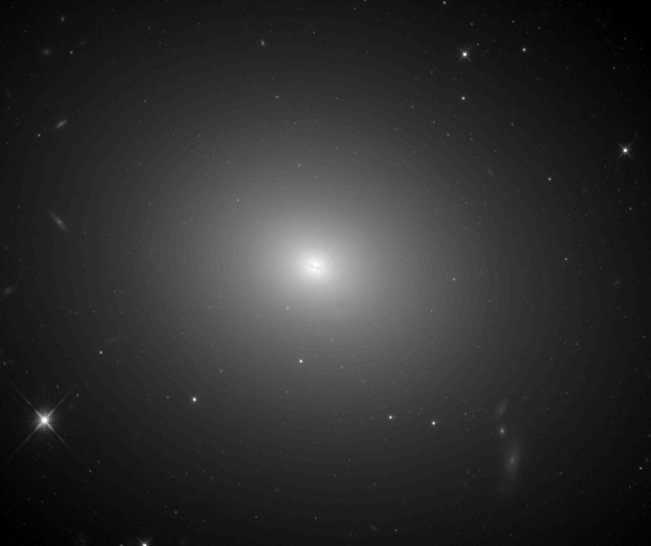
The MASSIVE Survey
Early-type galaxies are…
- hosts of the most massive black holes;
- quiescent counterparts of high-z luminous quasars;
- descendants of z~2 massive, compact galaxies;
- sites of varying/bottom-heavy stellar initial mass functions

Slide 17
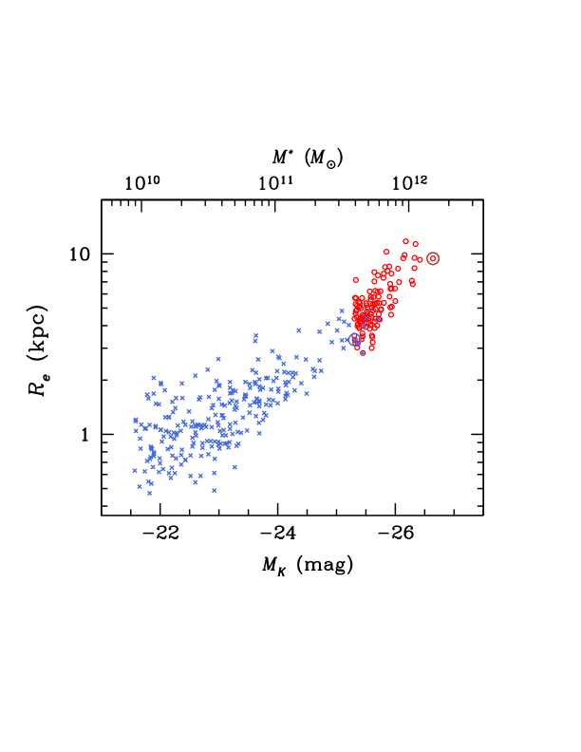
Size - Mass Relation
MASSIVE
survey
NGC 4889
M87
ATLAS^{3d}
Ma et al. (2014)
Notes:
MASSIVE probes a unique region of parameter space—but we need to go out farther to do it.

Slide 18
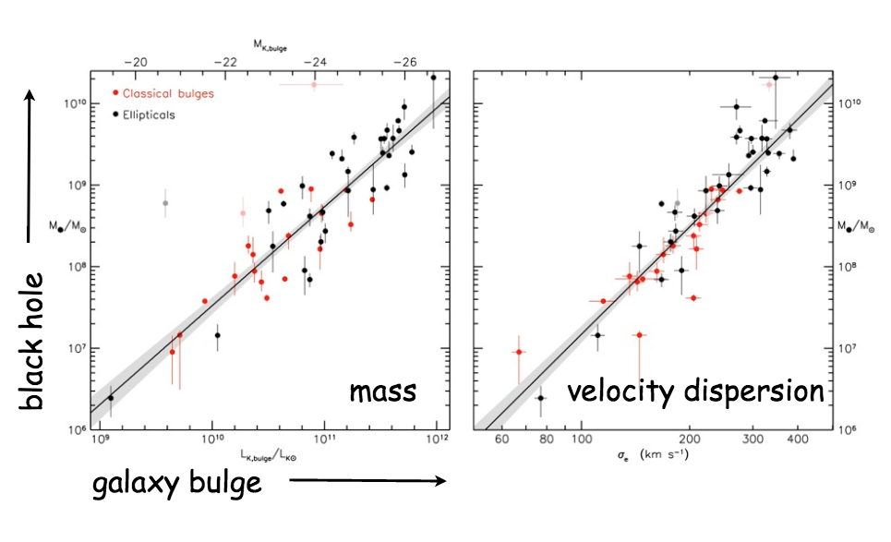
The most significant, and often overlooked, source of uncertainty in the black hole mass derivation is the uncertainty in distance.

Slide 19
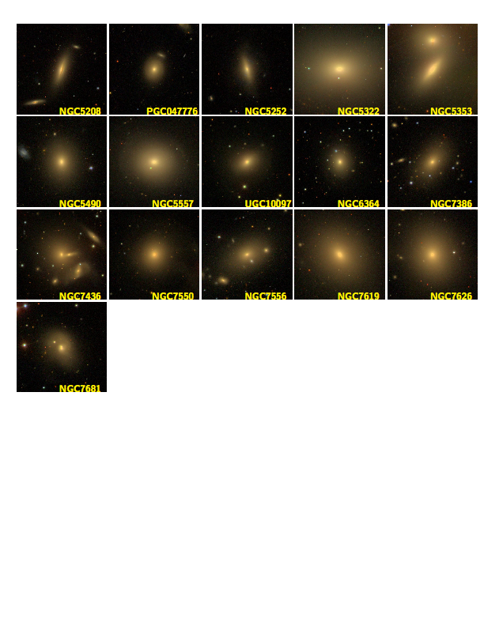
SDSS images of some MASSIVE galaxies
Applying IR SBF to MASSIVE Galaxies

Slide 20
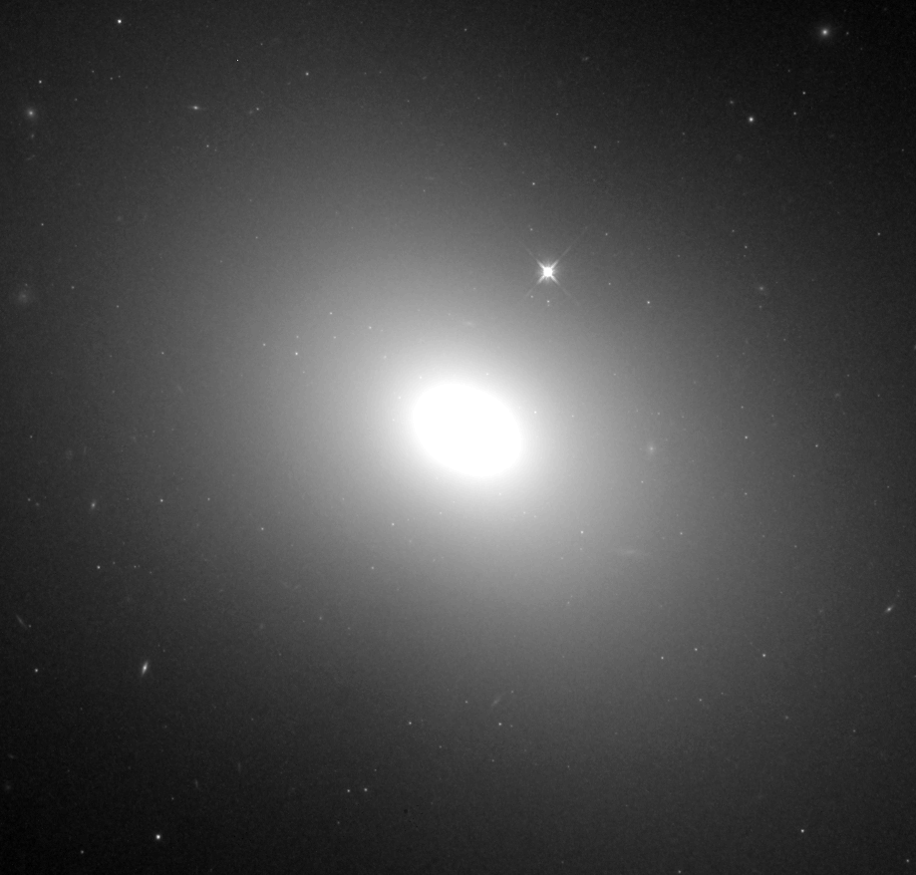
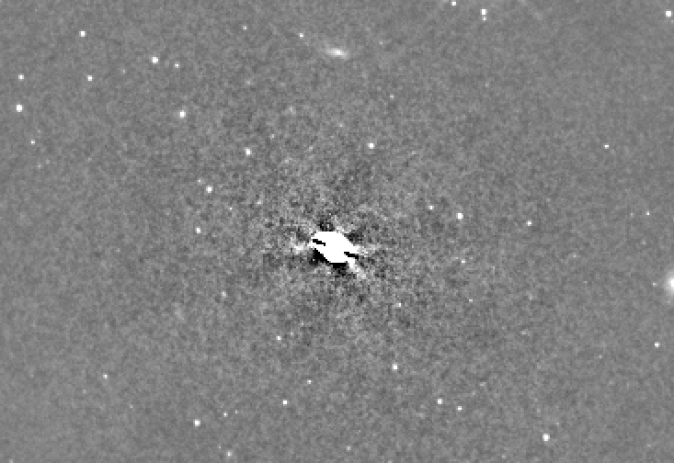

SDSS images of some MASSIVE galaxies
Applying IR SBF to MASSIVE Galaxies
25/34 galaxies have been observed so far.

Slide 21
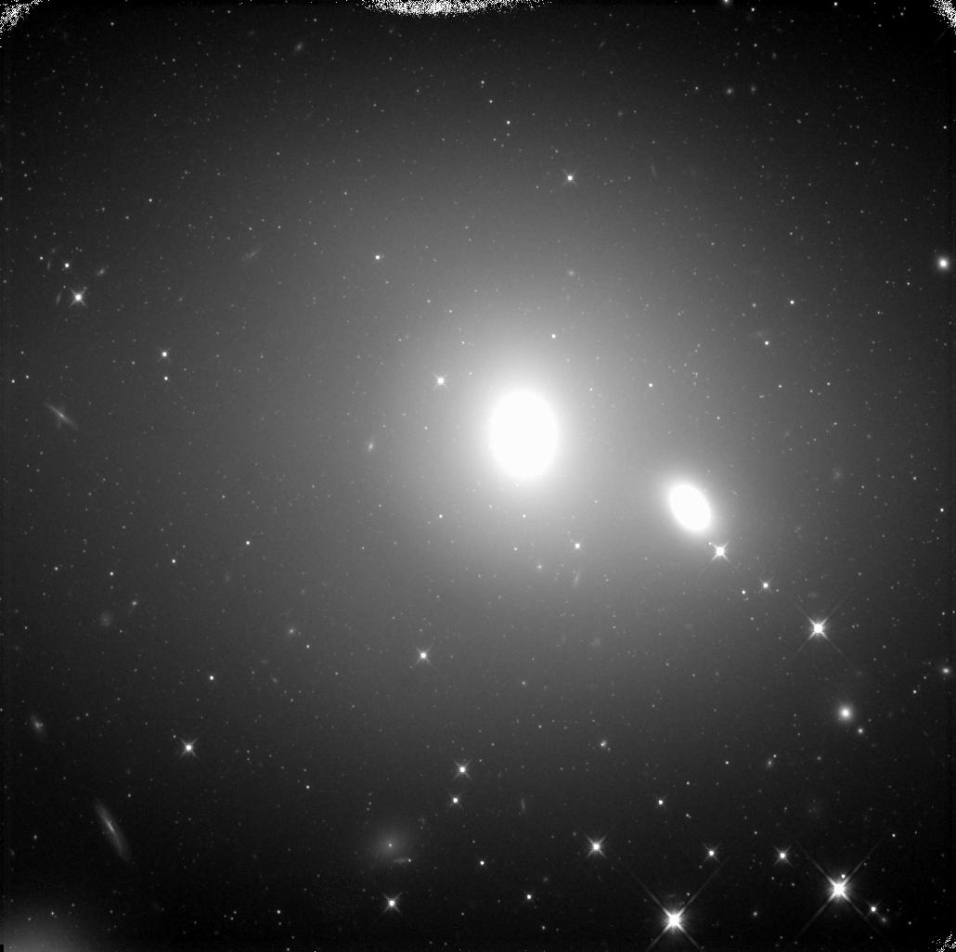
2. Testing for Bias in the
Type Ia SN Distance Scale
Peter Milne (Arizona) Joseph Jensen (UVU)
Peter Garnavich (Notre Dame) John Blakeslee (Herzberg)
Peter Brown (Texas A&M)
Notes:
NGC 1129

Slide 22
2. Testing for Bias in the
Type Ia SN Distance Scale
“Tension” between CMB model-dependent H_{o} and that derived from Cepheid-calibrated SN distances in the nearby universe.
SWIFT has revealed that Ia SNe vary in UV color and luminosity.
Notes:
NGC 1129

Slide 23
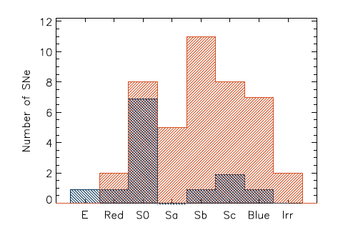
NUV-blue and NUV-red SNe
It turns out that SNe that are indistinguishable at optical wavelengths have different near-UV colors…
…and NUV-blue supernovae may be more common early-type galaxies.
Milne, Brown, et al. 2013, ApJ 779:23

Slide 24
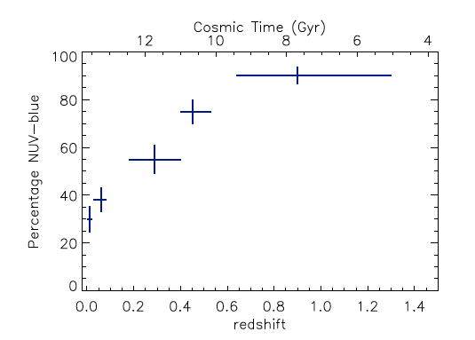
NUV-blue and NUV-red SNe
It turns out that SNe that are indistinguishable at optical wavelengths have different near-UV colors…
…and NUV-blue supernovae are more common at higher redshifts.
We really need a SN calibration for early-type host galaxies!
Milne, Brown, et al. 2013, ApJ 779:23
Notes:
Note that Cepheid calibration of SN locally is therefore limited to late-type galaxies, which are not the most common host types at high redshift.

Slide 25
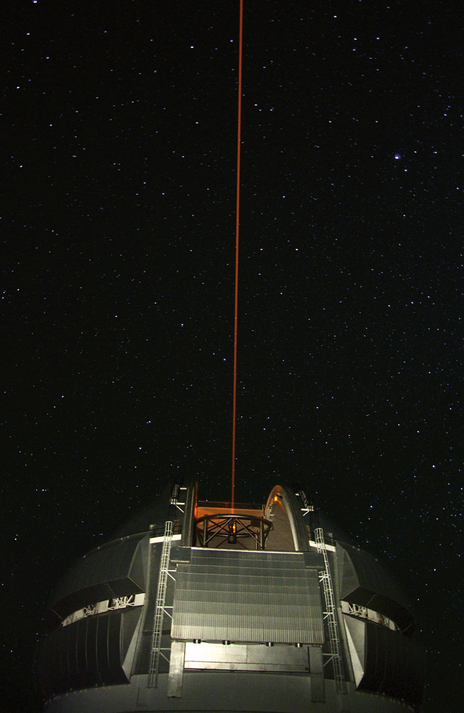
3. IR SBFs with Adaptive Optics
SBF measurements rely on photometric PSF fitting in Fourier space (so the sharper the image, the better)
Temporal and spatial variations of the PSF in AO images have limited the usefulness of AO SBF measurements to-date

Slide 26
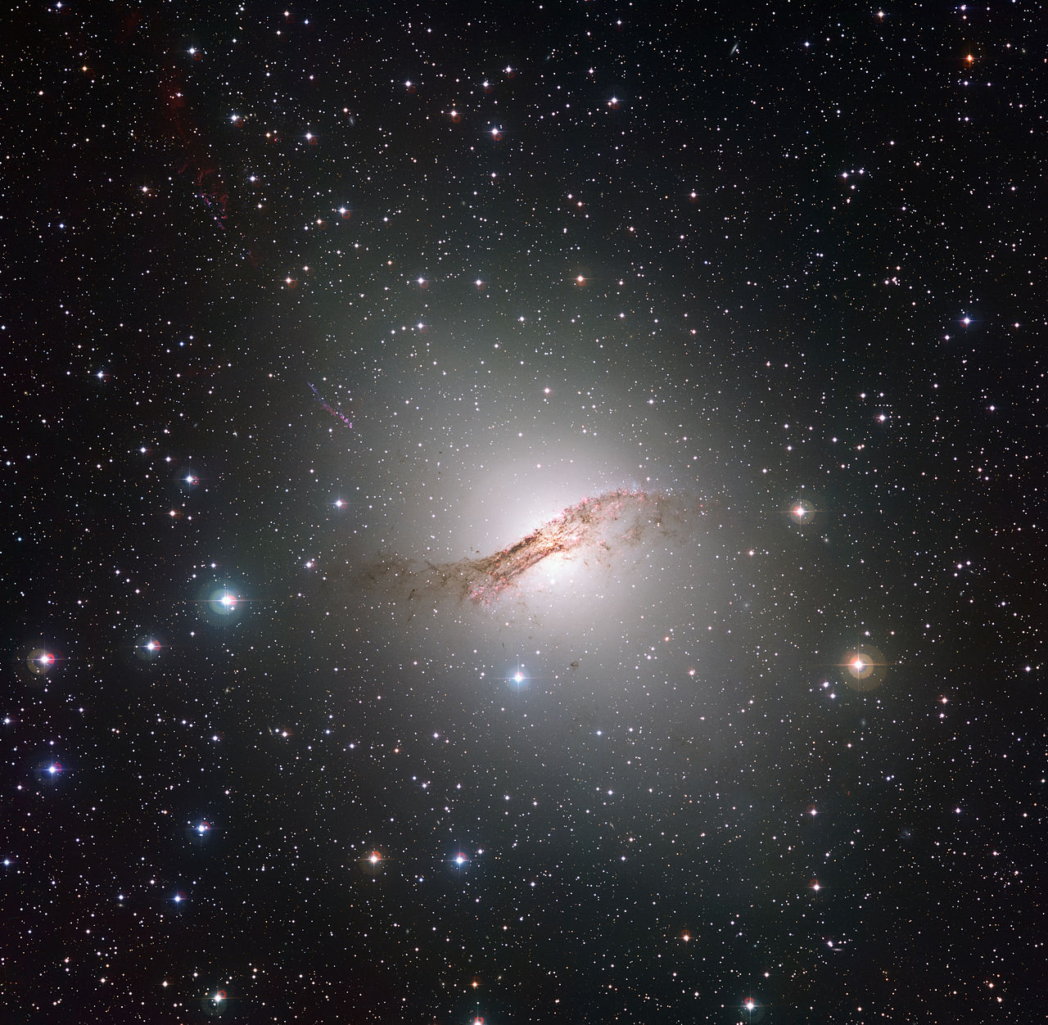
NGC 5128 (Cen A)
Notes:
Gemini MCAO (GeMS)
Provides a uniform PSF across a 1.4×1.4 arcmin field
3 DMs, 5 laser guide stars, 3 natural tip-tilt guide stars
4096×4096 with 0.02 arcsec pixels, 2 arcmin²
Now operational on Gemini-South

Slide 27
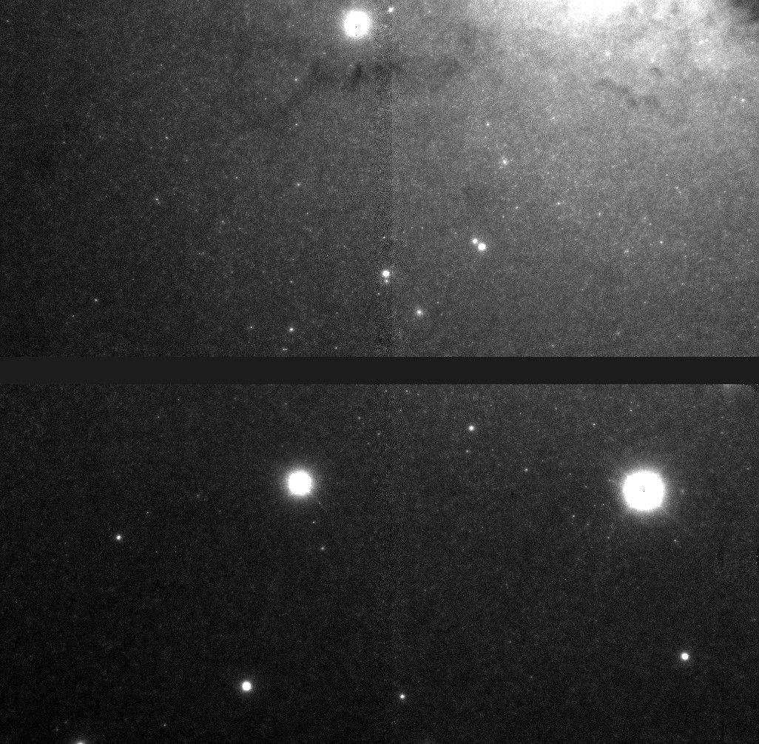
J
Notes:
N5128 images: 150 sec in both J and Ks
n5128j, n5128k: linear stretch, FOV ~ 82x84 arcsec

Slide 28
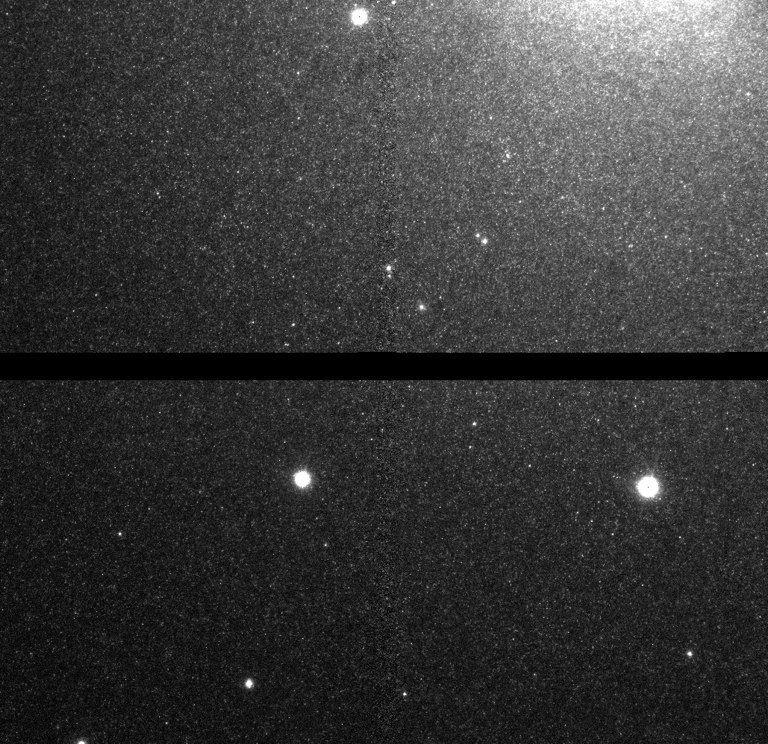
K_{s}

Slide 29
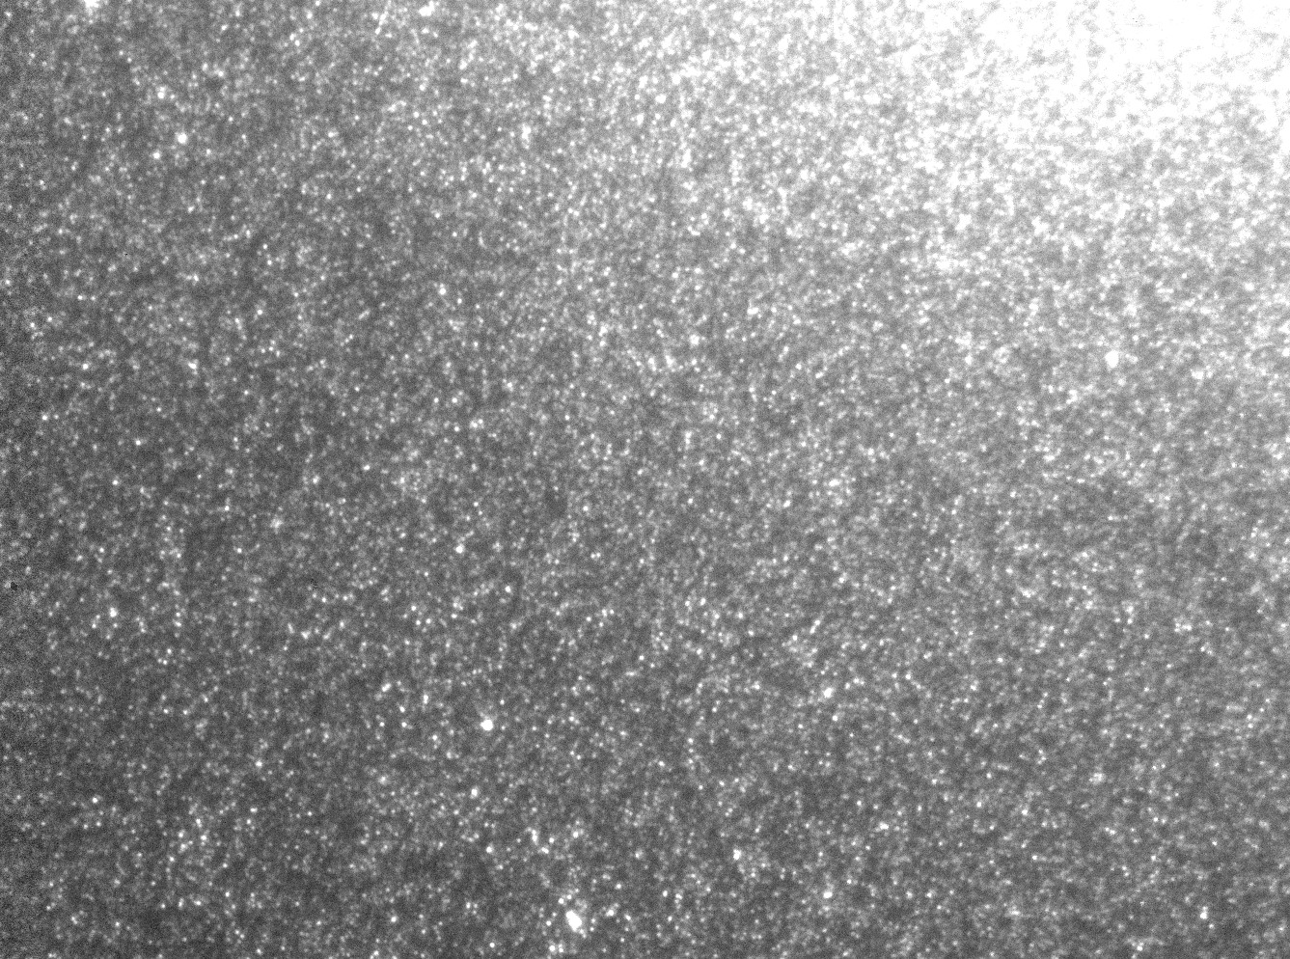
Notes:
n5128k-zoom1, zoom2: linear stretch, FOV~28x20 arcsec

Slide 30
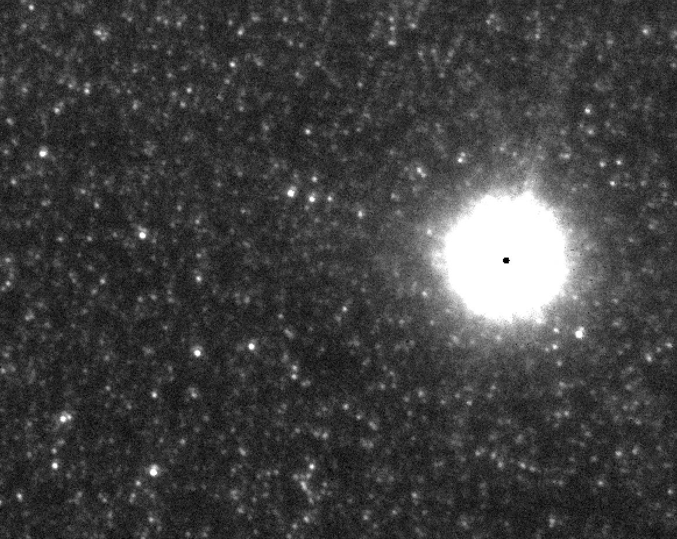
Notes:
10x8 arcsec, FWHM =3.65 pix = 0.073 arcsec

Slide 31
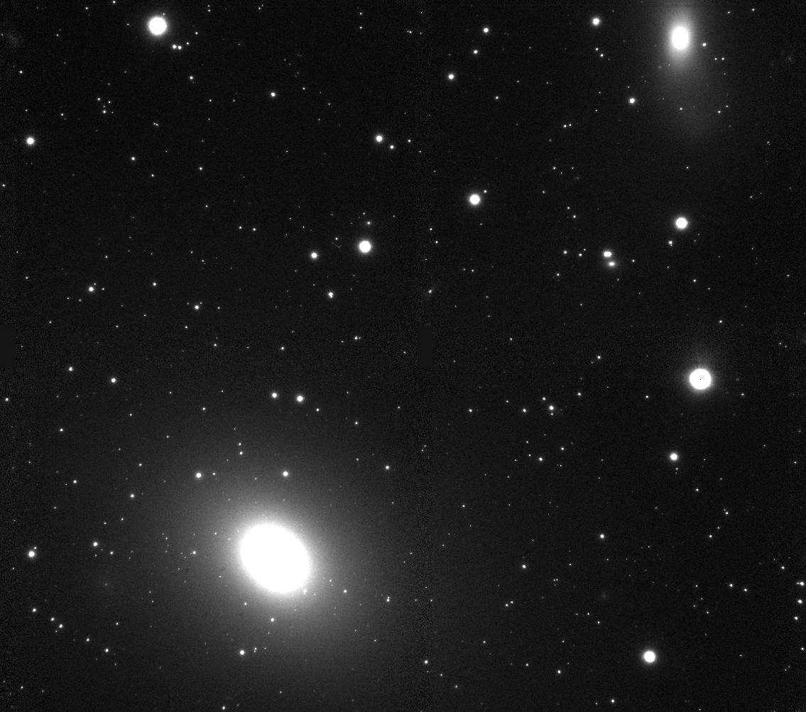
ESO 137G-006 (Norma Cluster)
Notes:
eso137k.jpg: linear stretch, FOV ~ 88x80 arcsec, 1290 sec integration (21.5 min) at ~75 Mpc

Slide 32
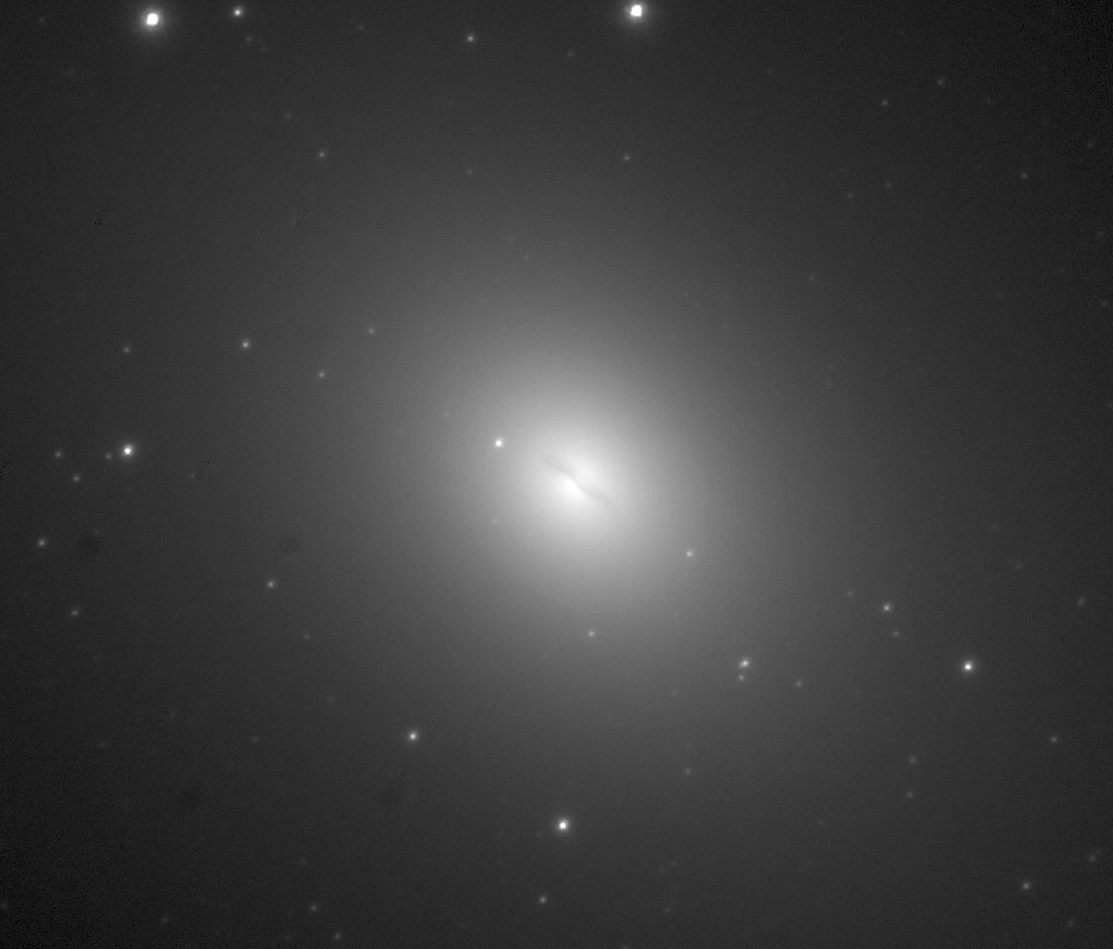
ESO 137G-006 (Norma Cluster)
Notes:
eso137k-center: sqrt stretch, FOV ~ 21x20 arcsec

Slide 33
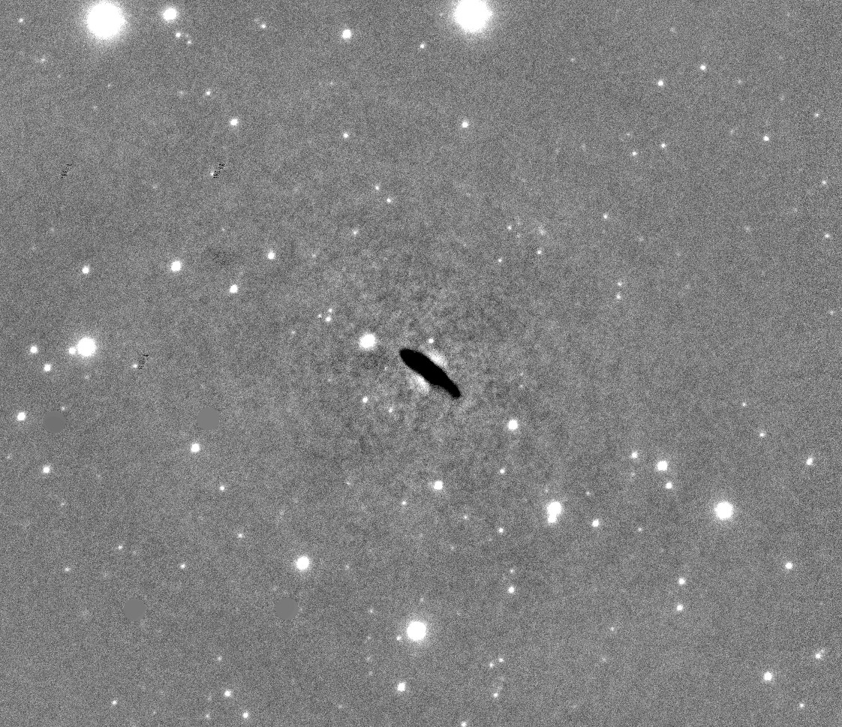
Preliminary Results:
ESO 137-G006
~65 Mpc
H_{o}=74 km/s/Mpc
NGC 5128
3.5 Mpc
consistent with TRGB and Cepheids, but not with some measurements of SN 1986G
NGC 3309
51 Mpc
(calibration reference)

Slide 34
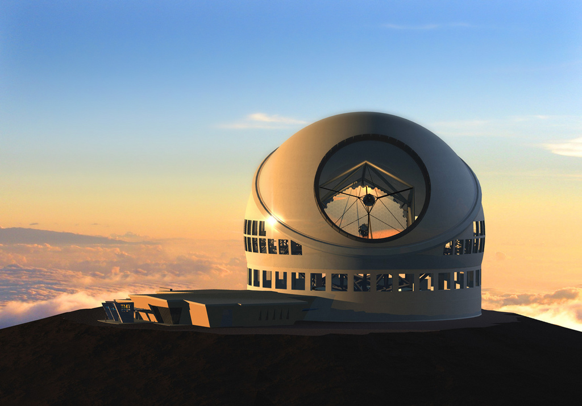
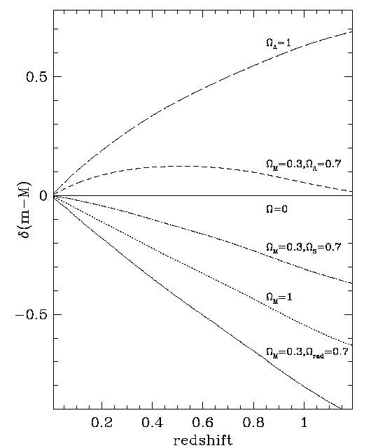
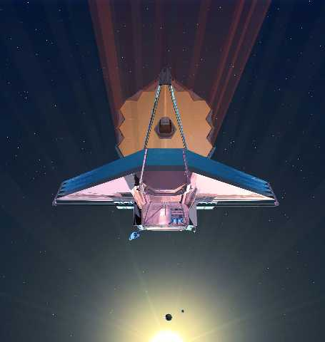
Beyond H_{o}
accelerating
50× faster than Gemini
10× farther than HST/WFC3
decelerating

Slide 35
Summary
By this time next year we will have 70+ homogeneous, high-accuracy HST IR SBF distances to galaxies all over the sky, many of them at ~50-80 Mpc.
JWST and the next generation of ground-based telescopes with MCAO will extend the range of the SBF technique to cosmologically interesting distances.
Notes:
SBF may not be as efficient as large surveys, but it is more efficient and practical than Cepheids or Sne.

