Slide 1
Cosmological information from the Kinetic Sunyaev Zeldovich effect in an anisotropic CMB
Elena Pierpaoli (University of Southern California)
Siavash Yasini & EP, arXiv:1605.0211 PRD in press
Quy Nhon, July 7, 2016
Notes:
To do:
Check sensitivities for ACTPol and SPTPol
kSZpol and difference with T2inpol

Slide 2
Which Sunyaev-Zeldovich (SZ) effect?
Thermal SZ
Due to thermal motion of the electrons.
Produces both intensity and polarization effects.
Dominant in intensity wrt kSZ.
Subdominant (comparable) in polarization wrt the kSZ effect, comparable to low-multiple effect
Kinetic SZ
Due to the motion of the cluster as a whole wrt the CMB rest frame

Slide 3
Why do we care about kinetic SZ?
Velocities measure gravity, and therefore probe dark matter distribution “directly”
Deviations from standard cosmological models (modified gravity, isocurvature perturbations…) predict deviation from standard model prediction for velocities
First detection of pairwise velocities is only 4 years old
Current and future CMB surveys will naturally provide temperature and polarization measurements for a large portion of the sky.
BUT: Harder to measure!

Slide 4
Ways to use kSZ to infer cosmology
Bulk flow
(Kashlinsky + method, WMAP and Planck results )
Pairwise peculiar velocities
(Davis, Peebles + method, ACT, SPT results out)
Ways to use SZ polarization signal to infer cosmology
Reducing cosmic variance
(Kamionkowski & Loeb, Seto & EP)
***PUT FIGURES ********

Slide 5
Kinetic SZ: What we did (which is not rediscovering history)
Consider CMB temperature anisotropies and full frequency dependence of the signal
Full-sky, general coordinate calculation
Neglect thermal effects
(They can be treated perturbatively, and simply added to the results of kSZ. Both Intensity and polarization thermal effects are proportional to Q=kT_{e}/m_{e}c²)

Slide 6
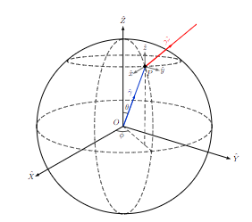
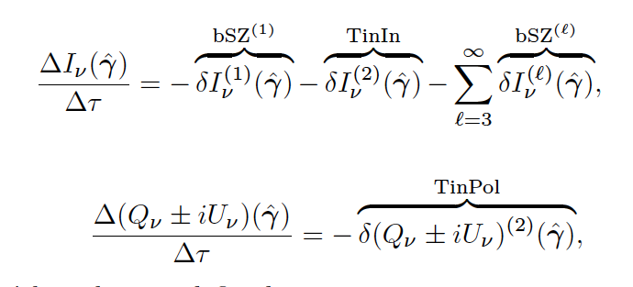
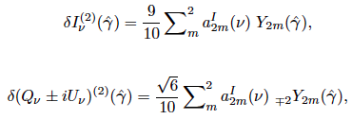
Method part I: non-moving cluster
Radiative transfer equation for non-moving cluster:
The expected signal does not have frequency distortions.
If the CMB is isotropic, there is no signal in either intensity or polarization
Notes:
In an isotropic CMB, Delta_I and Delta_Pol are =0.

Slide 7
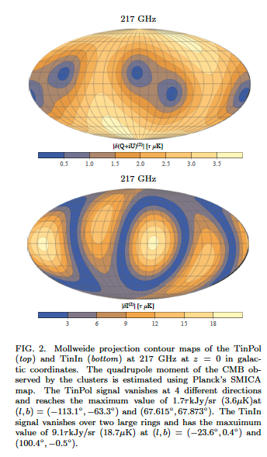
Expected signal for non-moving clusters at z =0 in our real Universe
Notes:
Note that the second figure is only the quadtupole term

Slide 8
Method part II: moving cluster
Motion induces a Doppler and
an aberration effect.

Slide 9
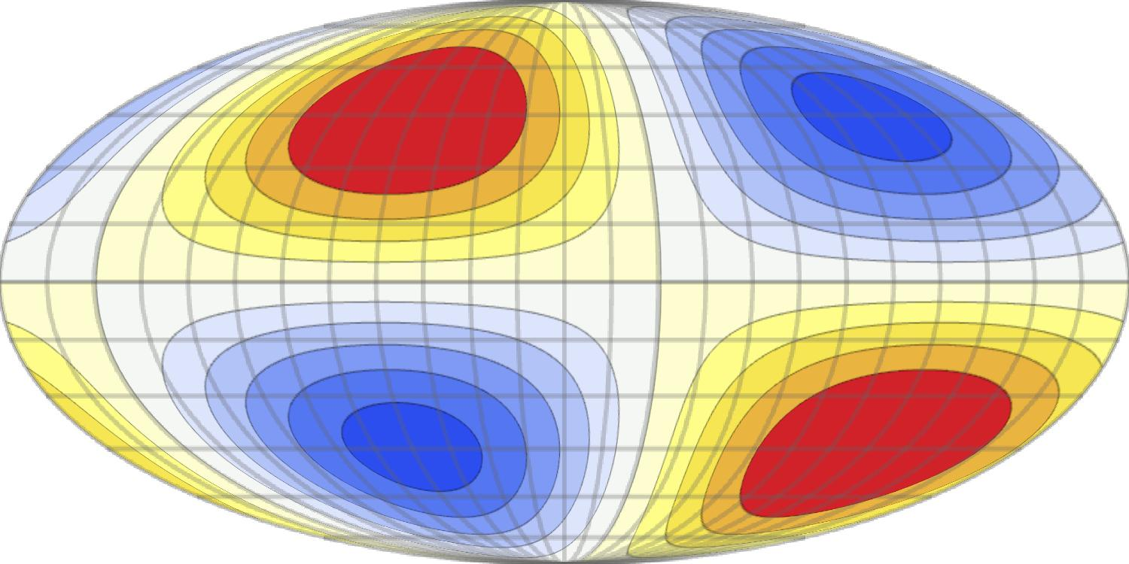
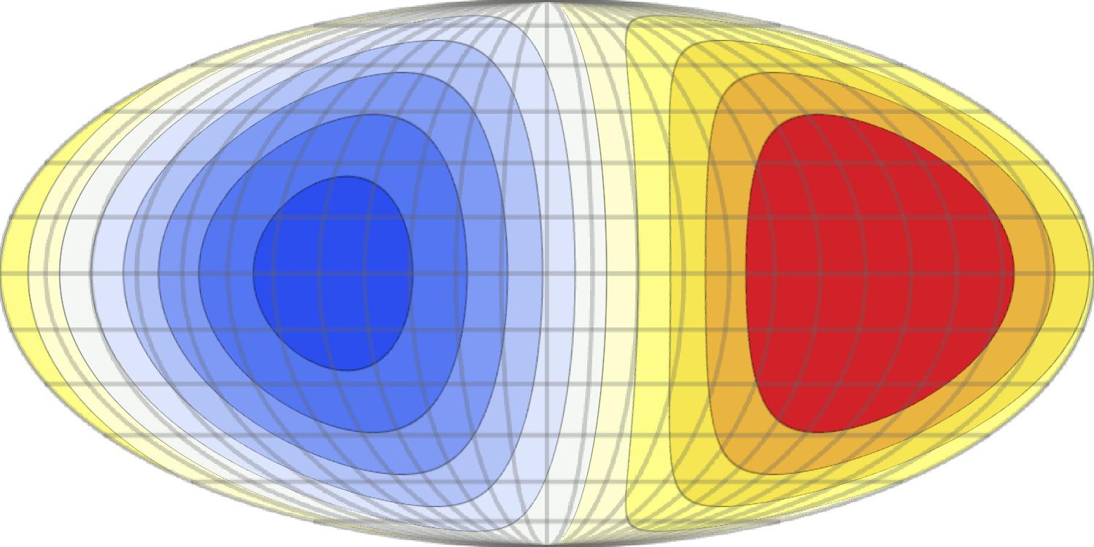
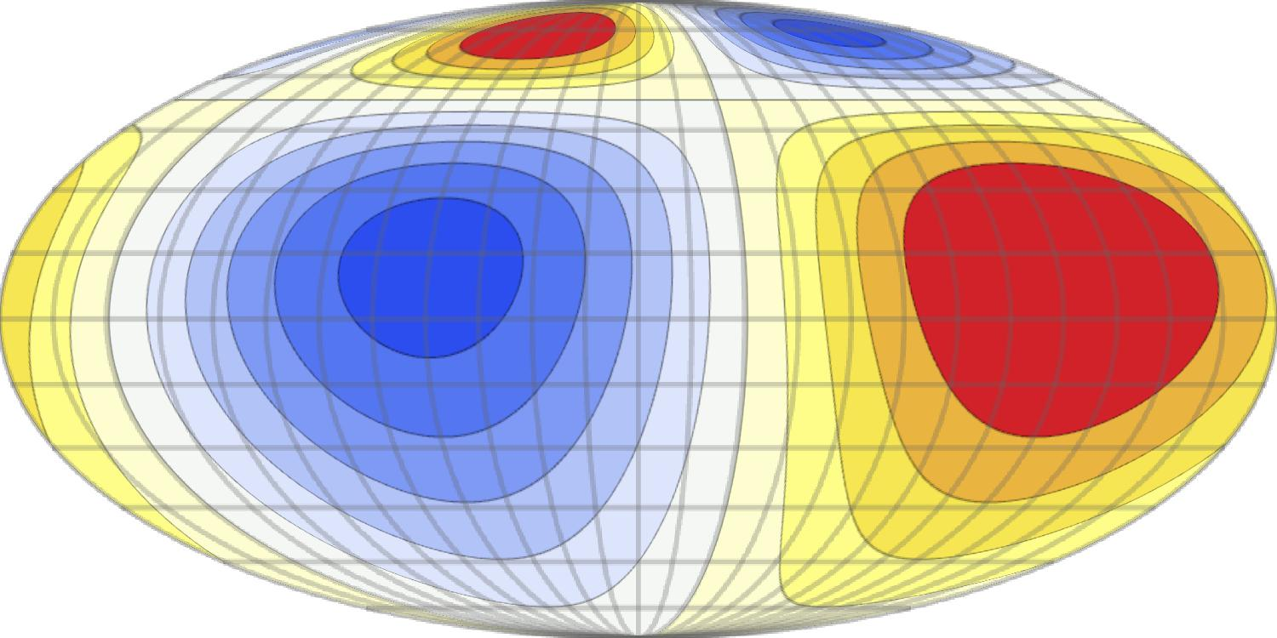
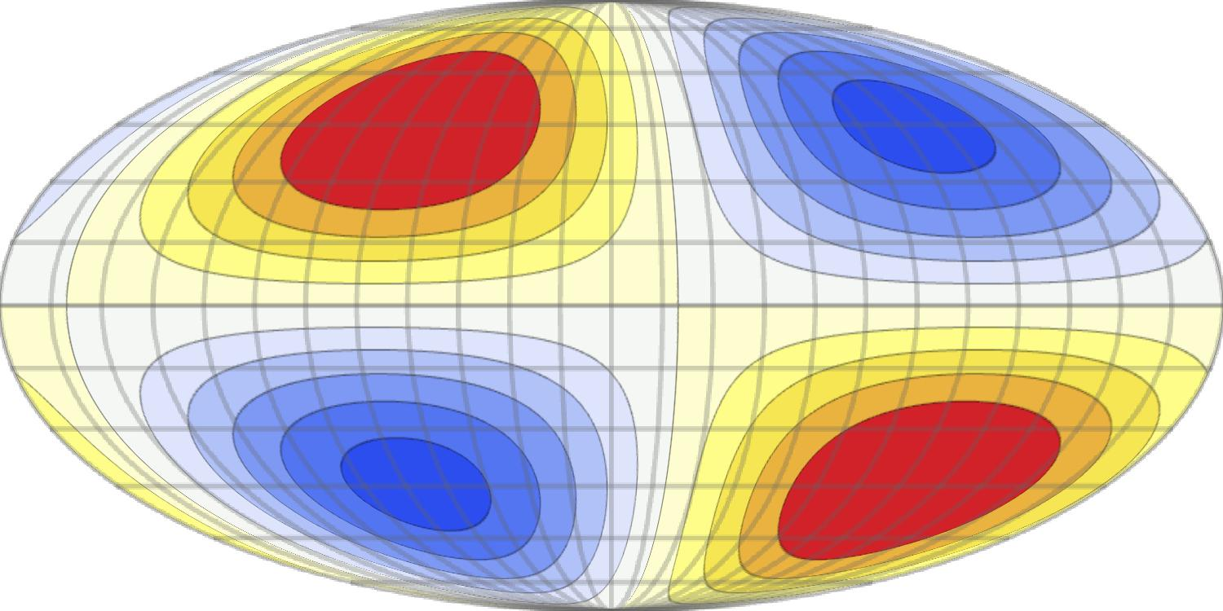
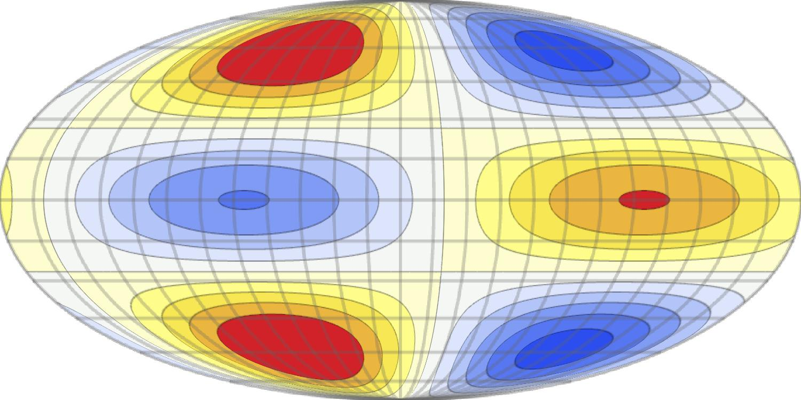
Aberration Effect
=

Slide 10
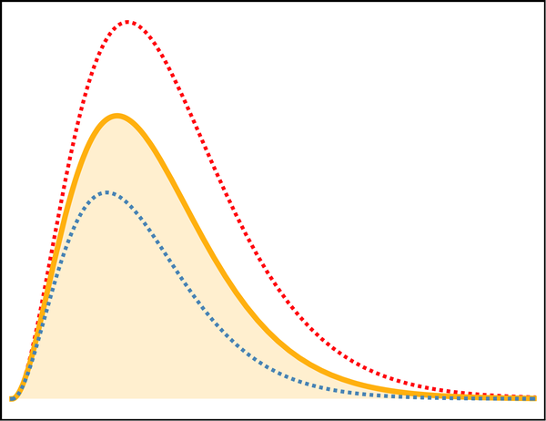
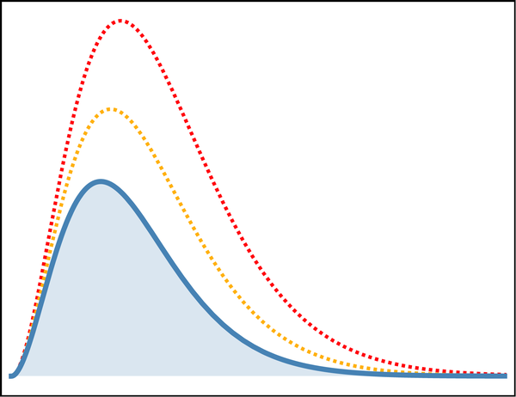
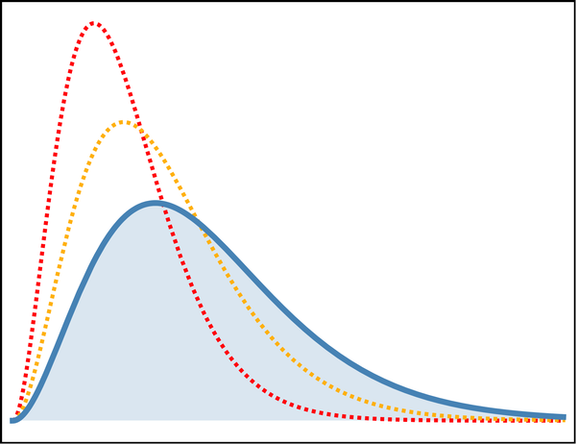
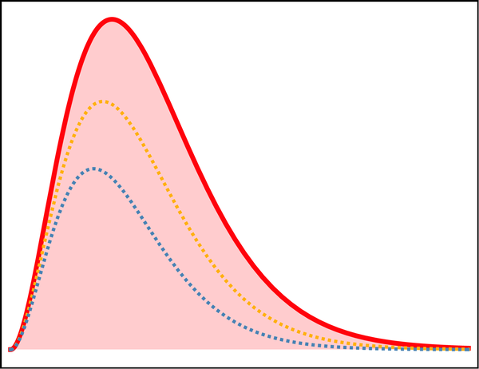
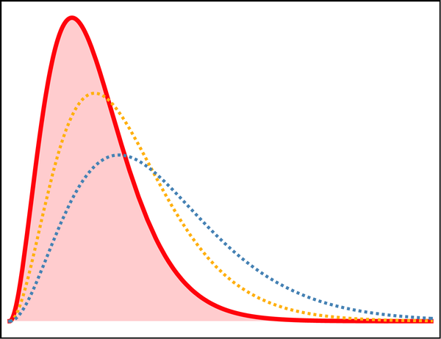
Doppler Effect
+
-
+
-
+

Slide 11
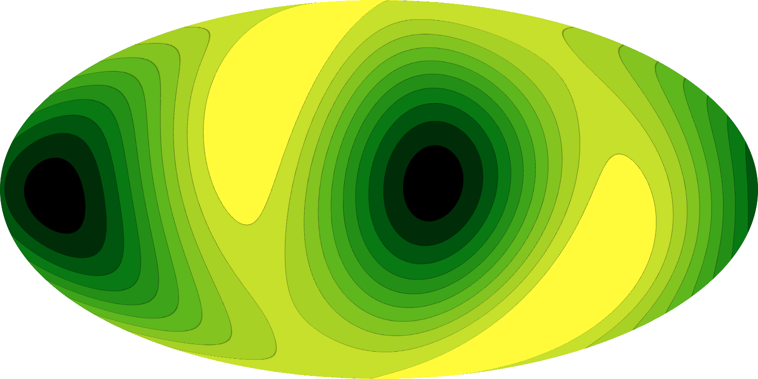
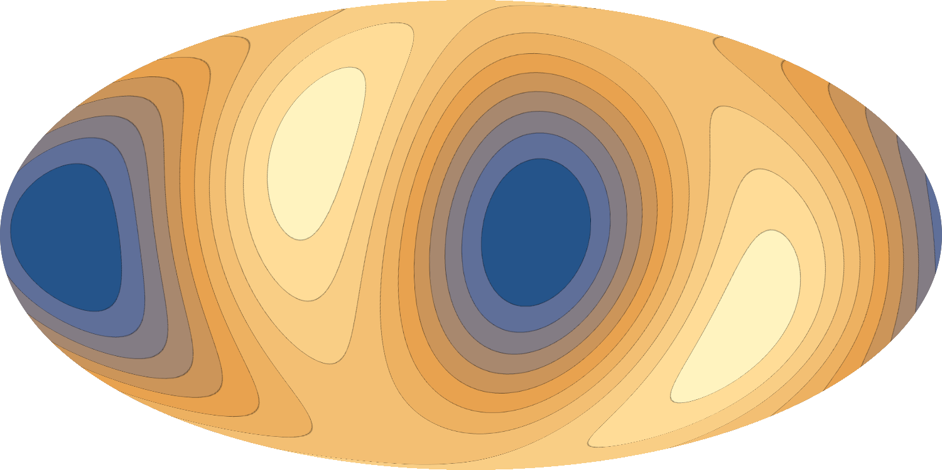
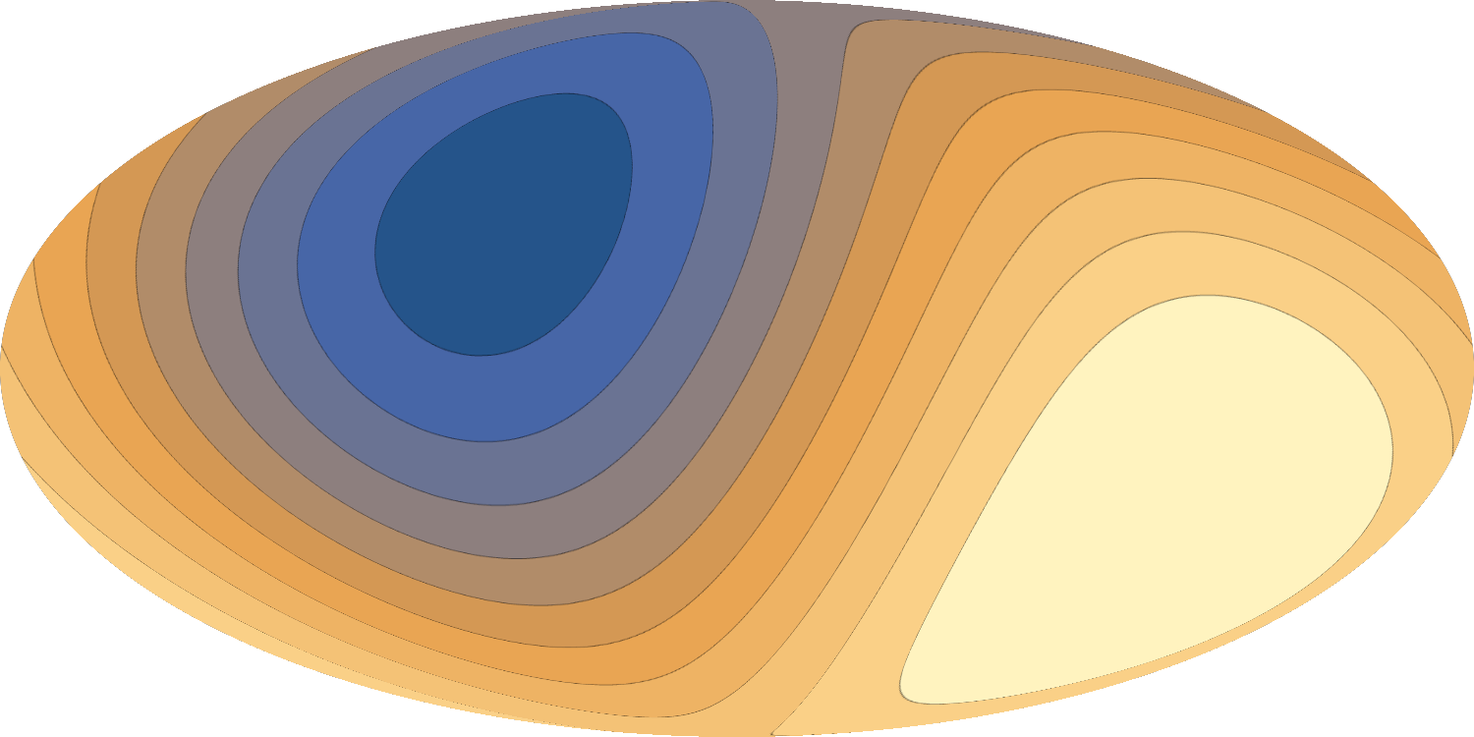
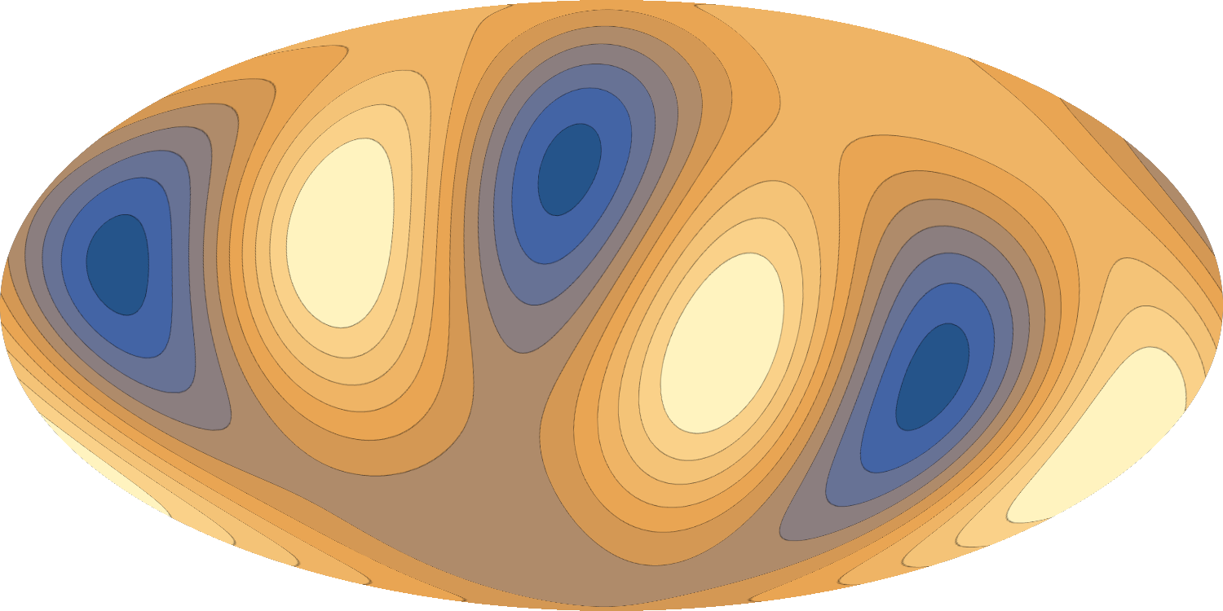
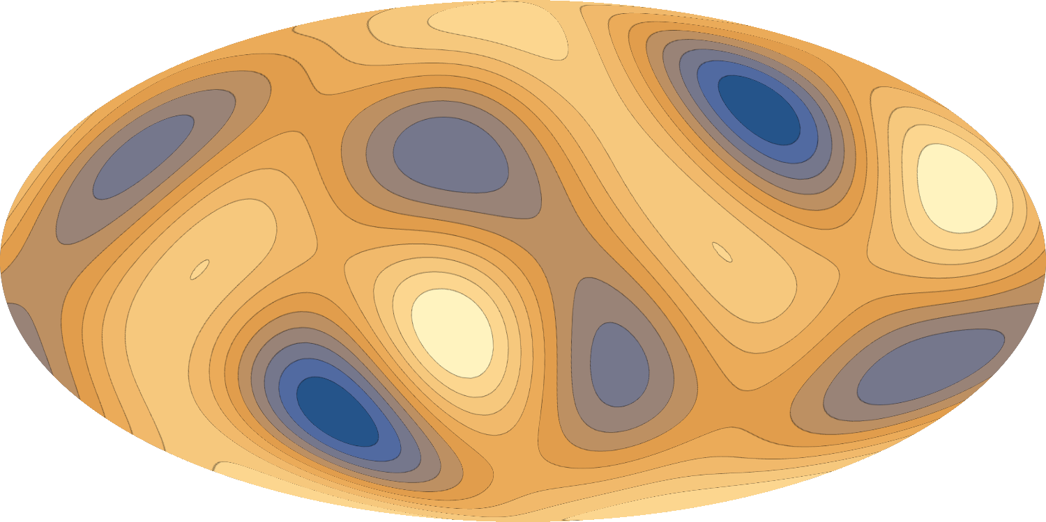
T₂ (quadrupole) in the moving frame
T₂ in the CMB frame
=
Frequency Function
T₃ (CMB frame)
Frequency Function
T₁ (CMB frame)
+
β
x
+
β
x
T₄ (CMB frame)
Frequency Function
β
2
+
x
+
...
β=
V
~0.01
C
Notes:
I'm showing mathematically that if the galaxy cluster is moving the quadrupole that it observes is equal to the primordial quadrupole of the cmb + a little bit of the primordial octupole (l=3) times a frequency function (beta is v over c) + a little bit of the dipole + tinier bit of the hexadecapole (l=4)
the prefactor beta is relatively small so it seems like these terms will only have a one percent contribution to the final signal but the frequency functions boost the signal

Slide 12
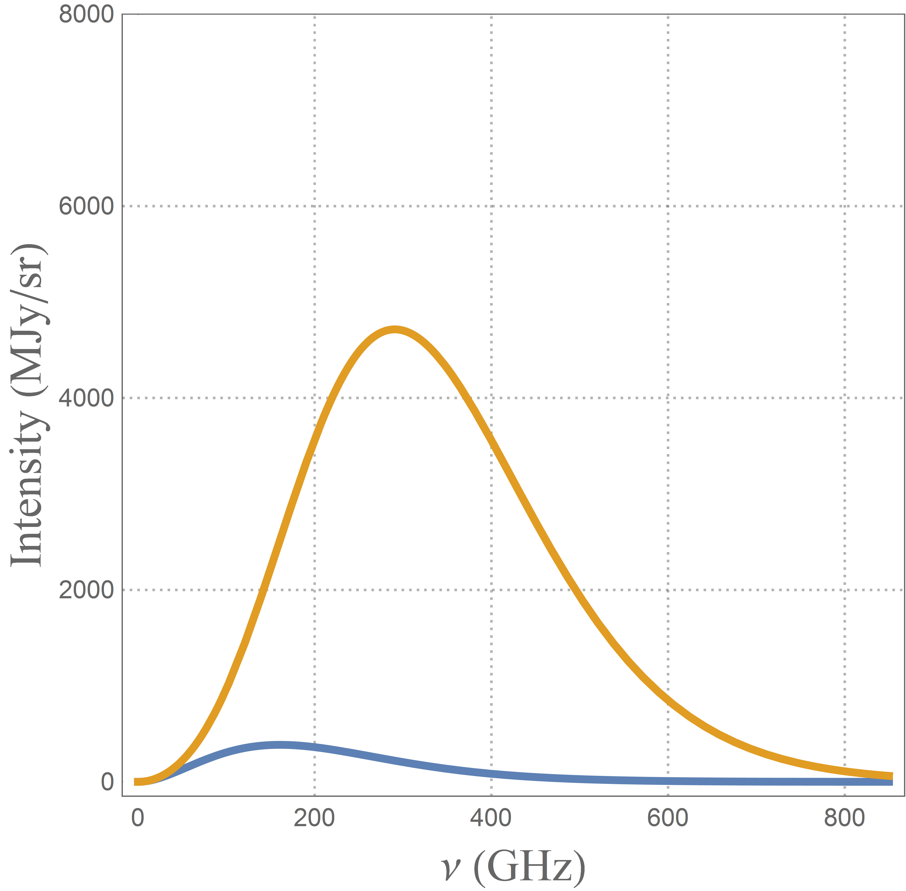
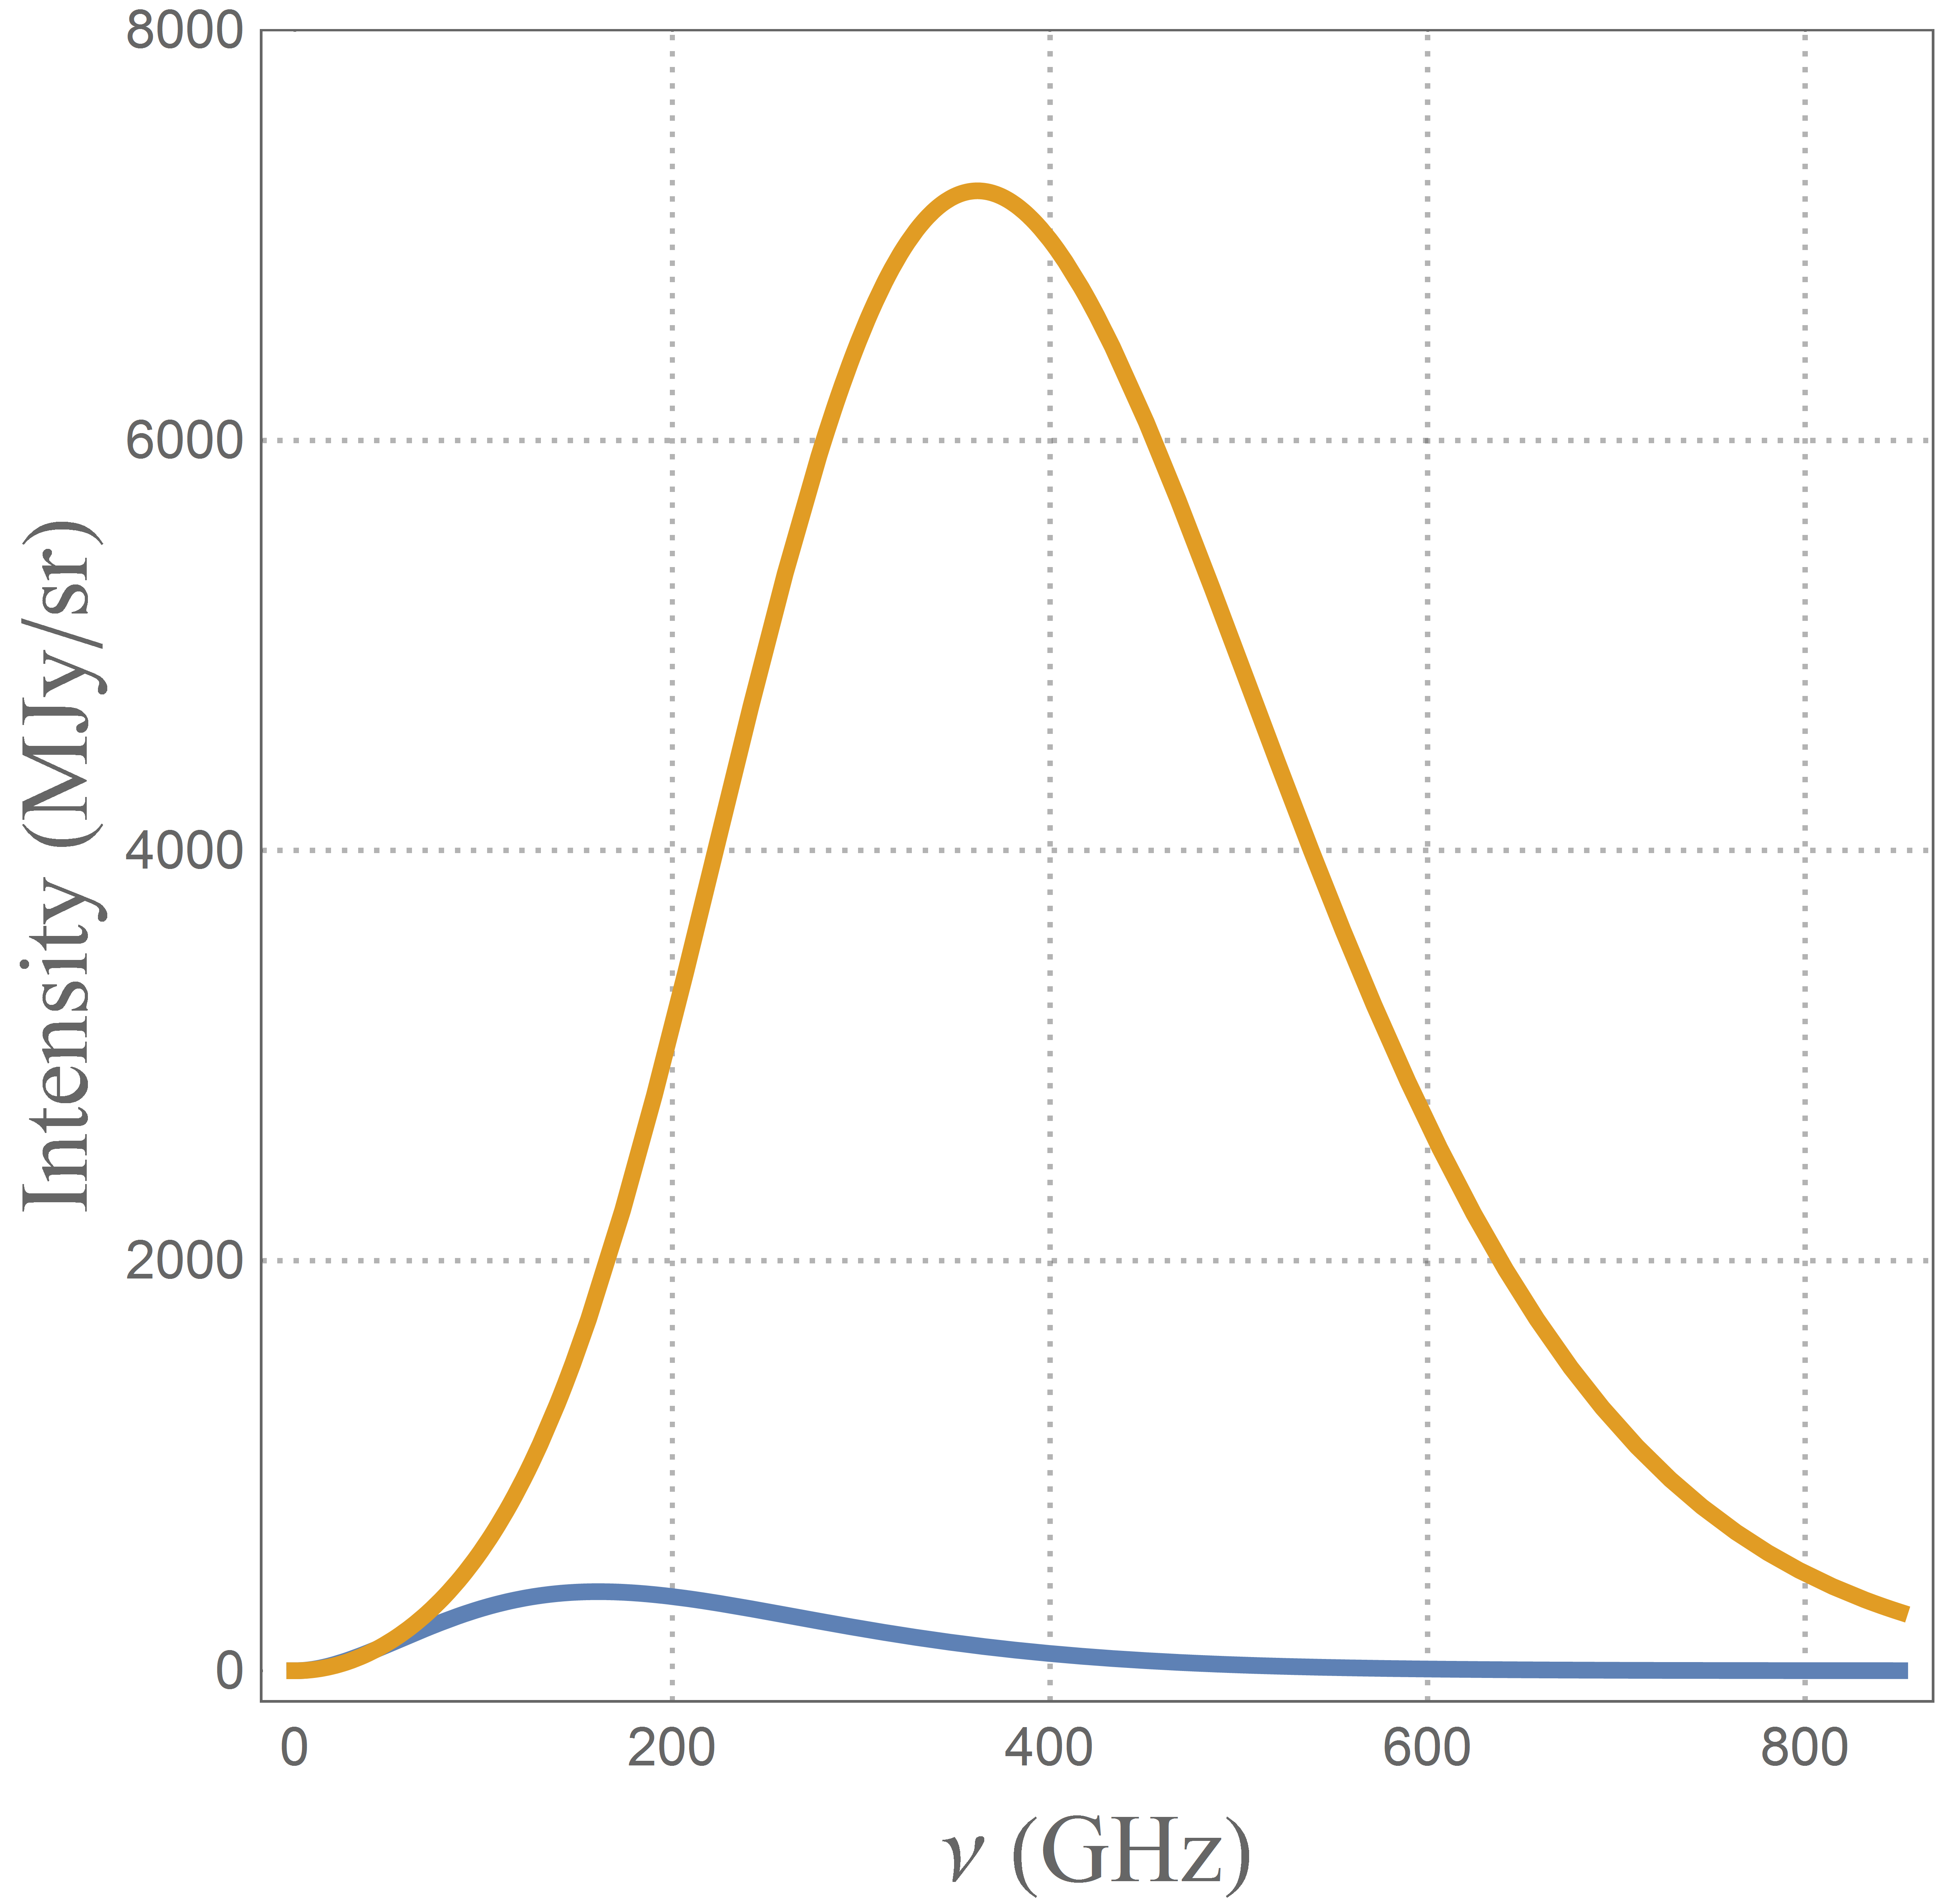
T₂ (quadrupole) in the moving frame
T₂ in the CMB frame
=
Frequency Function
Frequency Function
x 10
T₃ (CMB frame)
x 10
T₁ (CMB frame)
+
β
x
+
β
x
T₄ (CMB frame)
Frequency Function
x 50
T₂inPol ~70 nK
β
2
+
x
+
...
T_{1,3}inPol ~15 nK
β=
V
~0.01
C
Notes:
these are functions of intensity versus frequency and I also put the cmb Blackbody spectrum here in blue so that you can see how large these frequency functions are
for the dipole and the octupole these functions can boost the signal by a factor of 10 and for the hexadecapole by a factor of 50
*the frequency functions just show how much the Doppler can boost the signal (compare with figure 3 in the paper)

Slide 13
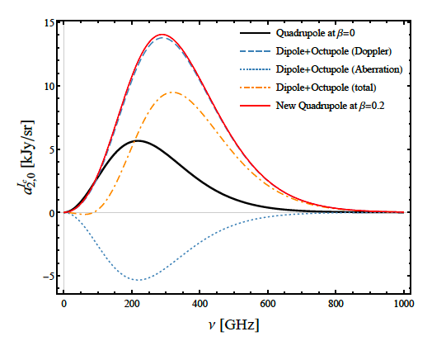
Frequency dependence (exaggerated)
Details (total amplitude, and location of maximum) depend on direction of motion
Mapping this curve precisely would allow to infer information on low multiples other than the quadrupole at other location than ours, allowing to reduce cosmic variance.

Slide 14
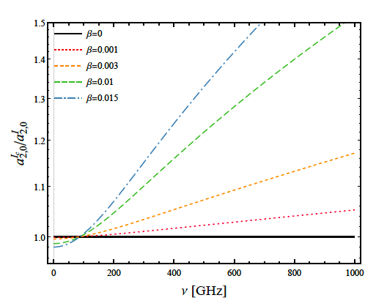
Frequency dependence (more realistic)
Effect is 2-10% for a ~1000 km/s cluster

Slide 15
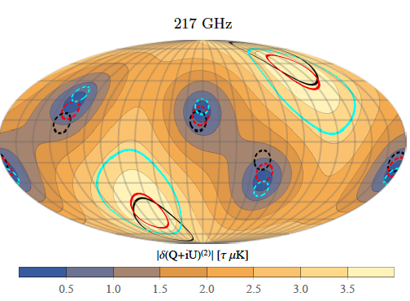
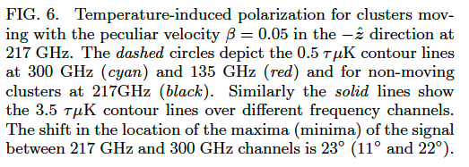
All-sky map (pol)

Slide 16
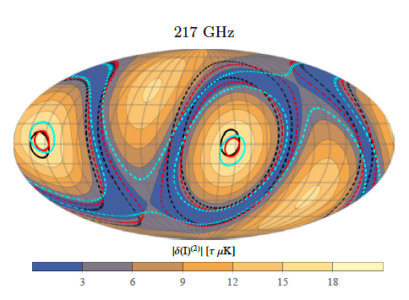
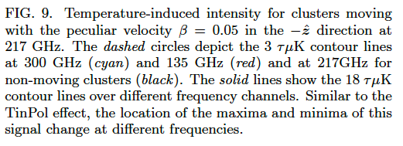
All-sky map (Int)

Slide 17
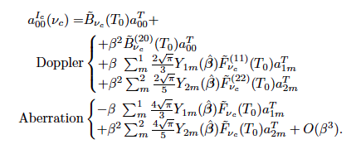
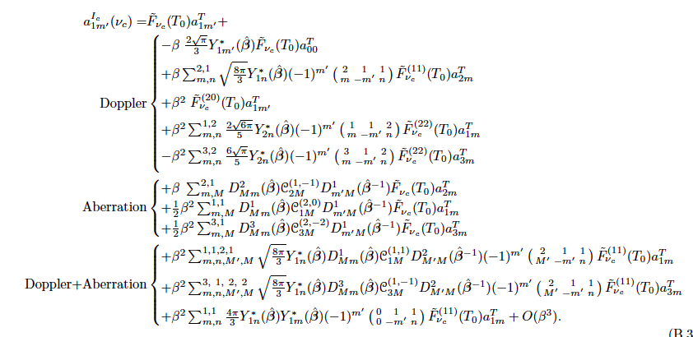
Other potential applications: bulk flow and primordial quadrupole
Idea: reconstruct CMB bulk flow and primordial quadrupole from future CMB distortion experiments

Slide 18
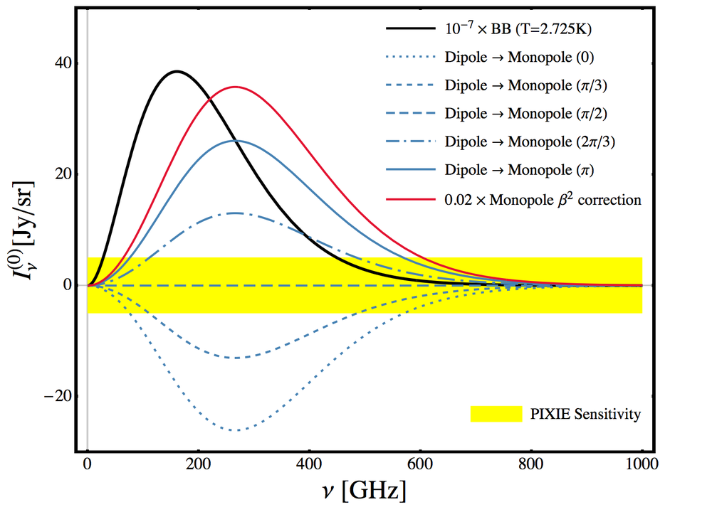
Other potential applications: bulk flow and primordial quadrupole

Slide 19
SUMMARY
We developed a full prediction of SZ signal in moving clusters, also considering CMB aniostropies and full frequency dependence of the signal.
We show that anisotropies produce a signal that is up to ~15% in polarization, it is frequency-dependent and location dependent.
The method allows for general direction for the cluster’s location and its velocity. This makes it suitable for all-sky analysis and cross-correlation analysis, as well as other application.
Application to bulk flow: it is possible to reconstruct the primordial dipole and our velocity with respect to the CMB frame with future CMB distortion measurement experiments.
Notes:
I changed the percentage to 15% because that’s the number that we report in the paper

Slide 20
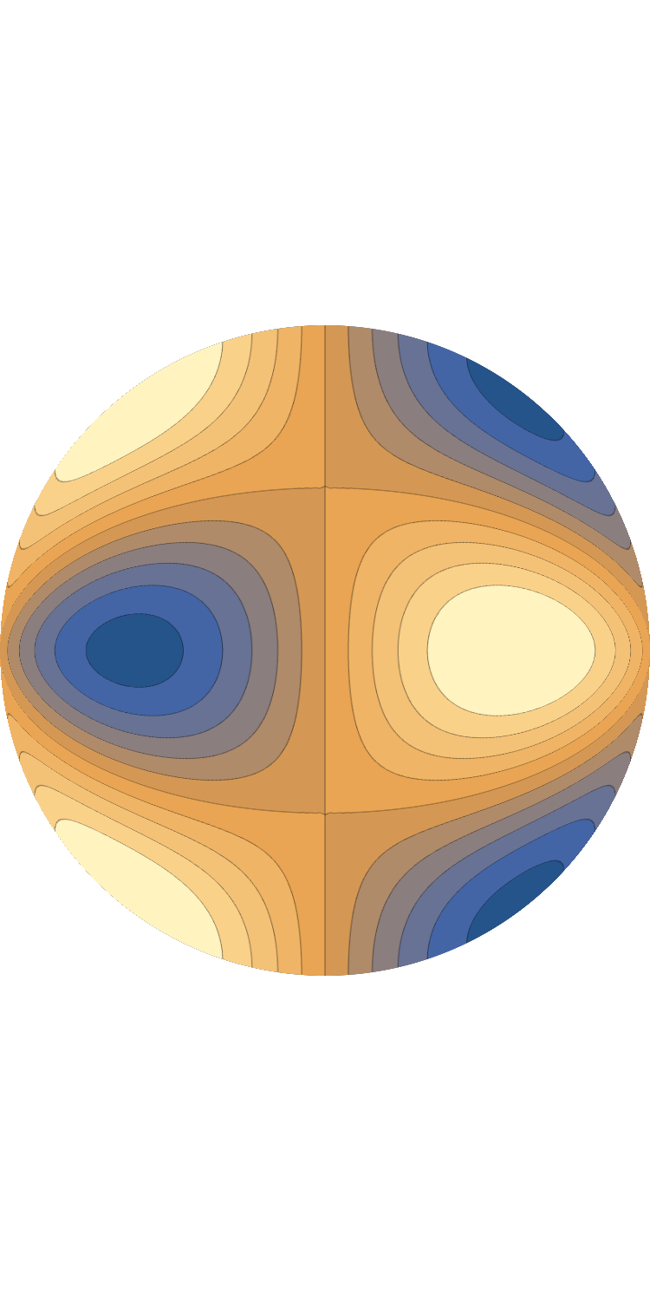
Thomson Scattering
e

Slide 21
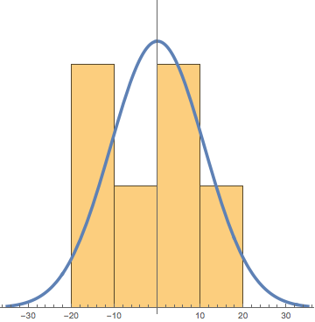
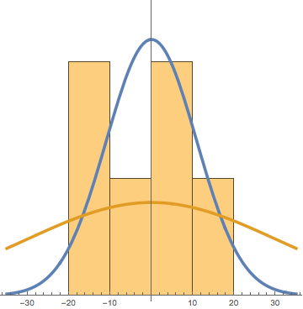
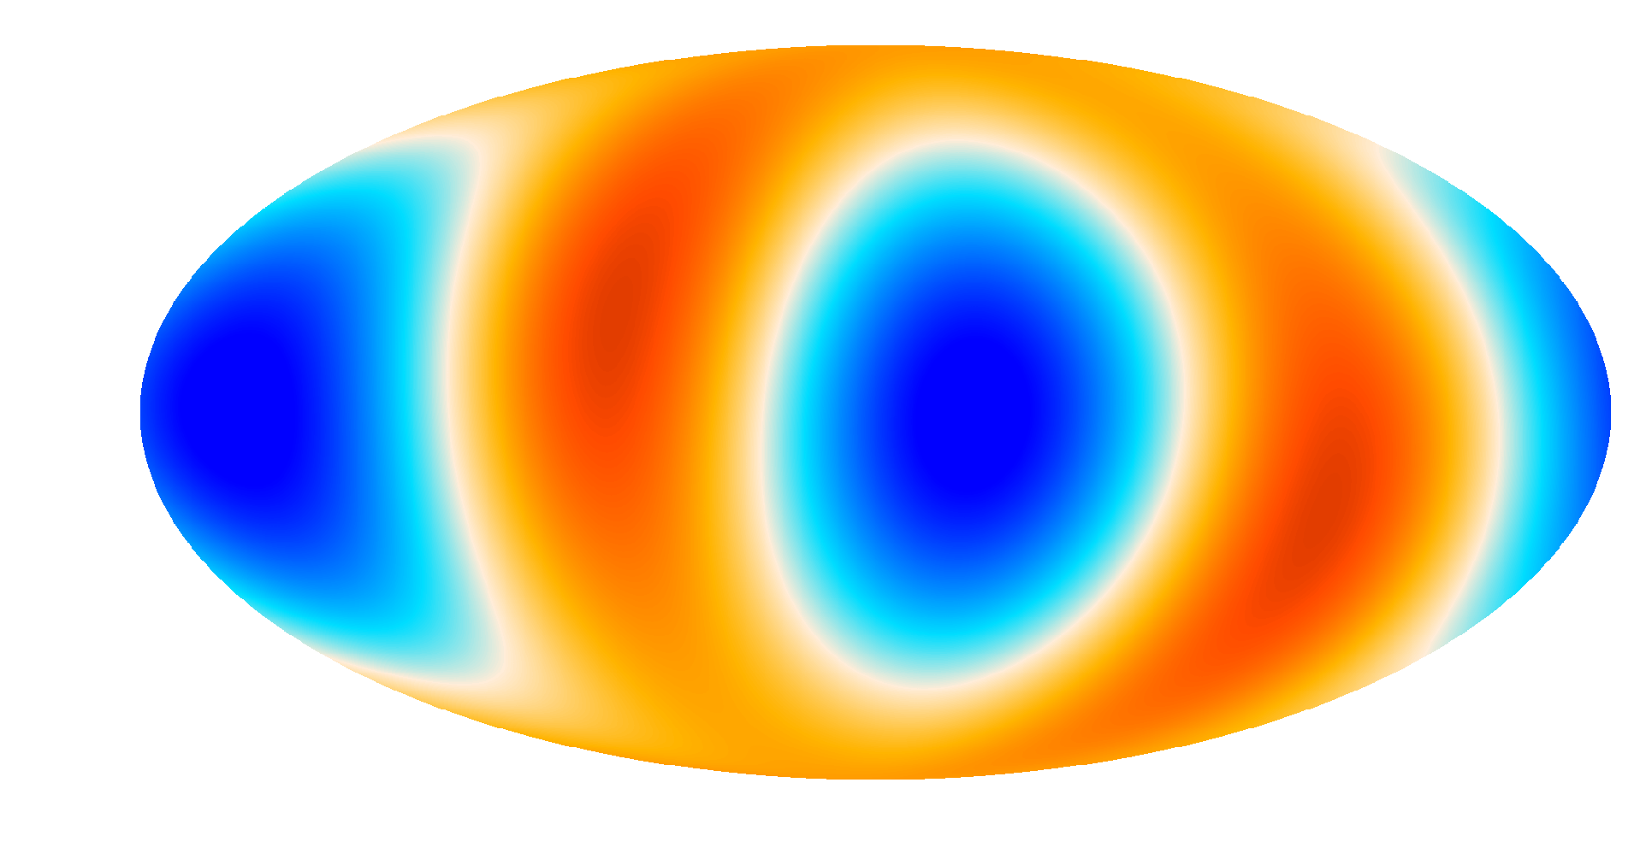
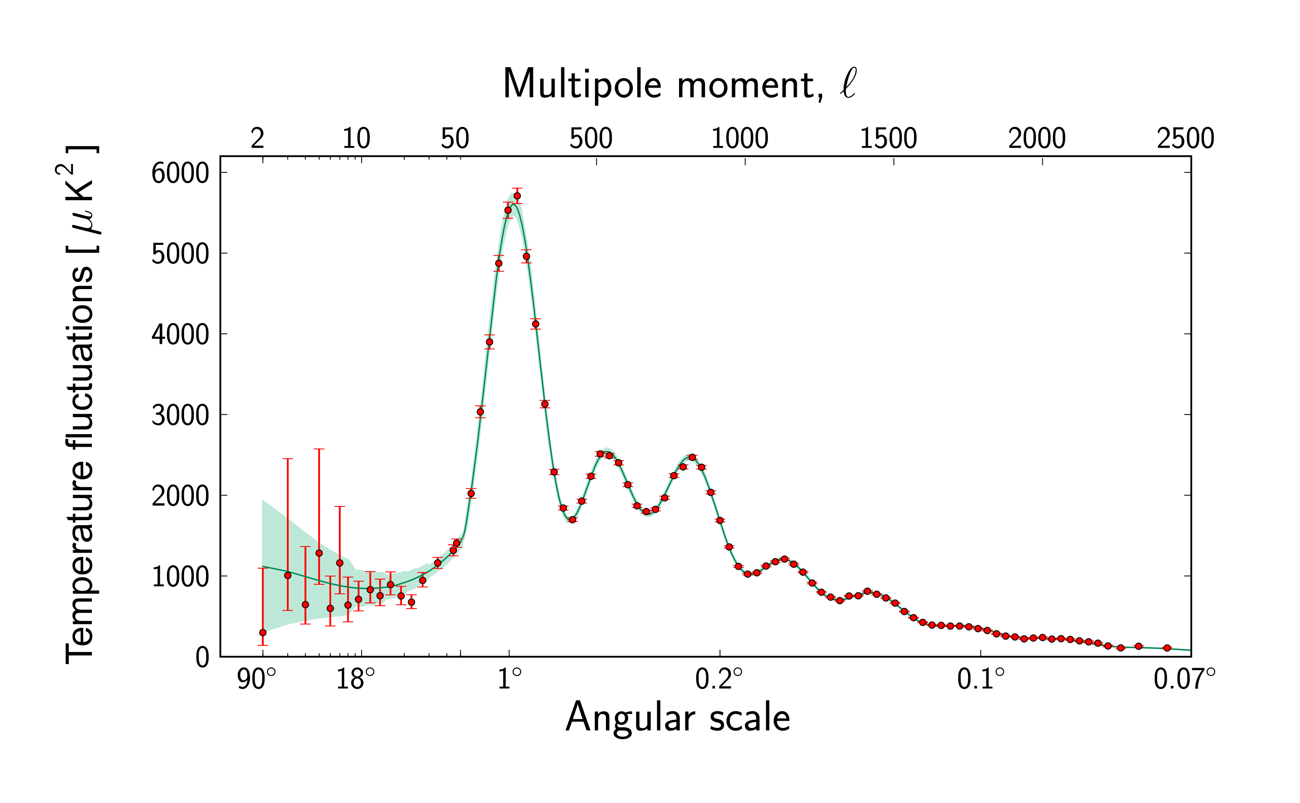
Cosmic Variance
Low quadrupole
Anomaly
a
lm
a
< >=0
lm
a
2
<| |>=
C
lm
l
Siavash Yasini
Image credit: Planck Collaboration
University of Southern California

Slide 22
Cosmic Variance
Low quadrupole
Anomaly
a
lm
a
< >=0
lm
a
2
<| |>=
C
lm
l
Siavash Yasini
Image credit: Planck Collaboration
University of Southern California

