Slide 1
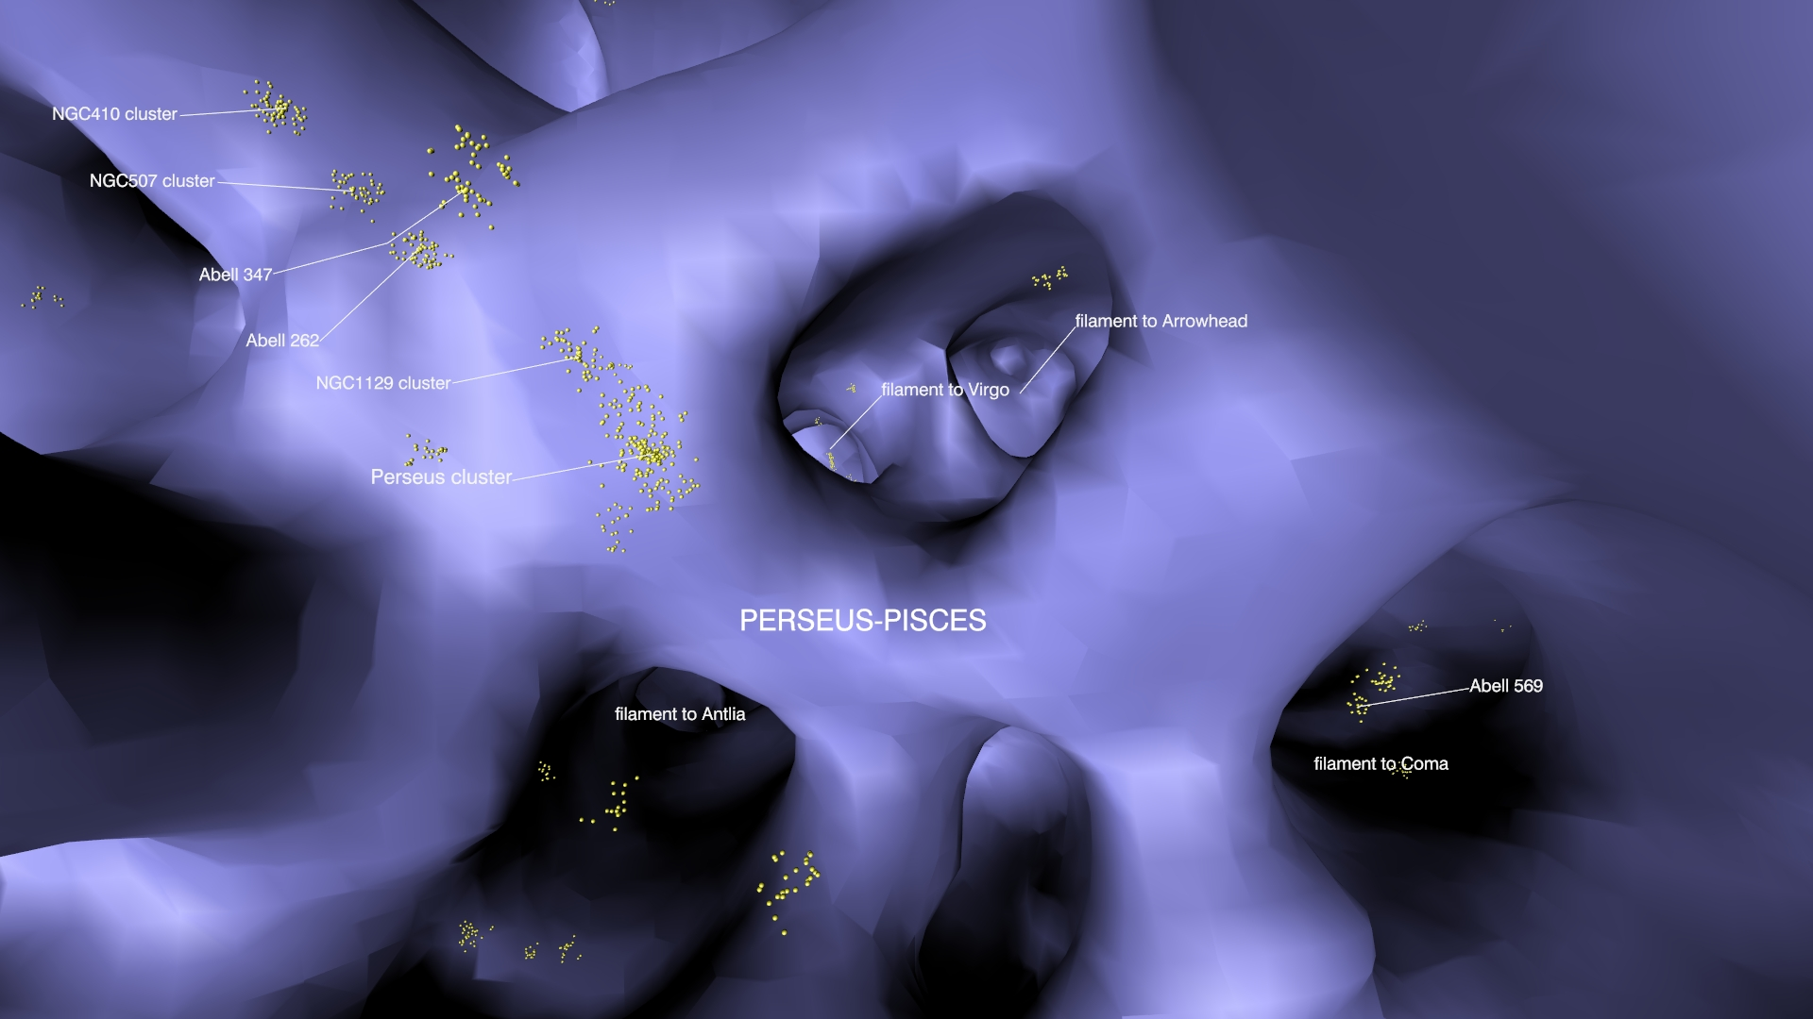
The cosmography unveiled by the V-Web
Daniel Pomarède (CEA/Saclay – IRFU)
Yehuda Hoffman, R. Brent Tully, Hélène Courtois
XIIth Rencontres du Vietnam – Large Scale Structures and Galaxy Flows

Slide 2
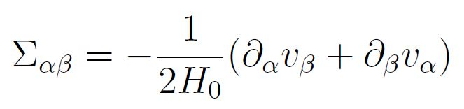
The V-Web classification
Hoffman et al. MNRAS 425 (2012) 2049
The Cosmicflows-2 catalog of 8161 peculiar velocities is used as input to a Wiener filter and constrained realizations to reconstruct the velocity field
Information on local collapse and expansion is provided by the shear tensor:
The analysis of the eigenvalues of the shear tensor allows to reconstruct the Velocity Web:
  3 ordered eigenvalues λ₁ > λ₂ > λ₃ at each position in space, 4 possible conditions:
  λ₁ > λ₂ > λ₃ > 0 is condition for a knot (flow is inward in 3 directions)
  λ₁ > λ₂ > 0 > λ₃ is condition for a filament (flow is inward in 2 directions, outward on the third)
  λ₁ > 0 > λ₂ > λ₃ is condition for a sheet (flow is inward in 1 direction, outward on the 2 others)
  0 > λ₁ > λ₂ > λ₃ is condition for a void (flow is outward in all 3 directions)
A few examples at selected locations:
  the Milky Way:
    λ₁=0.277, λ₂=0.086, λ₃=-0.173 => the Milky Way resides in a filament
  the Perseus Cluster
    λ₁=0.357, λ₂=0.215, λ₃=0.065 => the Perseus cluster is located in a knot
  somewhere in the middle of the Hercules Void
    λ₁=-0.013, λ₂=-0.128, λ₃=-0.300 => this location is in a void

Slide 3
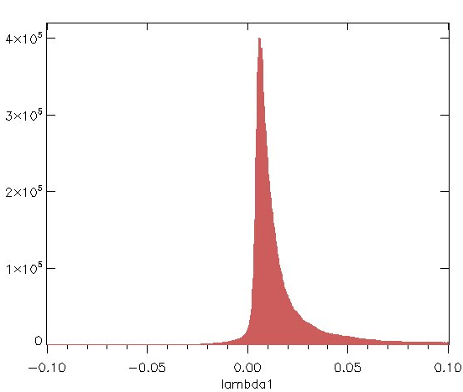
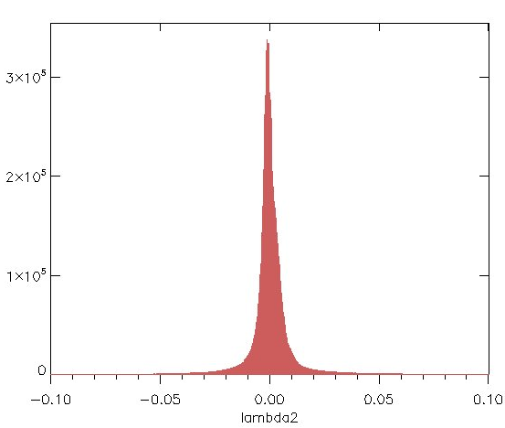
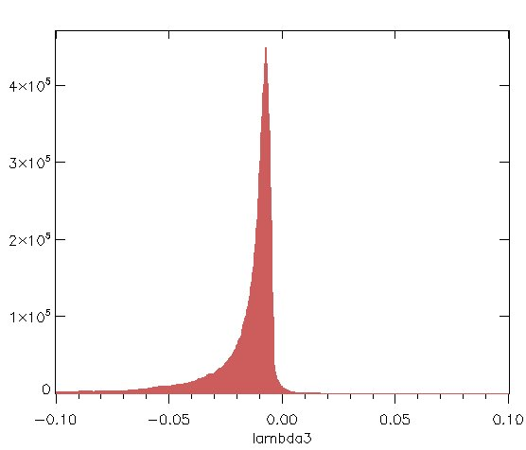
V-Web classification
V-Web classification scheme:
  3 ordered eigenvalues λ₁ > λ₂ > λ₃ at each position in space, 4 possible conditions:
  λ₁ > λ₂ > λ₃ > 0 is condition for a knot (flow is inward in 3 directions)
  λ₁ > λ₂ > 0 > λ₃ is condition for a filament (flow is inward in 2 directions, outward on the third)
  λ₁ > 0 > λ₂ > λ₃ is condition for a sheet (flow is inward in 1 direction, outward on the 2 others)
  0 > λ₁ > λ₂ > λ₃ is condition for a void (flow is outward in all 3 directions)
Use of multiple non-null thresholds to reconstruct surfaces of constant values:
Void cells
Sheet cells
Filament cells
Knot cells
λ₁
λ₂
λ₃

Slide 4
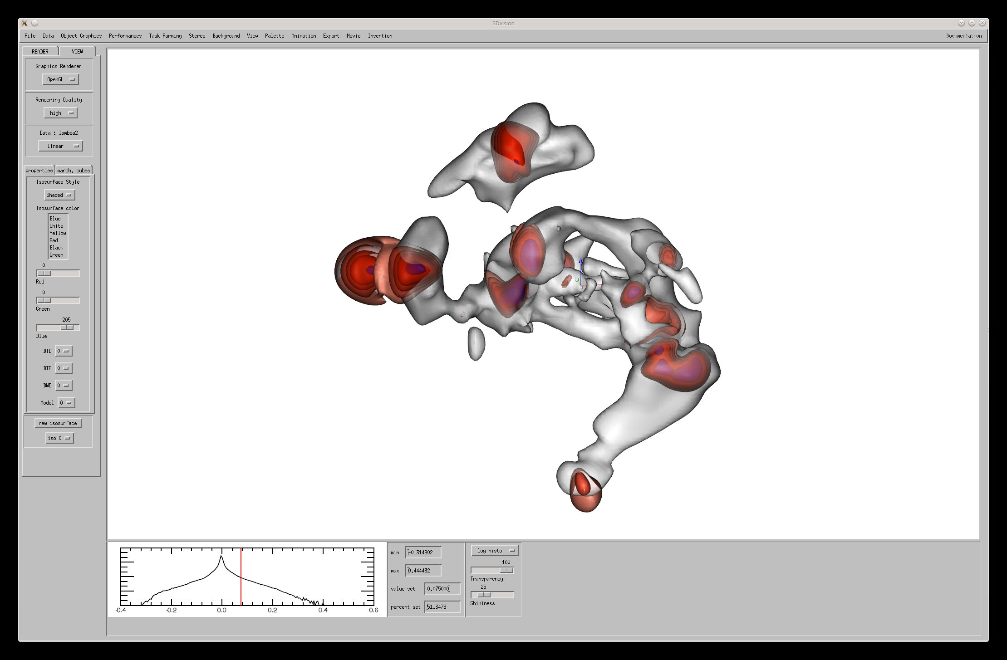
Analysis of the V-Web using the SDvision visualization software
Visualization of the knots using 5 surface levels of λ₃
1) Set the desired level of λ₂
2) Get the corresponding filament surface
λ₂= 0.075
Using a high λ₂ level to materialize the filaments and several levels of λ₃ to materialize the knots

Slide 5
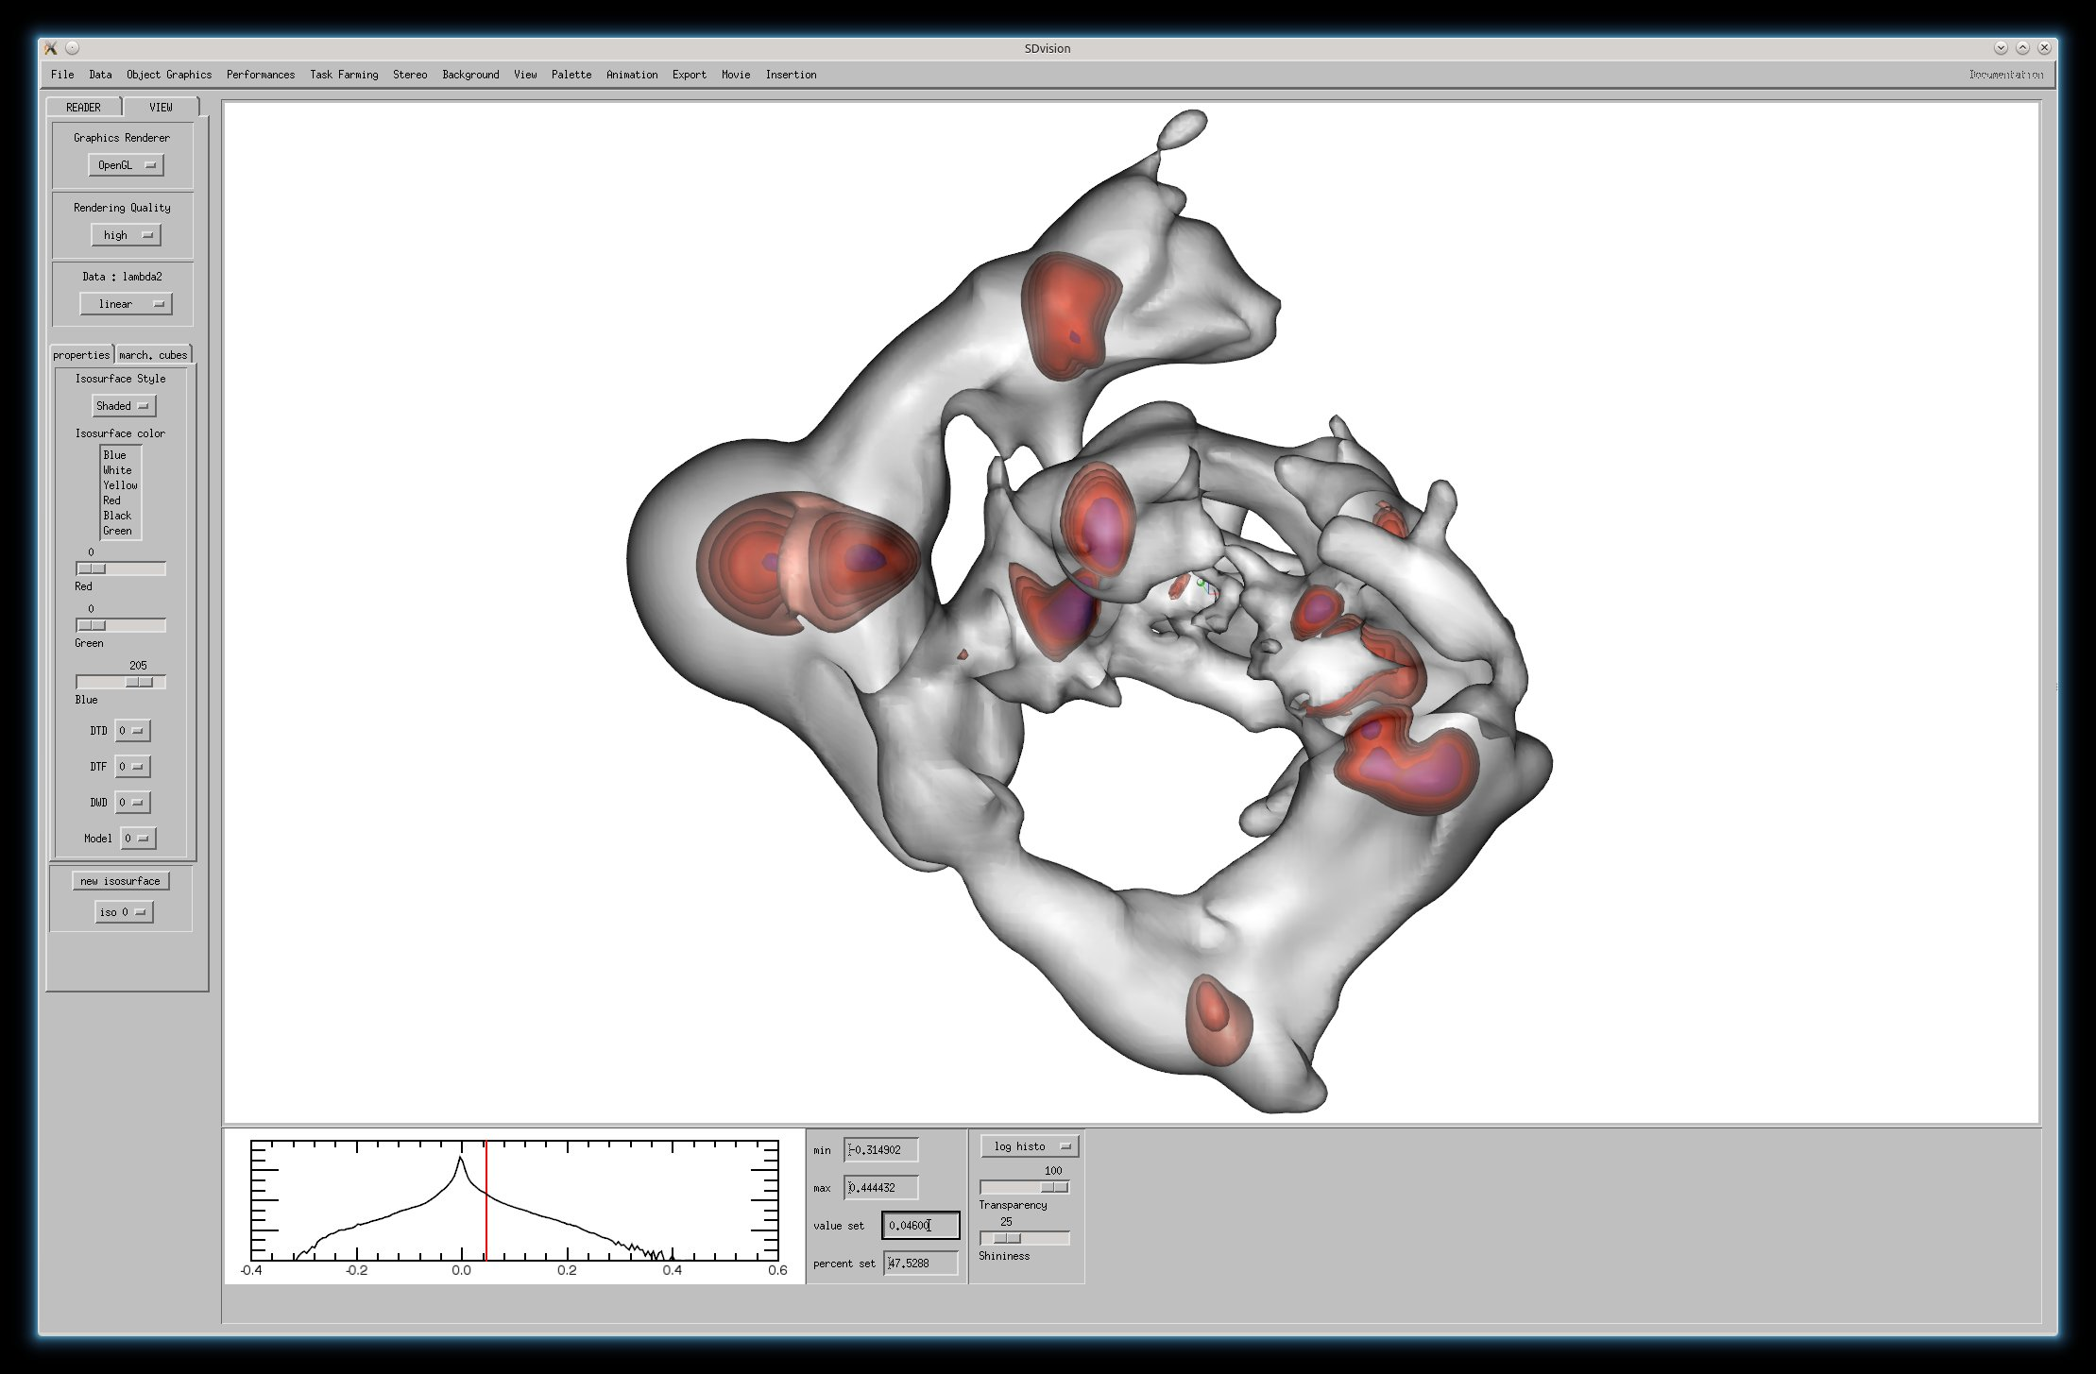
Analysis of the V-Web using the SDvision visualization software
Visualization of the knots using 5 surface levels of λ₃
1) Set the desired level of λ₂
2) Get the corresponding filament surface
λ₂= 0.046
A right balance between high level (surface is vanishing) and low level (surface fills the whole space) for λ₂

Slide 6
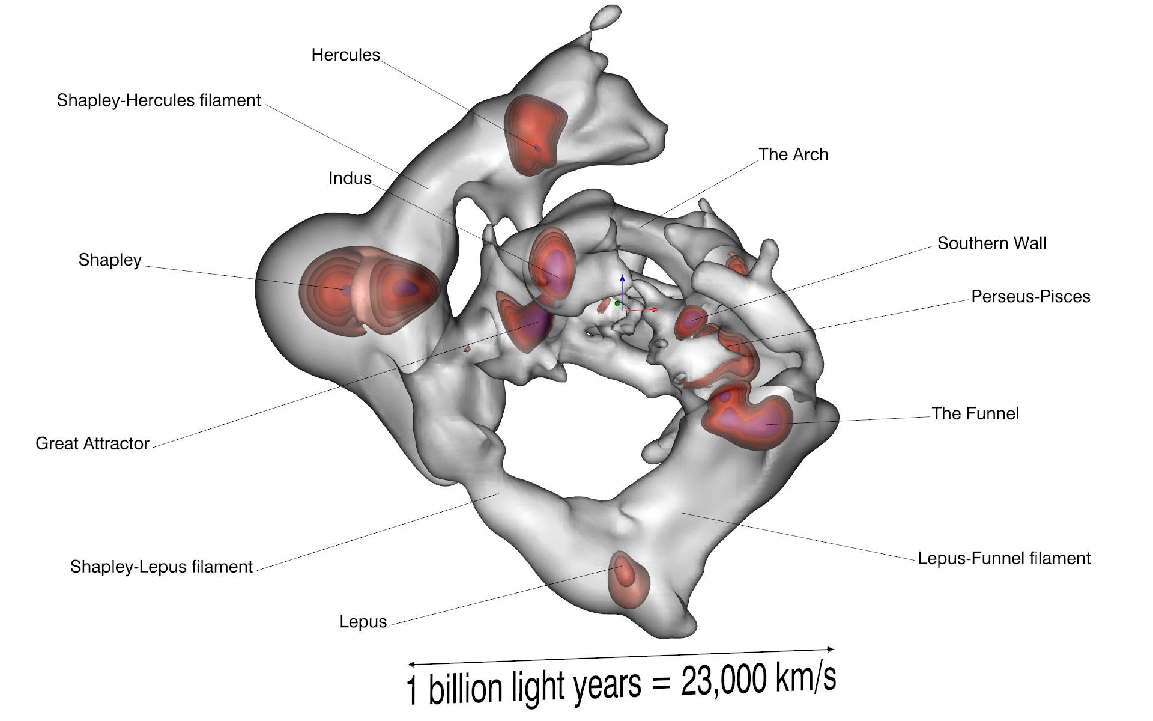
V-Web cartography a three-dimensional network
Reconstruction of the filaments that run through the uncharted Zone of Avoidance

Slide 7
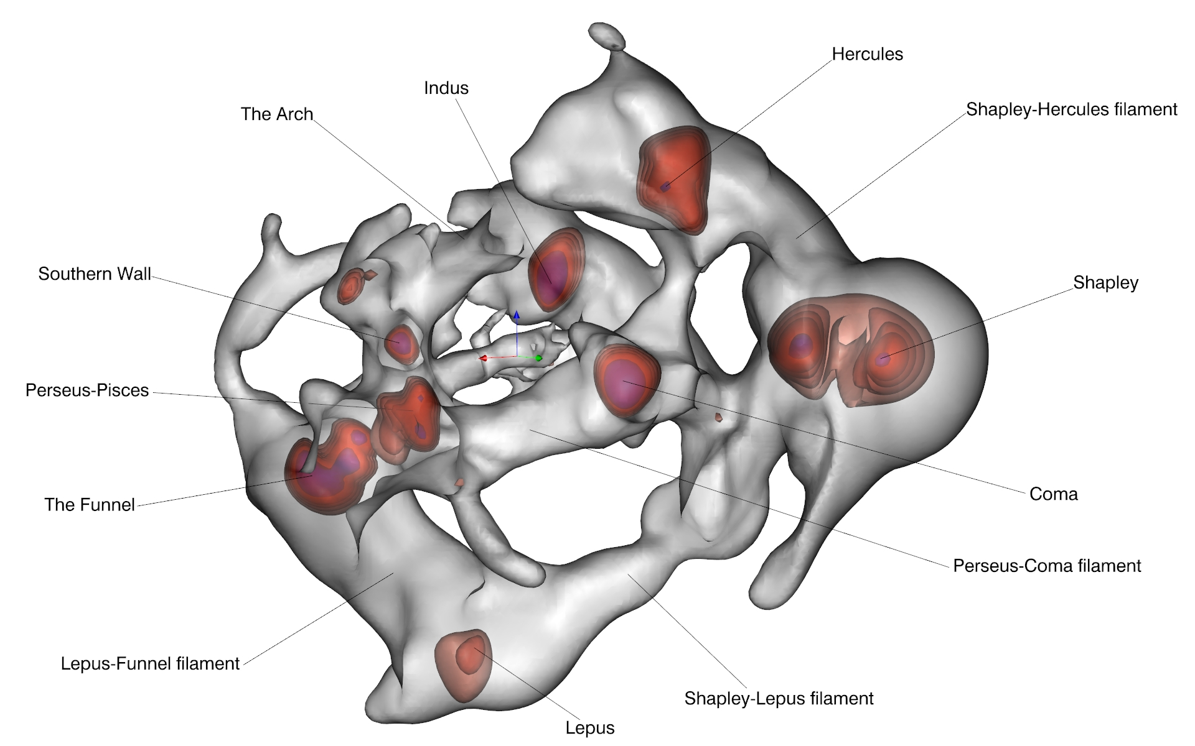
V-Web cartography
Reconstruction of the filaments that run through the Zone of Avoidance

Slide 8
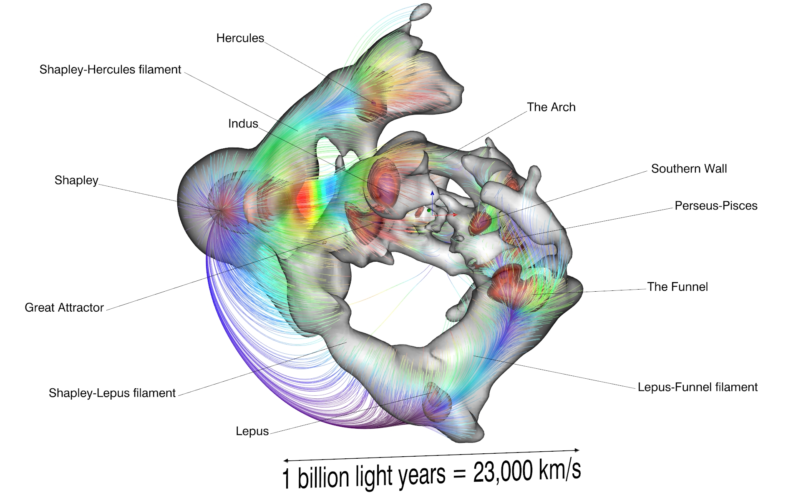
V-Web versus Full Flow
The structure of the full flow is determined by the gravitational potential, not by the V-Web that is a tracer of local collapse and expansion.
Shapley is the dominant sink of velocity flows.

Slide 9
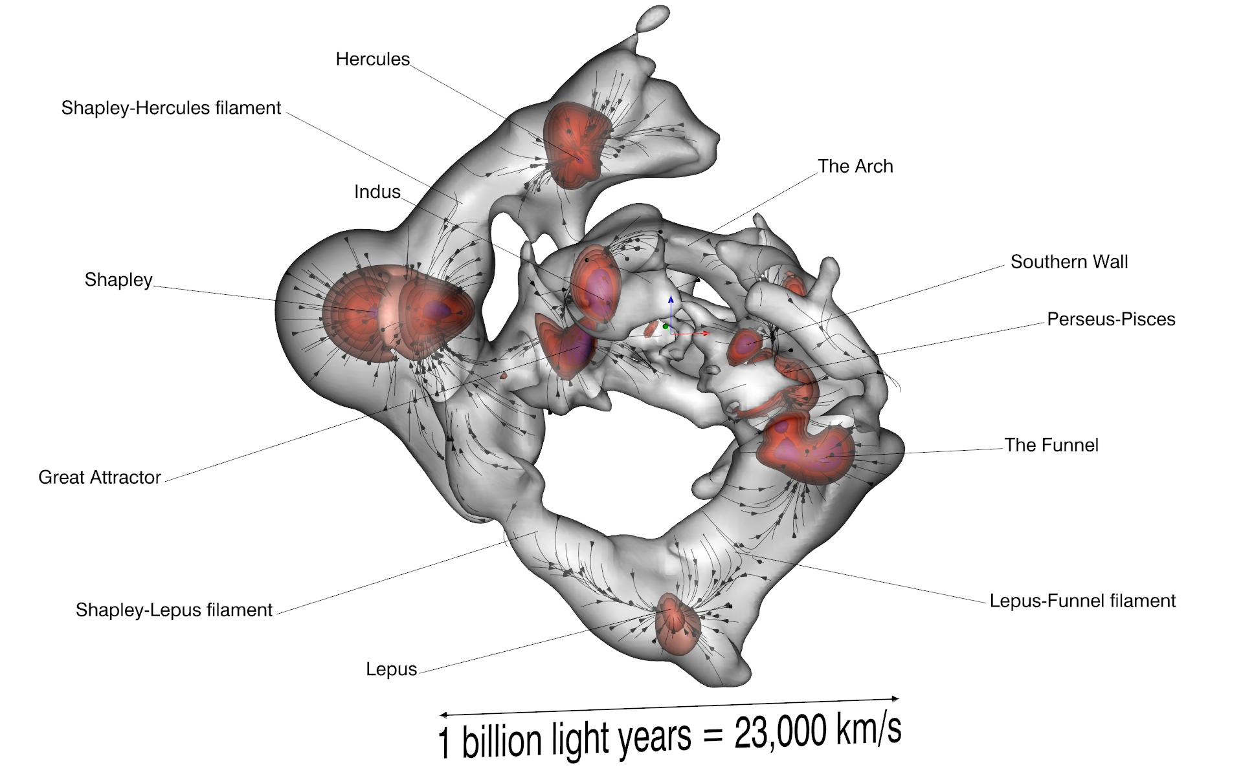
V-Web versus local (divergent) flows
Each streamline benefits from its own local field obtained by the separation of the divergent and tidal flows
Local flows run along filaments; shearing points are observed at each filaments midsections
Local flows delineate Basins of Attractions (superclusters)

Slide 10
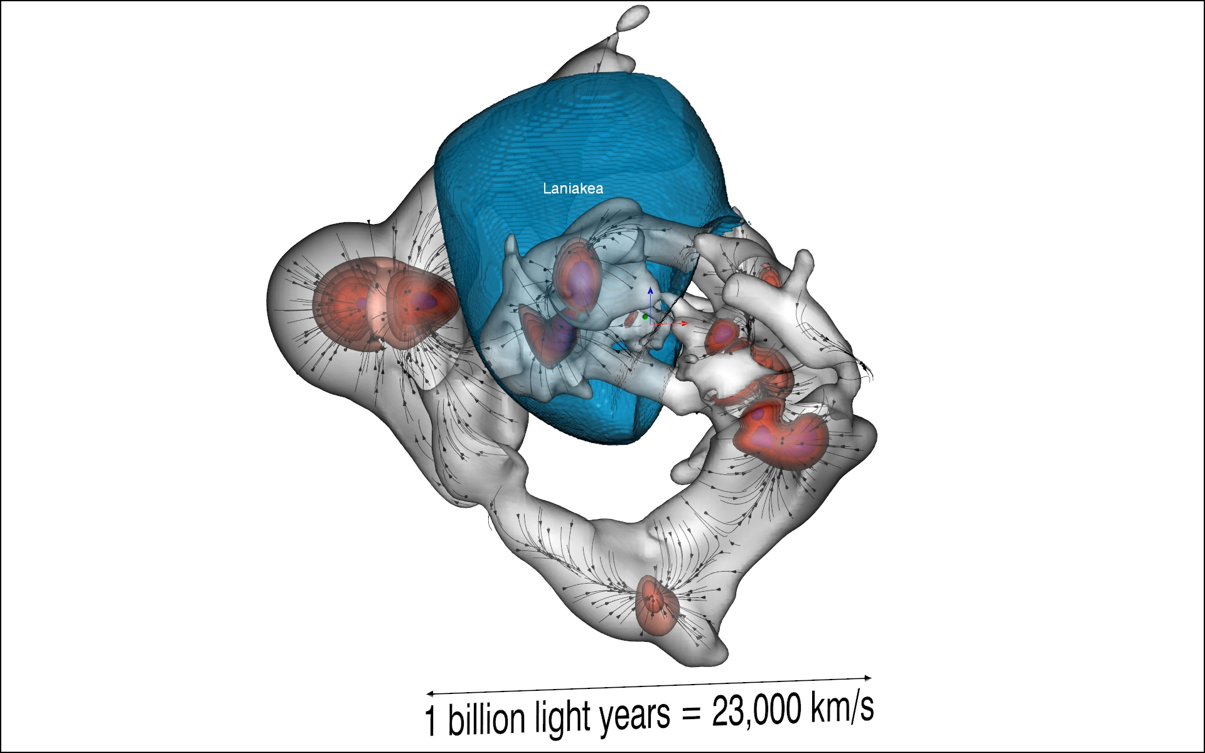
V-Web versus Laniakea BoA
The Laniakea basin of attraction reaches out to:
the voids surrounding the Great Attractor
the midsections of filaments where local flows shear appart

Slide 11
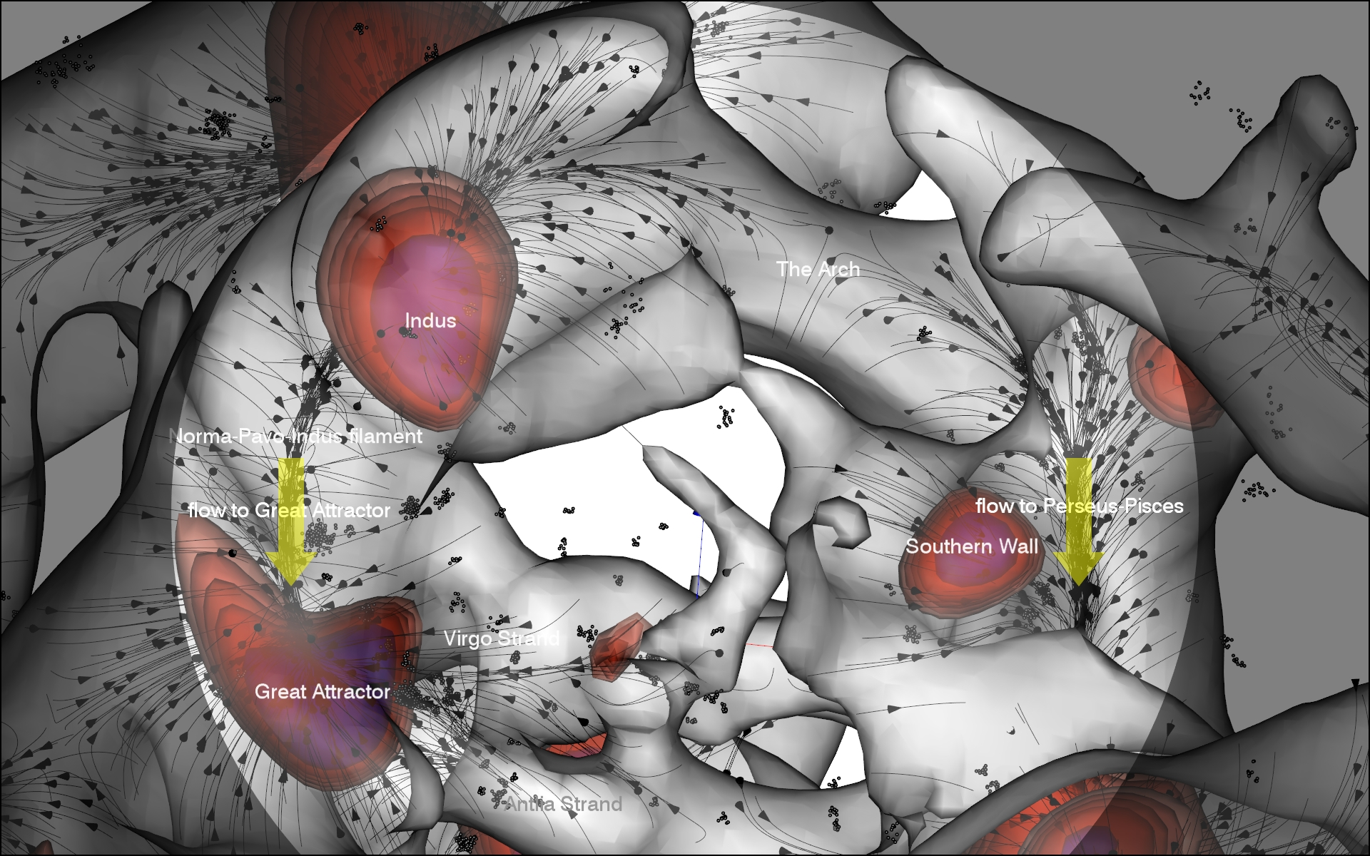
Zoom map
The Arch is a filament where flows headed to the Great Attractor and Perseus-Pisces shear apart

Slide 12
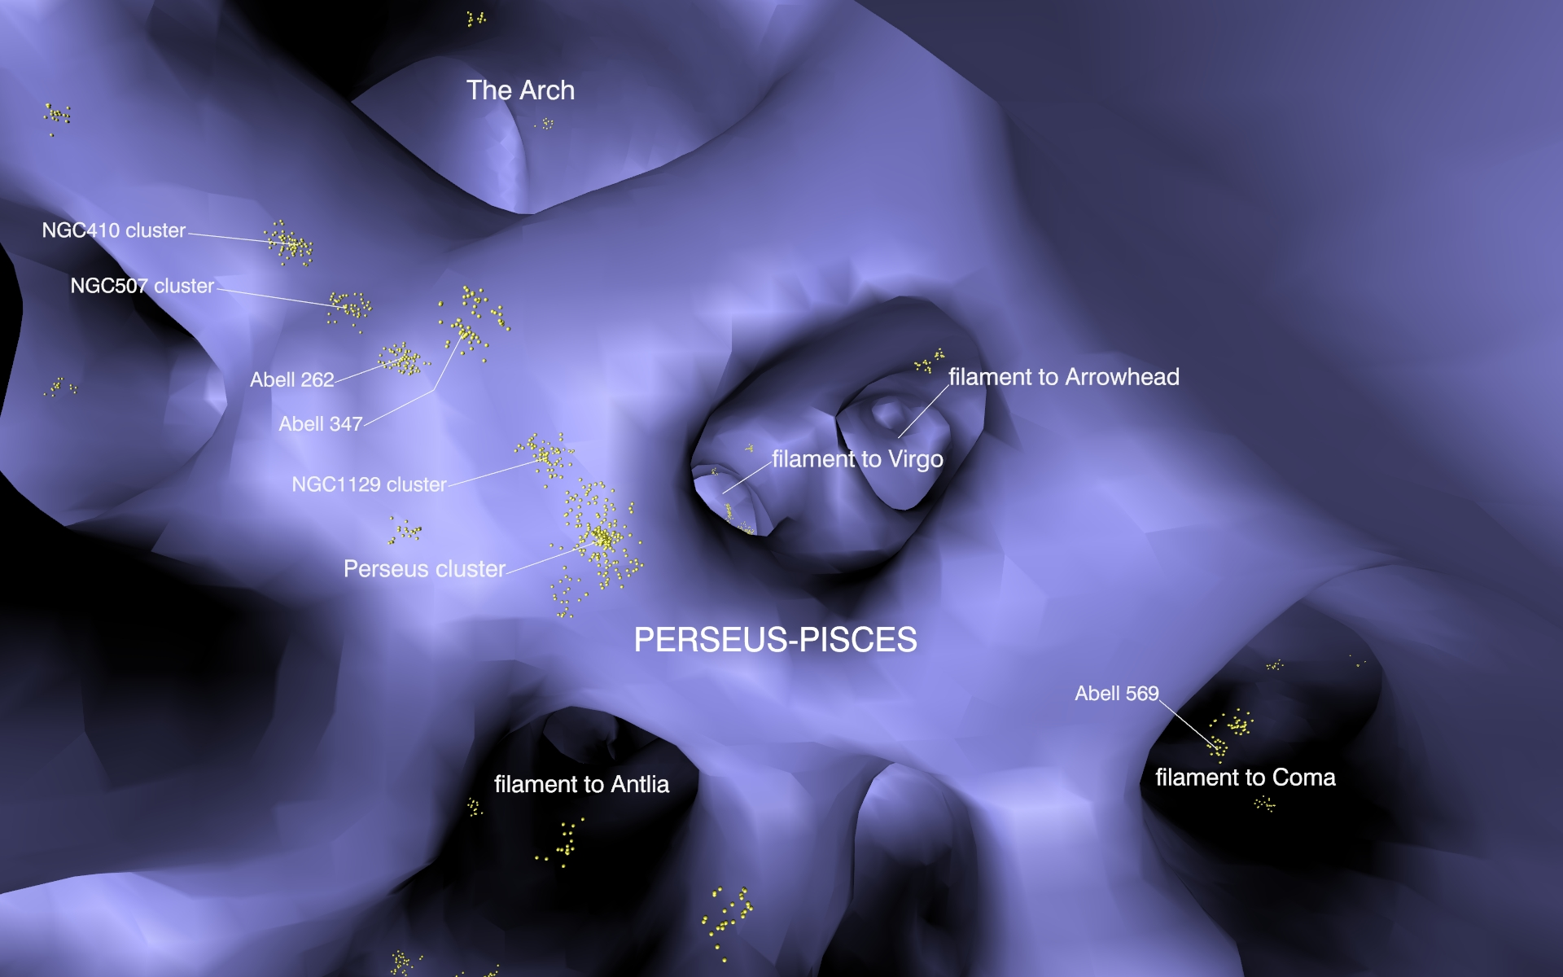
Immersive maps
Perseus-Pisces: a node of the V-Web where several filaments converge

Slide 13
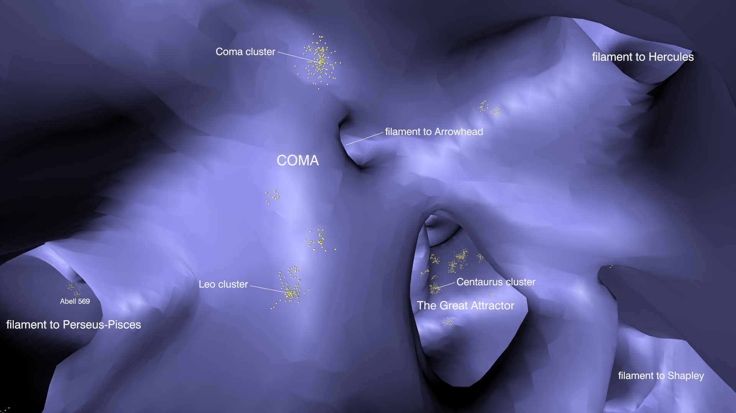
Immersive maps
Coma: a node of the V-Web where several filaments converge

Slide 14
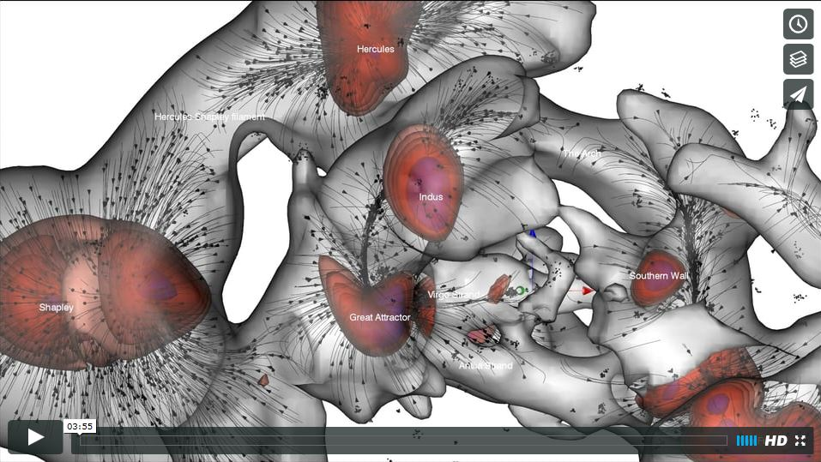
VIDEO a special shorter/faster edit of a 13min video (to be submitted)

Slide 15
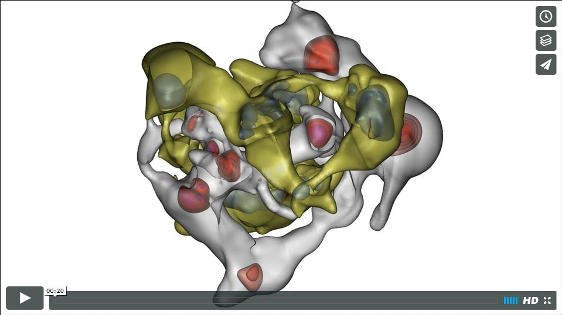
What about sheets and voids? preliminary results
The sheets and voids are organized in a three dimensional network of nodes (voids) connected by filamentary sheets.
The network of knots connected by filaments and the network of voids connected by sheets are complementary.

Slide 16
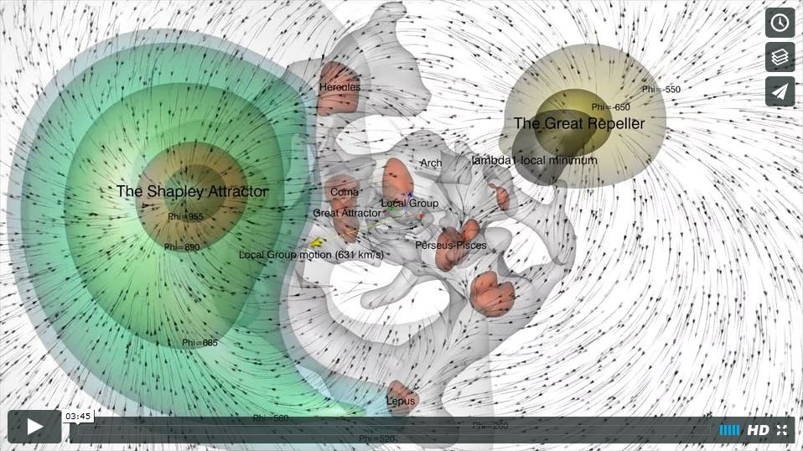
The V-Web versus the Great Repeller

