Slide 1
THE DYNAMICS OF THE LOCAL SUPERCLUSTER
Offered July 8, 2016:
WHEREAS, many new and improved distances to nearby galaxies have been obtained,
WHEREAS, the dark matter distribution around the Virgo Cluster and throughout the LSC remains terra incognita,
WHEREAS, the Numerical Action Method and back-Integration reveals the meanderings of galaxies,
RESOLVED, a new model of the Local Supercluster is hereby warranted to determine the total mass of the Virgo Cluster, the true M/L of galaxies, and the amount of dark matter strewn apart from the galaxies.
Commending: Ed Shaya (U. of Maryland), R. Brent Tully (U. of Hawaii), & Yehuda Hoffman (HUJI)

Slide 2
OUTLINE
Galaxy Distribution < 40 Mpc
External tidal field
NAM
Backtracking
Look at Trajectories in a best solution
Vary Ho
We will contemplate on the redshift of the Virgo Cluster.

Slide 3
GALAXY DISTRIBUTION MAP
1381 galaxies/groups/clusters
  < 40 Mpc
  cz and brightness
  CosmicFlows, plus additional redshift surveys for ZOA.
  681 have distances based on 1694 individual galaxy distances.
  Typical 5% errors on individual galaxy distances out to 8 Mpc. (Cepheids, TRGB, RR-Lyrae etc).
  Chi-square based on 358 with d_error < 0.15.

Slide 7
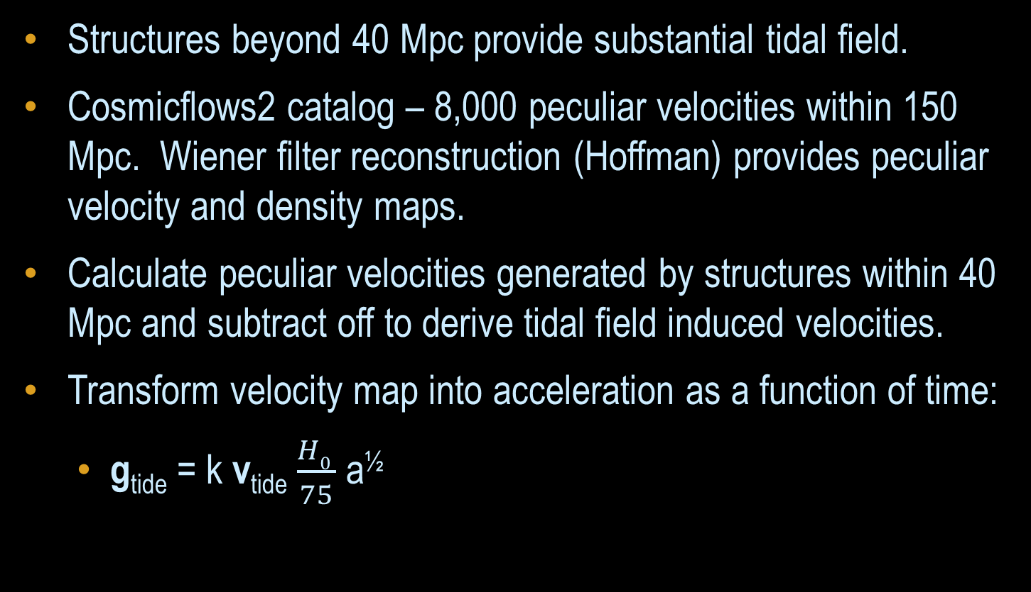
EXTERNAL FIELD
Structures beyond 40 Mpc provide substantial tidal field.
Cosmicflows2 catalog – 8,000 peculiar velocities within 150 Mpc. Wiener filter reconstruction (Hoffman) provides peculiar velocity and density maps.
Calculate peculiar velocities generated by structures within 40 Mpc and subtract off to derive tidal field induced velocities.
Transform velocity map into acceleration as a function of time:
  g_{tide} = k v_{tide} $\frac{H0 }{75}$ a^{½}

Slide 8
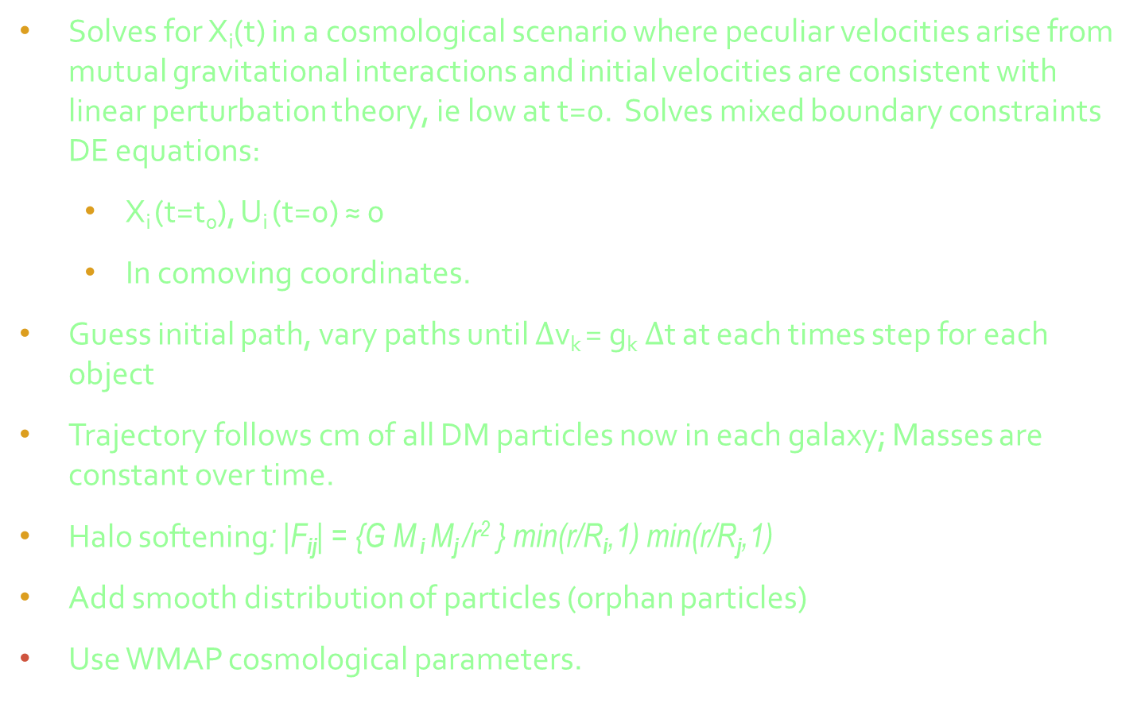
Numerical Action Method (NAM, Peebles 1989)
Solves for X_{i}(t) in a cosmological scenario where peculiar velocities arise from mutual gravitational interactions and initial velocities are consistent with linear perturbation theory, ie low at t=0. Solves mixed boundary constraints DE equations:
  X_{i} (t=t₀), U_{i} (t=0) ≈ 0
  In comoving coordinates.
Guess initial path, vary paths until $∆$v_{k} = g_{k}$∆$t at each times step for each object
Trajectory follows cm of all DM particles now in each galaxy; Masses are constant over time.
Halo softening: |F_{ij}| = {G M _{i} M_{j} /r² } min(r/R_{i},1) min(r/R_{j},1)
Add smooth distribution of particles (orphan particles)
Use WMAP cosmological parameters.

Slide 9
BACKTRACKING
Multiple solutions: NAM may choose wrong one. Need to correct.
For low mass galaxies, we can integrate acceleration backwards in time for comoving v(t) and x(t) given by the potential field from the high mass galaxies.
Need |v(z=4)| to be very low ( < 30 km/s)
Since PMs not known (yet), we must try all 4Π directions for the velocity (well, in 1◦ intervals) constrained to v•x + Hod = cz
.

Slide 10
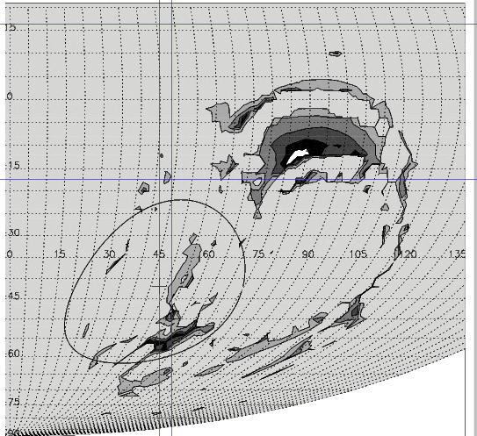
LEO I VELOCITY at z=4 on map (SGL_{V}, SGB_{V})

Slide 13
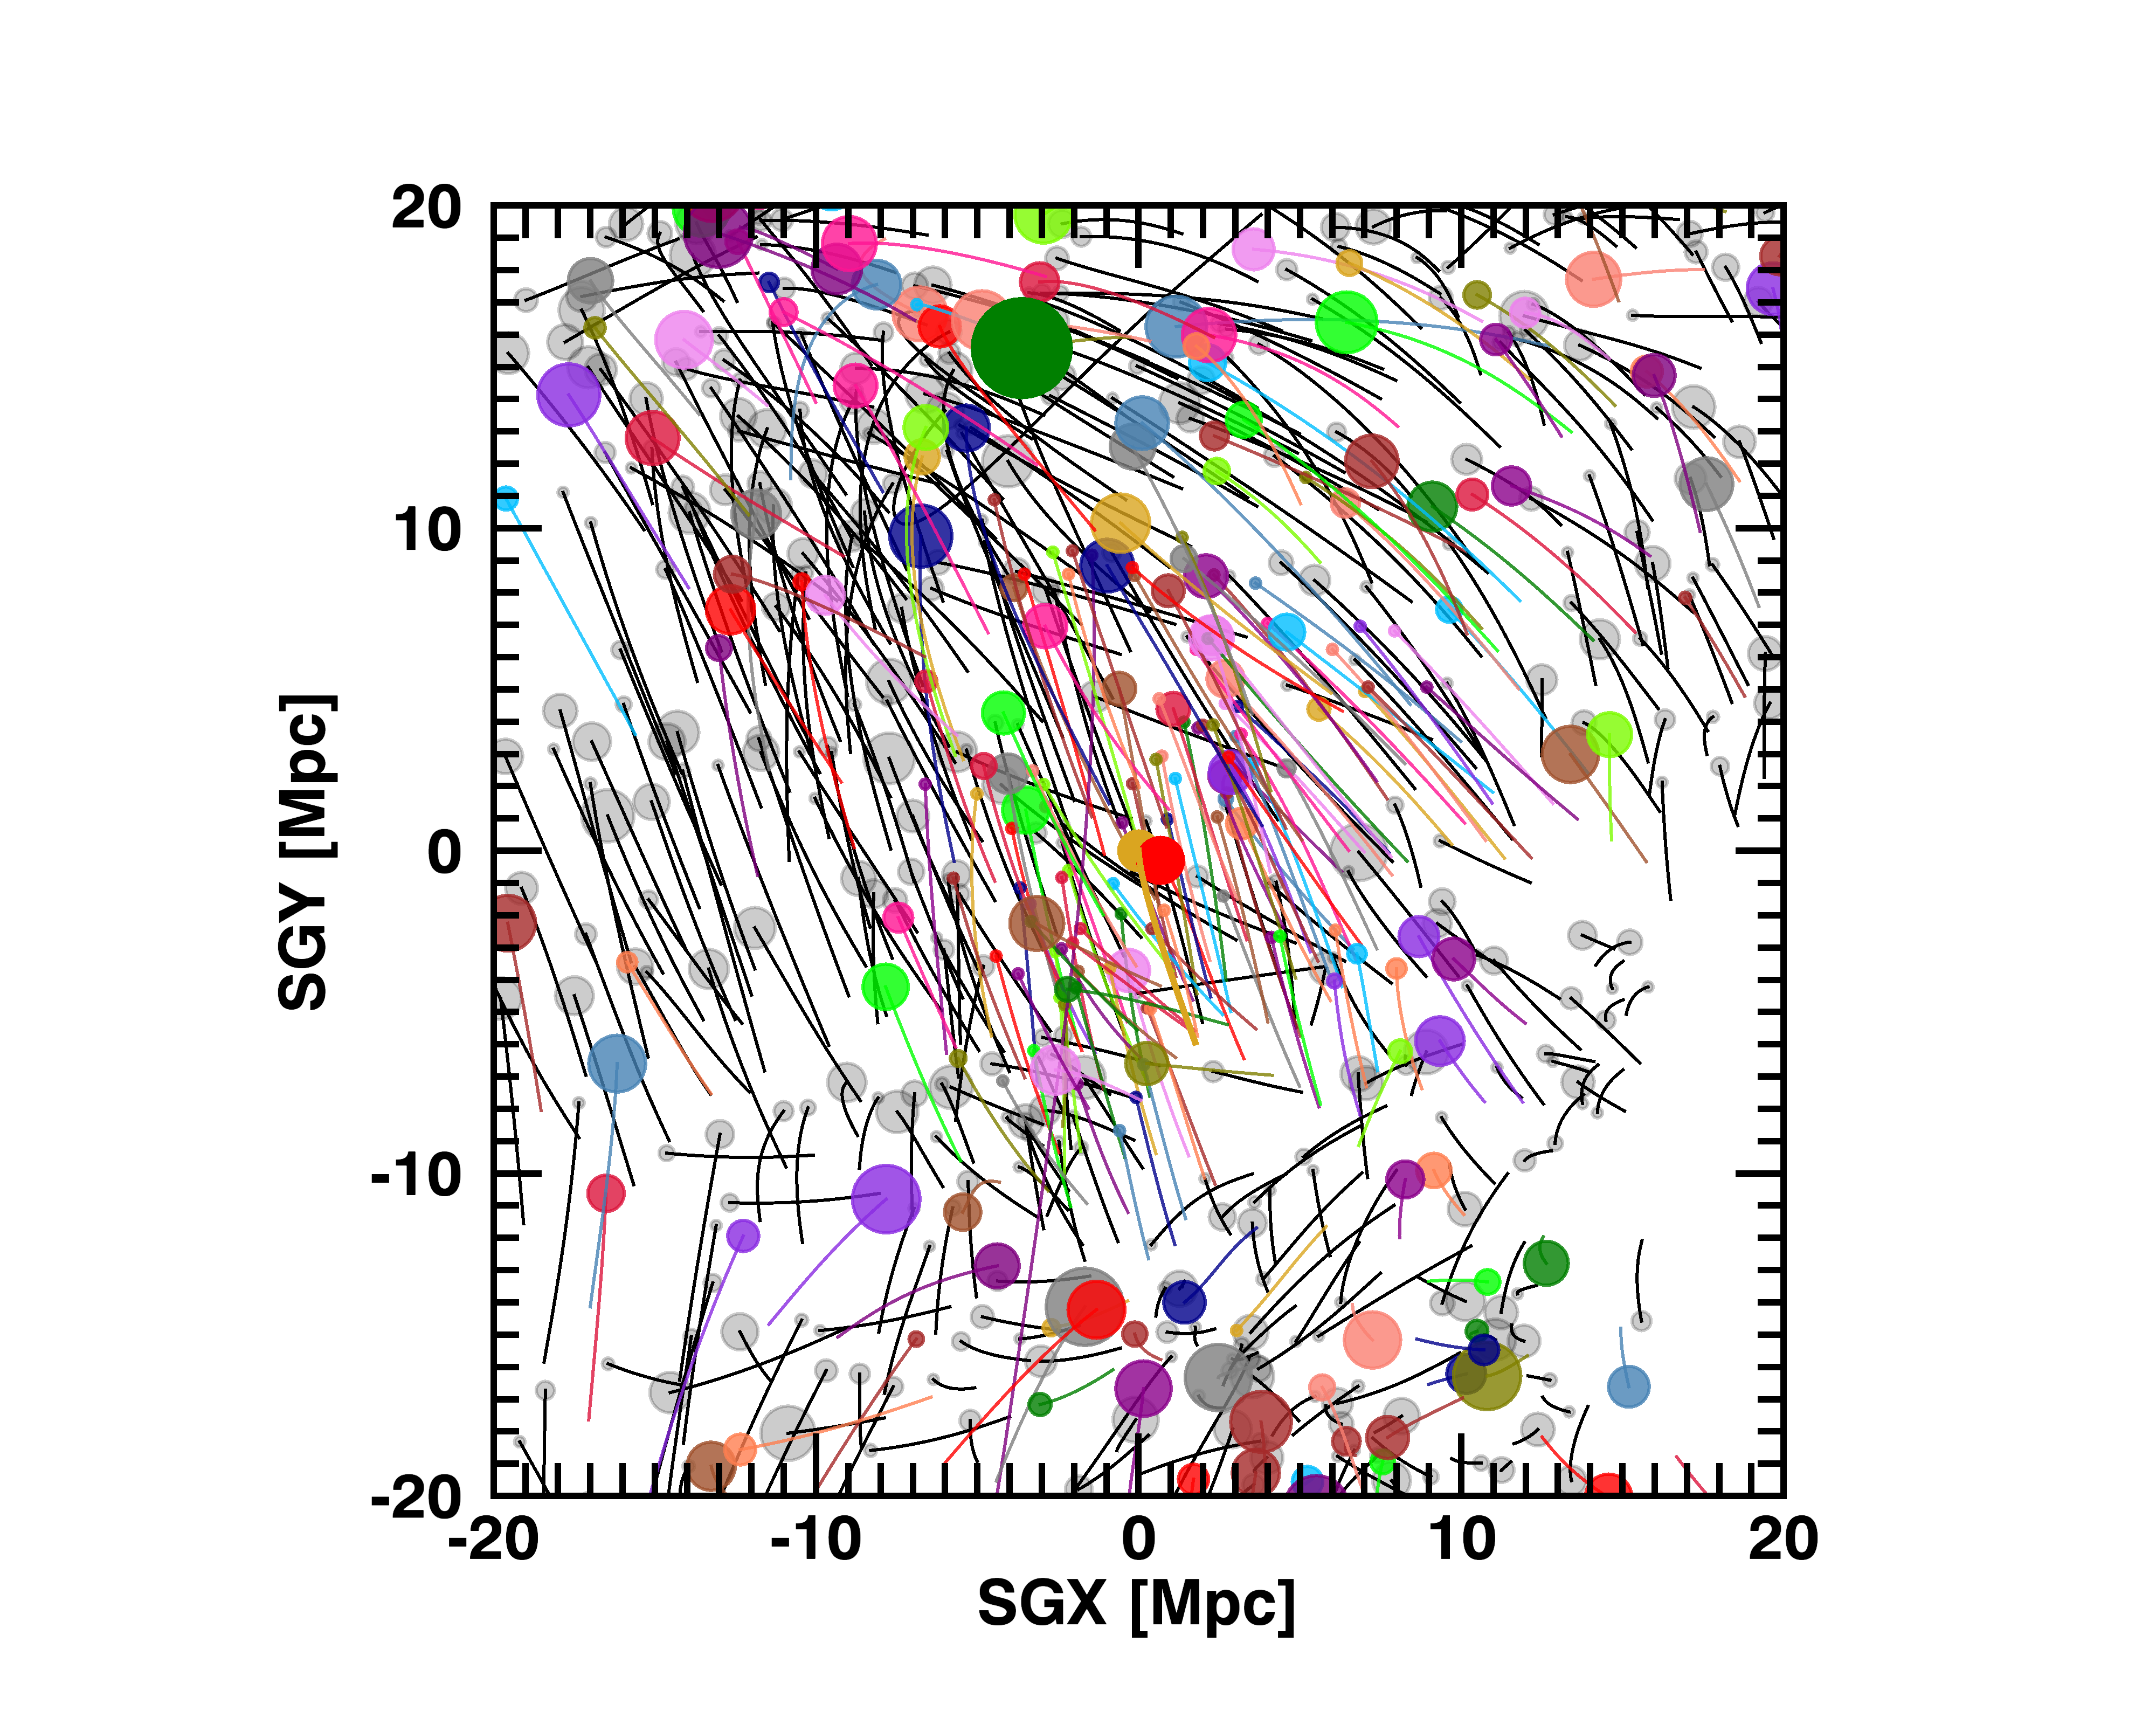

Slide 14
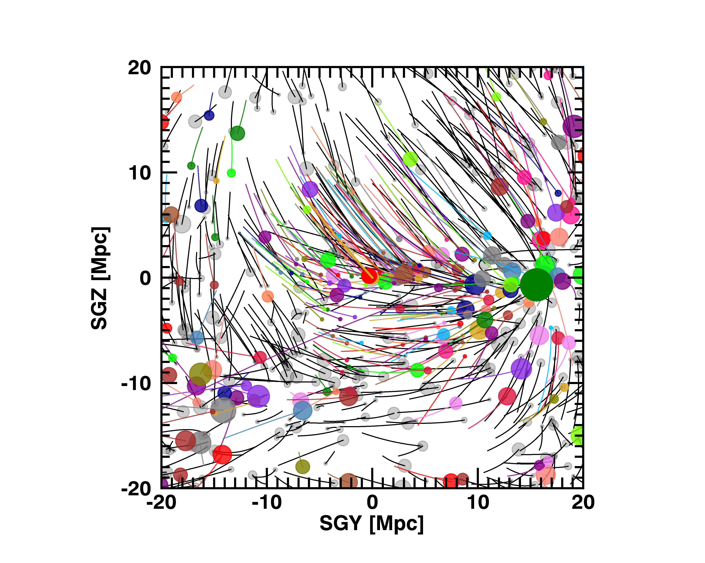

Slide 15
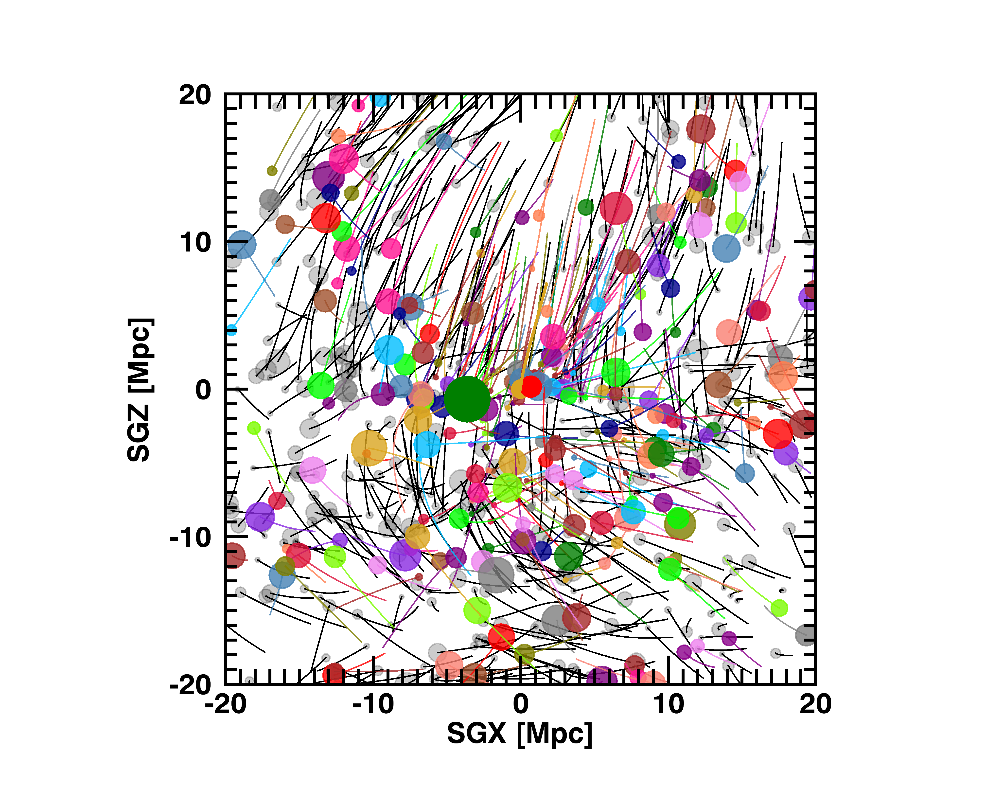

Slide 20
PARAMETERS AS FN OF H_{O}
Choose Ho
Vary parameters to reduce chi-sq to a minimum:
Parameters: M/L_{K}, M_{virgo}, Ω_{orphan}, External field strength
Change Ho

Slide 23
History of Peculiar velocity of the Virgo Cluster
∆V = 125⁺⁵⁰₋₃₅ km/s (Yahil, Sandage, Tammann 1980),
∆V = 480±75 km/s (Aaronson et al. 1980),
∆V ≈ 330 km/s (De Vaucouleurs 1978)
∆V = 240 km/s, Hoffman, Olson & Salpeter, 1980
  Vv = 1050 km/s, Mv = 4E14 M⨀/L⨀
  Assumed spherical symmetry and no distance info
  Turnaround radius = 27°
But now we know Ho, right?
Ho=73, Hubble flow velocity of virgo = 16.0*73 = 1168
and ∆V = = 1168 - 1050 = 118 km/s
A dilemma of the first kind.
Rather Vv = 930 so ∆V = 1168 – 930 = 238 km/s

Slide 24
.
RESOLVED
We can now solve for the paths of the nearby galaxies through cosmological time.
Mean M/L_{K}= 1.5(Ho -73) + 48 M⨀/L⨀
Matter outside of galaxies and groups:
  𝞨_{orphan} = .0034(Ho – 73) + 0.07
Can determine Ho and 𝞨_{m} global from non-linear motions within 40 Mpc. Do not need to worry about possibility of a large density bubble around us.

