Slide 1
2MTF and Future TF Surveys
Lister Staveley-Smith
International Centre for Radio Astronomy Research
University of Western Australia

Slide 2
2MTF team
Aidan Crook
Tao Hong
Cullan Howlett
John Huchra
Tom Jarrett
Heath Jones
Baerbel Koribalski
Lucas Macri
Karen Masters
Chris Springob
Lister Staveley-Smith
Also starring: Pirin Erdogdu, David Lagatutta, Christina Magoulas, Jeremy Mould, Morag Scrimgeour

Slide 3
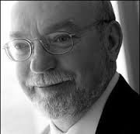
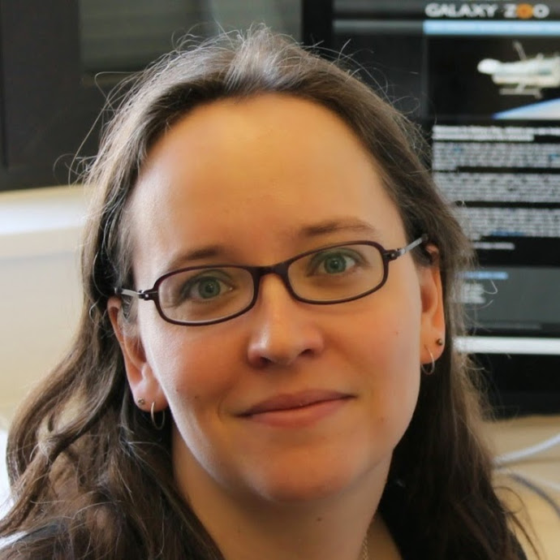
2MTF founders
John Huchra (1948-2010):
instigated as a follow-up of 2MASS/2MRS to reduce ‘zone of avoidance’
Karen Masters:
started GBT HI observations in 2006, but moved to Portsmouth in 2008

Slide 4
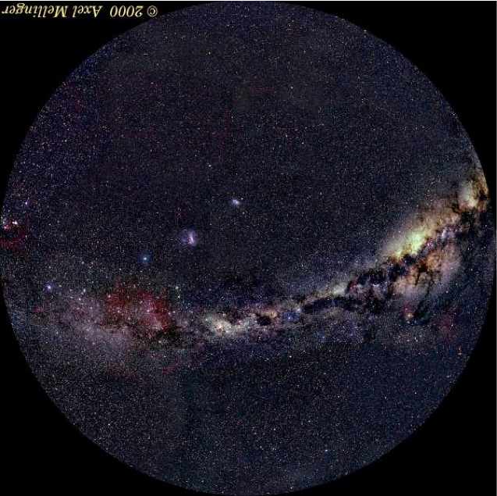
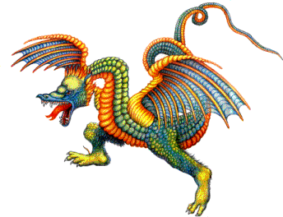
Here be dragons
bulk flow
direction

Slide 5
Content
2MTF sample
Results
Cosmography
Bulk flow (Tao Hong), residual bulk flow
Power spectrum (Cullan Howlett)
Reducing the ZOA
HIZOA
2MTF+ (Khaled Said, Anja Schroeder)
Future TF surveys: ASKAP+FAST

Slide 6
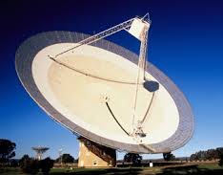
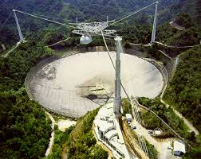
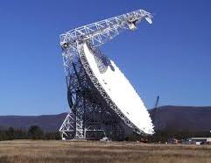
HI data
Archival (1502): Cornell archive
ALFALFA-100 (800): Haynes+(2011)
GBT (479/1194) and Parkes (151/303): Masters+(2014), Hong+(2013)

Slide 7
Why velocities?
Cosmography
Local Supercluster (de Vaucouleurs+)
Great Attractor (Dressler+)
Hydra-Centaurus and Norma superclusters
Laniakea supercluster (Tully+)
Shapley supercluster
Dark Flows (Kashlinsky+)
ΛCDM parameters
Distortion parameter Ω_{m}^{0.552}/ b (matter density)
Velocity power spectrum A_{v}
Growth factor f σ₈
Non-gaussianity f_{NL}
Cosmological tests
GR

Slide 8
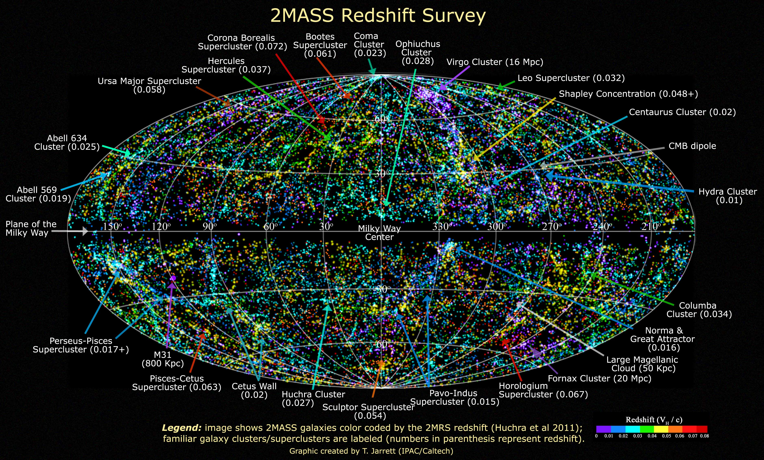

Slide 9
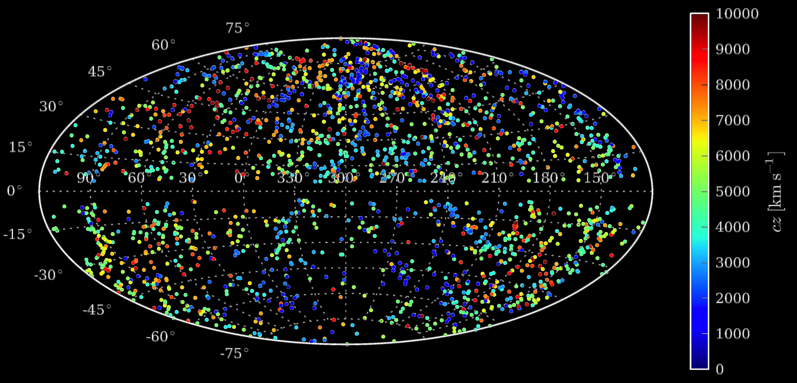
2MTF subset
Hong et al (2014)

Slide 10
Adaptively smoothed field
Coma
Hydra-Centaurus
Virgo
Hydra-Centaurus
Virgo
Coma
Perseus-Pisces
Hydra-Centaurus
Perseus-Pisces
Virgo
Perseus-Pisces
Coma

Slide 11
Reconstructions
Use redshift surveys to predict distances, mass distribution, and velocities, e.g:
PSCz (Branchini et al. 2001)
2MRS (Erdogdu et al. 2006, 2016+)
2M++ (Carrick et al. 2015)

Slide 12
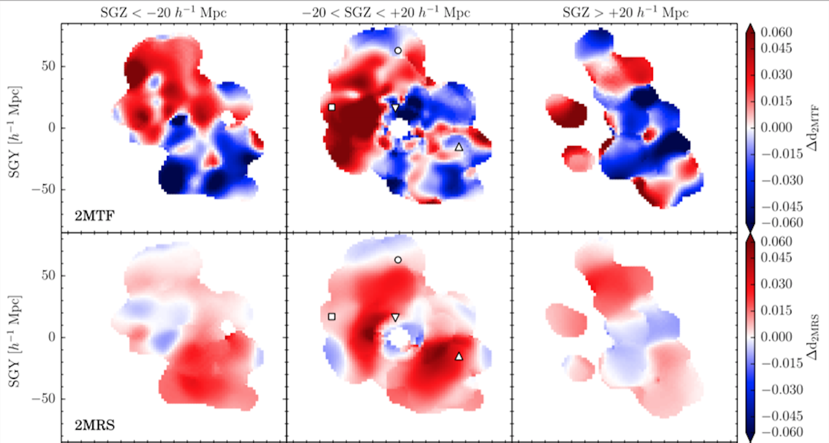
2MTF v reconstructions

Slide 13
Difference fields -

Slide 14
Difference fields - zero-point offsets applied

Slide 15
Residual bulk flow amplitude
2MTF bulk flow
Residual flow (2MRS)
Residual flow (PSCz)
weighting scale [h⁻¹ Mpc]
Springob et al. (2016)

Slide 16
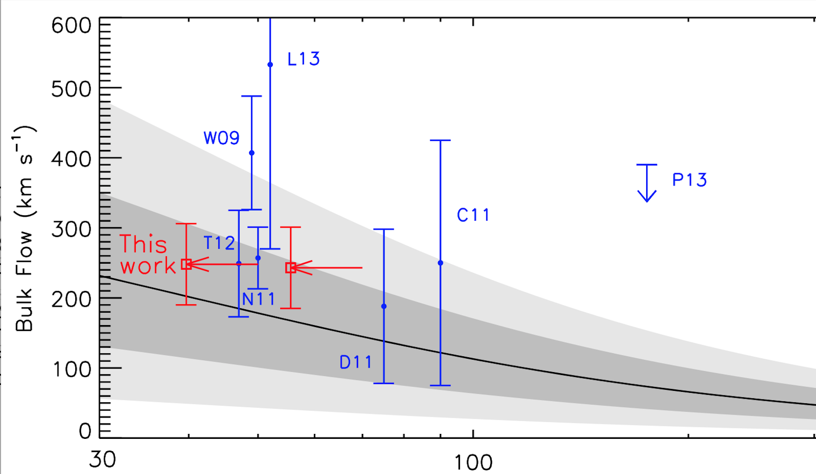
Consistency with ΛCDM
Adapted from Scrimgeour et al. (2016)
2MTF
S16
2MTF residual bulk flow
ΛCDM prediction

Slide 17
Best-fit
2MTF fit to 2MRS model
2MTF fit to PSCz model

Slide 18
Derived parameters
Matter density
assume 6dFGS bias (b=1.52, Beutler et al. 2012)
Matter density, Ω_{m} = 0.32 ± 0.13
Bias
assume Planck matter density (Ω_{m}=0.308, XIII)
Galaxy bias, b = 1.49 ± 0.17
Growth rate Γ = fσ₈
assume 2MRS (σ_{8,g}=0.97, Westover 2007)
Growth rate, Γ = 0.34 ± 0.04

Slide 19
Residual bulk flow direction
2MTF bulk flow
Carrick et al. (2015): 2M++
Hudson et al. (2004): PSCz
Magoulas et al. (2012): 2MRS
Residual flow (2MRS)
PSCz
2MRS
Residual flow (PSCz)
Springob et al. (2016)

Slide 20
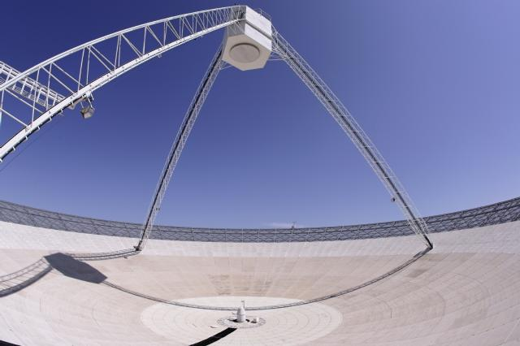
Parkes telescope
HIZOA surveys
Integration time 1900 hrs
Galactic latitude within ±5 deg
Henning+ (2000), Juraszek+ (2000)
Donley+ (2005)
Staveley-Smith, Kraan-Korteweg, Schroeder, Henning et al. (2016)

Slide 21
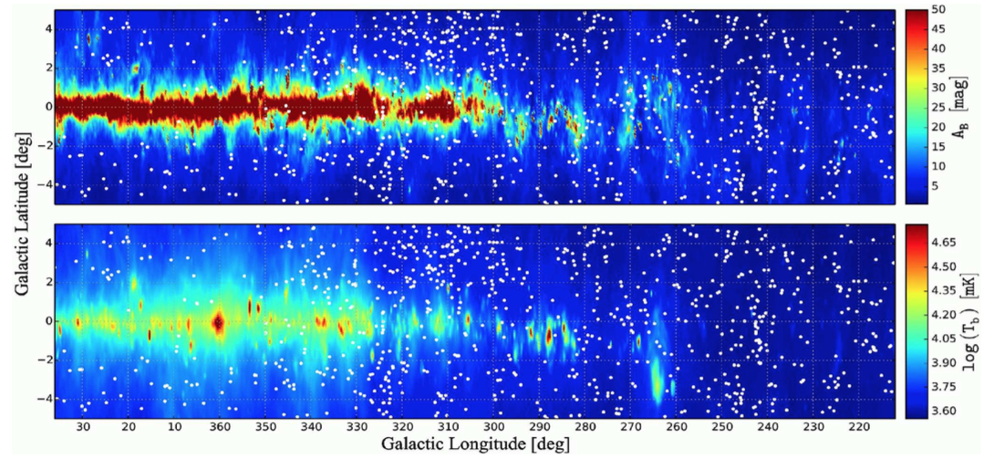
Zone of Avoidance
883+77 new galaxies
Complete to 17 mJy/2.8 Jy km/s
Only 8% with previous redshift measurement
Talks by Khaled Said, Renee Kraan-Korteweg, Anja Schroeder

Slide 22
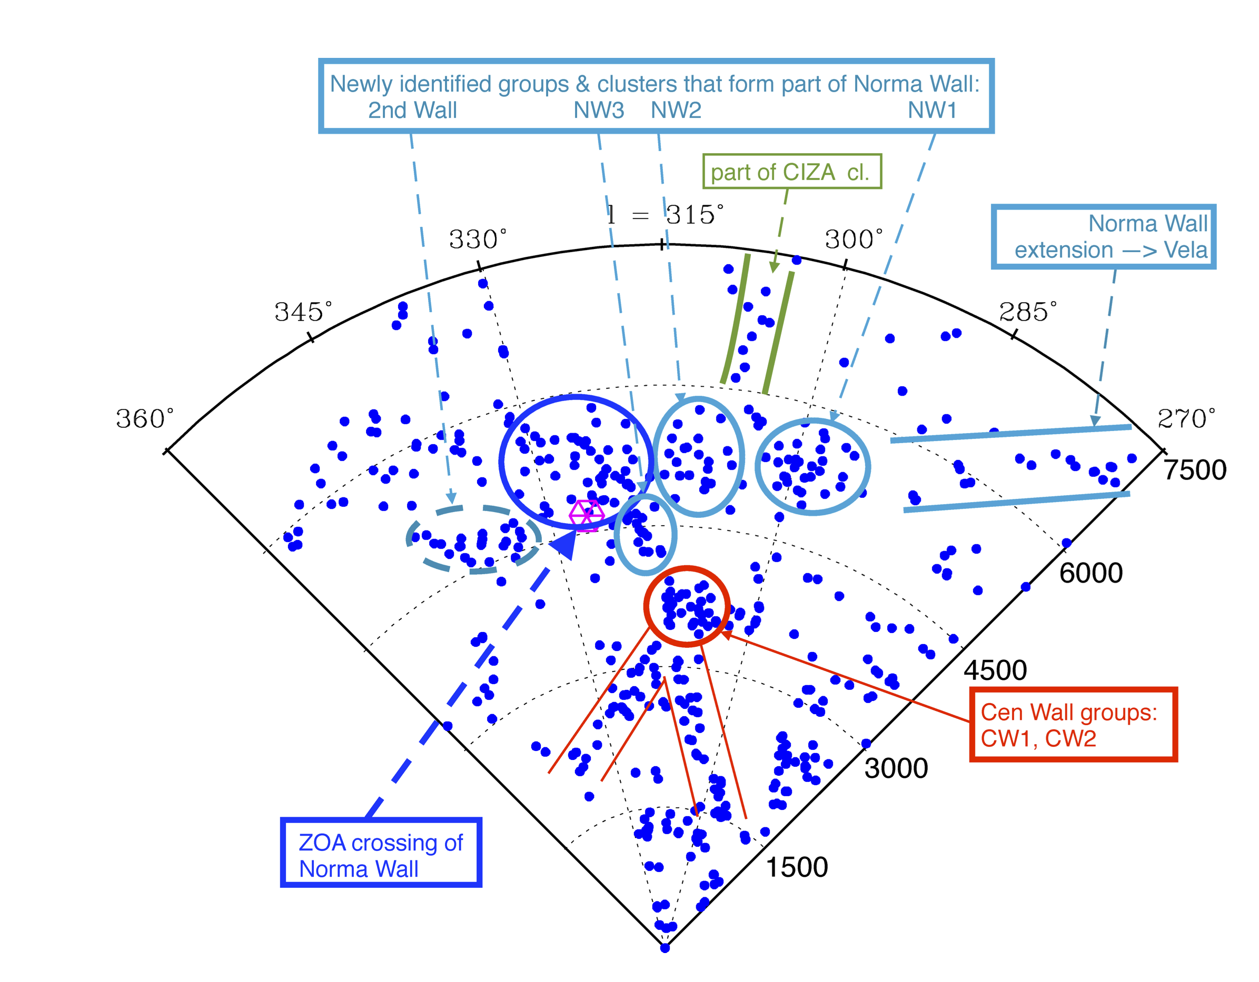
New ZOA structures
Staveley-Smith, Kraan-Korteweg, Schroeder, Henning et al. (2016)

Slide 23
The Future: ASKAP, SKA
Sensitivity of a 72-m telescope
Phased array feed technology gives FOV of 30 sq. deg
John Goldsmith

Slide 24
FAST telescope

Slide 25
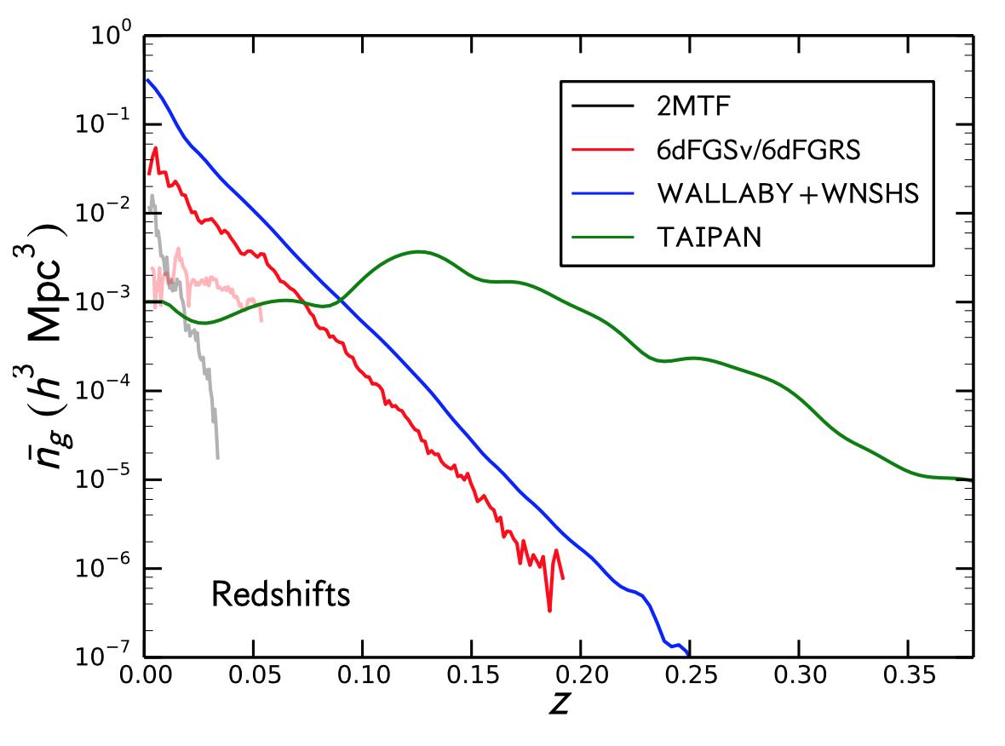
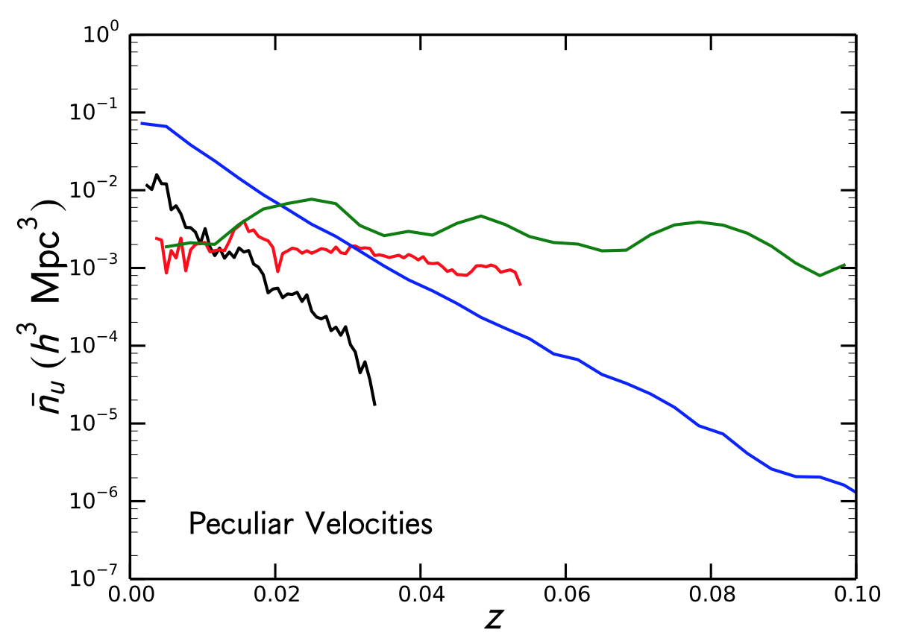
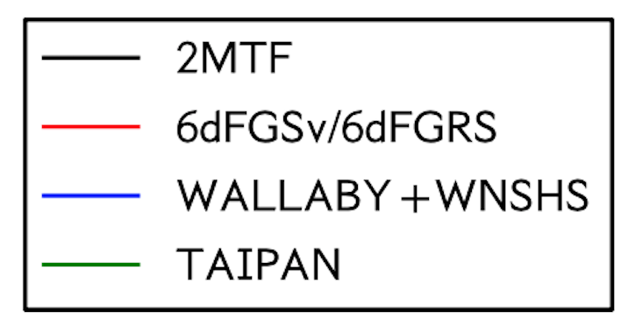
Wallaby: ASKAP key survey
+ FAST
+ FAST
Howlett et al (2016+)

Slide 26
Data availability
2MASS/2MRS data published
New GBT/Parkes data published
ALFALFA 70-100 data unpublished
Compendium of data and velocities to accompany final 2MTF data + bulk flow paper in 2017
See also ict.icrar.org/2MTF

Slide 27
Summary
2MTF survey complete: high-accuracy velocity measurements in local Universe
Spectral and photo data published; velocity compendium available 2017
Comparison with reconstructed density fields indicates residual bulk flow ~150 km s⁻¹
Consistent with ΛCDM, Planck XIII parameters
ASKAP/FAST almost ready to extend TF surveys to Shapley supercluster volume

