Slide 1
Cosmicflows-3
Brent Tully Helene Courtois Jenny Sorce

Slide 2
Cosmic Flows Program
Measure distances d
Peculiar velocities: V_{pec} = V_{obs} - H₀d
Infer 3D velocities and density field
Project to initial conditions
Simulate evolution to present conditions
Helene Courtois, Yehuda Hoffman, Daniel Pomarede
Ehsan Kourkchi, Po-Feng Wu
Karachentsev, Rizzi, Shaya
Gottloeber, Hoffman, Klypin, Yepes (CLUES collaboration)
Sorce, Kitaura, Libeskind

Slide 3
Cosmic Flows Program
errors increase with distance
V_{pec} uncertainties
large at large distances
Measure distances d
Peculiar velocities: V_{pec} = V_{obs} - H₀d
Infer 3D velocities and density field
Project to initial conditions
Simulate evolution to present conditions
strong constraints nearby;
diminishes with distance
Gottloeber, Hoffman, Klypin, Yepes (CLUES collaboration)
Sorce, Kitaura, Libeskind

Slide 4
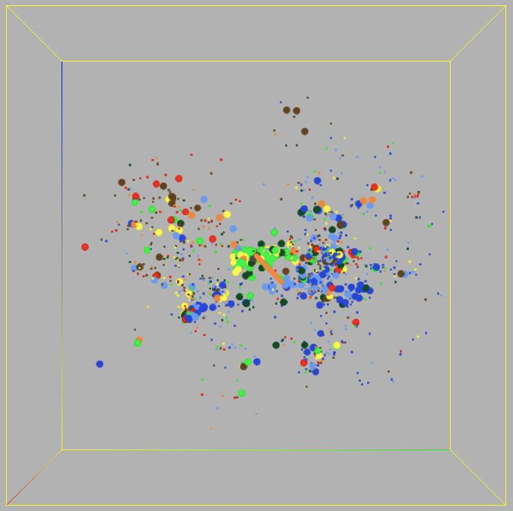
The MW has a motion of 323 km/s w.r.t. 1800 galaxies with measured distances within 3000 km/s
Most important result from Cosmicflows-1
BT, Shaya, Karachentsev, Courtois, Kocevski, Rizzi, Peel [2008, ApJ, 676, 184]
green/yellow V_{pec}~0
red V_{pec} > +100
blue V_{pec} < -100

Slide 5
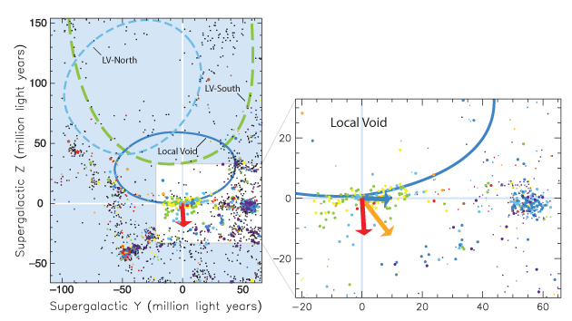
the local volume
tiny peculiar velocities within Local Sheet
discontinuity in peculiar velocities passing to adjacent structures
185 km/s motion toward Virgo Cluster
260 km/s motion away from Local Void

Slide 6
Contributions to Cosmicflows-2
Cosmicflows-1: 1797 distances within 3300 km/s
catalog in Extragalactic Distance Database: http://edd.ifa.hawaii.edu
Tully et al. 2008, ApJ, 676, 184
297 TRGB: Tip of the Red Giant Branch
133 TRGB Literature
31 RR Lyr, Horiz Br, Eclip Bin, Maser
60 Cepheid Period-Luminosity
382 SBF: Surface Brightness Fluctuation
306 SNIa: Type Ia Supernova
1508 FP: Fundamental Plane
5998 TF: Luminosity-Linewidth
8315 distance measures within 30,000 km/s
1209
BT, Courtois, Dolphin, Fisher, Heraudeau, Jacobs, Karachentsev, Makarov, Makarova, Mitronova, Rizzi, Shaya, Sorce, Wu
2013, AJ, 146, 86

Slide 7
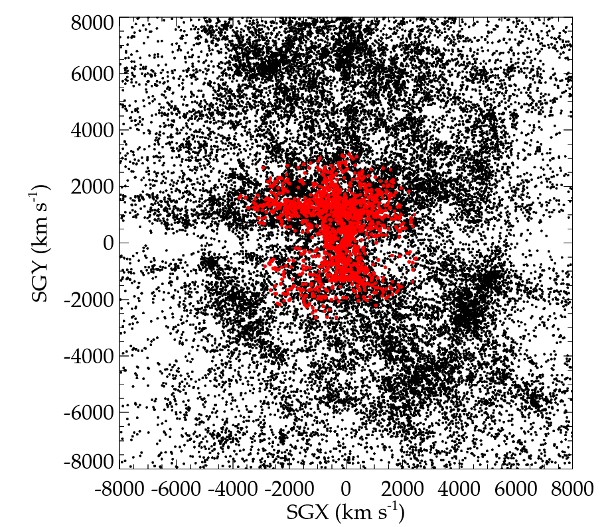
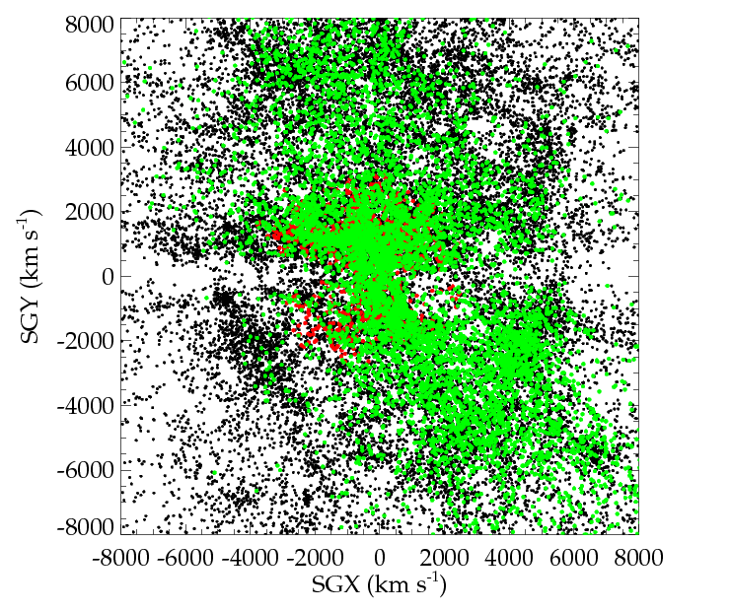
Cosmicflows-1 => Cosmicflows-2
CF 2.1 now available at edd.ifa.hawaii.edu
CF1: 1800 galaxies
V < 3,000 km/s
CF2: 8000 galaxies
V < 30,000 km/s
2008 2013
Notes:
7
GBT SOUTH / NORTH

Slide 8
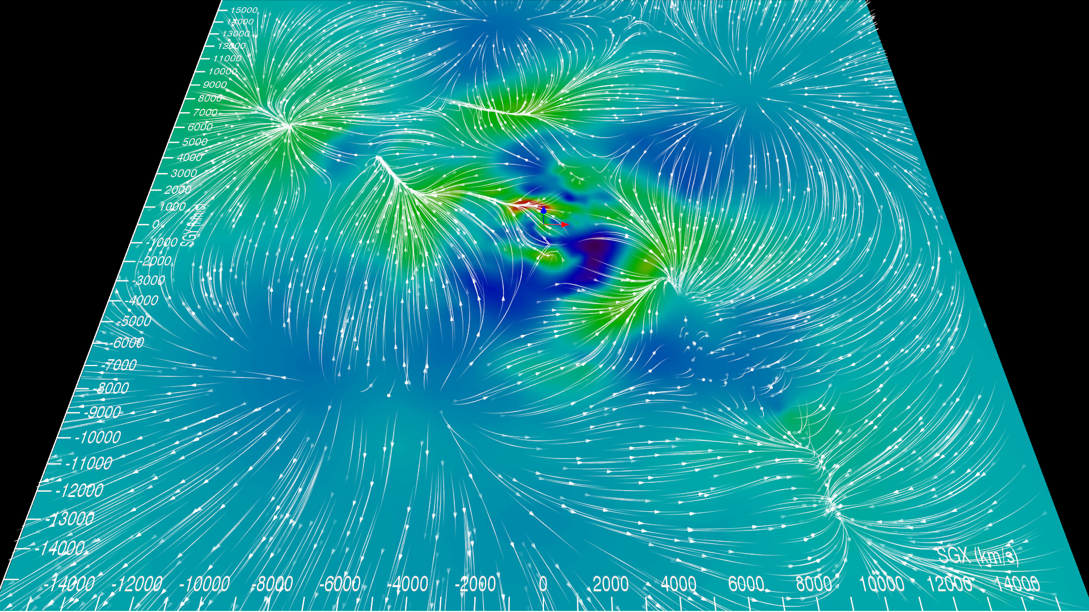
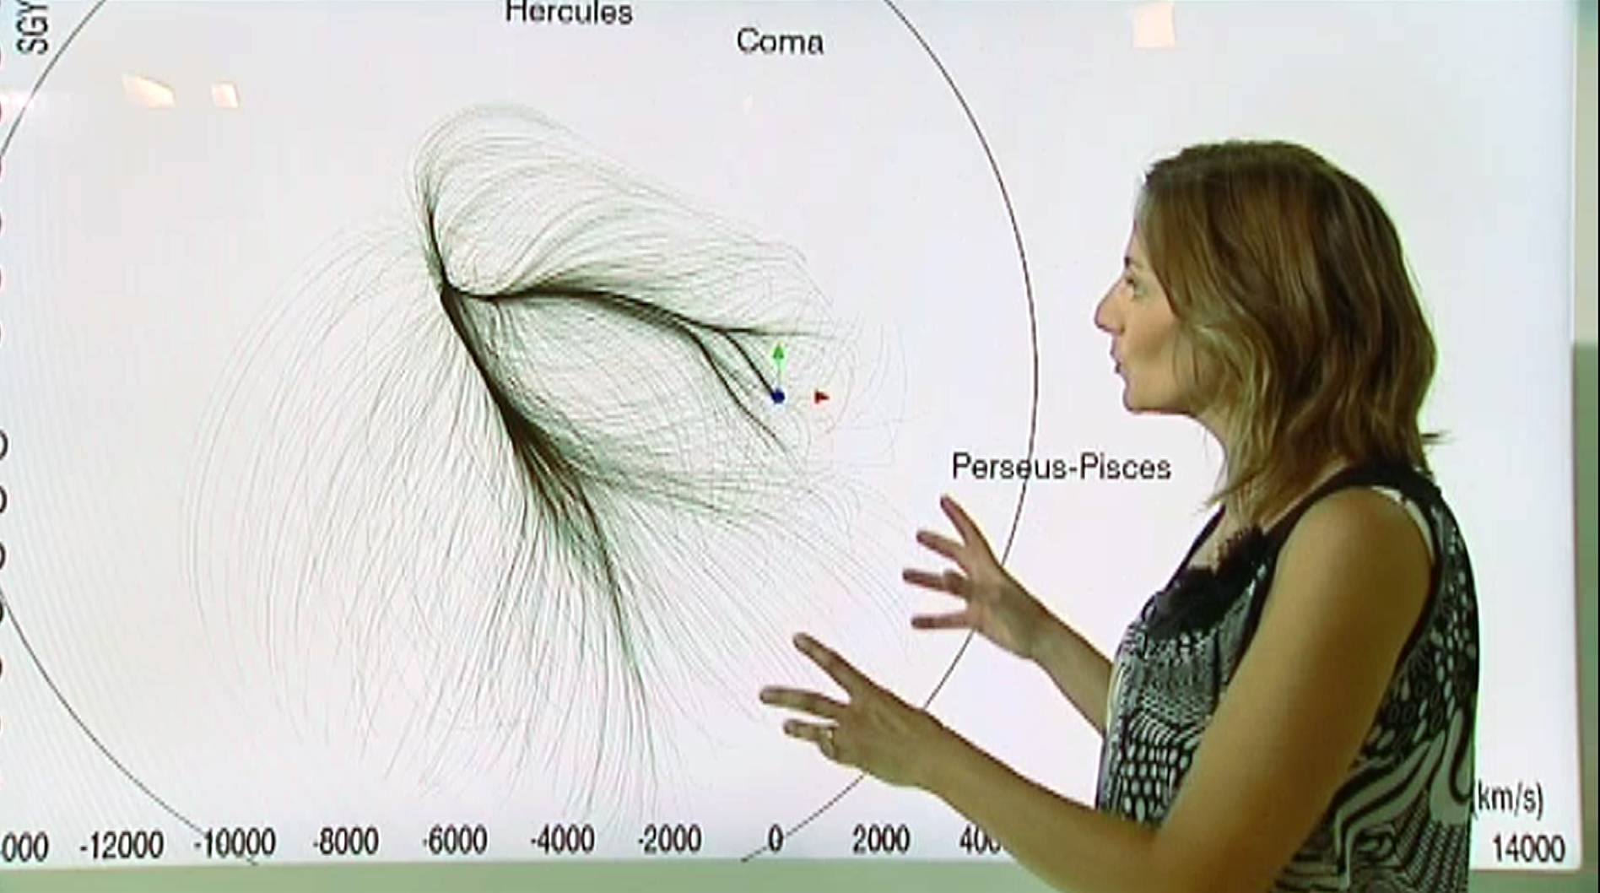
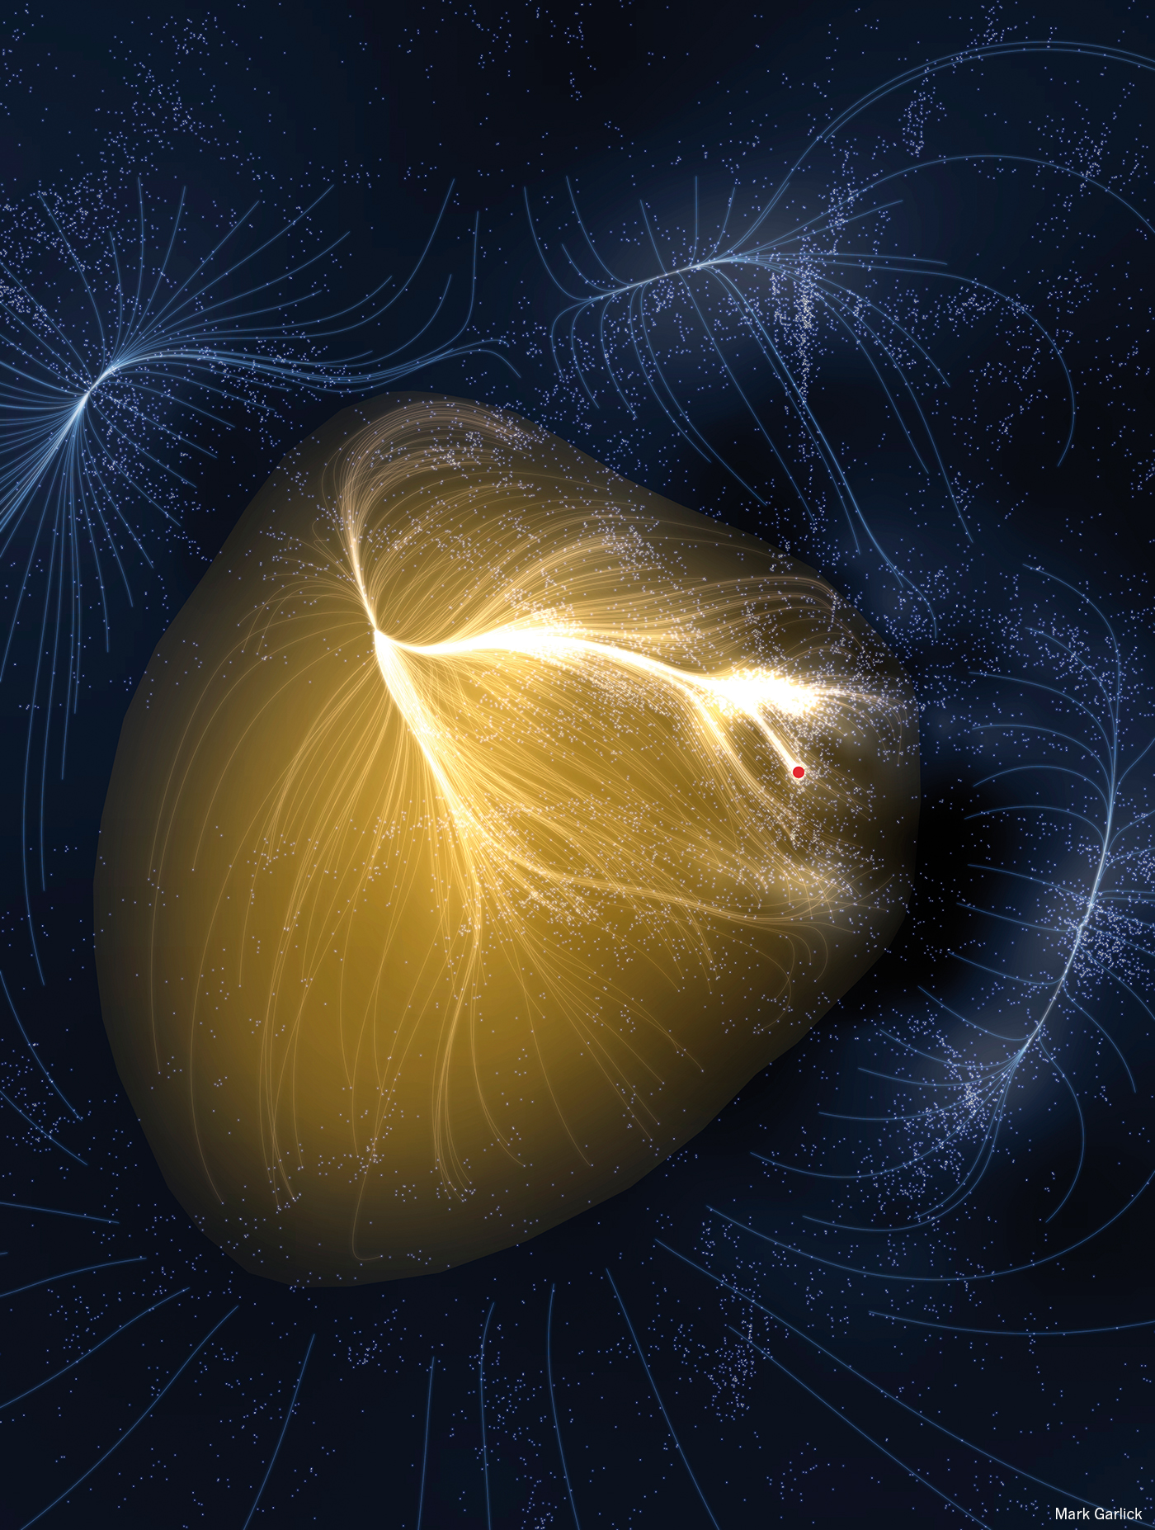
Laniakea images
CF2
Laniakea

Slide 9
Contributions to Cosmicflows-2
297 TRGB: Tip of the Red Giant Branch
133 TRGB Literature
31 RR Lyr, Horiz Br, Eclip Bin, Maser
60 Cepheid Period-Luminosity
382 SBF: Surface Brightness Fluctuation
306 SNIa: Type Ia Supernova
1508 FP: Fundamental Plane
5998 TF: Luminosity-Linewidth
8315 distance measures within 30,000 km/s
new to Cosmicflows-3
Incremental:
TRGB: 297 => 384
SNIa: 306 => 390
All new:
Spitzer TF: 2257
6dFGS FP: 8885
17,669 distance measures within 30,000 km/s

Slide 10
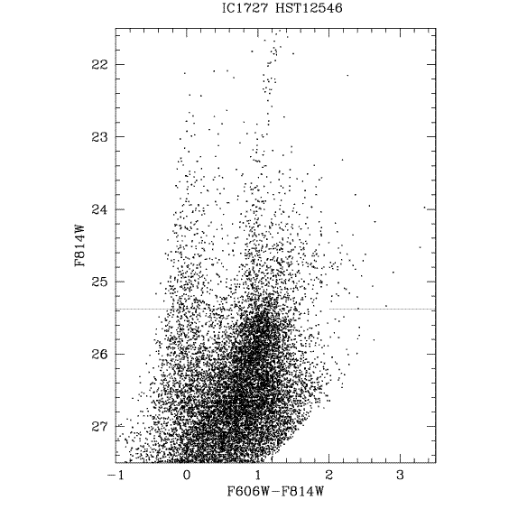
excellent TRGB coverage locally
new !
-114 km/s
V_{LS} > +100 km/s
-100 to +100 km/s
V_{LS} < -100 km/s

Slide 11
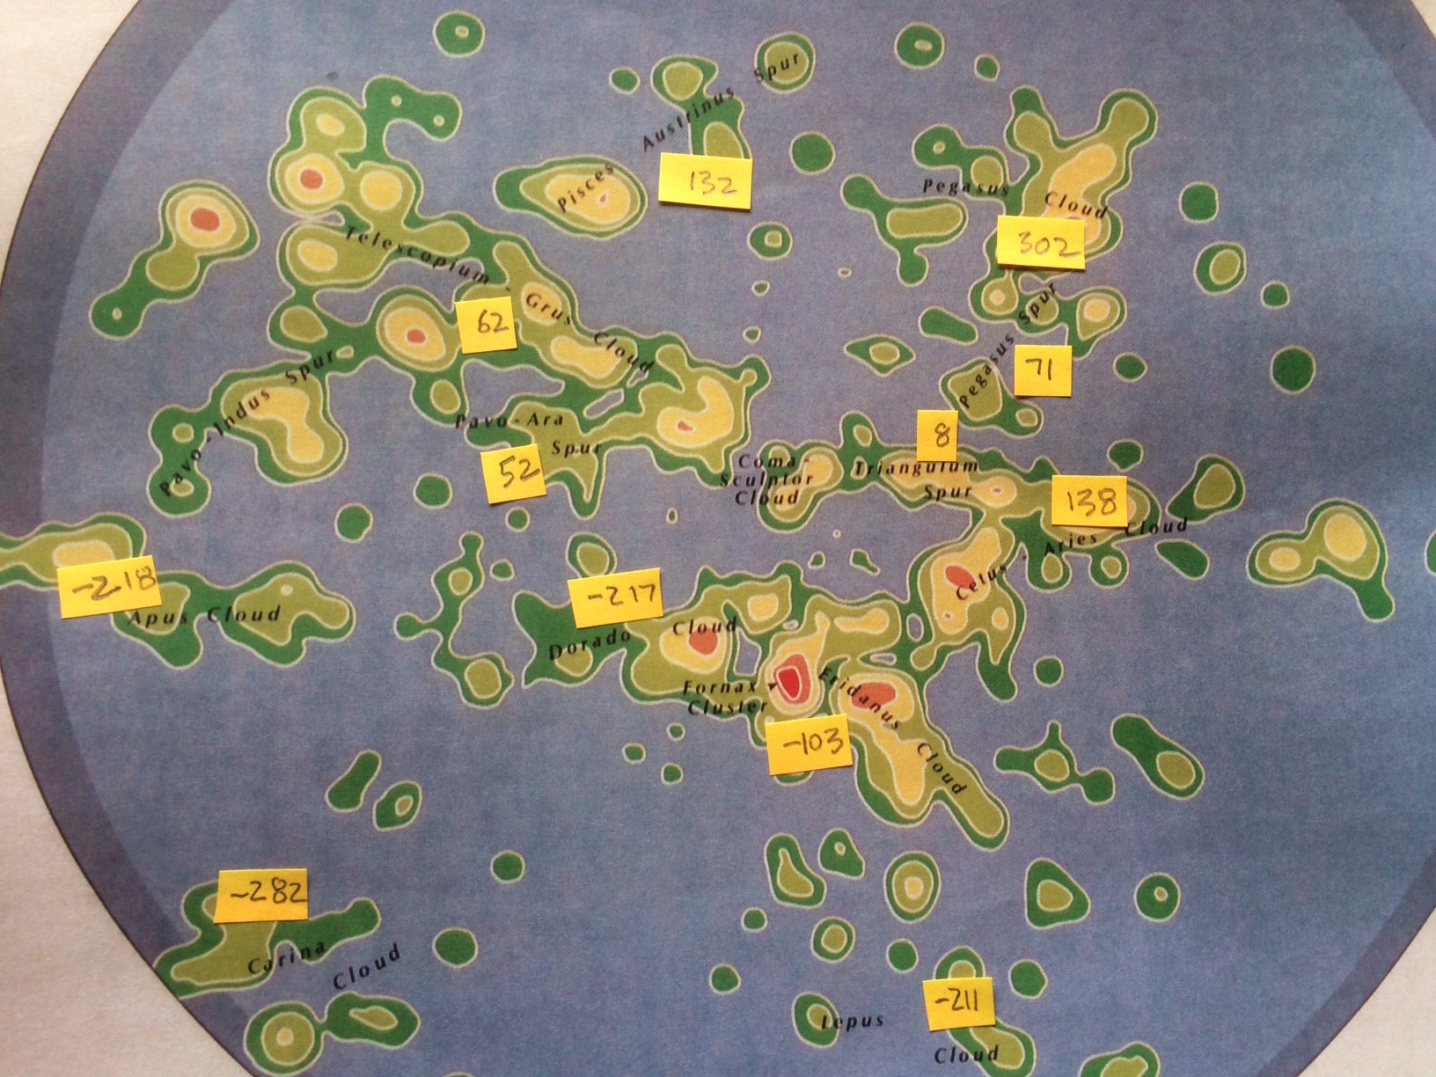
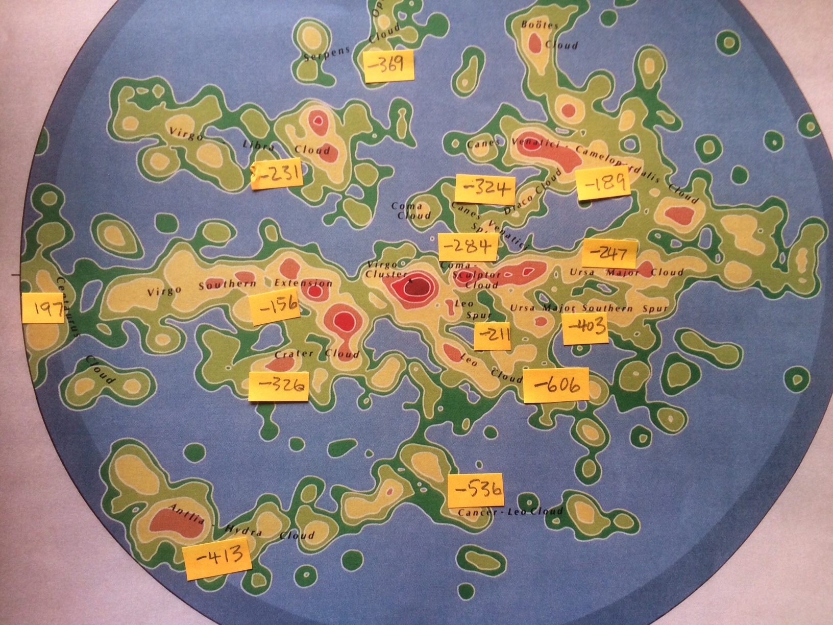
motions of local filaments
SGZ=0
South
North

Slide 12
motions of local filaments
V_{pec} mostly negative in north
[reflex of our motion toward Virgo]
compression toward SGZ=0
most positive
SGZ=0
+ve toward GA
most negative
South
North
V_{pec} negative below the supergalactic plane
[reflex of our motion away from Local Void]

Slide 13
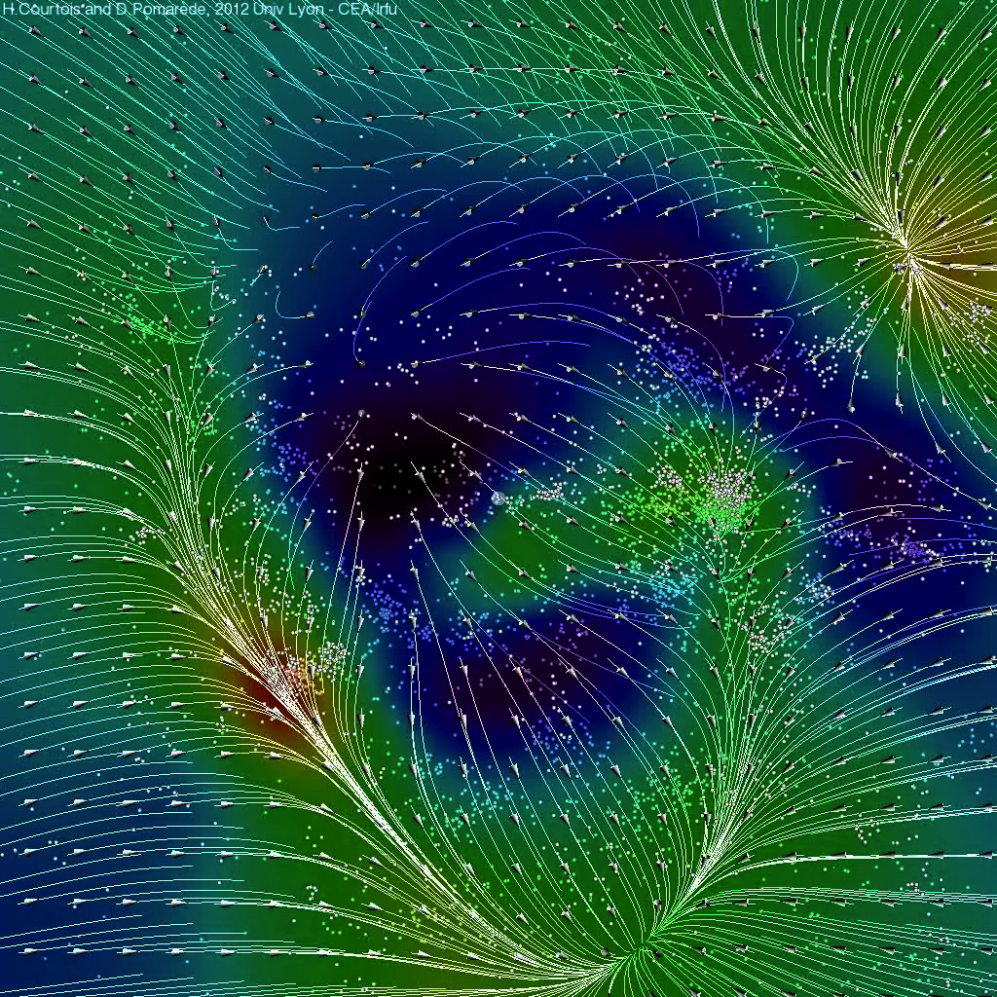
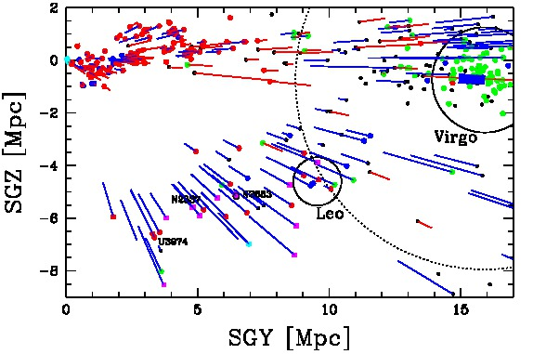
Wiener Filter reconstructions of 3D velocity fields and density maps. Results from cosmicflows-1
Courtois, Pomarede, Hoffman
2013, AJ,146, 69
Expulsion from the Local Void.
SGZ
SGY

Slide 14
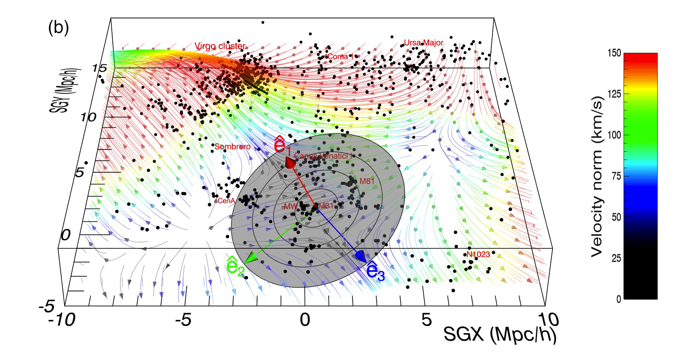
Virgo Infall
Wiener Filter Reconstruction

Slide 15
Spitzer Luminosity vs HI Linewidth

Slide 16
Properties of 2257 galaxies of Spitzer sample
13 template calibrators
binned medians
H_{i} = V_{i}/d_{i}

Slide 17
6dFGS FP & other Components of CF3
Springob et al. 2014, MNRAS, 445, 2677
SNIa
CF2
TRGB
6dFGS
Spitzer TF

Slide 18
Distances: quality
4%
7%
10%
20%

Slide 19
6dFGS FP morphology adjustment
6dFGS with TF measures
all 6dFGS
E
S0
Spiral
individual 6dFGS with SNIa, SBF, FP measures
means for 29 groups

Slide 20
SNIa zero point and H₀
at least 3 other
Cepheid
H₀=76.2 +/-3.4 rms +/-2.7 sys

Slide 21
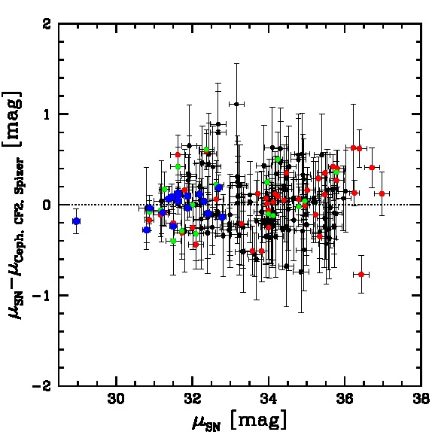
SNIa zero point and H₀
at least 3 other
Cepheid
75.5
Cepheids alone => 73
Riess+ 2011 => 2016
+ SN in groups
H₀=76.2 +/-3.4 rms +/-2.7 sys

Slide 22
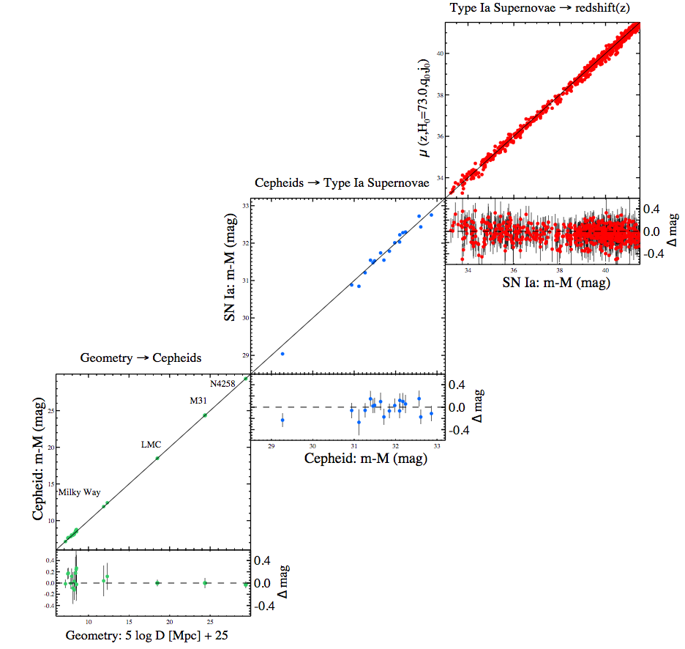
Tension in the Value of H₀
67.27 +-0.66 km/s/Mpc (Planck Collab. 2015) assuming ΛCDM, 3 neutrino species, Planck CMB data
73.02 +-1.79 km/s/Mpc (Riess et al. 2016) Cepheid – SNIa distance ladder

Slide 23
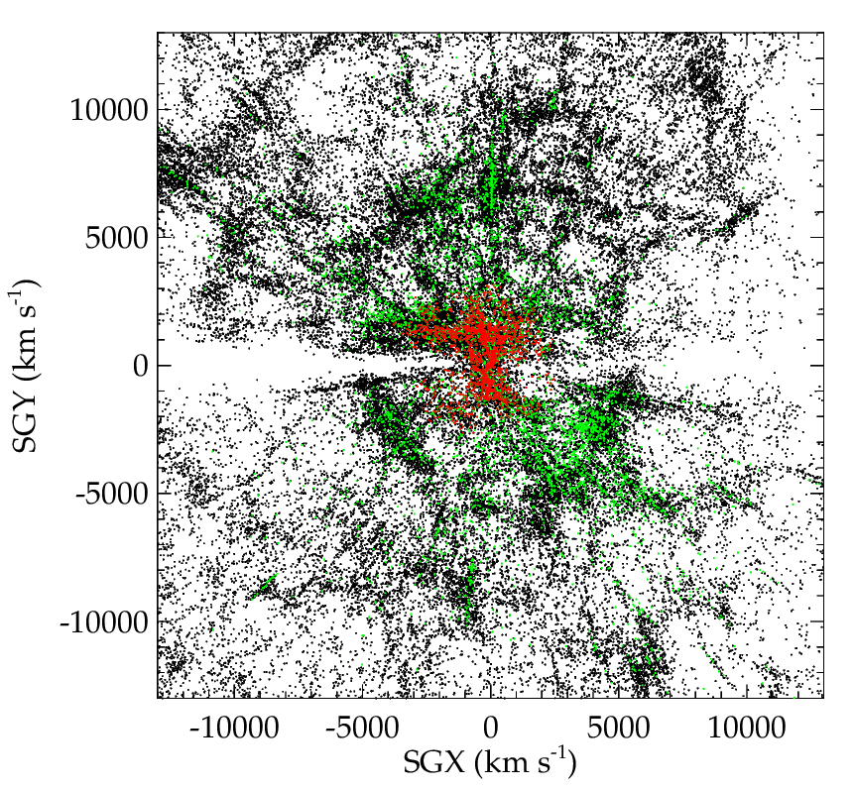
CF3 Peculiar Velocities
CF1, CF2
2MASS XSCz
red, orange > +100 km/s
cyan, blue < -100 km/s

Slide 24
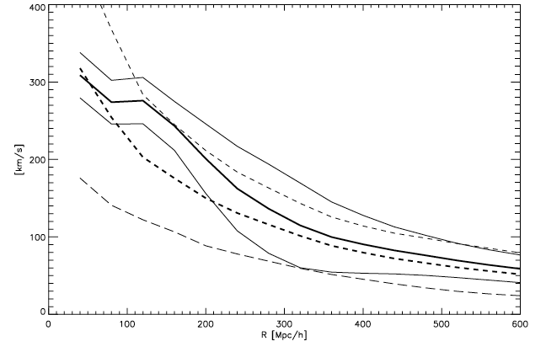
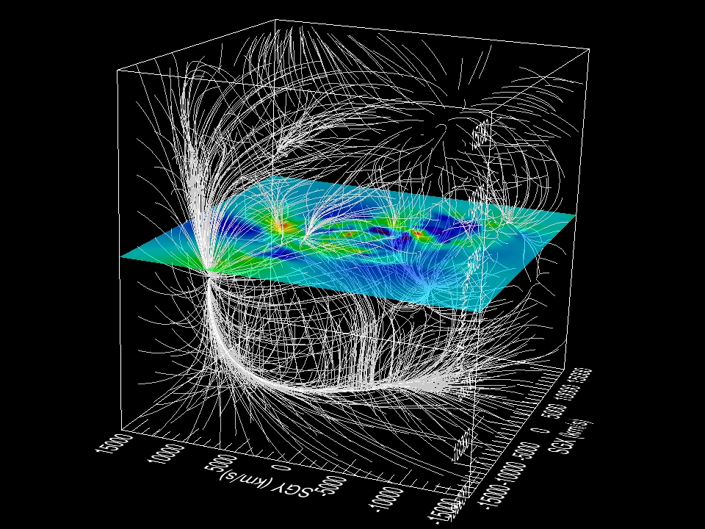
Bulk Flow
Hoffman, Courtois, Tully 2015, MNRAS, 449, 4494
from CF2
WF mean constrained realization, +-1σ
WF mean random realization, +-1σ

Slide 25
minimizing the monopole
H₀=75 +/-2 if out/in < +/-100 km/s

Slide 26
minimizing the monopole
H₀=75 +/-2 if out/in < +/-100 km/s
If H₀=68 => 700 km/s ouflow at 0.05c !!
H₀
outflow
infall
increase H₀ 1 unit => -40 km/s infall
decrease H₀ 1 unit => +40 km/s outflow

Slide 27
Laniakea Supercluster
Cosmicflows-3
18 thousand distances !

