Slide 1
Percolation analysis for cosmic web with discrete points
Jiajun Zhang, Dalong Cheng, Ming-Chung CHU
The Chinese University of Hong Kong

Slide 2
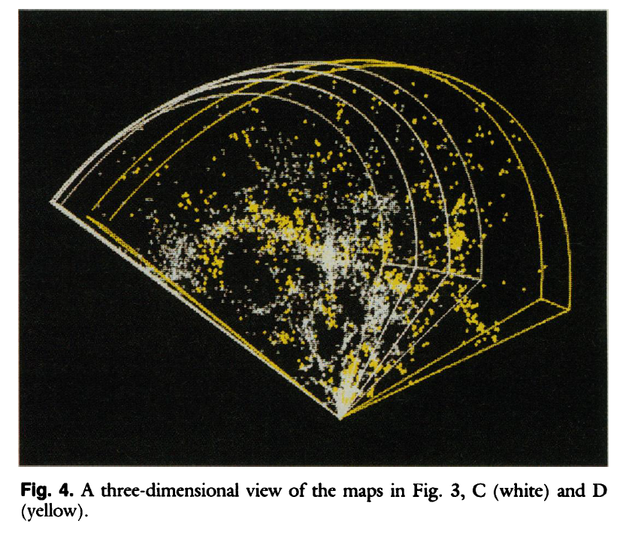
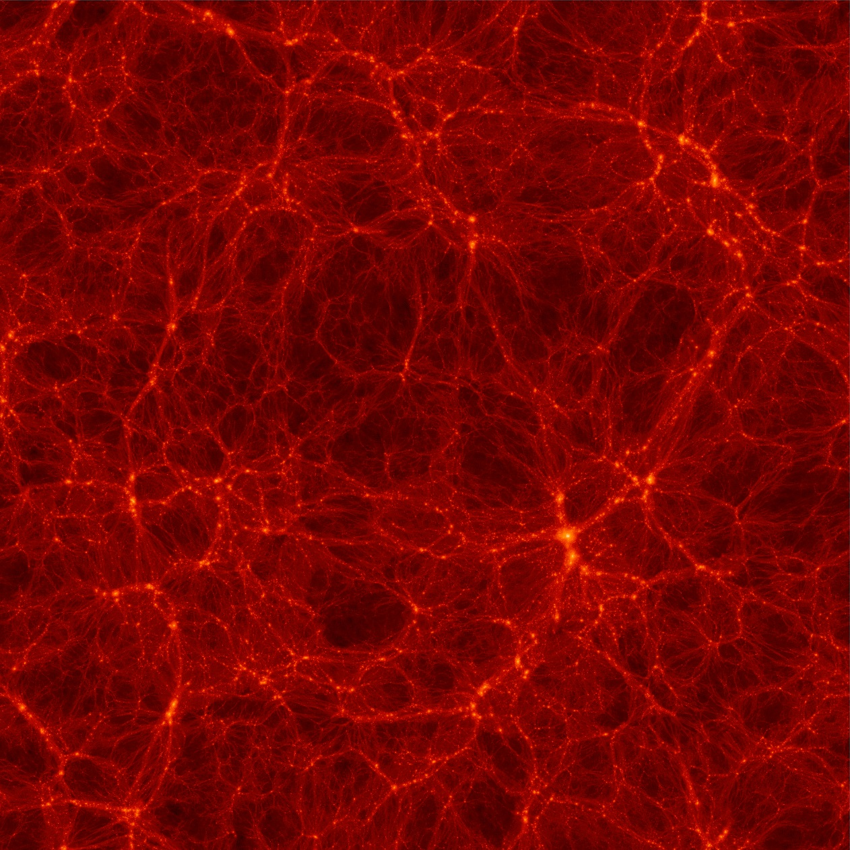
CfA redshift survey
Geller & Huchra 1989
Bolshoi simulation
Klypin, Trujillo-Gomez & Primack 2010

Slide 3
Percolation analysis has a long history
First proposed in 1980s.
Using density field, site percolation
Apply for observational data.
Difficulty:
  Smoothed to density field, what about the properties of galaxies? (e.g. Luminosity.)
  No model relate percolation analysis to cosmology or correlation function.
Zel’dovich 1982; Zeldovich et al. 1982; Shandarin 1983; Klypin & Shandarin 1993; Yess & Shandarin 1995; Sathyaprakash et al. 1996; Colombi et al. 2000; Shandarin et al. 2004, 2005; Shandarin 2009; Yan & Fan 2011; Shandarin et al. 2012; Klypin & Shandarin 1993; Yess & Shandarin 1995; Sathyaprakash et al. 1996; Colombi et al. 2000; Shandarin et al. 2004, 2005; Shandarin 2009; Yan & Fan 2011; Shandarin et al. 2012

Slide 4
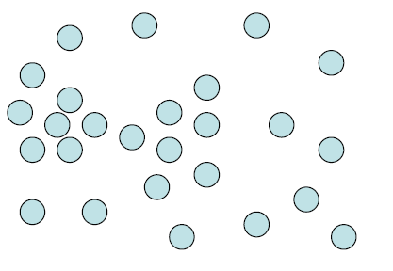
Definition for percolation and S-bb relation
Friend of Friend (FoF)
2
bb: linking length
1
3

Slide 5
Definition for percolation and S-bb relation
S: mass fraction of the largest group
As fast as 2-point correlation function
S
bb

Slide 7
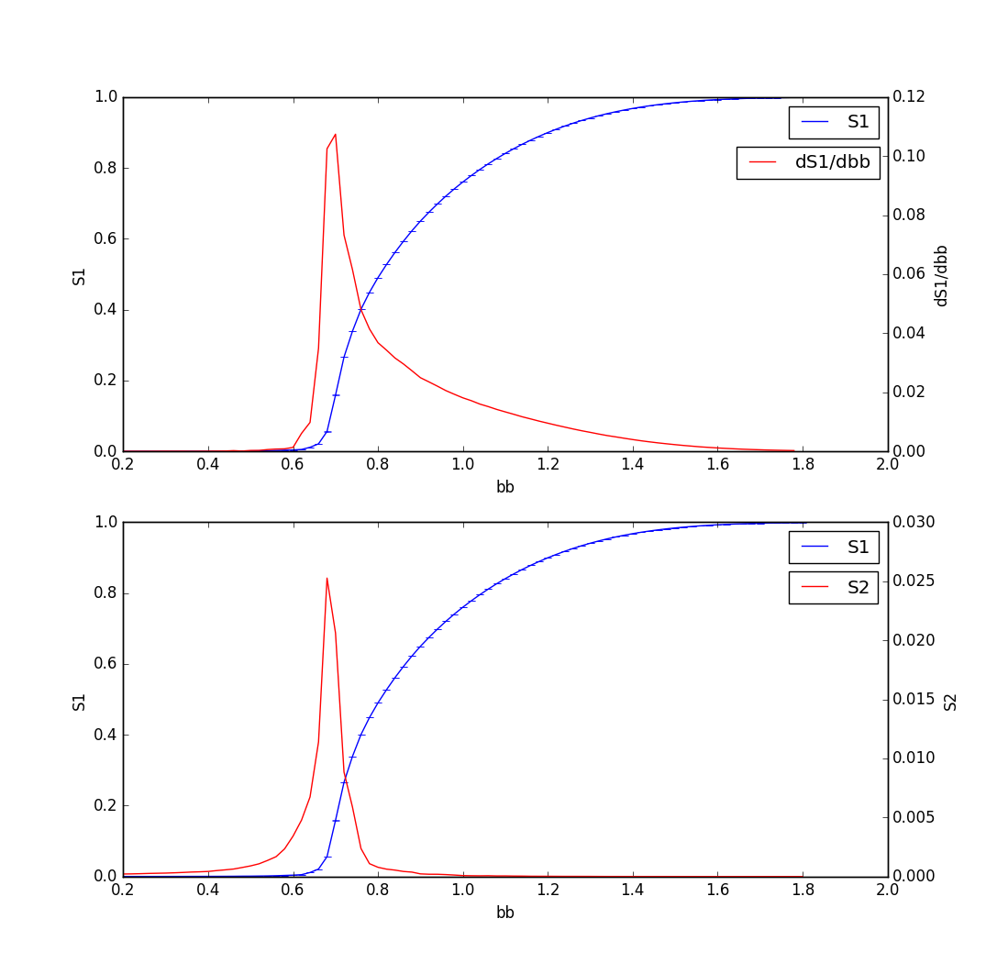
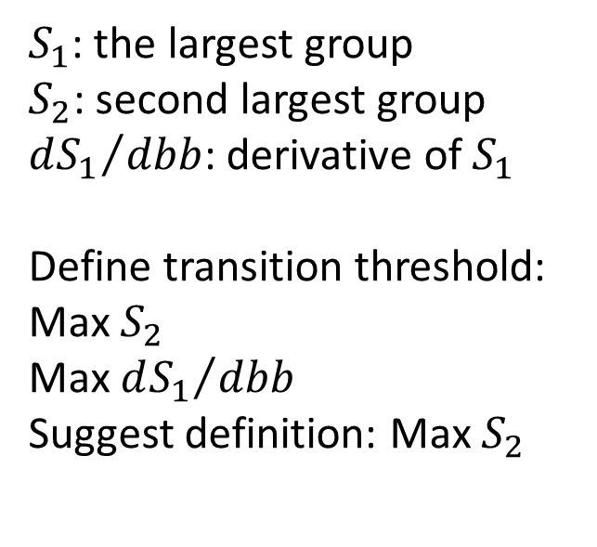
S-bb relation
$S_{1}$: the largest group
$S_{2}$: second largest group
${dS_{1}}/{dbb}$: derivative of $S_{1}$
Define transition threshold: Max $S_{2}$
Max ${dS_{1}}/{dbb}$
Suggest definition: Max $S_{2}$
J. Zhang, D. Cheng & M-C CHU in prep.

Slide 8
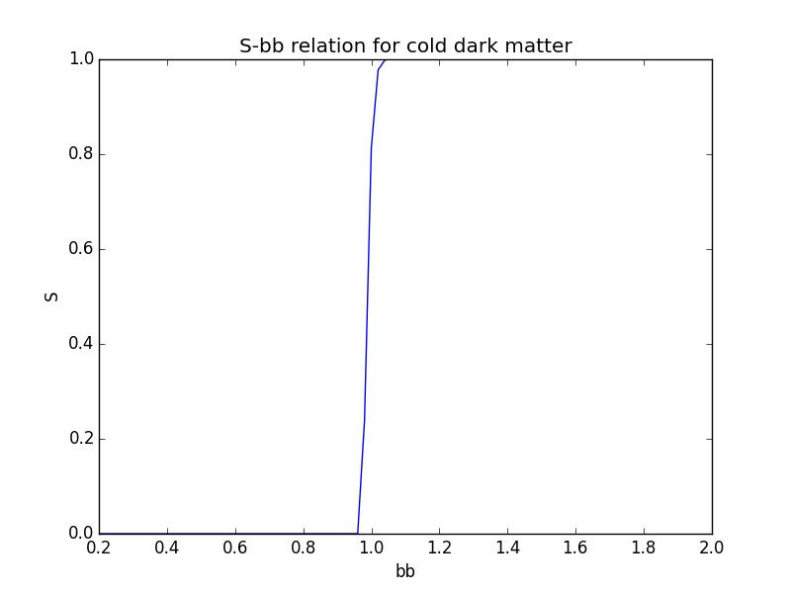
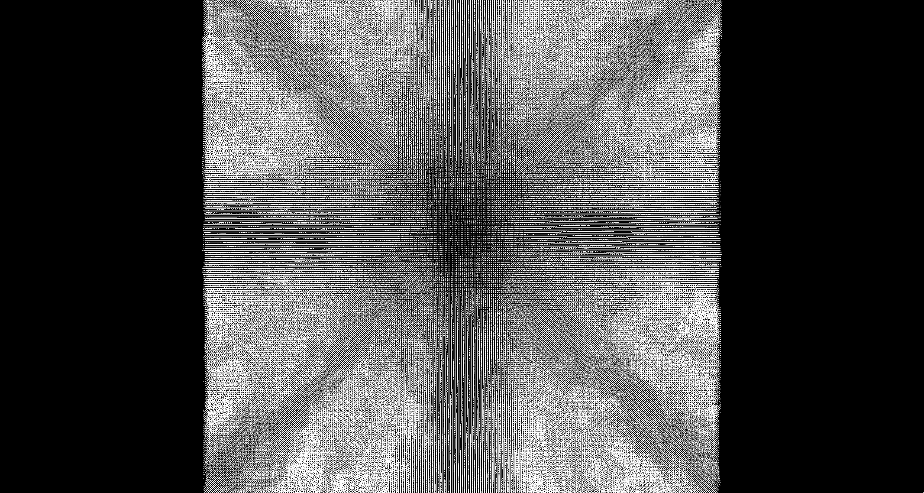

Slide 9
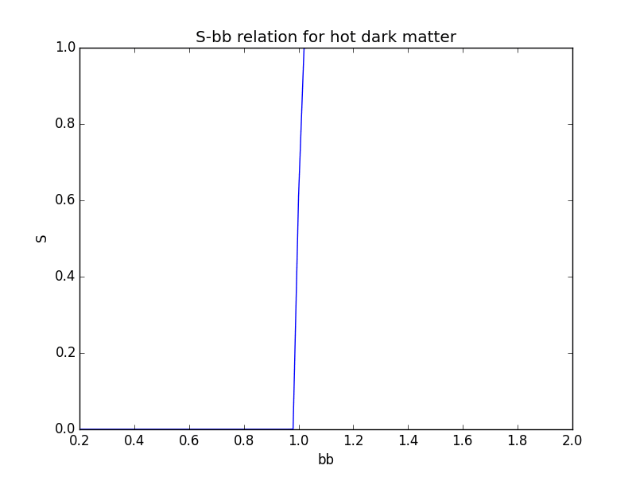
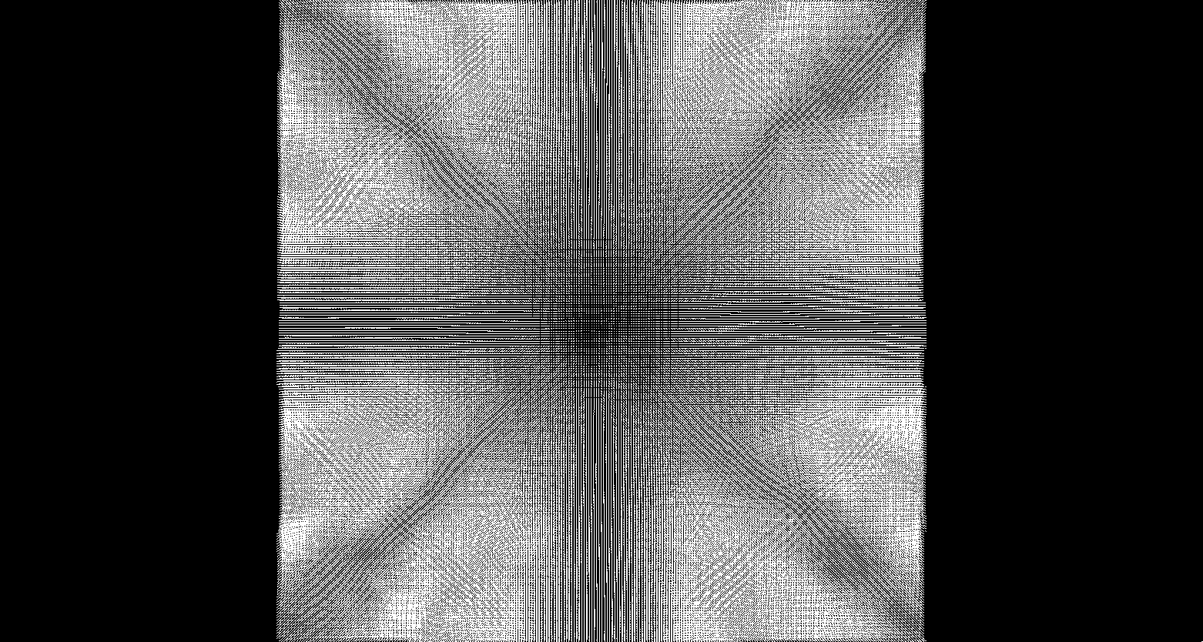

Slide 10
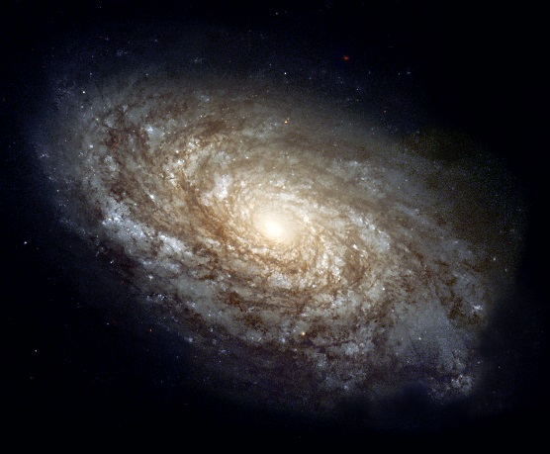
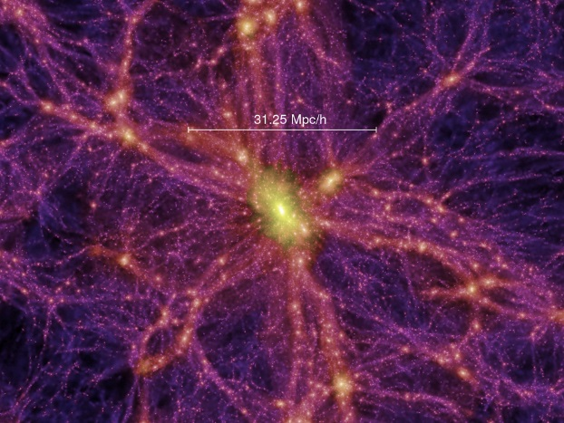
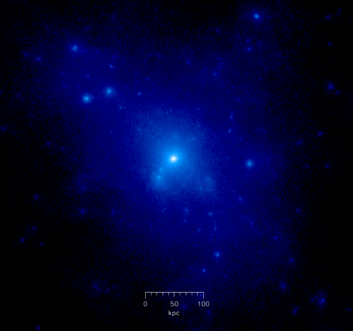
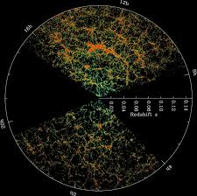
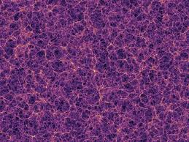
How to compare simulation and observation?
GALAXY
DM HALO
DM PARTICLE
BIAS
BIAS
Springel et al. (2005)

Slide 11
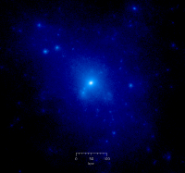




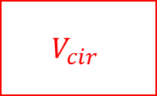
Halo Abundance Matching
$$L_{gal}$$
$$V_{cir}$$
Method learned from
Sebastian Trujillo-Gomez et al. 2011 ApJ

Slide 12
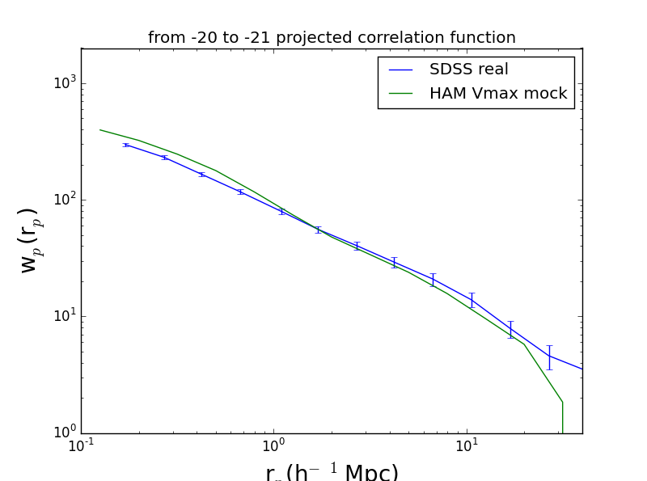
J. Zhang, D. Cheng & M-C CHU in prep.

Slide 13
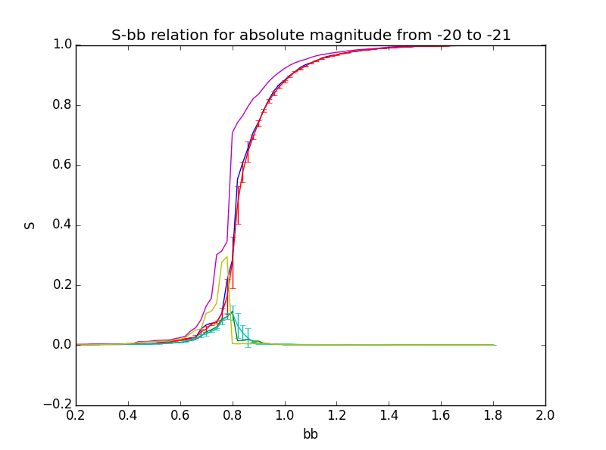
observation
Mock
Red error bar
J. Zhang, D. Cheng & M-C CHU in prep.

Slide 14
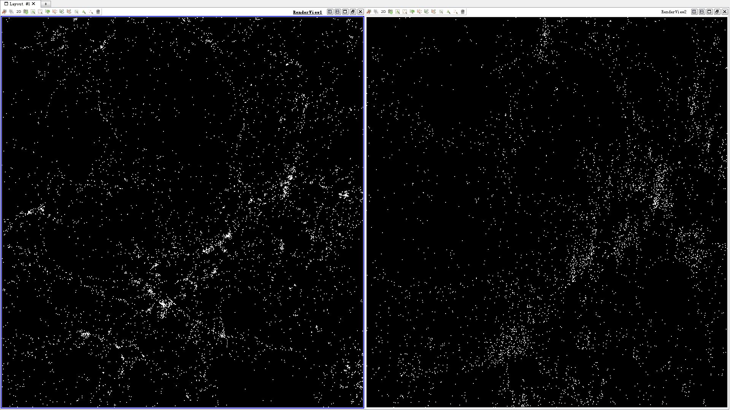

Slide 15
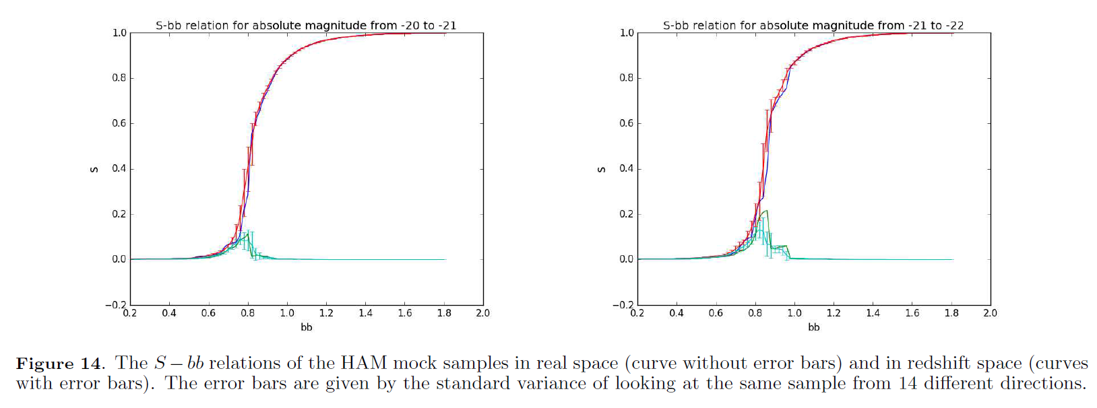
Robust against redshift distortion
J. Zhang, D. Cheng & M-C CHU in prep.

Slide 16
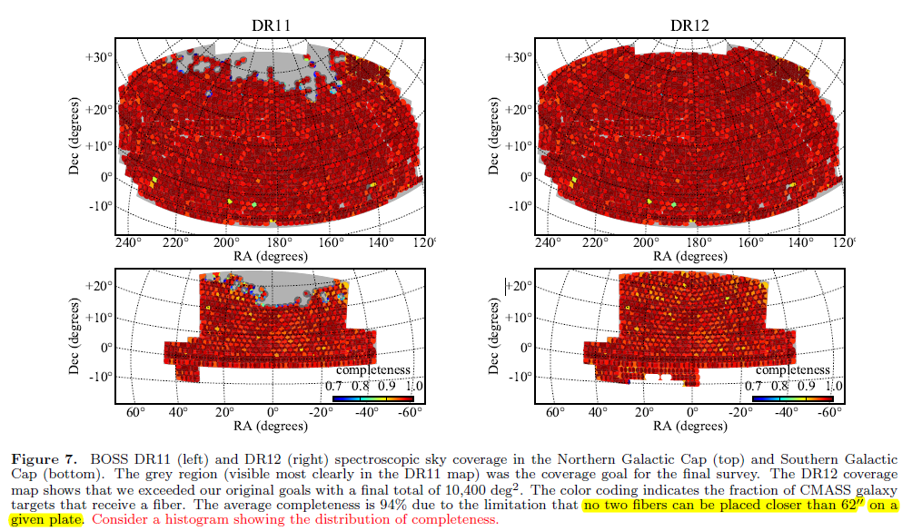
Jackknife error estimate
Average completeness is 94% due to the limitation that no two fibers can be placed closer than 62’’ on a given plate (fiber collision)
SDSS DR12
Alam et al. 2015

Slide 17
Jackknife error estimate
We assume fiber collision means randomly lose spectra of galaxies.
How important will incompleteness be in S-bb relation?
Can we estimate the error bar of S-bb relation?
  Jackknife!
  Randomly choose 90% of mock galaxies from our mock catalog, 10 times
  Calculate the S-bb relation for the jackknife samples, 10 times
  Take average and standard error
  Not only a game with data, but also mock fiber collision! Two birds with one stone!

Slide 18
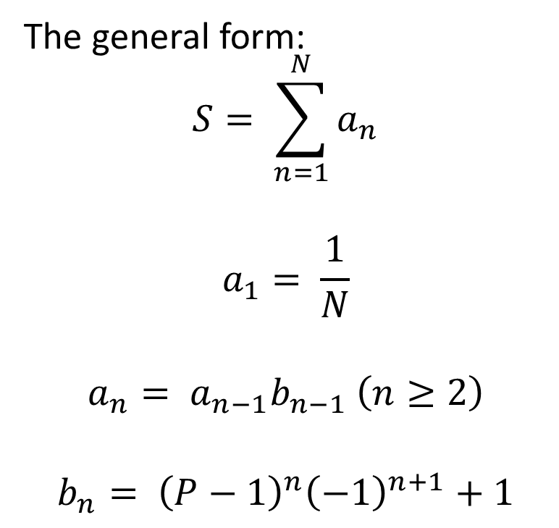
Probability Cloud Cluster Expansion Theory
The general form:
$$S= \sum_{n=1}^{N}{a_{n}}$$
$$a_{1}= \frac{1}{N}$$
$$a_{n}= a_{n−1}b_{n−1} \left(n≥2\right)$$
$$b_{n}= {\left(P−1\right)}^{n}{\left(−1\right)}^{n+1}+1$$
Two steps:
S-P: control the series expansion accuracy
P-bb: control the correction from correlation function
P is the probability that two points are linked
J. Zhang, D. Cheng & M-C CHU in prep.

Slide 19
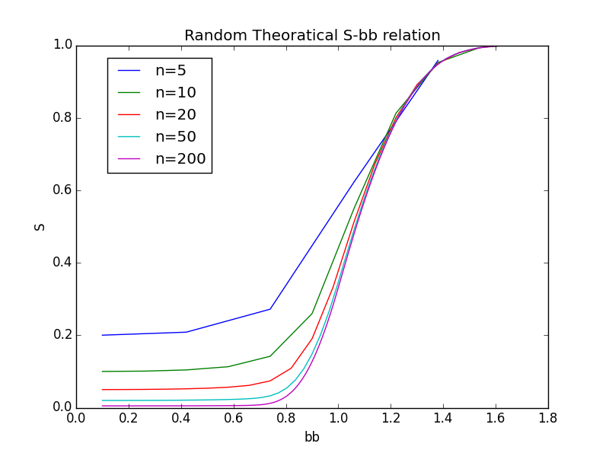
Probability Cloud Cluster Expansion Theory
J. Zhang, D. Cheng & M-C CHU in prep.

Slide 20
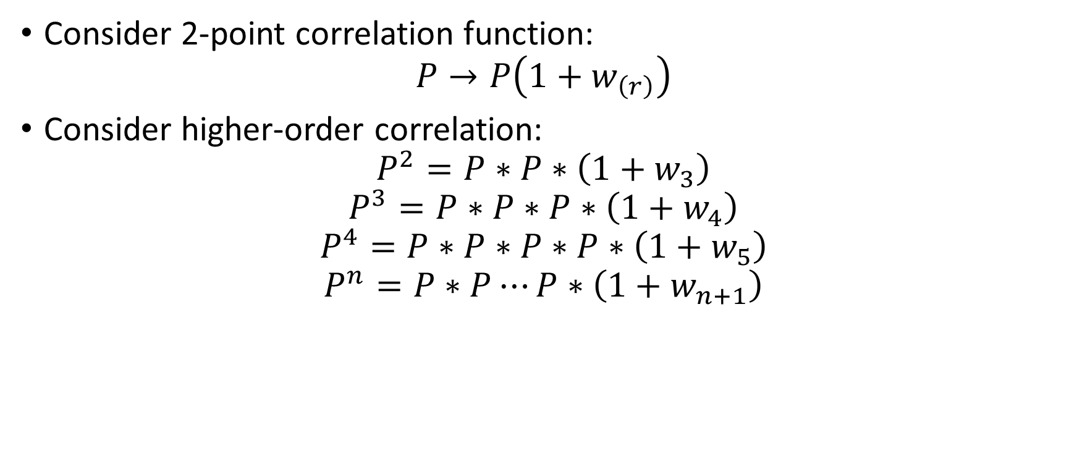
Probability Cloud Cluster Expansion Theory
Consider 2-point correlation function:
$$P→P\left(1+w_{\left(r\right)}\right)$$
Consider higher-order correlation:
$$P^{2}=P∗P∗\left(1+w_{3}\right)$$
$$P^{3}=P∗P∗P∗\left(1+w_{4}\right)$$
$$P^{4}=P∗P∗P∗P∗\left(1+w_{5}\right)$$
$$P^{n}=P∗P⋯P∗\left(1+w_{n+1}\right)$$

Slide 21
Conclusion
S −bb relation as a branch of percolation analysis of the cosmic web.
  Fast, the same order of 2-point correlation function calculation.
  Robust against redshift distortion and incompleteness in observation.
  Widely applicable, from galaxy catalogue to simulation particles.
  Information of all orders of correlation function.

Slide 22
Simple
Fast
Powerful

