Slide 1
From time ordered information to maps and end-to-end simulations
Paolo Natoli (Università di Ferrara and INFN)
XIIIth School of Cosmology
  November 12 - 18, 2017 — IESC, Cargèse
The CMB from A to Z
  promises and challenges of the CMB as a cosmological probe

Slide 2
Overview
The complexities of CMB data analysis
The map-making problem
The role of simulations
Take home messages & bibliography

Slide 3
The CMB landscape

Slide 4
Science targets
Inflation
Primordial GW = Energy
scale of Inflation

Slide 5
Science targets
Barions

Slide 6
Science targets
Neutrino mass and number
Reionization history

Slide 7
CMB exploitation in a nutshell
Wide list of science targets in cosmology and fundamental physics
… Arising from signals spread over several orders of magnitudes in amplitude and angular scale.

Slide 8
Some three order of magnitude in angular extension

Slide 9
Exploitation issues
Wide list of science targets in cosmology and fundamental physics
Wide range of angular scales:
  Large datasets: full sky maps (Mpix), you’ve heard a talk by E. Hivon about the challenges this poses on harmonic analysis.

Slide 10
At least three/four orders of magnitude
in anisotropy

Slide 11
Exploitation issues
Wide list of science targets in cosmology and fundamental physics
Wide range of angular scales:
  Large datasets: full sky maps (Mpix)
Signals ranking from faint to extremely faint
  Large datasets: many detectors, long observations (Tb to Pb)

Slide 12
Systematics from the instrument
Far Beam
Main Beam
White Noise
Correlated noise
Gain and other nasty systematics

Slide 13
Systematics from the sky
talks by JF Cardoso

Slide 14
Exploitation issues
Wide list of science targets in cosmology and fundamental physics
Wide range of angular scales:
  Large datasets: full sky maps (Mega pixel)
Signals ranking from faint to extremely faint
  Large datasets: many detectors, long observations (Tb to Pb)
Large, not huge. But analysis is extremely challenging:
  Statistically optimal techniques needed: dense problem
  Error budget dominated by systematics of instrumental and sky origin

Slide 15
Map making: why not a trivial problem?
Large Problem
  Tb to Pb timelines
  Megapixel maps
Detectors inject noise
Noise is correlated (long memory, or “1/f” )
Systematics errors play significant role and complicate business significantly.

Slide 16
What do detectors measure
The signal measured by an (unpolarized) noiseless detector in the focal plan of a scanning telescope can be modeled as convolution between the sky pattern and the beam in the band, plus a further convolution with an instrumental transfer function [Beam and scanning can intermix: s.c. “scanning beam”]
Complex as you wish, but always a linear operation:

Slide 17
Noise
Data are a superposition of signal and noise
The two are assumed to be independent
Noise “adds up” after the optical chain as a stochastic process
This is to say we are considering its phases as random

Slide 18
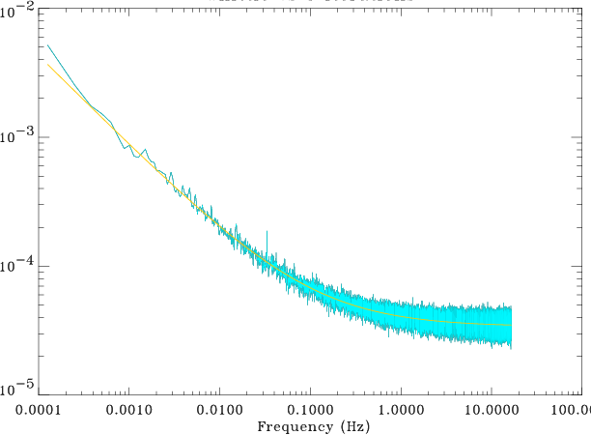
A closer look at noise
Understanding the noise statistical properties is crucial for accurate map making
Typically, noise exhibits a non zero autocorrelation function: well known “1/f” or “long memory” noise

Slide 19
A closer look at the A matrix
We have hidden all complexities inside A. It includes:
  An optical convolution with the beam profile
  A time convolution with detector response: bolometers exhibit a non trivial transfer function (will be much less of a problem for the fancy detectors of the future!)
  A sum within the band profile (this adds up to calibration, not too relevant for a single detector… but can be very messy for multi-detector map making!)

Slide 20
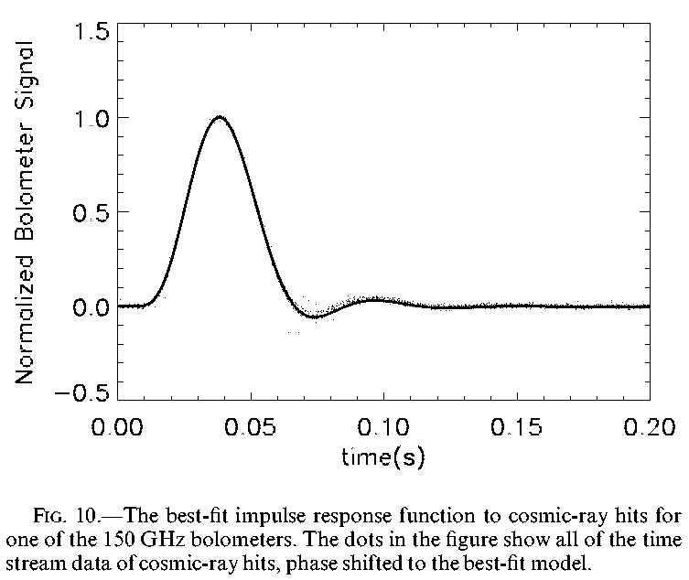
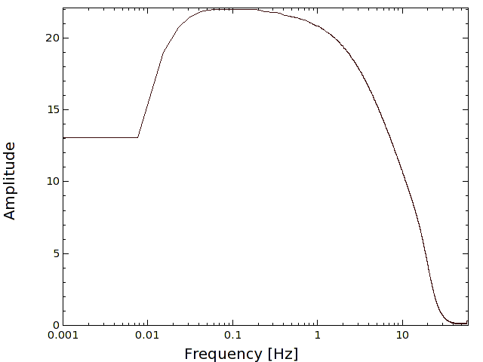
Bolometric transfer function
Electronics
Detector
Bolo response to impulse (note lag!); harmonic domain

Slide 21
How to account for this
Simplest approach is timeline deconvolution:
Note, however, how this affects noise:
Because of the poles in TF this means ultraviolet/infrared divergence in n. This must be cured!

Slide 22
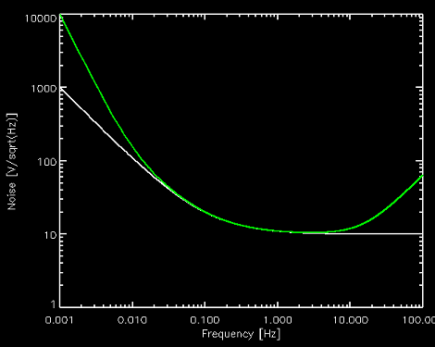
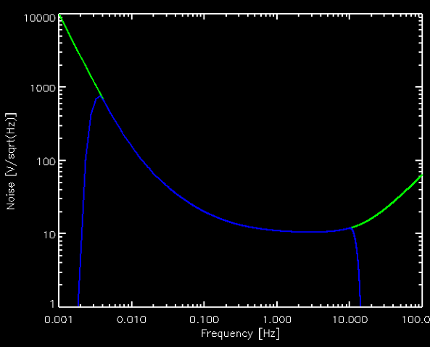
Another band pass filter!
Solution is to apply another band pass filter
Note that this means some frequencies are gone forever
One must ensure that the relevant signal lives within the band!

Slide 23
A closer look at the pointing matrix P in d = Pm + n
We are left with sky convolution Pm
In principle this is two operations in one:
  Beam smearing
  Sky pointing
Suppose that the beam profile is circular
Then “pointing” and “beam smearing” operations “commute”
Hence, we can look after a smeared map
If the beam profile is asymmetric this assumption would lead to a distorted map, and then power spectrum [example: T->P leakage]
We can take P to be bitwise i.e. only made of 1 and 0:

Slide 24
The data model for polarization
For implenetation see e.g. de Gasperis et al, 2004

Slide 25
Naïve estimators
We want to find an estimator for m.
Suppose that the noise is white:
Then noise in each time sample is independent from the others we can build a simple, ordinary least-squares (OLS) estimator for m:
This is called “naïve” map making!
This operator divides by
# of hits per pixel!
PT “sums” a timeline
Into pixels

Slide 26
Add some realism
Detector noise is not usually white:
Hence, let’s make it white!
Apply OLS with

Slide 27
GLS Map Making
The choice of W is dictated by the need to “whiten” noise: W=N^{-1/2}
But the method is unbiased for all positive definite matrices (just less optimal…)
This defines the
Generalized Least Squares
(GLS) estimator
See e.g. book by R. Lupton

Slide 28
Generalized Least Squares
A piece of classical statistics, “rediscovered” in the 1990’s for CMB mapping
Computationally unfeasible for realistic experiments, due to the size the matrices involved
This is way in the 1990 Planck’s map making was judged unfeasible.
Have to devise a better way!

Slide 29
Before doing that, though…
This solution does not come from nowhere…
The log-likelihood for the problem is (for Gaussian noise)
And N is a constant (if, and that’s a big if, the noise properties are known)
Minimizing this form yields the GLS solution
If the noise is not Gaussian, one can easily prove this solution has the minimal variance among all linear estimators.

Slide 30

There are shortcuts…
Noise can almost always be considered stationary (at least for small enough chunks: piecewise stationarity)
Stationary noise has a “quasi” circulant covariance matrix.
Quasi-circulant: in reality it is a Toeplitz matrix.
Circulant matrices have nice properties
  The n^{th} row can be obtained by shifting the first of n elements
  Easy to invert, and inverse is circulant too
  Multiplication of a circulant matrix times a vector is a convolution:
which is at most O(N_{d} log N_{d}) elements when using the FFT.
Indeed, a circulant matrix is diagonal in Fourier space.

Slide 31
Brief detour
Situation is similar to the CMB signal covariance matrix you’ve seen in Eric Hivon’s lecture yesterday
This object is non-diagonal in pixel space. But, if we assume the CMB is rotationally invariant (correlation function depends on a single angle) then the spherical harmonic transformation diagonalizes it:
However, “border” effects (the mask) destroy this property. Similar thing happen here.

Slide 32
A circulant matrix

Slide 33
Toeplitz vs circulant
Strictly speaking, real world stationary noise covariance matrix is Toeplitz, not circulant. There is no reason for noise autocorrelation to wrap around itself past the edges of the timestream (see e.g. Stompor et al.)

Slide 34
A Toeplitz matrix

Slide 35
Toeplitz vs circulant
Strictly speaking, real world stationary noise covariance matrix is Toeplitz, not circulant. There is no reason for noise autocorrelation to wrap around itself past the edges of the timestream
However Toeplitz matrices are hard to deal with:
  Hard to invert
  In general, inverse is not Toeplitz
  Multiplication by vector is O(N²), harder than circulant
Since edge effects are usual a minor perturbation, circulant is usually a very good approximation

Slide 36
A workable solution
Must solve iteratively for large datasets.
Preconditioned Conjugate Gradient is a good solver
This is sometimes called the “Unroll, Convolve & Bin” approach.
Natoli et al. 2001, Dorè et al. 2001

Slide 37
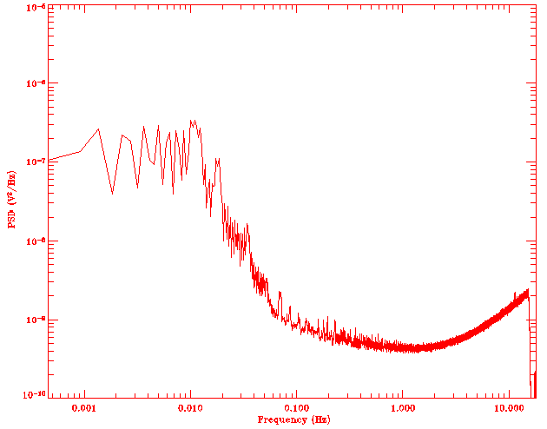
In practice, this deals with non trivial noise
The extra filter to “cure” TF divergence is applied at the map making level.
Since a GLS code basically “divides” by the noise PSD, it also cures lines and other noise features
Note that the high pass often makes convergence critical!
It does not cure noise with non random phases

Slide 38
How to estimate N
GLS map making requires knowledge of noise properties
They must be measured directly from the data.
This is best done iteratively.
Estimate Map
Unroll on timeline
N
Get map and noise properties
Convergence?
Y
Estimate noise
Subtract from data

Slide 39
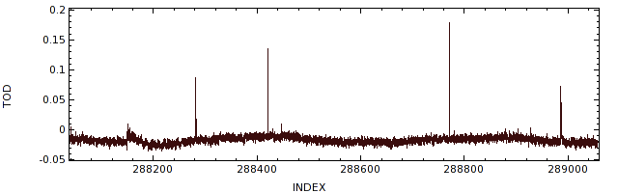
Preserving timeline continuity
One requirement (posed by FFT) is timeline continuity.
Spurious events (e.g. cosmic rays) tend to destroy this.
A good way to restore it while preserving noise properties within the gap is through constrained realizations.

Slide 40
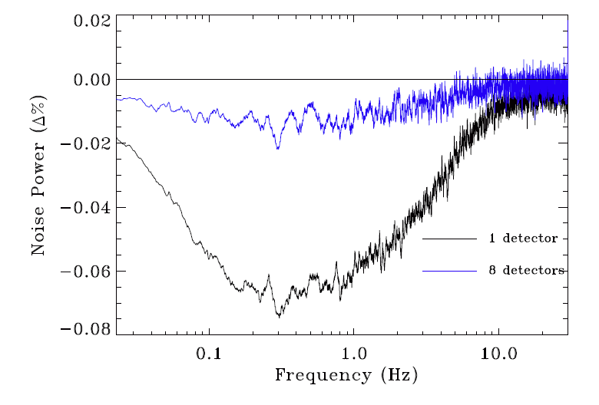
Multidector Map Making 1/2
Extension to joint multidetector map making is trivial in the case of detectors with no cross talk.
Just consider a longer timeline.
Each bolometer is weighted by its own noise.
Increased redundancy usually helps both map making and noise estimation

Slide 41
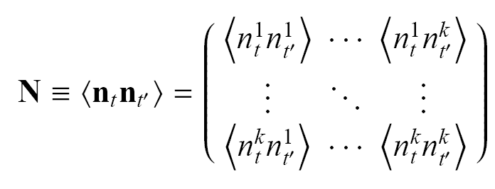
Multidetector MapMaking 2/2
It is also possible to account optimally for noise cross-correlations
This is done by Choleski decomposing the frequency coupling matrix (Fourier representation of the matrix shown above)
Patonchon et al, 2008; de Gasperis et al 2016

Slide 42
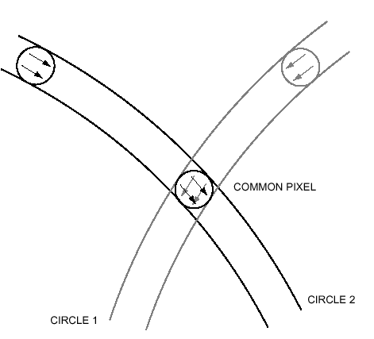
Hoq about faster approaches?
Correlated noise can be modeled as white noise plus a constant (“offset”)
Observe many time same path (circle) on the sky
Bin together samples observing same pixel → creates offsets
Solve for offsets minimizing χ². White noise map-making is then trivial

Slide 43
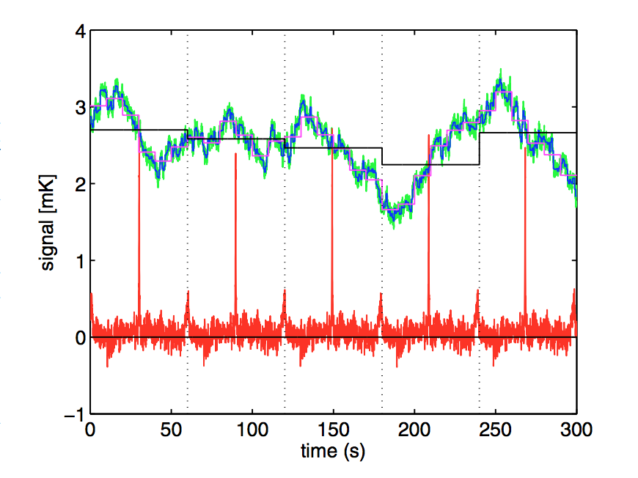
Destriping
Offsets can be made “arbitrarily” short
The shorter the baseline, the most accurate the modeling
Offsets will be correlated, in general. Accounting for this correlation produces better results, at the expense of introduces a noise prior, which has to be estimated from the data. This complication produces a “generalized” destriper.
By playing on the offset length and the prior one can have a very flexible code.
One public domain implementation is madam, Keihanen et al 2010,http://github.com/hpc4cmb/libmadam
Light yet accurate codes are very appealing in view of simulations.

Slide 44
Timeline to map simulations: when and why
Mission study phase:
  To assess the impact of systematic effects (If I do not see it why worry?)
  To validate algorithms and tools
Actual data analysis:
  To perform debiasing of estimators from spurious contributions (systematics and noise which cannot be modeled otherwise)
  To assess uncertainties, including covariances that are notoriously tricky.

Slide 45
End-to-end simulations: how
Need a “flight” or otherwise instrumental simulator. Minimal version is a tool that:
  Observes a simulated (yet realistic) sky: CMB and foreground at a set of frequencies
  Convolves this with instrumental kernels: beam, bands, transfer functions…
  Adds noise
  Scans the telescopes and moves the payload (and the Earth)
  Public tool: TOAST, http://github.com/hpc4cmb/toast by T. Kisner et al.

Slide 46
Simple examples of use
Debiasing of noise for auto-spectra and cross-spectra in presence of correlated noise, by estimating an ensemble mean across a simulation set:
Computation of covariances:

Slide 47
CMB data analysis pipeline
Pipeline flows through several domain: time and frequency to pixel and harmonic.
Radical compression: from Pb to “few” numbers.
Accurate propagation of error budget (covariances)
Heavily relies on simulations
Primordial non Gaussianity
Lensing/delensing likelihood
(Non Gaussian)
Component
separation
Fundamental symmetries
CMB likelihood
(=Gaussian)
…
Cosmological/Physical
Parameters
Loop Over

Slide 48
Take home messages
Timeline to map analysis dominates the current computational cost in CMB analysis.
It is a non-trivial task because of the size and complexity of the dataset and of the faintness of the signal we seek.
Efficient algorithms have been devised, which make the job tractable (further improvements may well appear).
Simulations are costly, require specialized hardware and there is never enough of them. Yet, they are essential to the analysis of CMB datasets.

Slide 49
Minimal bibliography
R. Lupton, Statistics in theory and practice, Princeton, 1993
R. Stompor et al. Phys.Rev.D, 65(2):022003, 2002
P. Natoli et al., A&A, 372, 346, 2001
O. Dorè et al., A&A, 374, 358, 2001
E. Keihanen et al, MNRAS, 360, 390, 2005
P. Natoli et al, arXiv1707.04224
Planck coll., A&A, 594, 12, 2016
de Gasperis et al, A&A, 436:1159, 2005
Patanchon et al., ApJ, 681:708, 2008
de Gasperis et al., A&A, 593:A15, 2016
S. Dodelson, Modern Cosmology, AIP [Chapt. 11]

