Slide 1
Primordial non-Gaussianity and y-distortions: dealing with secondary sources.
CMB from A to Z, IESC-Cargèse
14 November 2017
Andrea Ravenni
DFA “G. Galilei” Unipd & INFN
andrea.ravenni@pd.infn.it

Slide 2
Outline
Brief introduction to CMB spectral distortion (SD) anisotropies and to primordial non-Gaussianity.
SD as a probe of primordial non-Gaussianity.
Low-redshift secondary sources and how to mitigate their contribution:
Sunyaev Zeldovich (SZ) effect.
Non-linear-kinetic-SZ aka quadratic doppler effect.
Signals, and forecast results.
Based on a paper by AR, Michele Liguori, Nicola Bartolo, and Maresuke Shiraishi. JCAP 2017 09 042. arXiv:1707.04759.
2/15

Slide 3
CMB spectral distortions
Black body + energy injection$≠$ new blackbody.
Need to rearrange photons occupation numbers and their numerical density.
3/15

Slide 4
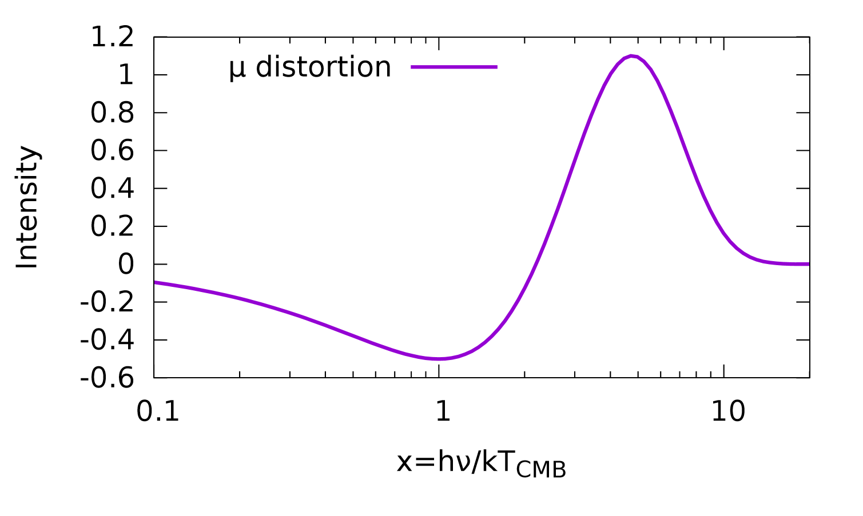
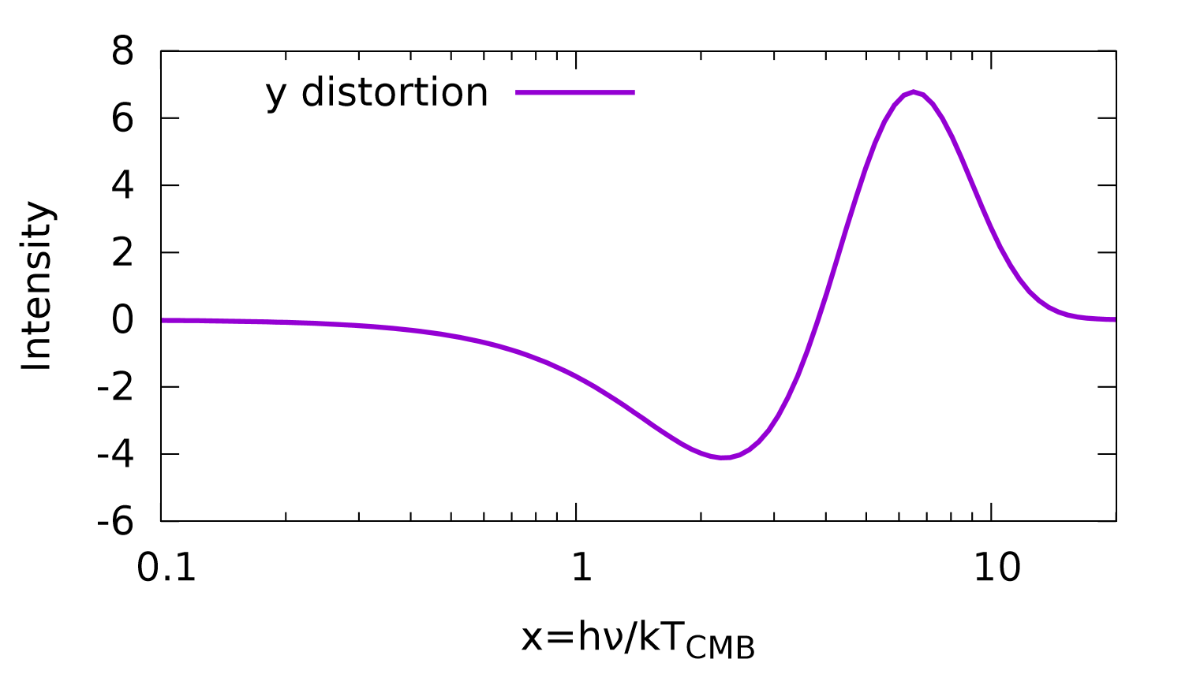
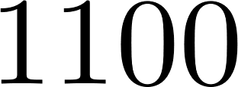
CMB spectral distortions
Black body + energy injection$≠$ new blackbody.
Need to rearrange photons occupation numbers and their numerical density.
z
Compton, double Compton
and Bremsstrahlung are efficient.
$⇒$ Planckian.
Compton is efficient.
Number of $γ$ is fixed.
$⇒$ Bose-Einstein: $μ$-distortions.
No $γ$ energy redistribution.
$⇒$ y-distortions.
Recombination.
CMB is generated.
3/15

Slide 5
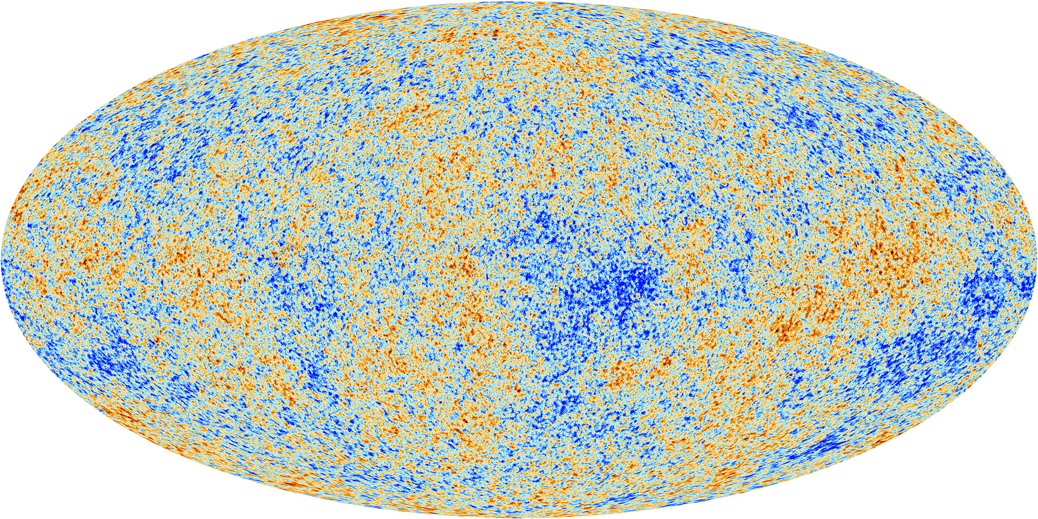
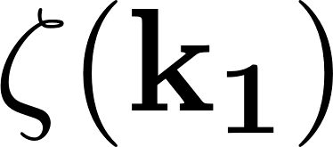
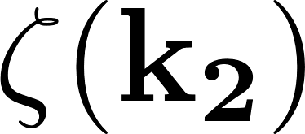
Primordial non-Gaussianity (NG)
Inflation generated a stochastic field of primordial curvature perturbations $ζ(x)$.
Its statistical properties are defined by the N-points correlation functions or their Fourier transforms:
2points $→$ Power Spectrum (PPS)
Gaussian universe: uncorrelated modes.
4/15

Slide 6
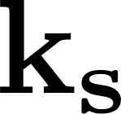
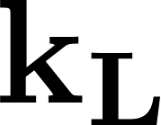
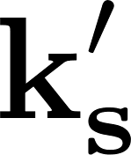
Primordial non-Gaussianity (NG)
Inflation generated a stochastic field of primordial curvature perturbations $ζ(x)$.
Its statistical properties are defined by the N-points correlation functions or their Fourier transforms:
2points $→$ Power Spectrum (PPS)
3points $→$ Bispectum
Gaussian universe: uncorrelated modes.
Non-Gaussianity correlates modes.
Local model primordial non-Gaussianity:
Test inflationary paradigm as a whole.
Test single-field VS multi-field inflation.
Strongly constrained by Planck ON CMB SCALES!
4/15
Notes:
Stress ON CMB SCALES

Slide 7
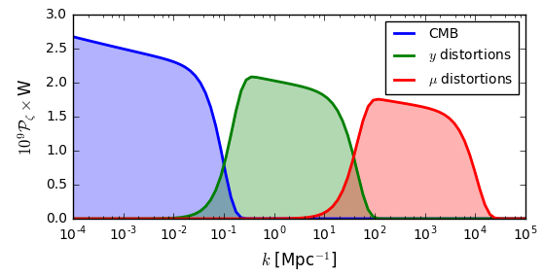
Primordial NG and spectral distortions - I
Local model primordial non-Gaussianity:
CMB
$$y$$
$$μ$$
CMB:
$μ/y$:
Energy is injected by the dissipation of acoustic waves of the photon-baryon gas that oscillate in the gravitational wells.
$μ\left(x\right)$ and $y(x)$ probes the second power of the primordial curvature perturbations in $x$ thus the correlation of $y(x)$-$T\left(x^{′}\right)∝ζ^{3}$.
$y$- and $μ$-distortions probe different scales.
The diffusion damping scales, changes significantly from the $μ$- to the $y$-era.
5/15

Slide 8
Primordial NG and spectral distortions - I
Local model primordial non-Gaussianity:
CMB
$$y$$
$$μ$$
CMB:
$μ/y$:
Energy is injected by the dissipation of acoustic waves of the photon-baryon gas that oscillate in the gravitational wells.
$μ\left(x\right)$ and $y(x)$ probes the second power of the primordial curvature perturbatins in $x$ thus the correlation of $y(x)$-$T\left(x^{′}\right)∝ζ^{3}$.
$y$- and $μ$-distortions probe different scales.
The diffusion damping scales, changes significantly from the $μ$- to the $y$-era.
5/15
Notes:
I talk of y, but some can be applied to mu, more later.

Slide 9
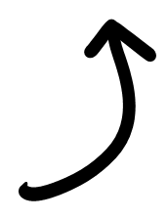
Primordial NG and spectral distortions - II
How does it work?
The signal is:
The noise is:
Sunyaev-Zeldovich is a secondary source of $y$-distortions. $y$_{TOT}$=y$_{prim}$+$SZ.
This gives two problems:
(Pajer&Zaldarriaga ’12)
Noise
Bias
6/15

Slide 10
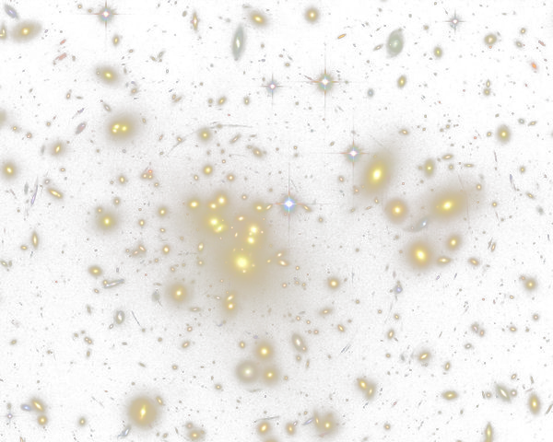
Sunyaev-Zeldovich effect - I
Distortion due to the up-scattering of CMB photons by hot electrons in the intergalactic medium.
Can be divided in two components:
Resolved Clusters. $⇒$ Apply a mask, tracing them with external datasets.
Diffuse component, i.e. unresolved Clusters. $⇒$ Trace it statistically.
7/15

Slide 11
Sunyaev-Zeldovich effect - I
Distortion due to the up-scattering of CMB photons by hot electrons in the intergalactic medium.
Can be divided in two components:
Resolved Clusters. $⇒$ Apply a mask, tracing them with external datasets.
Diffuse component, i.e. unresolved Clusters. $⇒$ Trace it statistically.
7/15

Slide 12
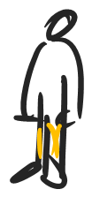
Sunyaev-Zeldovich effect - II
It can be studied using the halo model.
Assume all matter is clumped in halos.
Calculate the correlation function of the matter at the haloes centres.
Weight it by the pdf of finding an halo of a given size at a given redshift.
Convolve with pdf of $γ$ being up scattered by hot electron, given the distribution of free electron in the halo.
.$B$
.$A$
8/15

Slide 13
Sunyaev-Zeldovich effect - II
It can be studied using the halo model.
Assume all matter is clumped in halos.
Calculate the correlation function of the matter at the haloes centres.
Weight it by the pdf of finding an halo of a given size at a given redshift.
Convolve with pdf of $γ$ being up scattered by hot electron, given the distribution of free electron in the halo.
.$B$
.$A$
8/15

Slide 14
Sunyaev-Zeldovich effect - II
It can be studied using the halo model.
Assume all matter is clumped in halos.
Calculate the correlation function of the matter at the haloes centres.
Weight it by the pdf of finding an halo of a given size at a given redshift.
Convolve with pdf of $γ$ being up scattered by hot electron, given the distribution of free electron in the halo.
.$B$
.$A$
8/15

Slide 15
Sunyaev-Zeldovich effect - II
It can be studied using the halo model.
Assume all matter is clumped in halos.
Calculate the correlation function of the matter at the haloes centres.
Weight it by the pdf of finding an halo of a given size at a given redshift.
Convolve with pdf of $γ$ being up scattered by hot electron, given the distribution of free electron in the halo.
.$B$
.$A$
8/15

Slide 16
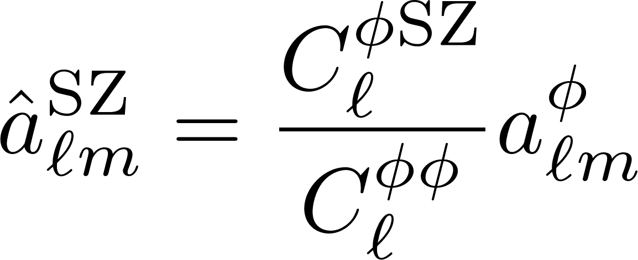
SZ template removal
The diffuse component can be tracked exploiting its cross correlation with other tracers of the matter distribution.
Use Halo Model to calculate the SZ power spectrum.
Use Halo Model to calculate the Lensing-SZ Cross correlation.
Maximum likelihood estimator of the SZ map given the observed lensing map.
Subtract the reconstructed SZ-map from the observed SZ-map. In the resulting map the signal is less contaminated.
9/15

Slide 17
SZ template removal
The diffuse component can be tracked exploiting its cross correlation with other tracers of the matter distribution.
Use Halo Model to calculate the SZ power spectrum.
Use Halo Model to calculate the Lensing-SZ Cross correlation.
Maximum likelihood estimator of the SZ map given the observed lensing map.
Subtract the reconstructed SZ-map from the observed SZ-map. In the resulting map the signal is less contaminated.
9/15

Slide 18
SZ template removal
The presence of secondary sources of $y$-distortions gives two problems
Noise
Bias
We mitigated the SZ contribution to the noise term.
Now about the bias…
10/15

Slide 19
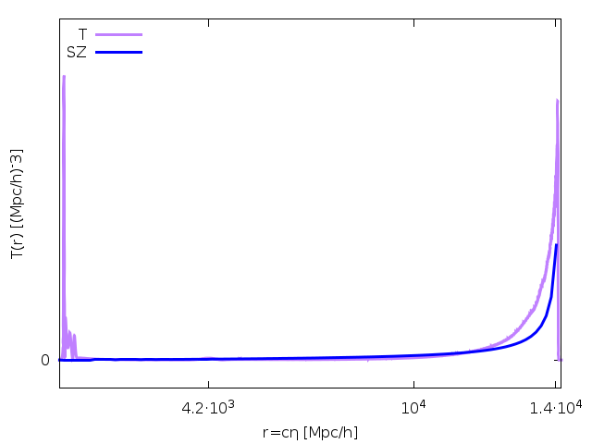
Deal with SZ-Temperature correlation
The CMB photons gain a net amount of energy when crossing a time-evolving gravitational well (ISW effect).
SZ is generated by clusters sitting in the same gravitational wells, thus the two effects are correlated.
ISW
What does correlate less with SZ?
Recombination
11/15

Slide 20
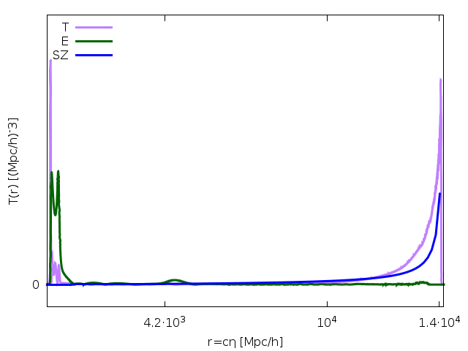
Deal with SZ-Temperature correlation
The CMB photons gain a net amount of energy when crossing a time-evolving gravitational well (ISW effect)
SZ is generated by clusters sitting in the same gravitational wells, thus the two effects are correlated.
ISW
What does correlate less with SZ?
Recombination
Reionization
Polarization!
11/15

Slide 21
Non-Linear Kinetic-SZ
After reionization, free electrons source $y$-distortions:
non-Linear Kinetic-SZ due to the bulk motion of free electrons. It is proportional to the baryon velocity squared .
It may correlate with polarization sourced at reionization
Thus, in a gaussian universe, the leading order of E-$y$_{reio} correlation is proportional to the primordial trispectrum.
SONG calculates E⁽²⁾ at 10% accuracy. The cross correlation has been evaluated numerically.
(Pettinari et al ’14, https://github.com/coccoinomane/song)
12/15

Slide 22
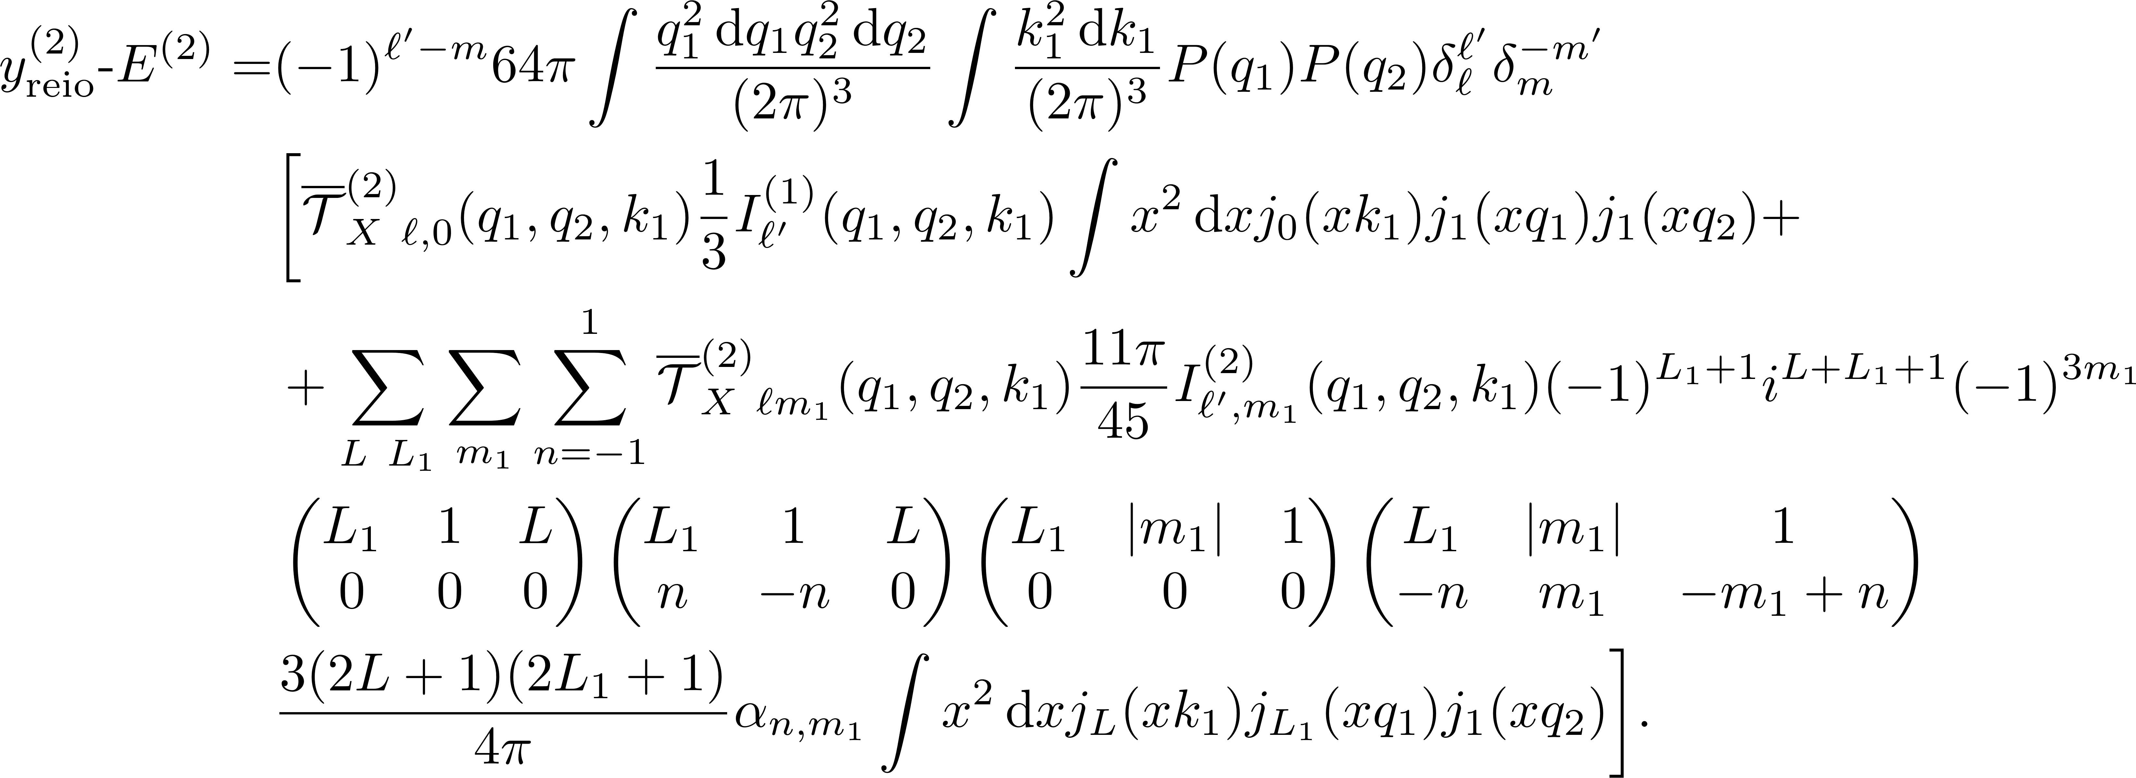
Non-Linear Kinetic-SZ
After reionization, free electrons source $y$-distortions:
non-Linear Kinetic-SZ due to the bulk motion of free electrons. It is proportional to the baryon velocity squared .
It may correlate with polarization sourced at reionization
Thus, in a gaussian universe, the leading order of E-$y$_{reio} correlation is proportional to the primordial trispectrum.
SONG calculates E⁽²⁾ at 10% accuracy. The cross correlation has been evaluated numerically.
https://github.com/coccoinomane/song
12/15

Slide 23
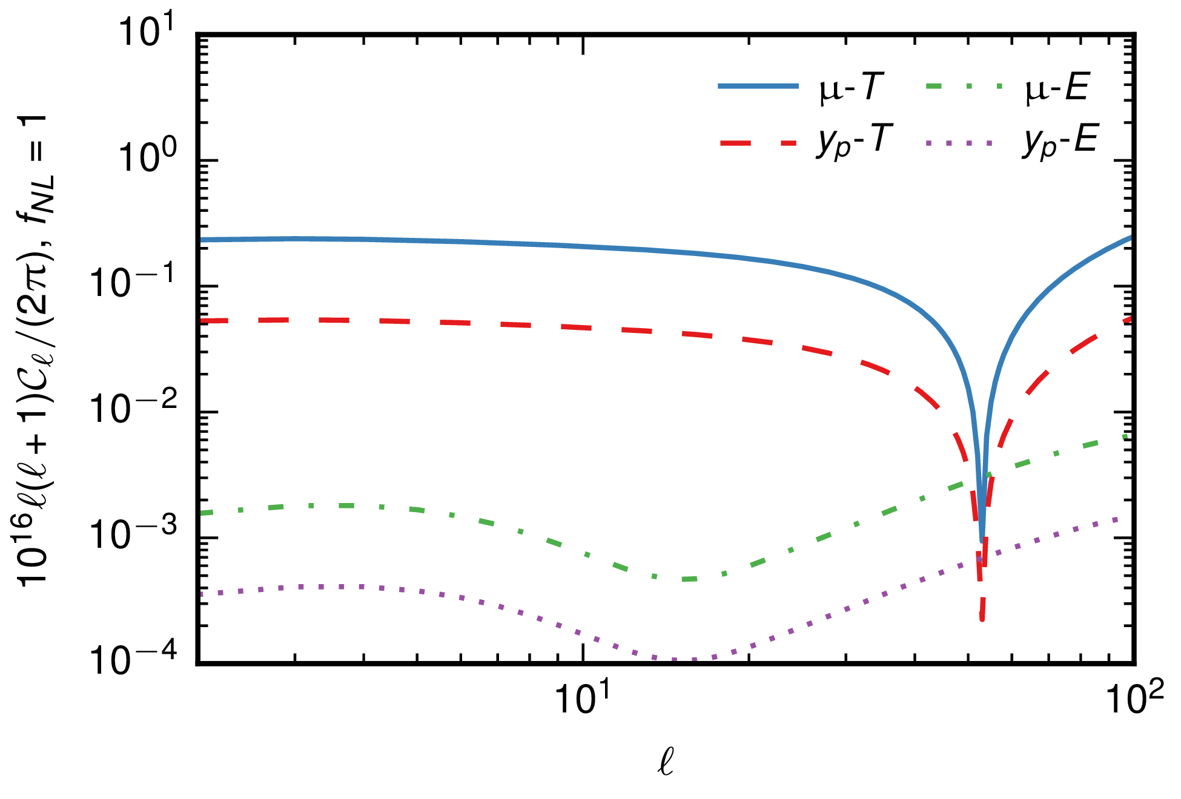
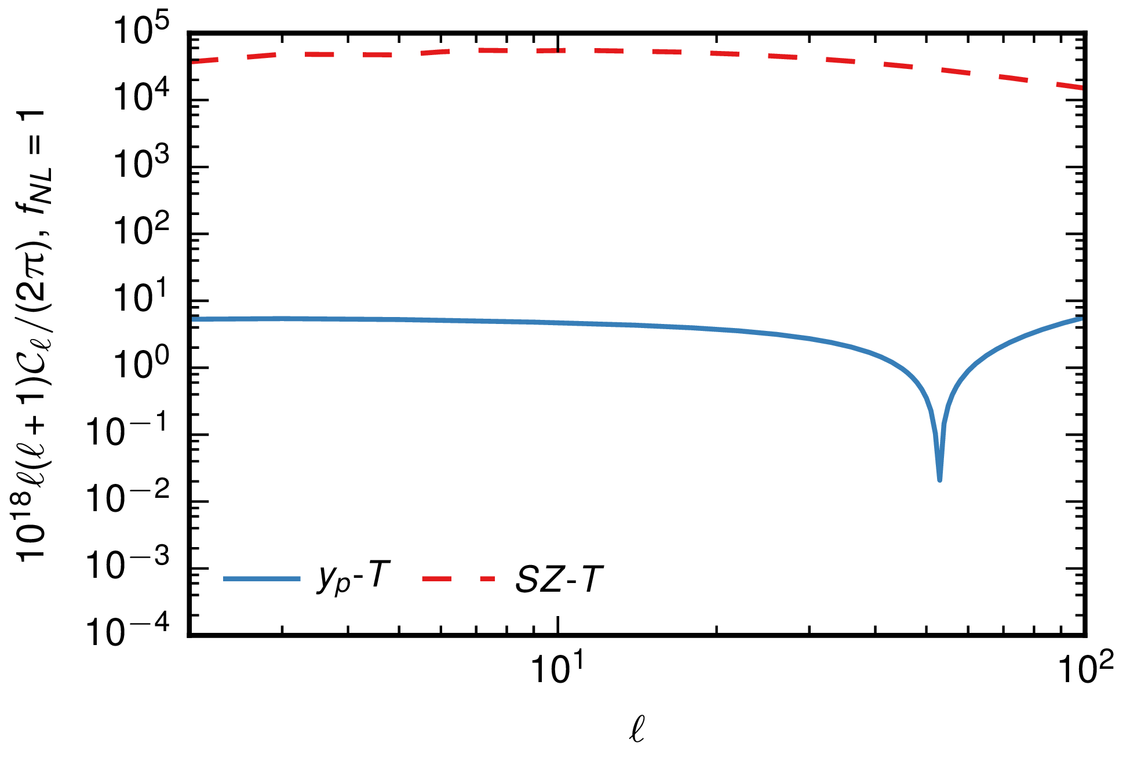
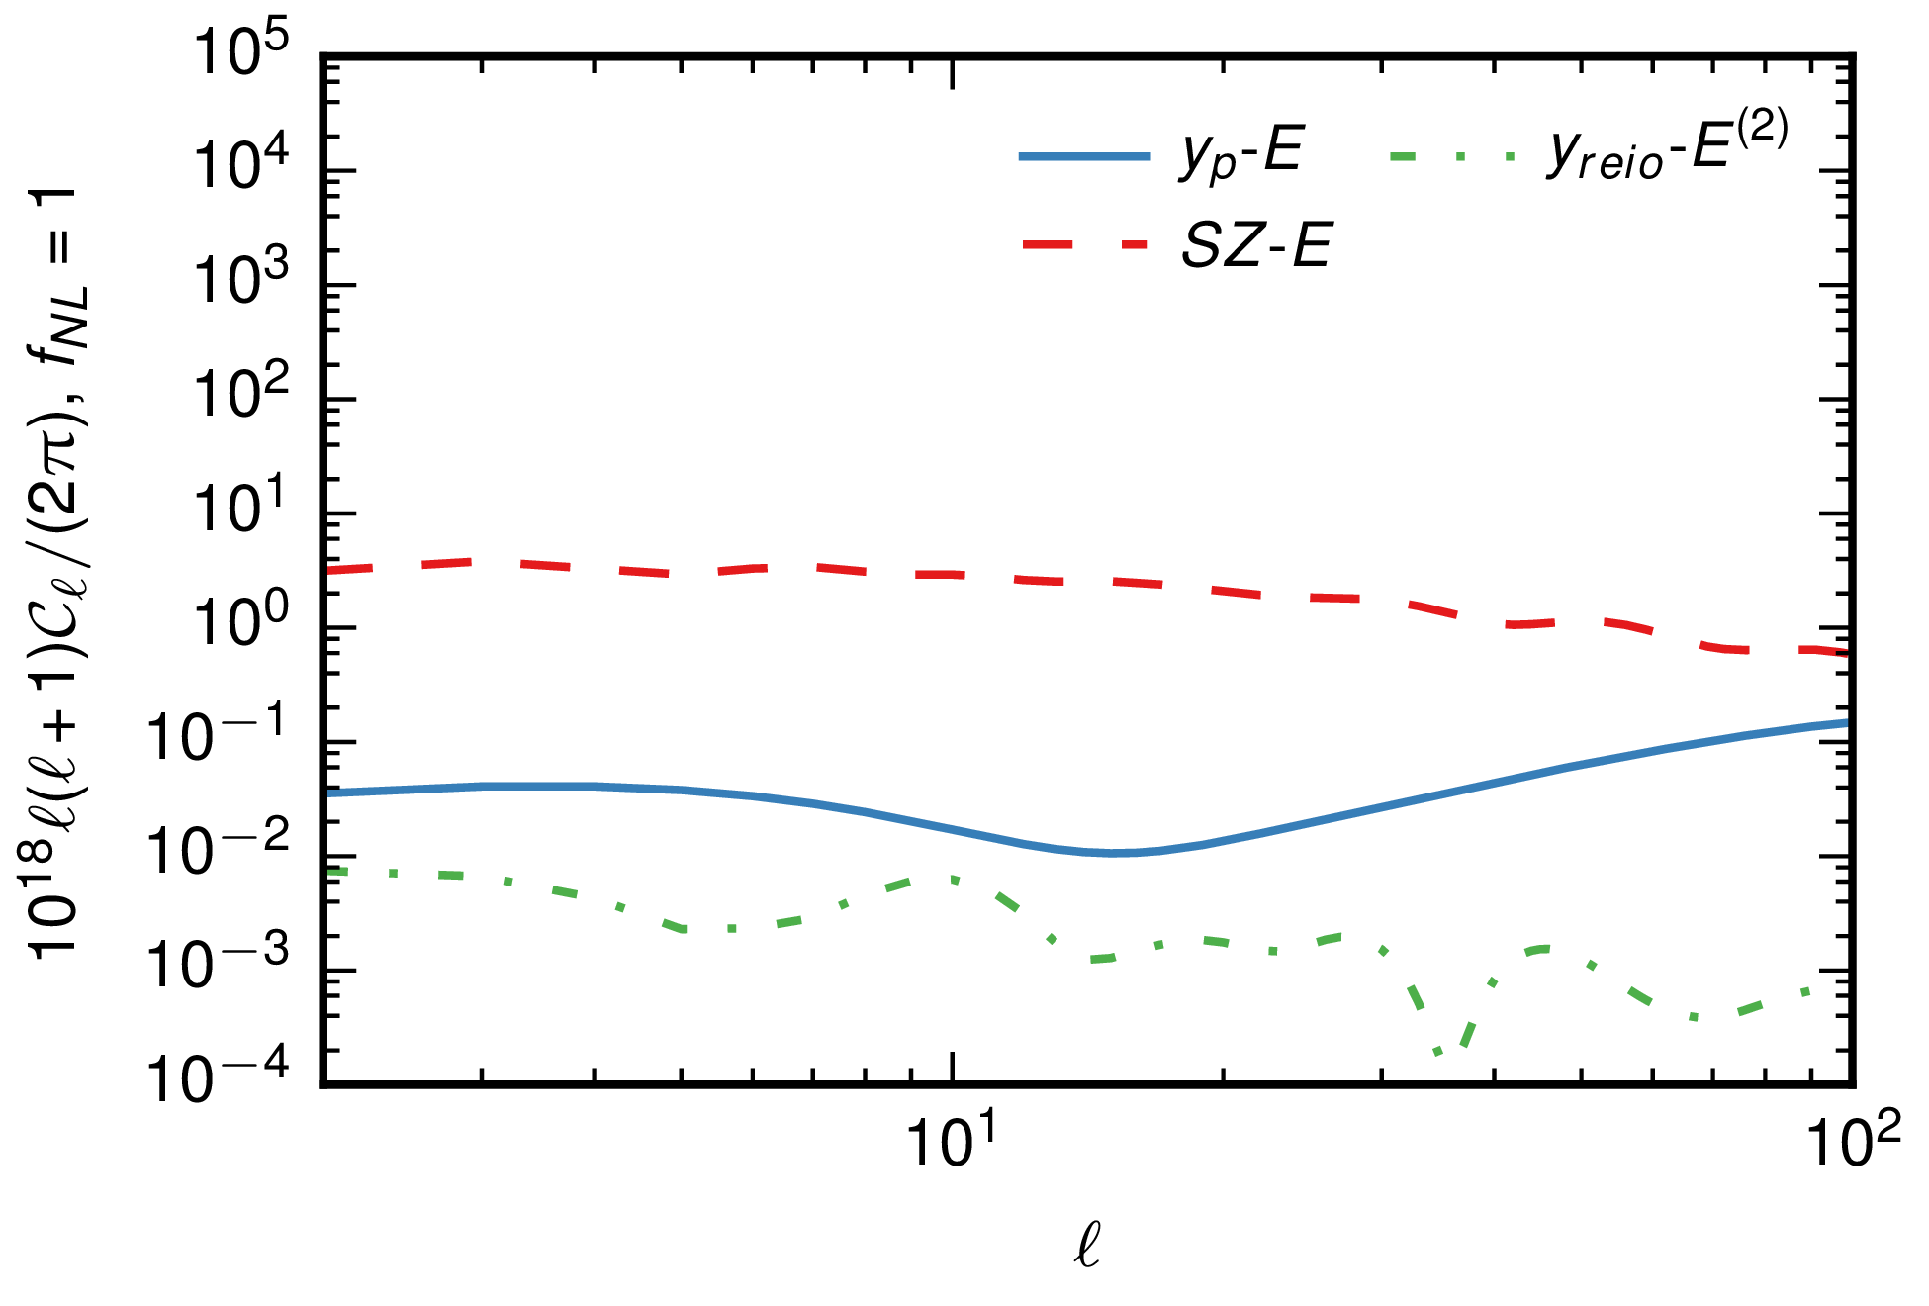
Signals
The cross correlations with E are $≈$100 times smaller then those with T…
WAIT TO SEE THE S/N!
13/15

Slide 24
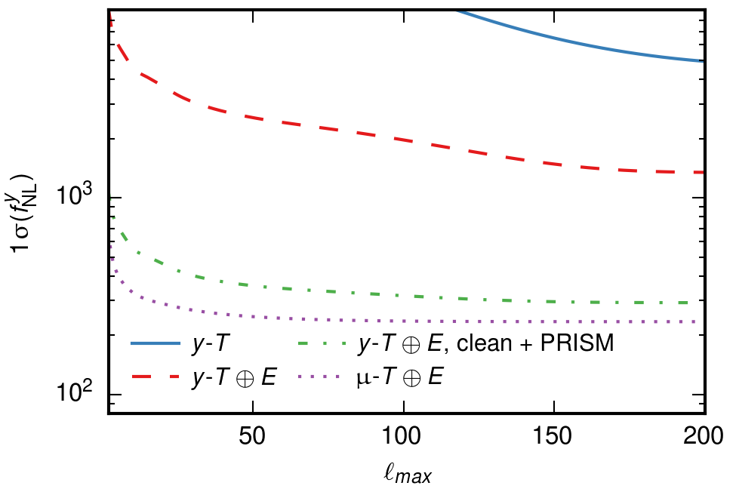
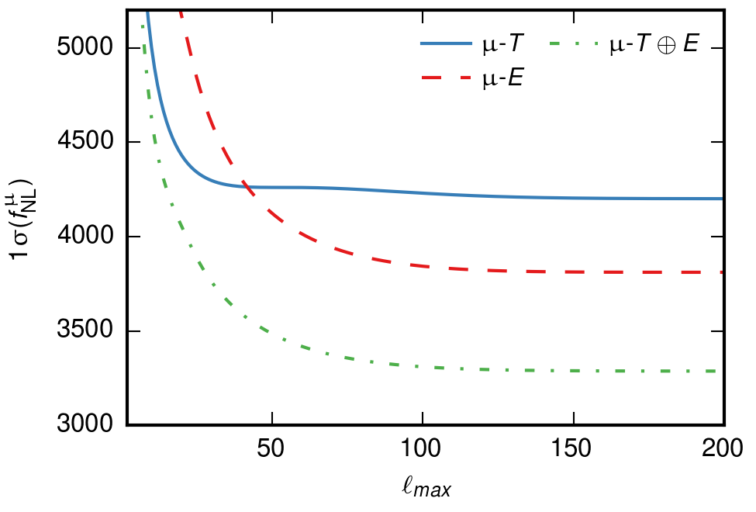
Forecast results
Using $y$
Using $μ$
PIXIE
PRISM
>3x improvement w.r.t. previous methods for $y$!
20% improvement for $μ$!
Cosmic Variance Limited
14/15

Slide 25
Summary
It is important to use both $μ$- and $y$-distortions: they carry information about different scales.
Adopting aggressive sky masks and template cleaning, the noise due to the SZ effect can be drastically lowered.
CMB polarization can break the degeneracy of the primordial signal with the SZ spectrum.
For near future experiment (PIXIE, PRISM), $y$-distortions will be as informative as $μ$ for primordial non-Gaussianity.
A PRISM-like experiment will almost achieve the limit set by cosmic variance.
Cross correlation with CMB polarization will greatly enhance the S/N both for $y$- and $μ$-distortions.
15/15

