Slide 1

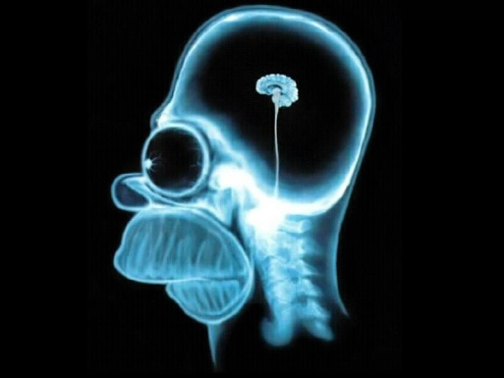
A GW yielding small field model:
OR: How to kill a model
and revive it in one stroke
Ben-Gurion University
of the Negev
Ira Wolfson
Notes:
Hello. My name is Ira Wolfson, I am a PhD student at Ben Gurion University of the Negev. I am happy to be here today and to be able to present some of the results of my research.
As the title suggests, my work deals with inflationary potentials. Specifically small field model, which have the ability to generate a significant gravitational wave signal.

Slide 2
Motivation
The hunt for Primordial Gravitational Waves
Alternatives to large field models.
(GW production near an inflection point or plateau)
Fundamental Physics?
Ben-Dayan, Brustein JCAP 1009, 007 (2010)
Hotchkiss, Mazumdar, Nadathur JCAP 1202, 008 (2012)
And others
Notes:
This field of study should interest all of us (I feel), since it aims to provide valid alternatives to large field model inflation, which seem to be favorable today in light of the data.
More to the point, the recent LIGO discovery hints at the real possibility of picking up Primordial gravitational waves. This is exciting since it might tell us something about the energy scale of inflation.
In turn this may give us access to studying how fundamental physics behave in such high energies.

Slide 3
Outline
Some theory
  Primordial Power Spectrum
  Observables – in theory
II. The small field model
  The model(s)
  How to construct it
Disproving and re-calculating
  Discrepancy: Exact vs. Predictions.
  Delivering most probable candidate.
Analysis
Summary and outlook
Wolfson, Brustein (2016) arXiv:1607.03740
And ongoing work
Notes:
So, here we go.
As the saying goes – I will first tell you what I am going to tell you about.
I will start by discussing some theory – setting up the stage as it were to discussions about slow roll parameters and their potential derivative cousins.
Next, I will tell you about the simulator I built and try to convince you it is accurate enough.
I will then go to discuss the Recent results and (maybe) some of the methods we use.
I will additionally discuss a very interesting disparity between analytical expressions and numerical results.
I will try to show the origins of the above.
Finally I will conclude by telling you about what is currently on our table so to speak.

Slide 4
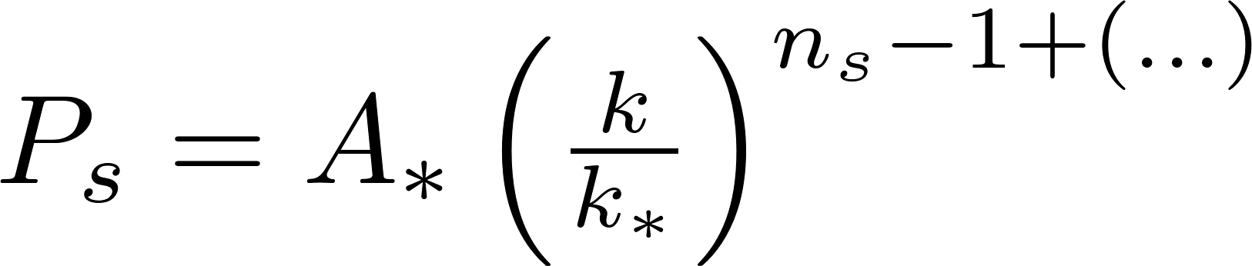
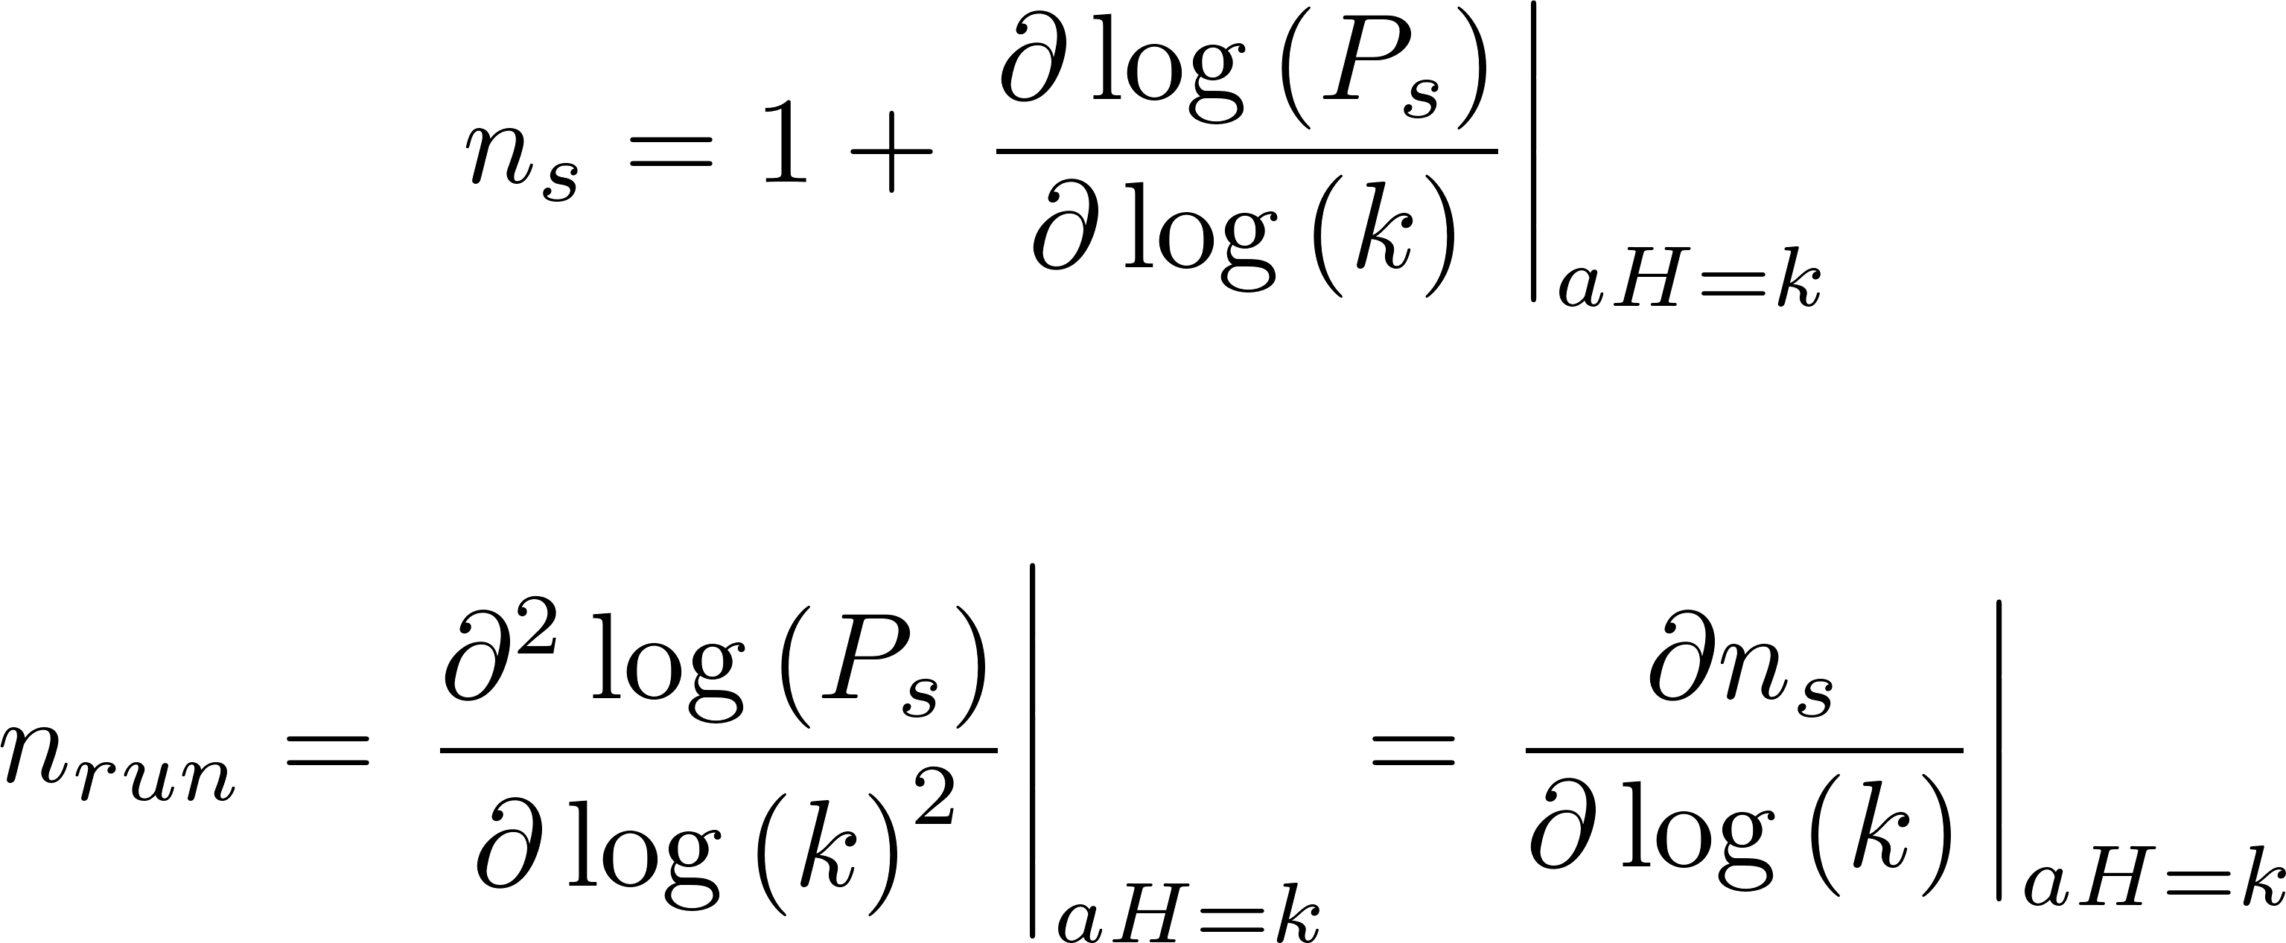
Some Theory
The primordial power spectrum (PPS)
Some theory
  Primordial Power Spectrum
  Observables – in theory
The small field model
  The model(s)
  How to construct
Disproving & re-calc
  Discrepancy
  Most probable candidate
Analysis
Summary and outlook
Notes:
Traditionally the primordial power spectrum is given by the first expression here, with k star being the pivot scale, and A star the amplitude at that scale.
The power term here is the traditional expansion that allows for deviations from a pure power law expression. The scalar index is given by ns, and the running of the scalar index is given by nrun.
We can go on and on like that for further refinement.

Slide 5
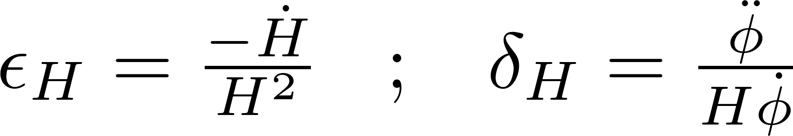
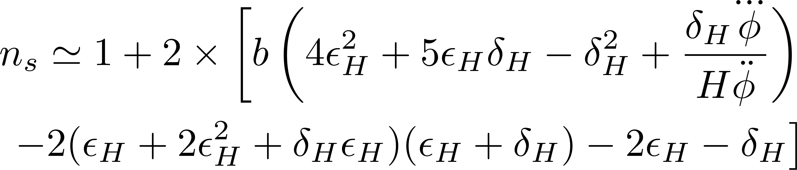
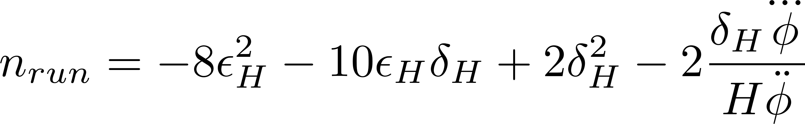
Some Theory
Observables – in theory
Some theory
  Primordial Power Spectrum
  Observables – in theory
The small field model
  The model(s)
  How to construct
Disproving & re-calc
  Discrepancy
  Most probable candidate
Analysis
Summary and outlook
Slow-roll parameters
Observables in slow-roll language
Notes:
Now, let’s talk a bit about slow-roll inflation:
The basic idea is that if the Hubble parameter is fixed we have inflation which is purely exponential.
The slow roll idea plays on that dynamic, with a Hubble parameter that changes sufficiently slow as to yield an almost exponential inflation.
The slow roll parameters are simply indicators for a Hubble parameter which is very slowly changing.
Now, these terms here neatly tie the power spectrum observables to the slow roll parameters. That’s nice but if we could correlate the potential itself to the power spectrum it yields, that would give us an invaluable tool.

Slide 6
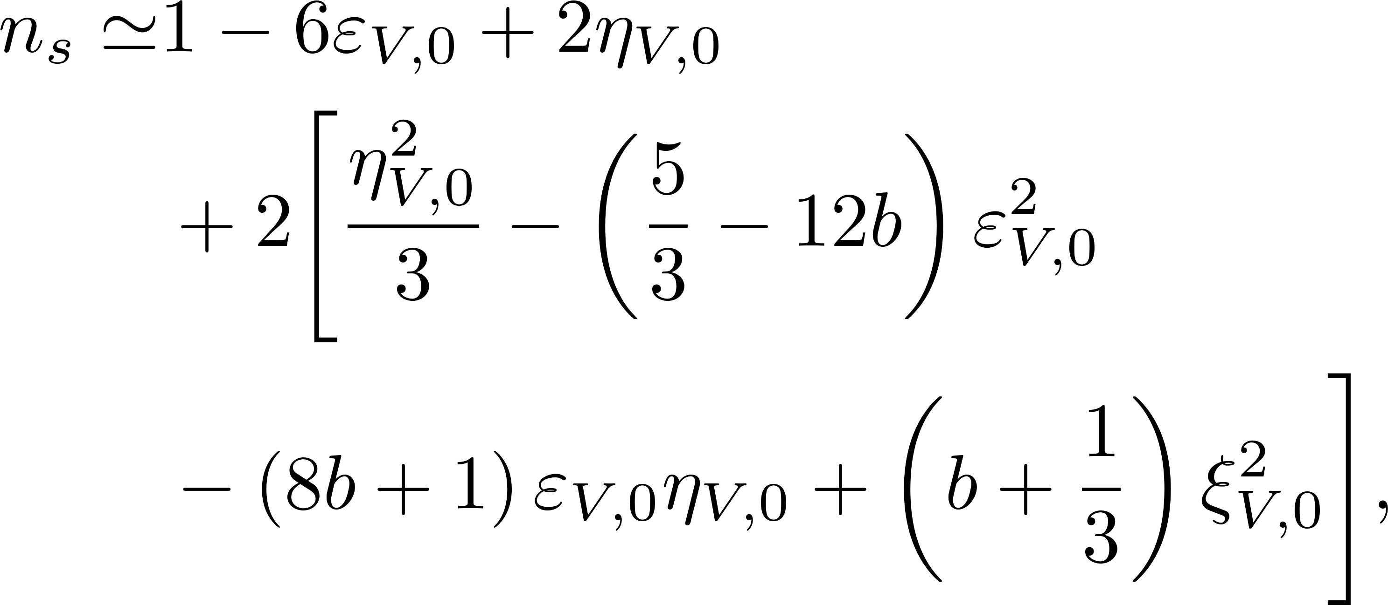
Some Theory
Observables – in theory
Some theory
  Primordial Power Spectrum
  Observables – in theory
The small field model
  The model(s)
  How to construct
Disproving & re-calc
  Discrepancy
  Most probable candidate
Analysis
Summary and outlook
Observables in potential derivative language
Stewart & Lyth: Phys. Lett.B 302, 171 (1993)
Notes:
And in fact Stewart and Lyth back in 1993 were able to do just that, and tie the potential derivative terms to the power spectrum (use the white board to explain what epsilon ,eta , xi squared are)

Slide 7
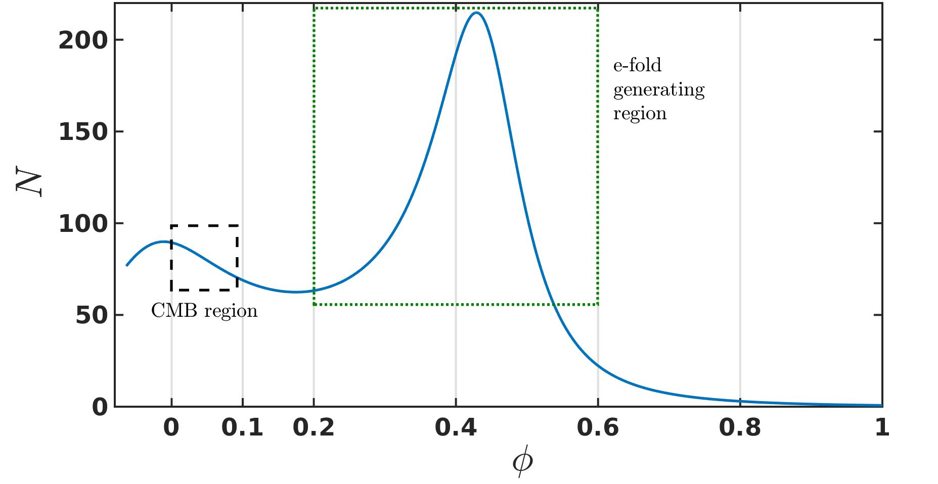
The argument for small fields
Why look at these models?
Some theory
  Primordial Power Spectrum
  Observables – in theory
The small field model
  The model(s)
  How to construct
Disproving & re-calc
  Discrepancy
  Most probable candidate
Analysis
Summary and outlook
Notes:
The virtue of these models is the separation of the region in which the modes we currently detect in the CMB are created, and the region responsible for generating enough efolds to account for physical inflation.
Thus we can control the CMB observable signature in great detail, while still having enough efolds.
In theory this could be done for every reasonably high Tensor to Scalar ratio we wish to study : spoiler alert – this is not really the case.

Slide 8
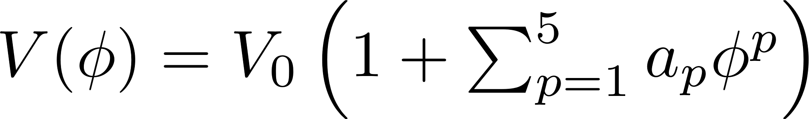
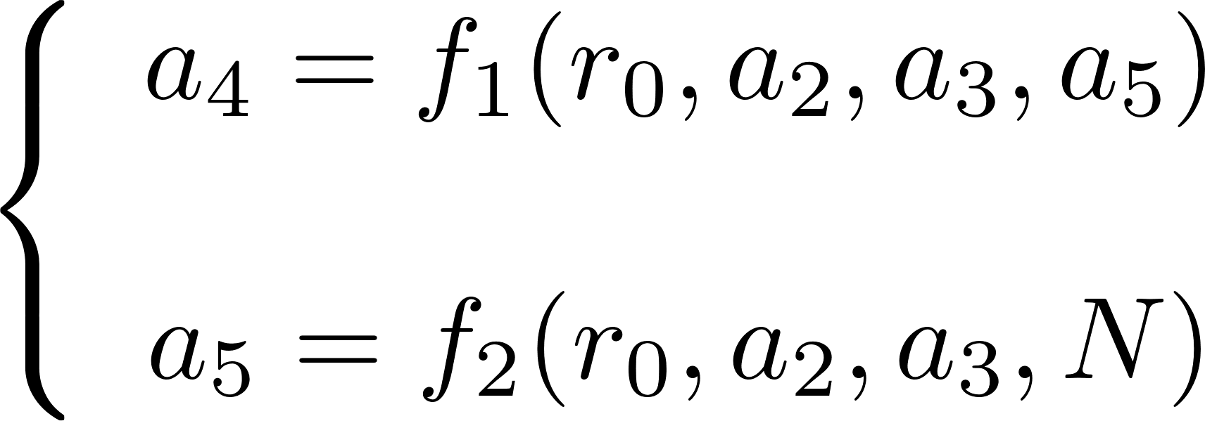
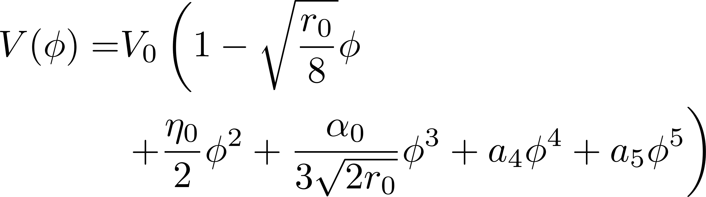

How to construct a model
A-la Ben Dayan & Brustein
Some theory
  Primordial Power Spectrum
  Observables – in theory
The small field model
  The model(s)
  How to construct
Disproving & re-calc
  Discrepancy
  Most probable candidate
Analysis
Summary and outlook
$$⇓$$
Ben-Dayan & Brustein JCAP 1009, 007 (2010)
Notes:
The models we were looking at are 5 degree polynomial potentials, which are built to comply with two main ideas:
a. They yield slow roll inflation
b. Through normalization of \Delta phi = 1 we keep the field excursion small.
So, supposedly we have 5 degrees of freedom, but this is an illusion: the first coefficient is set by the Tensor to Scalar ratio we wish to explore.
The normalization to 1 enforces a connection between a_4, and the other coefficients.
Finally demanding a specific number of efolds places constraints on a_5.
So in effect we only have 2 degrees of freedom to play with, in order to cover the complete n_s – n_run plain of interest.

Slide 9
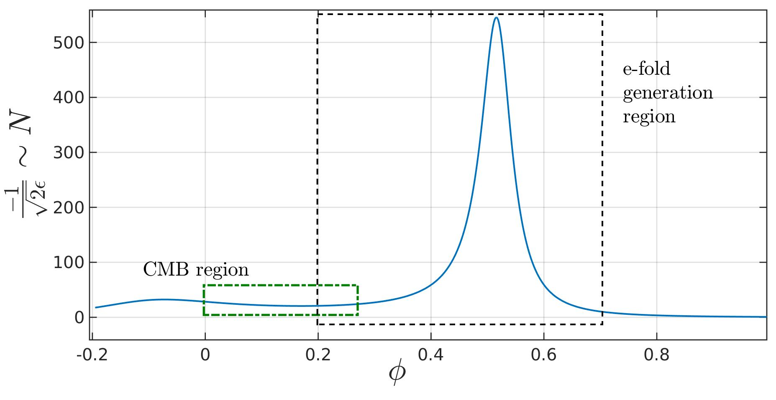
Arbitrarily high r?!
6 Degree polynomial model - why?
Some theory
  Primordial Power Spectrum
  Observables – in theory
The small field model
  The model(s)
  How to construct
Disproving & re-calc
  Discrepancy
  Most probable candidate
Analysis
Summary and outlook
Notes:
The previous study was performed for a relatively humble r_0=0.001, when we tried to up r_0 we saw that we could not “make the mark”.
The reason for that is that as we increase r_0 the amount of efolds per field excursion is decreased, thus the CMB region gets a bit smeared. The result of this is the “bleeding” of the CMB region into the efolds region.
In order to retrieve this disconnect we need to push the peak further away. This is done by considering a higher degree polynomial model.
It is easy to show that a 7 degree polynomial allows us to tune the observables to basically whatever we want. However, we are interested in the most simple model that still works. Which makes things a bit difficult for us.

Slide 10
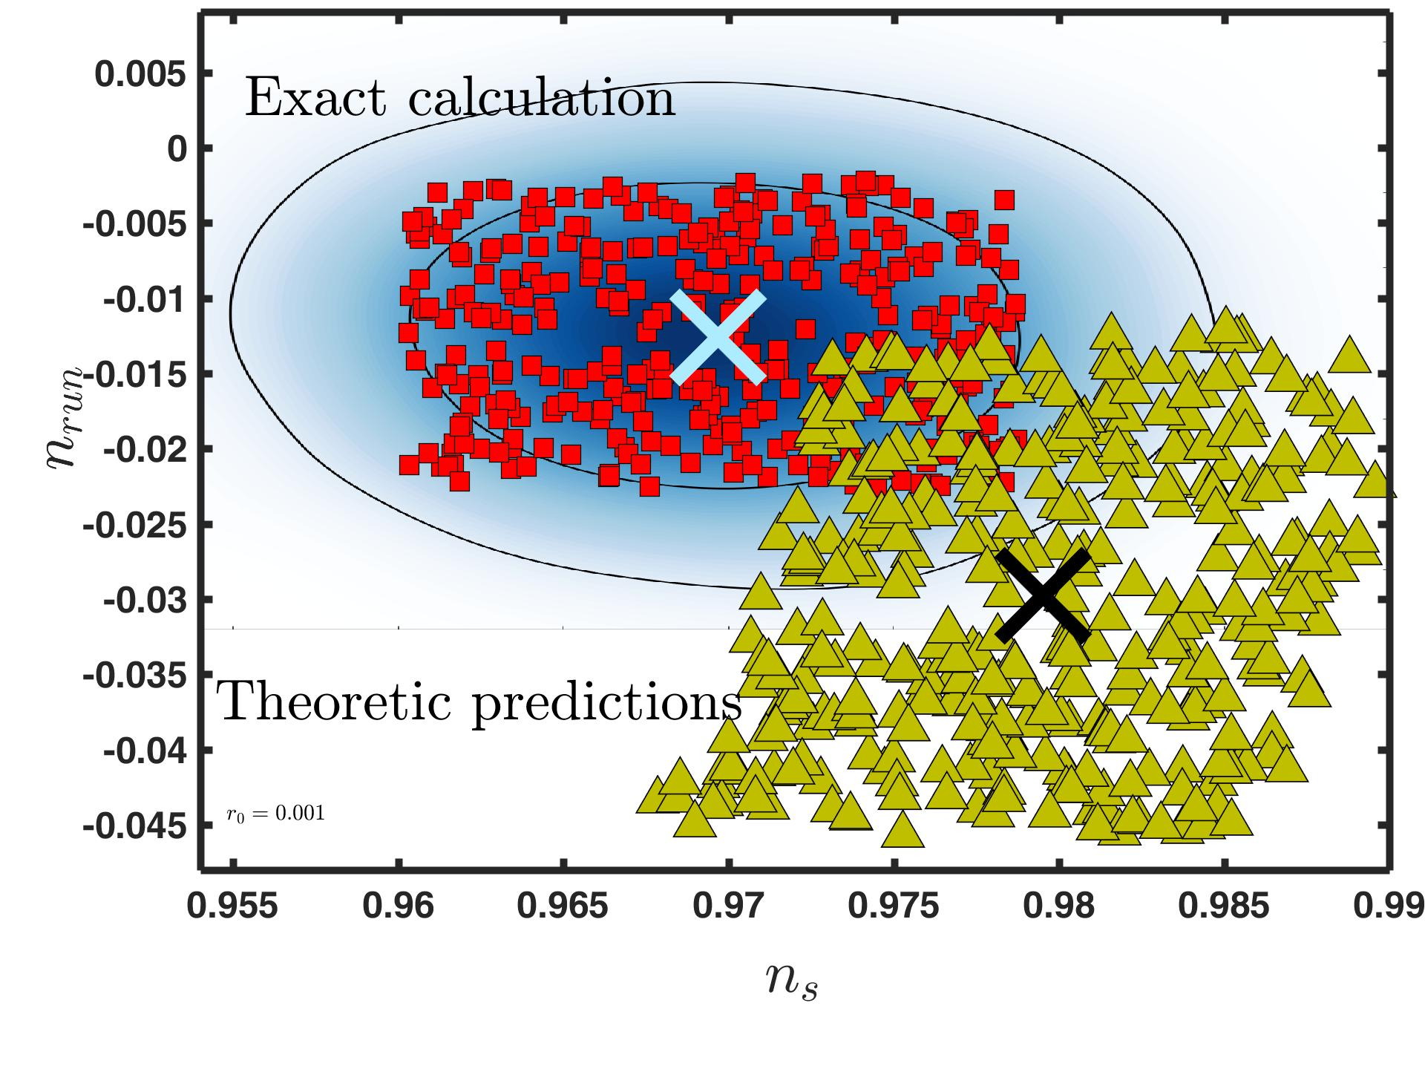
Exact calculations
Results vs Theory
Some theory
  Primordial Power Spectrum
  Observables – in theory
The small field model
  The model(s)
  How to construct
Disproving & re-calc
  Discrepancy
  Most probable candidate
Analysis
Summary and outlook
Notes:
Solve background geometry while ensuring slow roll
Track all relevant quantities (slow roll, etc.)
Construct pump field
Solve MS equations for a bunch of k-modes (that correspond to our CMB region)
Stack em’ high (stack k-modes to create F(k,t) and slice it at a time much later than the last freeze-out time)
Analyze the resulting power spectrum for ns nrun etc.

Slide 11
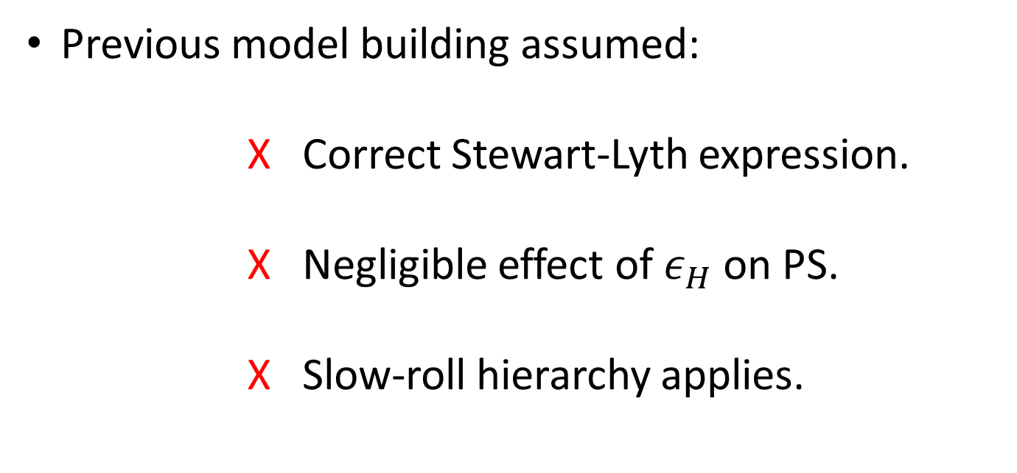
The killing of a model
Where ill-suited assumptions are challenged
Some theory
  Primordial Power Spectrum
  Observables – in theory
The small field model
  The model(s)
  How to construct
Disproving & re-calc
  Discrepancy
  Most probable candidate
Analysis
Summary and outlook
Previous model building assumed:
        Correct Stewart-Lyth expression.
        Negligible effect of $ε_{H}$ on PS.
        Slow-roll hierarchy applies.
Notes:
This shows the extraction of a_2 and a_3 and the resultant power spectrum of the most probable member of this class of models.

Slide 12
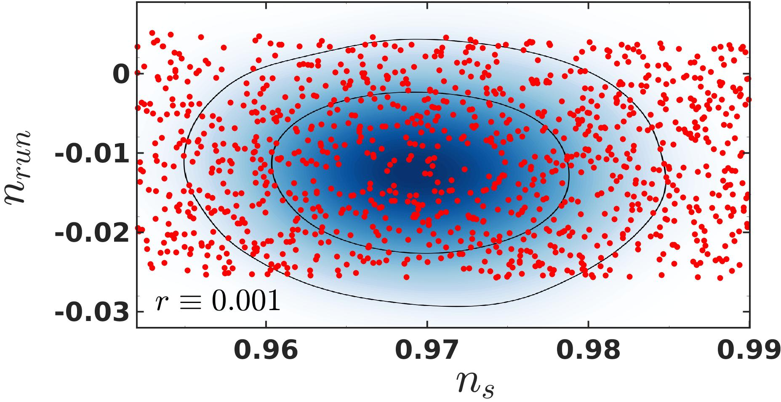
Electro-shock treatment
5 Degree polynomial model
Some theory
  Primordial Power Spectrum
  Observables – in theory
The small field model
  The model(s)
  How to construct
Disproving & re-calc
  Discrepancy
  Most probable candidate
Analysis
Summary and outlook
Notes:
What this graph shows is a tour de force: we are able to simulate and analyze a large amount of potentials, in a reasonable amount of time.
The underlying “map” is the joint probability function of n_s and n_run as extracted from BICEP+Planck data.
Every point on the graph is a potential, after background evolution, power spectrum extraction and analysis.
What we do is, for each potential we attach the underlying probability, and so we are able to transfer probabilities to the coefficients used.

Slide 13
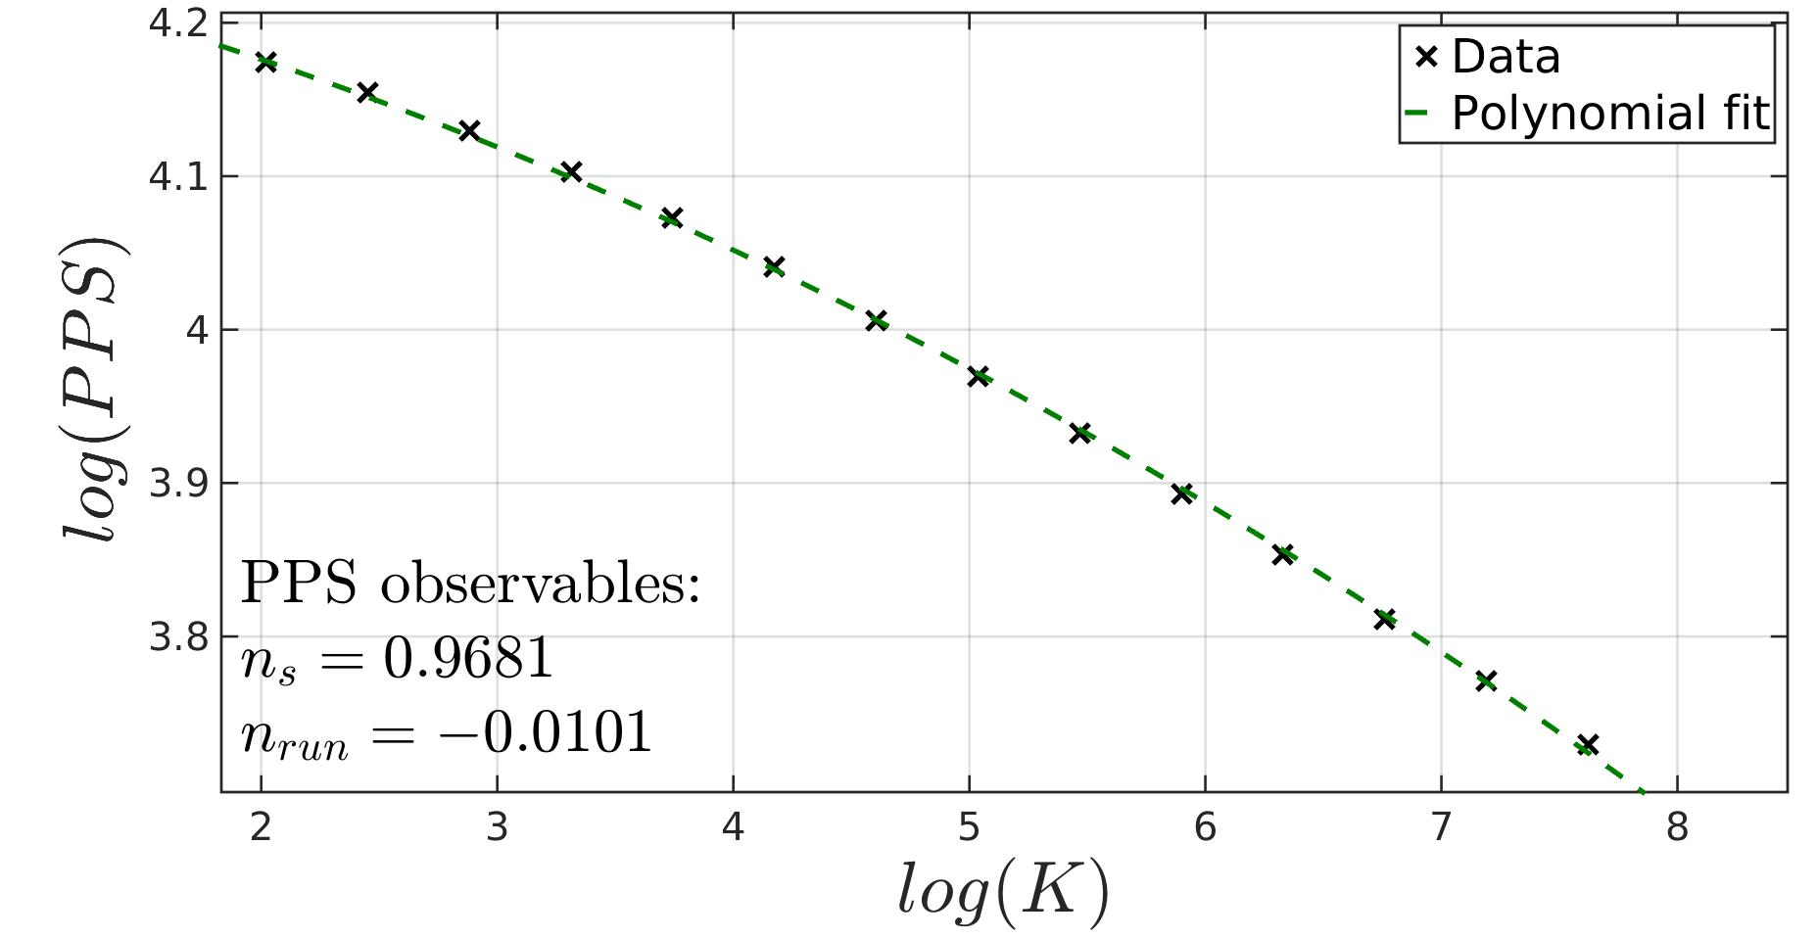
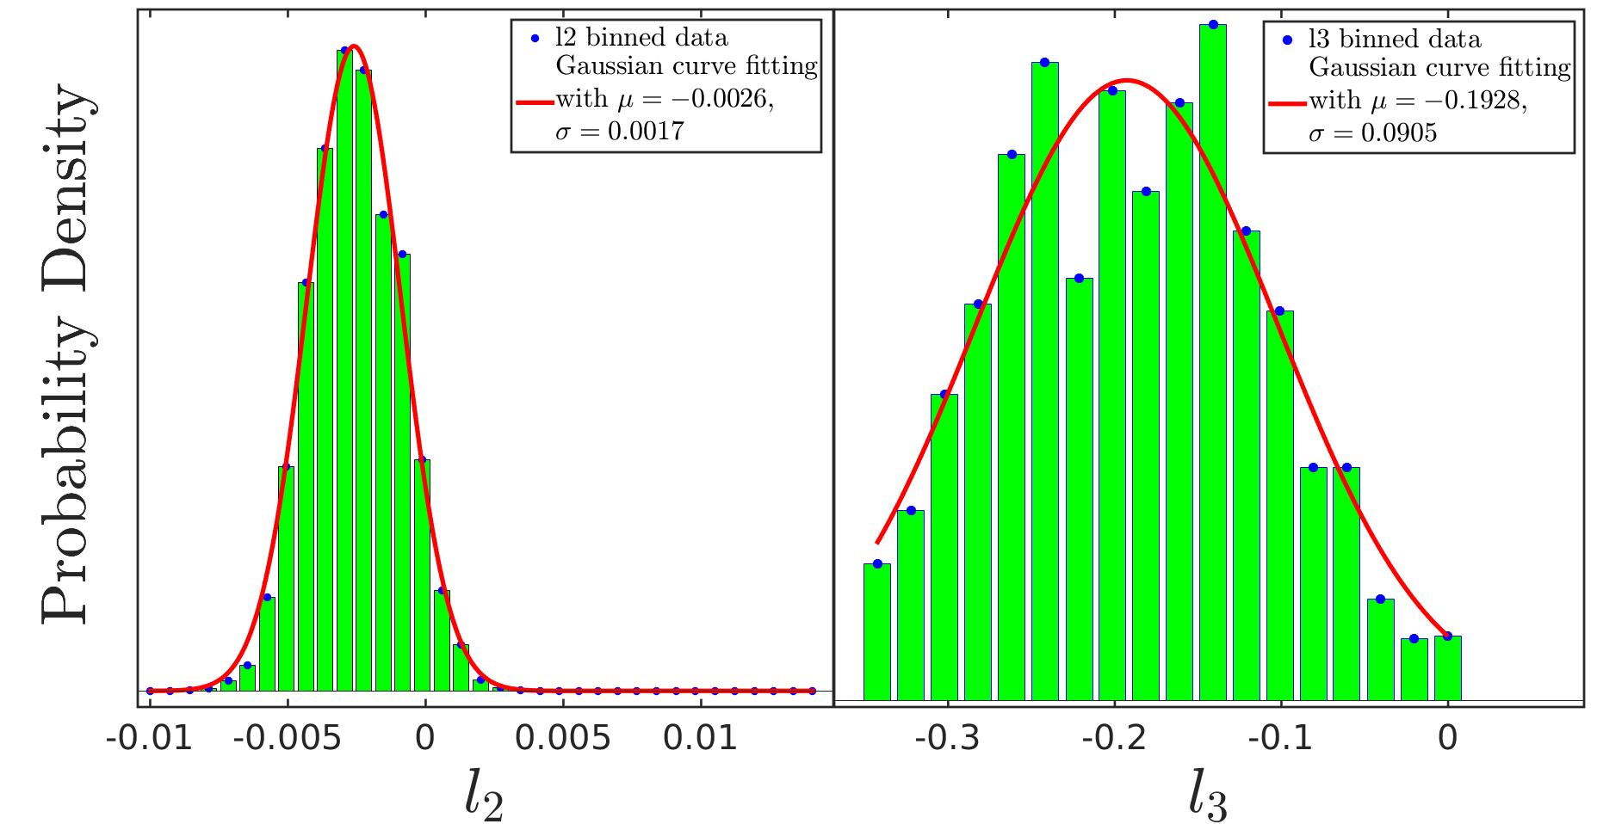
Results
5 Degree polynomial model
Some theory
  Primordial Power Spectrum
  Observables – in theory
The small field model
  The model(s)
  How to construct
Disproving & re-calc
  Discrepancy
  Most probable candidate
Analysis
Summary and outlook
ShortCut
Notes:
This shows the extraction of a_2 and a_3 and the resultant power spectrum of the most probable member of this class of models.

Slide 14
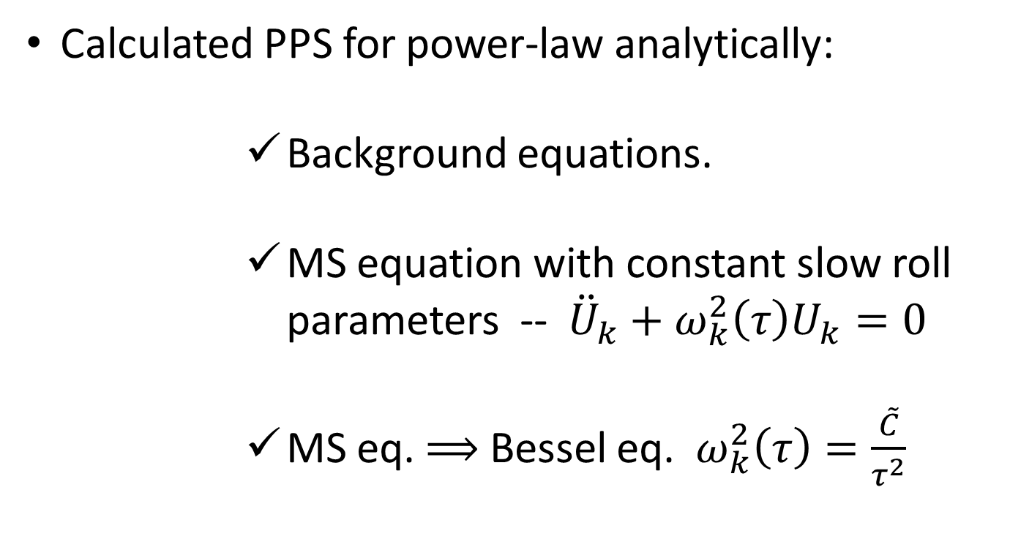
So, what went wrong?
The origin of analytics (the recipe)
Some theory
  Primordial Power Spectrum
  Observables – in theory
The small field model
  The model(s)
  How to construct
Disproving & re-calc
  Discrepancy
  Most probable candidate
Analysis
Summary and outlook
Calculated PPS for power-law analytically:
        Background equations.
        MS equation with constant slow roll parameters -- ${\ddot{U}}_{k}+ω_{k}^{2}\left(τ\right)U_{k}=0$
        MS eq. $⟹$ Bessel eq. $ω_{k}^{2}\left(τ\right)=\frac{\tilde{C}}{τ^{2}}$
Stewart & Lyth: Phys. Lett.B 302, 171 (1993)
Notes:
In order to account for this discrepancy and try to find its origins, it proved necessary to delve deeper into the origin of the analytic expression.
So, Stewart and Lyth’s paper goes through the process in great detail, I will go through it in broad strokes.
You first calculate the PPS using the power law model:

Slide 15
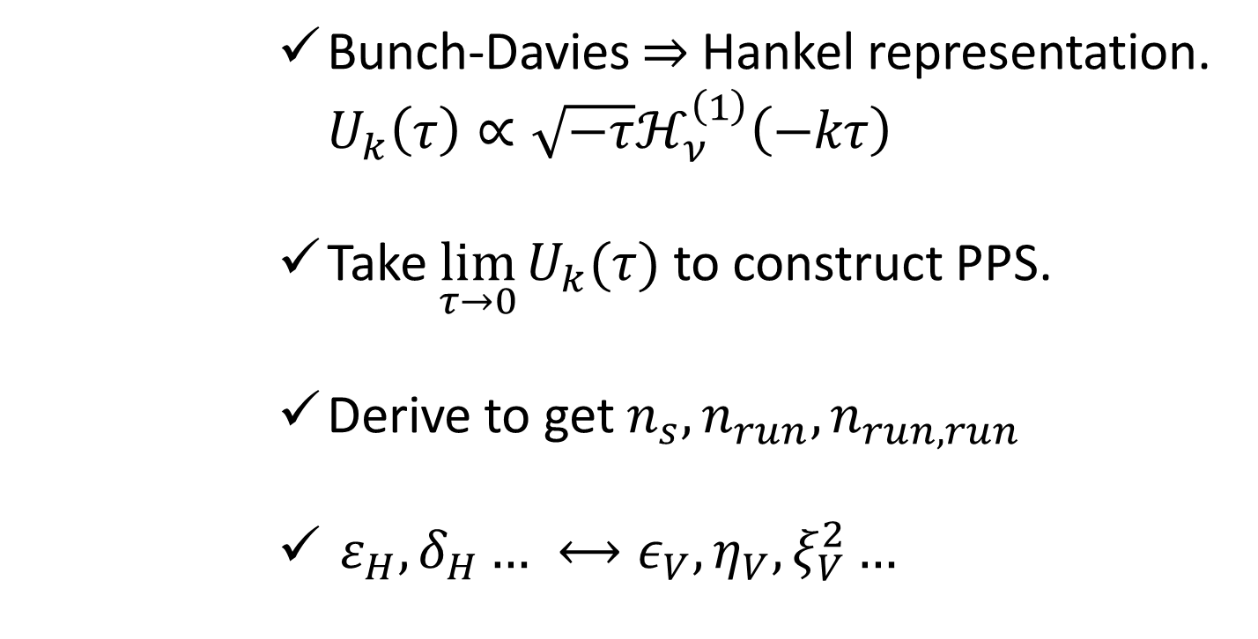
So, what went wrong?
The origin of analytics (the recipe cont.)
Some theory
  Primordial Power Spectrum
  Observables – in theory
The small field model
  The model(s)
  How to construct
Disproving & re-calc
  Discrepancy
  Most probable candidate
Analysis
Summary and outlook
        Bunch-Davies $⇒$ Hankel representation. $U_{k}\left(τ\right)∝\sqrt{−τ}ℋ_{ν}^{\left(1\right)}\left(−kτ\right)$
        Take $\lim_{τ→0}{U_{k}(τ)}$ to construct PPS.
        Derive to get $n_{s}, n_{run}, n_{run,run}$
        $ε_{H},δ_{H}… ⟷ε_{V},η_{V},ξ_{V}^{2}…$
Stewart & Lyth: Phys. Lett.B 302, 171 (1993)

Slide 16
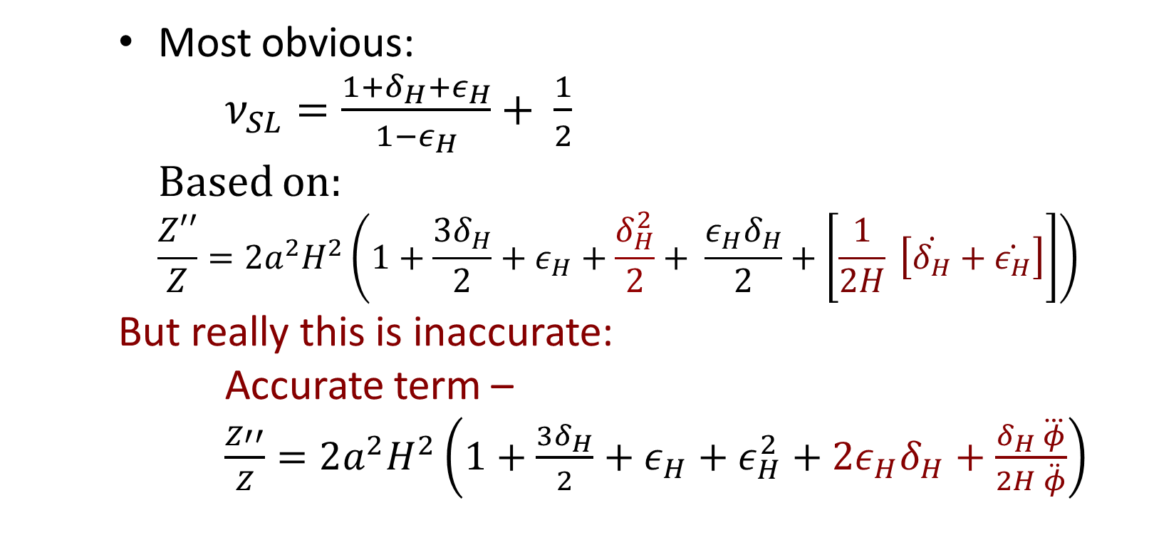
So, what went wrong?
Some theory
  Primordial Power Spectrum
  Observables – in theory
The small field model
  The model(s)
  How to construct
Disproving & re-calc
  Discrepancy
  Most probable candidate
Analysis
Summary and outlook
    Most obvious:
    $ν_{SL}=\frac{1+δ_{H}+ε_{H}}{1−ε_{H}}+ \frac{1}{2}$
    Based on:
    $\frac{Z′′}{Z}=2a^{2}H^{2}\left(1+\frac{3δ_{H}}{2}+ε_{H}+\frac{δ_{H}^{2}}{2}+ \frac{ε_{H}δ_{H}}{2}+\left[\frac{1}{2H} \left[\dot{δ_{H}}+\dot{ε_{H}}\right]\right]\right)$
    But really this is inaccurate:
    Accurate term –
    $\frac{Z′′}{Z}=2a^{2}H^{2}\left(1+\frac{3δ_{H}}{2}+ε_{H}+ε_{H}^{2}+2ε_{H}δ_{H}+\frac{δ_{H} \overset{⃛}{φ}}{2H \ddot{φ}}\right)$
Notes:
So, what seems to be the problem?
Well there are a few:
The most obvious problem has to do with how stewart and lyth defined nu.
So who is nu? Nu is the ORDER of the Hankel type solution to the Mukhanov –Sasaki equation
In the power law scenario, and is connected to Z’’/Z. In that scenario the overdotted terms are actually zero, and you can throw them away.
However in any other case, if you do that, you are actually dealing with an inaccurate expression.

Slide 17
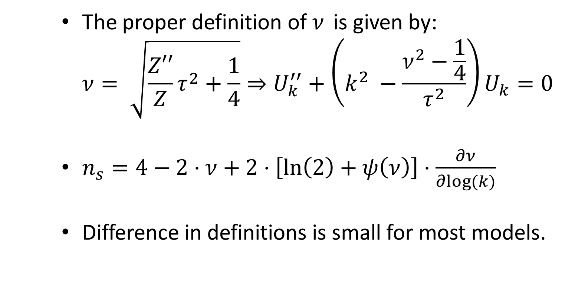
So, what went wrong?
Some theory
  Primordial Power Spectrum
  Observables – in theory
The small field model
  The model(s)
  How to construct
Disproving & re-calc
  Discrepancy
  Most probable candidate
Analysis
Summary and outlook
    The proper definition of $ν$ is given by:
    $ν= \sqrt{\frac{Z′′}{Z}τ^{2}+\frac{1}{4}}⇒U_{k}^{′′}+\left(k^{2} −\frac{ν^{2}−\frac{1}{4}}{τ^{2}}\right)U_{k}=0$
    $n_{s}=4−2⋅ν+2⋅\left[\ln\left(2\right)+ψ\left(ν\right)\right]⋅\frac{∂ν}{∂log⁡(k)}$
    Difference in definitions is small for most models.
Notes:
OK, so how is nu connected to Z’’/Z???
This is the proper definition for nu.
With this definition one can recast the MS equation as this one.
And get the scalar index as written below.

Slide 18
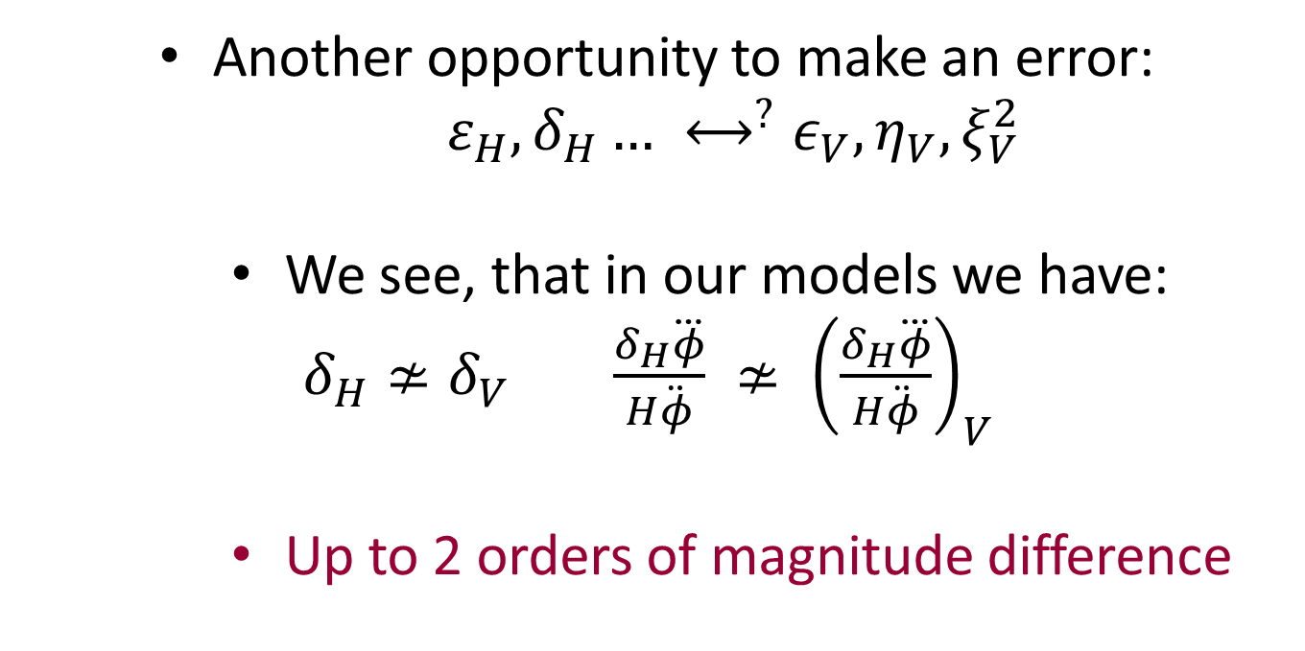
So, what went wrong?
Some theory
  Primordial Power Spectrum
  Observables – in theory
The small field model
  The model(s)
  How to construct
Disproving & re-calc
  Discrepancy
  Most probable candidate
Analysis
Summary and outlook
    Another opportunity to make an error:
    $ε_{H},δ_{H}… ⟷^{?}ε_{V},η_{V},ξ_{V}^{2}$
      We see, that in our models we have:
    $δ_{H}≄δ_{V} \frac{δ_{H}\overset{⃛}{φ}}{H\ddot{φ}} ≄ {\left(\frac{δ_{H}\overset{⃛}{φ}}{H\ddot{φ}}\right)}_{V}$
      Up to 2 orders of magnitude difference
Notes:
Yet another approximation usually made is the connection between slow roll parameter in their original definition, and approximated expressions using the potential and its derivatives.
In most cases, this approximation is valid to some degree, however in these type of models, these approximations fail altogether.
We have checked and found that the discrepancy between delta and deltaH as well as the third parameter and its counterpart can sometimes be of the order of 2 orders of magnitude!!!
(example delta=0.005 deltah=0.2, third~10^(-4) thirdH=0.4 etc.)

Slide 19
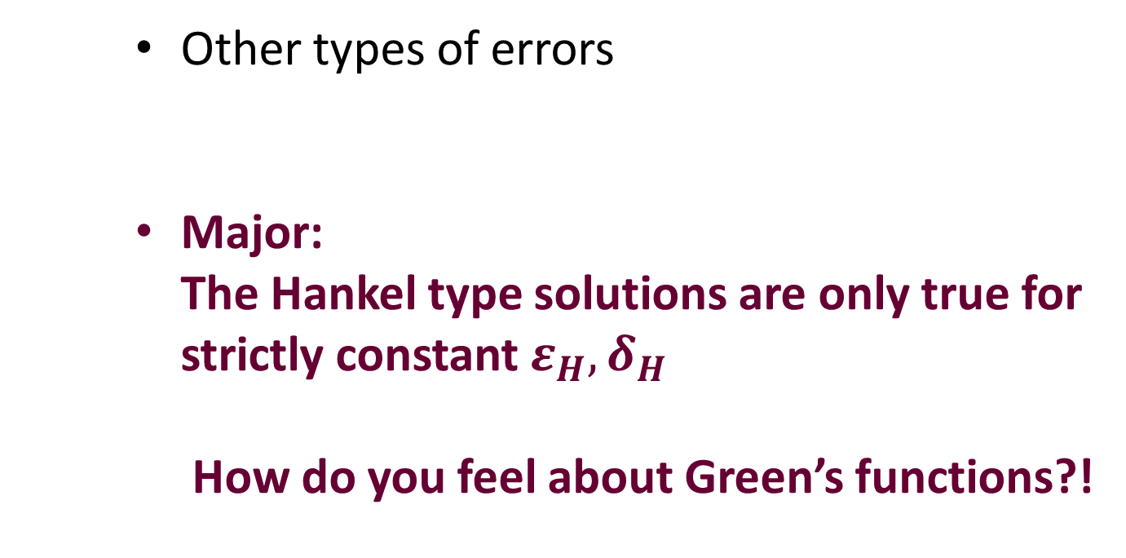
So, what went wrong?
Some theory
  Primordial Power Spectrum
  Observables – in theory
The small field model
  The model(s)
  How to construct
Disproving & re-calc
  Discrepancy
  Most probable candidate
Analysis
Summary and outlook
    Other types of errors
    Major:
    The Hankel type solutions are only true for strictly constant $ε_{H},δ_{H}$
    How do you feel about Green’s functions?!
Dodelson & Stewart: Phys. Rev. D 65, 101301 (2002)
Notes:
There are of course other slight errors to be considered:
For instance the error between the nu derivative in the two formulations sometimes can get to hundreds of percents, but since its multiplied by a small quantity, this has a marked yet second in importance effect (can sometimes get to 0.5~1 %).
Another problem is where to truncate the term? 2nd order? 3rd order? Maybe more?
There seems to be a small error that is associated with throwing away terms of more that third order, but not a truly significant one.
And so we had no choice but to concider the major problem:
The MS->Bessel approximation could be altogether wrong when we speak of our models.

Slide 20
Summary and outlook
where do we go from here?
Some theory
  Primordial Power Spectrum
  Observables – in theory
The small field model
  The model(s)
  How to construct
Disproving & re-calc
  Discrepancy
  Most probable candidate
Analysis
Summary and outlook
See what BICEP3/Planck 2018 yields, and adjust.
Find a better analytic expression from first principles?
Quantify perturbations – give better analytic tools.

Slide 21
Questions?

Slide 22

Thank you!

Slide 23
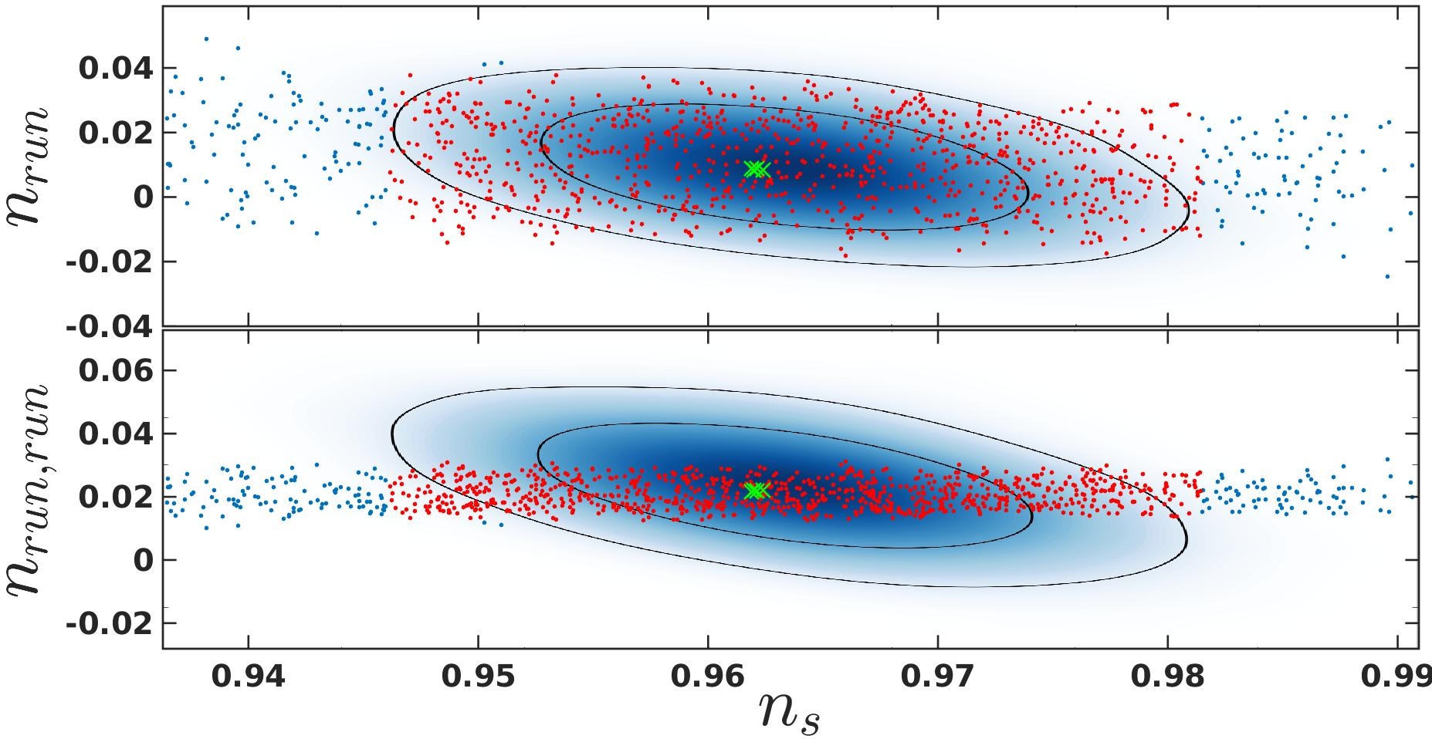
Results
6 Degree polynomial model
Some theory
  Primordial Power Spectrum
  Observables – in theory
Stand Alone Simulator
  In a nutshell
  Benchmarking
Recent Results
  Fifth degree polynomial model
  Sixth Degree polynomial model
Discrepancy between analytics and numerics
Summary and outlook
Notes:
This is a recent result.
You can see we were able to cover the complete ns-nrun plain of interest.
You can also see that the sample on the ns-nrunrun graph is “compresed”.
In order to examine this further we took a “wide angle” picture.

Slide 24
Results
6 Degree polynomial model
Some theory
  Primordial Power Spectrum
  Observables – in theory
Stand Alone Simulator
  In a nutshell
  Benchmarking
Recent Results
  Fifth degree polynomial model
  Sixth Degree polynomial model
Discrepancy between analytics and numerics
Summary and outlook
Notes:
One can easily see the upper panel and the lower panel are mirror images of one another.
Which suggest a mostly linear connection between the two.

Slide 25
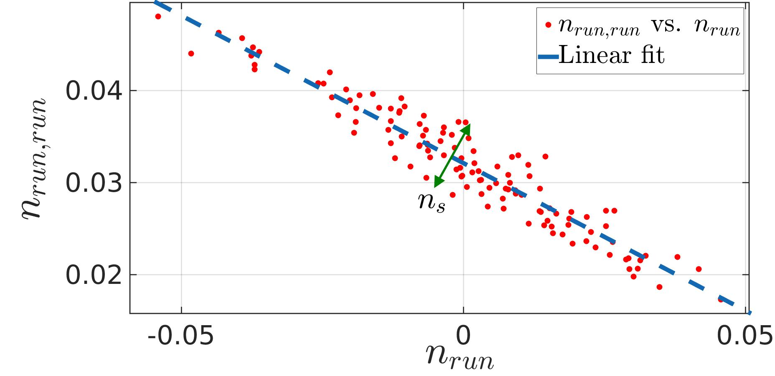
Results
6 Degree polynomial model
Some theory
  Primordial Power Spectrum
  Observables – in theory
Stand Alone Simulator
  In a nutshell
  Benchmarking
Recent Results
  Fifth degree polynomial model
  Sixth Degree polynomial model
Discrepancy between analytics and numerics
Summary and outlook
Notes:
This might have repercussions on the analysis that is currently used in the business.
What is usually done, in for instance CosmoMC analysis, is to have the n_s n_run n_runrun degrees of freedom uncorrelated. However, provided this correlation actually hold, a complete different set of observables may arise out of a CosmoMC analysis.

Slide 26
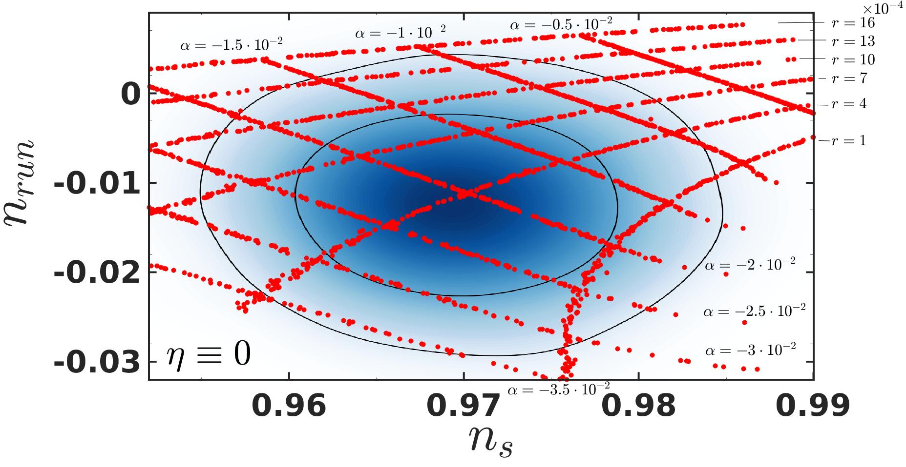
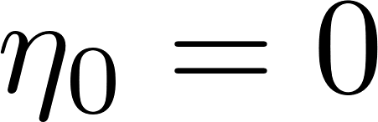
Results
5 Degree polynomial model
Some theory
  Primordial Power Spectrum
  Observables – in theory
Stand Alone Simulator
  In a nutshell
  Benchmarking
Recent Results
  Fifth degree polynomial model
  Sixth Degree polynomial model
Discrepancy between analytics and numerics
Summary and outlook
Notes:
This is a bit of a “side project” that turned surprising results.
It is always a good idea to “map” and not just to “cover” – a map implicates a dynamic while a cover doesn’t.
For simplicity we set eta to zero and looked at the r_0 alpha_0 map.
What I want you to take away from this graph is the large effect of small changes in r_0 on n_s. This is in itself surprising, since the characteristic epsilon is of the order of 10^-4 and cannot account for this shift.

Slide 27
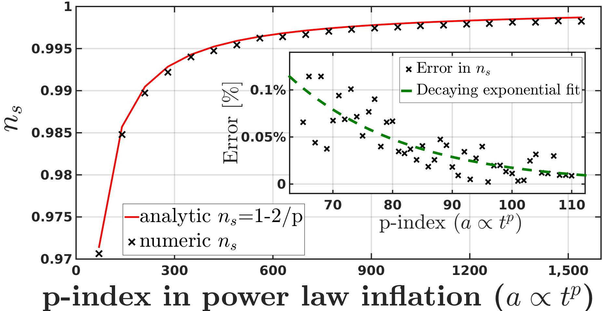
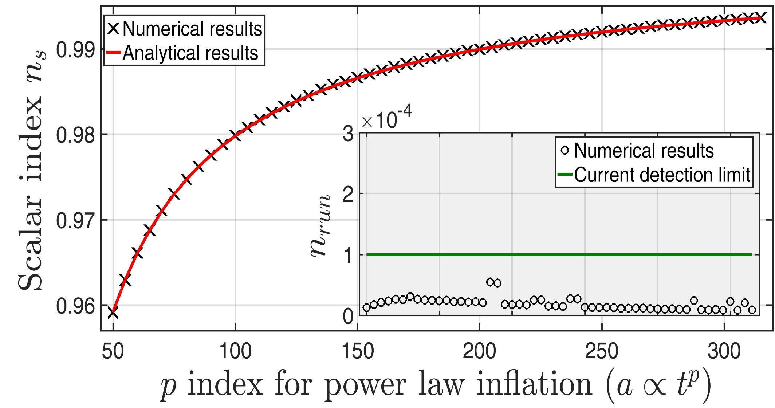
Stand alone simulator
Benchmarking
Some theory
  Primordial Power Spectrum
  Observables – in theory
Stand Alone Simulator
  In a nutshell
  Benchmarking
Recent Results
  Fifth degree polynomial model
  Sixth Degree polynomial model
Discrepancy between analytics and numerics
Summary and outlook
Notes:
Explain the graph:
The power law inflation case, which is the only fully analytical case we know, yields a scalar index of 1-2/p with p being the power index of this inflation (a propto t^p).
As you can see the numerical results follow closely the theoretical predictions, and the overall dynamic converges to a de-sitter universe.
After a few improvements to the code, the error in ns is now bounded from above by 0.02%, and converges to zero for large values of p. Notice also the running is well below the current detection limit.

Slide 28
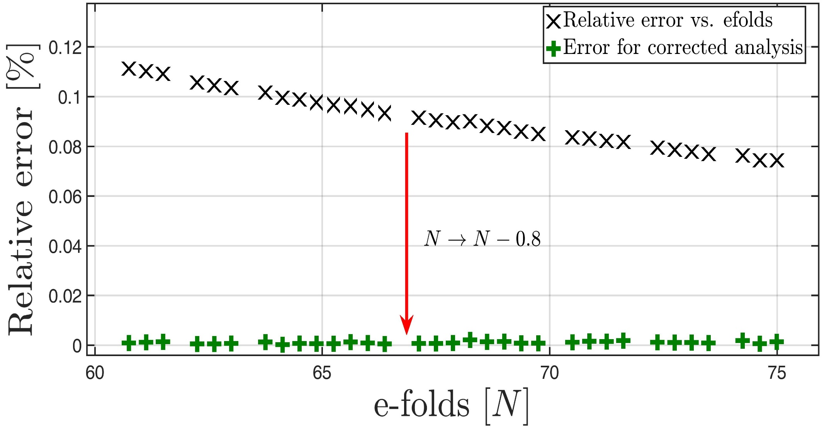
Stand alone simulator
Benchmarking
Some theory
  Primordial Power Spectrum
  Observables – in theory
Stand Alone Simulator
  In a nutshell
  Benchmarking
Recent Results
  Fifth degree polynomial model
  Sixth Degree polynomial model
Discrepancy between analytics and numerics
Summary and outlook
Notes:
What we see in this graph is a quick study of the quadratic type inflation.
We plot the relative error between the numerical results of the scalar index, and the analytic ones.
The initial error levels are very satisfactory with a relative error of ~ 0.1%
However we have found a systematic error….

Slide 29
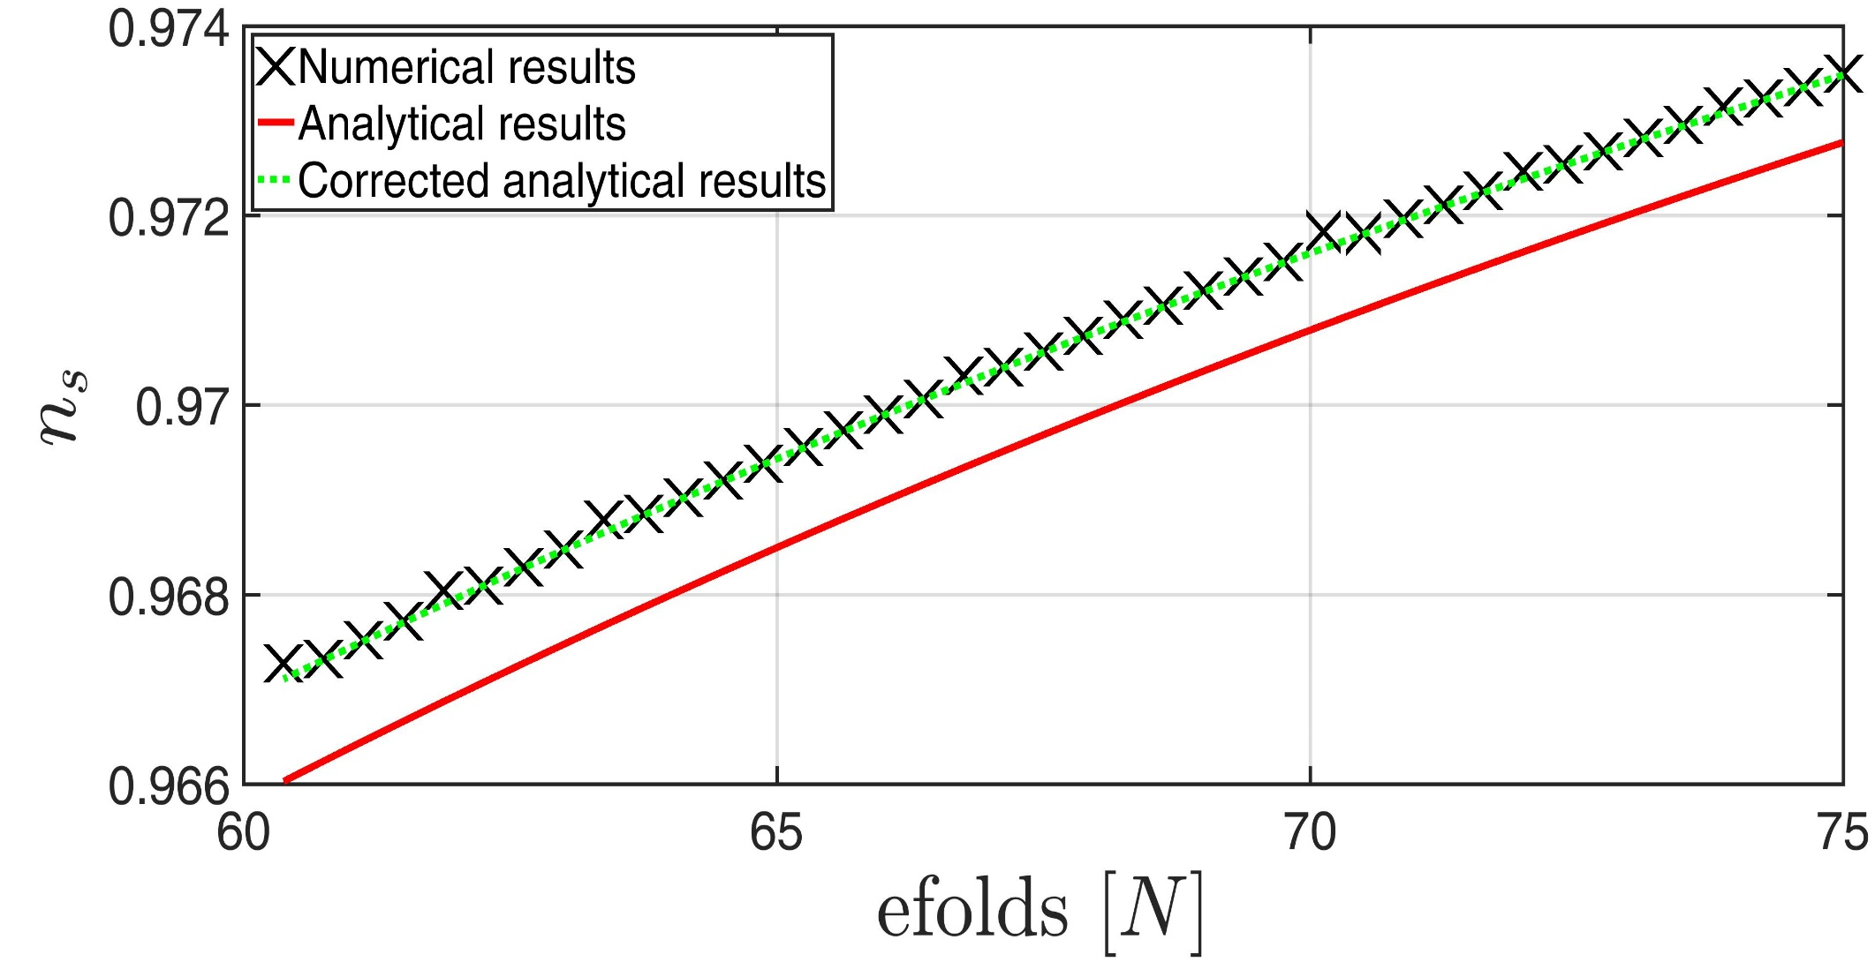
Stand alone simulator
Benchmarking
Some theory
  Primordial Power Spectrum
  Observables – in theory
Stand Alone Simulator
  In a nutshell
  Benchmarking
Recent Results
  Fifth degree polynomial model
  Sixth Degree polynomial model
Discrepancy between analytics and numerics
Summary and outlook
Notes:
This systematic error is corrected by the translation N->N-0.8, which could be explained by the discrepancy between N=-int (V/V’) dphi and N=int H dt
The corrected analytic n_s is in agreement with the numerical to a 10^(-3)~10^(-4)% relative error.

