Slide 1



Looking for high-z (z>6.5) galaxies behind the lensing cluster A2667
Nicolas Laporte
IES Cargesse – 18 September 2012
R. Pellό, M. Hayes, D. Schaerer, J. Richard, F. Boone, J.-P. Kneib, E. Egami, J.- F. Le Borgne and F. Combes

Slide 2
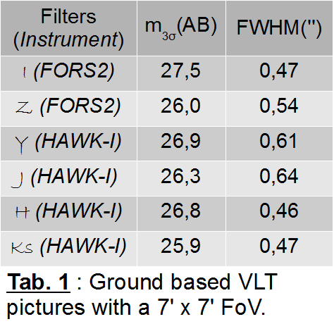
The data
We used data from ground based telescopes : FORS2 & HAWK-I@VLT to select high-z candidates.
We combined these images with space data from Spitzer, HST and Herschel when available.
FoV ≈ 45 arcmin² (≈33 arcmin² when corrected for dilution at z>6.5)

Slide 3
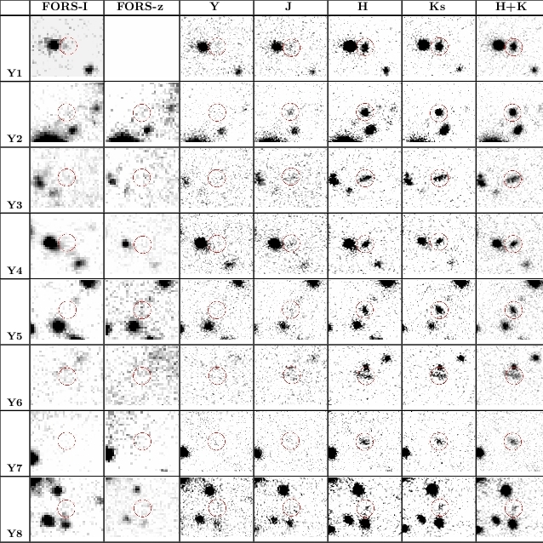
Selection of high-z sources
We used the Lyman Break technique (Steidel et al. 1996) combining strong detection/non-detection criteria with the use of a color diagram.
We retained 9 sources with modest magnification factor (ranging from 1.0 to 1.3)
    1 J-drop (8.5<z < 9.5)
    8 Y-drops (7.5<z<8.5)
At most 4 sources were expected (if we assume the standard evolution of galaxies at high-redshift)
Contamination >50%
Laporte et al., 2011, A&A, 531,74

Slide 4
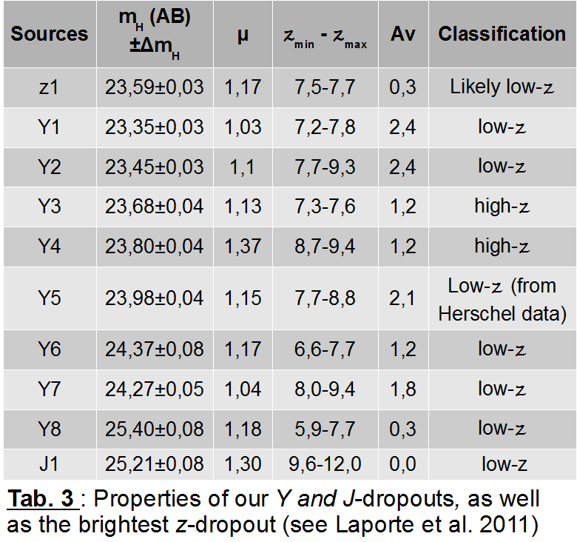
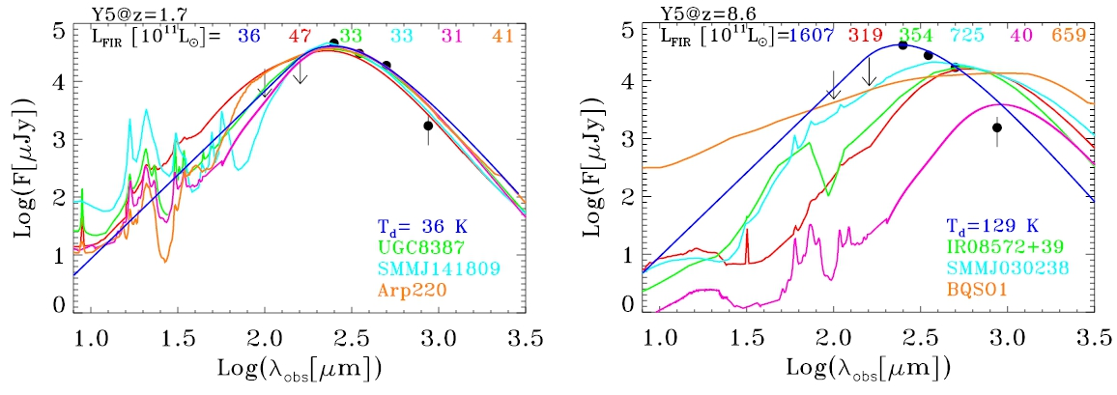
Adding data at large wavelength
To remove low/mid-z interlopers we used complementary data from PACS & SPIRE instruments (Herschel)
Boone et al., 2012, A&A, 534,124

Slide 5
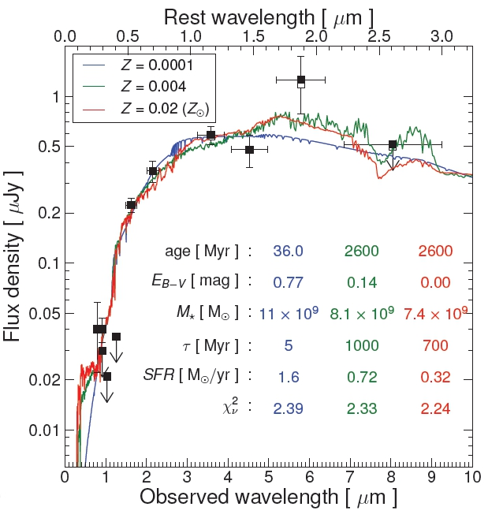
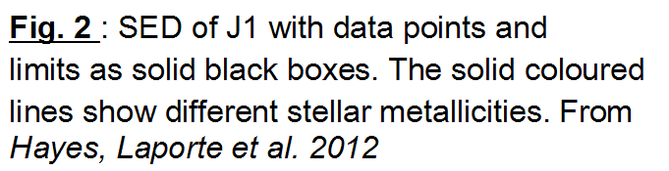
Spectroscopic follow-up
Using X-Shooter observations (1h exposure time) we refuted the high-z solution for our J-drop candidate
These observations placed this source at z≈2.08
We found that this source combined two different stellar populations and required a depth of 30(AB) in B-band to be identified as mid-z interloper

Slide 6
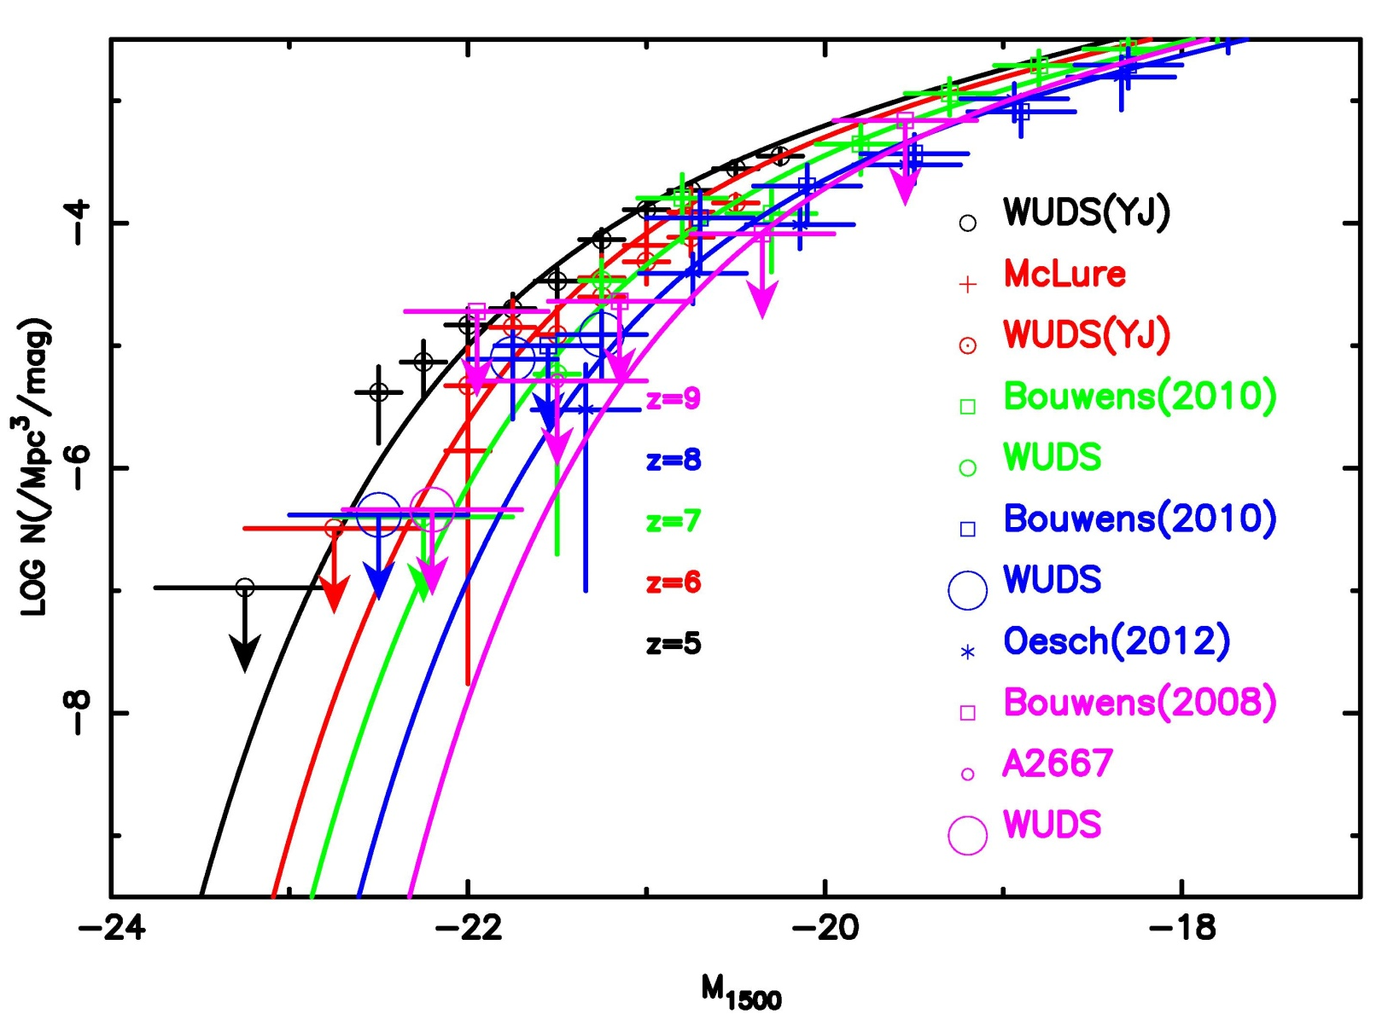
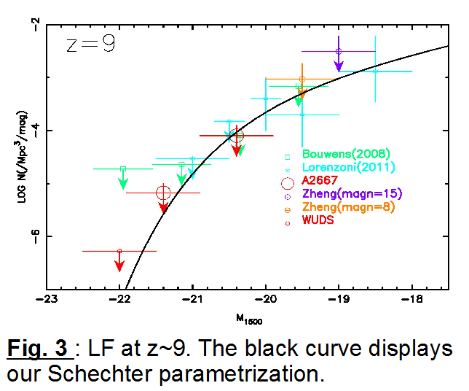
UV Luminosity function at z≈9
Assuming that no J-drop was found, we computed an upper limit on the density of sources.
Considering the lensing effect , we were able to compute another upper-limit at faintest luminosities
Laporte et al., 2012, A&A, 542,31

Slide 7
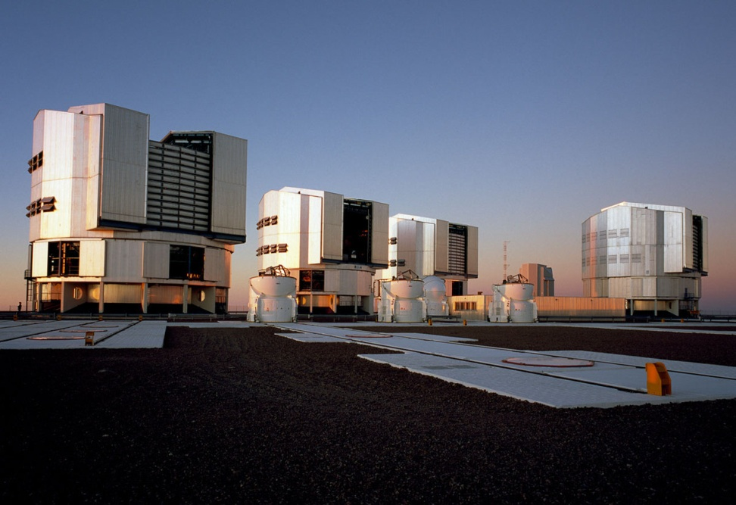
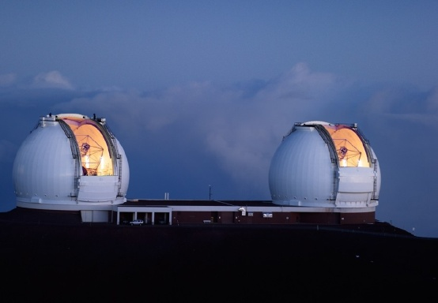
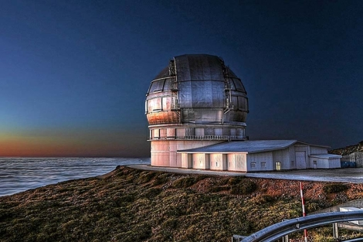
Conclusions
This study allow us to show the existence of extreme mid-z interlopers which can follow the selection criteria defined for high-z sources.
The use of a lensing cluster as gravitational telescope allow us to put strong constraints in the UV LF at high-redshift.

