Slide 1
Averaging Inhomogeneous Cosmologies
Thomas Buchert, CRALyon
XIIth School of Cosmology
IESC Cargèse
September 2014

Slide 2
Course 1 - Contents

Slide 3
Newton-Galilei spacetime

Slide 4
Simulations vs. Lagrangian Perturbation Theory
N-body
1st order LPT

Slide 5
Volume Averaging
Spatial Average on a compact domain :
Restmass conservation on the domain D

Slide 6
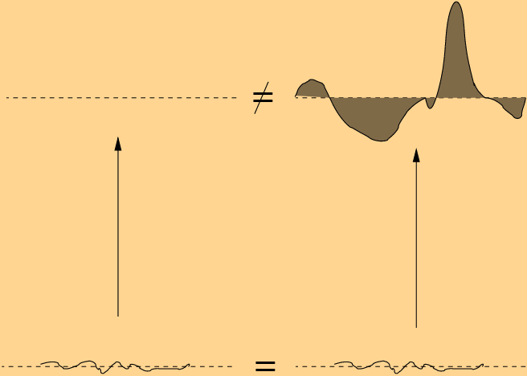
Commutation Rule

Slide 7
Euler’s Equation
Euler’s Equation
Lagrangian derivative
Kinematical decomposition :
Rate of expansion, shear and vorticity

Slide 8
Raychaudhuri’s Equation
Newtonian field equations :
Raychaudhuri’s Equation

Slide 9
Averaging Raychaudhuri’s Equation

Slide 10
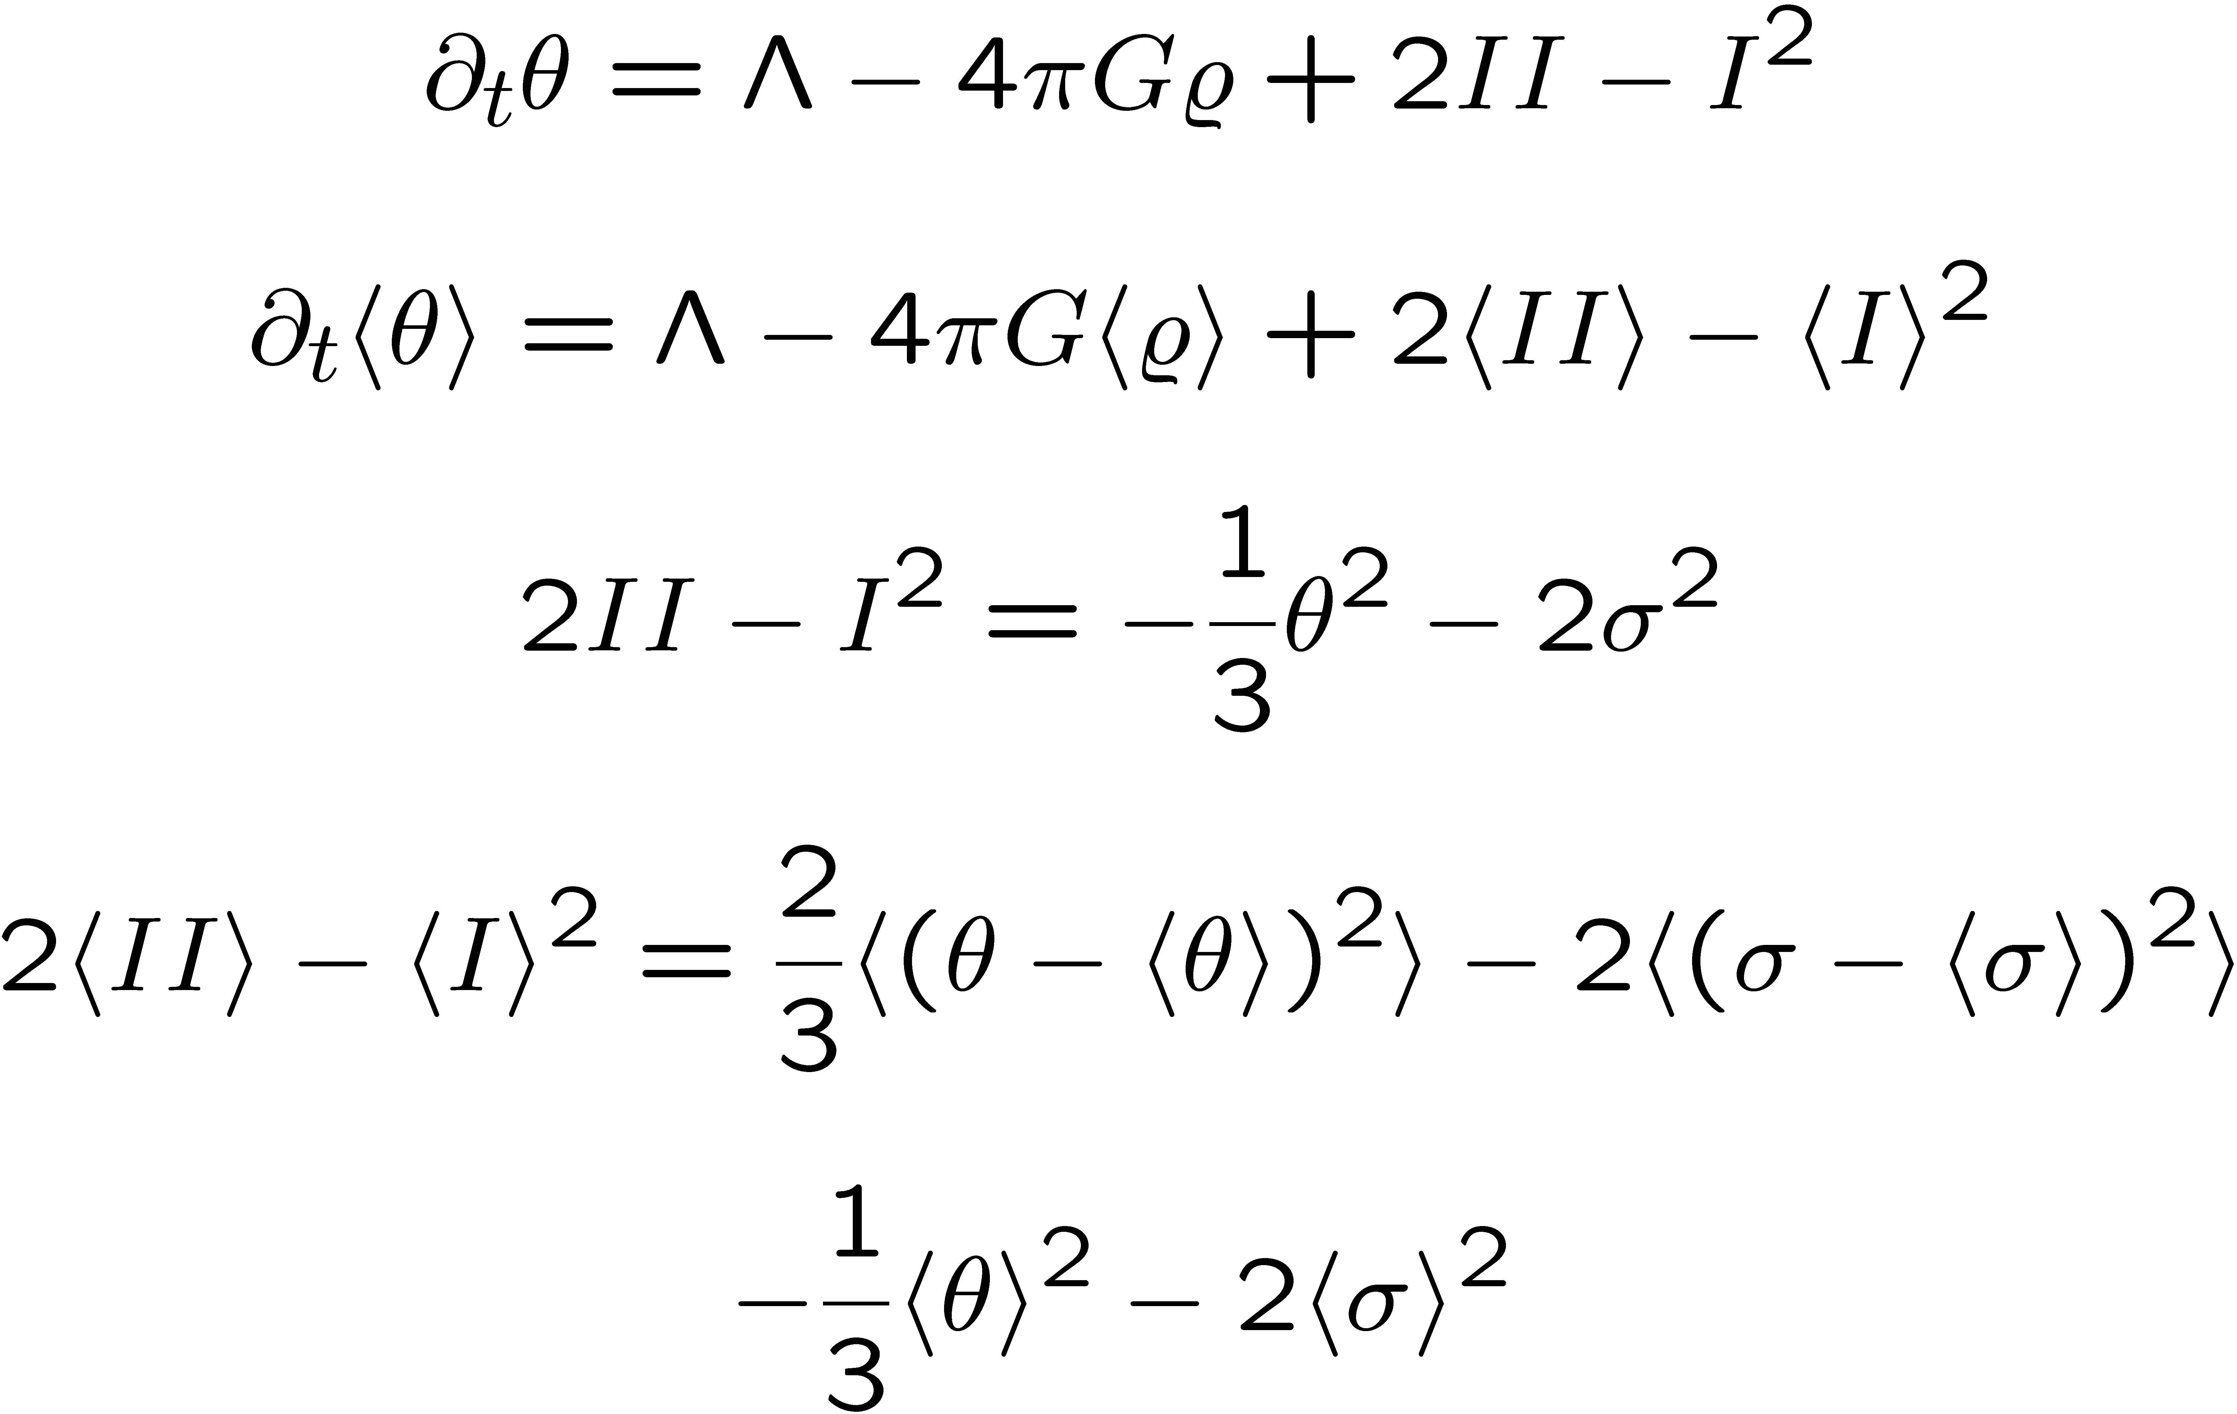
Volume acceleration despite local deceleration

Slide 11
Averaged Cosmological Equations
Kinematical Backreaction :

Slide 12
Physical Interpretation
Positive Backreaction :
acts accelerating
Negative Backreaction :
acts decelerating
Large / Intermediate / Small Scales :
Dominance of Expansion Variance / Shear / Vorticity

Slide 13
How to treat boundary conditions ?
We can add to the gravitational potential
an arbitrary harmonic potential A
Asymptotic fall-off conditions or ii) periodic functions

Slide 14
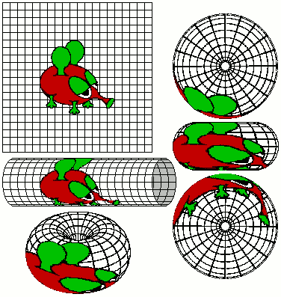
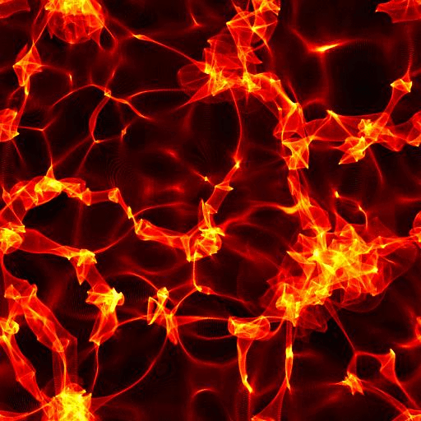
Integral Properties of Newtonian Models
global, scale-independent background is our choice
structures do not interact with the background
structures average out on the background

Slide 15
Properties of Backreaction in Euclidean Space

Slide 16
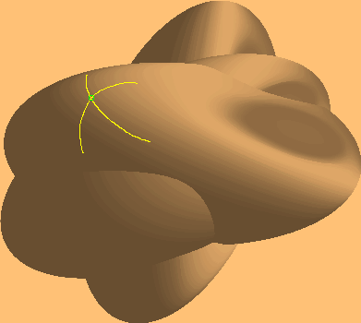
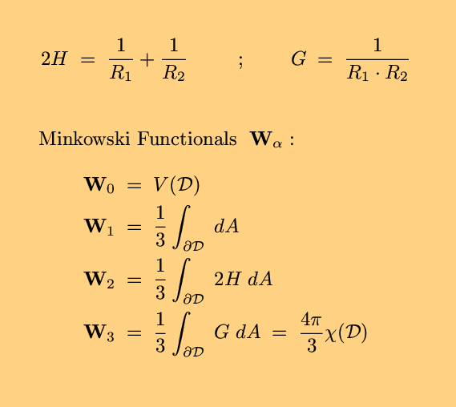
Morphological interpretation of backreaction
Integral Properties
of an averaging domain
Minkowski Functionals

Slide 17
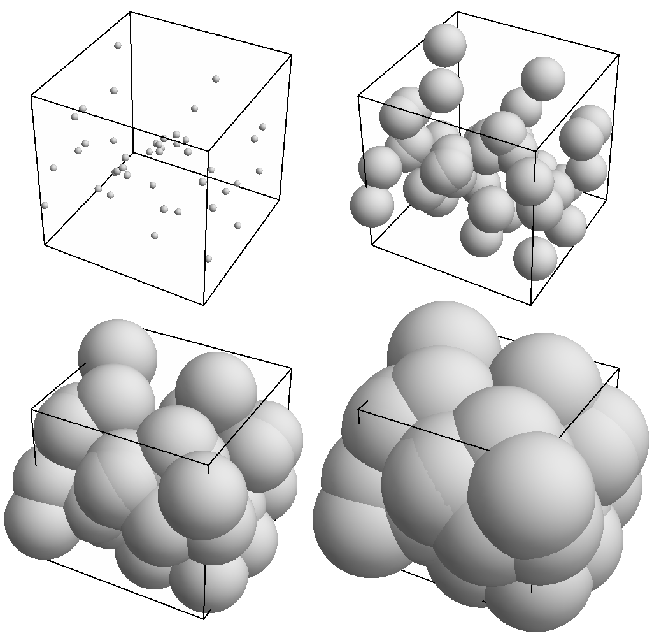
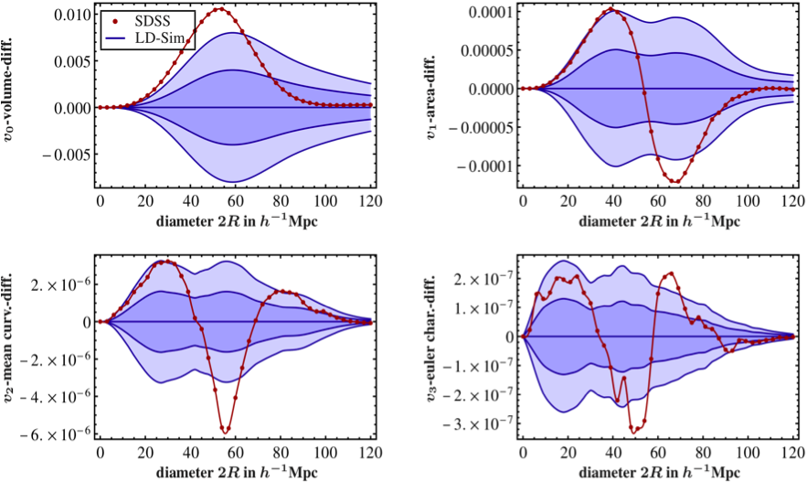
Statistical Analysis of galaxy catalogues
SDSS - DR7 – LRG Sample 700 Mpc/h :
Wiegand, Buchert, Ostermann arXiv: 1311.3661
Germ-Grain Model

Slide 18
Summary
Spatial Average on a mass preserving compact domain
delivers scale-dependent acceleration and expansion laws
The extra inhomogeneity term is a consequence
of the nonlocal nature of averaging and may lead to
volume acceleration despite local deceleration
Due to the Euclidean geometry of Newtonian space
this extra term vanishes globally and describes
a scale-dependent morphological cosmic variance
around an assumed background

Slide 19
Course 2 - Contents

Slide 20
Generalization of the standard cosmological model
1/3
⁴g = - dt² + g_{ij} dX^{i} dX^{j}
a_{D}= V_{R}
a(t)
Einstein
Spacetime
t
t
g_{ij}

Slide 21
Averaging Einstein’s Equations
Spatial Average on a compact domain :
Restmass conservation on the domain D

Slide 22
Non-commutativity

Slide 23
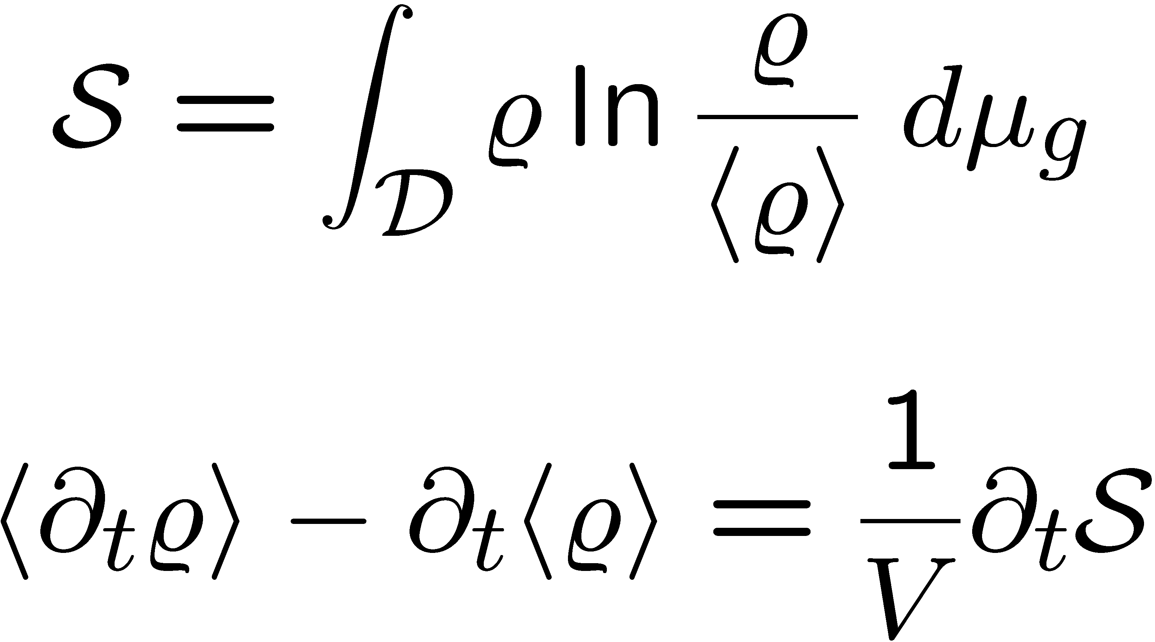
Relative Information Entropy
Kullback-Leibler :

Slide 24
Cosmological Equations
Acceleration Law :
Expansion Law :
Conservation Law :
Integrability :

Slide 25
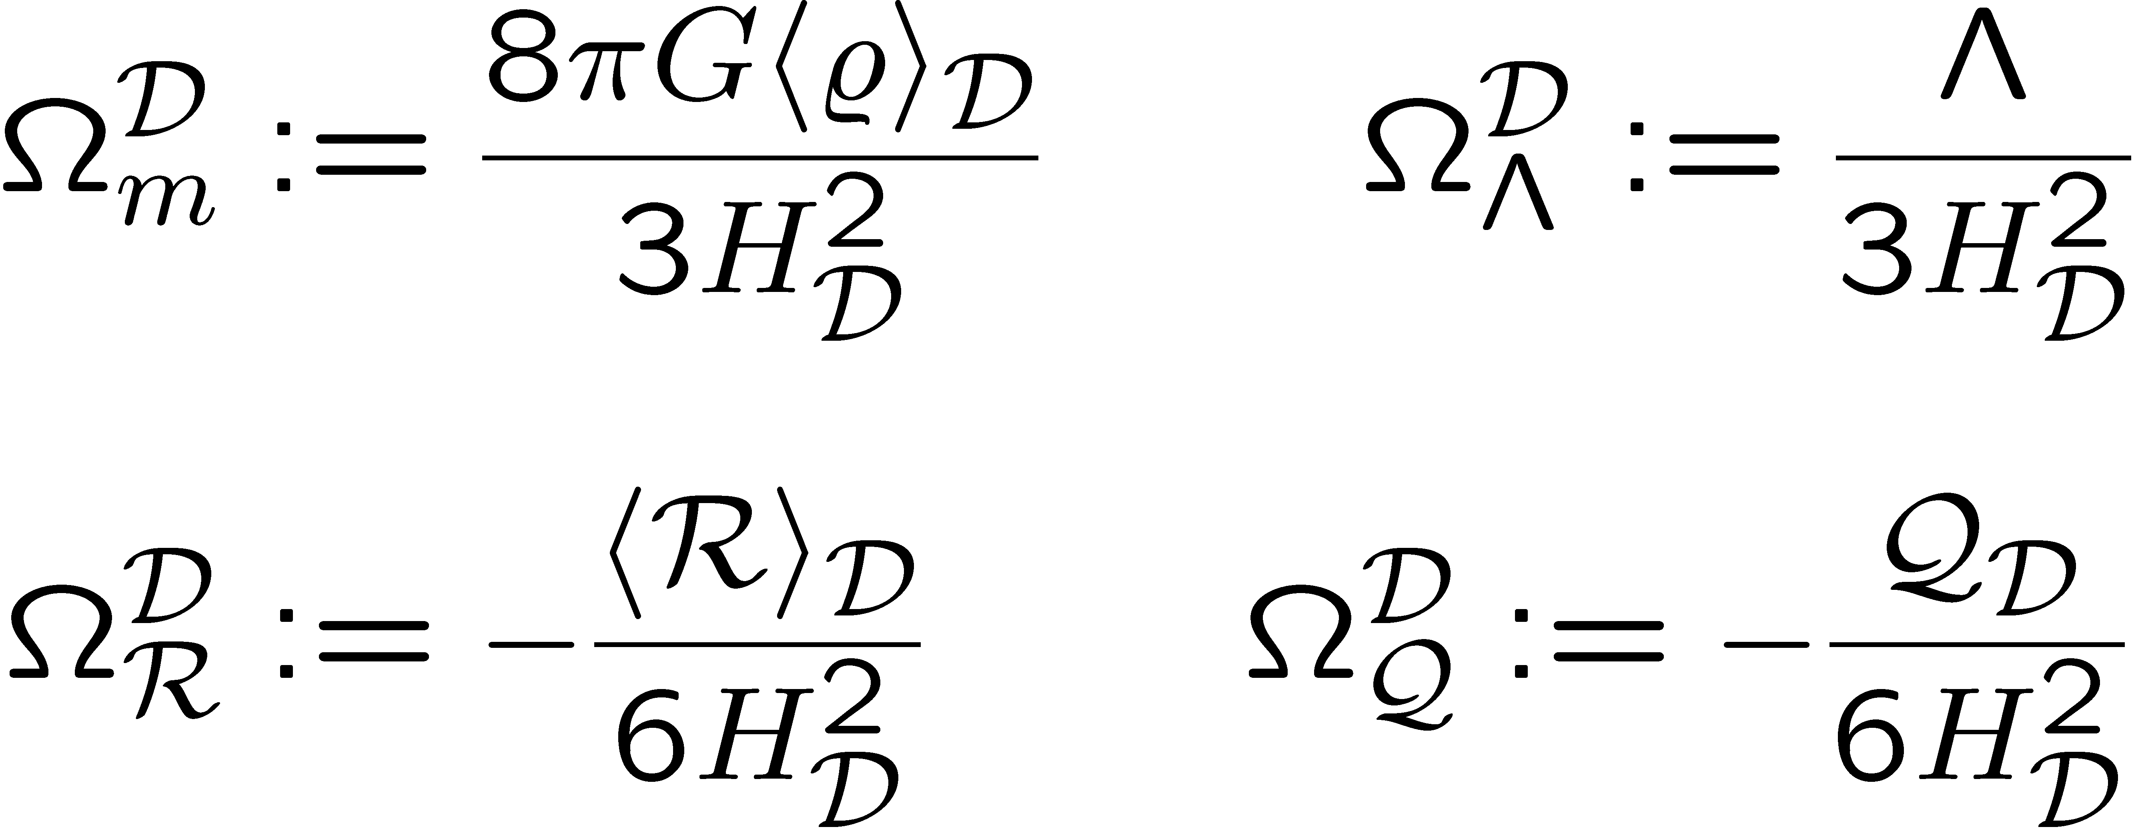
The Cosmic Quartet

Slide 26
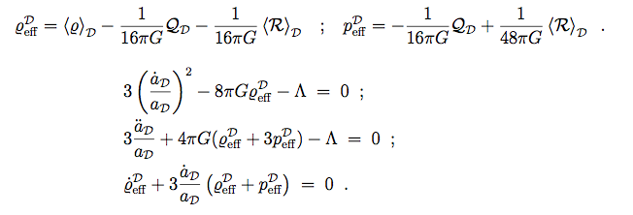
Effective Equations in Friedmannian form :
Effective Scalar Field :`Morphon´
Buchert, Larena, Alimi
arXiv: gr-qc / 0606020

Slide 27
Out-of-Equilibrium States

Slide 28
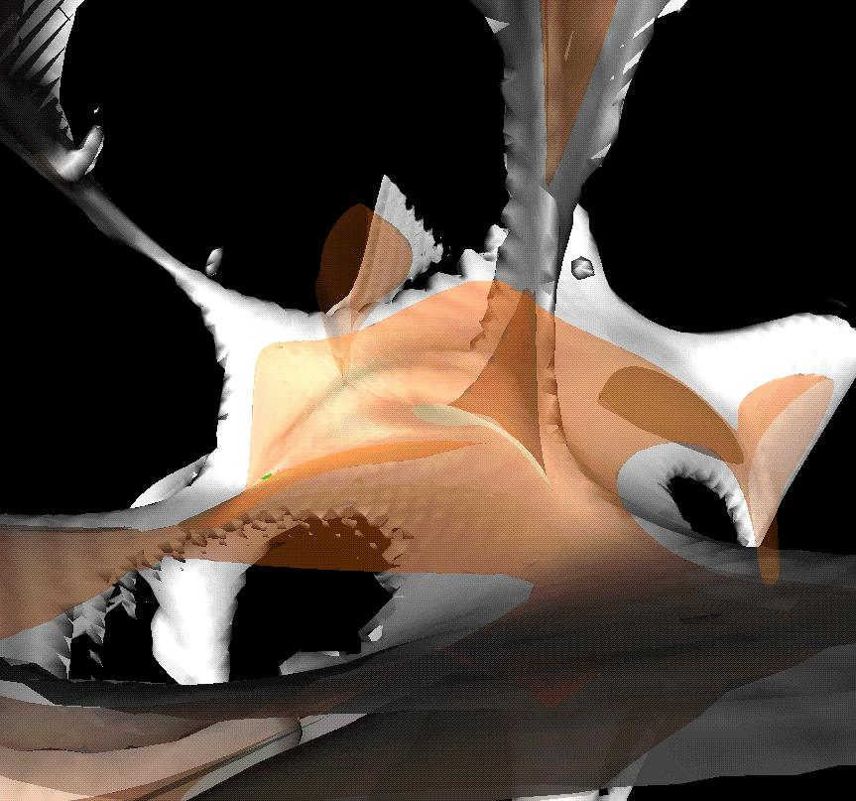
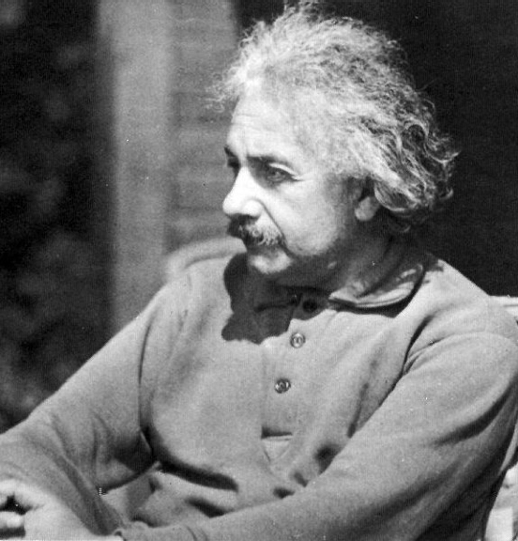
G_{μν} = κ T_{μν}
ρ_{m} + ρ_{φ}
P_{m} + P_{φ}
=
ρ_{m} + ρ_{φ}
P_{m} + P_{φ}
=

Slide 29
Integral Properties of Relativistic Models
Average is non-friedmannian :
generic scaling solutions : n = p
relativistic perturbation theory : n = p = -1
Average is friedmannian for :
Locally isotropic models (homogeneous)
Special LTB models with homogeneous curvature

Slide 30
Effective Quintessence

Slide 31
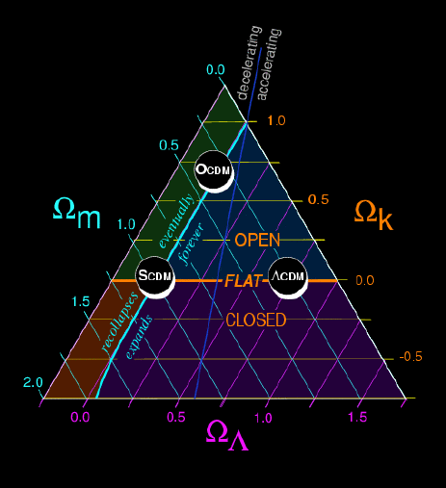
Global Gravitational Instability
Near FRW Cosmologies: Q small
Unstable Sectors :
Q < 0 and <R> > 0
Q > 0 and <R> < 0
Averaged Cosmologies
Roy, Buchert, Carloni, Obadia arXiv: 1103.1146

Slide 32
Phase Space for Λ = 0

Slide 33
Unstable Sectors Λ = 0
DM
DE

Slide 34
Dark Energy Sector Λ = 0
Q > 0 and <R> < 0
2
1/aD
1
1/aD
0
1/aD

Slide 35
Volume-dominance of Voids
Q_{D} ≈ 0 <ρ> ≈ 0 :
<R>_{D} - 2 Λ ≈ – 6 H_{D}²

Slide 36
Multi-scale Toy Models

Slide 37
Volume Partitioning

Slide 38
Volume Partitioning
D
M

Slide 39
Volume Partitioning
D
=
M
υ
E
D
M

Slide 40
Acceleration in the Multi-scale Model

Slide 41
Acceleration in the Multi-scale Model
Wiegand, Buchert
arXiv: 1002.3912

Slide 42
Re-Interpretation of Observations

Slide 43
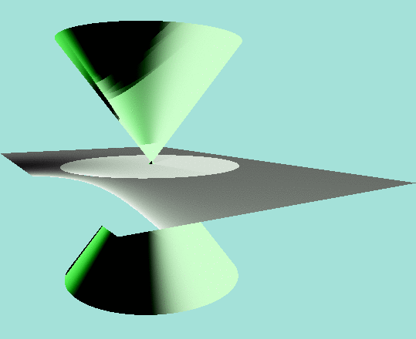
Acceleration in the Standard Model
local acceleration
⅓
_{α(t) =V (t)}
global acceleration
apparent acceleration
_{t}
₂
_{α(t) δij}
Λ

Slide 44
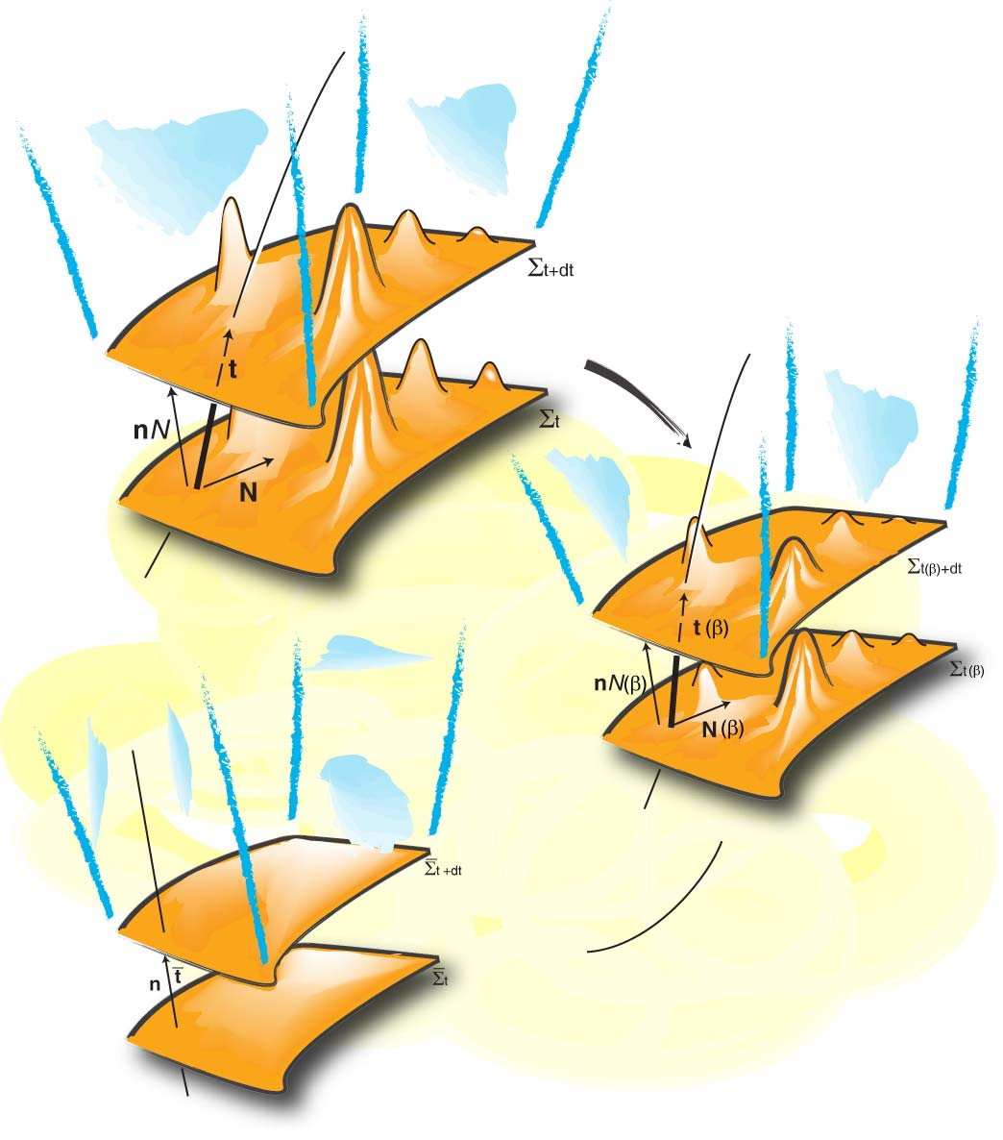
Observational Strategies
C
Template
Metrics
log(1+z)
Larena, Alimi, Buchert, Kunz, Corasaniti arXiv: 0808.1161
Euclid

Slide 45
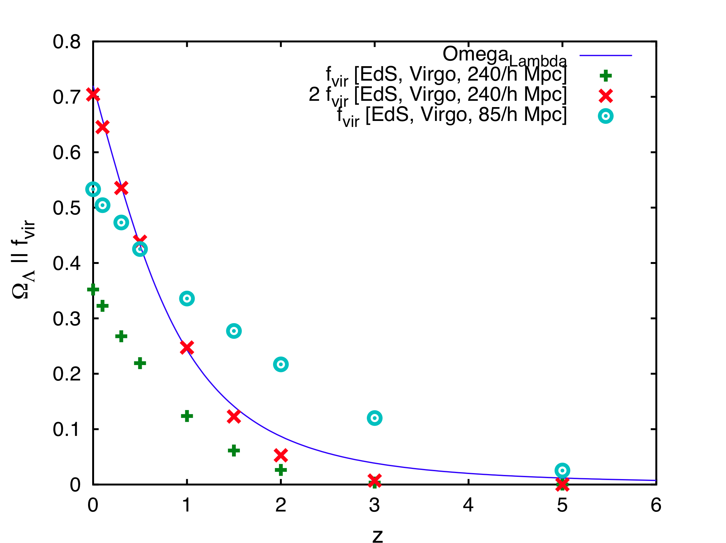
Structure formation and Dark Energy
Roukema, Ostrowski, Buchert
arXiv: 1303.4444

Slide 46
Conclusions
structure formation changes the geometry of
the average cosmology
Dark Energy and Dark Matter exist in terms of
“curvature energies“
qualitative understanding of the mechanism
is completed and it works in the right direction
quantitative understanding in terms of
non-perturbative models is in progress
→ reinterpretation of observations !

