Slide 1
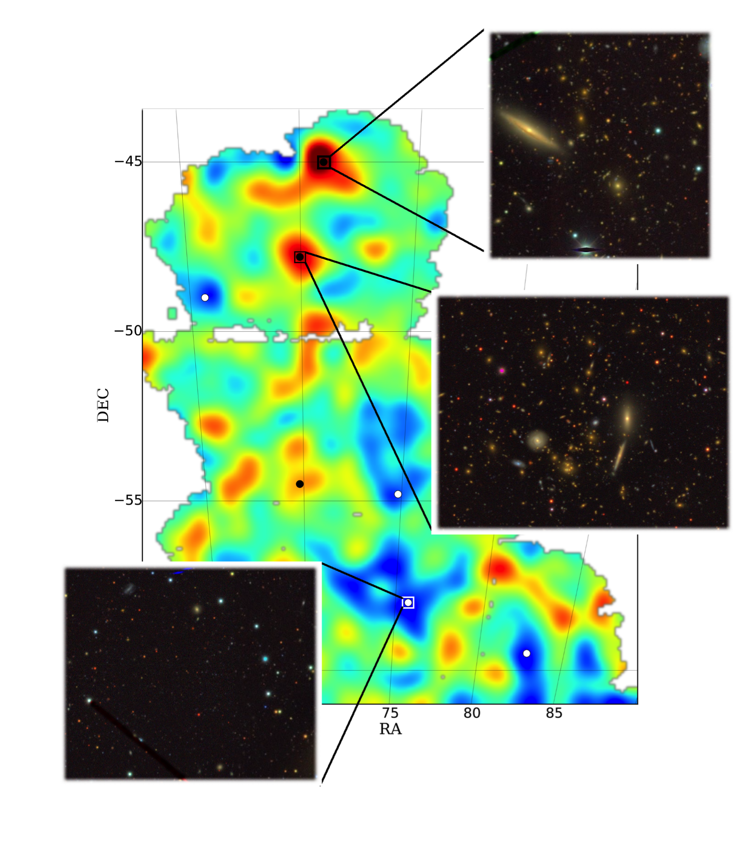
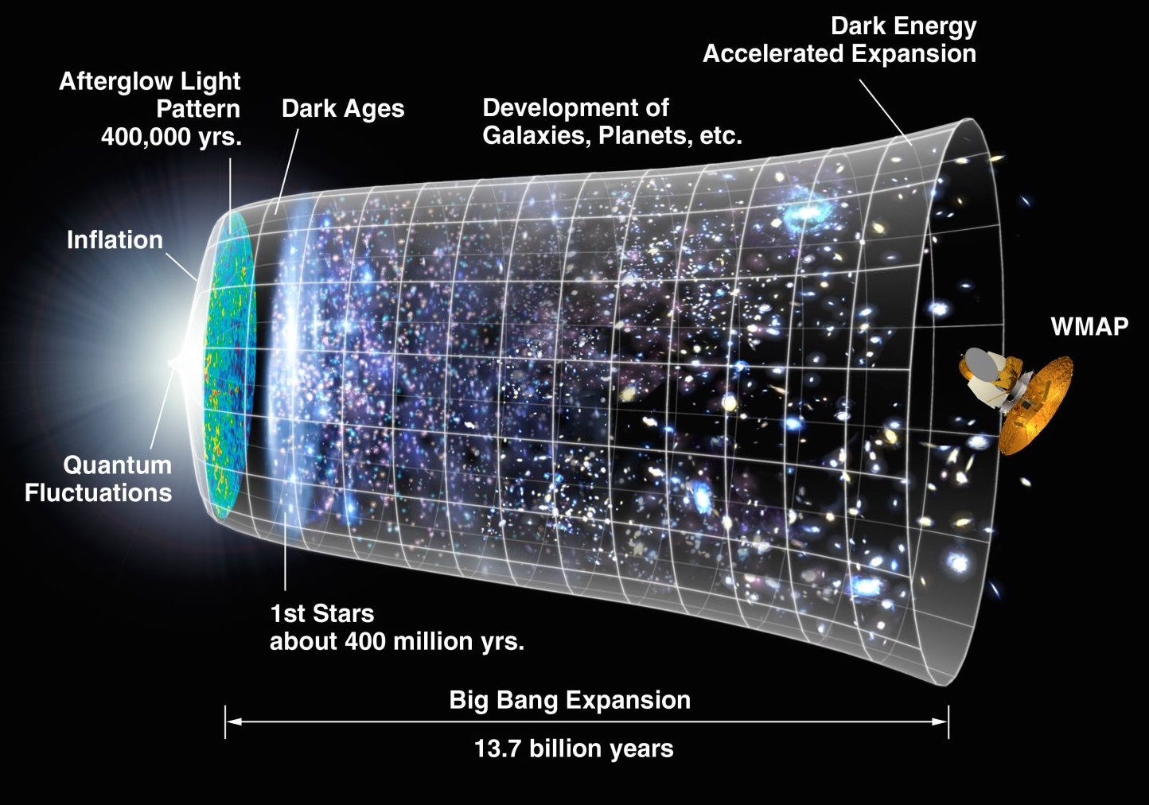
CMB lensing - galaxy lensing joint analysis: current status
Rupert Allison
University of Oxford, UK
13th August 2015
NASA
Vikram et al. (2015)
Notes:
DES – 140 sq. deg, 2 sources per sq. arcmin. 6.8 sigma cross-corr with foreground galaxies. Latest weak lensing published.
✓Systematics: Intrinsic alignments (Elisa paper),biases in shear estimation.
✓Liu 1504.05598, Hand 1311.6200v2
✓SPT, ACT, Planck, KiDS, HSC, CFHTLens, DESxSPT, DESxACT ...
✓Forecasts: SN on cross-spec detection.
✓Photo-zs of sources – could do tomography of this cross-correlation.
✓Make Kc, Kg realisation plot with sigurd’s code. Save maps as pdf for display. Move sources in redshift from z = 0.5, 1, 2 etc. and see how the cross-corr changes (also plot accompanying cross-spectrum). This would be cool to see.
✓Upcoming CCs? DES-SPT, ACTPol-KiDS, further afield AdvACT with HSC (some numbers in Colin’s paper – but that’s for Planck).
✓Colin discusses multiplicative bias – useful text.

Slide 2
Outline of the talk
Motivation: science, calibration
Physics of cross-correlation, modeling the signal
Construction of lensing maps
First detection and current status (2013-15)
Future prospects
Conclusion
Notes:
Hopefully will have convinced you this is a worthwhile cosmological observable, and why you should care.
Cross-correlations in vogue: hopefully this talk will go someway to convincing you why.
Cover some galaxy lensing and CMB lensing, since no-one else is looking like they will! Lensing in general, actually. The lewis and challinor plot -> lens equation.
I’ll finish, unsurprisingly, with my conclusion.

Slide 3
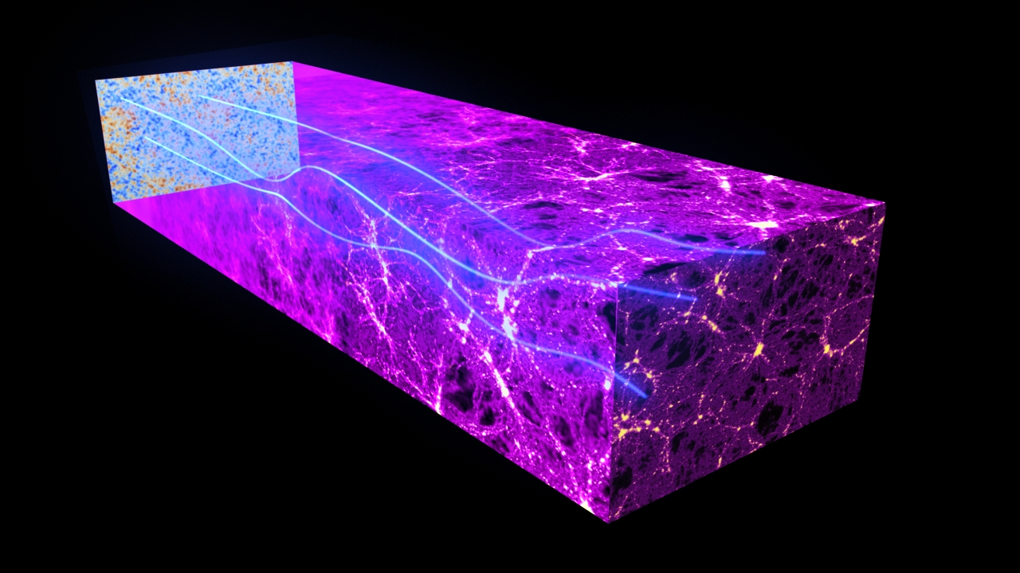
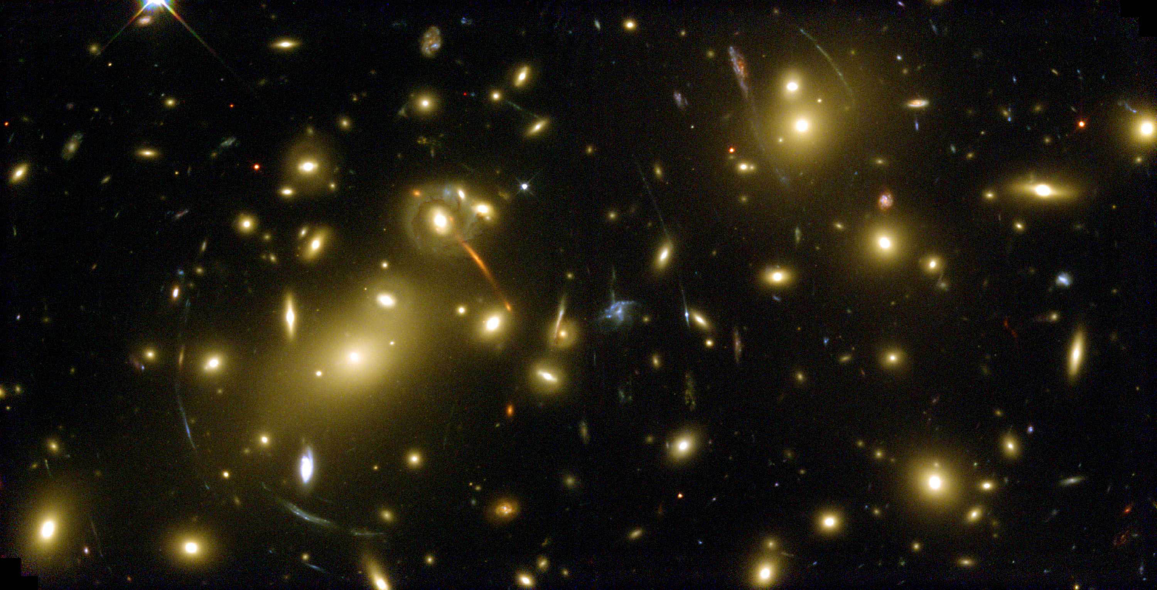
Motivation
ESA
NASA/ESA
CMB lensing - galaxy lensing joint analysis
Both probe underlying dark matter
Cosmological information
Calibration of auto-correlation, extraction of cosmology
Handling of multiplicative bias (e.g. mis-est. of ellipticities)
Tomography
Robust to systematics (no tracer bias)
Notes:
NASA/ESA for both images.
Both measure the integrated DM along the line of sight to the source: so that’s the galaxy for galaxy lensing, and last scattering for CMB lensing. There are, of course, geometrical weighting factors.
Cosmological info over and above the auto-spectra: lensing auto z ~0.5, CMB lensing auto z~2, cross-spectrum z~2.
Systematics: e.g. PSF, which is spatially varying, can artificially boost the auto-spectrum (looking like sigma8 or omegaM); this will not be correlated with the CMB, so if the cross-spectrum looks completely different to what one expected.
Also multiplicative bias, due to mis-estimation of galaxy ellipticity from the noisy, PSF convolved image of the galaxy.
In some sense CMB lensing is clean – we know the precisely source distribution: it’s a delta function at recombination. Extraction of lensing from CMB uses the correlation of modes in polarisation and temperature which would otherwise be uncorrelated.
Advantages: unbiases tracers of the DM! The unknown source bias makes cosmological inferences from EM tracers difficult.
Cross-correlation: no noise bias, cancellation of systematics (some just wont show up in the cross-correlation, although e.g. amplitude calibration error would do (multiplicative bias) )
Cross-check of results from auto spectra: e.g. if see feature in auto, likely would see in cross, and if don’t then likely systematic.

Slide 4
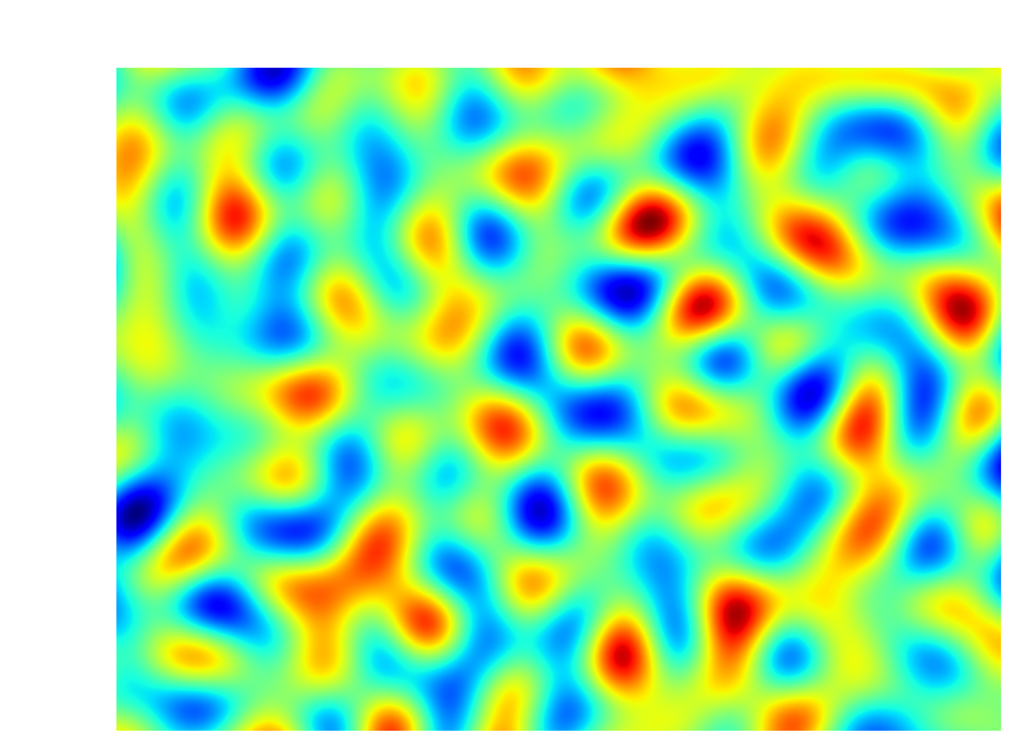
Simulated (noiseless) lensing fields
Radio galaxies are biased tracers of the underlying dark matter density field
CMB lensing also due to density fluctuations of the dark matter
Sources at
Low-pass filtered:
Notes:
40 x 30 deg area. (1200 deg^2, so that’s about 3% of the full sphere).
Will define these quantities soon, but for now just appreciate them as a measure of the lensing effect.
Convergence is a scalar quantity, and has the nice interpretation as a measure of the magnification (in weak-lensing limit, kappa = 2 mu).
Correlated Gaussian realisations for the CMB and galaxy convergence , drawn from model power spectra,
Can just about see more smaller scale power in the CMB power spec (peak of lensing power spectrum at smaller scales (the lensing efficiency is at higher redshift)).

Slide 5
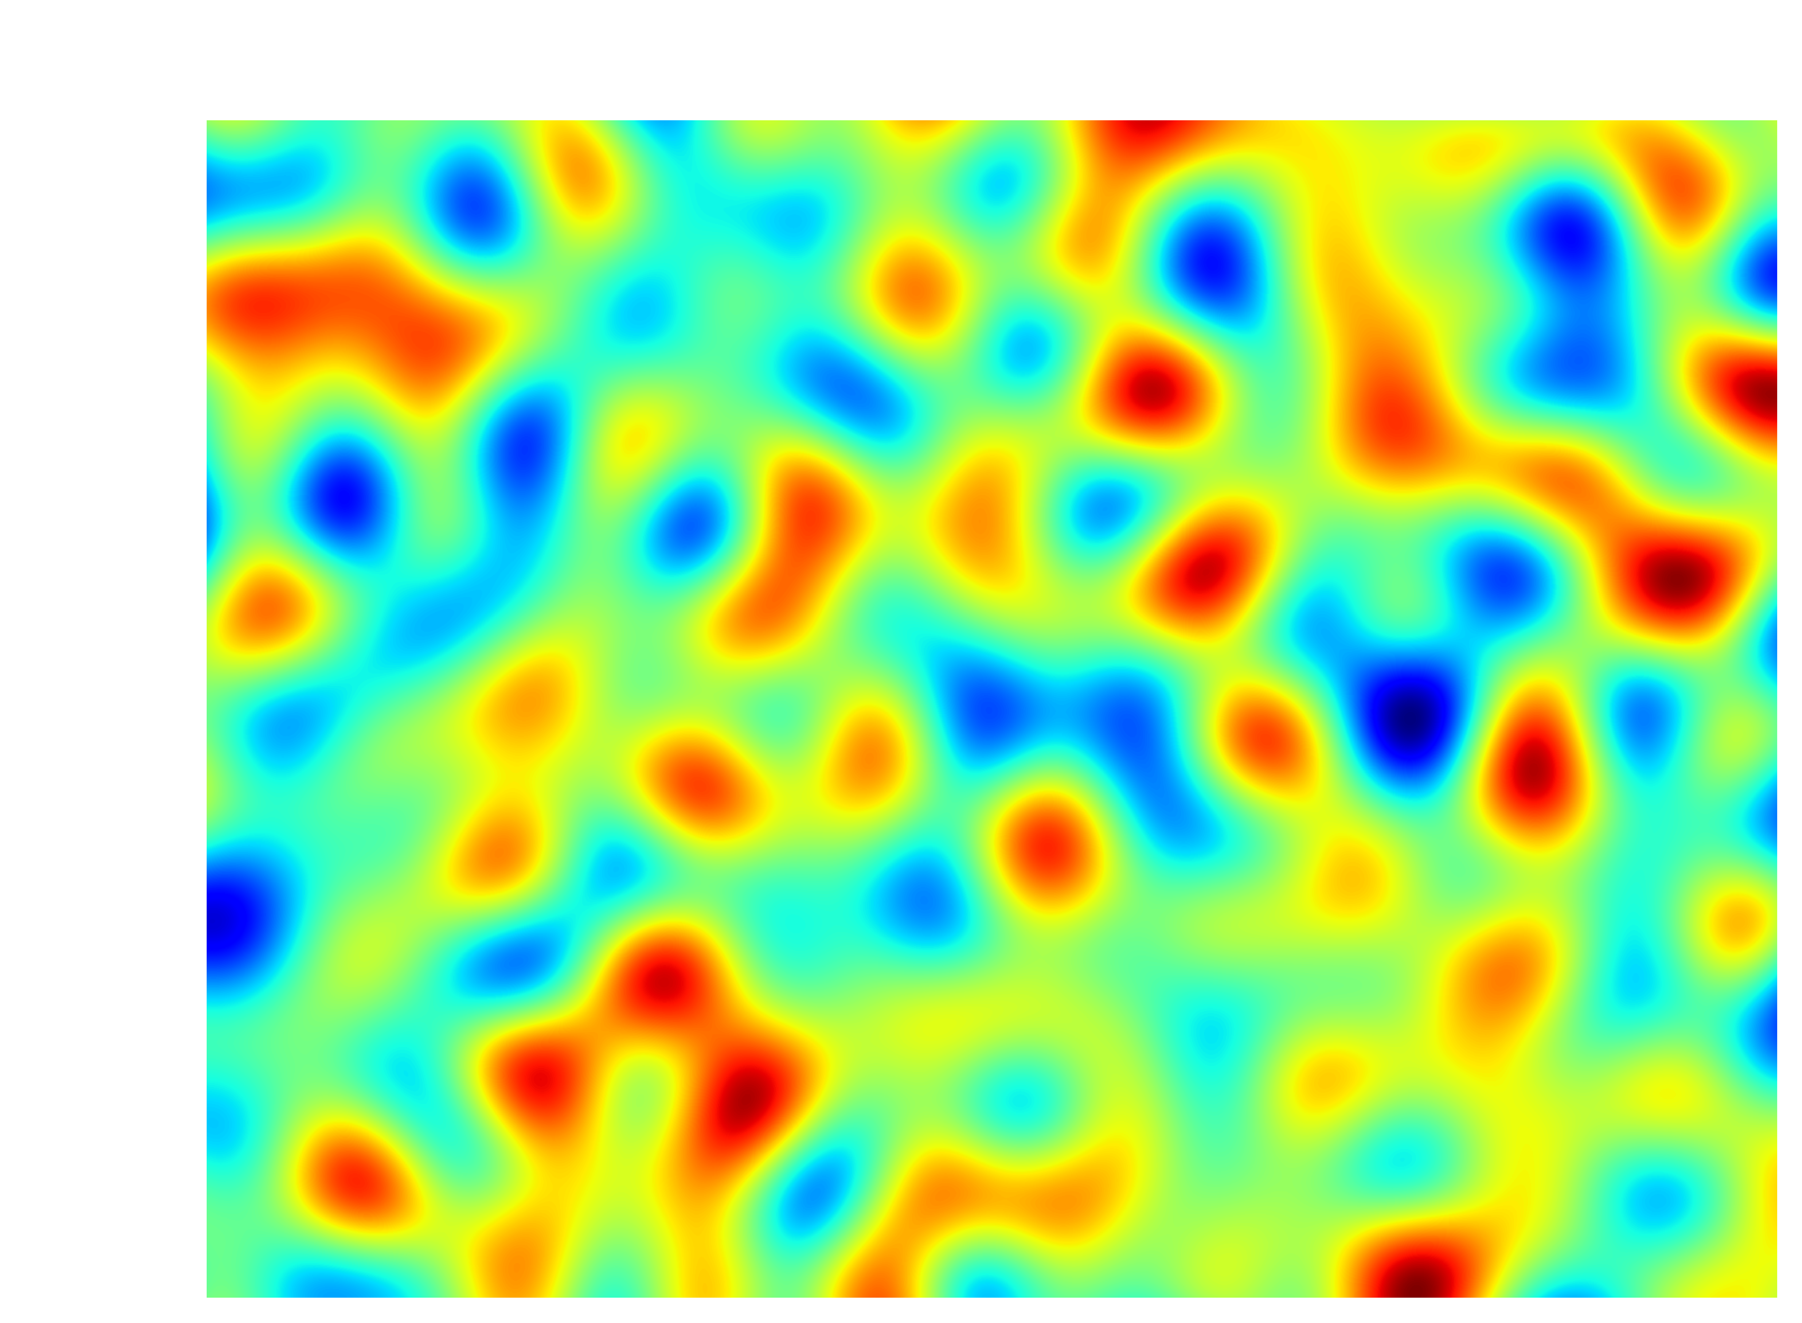
Simulated (noiseless) lensing fields
Radio galaxies are biased tracers of the underlying dark matter density field
CMB lensing also due to density fluctuations of the dark matter
Sources at
Low-pass filtered:
Notes:
40degx30deg.
No noise simulations of correlated Gaussian fields.

Slide 6
Definitions
Convergence is defined as the Laplacian of the lensing potential (up to a sign and factor of two), and may be written
with the integrand kernel (or window function):
Note GR is assumed when converting from the Weyl potential to matter overdensity (via the Poisson eq.); this be relaxed for weak-lensing in MG.
Convergence is a proxy for magnification; in the weak-lensing regime:
Notes:
40degx30deg.
No noise simulations of correlated Gaussian fields.
Born approximation is to evaluate the integral over the unperturbed ray. This approximation is fine for CMB and galaxy weak lensing.
Highlight the important terms.
Point out what cosmological parameter the probe is therefore sensitive to: sigma8, omegaM, omegaK; anything that influences angular diameter distances or the growth of perturbations
\kappa(\boldsymbol{\theta}) = \int_0^{\chi_H} d\chi W(\chi) \delta( f_k(\chi)\boldsymbol{\theta},\chi)
W(\chi) = \frac{3\Omega_{\rm m} H_0^2}{2c^2} \frac{f_k(\chi)}{a(\chi)} \int_\chi^{\chi_H} d\chi' p(\chi') \frac{f_k(\chi' - \chi)}{f_k(\chi')}

Slide 7
Definitions
Convergence is defined as the Laplacian of the lensing potential (up to a sign and factor of two), and may be written
with the integrand kernel (or window function):
Radial comoving distance
Matter overdensity
Normalized source distribution
Note GR is assumed when converting from the Weyl potential to matter overdensity (via the Poisson eq.); this be relaxed for weak-lensing in MG.
Convergence is a proxy for magnification; in the weak-lensing regime:
Notes:
40degx30deg.
No noise simulations of correlated Gaussian fields.
Born approximation is to evaluate the integral over the unperturbed ray. This approximation is fine for CMB and galaxy weak lensing.
Highlight the important terms.
Point out what cosmological parameter the probe is therefore sensitive to: sigma8, omegaM, omegaK; anything that influences angular diameter distances or the growth of perturbations
\kappa(\boldsymbol{\theta}) = \int_0^{\chi_H} d\chi W(\chi) \delta( f_k(\chi)\boldsymbol{\theta},\chi)
W(\chi) = \frac{3\Omega_{\rm m} H_0^2}{2c^2} \frac{f_k(\chi)}{a(\chi)} \int_\chi^{\chi_H} d\chi' p(\chi') \frac{f_k(\chi' - \chi)}{f_k(\chi')}

Slide 8
Source distribution
CMB lensing source: LSS at distance : easy!
Galaxy source distribution: challenging!
Now we have the ingredients to compute the window functions
        for any given set of cosmological parameters.
Source distribution in redshift – obtain from spec- or photo-z measurements (more on this later)
Notes:
Will return to the source distance later (where I can mention the Bonnett paper studying systematic effect of unknown source distribution. Solution: sample the allowed source distribution simulataneously to sampling cosmoligical parameters.
{\rm m} H_0^2}{2c^2} \frac{f_k(\chi)}{a(\chi)} \int_\chi^{\chi_H} p(\chi') \frac{f_k(\chi' - \chi)}{f_k(\chi')}

Slide 9
Cross-correlation of CMB lensing with galaxy lensing
One can compute the cross-spectrum, defined by
Notes:
The cross-spectrum is a weighted integral of the matter power spectrum
For any set of cosmological parameters we can easily compute the theory spectrum (with a little help from a Boltzmann solver)
We can also estimate the cross-spectrum from the data (next slide)
MG: Schmidt (2008) 1501.03509, Leonard et al. (2015) 1501.03509
Limber approximation
Theory
Power spectra
Data
Notes:
On the flat sky. Easily generalised to curved sky which used the spherical harmonic alm coefficients.
Cross-spectrum (given the auto-spectra) defines the scale-dependent correlation between the fields.
Interface of theory and data. This is a take-away message!
Modified gravity? Can affect all terms: modified Poisson equation which relates the potential to density perturbations delta, modified growth of fluctuations (goes into power spec), modification of cosmological distance measure (affects the geometry terms out front).
Paper by Fabian Schmidt (2008) 1501.03509 explains much, good starting point for MG effect on WL. Also Danielle’s paper 1501.03509 separates GR and MG terms, giving good physical insight into the effect of MG on weak-lensing observables, and some numerical forecasts for constraining MG with ML. All would apply to CMB lensing too.

Slide 10
Cross-spectrum: shifting the sources population
Theory
Power spectra
Data
Notes:
Plotting model power spectra for sources placed at different redshifts.
If you look at the amplitude of the cross-spectrum, it increases hugely on shifting from Z~0.5 -> Z~2 (factor of 7 in cross-spectrum). Physically this is because the photons being emitted by the source galaxies pass more dark matter fluctuations, are deflected by more potential wells, on their path to our telescopes, and this increases the variance in the deflection angle. (mention increased correlation next slide)
Peak moves to right at higher redshift since the typical lenses are more distant, so subtend a smaller angle on the sky.
Peak in cross-spec? Remember the cross-spec is a projection of the matter power spectrum! Same reason there’s a peak in the power spec: low ell -> low k (large modes) -> suppressed by power spec, high ell -> high k (small modes) -> suppressed by power spec.

Slide 11
Cross-spectrum: quantifies correlation of the fields as a function of scale
Theory
Power spectra
Data
Notes:
If you look at the amplitude of the cross-spectrum, it increases hugely on shifting from Z~0.5 -> Z~2 (factor of 3 in cross-spectrum).
Why increased correlation at large-scales? Well there you’re really picking up nearby lenses, which are common to the galaxies and the CMB (clearly lenses, i.e. DM blobs) at redshifts higher than the sources do no affect the galaxies but do so the CMB. Why does large scale → nearby? Well the typical size of the lenses (given by the peak o are a slowly varying function in redshift

Slide 12
Extraction of lensing signal
(construction of lensing maps)
CMB lensing:
    use coupling of otherwise uncoupled modes in T and P
Galaxy lensing:
    use the assumption of circularity (on average) and measure coherent distortions in the shape (i.e. cosmic shear)
    convert from (spin-2 field of) ellipticities to (scalar) convergence
Obtain (noisy) maps of CMB convergence and galaxy convergence
Ask me afterwards if you’re interested in the details of lensing estimation.
Have a cup of tea.
.
Unlensed
Lensed
Theory
Power spectra
Data
Notes:
Hu and Okamoto quadratic estimator.
Lensing introduces non-Gaussianity into the CMB Temperature and polarisation maps.
Define unbiased estimator – account for non-trivial window function.
Maps → FFT → Cross spectrum estimator → Data cross-spectrum.
Have a slide on CMB lensing and a slide on gal lensing (KS estimator) in case of questions. Also intrinsic dispersion of ellipticity. Derivatives of lensing potential.
Also slide on the cross-spectrum estimator.
After you’ve constructed your lensing maps, it’s probably been a struggle, so I recommend you have a break and a cup of tea.
\langle \tilde{T}(\boldsymbol{\ell}) \tilde{T}(\boldsymbol{\ell'}) \rangle = (2\pi)^2 \delta(\boldsymbol{\ell} - \boldsymbol{\ell}) C_\ell^{TT}
\langle T(\boldsymbol{\ell}) T^*(\boldsymbol{\ell'}) \rangle = f( \boldsymbol{\ell}, \boldsymbol{\ell}' ) \kappa( \boldsymbol{\ell + \ell'} )

Slide 13
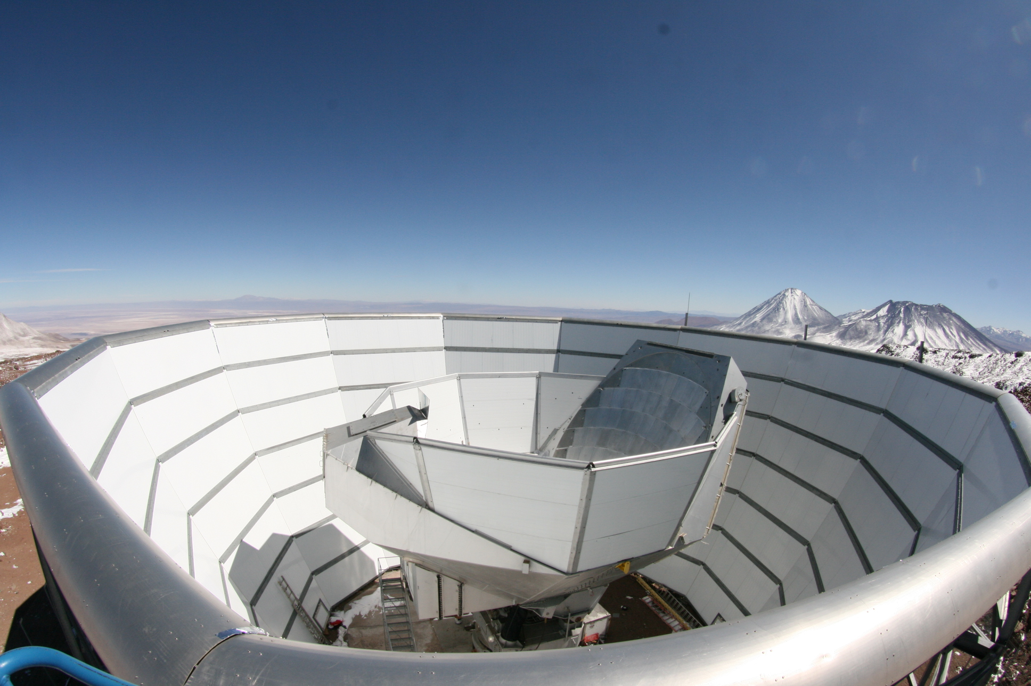
Results
First detection: Hand et al. (2013) at 4.2
Data
Mark Devlin
Notes:
Hand:
4.2 sigma results.
120 sq. deg. Canada-France-Hawaii Telescope Stripe 82 Survey, overlapping with lensing from the Atacama Cosmology telescope (include some slides at the end on ACT).
Liu.

Slide 14
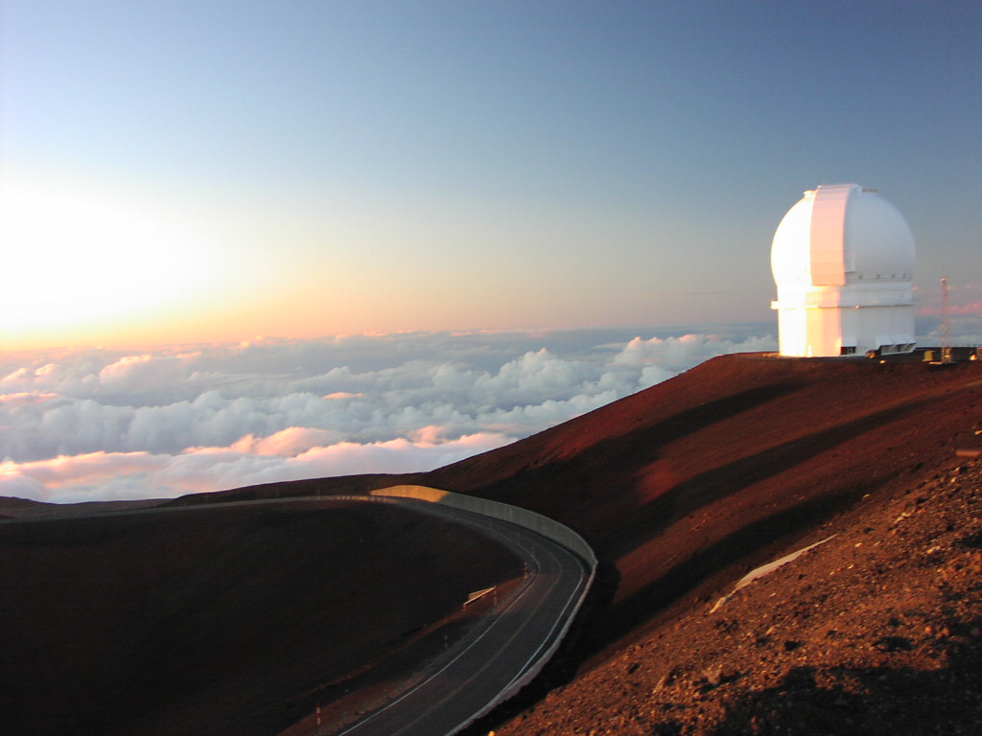
Results
First detection: Hand et al. (2013) at 4.2
jjcafe.net
Notes:
Hand:
4.2 sigma results.
120 sq. deg. Canada-France-Hawaii Telescope Stripe 82 Survey, overlapping with lensing from the Atacama Cosmology telescope (include some slides at the end on ACT).
Liu.

Slide 15
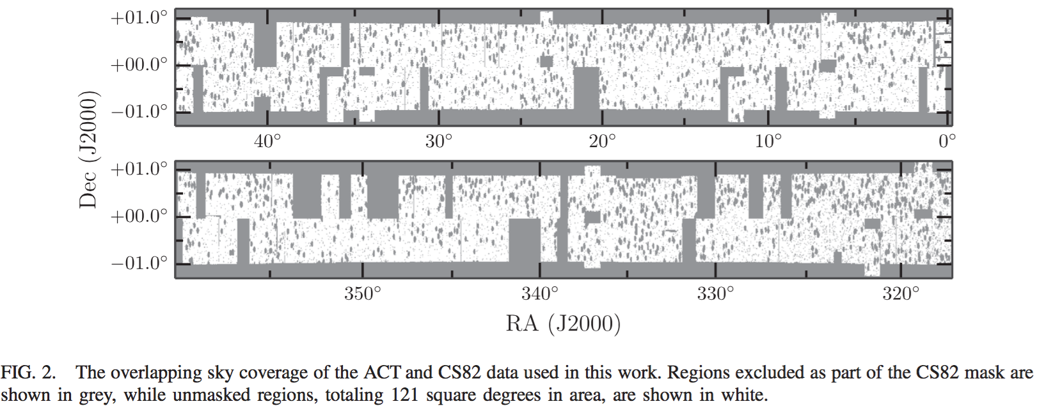
Results
First detection: Hand et al. (2013) at 4.2
Theory
Data
Notes:
Hand:
4.2 sigma results.
120 sq. deg. Canada-France-Hawaii Telescope Stripe 82 Survey, overlapping with lensing from the Atacama Cosmology telescope (include some slides at the end on ACT).
Describe the grey and the white.
0.3% of the sky. Highly masked.
Liu.

Slide 16
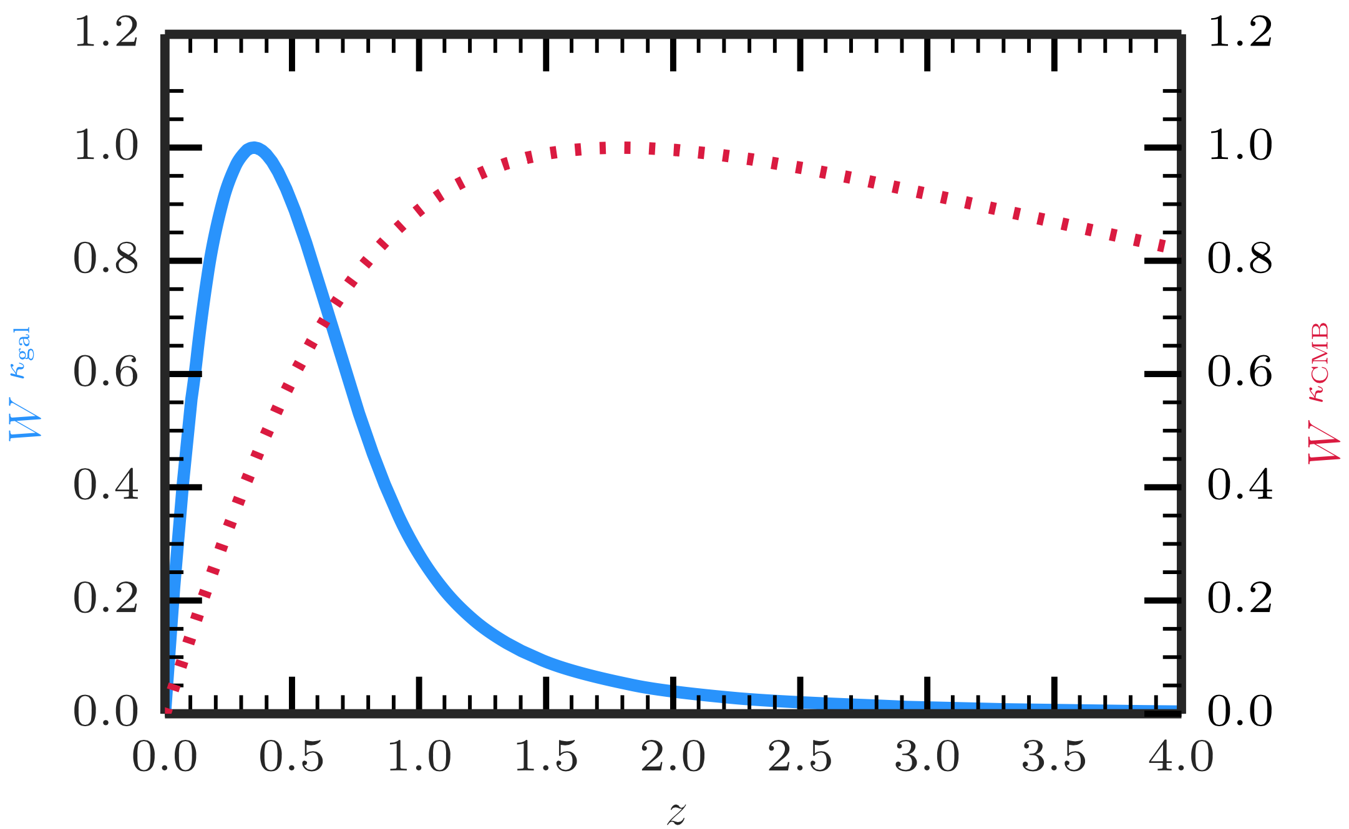
Results
First detection: Hand et al. (2013) at 4.2
Theory
Data
Notes:
Hand:
4.2 sigma results.
120 sq. deg. Canada-France-Hawaii Telescope Stripe 82 Survey, overlapping with lensing from the Atacama Cosmology telescope (include some slides at the end on ACT).
High redshift tail – redshifts most uncertain here, but this is significant for the cross-spectrum due to shape of the CMB lensing kernel.
Liu.

Slide 17
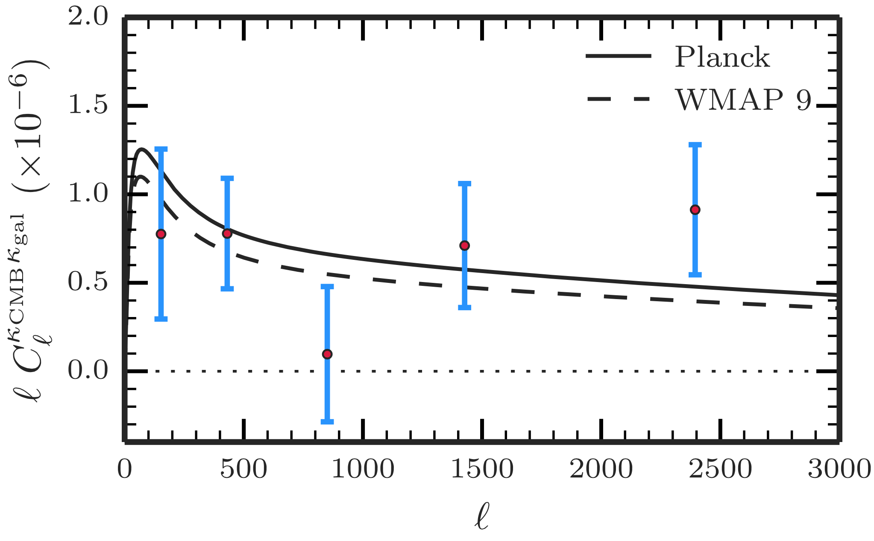
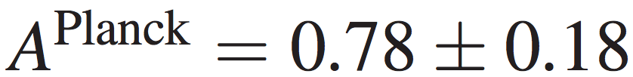
Results
First detection: Hand et al. (2013) at 4.2
Theory
Data
Notes:
Hand:
4.2 sigma results.
120 sq. deg. Canada-France-Hawaii Telescope Stripe 82 Survey, overlapping with lensing from the Atacama Cosmology telescope (include some slides at the end on ACT).
High redshift tail – redshifts most uncertain here, but this is significant for the cross-spectrum due to shape of the CMB lensing kernel.
Liu.

Slide 18
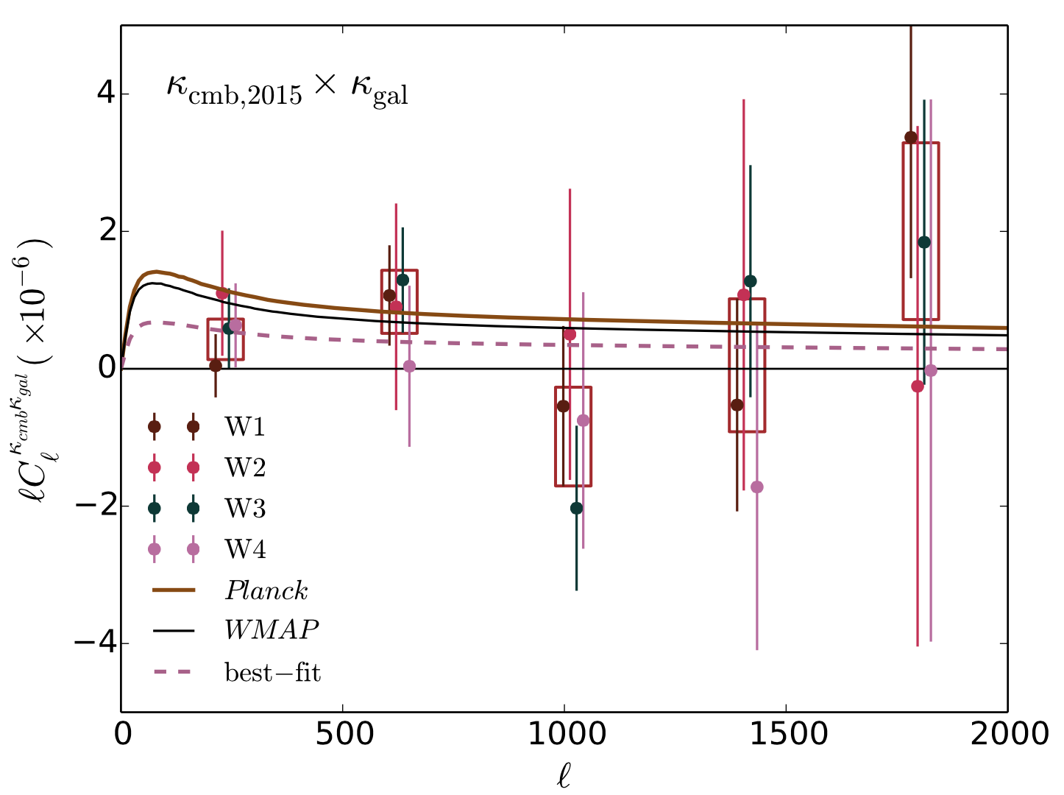

Results
Planck CFHTLens: Liu & Hill (2015) at 2
Theory
Data
Notes:
Hand:
4.2 sigma results.
120 sq. deg. Canada-France-Hawaii Telescope Stripe 82 Survey, overlapping with lensing from the Atacama Cosmology telescope (include some slides at the end on ACT).
4 fields (W1 – 4), combine results.
High redshift tail – redshifts most uncertain here, but this is significant for the cross-spectrum due to shape of the CMB lensing kernel.
Liu & Hill: Result much lower than expected. (Hand was also slightly low)

Slide 19
Systematic effects
Intrinsic alignments: Troxel & Ishak (2014), Hall & Taylor (2014), Chisari et. al (2015)
Tension of derived from Planck and CFHTLens
PSF systematics; can look like cosmic shear.
Redshift distribution uncertainties: really need full propagation of uncertainties, otherwise cosmological inferences are biased (e.g. Bonnet et al. 2015)
Non-linear power spectrum uncertainties.
Multiplicative bias in shear estimation (Das, Errard, Spergel 2014).
Galaxy auto-spectra also affected by these systematics – calibration with the cross-spectrum.
Theory
Data
Notes:
No pictures – systematics are a BAD THING AND WE DON’T LIKE THEM!
IAs affect gal lensing but not CMB, so, again cross-spectrum is a useful calibrator (when use the same galaxy population for gal lensing auto and cross).
Some of these might explain low value for amplitude in Liu (but, given error bar, could also be a fluctuation, will some of these effects possibly folded in.)
Bonnet et al. (2015) consider the bias coming from redshift distribution uncertainties. Best thing to do would be sample the gal-by-gal p(z) simulataneously to parameter inference.
Bonnett et al. (2015, 1507.05909) look at the bias which using an incorrect dndz can give. Find 3% bias on sigma8 (~<1 sigma on sigma8 in their cosmological analysis.
Multiplicative bias can be controlled (calibrated) by including the cross-correlation (~2% for survey specs used in Das, Errard and Spergel).
High redshift tail – redshifts most uncertain here, but this is significant for the cross-spectrum due to shape of the CMB lensing kernel.
Liu & Hill: Result much lower than expected. (Hand was also slightly low).
Only two papers so far which measure the cross-correlation.
Multiplicative bias (1+m): linear for the cross, quadratic for the auto.
Many of these systematics effects are common to gal auto and cross, but come in as different factors. Hence the power of cross-corr as a calibrator.

Slide 20
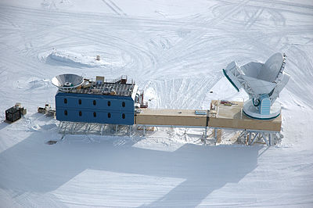
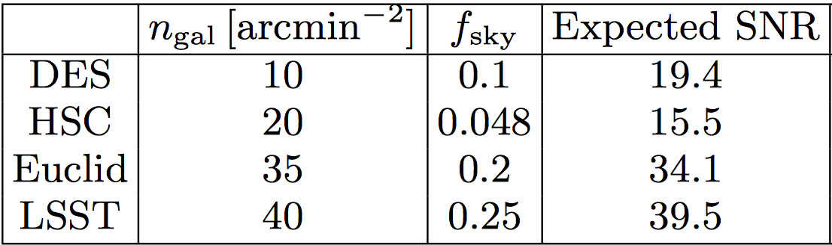
Future prospects for
SPT DES: depth, 2500 deg²,
ACTPol/SPTPol DES/KiDS:
Planck lensing cross-correlations:
Upcoming CMB data: AdvACT, SPT-3G
Upcoming weak-lensing data: KiDS, DES, HSC, LSST, Euclid
SKA radio weak-lensing (PSF known exactly)
Liu & Hill (2015)
Notes:
SPT-3G: 2500 deg^2
Compare to the state of the art 4.2 sigma. So much more to be done with respect to this cosmological observable, which is what makes it exciting.

Slide 21
Conclusions
CMB lensing is a natural and necessary complement to galaxy lensing
Improvement of cosmological constraints above auto-spectra alone (tomography).
Careful handling of systematic biases will be required for future analyses involving parameter extraction
Thanks for listening!
Notes:
A full analysis will si- multaneously estimate the three power spectra, marginalizing over uncertainty in the redshift distribution and cosmology (Pearson & Zahn 2014). With current data there are strong degeneracies in the cross-spectrum amplitude between sources from different redshifts. The shape of the power spectra contains information about the bias evolution, and larger, more sensitive surveys will allow us to break these degeneracies.
Precision astrophysics and cosmology

Slide 22
BONUS SLIDES
Notes:
A full analysis will si- multaneously estimate the three power spectra, marginalizing over uncertainty in the redshift distribution and cosmology (Pearson & Zahn 2014). With current data there are strong degeneracies in the cross-spectrum amplitude between sources from different redshifts. The shape of the power spectra contains information about the bias evolution, and larger, more sensitive surveys will allow us to break these degeneracies.
Precision astrophysics and cosmology

Slide 23
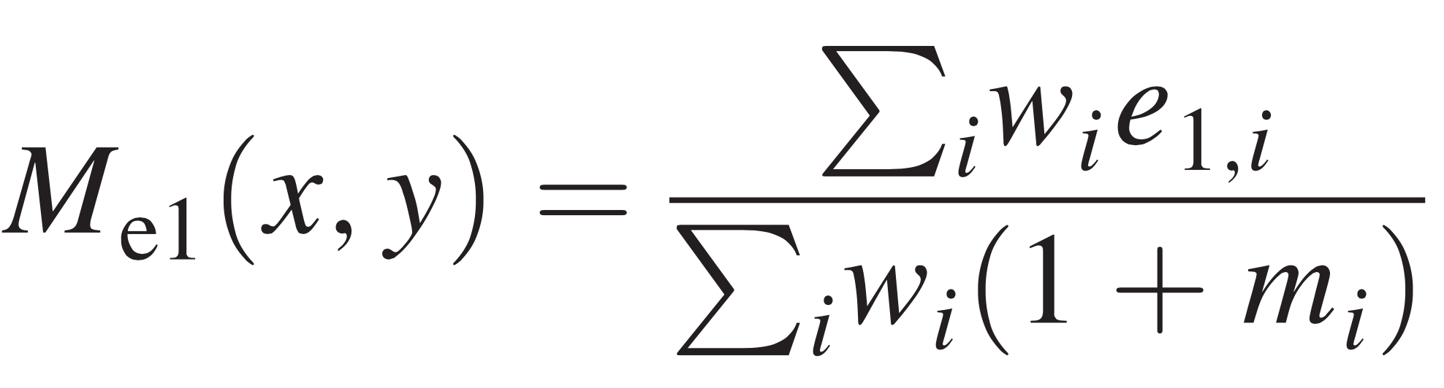
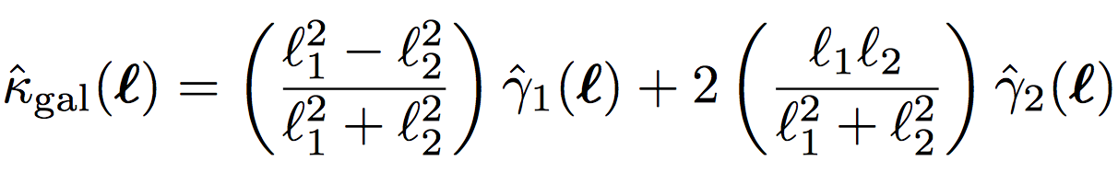

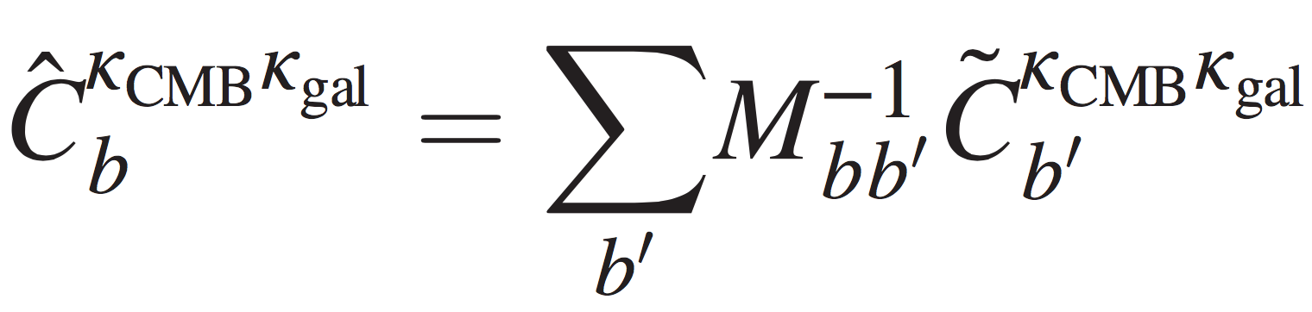
Galaxy shear and convergence estimation
Photometry → inference of galaxy shape
Shears estimated from the observed galaxy ellipticity e.g.
Relate convergence to ellipticity via the lensing potential
(Kaiser & Squires 1992):
This object goes into forming an unbiased estimate of the cross-spectrum:
Inverse mode-coupling matrix corrects for smoothing, windowing and binning operations.
Notes:
A full analysis will simultaneously estimate the three power spectra, marginalizing over uncertainty in the redshift distribution and cosmology (Pearson & Zahn 2014). With current data there are strong degeneracies in the cross-spectrum amplitude between sources from different redshifts. The shape of the power spectra contains information about the bias evolution, and larger, more sensitive surveys will allow us to break these degeneracies.
Precision astrophysics and cosmology

Slide 24
CMB lensing estimation (T and P).
Notes:
Wiener Filtered (weight the modes by their (S / N)^2)
A full analysis will si- multaneously estimate the three power spectra, marginalizing over uncertainty in the redshift distribution and cosmology (Pearson & Zahn 2014). With current data there are strong degeneracies in the cross-spectrum amplitude between sources from different redshifts. The shape of the power spectra contains information about the bias evolution, and larger, more sensitive surveys will allow us to break these degeneracies.
Precision astrophysics and cosmology

Slide 25
Gravitational lensing of the CMB induces mode coupling
We use the observed coupling of modes to estimate the lensing potential:
Take-away point: we can estimate the lensing potential directly from the observed CMB (in temperature and polarisation)
Notes:
Lensing:
1. Smooth peaks in the power spectra
2. Couples modes
This works because the statistics of the unlensed CMB are known (Gaussian and uncoupled modes).
A(L) given once we demand that the estimator is unbiased i.e. the average estimate is precisely the Fourier-space map of the lensing potential
The filter F can be chosen arbitrarily, but use it to upweight pairs of modes which are strongly coupled (large pair-response function f on previous slide) downweight pairs modes which have a large variance (sample/cosmic variance or noise variance).
The deflection field and convergence are just related to \phi(L) by factors of L/L_i.
With phi(L) in hand, we obtain a noisy map of the lensing potential by inverse Fourier transforming to real-space

Slide 26
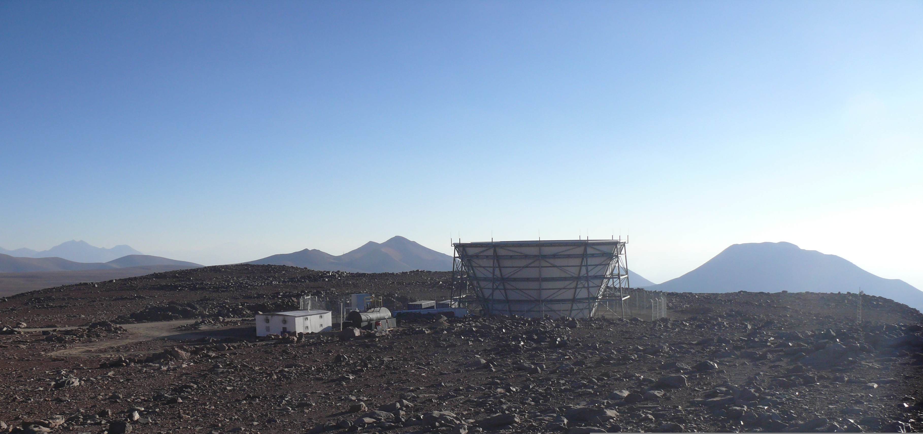
ACT
Atacama Cosmology Telescope
Cerro Toco, Northern Chile
6m dish CMB telescope
ACTPol polarimeter fitted 2013
90,150 GHz
First T and P data in Naess et al. (2014)
Photo: Lyman Page
Notes:
6m telescope, the Atacama Cosmology Telescope
Polarisation-sensitive array received first light in July 2013
Recent paper – science obs from Sept-Dec 2013.
Detection of E mode power spectrum, Resolve 6 peaks
Extensive overlap with various current and planned surveys e.g. LSST, BOSS, HSC, CFHTLens, KiDS
Observed in 4 fields: D1, 2, 5 and 6. T sensitivity < the 3 year ACT obs after just 3months! AdvACT is the successor

Slide 27
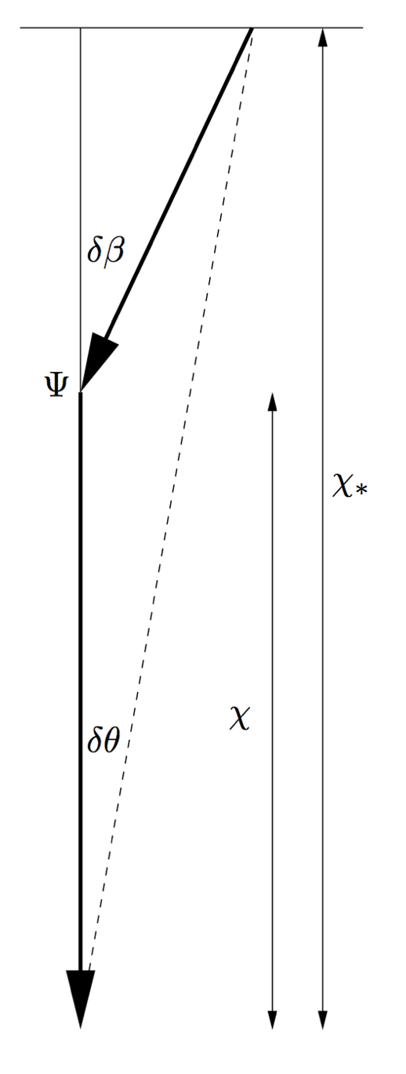
CMB lensing from ACTPol
ACTPol D1 convergence
Lewis & Challinor 2006
Planck lensing potential
Photo: Lyman Page
Notes:
Map is 6deg x 10deg
Modulated by the pixel hit count map -> larger variance in the centre which was observed more frequently.
Signal dominated on scales of 1 deg or more.

Slide 28
CMB lensing from ACTPol
(Real data: D6)
Notes:
This is the ACTPol D6 convergence map as derived from the TT estimator (there are polarisation estimators too)
TT estimator
D6 patch
Modulated by the ACTPol hit map (two factors thereof)
Noise dominated on small scales, signal dominated on scales above around 1 deg

Slide 29
CMB lensing: reconstruction noise

