Slide 1
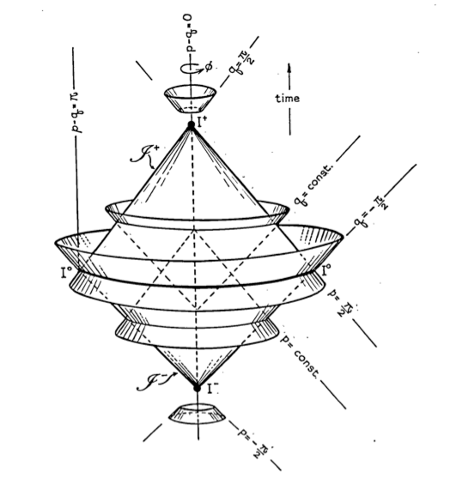
XIth Rencontres du Vietnam
August 12, 2015
Penrose, Les Houches 1963
Classical and quantum aspects of 3d asymptotically flat gravity at null infinity
Glenn Barnich
Physique théorique et mathématique
Université Libre de Bruxelles &
International Solvay Institutes
Notes:
First of all, thanks to the organizers for the opportunity to speak in this spectacular location.

Slide 2
Overview
Which of the successes of AdS3 gravity can be reproduced in the flat case ?
all of them !
C. Troessaert
H. A. Gonzalez
B. Oblak
A. Gomberoff
A. Maloney
Collaborators
Notes:
The research program is straightforward: try to see which of the successes of 3d asymptotically anti-de Sitter gravity can be generalized the flat case.
If gravity is to be holographic, this should not be limited to the AdS case, and it is worthwhile to try to understand what aspects of the AdS/CFT correspondence change in the flat case. Even though my main interest is eventually 4d gravity, the 3d case is an extremely rich, exactly solvable toy model, that is sufficiently close to the 4d case, without some of its technical complications.
First I should mention my collaborators. Besides an extremely gifted crop of PhD students, including most recently Blaza Oblak for the group theoretical aspects, some of the work has been done in collaboration with Andy Gomberoff, and Alex Maloney.

Slide 3
Overview
Asymptotic symmetry group :
Solution space : coadjoint representation
positive energy theorem
3d cosmologies
Dual theory : gauged chiral ISO(2,1) WZW model
One-loop partition function : BMS3 characters
Notes:
The plan of the talk the following. I will start by reviewing the structure of the asymptotic symmetry group, BMS3. Then I will discuss the classical solution space. First I will show that it coincides with the coadjoint representation of BMS3. This is used to classify solution space according to coadjoint orbits and to derive a positive energy theorem. Then I will discuss the most interesting classical solution, 3d cosmologies which are the flat limit of BTZ black holes.
The next point is to construct the dual boundary theory. It turns out to be given by a gauged ISO(2,1) chiral WZW model.
Finally I turn to quantum aspects: unitary irreducible representations of BMS3 are constructed using the Wigner-Mackey approach for induced representations. They are related to geometric quantisation of the coadjoint orbits. Their characters are obtained from the one-loop partition function of 3d flat gravity.

Slide 4
Notes:
Since this is mostly a non expert audience, I will try to skip most technicalities, and also recall the AdS3 results, when useful.
3d gravity is useful because it separates two types of problems, gravitational waves and black holes or cosmologies, in the sense that the former are completely absent, while the latter do exist in the model if one allows for non trivial asymptotics.

Slide 5
Notes:
This is most easily seen by doing the Hamiltonian degree of freedom count: the spatial metric is separated into the transverse-traceless, the trace and the longitudinal part. The longitudinal part is determined by a spatial vector, so it encodes 3 components in 4 and 2 components in 3 space-time dimensions. The tracepart is determined by a scalar, while the transverse-traceless part is the remainder, 2 components in 4 and 0 components in 3 dimensions.

Slide 6
Asymptotic symmetries
Gauge fixation
Main idea : asymptotic symmetries = residual gauge symmetries
BMS ansatz
null coordinate
3 gauge conditions
fix diffeomorphism invariance in 3 dimensions
fall-off conditions

Slide 7
Asymptotic symmetries
Minkowski background
background
Minkowski 3d
asymptotics
null infinity
fall-off conditions

Slide 8
Asymptotic symmetries
Result
transformations that leave class of spacetimes invariant
&
solution
representation of
algebra
isomomorphic to
superrotations
supertranslations

Slide 9
Asymptotic symmetries
Centrally extended algebra
representation in quantum theory
by canonical generators
Virasoro algebra
mode expansion
Poincaré subalgebra

Slide 10
Asymptotic symmetries
BMS3 Group
simply connected covering group of
Virasoro group
Bott-Thurston 2-cocycle
centrally extended BMS3 group
Schwarzian derivative

Slide 11
Solution space
General solution & ADM charges
solve Einstein equations with BMS ansatz
ADM charges
angular momentum aspect
Bondi mass aspect
Dirac bracket algebra

Slide 12
Solution space
Coadjoint representation
solution space
angular supermomentum
supermomentum
Dirac bracket
Kirillov-Kostant-Souriau bracket
central

Slide 13
Solution space
Coadjoint representation
action of symmetry group on solution space
coadjoint action
energy-momentum tensor of CFT2
change in orbital part
due to supertranslation

Slide 14
Solution space
Coadjoint orbits
solution space classified according to coadjoint orbits
result
Virasoro coadjoint orbit
little group orbit
well-known math problem
Witten, Coadjoint orbits of the Virasoro group, CMP ‘88
Balog et al., HEP-TH/9703045
coadjoint orbits are symplectic spaces, bi-Hamiltonian integrable systems
geometric quantization/ UIRREPS

Slide 15
Solution space
Virasoro coadjoint orbits
constant representative for
2 types of Virasoro coadjoint orbit
"restframe"
constant representative
little group
case 2
constant p
Minkowski
little group

Slide 16
Solution space
Positive energy theorem
total energy
study behaviour of energy functional on orbit
Schwarzian derivative
inequality
allows to show that energy for orbits with constant representatives is bounded from below iff orbit has a constant representative that lies above Minkowski space time

Slide 17
Solution space
Intrinsic angular momentum
total angular momentum
intrinsic angular momentum
total angular momentum computed in restframe
for constant
intrinsic angular momentum is free from supertranslation ambiguities

Slide 18
Solution space
Zero mode solutions
zero mode solutions
ADM form
of BTZ BH
only inner horizon remains
Killing and Cauchy horizon
repeat derivation of entropy of cosmological solutions from Cardy type formula

Slide 19
2d dual theory
CS to cWZW
start from CS formulation of 3d gravity
solve constraints with asymptotic condition
iso(2,1) cWZW model
iso(2,1) current algebra

Slide 20
2d dual theory
BMS Liouville
Hamiltonian reduction (Drinfeld-Sokolov)
BMS Liouville with centrally extended global BMS3 symmetry algebra
Hamiltonian form of Liouville
BMS algebra as global symmetry algebra

Slide 21
Quantum aspects
BMS3 particles: Induced representations
scattering theory
between
and
particle : UIRREP of BMS3
structure:
finite-dimensional Lie groups
Wigner-Mackey
cf. Poincaré group
all UIRREPS :
Penrose, Les Houches 1963
1) determine characters of
2) determine orbits & little groups of
3) induce UIRREPS of
out of UIRREPS of little group
again classified by coadjoint orbits of Virasoro group
reproduced by geometric quantisation of coadjoint orbits

Slide 22
Quantum aspects
One-loop partition function
aim: compute to 1-loop gravity partition function
background :
thermal spinning flat space
loop expansion
classical contribution determined from boundary term

Slide 23
Quantum aspects
One-loop partition function
1-loop contribution
massless symmetric traceless tensor
massless complex vector ghost
massless scalar (trace)
compute using heat kernels in flat space
method of images to compactify
result agrees with vacuum BMS character as computed from Frobenius formula

Slide 24
Conclusion
3d gravity with non trivial asymptotics
group theory for the diffeomorphism group on the circle

Slide 25
References
+ C. Troessaert, “Symmetries of asymptotically flat 4 dimensional spacetimes at null infinity revisited” arXiv:0909.2617
“Aspects of the BMS/CFT correspondence” arXiv:1001.1541
" Entropy of three-dimensional asymptotically flat cosmological solutions " arXiv:1208.4371
+ A. Gomberoff, H.A. Gonzalez, “Flat limit of three dimensional asymptotically anti-de Sitter spacetimes” arXiv:1204.3288
+ H.A. Gonzalez, “Dual dynamics of three dimensional asymptotically flat Einstein gravity at null infinity” arXiv:13031075
+ B. Oblak, “Notes on the BMS group in three dimensions. I. Induced representations” arXiv:1403.5803
“II. Coadjoint representation” arXiv:1502.00010
“Holographic positive energy theorems in three-dimensional gravity” arXiv:1403.3835
+ H.A. Gonzalez, A. Maloney, B. Oblak, “One-loop partition function of three-dimensional flat gravity” arXiv:1502.06185

