Slide 1
Detecting Dark Energy with Atom Interferometry
Clare Burrage
University of Nottingham
Clare.Burrage@nottingham.ac.uk
Outline:
Chameleon dark energy
A review of atom interferometry
Dark energy in the laboratory

Slide 2
Solutions to the Cosmological Constant Problem
There are new types of matter in the universe
Quintessence directly introduces new fields
New, light (fundamental or emergent) scalars
The theory of gravity is wrong
General Relativity is the unique interacting theory of a Lorentz invariant, massless, helicity-2 particle
Papapetrou (1948). Weinberg (1965).
New physics in the gravitational sector will introduce new degrees of freedom, typically Lorentz scalars

Slide 3
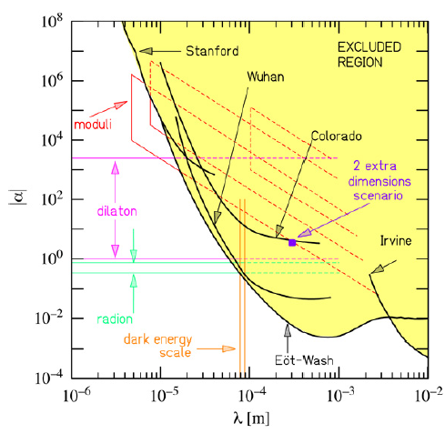
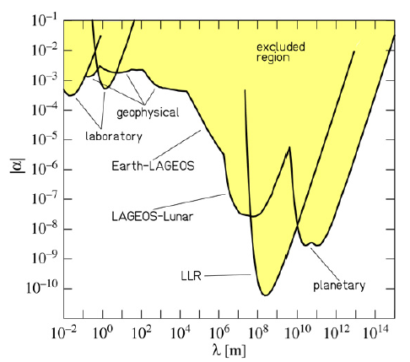
Problem: New fields and New Forces
The existence of a fifth force is excluded to a high degree of precision
Adelberger et al. (2009)

Slide 4
Screening Mechanisms
Locally weak coupling
Symmetron and varying dilaton models
Pietroni (2005). Olive, Pospelov (2008). Hinterbichler, Khoury (2010). Brax et al. (2011).
Locally large inertia
Vainshtein mechanism, Galileon and k-mouflage models
Vainshtein (1972). Nicolis, Rattazzi, Trincherini (2008). Babichev, Deffayet, Ziour (2009).
Locally large mass
Chameleon models
Khoury, Weltman (2004).

Slide 5
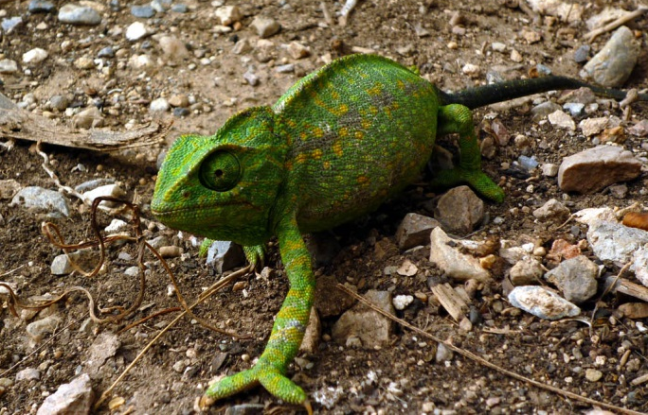
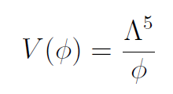
The Chameleon
Spherically symmetric, static equation of motion
Chameleon screening relies on a non-linear potential, e.g.
5
Khoury, Weltman. (2004). Image credit: Nanosanchez

Slide 6
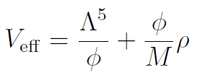
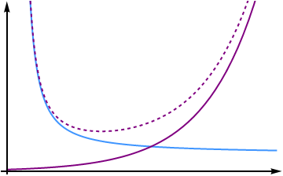
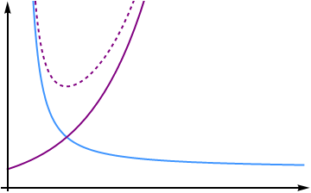
Varying Mass
The mass of the chameleon changes with the environment
Field is governed by an effective potential
Low density High density
Warning: Relies on non-renormalisible operators, no protection from quantum corrections
6

Slide 7
f(R) Chameleons
Attempt to modify gravity to explain the accelerated expansion of the universe
Field equations are second order in derivatives of R
Fourth order in derivatives of the metric
By Ostrogradski’s theorem there are hidden degrees of freedom
The extra degree of freedom can be made explicit

Slide 8
f(R) Chameleons
In the Einstein frame
Scalar field has potential and coupling
Only f(R) theories with a chameleon mechanism are observationally acceptable
Hu, Sawicki (2007). Brax, van de Bruck, Davis, Shaw (2008).

Slide 9
The Scalar Potential
This determines how responsive an object is to the chameleon field
When m_{bg}r is small the ratio of the acceleration of a test particle due to the chameleon and gravity is:

Slide 10
Why Atom Interferometry?
Over a large part of the chameleon parameter space atoms are unscreened in a laboratory vacuum

Slide 11
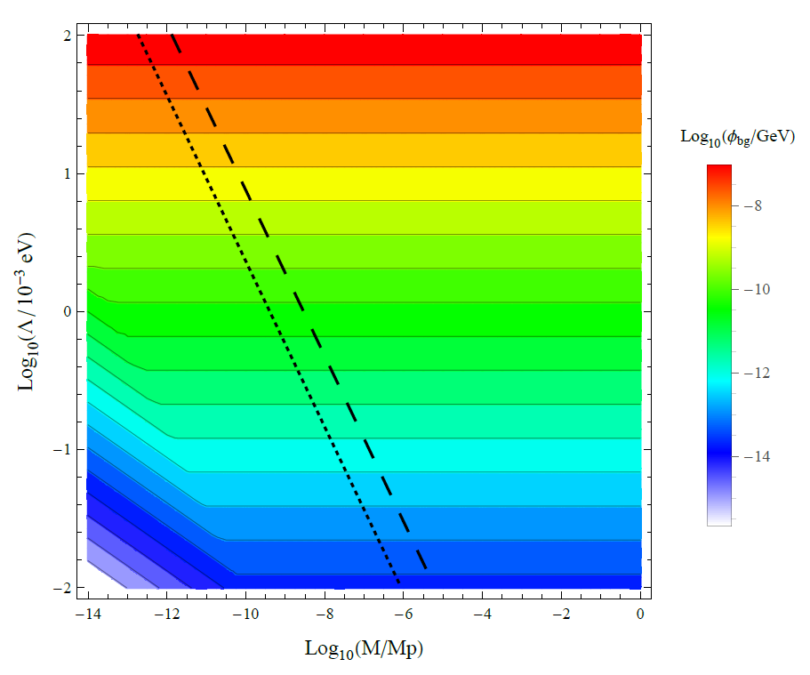
Why Atom Interferometry?
In a spherical vacuum chamber, radius 10 cm, pressure 10⁻¹⁰ Torr
Atoms are unscreened above black lines (dashed = caesium, dotted = lithium)
CB, Copeland, Hinds. (2015)

Slide 12
What is Atom Interferometry?
Interferometry – family of techniques in which waves are superimposed in order to extract information about their properties.
In atom interferometry the wave is made of atoms
Atoms can be moved around by absorption of laser photons

Slide 13
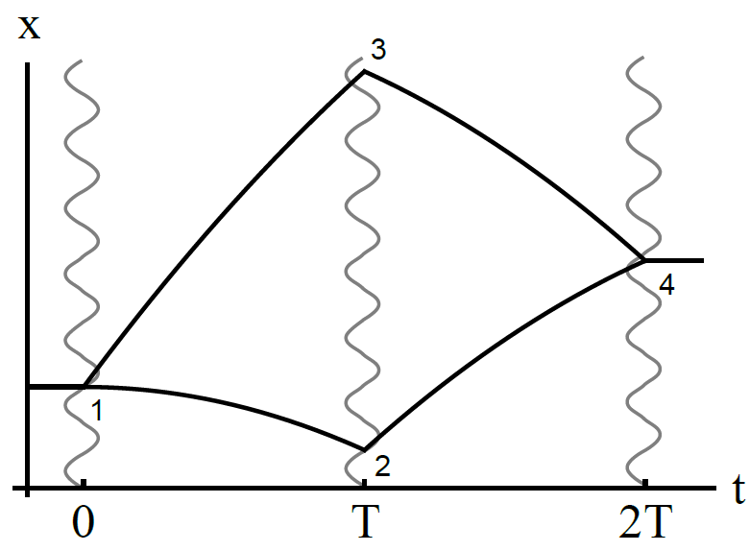
An Atom Interferometer
In between interactions with the laser, atoms move freely under a force acting in the x direction

Slide 14
The Atomic Wavefunction
The probability of measuring atoms in the unexcited state at the output of the interferometer is a function of the wave function phase difference along the two paths
For freely falling atoms the contribution of each path has a phase proportional to the classical action
Additional contributions from interactions with photons

Slide 15
The Phase Difference
For a constant force, the atomic Lagrangian is
Total action accumulated along each path is identical
Where V the velocity imparted by interactions with the laser and U the velocity orthogonal to the force
No overall phase difference

Slide 16
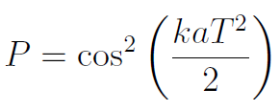
Interactions With Photons
Continuity of the wave function means that atoms pick up a phase proportional to
each time they interact with a photon
Assuming constant acceleration, the probability of measuring an atom in the ground state at the output of the interferometer is

Slide 17
Atom Interferometry for Chameleons
The walls of the vacuum chamber screen out any external chameleon forces
Macroscopic spherical mass (blue), produces chameleon potential felt by cloud of atoms (red)

Slide 18
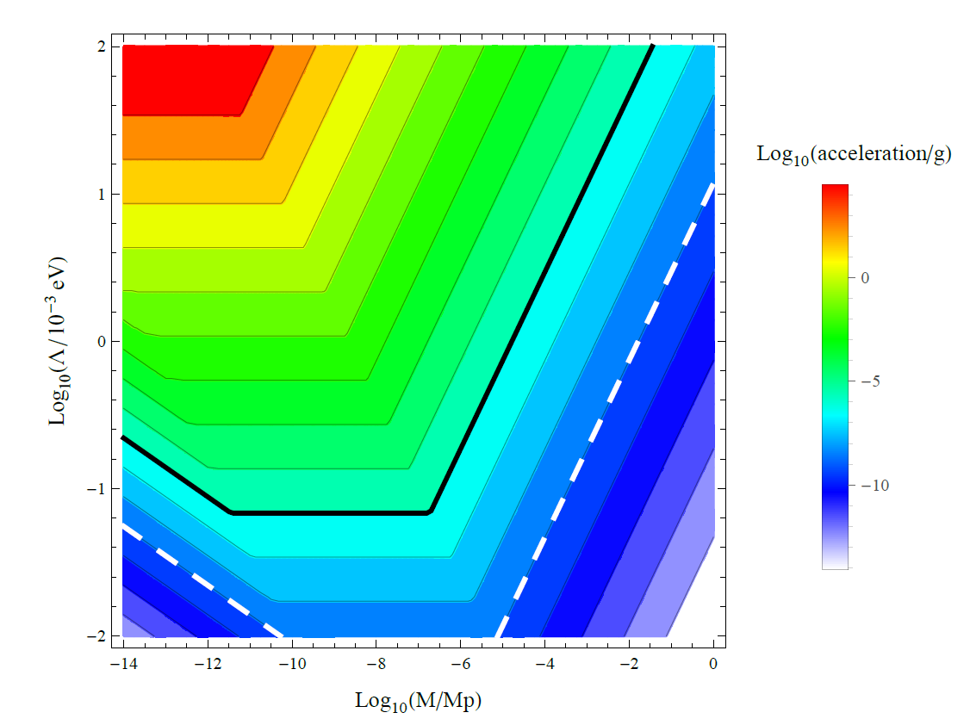
Proposed Sensitivity
Systematics: Stark effect, Zeeman effect, phase shifts due to scattered light, movement of beams
All negligible at 10⁻⁶ g sensitivity (solid black line)
Controllable down to 10⁻⁹ g (dashed white line)
CB, Copeland, Hinds. (2015)

Slide 19
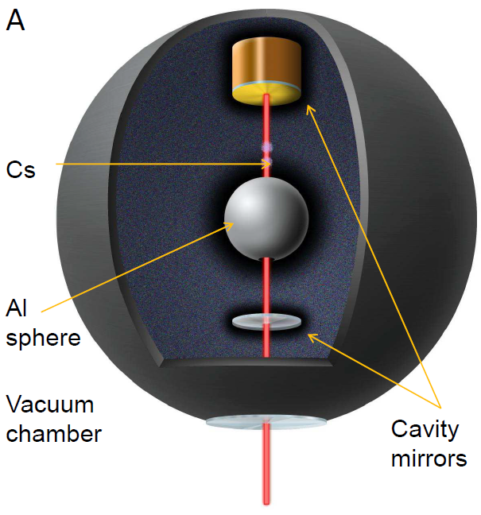
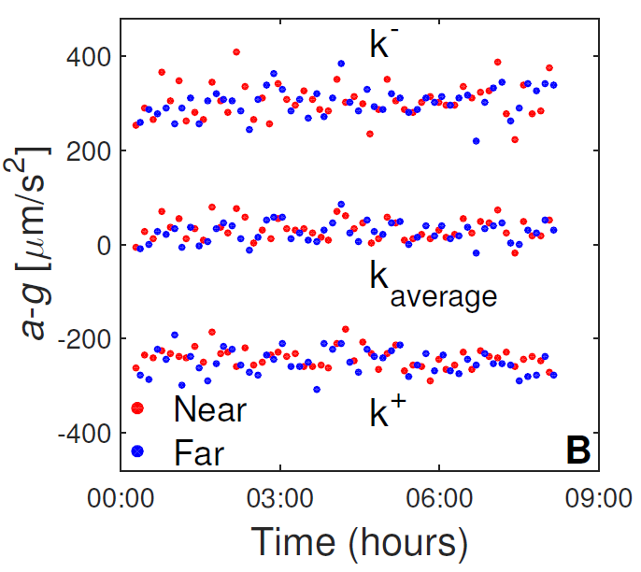
Berkley Experiment
Using an existing set up with an optical cavity The cavity provides power enhancement, spatial filtering, and a precise beam geometry
Hamilton et al. (2015)

Slide 20
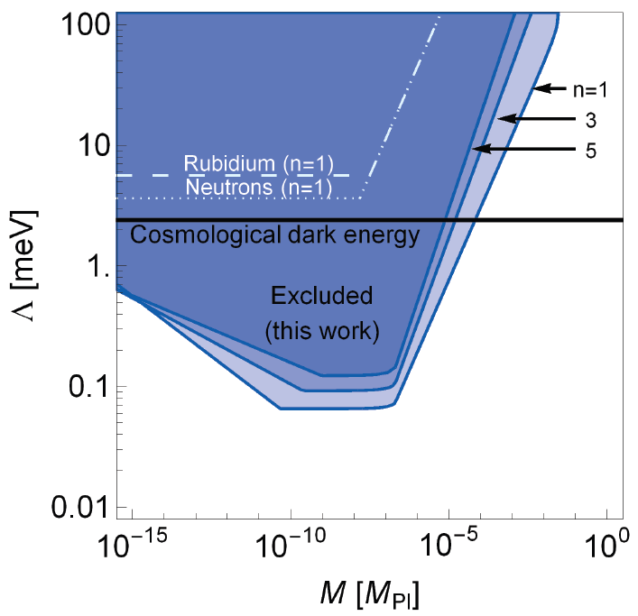
Berkley Experiment
Hamilton et al. (2015)
See also: neutron interferometry experiments: Lemmel et al. 2015

Slide 21
Combined Constraints
Atom Interferometry
Hamilton et al. (2015)

Slide 22
Combined Constraints
Atom Interferometry
Hamilton et al. (2015)
Colliders & Atomic spectroscopy
Brax, CB (2011)

Slide 23
Combined Constraints
Atom Interferometry
Hamilton et al. (2015)
Eöt-Wash
Upadhye (2012)
Colliders & Atomic spectroscopy
Brax, CB (2011)

Slide 24
Combined Constraints
Atom Interferometry
Hamilton et al. (2015)
Eöt-Wash
Upadhye (2012)
Colliders & Atomic spectroscopy
Brax, CB (2011)
Stellar burning
Sakstein et al. (2014)

Slide 25
Combined Constraints
Atom Interferometry
Hamilton et al. (2015)
Large scale structure
Dossett et al. (2014)
Eöt-Wash
Upadhye (2012)
Colliders & Atomic spectroscopy
Brax, CB (2011)
Stellar burning
Sakstein et al. (2014)

Slide 26
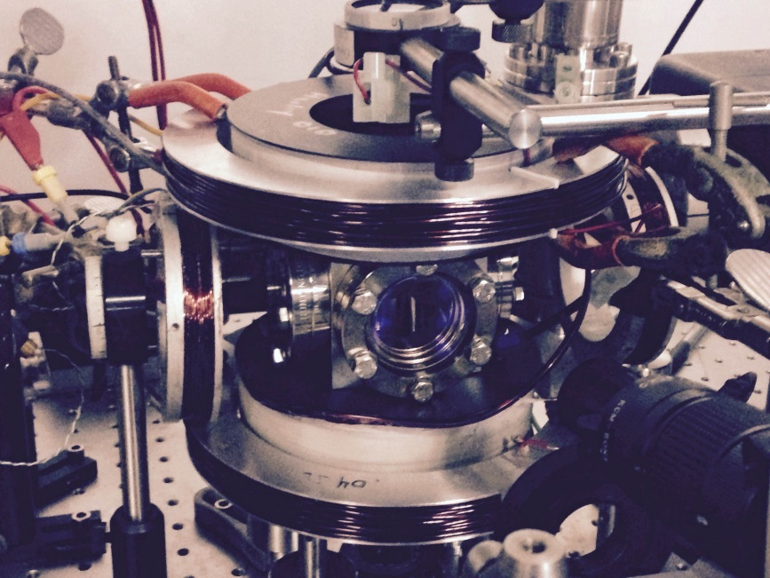
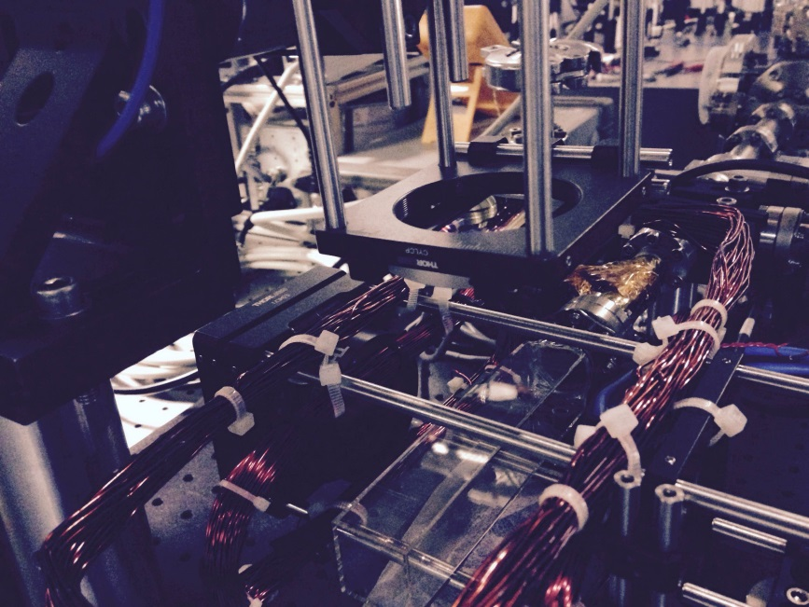
Imperial Experiment
Development underway at the Centre for Cold Matter, Imperial College
Experiment rotated by 90 degrees from the Berkeley experiment, so that no sensitivity to Earth’s gravity
Image Credit: Dylan Sabulsky

Slide 27
Summary
Attempts to solve the cosmological constant problem introduce new types of matter or modify gravity
Introduces new scalar fields but the corresponding forces are not seen
Screening mechanisms are required to hide these forces from fifth force searches
Can still be detected in suitably designed experiments
Atom interferometry is a new and powerful technique
When combined with other searches we could cover all of the interesting parameter space

Slide 29
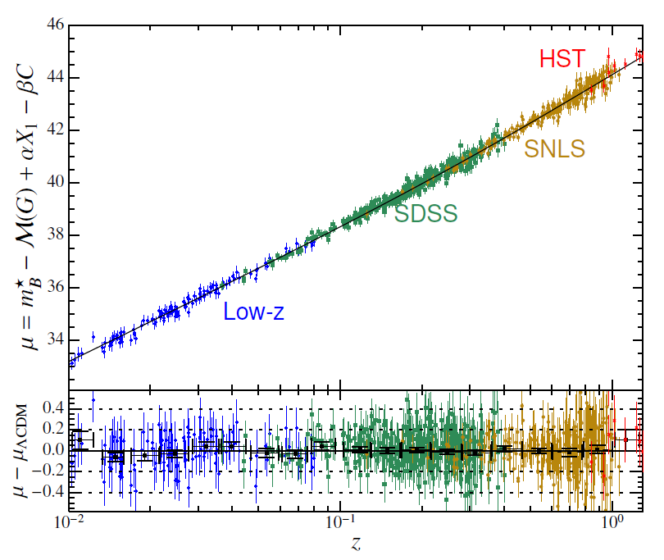
Supernova Hubble Diagram - 2014
740 Type 1a Supernovae
Betoule et al. 2014

Slide 30
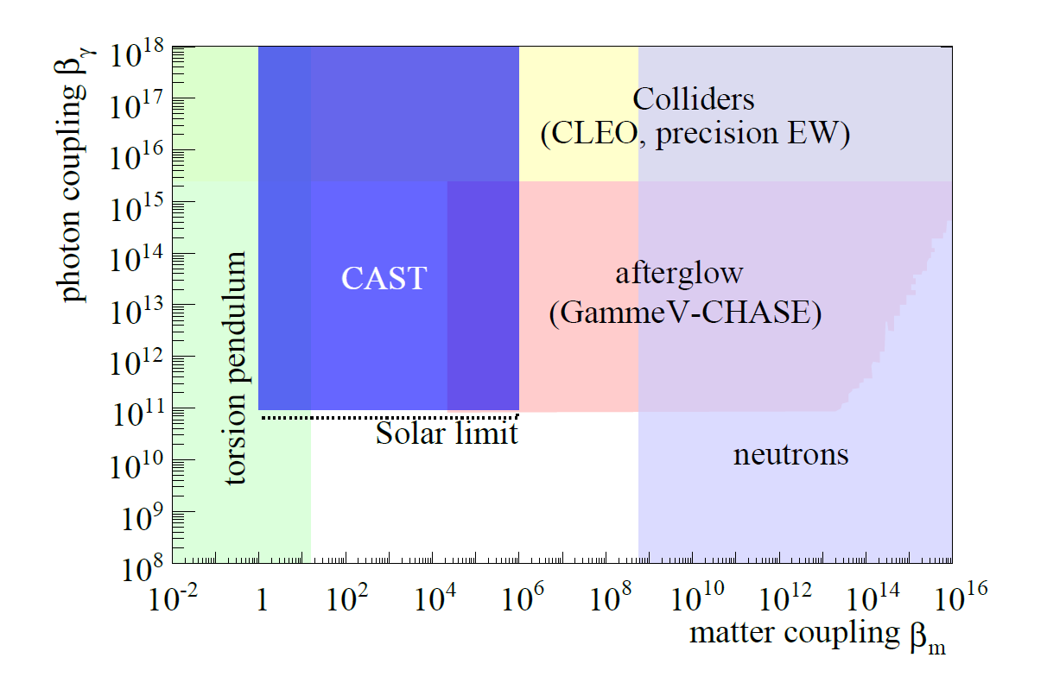
Matter vs Photon coupling
CAST collaboration 2015

Slide 31
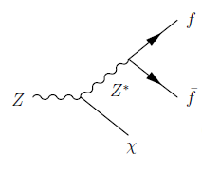
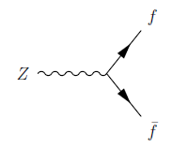
Scalar Bremsstrahlung
Contribution to the width of Z decay
Decay rate:
Prediction from the Standard Model:
Measurement at LEP:
Dark Energy correction negligible if
Brax, CB, Davis, Seery, Weltman. (2009).

Slide 32
f(R) Chameleons
Attempt to modify gravity to explain accelerated expansion
Field equations are second order in derivatives of R
Fourth order in derivatives of the metric
By Ostrogradski’s theorem there are hidden degrees of freedom
Make the extra degree of freedom explicit

Slide 33
f(R) Chameleons
In the Einstein frame
Scalar field has potential and coupling
Only f(R) theories with a chameleon mechanism are observationally acceptable
Hu, Sawicki (2007). Brax, van de Bruck, Davis, Shaw (2008).

Slide 34
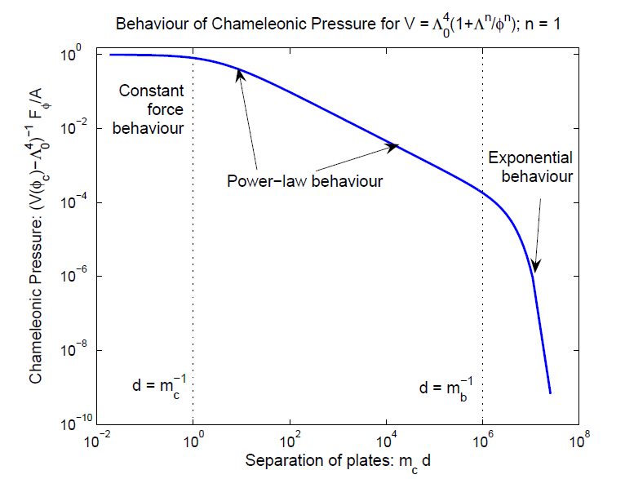
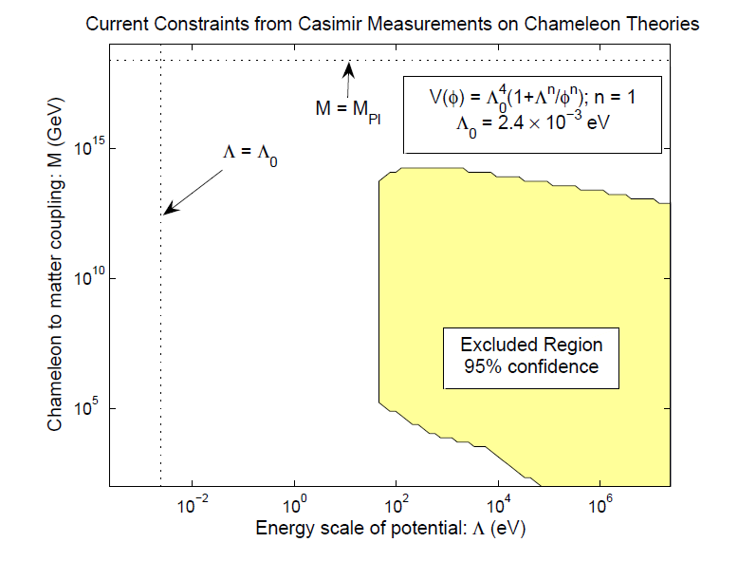
Casimir Searches
Tailor searches for chameleons by varying the density of gas between the plates
Chameleon Casimir experiment, CANNEX, underway in Amsterdam
Brax et al. (2007, 2010). Brax, Davis (2014).

Slide 35
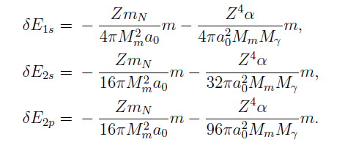
Atomic Precision Measurements
A scalar potential is sourced by the nuclear mass and electric field
Scalar forces lead to perturbations of the Schrödinger equation and energy levels
Precision measurements of 1s-2s transition constrain
Brax CB (2010)

Slide 36
Chameleon After-glow
Chameleons could be made in a vacuum chamber through the Primakov effect
To pass through the walls they need to become heavier
If chameleons are not energetic enough this is forbidden and they remain trapped
Reverse Primakov effect produces afterglow photons
Gies, Mota, Shaw. (2008). Ahlers, Lindner, Ringwald, Schrempp, Weniger. (2008).
Image credit: Upadhye, Steffen, Chou. (2012).

Slide 37
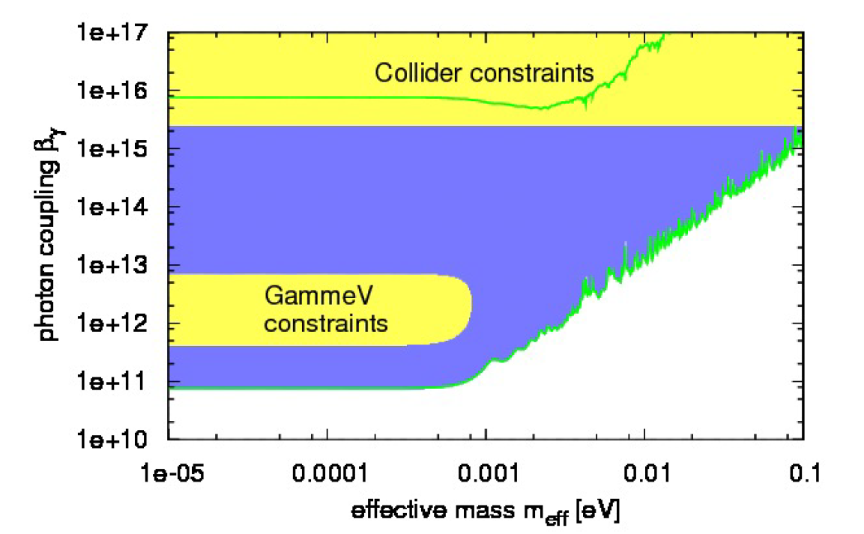
GammeV-CHASE
Results from the Gammev Chameleon Afterglow Search at Fermilab
Steffen et al. (2010)

Slide 38
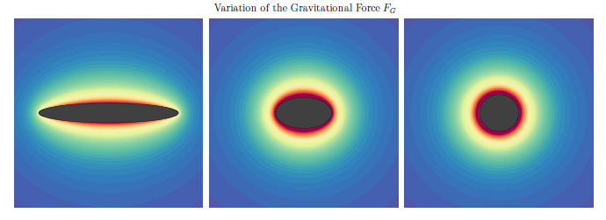
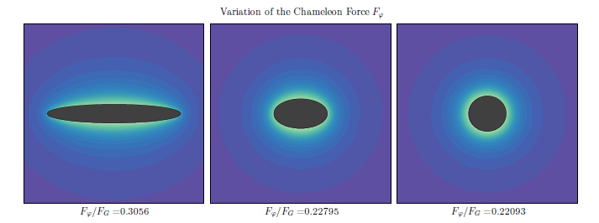
Future Prospects: Source Shape
CB, Copeland, Stevenson (2014)

Slide 39
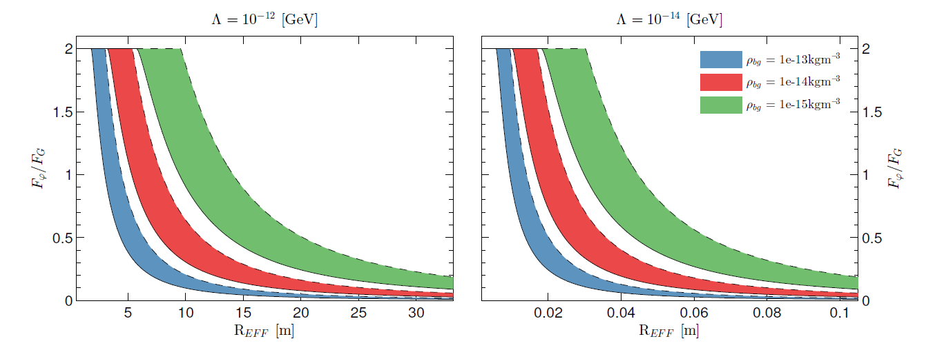
Shape Dependence of Chameleon Force
Deviations from spherical symmetry impede the formation of a thin shell
CB, Copeland, Stevenson (2014)

