Slide 1



Modified Gravity
& Pulsar Tests
Quy Nhon
ICISE
August 14th 2015
Claudia de Rham

Slide 2
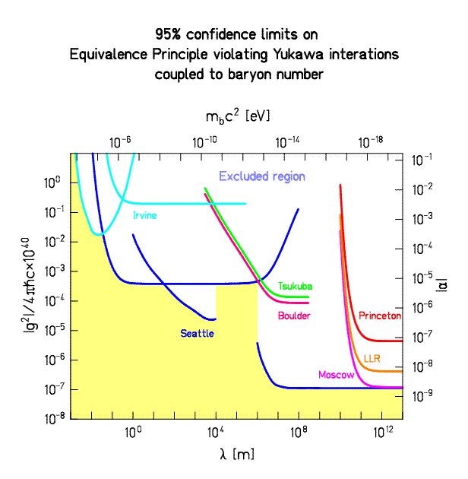
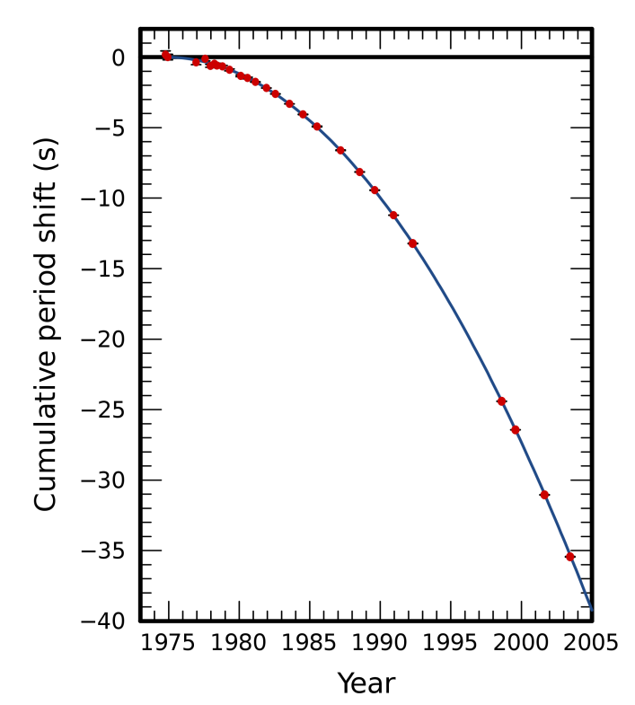
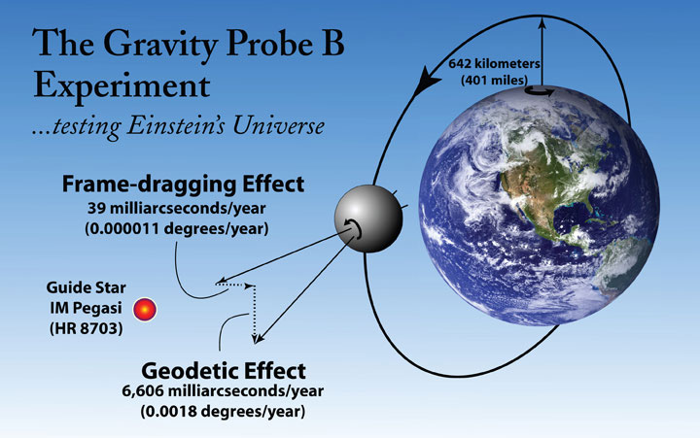
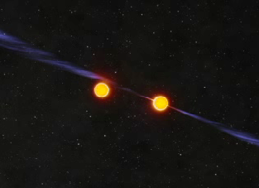
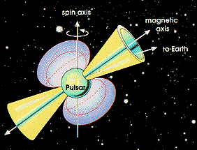
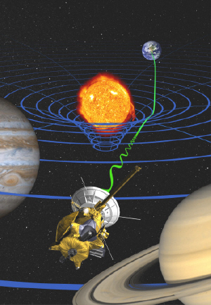
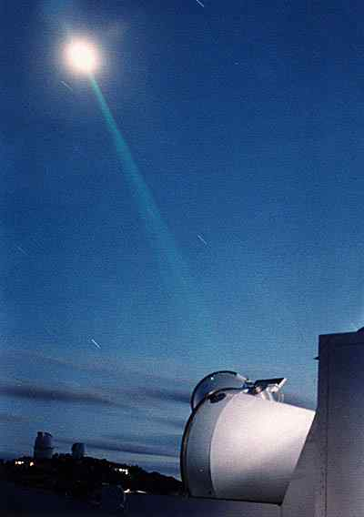
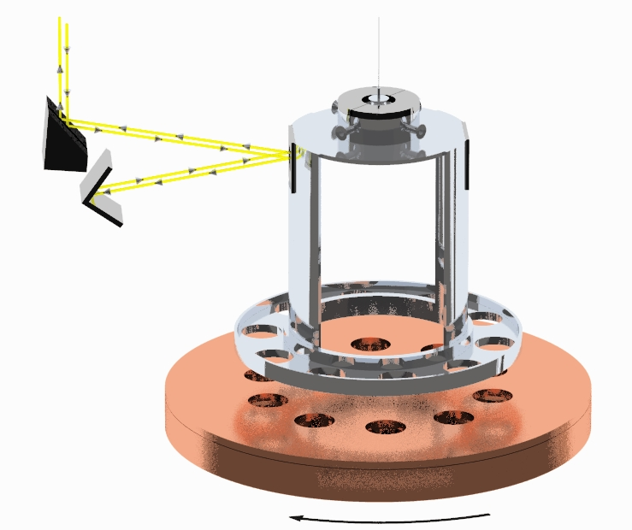
GR has been a successful theory from mm length scales to Cosmological scales
Then WHY Modify Gravity ?

Slide 3
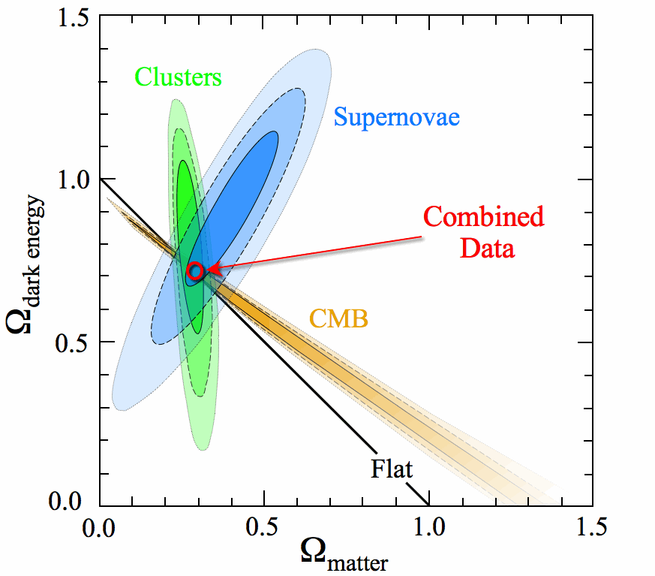
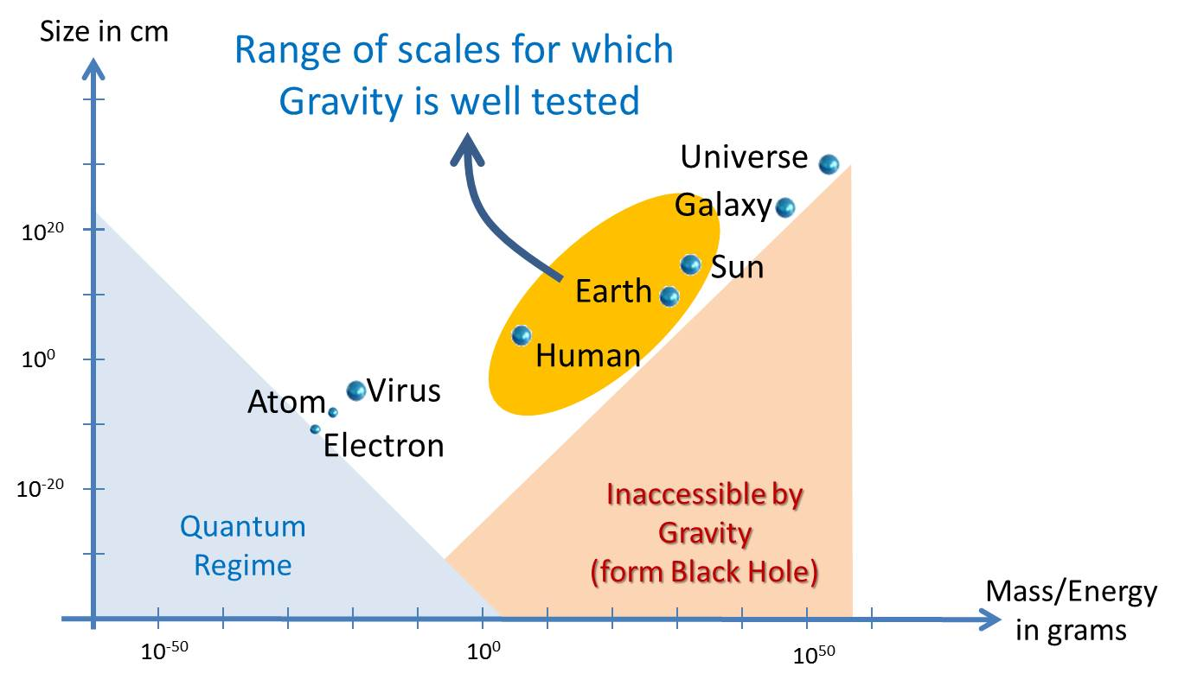
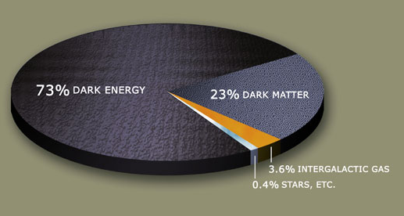
Tests specific characteristics in specific environments
Assume gravity is correct for other measurements
Tackle some of the open questions of cosmology
& astrophysics: Nature of Dark Energy / Dark Matter
Late time acceleration
&
CC problem
First signs of the
breakdown of GR
on cosmological scales ?
Learn from the behaviour of gravity

Slide 4
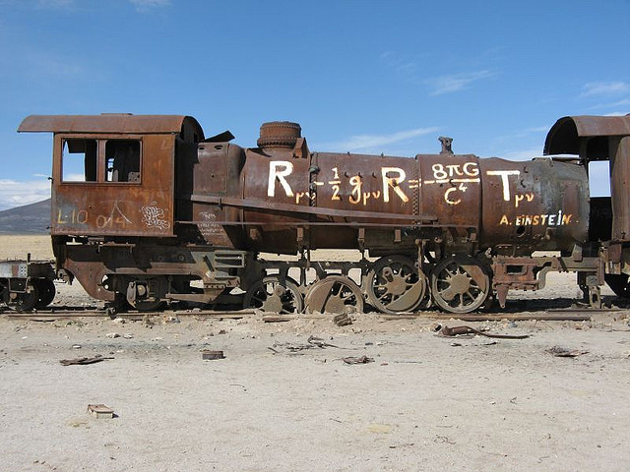
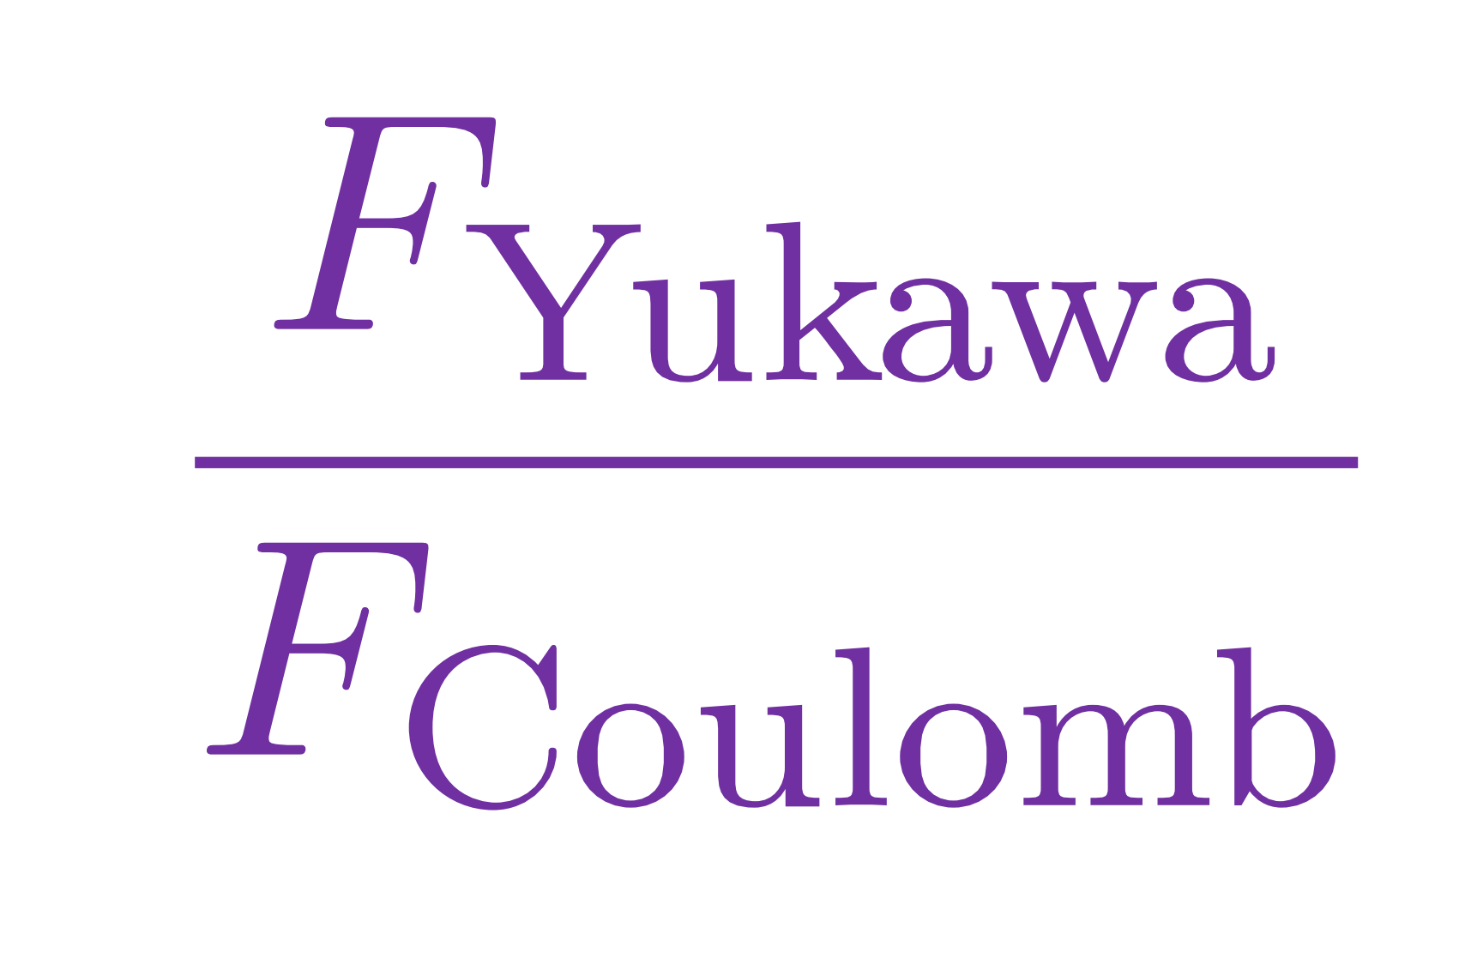

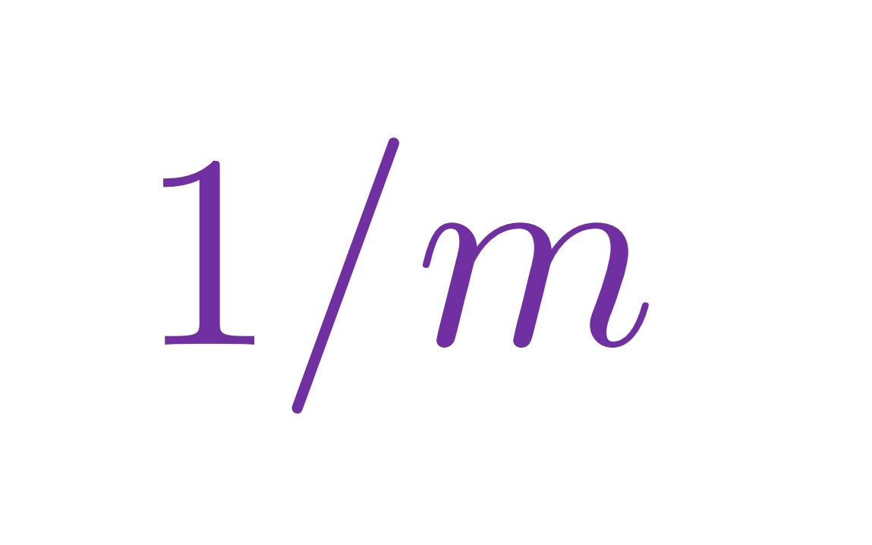
Gravity
So far, the best model for Gravity is GR
GR is the unique consistent theory of a
massless spin-2 field
Assuming Global Lorentz invariance, locality & Stability
Giving the graviton a mass is the most direct way to modify gravity at large distances
1960’s: Feynman, Weinberg, Deser,…

Slide 5
Relaxation mechanism
Massive gravity could lead to the degravitation of a CC
Λ
Phase transition
time
H²
time
Notes:
To see that, we can simply look at the linearized Einstein equation.
If I omit the tensor structure for a second, the Einstein equation looks like

Slide 6
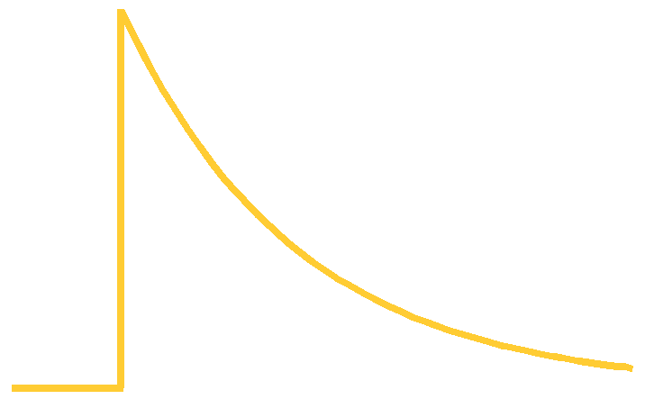
Relaxation mechanism
Massive gravity could lead to the degravitation of a CC
Λ
Phase transition
time
H²
1/m
time
Notes:
To see that, we can simply look at the linearized Einstein equation.
If I omit the tensor structure for a second, the Einstein equation looks like

Slide 7
Relaxation mechanism
Massive gravity could lead to the degravitation of a CC
Λ
Phase transition
time
H²
1/m
time
Notes:
To see that, we can simply look at the linearized Einstein equation.
If I omit the tensor structure for a second, the Einstein equation looks like

Slide 8
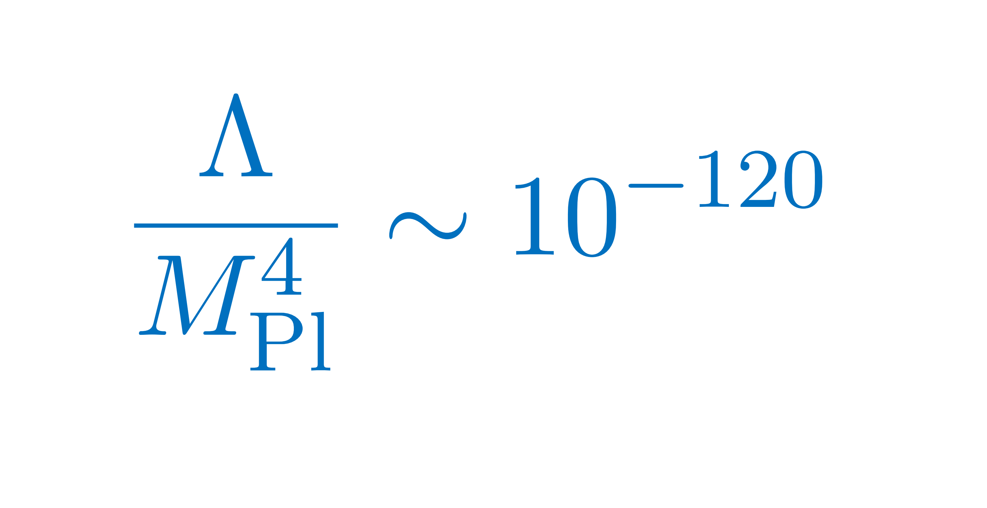
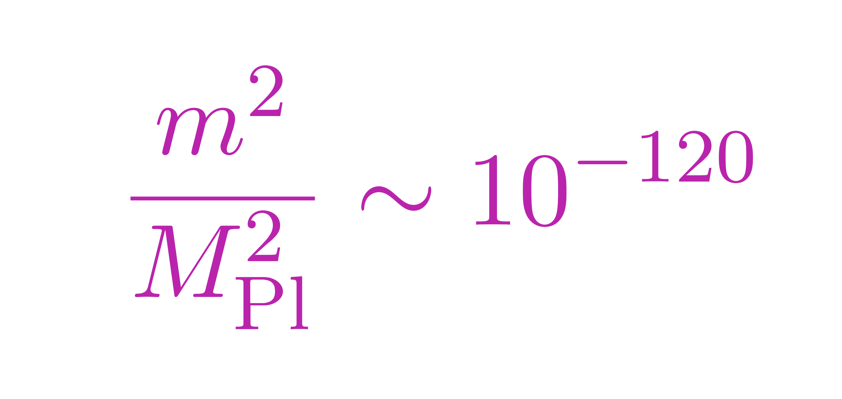
Tuning / Fine-tuning
From naturalness considerations, we expect a vacuum energy of the order of the cutoff scale (Planck scale).
But observations tell us
For the degravitation mechanism to work, the mass of the graviton should be
Notes:
To see that, we can simply look at the linearized Einstein equation.
If I omit the tensor structure for a second, the Einstein equation looks like

Slide 9
Tuning / Fine-tuning
The amount of tuning is the same
But the graviton mass remains stable against quantum corrections
we recover a symmetry in the limit m 0
The theory is tuned
but technically natural
Notes:
To see that, we can simply look at the linearized Einstein equation.
If I omit the tensor structure for a second, the Einstein equation looks like

Slide 10
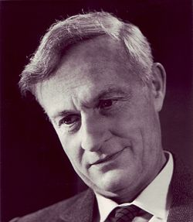
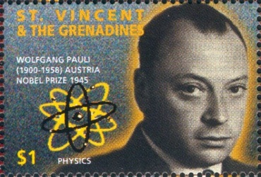
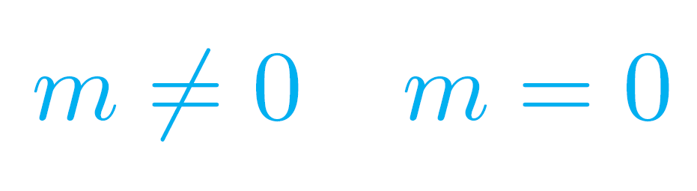
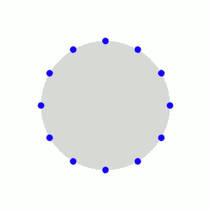


Massive Gravity
1939: Fierz-Pauli action
Massive spin-2 particles first studied by Fierz & Pauli
+ 2
- 2
$$±2$$
tensors
$$GR:$$

Slide 11
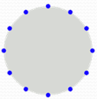


Massive Gravity
1939: Fierz-Pauli action
Massive spin-2 particles first studied by Fierz & Pauli
+ 2
+ 1
0
- 1
- 2
$$±2$$
tensors
$$±1$$
vectors
0
scalar
$$massive gravity:$$

Slide 12
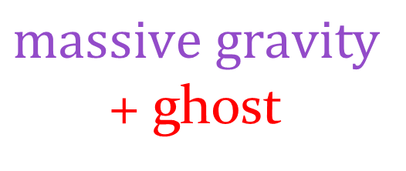
Massive Gravity
1972: Boulware-Deser: MG generically excite a 6th mode non-linearly: BD ghost
+ 2
+ 1
0
- 1
- 2
$$±2$$
tensors
$$±1$$
vectors
0
scalar
$$massive gravity$$
+ ghost

Slide 13
MG from Extra Dimensions
Best way to obtain a sensible theory of Gravity
(with no ghost) is to start with GR
5d Gravity
Massless spin-2 in 5d:
5 dofs
Soft massive Gravity
(DGP)
Hard massive Gravity
Ghost-free mGR
Galileons
Dvali Gabadadze Porrati, 2000
Nicolis, Rattazzi, Trincherini, 0811.2197
CdR, Tolley, 1003.5917

Slide 14
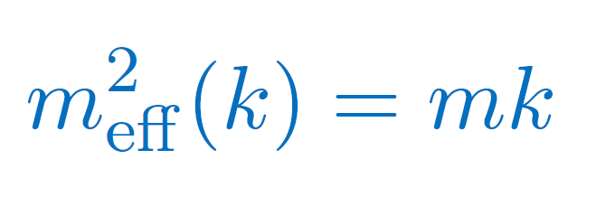
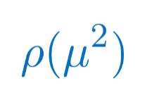
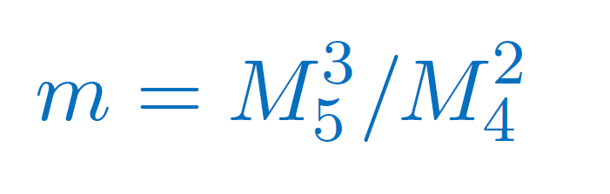

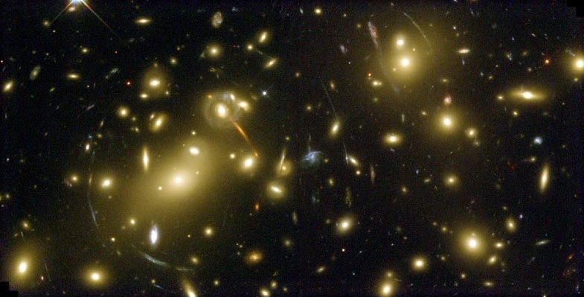
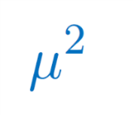
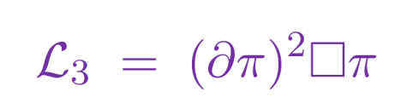
DGP – soft MG
5d Gravity
4d
gravity
Brane bending mode behaves as
a cubic Galileon in the DL
Infinite extra dimension
Confine Gravity on a brane
DGP model
Dvali Gabadadze Porrati, 2000
Deffayet, 2001
Luty, Porrati, Rattazzi, 2003

Slide 15
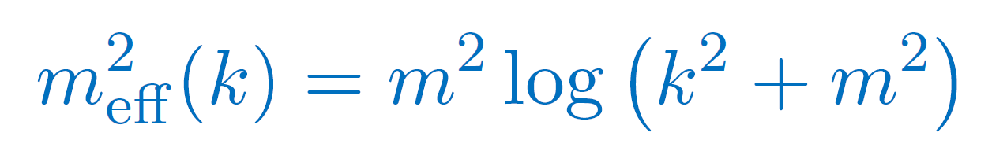
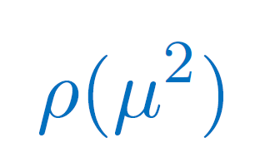


Cascading Gravity
4d
gravity
6d Gravity
CdR, Dvali, Hofmann, Khoury,
Pujolas, Redi, Tolley, 2007
CdR, Hofmann, Khoury, Tolley, 2007

Slide 16
Cascading Gravity
4d
gravity
Positive Tension
Corresponds to deficit angle
in the 2 extra dimensions
CdR, Dvali, Hofmann, Khoury,
Pujolas, Redi, Tolley, 2007
CdR, Hofmann, Khoury, Tolley, 2007

Slide 17
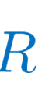
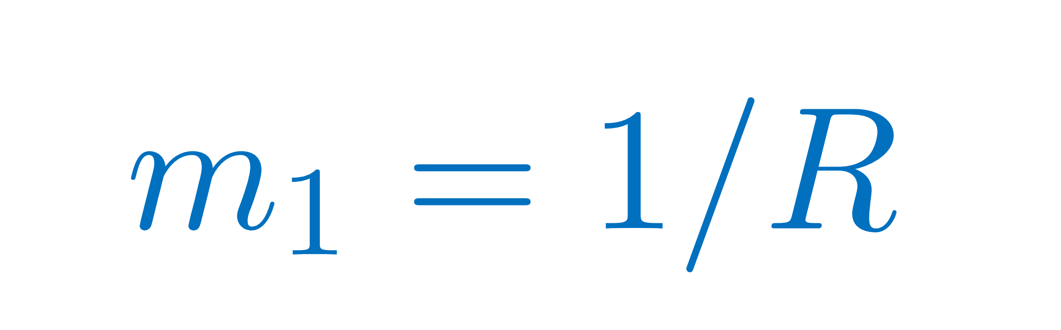
Induced Gravity
4d
gravity
5d Gravity
5d Gravity
Infinite extra dimension
Confine Gravity on a brane
DGP model
Finite-size extra dimension
KK or deconstruction
Hard massive Gravity
(or multi-gravity)

Slide 18

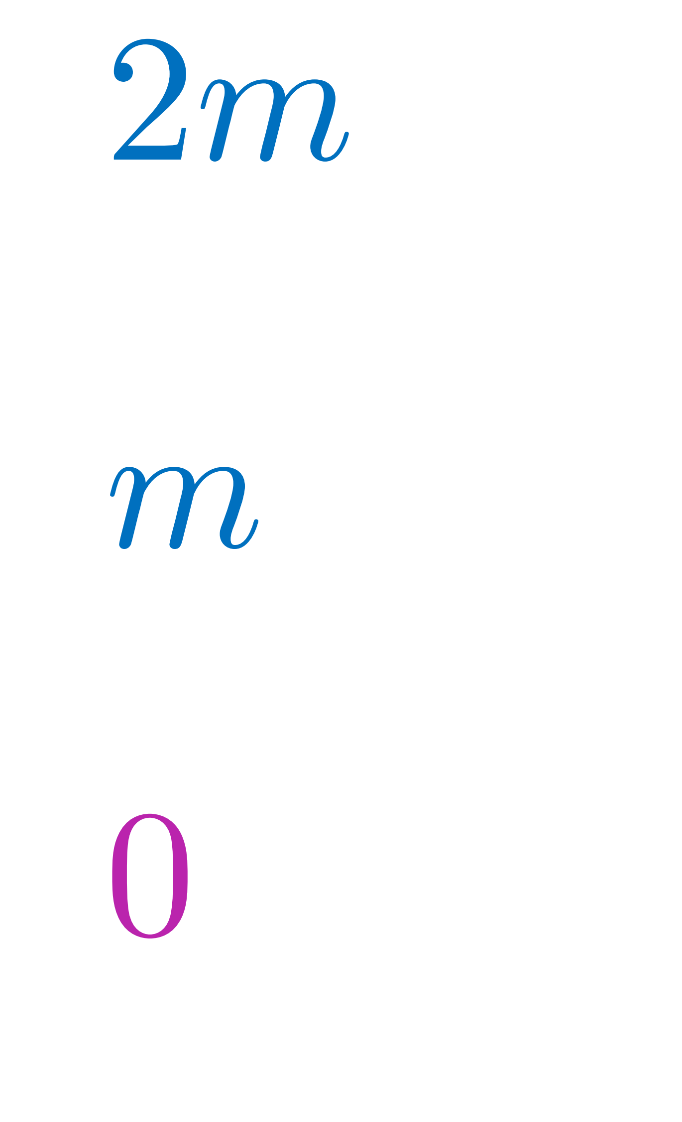
Kac-Moody Symmetry
5d Gravity
5d Poincaré Kac-Moody group (infinite dim)
Vacuum preserves 4d Poincaré + U(1)
Symmetry ensures some level of stability
Dolan & Duff, PRL 52 (1) 1984

Slide 19
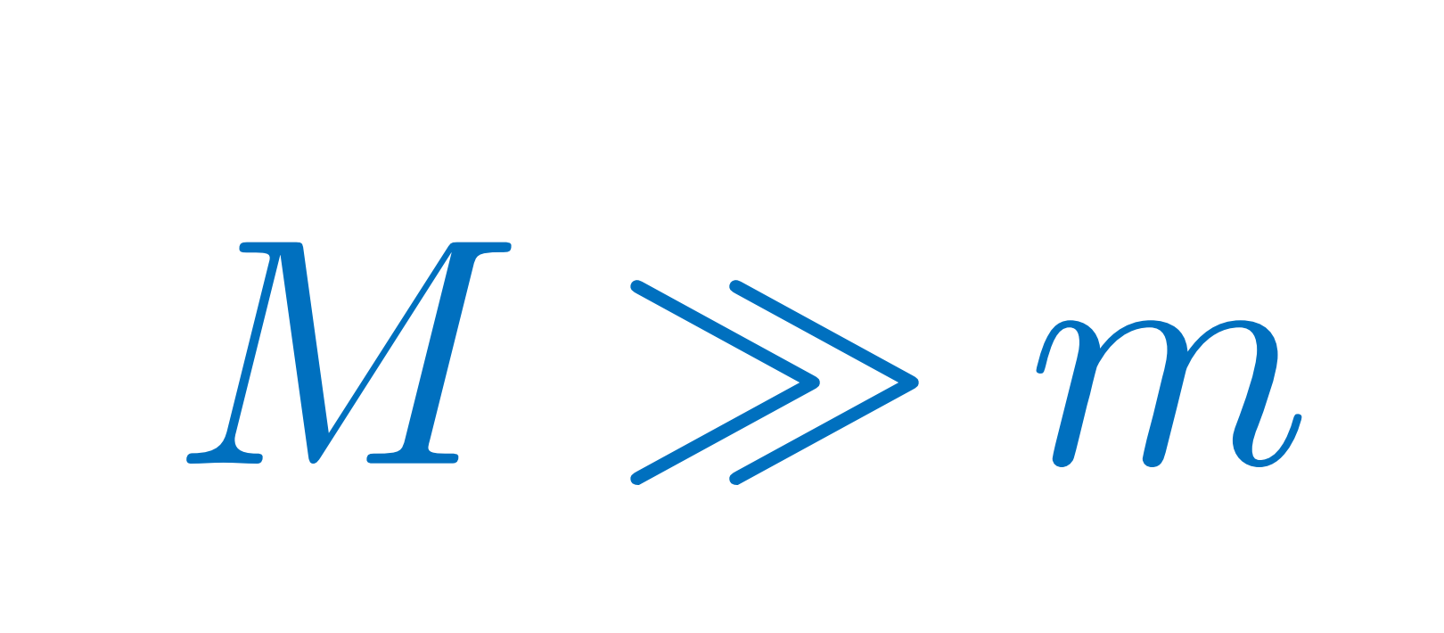
Kac-Moody Symmetry
5d Gravity
5d Poincaré Kac-Moody group (infinite dim)
Vacuum preserves 4d Poincaré + U(1)
Symmetry ensures some level of stability
Can we modify the setup to
create a different mass gap?
(hierarchy)
Decoupled bi-gravity

Slide 20
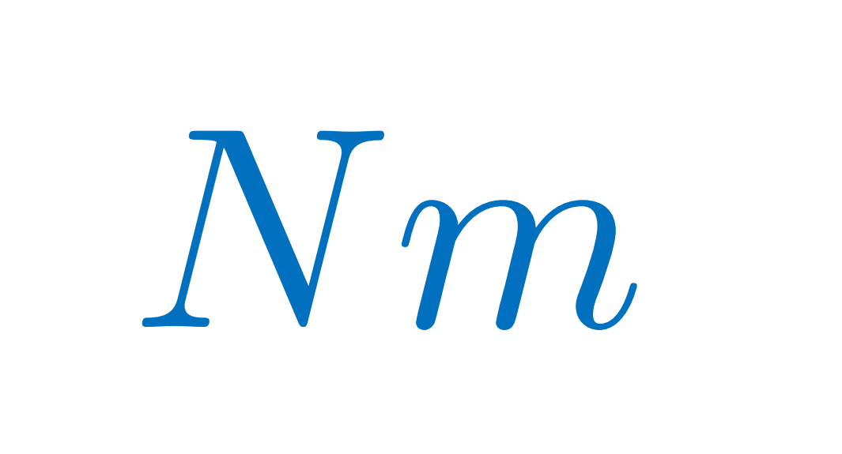
Deconstruction
Poincaré algebra can be truncated
by identifying P_{n+N}=P_{n} and M_{n+N}=M_{n}
Discretization in real space

Slide 21
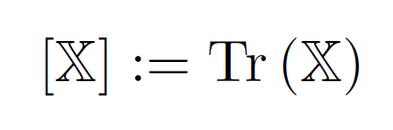
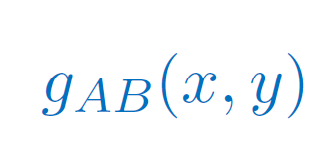
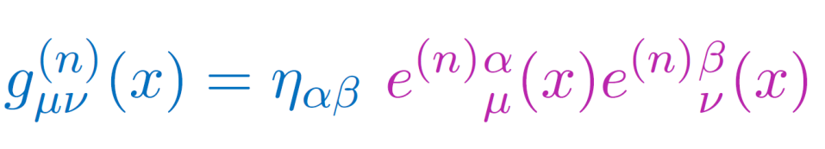
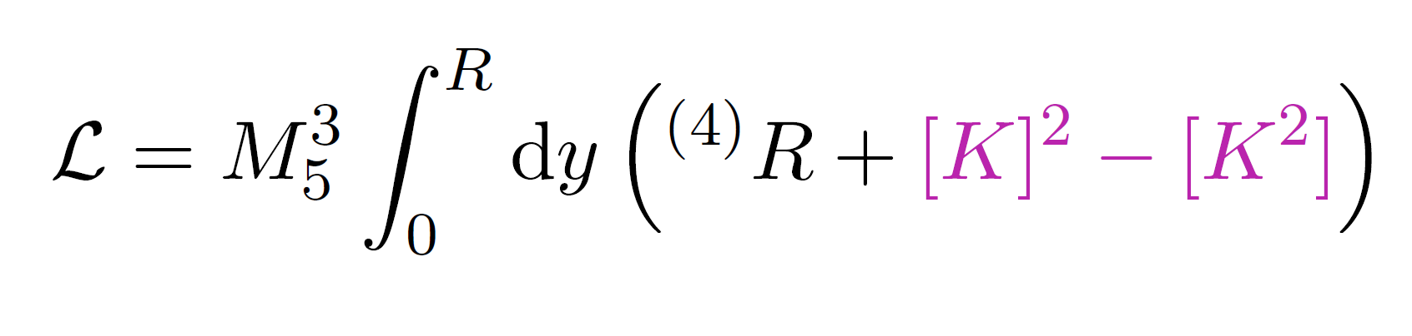
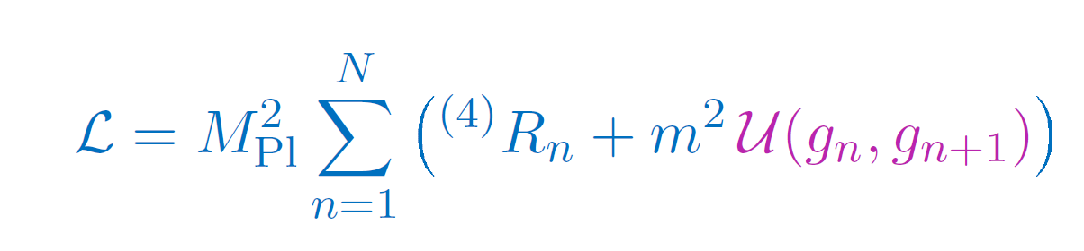
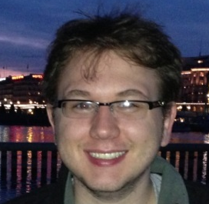
Deconstruction
y
After fixing the gauge where 5d lapse=1
CdR, Matas & Tolley, 2013

Slide 22
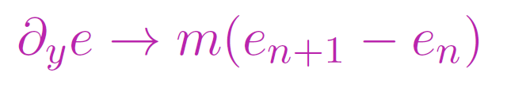
Deconstruction
y
After fixing the gauge where 5d lapse=1
CdR, Matas & Tolley, 2013

Slide 23
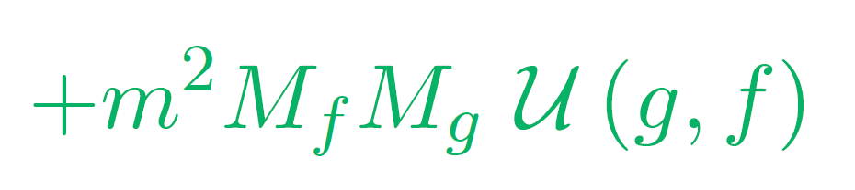
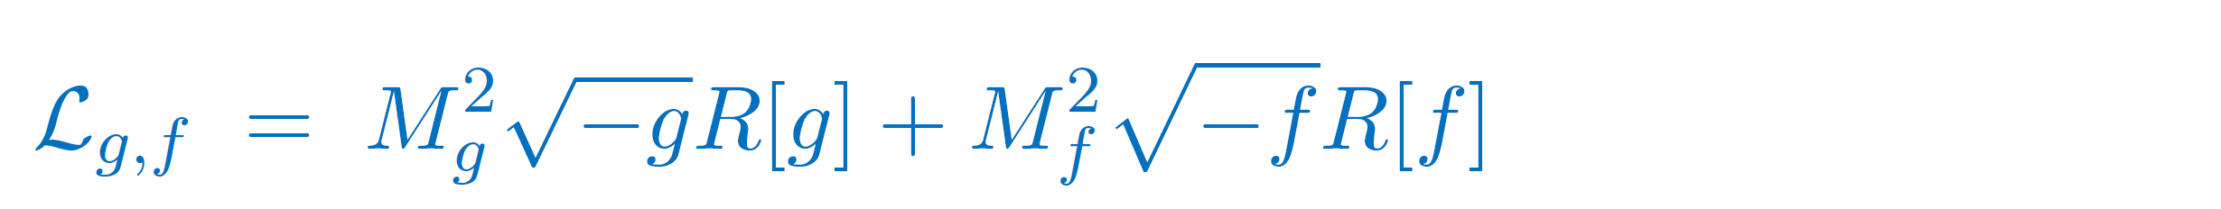
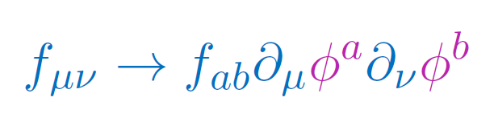
Bi-Gravity
g
f
Discretization with only 2 sights
1 massless spin-2 field
1 massive spin-2 field
2+5 = 7 degrees of freedom
Only 1 copy of diff
2nd diff is broken
Restored with 4 Stückelberg fields
(only 3 independent Stückelberg fields)
Hassan & Rosen, JHEP, 1202, 126 (2012)

Slide 24
Bi-Gravity
g
f
Decoupled bi-gravity

Slide 25
Bi-Gravity
g
f
Bi-Gravity = GR + exotic matter
Massive Gravity limit corresponds to sending
This can be done on any background

Slide 26
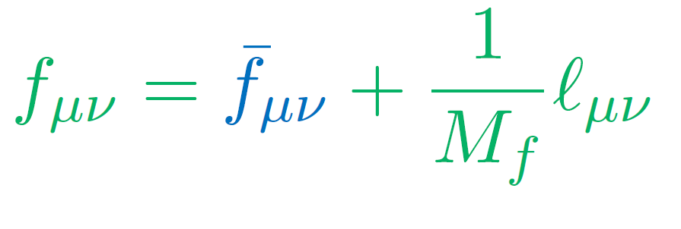
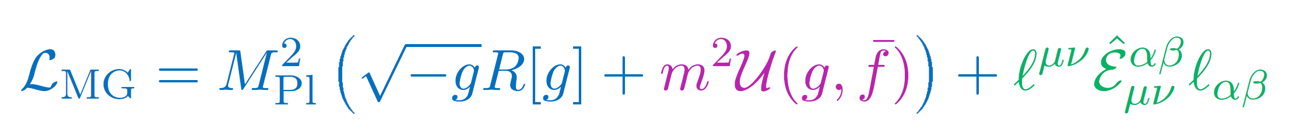
Massive Gravity
The 2 metrics decouple
in the limit
Obtain MG on a fixed ref. metric + decoupled spin-2 field
5 degrees of freedom in massive graviton (ghost-free)
(+ 2 in decoupled massless spin-2)
Decoupled
massless spin-2
Massive Gravity
CdR, Gabadadze, Tolley, PRL, 106, 231101 (2011)

Slide 27




Massive Gravity
4d diff invariance is present if keep the Stückelberg fields
Helicity-2: behaves as GR with small mass
Heliciy-1: decouples from matter
Helicity-0: behaves as a Galileon scalar field
in some limit
2+3 dofs:

Slide 28



Stückelberg Fields
Helicity-0 mode behaves as a `Galileon’ in some limit

Slide 29

Stückelberg Fields
Helicity-0 mode behaves as a `Galileon’ in some limit
Where the Galilean symmetry is manifest
And the equations of motion for π are second order.
Couples to matter
Screened via the Vainshtein Mechanism
CdR & Gabadadze, 1007.0443

Slide 30
Observational Tests
Size in cm
Range of scales for which
Gravity is well tested
Universe
Galaxy
10²⁰
Sun
Earth
10⁰
Human
Atom
Virus
Electron
10⁻²⁰
Inaccessible by Gravity
(form Black Hole)
Quantum Regime
Mass/Energy
in grams
10⁻⁵⁰
10⁰
10⁵⁰

Slide 31
Observational Tests
Solar System
Binary Pulsars
Black Holes
Massive Gravity
Primordial Gravity Waves
Supernovae
Weak Lensing
Cluster of galaxies
CMB, …
Structure
Formation
Universe
Evolution
(Supernovae, BAO, CMB,…)

Slide 32
Observational Tests
Effect of mass on tensor mode becomes relevant
Size in cm
Universe
Galaxy
10²⁰
Effect on GWs
Tests from SN
Sun
Earth
10⁰
Human
Atom
Virus
Electron
10⁻²⁰
Inaccessible by Gravity
(form Black Hole)
Quantum Regime
Mass/Energy
in grams
10⁻⁵⁰
10⁰
10⁵⁰

Slide 33
Observational Tests
Vainshtein mechanism less efficient larger departures from GR
Size in cm
Universe
Galaxy
10²⁰
Sun
Earth
10⁰
Human
Atom
Virus
Electron
10⁻²⁰
Inaccessible by Gravity
(form Black Hole)
Quantum Regime
Mass/Energy
in grams
10⁻⁵⁰
10⁰
10⁵⁰

Slide 34





Vainshtein mechanism
Well understood for Static & Spherically Symmetric configurations
Force mediated by the scalar mode

Slide 35


Vainshtein mechanism
Well understood for Static & Spherically Symmetric configurations
Force mediated by the scalar mode
Vainshtein radius:

Slide 36

Binary Pulsar System
The existence of a scalar mode leads to new monopole, dipole and quadrupole channels of radiation.
They are suppressed compared to GR thanks to Vainshtein mechanism.
Monopole & dipole suppressed due to conservation of energy & momentum.
Notes:
The spin-down of binary pulsars represent the most direct or indirect evidence for the existence of gravitational waves. This is the spin-down for the Hulse Taylor pulsar measured over a period of 30 years and they are in incredible agreement with the expectations from General Relativity over more than 3 orders of magnitude accuracy. Now the presence of an additional scalar in these theories of modified gravity opens up the possibility for new channels of radiation and if they were not suppressed they would give order one departures from the measured spin-down. Now this of course not the case if a screening mechanism such as the Vainshtein mechanism is in place which is the case for massive gravity. In that case the power emitted through these scalar channels is very much suppressed.

Slide 37






Hierarchy of Scales

Slide 38

Hierarchy of Scales
Start with both objects at the center of mass and perturb around it
Total mass at center of mass
Radiation emitted by that scalar

Slide 39

Effective Action
Consider the Cubic Galileon
Total mass at center of mass
Radiation emitted by that scalar

Slide 40

Effective Action
Consider the Cubic Galileon
Total mass at center of mass
Radiation emitted by that scalar

Slide 41



Binary Pulsar System
Implementing the Vainshtein Mechanism
Strong Coupling region
Free Field
in Minkowski
CdR, Tolley & Wesley, PRD87 (2013) 4, 044025

Slide 42



Monopole
The leading order contribution to the monopole vanishes by conservation of energy…
The first relativistic correction gives
With

Slide 43



Monopole
The leading order contribution to the monopole vanishes by conservation of energy…
The first relativistic correction gives
For the Hulse-Taylor Pulsar
With

Slide 44


Quadrupole
A priori the quadrupole is suppressed by a few powers of velocity compared to the monopole…
But does not need to include to relativistic corrections
For the Hulse-Taylor Pulsar
Higher multipoles are suppressed by additional powers of velocity

Slide 45





Numerical Checks
Work with Furqan Dar, Tate Deskins,
John Tom Giblin & Andrew Tolley
Switching on the source

Slide 46

Numerical Checks
Work with Furqan Dar, Tate Deskins,
John Tom Giblin & Andrew Tolley
Response of the field

Slide 47

Numerical Checks
Work with Furqan Dar, Tate Deskins,
John Tom Giblin & Andrew Tolley
Late-time
response of the field
averaged over one period

Slide 48

Contours of

Slide 49
Beyond the cubic Galileon
Cubic Galileon is a special case of general family
Massive gravity and stable self-accelerating models always include at least a quartic Galileon
In the Quartic Galileon, the angular direction is not screened as much as the others many multipoles contribute to the power with the same magnitude…
with
Multipole expansion breaks down
CdR, Matas & Tolley, PRD87 064024, 2013

Slide 50


Effective metric
In the Cubic Galileon, the Effective metric for perturbations had of the same behavior along all directions

Slide 51

Effective metric
In the Cubic Galileon, the Effective metric for perturbations had of the same behavior along all directions
With

Slide 52

Effective metric
In the Quartic Galileon, the Effective metric for perturbations is different along different directions

Slide 53
Effective metric
In the Quartic Galileon, the Effective metric for perturbations is different along different directions
Multipoles are no longer suppressed
by more power of velocity
CdR, Matas & Tolley, PRD87 064024, 2013

Slide 54

Quartic Galileon
Perturbations are under control when there is another Hierarchy of scales
eg. hierarchy of mass between the two objects
Solar System
For a generic binary pulsar system,
one needs to do perturbations
about a different background…
Important for structure formation !
CdR, Matas & Tolley, PRD87 064024, 2013

Slide 55
Outlook
Massive Gravity is a specific framework to study IR modifications of Gravity
It could play a role for
- the late-time acceleration of the Universe
- the cosmological constant problem
We now have the theoretical formalism to describe a stable theory of massive gravity
It behaves a scalar-tensor Galileon theory in some limit, hand in hand with a Vainshtein mechanism

Slide 56
Outlook
The scalar field opens new channels of radiations which would have been observable in binary pulsar systems if they were not Vainshtein screened.
The monopole is suppressed by a factor of
The quadrupole is suppressed by
While this suppression makes these effects unobservable in binary pulsar, it shows that the Vainshtein mechanism is much more subtle in time-dependent configurations.

Slide 57
Quantum Corrections

Slide 58

Ghost-free Massive Gravity
Structure of mass term is essential to avoid BD ghost
Boulware & Deser, PRD 6, 3368 (1972)
CdR & Gabadadze, PRD 82, 044020 (2010)
CdR, Gabadadze & Tolley, PRL 106, 231101 (2011)

Slide 59


Ghost-free Massive Gravity
Structure of mass term is essential to avoid BD ghost
We expect the structure to detune the potential

Slide 60



Ghost-free Massive Gravity
Structure of mass term is essential to avoid BD ghost
We expect the structure to detune the potential
CdR, Heisenberg & Ribeiro, 1307.7169

Slide 61

Ghost-free Massive Gravity
Structure of mass term is essential to avoid BD ghost
We expect the structure to detune the potential
CdR, Heisenberg & Ribeiro, 1307.7169

Slide 62



1-loop Effective Action
The 1-loop effective action is itself redressed
The detuning of the potential is never a problem at that level
Even on top of large background configurations
CdR, Heisenberg & Ribeiro, 1307.7169

Slide 63





Beyond 1-loop…
Beyond 1-loop the question is still open…
At higher order in loops, loops can mix virtual matter fields and graviton fields
Could have a mixing which could be fatal…

Slide 64
Beyond 1-loop…
Beyond 1-loop the question is still open…
At higher order in loops, loops can mix virtual matter fields and graviton fields
Consider an all-loop argument
Could have a mixing which could be fatal…

Slide 65



Ridding on Irrelevant Operators
Consider an arbitrary theory
The theory exhibits the Vainshtein mechanism
if

Slide 66

Ridding on Irrelevant Operators
Consider an arbitrary theory
The theory exhibits the Vainshtein mechanism
if
Coupling to heavier fields with would naively detune the theory…
at least perturbatively

Slide 67



Ridding on Irrelevant Operators
Consider the exact Renormalization Group equation
: regulator operator
: effective average action
: IR regulator
Wetterich, 1993

Slide 68

Ridding on Irrelevant Operators
Consider the exact Renormalization Group equation
Deep in the Vainshtein Region,
Fully Non-perturbatively
CdR & Raquel Ribeiro, JCAP 1411 (2014) 11, 016

Slide 69



Ridding on Irrelevant Operators
Suppressing the loops…
Quantum corrections become irrelevant
deep in the Vainshtein regime
Fully Non-perturbatively
CdR & Raquel Ribeiro, JCAP 1411 (2014) 11, 016

