Slide 1
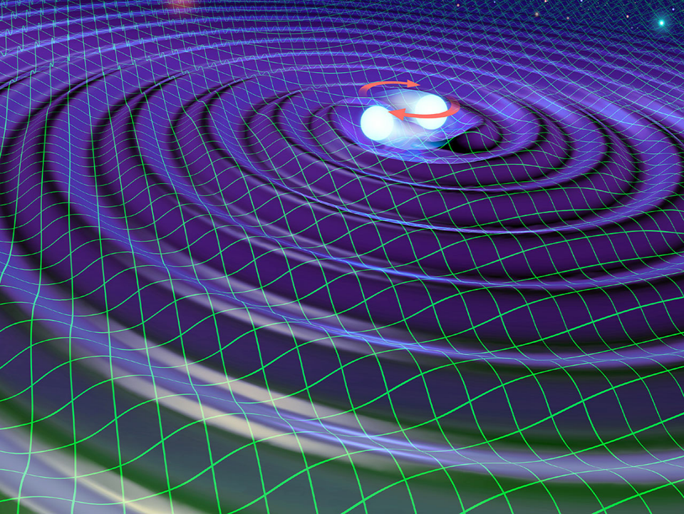
Gravitational Wave Astronomy
Hot Topics in General Relativity and Gravitation
Aug. 10, 2015
Quy Nhon, Vietnam
JGW-G1503935-v1
Seiji Kawamura (ICRR, UTokyo)

Slide 2
Outline:
Gravitational wave and its detection
Current status of detectors
Summary

Slide 3
Gravitational wave
Predicted by A. Einstein
Not yet detected
Tidal space distortion of ∼10⁻²²
Propagates at the speed of light

Slide 4
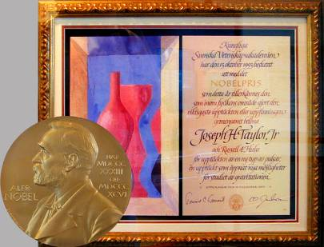
GW exists!
PSR1913+16 found by Hulse and Taylor
Period of rotation decreases by GW
Nobel prize in 1993
Taylor et al., ApJ.345(1989) p435

Slide 5

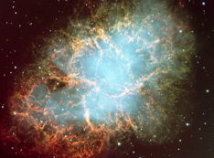
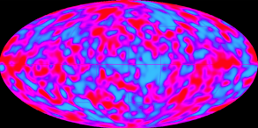
Expected GW sources
Binary coalescence:
Neutron star
Black hole
Burst:
Supernovae
Black hole ringdown:
Continuous:
Pulsar
Binary
Stochastic Background
Early universe (i.e. Inflation)
Cosmic string
Unknown

Slide 6


Neutron star binary coalescence
inspiral phase
merger
Black hole quasi-
normal mode
strain amplitude
time

Slide 7
Matched filter
Signal + Noise
Lower mass
20
-15
10
x10
0
-10
-20
17.85
17.90
17.95
18.00
Matched !
Higher mass
20
-15
10
x10
0
-10
-20
17.85
17.90
17.95
18.00

Slide 8
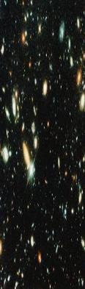

Observation of the beginning of the Universe
The beginning of the Universe
Gravitational wave
10 ⁻⁴³ sec
(Planck epock）
Neutrino
Electromagnetic wave
1 sec
(First atoms)
380,000 year
(Recombination)
13.7B year
(Now)

Slide 9

Gravitational wave detector
Gravitational waves
The mirrors and beam splitter are suspended.
Mirror
Mirror
Lens
Beam splitter
Interfering light
Screen
Laser

Slide 10
Large-scale interferometer
Mirror
Mirror
Mirror
Laser
Photodetector
Laser
Mirror
Photodetector

Slide 11
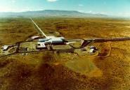
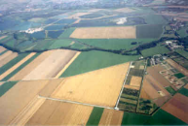
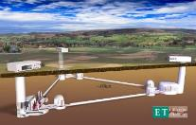
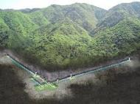
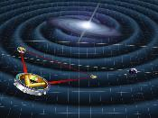
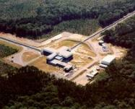
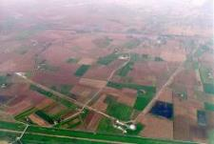
Detectors in the world
Ground-based
3rd-generation detectors
Ground-based 2nd-generation detectors
LIGO
GEO
ET
Space detectors
KAGRA
LISA
LIGO
Virgo
DECIGO

Slide 12
Key Technologies for the 2nd-generation detectors
Seismic noise
Typical sensitivity of the 1st generation detectors
Strain
Quantum noise
Thermal Noise
Frequency
Super-high vibration isolation system
Super-low mechanical loss in mirror coating and suspension
Resonant sideband extraction interferometer

Slide 13
Resonant Sideband Extraction interferometer
Fabry-Perot arm cavity:
Increase the effective arm length
-> Increase the GW signal
Power recycling mirror:
Increase the effective power
-> Improve the shot noise
Signal extraction mirror:
Extract GW signal before cancellation
-> Optimize the quantum noise
Detuned for the best NS-NS inspiral range

Slide 14
Advanced LIGO
The following slides were provided by the LIGO project.

Slide 15
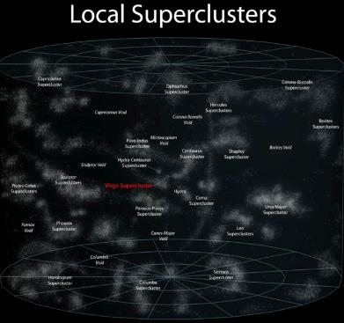
Advanced LIGO
Advanced LIGO is a discovery machine: it will open the field of gravitational-wave astronomy through the direct detection of gravitational waves
Initial LIGO
Reach
Advanced LIGO is a complete redesign and rebuild of the LIGO interferometers in the existing vacuum envelope
Cost: $205M (NSF) and $16M in hardware from partner agencies in Germany, UK, and Australia
Advanced LIGO construction by led by LIGO Laboratory with participation by member groups of the LIGO Scientific Collaboration
10x more sensitive →1000x more volume probed
Three interferometer upgrade: one @ Hanford, one @ Livingston, components of one assembled and stored for installation in India late this decade
Advanced LIGO Reach
Predicted binary neutron star merger detection rates for Advanced LIGO:
in the range of one per week to one per month (but could be greater or less)

Slide 16
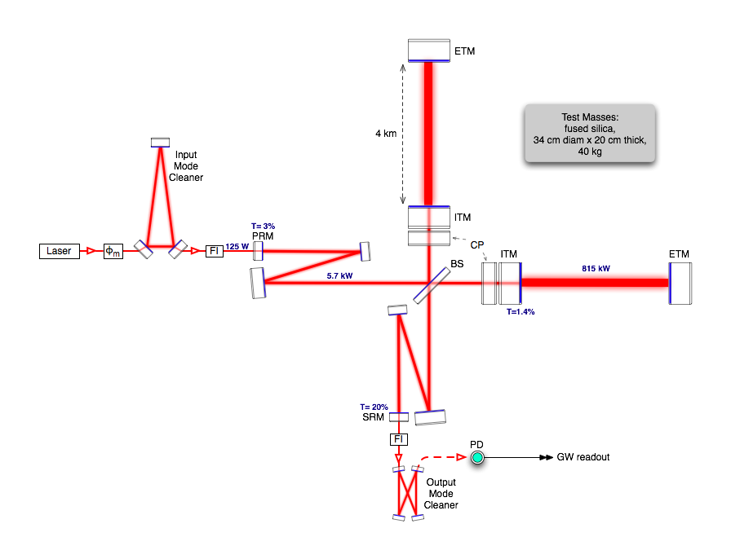
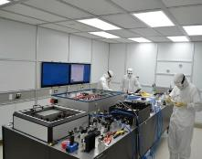
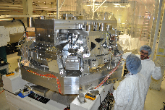
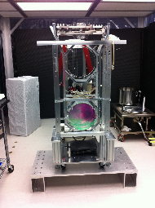
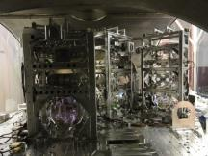
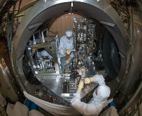
Advanced LIGO
Pre-stabilized Laser
Active Seismic Isolation
‘Test Mass’ Mirror
Input Optics
Output Mode Cleaner
Auxiliary Laser

Slide 17
Advanced LIGO Commissioning Progress/Timeline to First Observing Run
Optimistic Sensitivity
goal for O1
Conservative
goal for O1
Improve Duty Cycle
Initial
LIGO
LLO
LHO

Slide 18
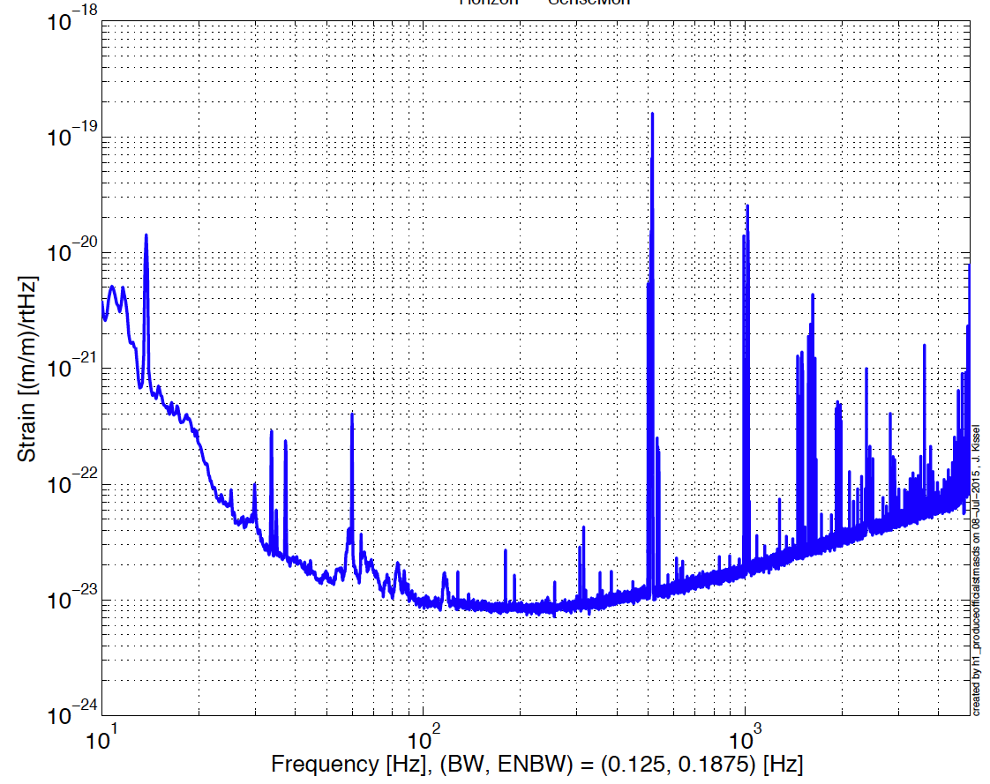
Current LIGO Livingston Sensitivity: Ready for the First Observing Run!
Binary Neutron Star
Inspiral Range: 62 Mpc
Preliminary

Slide 19
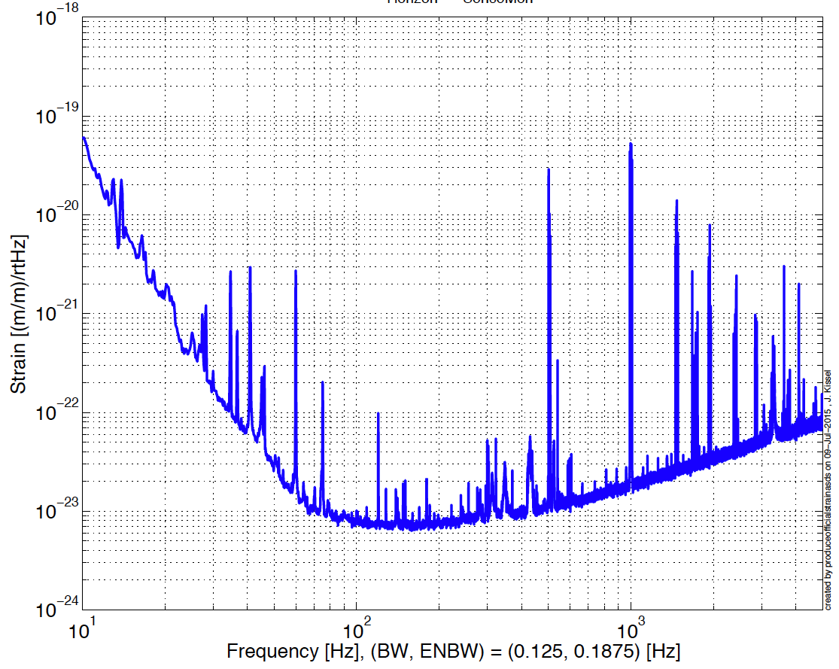
Current LIGO Hanford Sensitivity: Ready for the First Observing Run
Binary Neutron Star
Inspiral Range: 65 Mpc
Preliminary
Preliminary

Slide 20
LIGO Overall Status
The Advanced LIGO Construction Project: officially completed on March 31, 2015 on schedule and on budget
Interferometer Commissioning: The Advanced LIGO interferometers have already exceeded the sensitivity of the initial LIGO interferometers by more than a factor of three and are operating at sensitivities that are interesting from an astrophysical point of view
First Advanced LIGO Science Run: The LIGO Laboratory and the LIGO Scientific Collaboration are making intensive preparations for ‘Observing Run 1’ to start in Sept 2015.
LIGO-India: LIGO continues to work with institutes in India to plan the LIGO-India Project which will locate an Advanced LIGO interferometer in India; awaiting approval from Government of India

Slide 21
Advanced Virgo
The following slides were provided by the Virgo project.

Slide 22
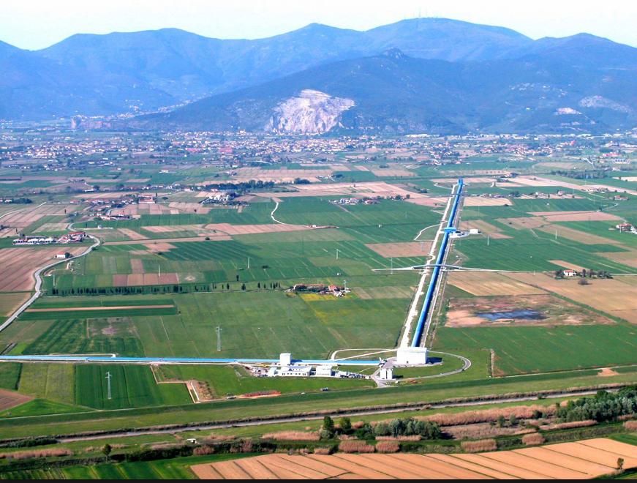






THE VIRGO COLLABORATION:
5 European countries
19 labs
APC Paris
ARTEMIS Nice
EGO Cascina
INFN Firenze-Urbino
INFN Genova
INFN Napoli
INFN Perugia
INFN Pisa
INFN Roma La Sapienza
INFN Roma Tor Vergata
INFN Trento-Padova
LAL Orsay – ESPCI Paris
LAPP Annecy
LKB Paris
LMA Lyon
NIKHEF Amsterdam
POLGRAW(Poland)
RADBOUD Uni. Nijmegen
RMKI Budapest
Participated by scientists from Italy and France (former founders of Virgo), The Netherlands, Poland and Hungary
Tot.~300 scientists

Slide 23
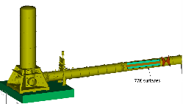
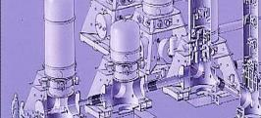
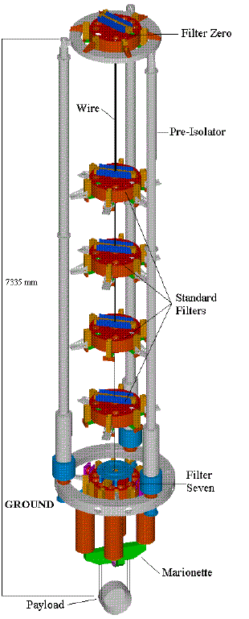
Ad Virgo in a nutshell
Large cryotraps
Larger central vacuum links
heavier mirrors
(42 kg)
high finesse
(≈1000)
new IP
tilt control
larger beam waist
signal recycling
new payload
fused silica
suspensions
high power SSL
(200 W)
DC detection

Slide 24
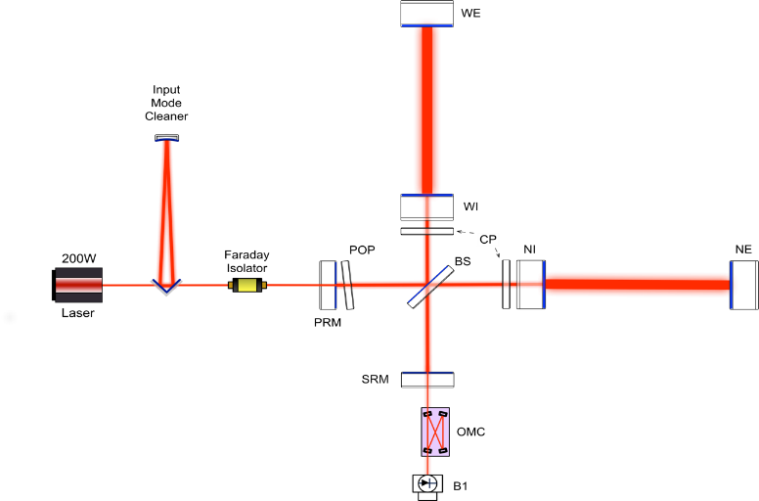
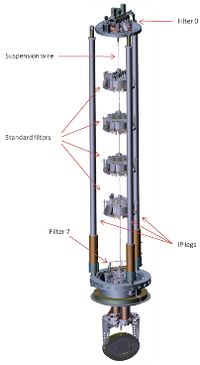
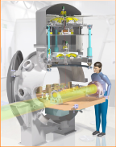
Where we are: integration in advanced state
Installation of the TCS
Commissioning of the IMC cavity
Commissioning of the
SIB2/SDB2/SPRB MSAS
Upgrade the superattenuators,
Installation of the mirror payloads
Preparation/installation of the
suspended detection benches

Slide 25
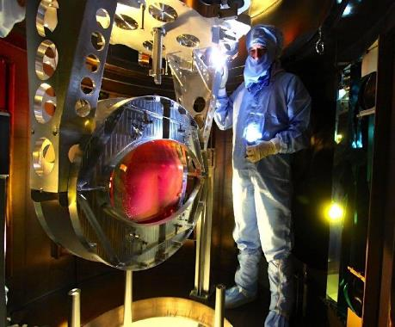
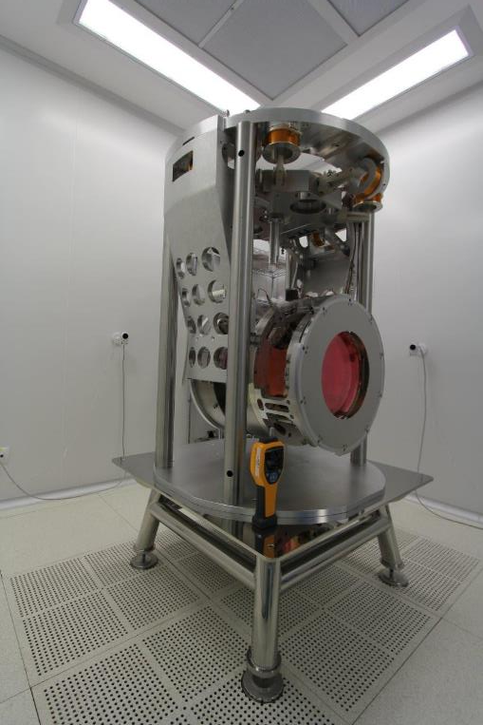
Payloads
Beam Splitter integrated hooked to the super attenuator (now in vacuum )
Input mirror payloads of the FP cavities
assembled and integrated in the super attenuator vacuum chamber

Slide 26
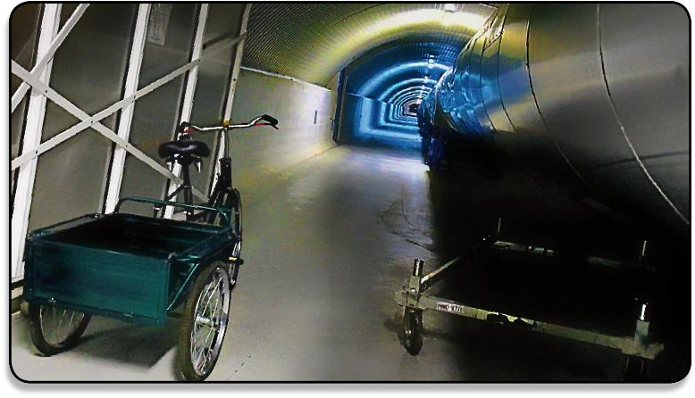
Conclusions
We are in the middle of the integration phase
80% of project cost committed so far
Our commitment: join LIGO in O2, the 2016 science run!

Slide 27
GEO600
The following slides were provided by the GEO project.

Slide 28
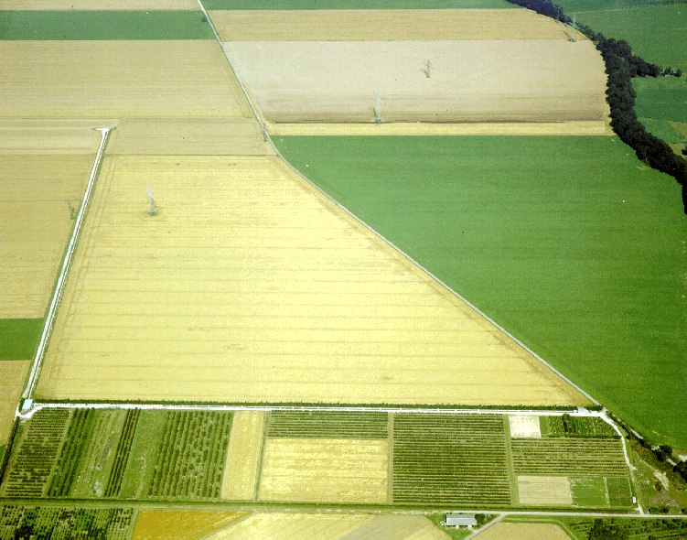






The GEO600 Project
German-British collaboration, location Hannover / Germany
Michelson Interferometer with power- and signal-recycling (folded 600m long arms, no armcavities)
U Birmingham
U Mallorca
Glasgow

Slide 29
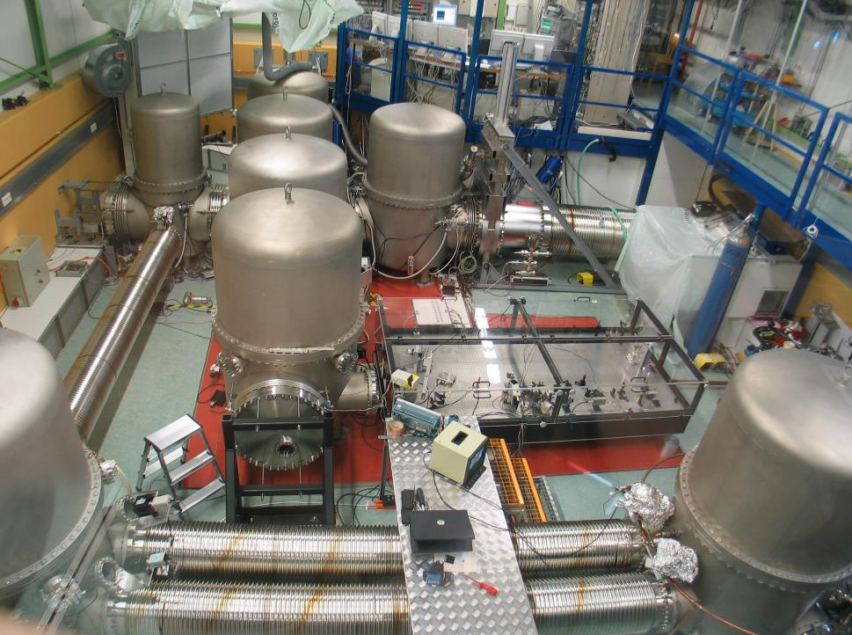

Slide 30
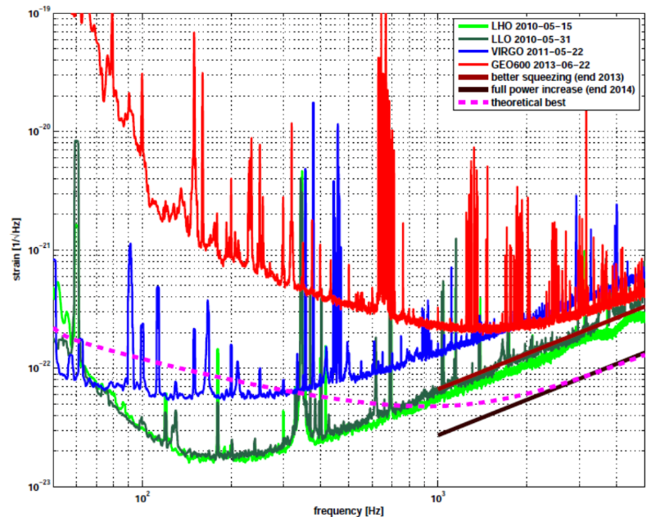
GEO600, Virgo, LIGO Sensitivities
GEO600 2012
GEO600 2014
GEO600 2015
Virgo
LIGO

Slide 31
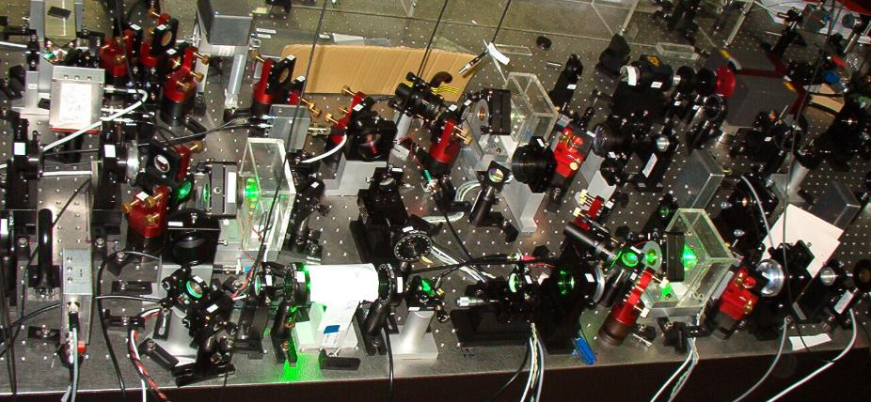
Squeezed Light in Hannover

Slide 32
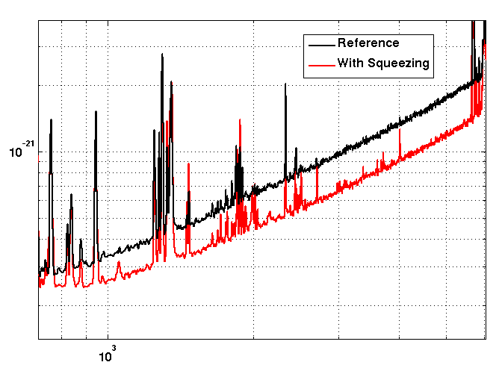
Squeezing result so far: 3.4dB 3-times increase in observable volume! Problem in Space: Optical Losses!
Strain [1/sqrt(Hz)]
Frequency [Hz]

Slide 33
KAGRA

Slide 34
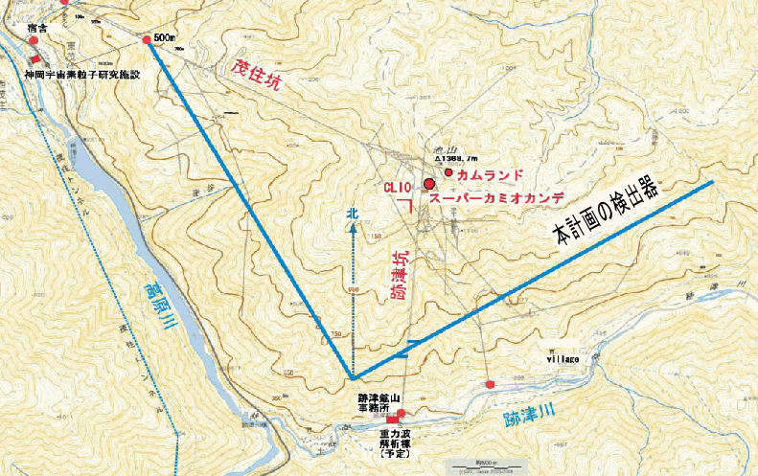
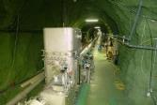
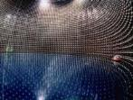
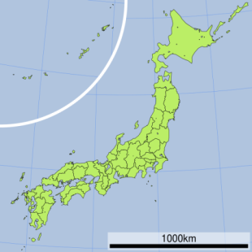
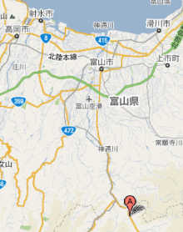
Location (Kamioka)
Mozumi Entrance
CLIO
Super-Kamiokande
3km
K A G R A
3km
Toyama airport
Kamioka◎
◎Tokyo
40min.
by car
Shin-atotsu Entrance

Slide 35
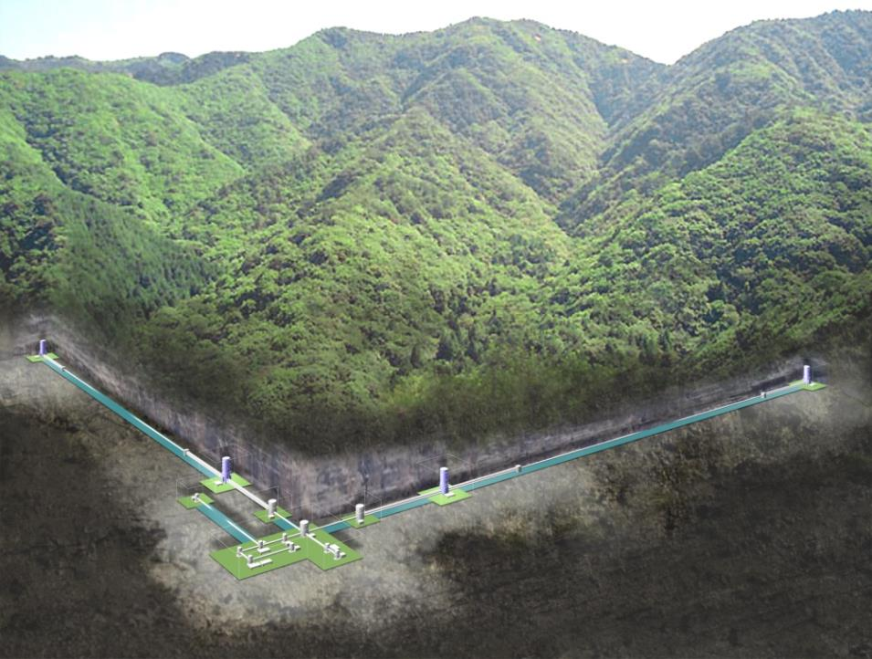
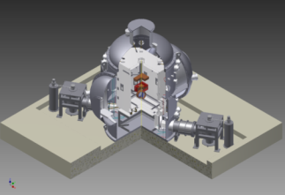
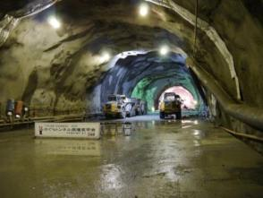
Cryogenic Mirror
Key features of KAGRA
Underground
Technologies crucial for the 3rd-generation detectors;
KAGRA can be regarded as a 2.5-generation detector.

Slide 36


Two technologies + one
Seismic noise
Typical sensitivity of the 1st generation detectors
Strain
Quantum noise
Thermal Noise
Frequency
Underground Cryogenic Mirror Resonant Sideband
Extraction

Slide 37
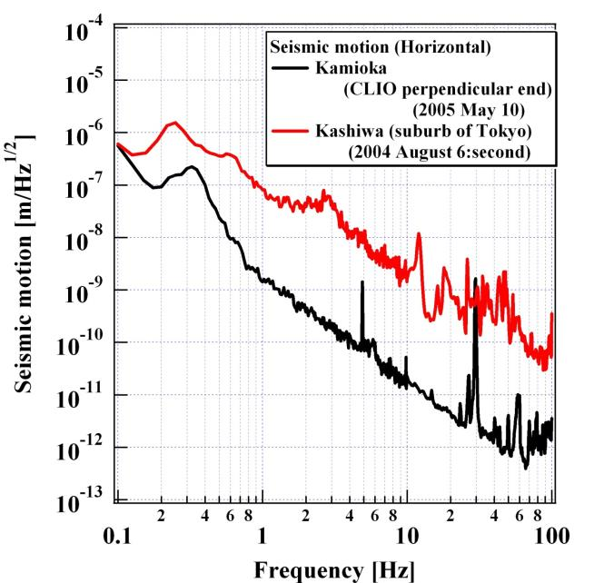
Ground motion in Kamioka mine
Kashiwa
Kamioka

Slide 38
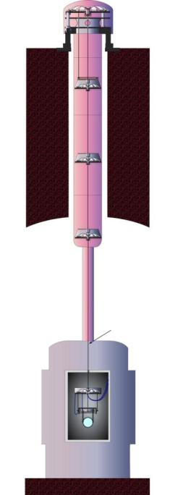
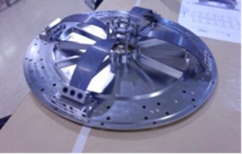
Vibration isolation system
2nd floor
Inverted pendulum
Geometrical antispring
(GAS) filter
Multi-stage pendulum
(with GAS filter)
1st floor
Another pendulum
(with GAS filter)
Mirror suspension
GAS filter
Two-layer structure to avoid the resonances of the tall structure.

Slide 39
Cryogenic system
Platform (14 K)
Upper mass (15 K)
Mirror (20 K)
Inner shield (8 K)
Outer shield (80 K)
Heat link
Cryocooler
Cryocooler
Cryocooler
Main beam
Beam tube shield

Slide 40
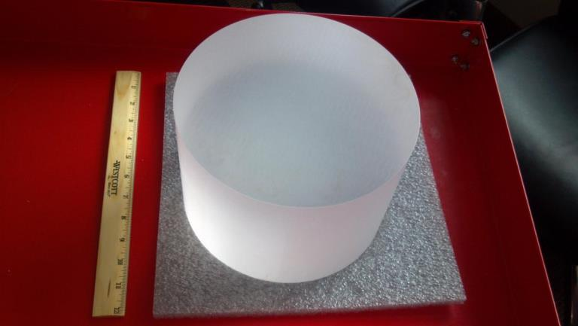
Sapphire Mirror
Φ220mm, t 150mm, c-axis

Slide 41
Ultimate Sensitivity Limit of KAGRA
Duty factor: > 80%
Beating the standard quantum limit

Slide 42
Expected event rate for NS-NS coalescence
Inspiral range: 176 Mpc
(the same definition as LIGO/Virgo)
Assuming Inspiral rate per galaxy: ∼100 Myr⁻¹
Expected event rate: ∼10 yr⁻¹

Slide 43
Other GW sources
BH-BH coalescence: e.g. 20 M at 2 Gpc, 0.4∼1000 events per year
Quasi-normal mode of BH: e.g. 100∼300 M at 3 Gpc
Supernova: Hopefully ∼1 Mpc, ∼1 event per 30 years
Pulsar: Crab and Vela, possibly other invisible pulsars
Beginning of the Universe: non-standard model
Unknown: Nature likes to surprise us.

Slide 44
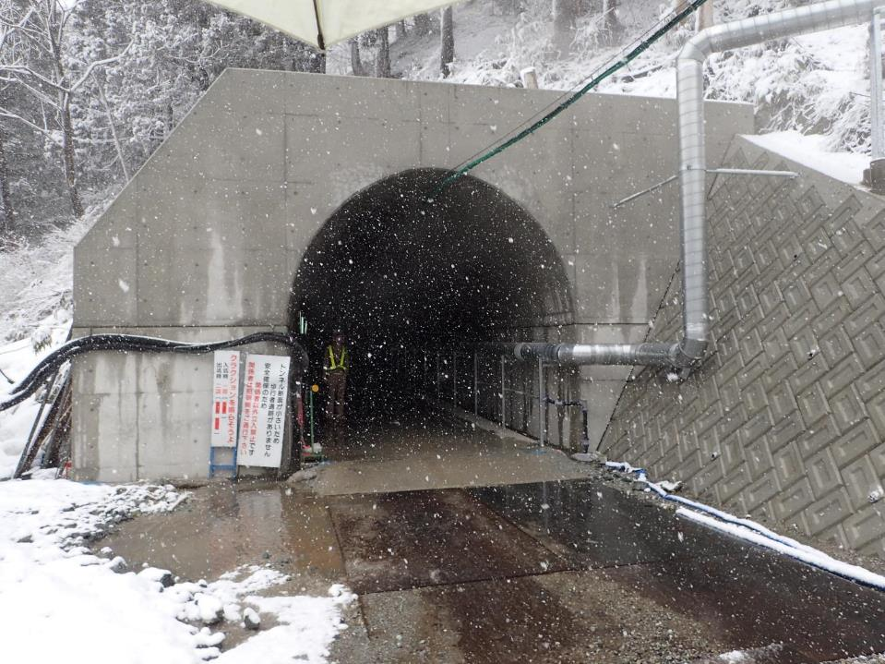
Shin-Atotsu entrance (2015.3.10)

Slide 45
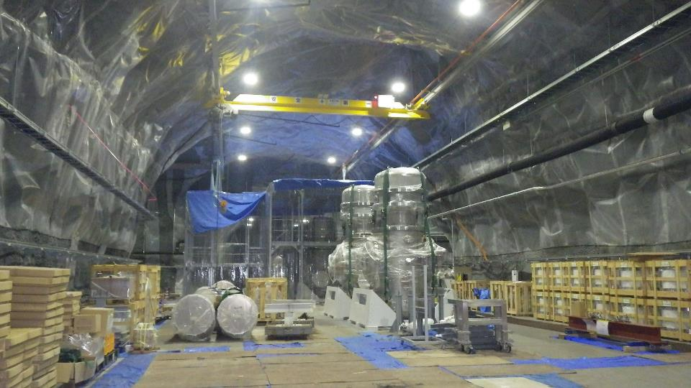
Central area (2015.6.17)

Slide 46

Cryostat and shaft (2015.6.17)

Slide 47

Slope to the 2nd floor (2015.6.17)

Slide 48

2nd floor (2015.6.17)

Slide 49

Pre-stabilized laser (2015.3.10)

Slide 50

Vacuum chamber for beam splitter (2015.6.17)

Slide 51

Beam tubes (2015.6.17)

Slide 52

Control room in KAGRA research building (2015.6.17)

Slide 53

Cryogenic suspension
Sapphire spring
[Requirements]
Strength
Heat conductivity
Mechanical loss
The component test showed the current design is OK. We plan to do the prototype test.
In collaboration with ET
Sapphire nail head
Sapphire fiber
Sapphire mirror
Hydroxide Catalysis
Bonding
22cm
Indium Bonding
Sapphire nail head

Slide 54
Schedule of KAGRA
Calendar year
Project start
Tunnel excavation
initial-KAGRA
baseline-KAGRA
Observation
 | 2010 | 2011 | 2012 | 2013 | 2014 | 2015 | 2016 | 2017 | 2018
iKAGRA obs.
Adv. Optics system and tests
Cryogenic system
iKAGRA
Michelson interferometer
Room temperature
Simple seismic isolation system
bKAGRA
Resonant sideband extraction
Cryogenic temperature
Advanced seismic isolation system

Slide 55


KAGRA in network
LIGO(H)+LIGO(L)+Virgo
Coverage at 0.5 M.S.: 72%
3 detector duty factor: 51%
LIGO(H)+LIGO(L)+Virgo+KAGRA
Max sensitivity (M.S.): +13%
Coverage at 0.5 M.S.: 100%
3 detector duty factor: 82%
L/H+L/L+V 50%
L/H+L/L+V+LCGT
50%
B. F. Schutz

Slide 56
ET
The following slides were provided by the ET project.

Slide 57

Einstein Telescope (ET) Project
The ET project born in 2008 thanks to the support of the Europen Commission who funded its design study with a 3 years grant
It is based on the assumption that the upgrade of the 2nd generation (or advanced) interferometers after the detection of GW will be limited by the research infrastructure hosting the detector
For this reason the ET project focused mainly on the design of the infrastructure rather than on the technologies for future (3G) observatories

Slide 58


The ET infrastructure
A triangular, 10 km each side, underground infrastructure has been drafted
The triangular shape allows to host up to three detectors, each composed up to two interferometers, each specialised in a frequency range (Xylophone design)
In this configuration, ET will be able to fully reconstruct the polarisation of the GW signal (through virtual interferometry), will produce a null stream (for false allarm suppression) and will show an high redundancy level

Slide 59

Sites investigation
ET site still undecided, but a few sites in Europe have been found compliant with the requirements during a first investigation campaign

Slide 60

ET technologies
The ET design study focused on the “research infrastructure”, designing an observatory able to host the evolution of the GW detectors in the next decades
Nevertheless, a (brute force) attempt to describe the ET technologies has been performed
Low frequency interferometer ET-LF:
Long suspension chains of seismic filters (“à la Virgo”)
Cryogenic and massive payloads
Silicon mirrors (~200kg) and new 1.55μm wavelength laser
Frequency dependent squeezing
High Frequency interferometer ET-HF
High power 1064nm wavelength laser
High mass (~200kg) fused silica test masses
Low absorption coatings
Advanced thermal correction of the aberrations
Frequency dependent squeezing

Slide 61
ET Conceptual design
ET possible Roadmap
R&D
Technical design
First detection on advanced interferometers
ET Observatory Funding
Site preparation
ET Site and infrastructures realisation
2012
2013
2014
2015
2016
2017
2018
2019
2020
2021
2022
2023
2024
2025
2026
2027
2028
2029

Slide 62
LISA
The following slides were provided by the LISA project.

Slide 63



LISA: An Observatory for Gravitational Waves in Space
3 Satellites
Million km arms
50 Million km behind Earth

Slide 64


Black Hole Astronomy by 2030
E. Berti
eLISA
Redshift Z →
SNR
Future EM Obs.
LSST, JWST, EELT
Mass [log M/M☉]→

Slide 65

All Binary Black Holes cross eLISA band: Trace Galaxy Mergers

Slide 66

LISA Layout
Laser transponder with 6 links, all transmitted to ground
Diffraction widens the laser beams to many kilometers
1 W sent, 100 pW received by 40 cm Cassegrain
Michelson with 3rd arm and Sagnac mode
Can distinguish both polarizations of a GW
Can form Null combination!
reference
laser beams
main transponded
laser beams

Slide 67


LISA Pathfinder
Testing LISA technology in space!

Slide 68

One LISA Arm: Few Million kms – two test masses
Test-mass
Laser link
Test-mass

Slide 69

Spacecraft is completed!
Next step is acoustic test, functional checkout
Ready for shipping to launch site in August 2015

Slide 70

Ready and Waiting!
Launch window opens November 15th, 2015!

Slide 71
Roadmap for LISA
Launch LISA Pathfinder in 2015
Coordination of international partners
Technology development until 2019
Mission concept selection 2020
Payload EQM 2020 – 2024
Start industrial implementation 2025
Launch 2034

Slide 72
DECIGO

Slide 73
What is DECIGO?
Deci-hertz Interferometer Gravitational Wave Observatory
Bridges the gap between LISA and ground-based detectors
Low confusion noise -> Extremely high sensitivity
10⁻¹⁸
moved above
LISA band
LISA
10⁻²⁰
To be moved
into GBD band
Ground-based detectors
Strain [Hz^{-1/2}]
DECIGO
10⁻²²
Confusion Noise
10⁻²⁴
10⁻⁴
10⁻²
10⁰
10²
10⁴
Frequency [Hz]

Slide 74
Pre-conceptual design
Differential FP interferometer
Arm length: 1000 km
Mirror diameter: 1 m
Laser wavelength：0.532 μm
Finesse: 10
Laser power: 10 W
Mirror mass: 100 kg
S/C: drag free
3 interferometers
Arm cavity
Arm cavity
Laser
Mirror
Photo-
detector
Drag-free S/C

Slide 75
Orbit and constellation (preliminary)
Earth
Correlation for stochastic background
Record disk
Sun
Increase angular resolution

Slide 76
Science by DECIGO
10⁻¹⁹
10⁻²⁰
10⁻²¹
10⁻²²
10⁻²³
10⁻²⁴
10⁻²⁵
10⁻²⁶
Mini-black hole
⇓
Dark matter
Formation of super-massive BH
BH binary
(1000 M◎ z=1)
Coalescence
Brans Dicke
parameter
5 years
1 cluster
Radiation pressure noise
3 months
Strain [Hz^{-1/2}]
NS binary (z=1)
Shot noise
Correlation
(3 years)
Acceleration of Universe
⇓
Dark energy
Verification of inflation
Inflation
(Ω_{GW}~2×10⁻¹⁶)
Coalescence
10⁻³ 10⁻² 10⁻¹ 1 10 10² 10³
Frequency [Hz]

Slide 77
Summary
Gravitational waves could be detected by ground-based 2nd-generation detectors within a couple of years. Then gravitational wave astronomy will be established.
In the future gravitational wave astronomy will be further extended by ground-based 3rd-generation detectors and space antennas.

