Slide 1
Cosmological modelling with the Collins-Williams Regge calculus formalism
Rex Liu (DAMTP, Cambridge, UK)
In collaboration with
Ruth Williams (DAMTP, Cambridge, UK)
Hot Topics in General Relativity and Gravitation
9 August – 15 August 2015 • Quy Nhon, Vietnam
Notes:
The topic of my talk is on using a form of Regge calculus, specifically the Collins-Williams formalism, to model cosmological systems.

Slide 2
Cosmological context – FLRW models
Tremendously successful in accounting for observations:
Hubble expansion
the cosmic microwave background (CMB)
baryon acoustic oscillations
CMB isotropic to one part in 100,000
In spite of success:
matter in late-universe highly inhomogeneous
mostly in clusters and superclusters of galaxies with large voids in between
explain universe’s acceleration without needing dark energy? (Ellis, arXiv:1103.2335)
Notes:
FLRW models highly successful in accounting for many cosmological observations. Examples include Hubble expansion, the CMB, and baryon acoustic oscillations.
Underlying assumption of homogeneity & isotropy well-supported by precision observations that CMB is isotropic to one part in 100,000.
But, late matter-dominated universe satisfies the Copernican principle in a very coarse-grained manner only. Most matter is concentrated in clusters & superclusters of galaxies with large voids in between.
Relative importance of such inhomogeneities to observations is a subject of debate. Some even propose that a correct account of homogeneities may explain the observed acceleration of the universe as an apparent effect without any need for dark energy.

Slide 3
Modelling inhomogeneities
non-perturbative approach needed
  (Clarkson & Maartens, arXiv:1005.2165; Clarkson & Umeh, arXiv:1105.1886)
Regge calculus provides a non-perturbative approach
  (Regge, Il Nuovo Cimento 19, 1961)
Collins and Williams (CW) formalism for approximating FLRW space–times
  (Collins & Williams, Phys Rev D7, 1973; Brewin, Class Quant Grav 4, 1987)
Notes:
Because of non-linear nature of the Einstein field equations, some have argued that a non-perturbative approach is needed to model properly inhomogeneities and their observational effects.
Regge calculus offers one such approach, and in this talk, I shall focus specifically on a form of Regge calculus originally developed by Collins and Williams to approximate FLRW space-times.

Slide 4
Outline
Regge calculus and CW formalism
Closed vacuum Λ-FLRW universe
Closed “lattice universes”
Notes:
I shall begin with a very cursory introduction to Regge calculus and the CW formalism.
I shall then describe our work in adopting the CW formalism to model two toy universes.
The first universe is one for which the continuum solution is well-established; that is, the closed vacuum FLRW universe w non-zero cosmological const. By comparing our approximation with the actual solution, we can have a better understanding of the formalism.
The second universe is a toy inhomogeneous universe, the so-called “lattice universe”. Lattice universes are universes where the matter content consists of point masses arranged into a regular lattice on space-like Cauchy surfaces; there is pure vacuum in between. Matter content still regular compared to actual universe’s, allowing it to be more easily modelled, but more representative of actual universe’s matter content compared to matter content of FLRW.

Slide 5
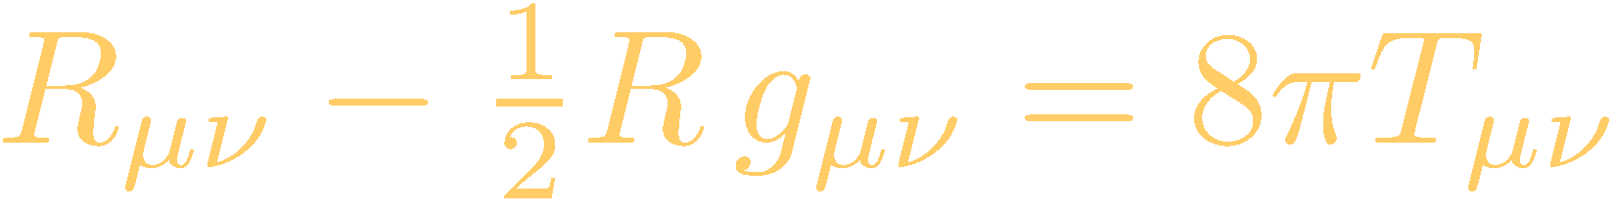
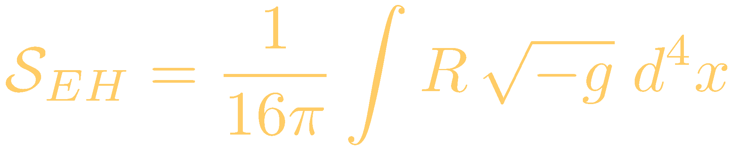

General relativity
Can obtain Einstein field equations
by varying Einstein–Hilbert action
with respect to metric
Action is over a continuous manifold.

Slide 6
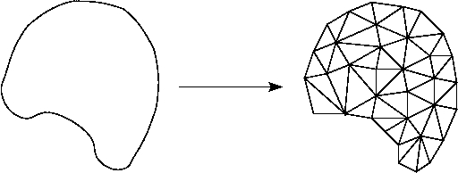
Regge calculus skeleton
Key idea of Regge calculus:
  Replace continuum manifold with piecewise linear one (called skeleton)

Slide 7
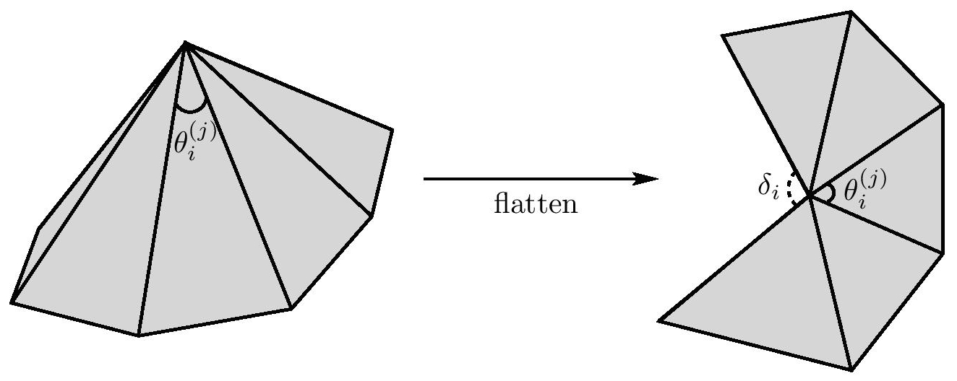
Regge calculus skeleton
Skeleton consists of flat blocks glued together at shared faces
Flat blocks – interior metric is Minkowski
Curvature manifests as conical singularities on sub-faces of co-dim 2 (called hinges)
Analogue to metric are the blocks’ edge-lengths
Notes:
Size of gap gives measure of conical sing at hinge; the gap angle is known as the “deficit angle”.

Slide 8
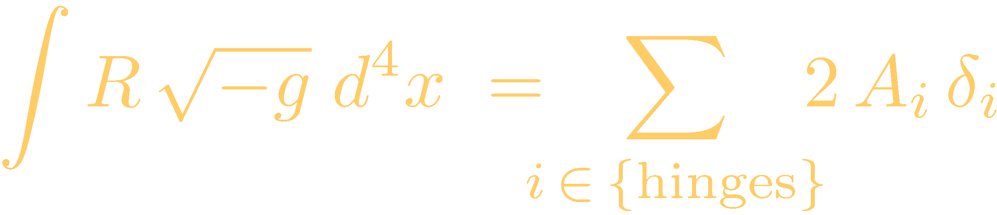
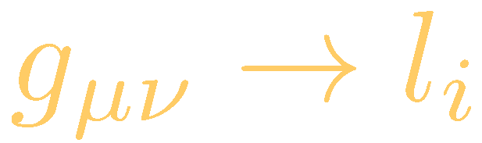
Regge calculus
Apply Einstein–Hilbert action to skeleton to get Regge action
Analogue of metric are the blocks’ edge-lengths
Vary with respect to edge-lengths to get Regge equations, analogue of the Einstein field equations
Notes:
Because curvature R has support on the hinges only, the integration reduces to a discrete summation over the hinges.
A_i are the hinge areas and \delta_i is something called the deficit angle of the hinge; it gives a measure of the curvature at the hinge.

Slide 9
Collins–Williams formalism
Skeleton designed to approximate FLRW space–times
FLRW universes can be foliated into Cauchy surfaces of constant curvature
Surfaces are identical apart from an overall scale factor
CW Cauchy surfaces: tessellate FLRW Cauchy surfaces with a single regular polytope

Slide 10
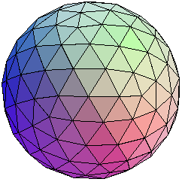
Collins–Williams formalism
For closed universes, only three possible tessellations with identical, equilateral tetrahedra
  5, 16, or 600 tetrahedra universes
Can be generalised to other tessellations and other background curvatures
Notes:
I shall focus on closed universes only, and on skeletons based on the tetrahedral tessellations specifically.

Slide 11
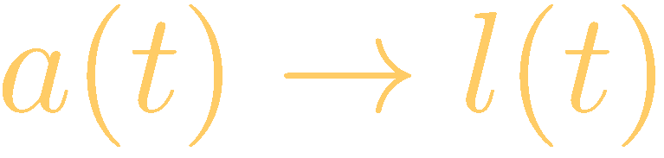
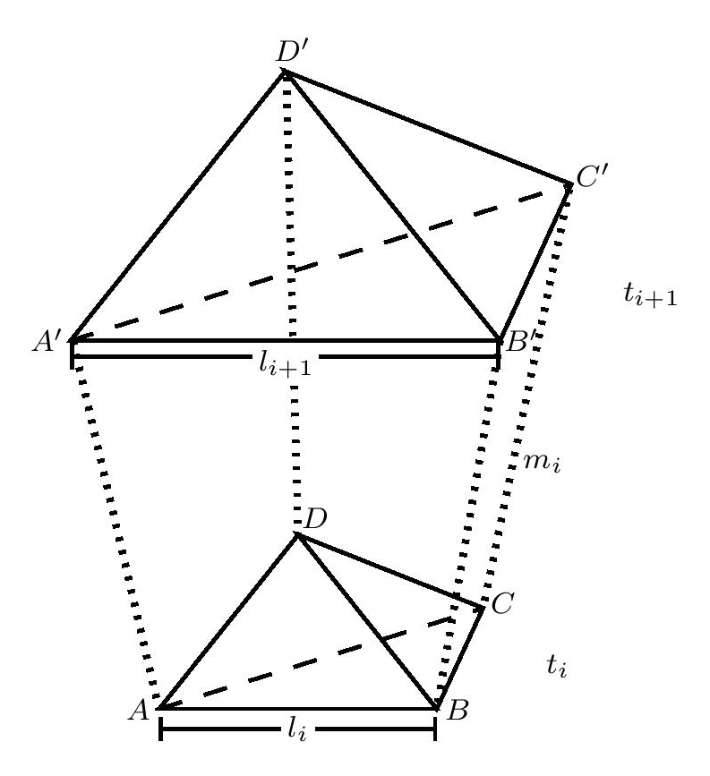
Collins–Williams formalism
All lengths in a surface identical
All surfaces identical apart from overall scaling
Surfaces joined together by struts
Surfaces parametrised by time t
  Shall take continuum time limit of Regge equations, dt ⟶ 0
  Generates a differential equation for surface edge-lengths l(t)
Notes:
Continuum time formulation of Regge calculus.

Slide 12
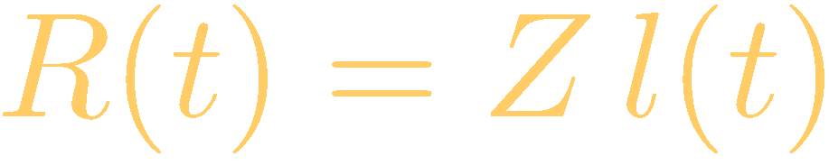
Embedding Cauchy surfaces into 3-spheres
CW Cauchy surfaces triangulate 3-spheres
  hence, can embed CW Cauchy surfaces into 3-spheres in E⁴
  embedding radius R(t) provides more natural analogue to scale FLRW scale factor a(t)
Multiple ways to define radius
  e.g. radius to vertices or to tetrahedral centres
  in all cases, related to tetrahedral edge-length l(t) by const scaling

Slide 13
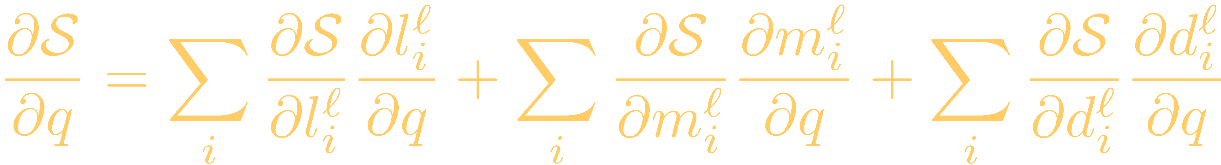
Varying the CW Regge action
Two ways to vary action:
  impose constraints on edge-lengths first
    all edges that are constrained to share identical lengths get varied at once
    this is called global variation
  impose constraints on edge-lengths after
    each edge gets varied independently of all others
    requires fully triangulating skeleton to determine varied geometry
      done by introducing additional diagonal edges between Cauchy surfaces
    this is called local variation
    more analogous to standard general relativity
If global and local actions are equivalent, then global Regge equation can be related to local equation via a chain rule (Brewin, Class Quant Grav 4, 1987)
  By chain rule, variation of action with respect to arbitrary edge q gives
  Solution of local equations are also solutions of global equations but not vice versa
  In all models we shall consider, global and local actions are equivalent

Slide 14
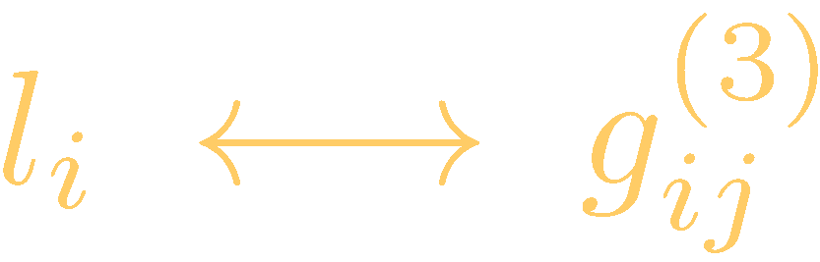

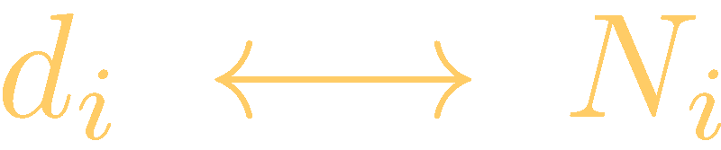
Analogies with ADM formalism
Can draw certain analogies between the CW and the ADM formalisms
(Brewin, Class Quant Grav 4, 1987)
Tetrahedral edge-lengths analogous to Cauchy surface 3-metric
Time-like struts analogous to ADM lapse functions
Diagonal edges analogous to ADM shift functions
Therefore, we shall call
  Regge equations obtained from varying struts the Hamiltonian constraints
  Regge equations obtained from diagonals the momentum constraints
  Regge equations obtained from tetrahedral edges the evolution equation
But certain limitations to this analogy (beyond scope of this talk)

Slide 15
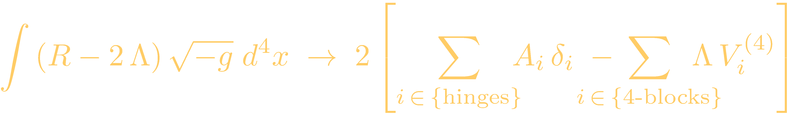
Λ-FLRW Regge models
If Λ ≠ 0, actions acquire volume term
Hamiltonian constraint:
  get same equation via local or global variation
    In local variation, does not matter which strut is varied because all equivalent by symmetry
  satisfies the initial value equation at the moment of time symmetry (moment of minimum expansion)
  first integral of “global” evolution equation
    can use Hamiltonian constraint to study evolution of model
  also first integral of “local” evolution equation provided momentum constraints also satisfied
  but, momentum constraints unphysical because diagonals actually break surface symmetries
Notes:
Relationship between global and local evol eqn: can be seen via direct calculation or via the chain rule. Both the local evolution eqn and the momentum constraint have the same leading order in dt, so if we use the chain rule, both must contribute to the global evolution eqn at leading order. On the other hand, if we use the chain rule for the Hamiltonian constraint, we find that only the local Hamiltonian constraint contributes at leading order in dt to the global Hamiltonian constraint.

Slide 16
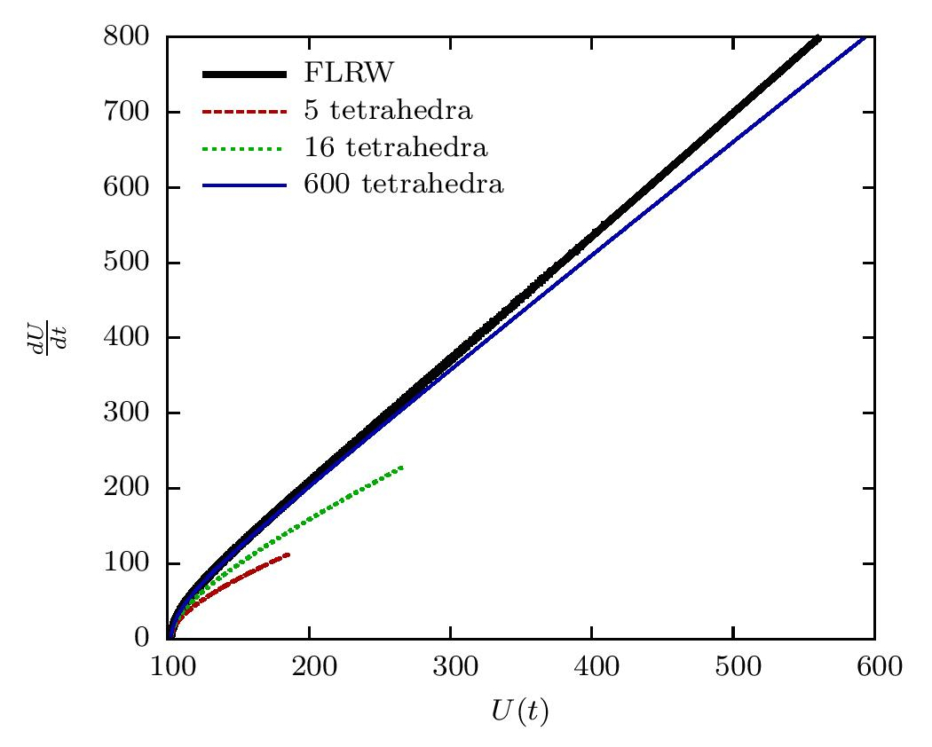
Λ-FLRW Regge models
Notes:
Plots of the expansion rate of the universe’s volume against the volume itself. The black graph is the continuum FLRW graph.
For Regge models, we have chosen the volume of a 3-sphere where the radius is chosen to co-incide with the FLRW radius at the moment of minimum expansion. This definition of the 3-sphere radius seems to allow a clearer comparison of the different models’ performance.
In particular, models diverge more slowly from FLRW as the number of tetrahedra is increased.
This makes sense because we are approximating a 3-sphere using a fixed number of tetrahedra. As the universe expands, the resolution of our approximation will degrade but it will degrade more slowly if we have more tetrahedra.

Slide 17
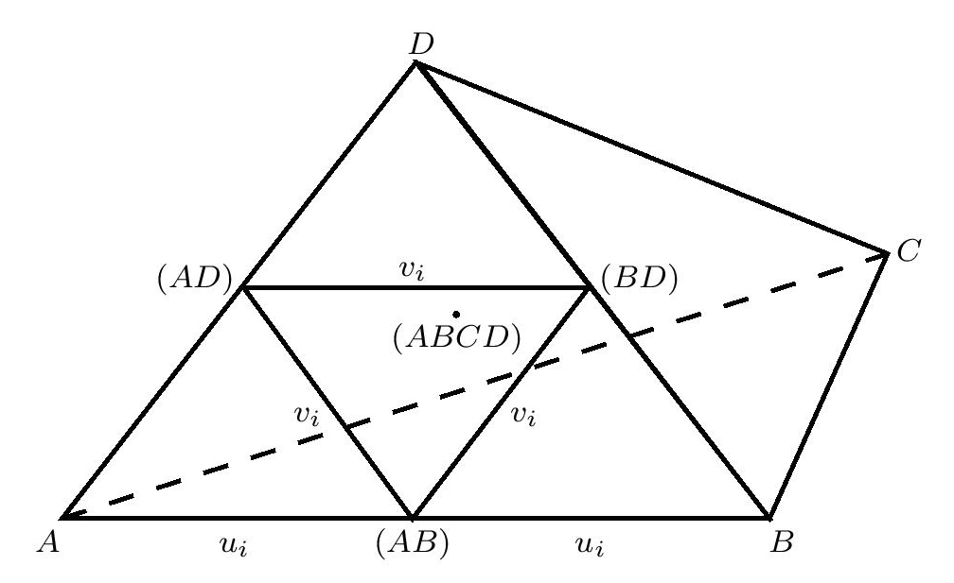
Subdivided Λ-FLRW models
Brewin’s algorithm subdivides each parent tetrahedron into a set of smaller tetrahedra
(Brewin, Class Quant Grav 4, 1987)
  tetrahedra no longer identical nor equilateral
  algorithm can be repeated indefinitely to get even finer-grained models
  Consider only first generation here
  3 different types of vertices
  3 different types of tetrahedral edges
  3 different types of tetrahedra
  3 different types of struts
Notes:
We can increase the number of tetrahedra in the model by triangulating them into smaller tetrahedra.

Slide 18
Subdivided Λ-FLRW models
Consider globally varied models only
All three sets of strut-lengths constrained to be same
Hamiltonian constraint:
  satisfies initial value equation at time symmetry
  first integral of evolution equation if tetrahedra all equilateral
    otherwise, not a first integral in general
    might be a consequence of fixing the strut-lengths to be equal
Notes:
Perhaps by suitably relaxing this constraint on the strut-lengths, we can get the Hamiltonian constraint to be a first integral of the evolution equation in general. This is something we’d have to look into.

Slide 19
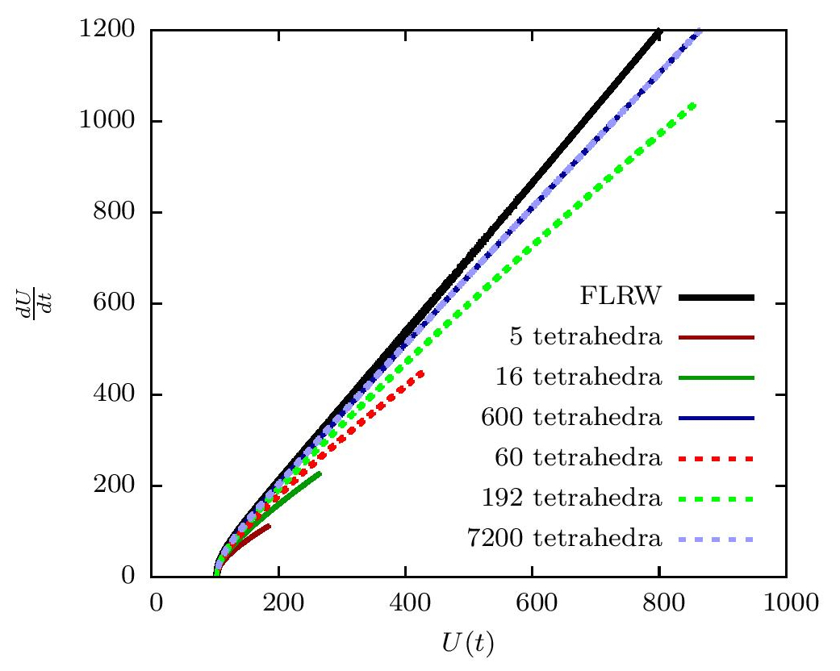
Subdivided Λ-FLRW models
Notes:
Graph of expansion rate of universe’s volume against the volume itself. We’re using 3-sphere volumes with the radius chosen again to coincide with FLRW at minimum expansion.
Graph shows both the parent models and the three first-generation subdivided models.
Again, increasing the number of tetrahedra improves the model’s performance.
Interestingly, the graphs for the 600 parent model and its 7200 child model coincide.

Slide 20
Lattice universes
Matter consists of point masses distributed into regular lattice
  otherwise vacuum throughout
  should be more representative of late universe’s matter distribution than FLRW’s distribution
Shall ultimately take masses to be at centres of the tetrahedra
  other arrangements possible

Slide 21
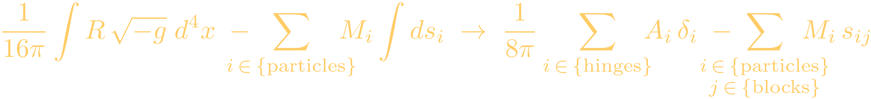
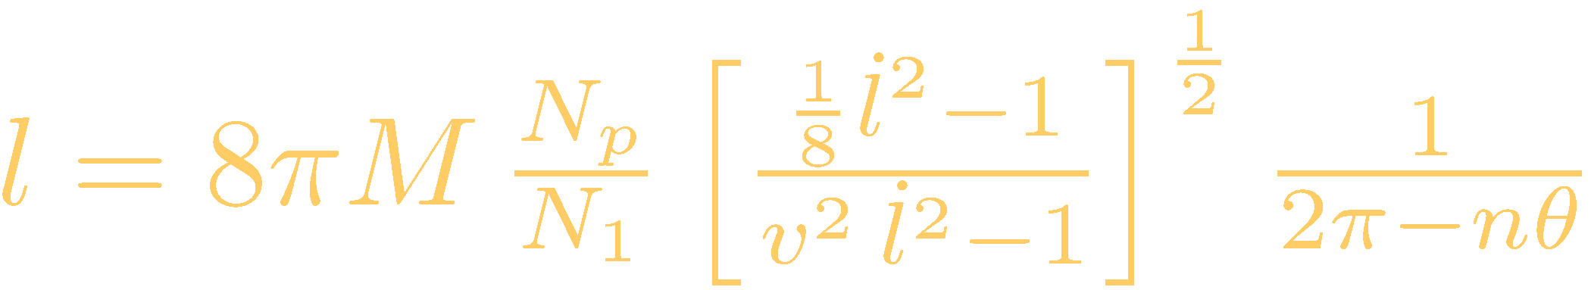
Lattice universe Regge calculus
If point particles are present, action becomes
where s_{ij} is length of the path of particle i through block j
depends on particle’s trajectory through the 4-blocks (world-tube of tetrahedra between two Cauchy surfaces)
Hamiltonian constraint:
  first integral of evolution equation
  model’s behaviour depends on particle’s placement (parametrised by v in denominator)
    unconditionally well-behaved iff each particle inside a spherical region of convergence that is centred on cell and just touches cell edges
    otherwise, universe’s evolution diverges and model breaks down
      artefact of Regge model; not expected to be case in continuum model

Slide 22
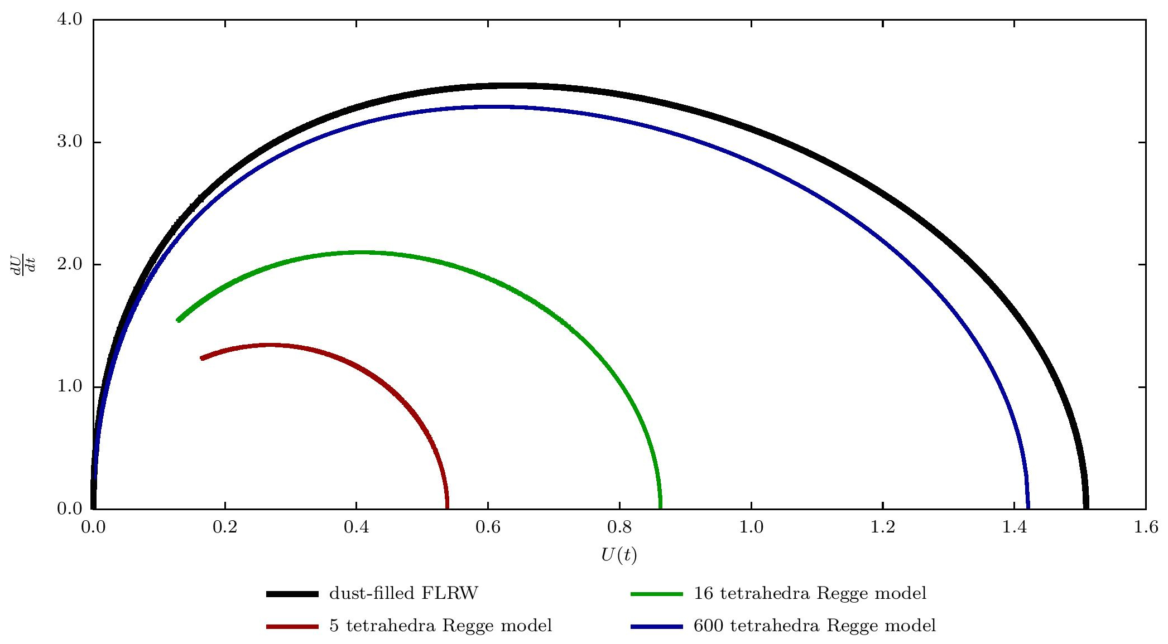
Evolution of lattice universes
Notes:
This graph shows the behaviour of the universes’ evolution. We’ve also plotted the evolution of the continuum dust-filled FLRW universe in black. We’ve fixed the total mass of the universe to be the same across all universes here. As we increase the number of particles, the model’s behaviour approaches that of the dust-filled continuum model, which is expected because the matter content becomes more and more like homogeneous and isotropic dust.

Slide 23
Perturbing a single mass
Consider perturbing M ⟶ M + δM
  Skeletal geometyr would get perturbed as well
    by symmetry, tetrahedron with perturbed mass remains equilateral
    but not the other tetrahedra
    depending on the model, can have anywhere from two to 100+ independent tetrahedral edge-lengths!
    for simplicity, focus only on five-tetrahedra model
      involves only two independent tetrahedral edge-lengths
      also involves two distinct types of struts, although lengths not independent
Notes:
Now we’ve decided to put the masses at the centres of tets. We see that this would put them right at centre of the region of convergence.
For the regular lattice universe, this is also the only position where co-moving particles would follow geodesics globally. At any other position, co-moving particles would follow piecewise linear trajectories instead bc the underlying space-time is piecewise linear.
This is an artefact of the Regge model. It’s also true in CW models of FLRW too, where the Cauchy surfaces are supposed to be homogeneous and isotropic in the continuum limit.

Slide 24
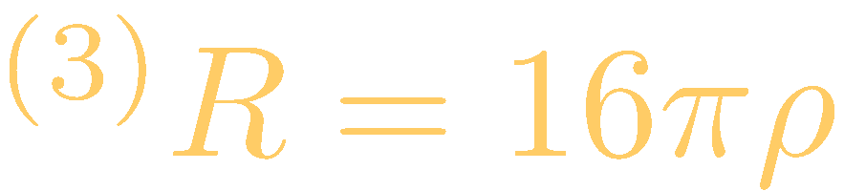
Obtaining and solving the Regge equations
obtain global solution via chain rule
focus on Hamiltonian constraint only
  assume it is first integral of evolution equation
  locally varying two struts gives two constraints
    just enough to solve for the two tetrahedral edge-lengths
    had we directly varied the action globally, would have obtained just one constraint – not enough to solve for both edge-lengths
two constraints have form of two coupled, non-linear differential equations for the two edge-lengths
linearise by perturbative expansion in δM/M
  considered up to first order only
solve numerically using initial value equation at time symmetry (max expansion) as initial conditions
  equation satisfied order-by-order in δM/M
Notes:
For this model, we obtained the global solution via the chain rule approach. As I shall soon explain, this actually makes a difference.
Once again, we focused on Hamiltonian constraint only. This time, we assumed it’s a first integral of the evolution equation, bc it has been in all the other cases we’ve considered so far.
Since we are using the chain rule approach, we locally varied the action with respect to the two different types of struts. This gave two constraints. Just enough to solve for the two edge-lengths.
If we directly varied action globally instead, we would have varied both struts simultaneously and obtained just one constraint. Not enough to solve for both edge-lengths.
Thus the chain rule approach has this advantage: it allows us to pick a unique solution out of all the global solutions possible.
Two constraints have form of …
To solve, we linearise by …

Slide 25
Behaviour of model
Evolution of universe stable against mass perturbations.
Notes:
Rate of expansion of universe’s volume against the volume itself.
The dM/M = 0.0001 and dM/M = 0.001 perturbations are so small that they have effectively covered up the black, zero-perturbation graph.
We see that the evolution is stable and closed and that increasing the mass perturbation increases the maximum expansion of the universe.

Slide 26
Conclusions and future directions
Λ-FLRW models:
  reasonable approximation, especially at small volumes
  accuracy improves as number of tetrahedra increases
Lattice universes:
  both regular and perturbed lattices closed and stable
  improve accuracy by subdividing tetrahedra
  increase inhomogeneities:
    different masses in different cells
    even leave some cells empty to model irregular voids
  investigate optical properties & redshifts
    potentially shed light on whether inhomogeneities have any significant effect on cosmological observations

Slide 27



Thank you
Λ-FLRW Regge models [arXiv:1501.07614]
Regge lattice universes [arXiv:1502.03000]
Leo Brewin, Tim Clifton, Ulrich Sperhake
Cambridge Commonwealth Trust
Trinity College, Cambridge

