Slide 1


Gravitational Waves from
the Early Universe
Jun’ichi Yokoyama (Tokyo)

Slide 2

Gravitational wave Physics and Astronomy
New Eyes to Observe the Universe

Slide 3
Gravitational wave Physics and Astronomy
Science Goals
Fundamental Physics
  Is GR the correct theory of gravity?
  Do black holes really have “no hair” ?
  What is the neutron star equation of state?
Astrophysics
  What is the black hole mass distribution?
  How did supermassive BHs grow?
  What are the progenitors of GRBs?
Cosmology
  Can we directly see before the CMB era?

Slide 4
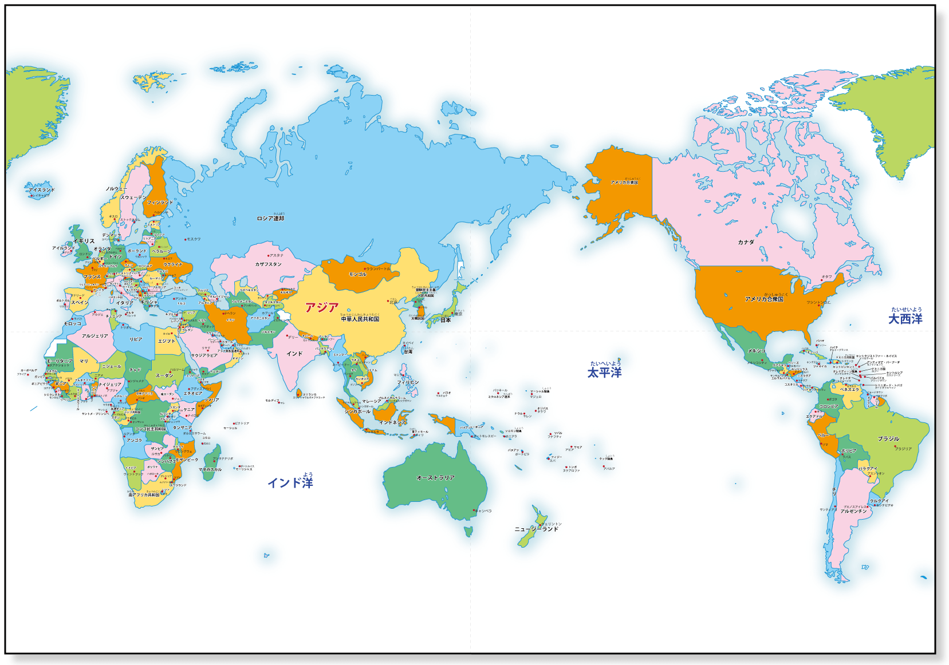
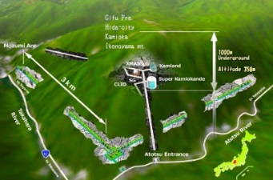
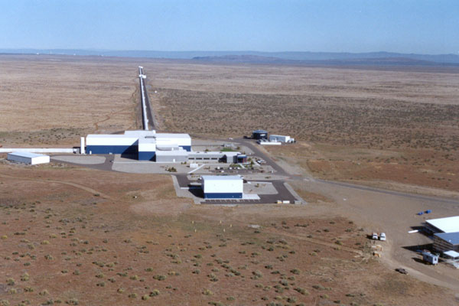
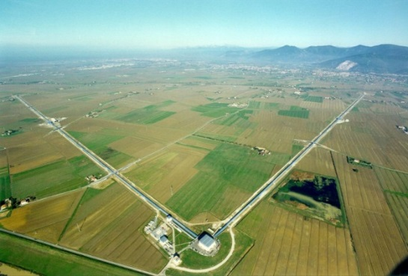
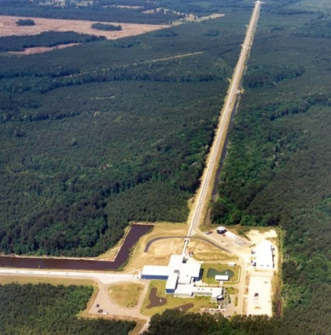
World wide network of km ground-based laser interferometers
KAGRA 3 km
LIGO Hanford 4 km
Virgo Cascina 3 km
LIGO Livingston 4 km,

Slide 5
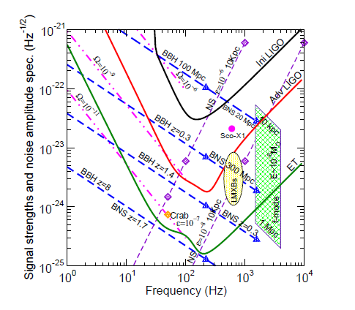
: signal strength in Fourier space
unit:
: noise amplitude, unit
Sathyaprakash & Schutz Liv. Rev. Rel. (2009)

Slide 6
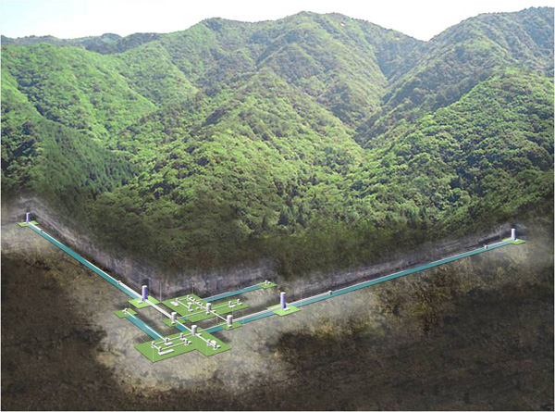
KAGRA
World’s first
2.5 generation GW detector
Cryogenic to reduce
thermal noises
(T=20K @mirrors)
Underground to reduce
seismic noises
3km
3km
Fabry-Perot Michelson type Laser interferometer

Slide 7
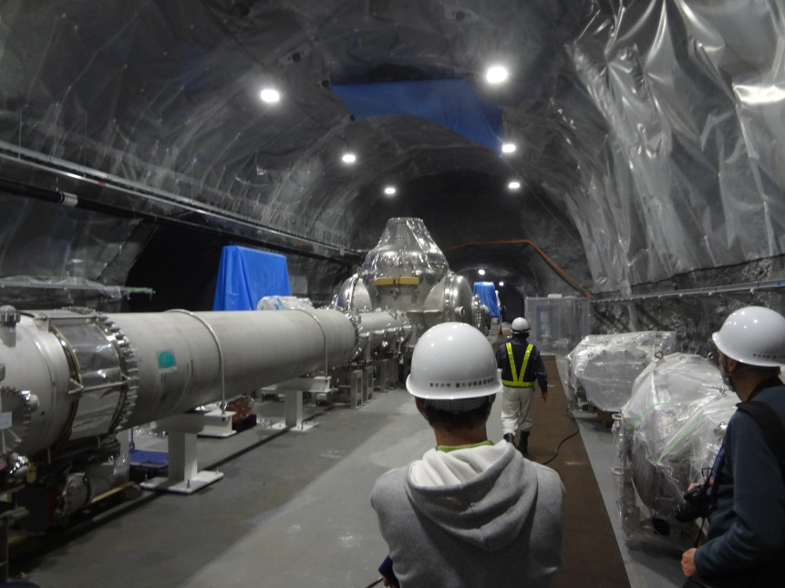

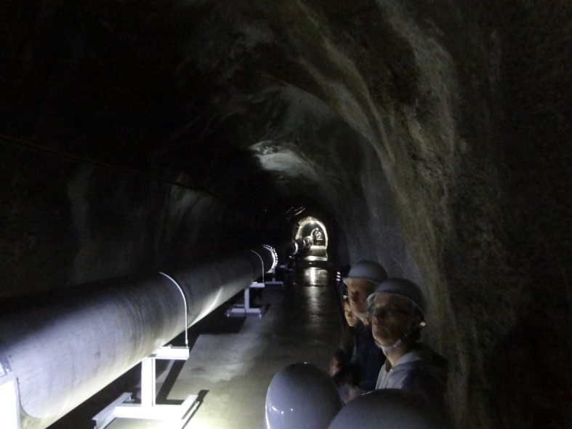
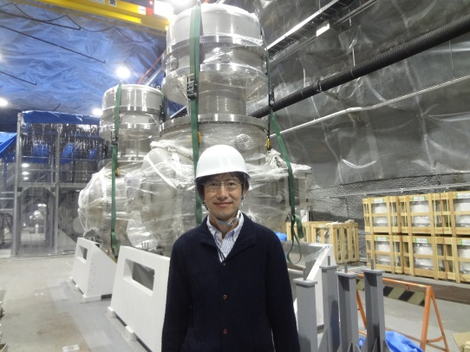
Establishing a new
data analysis group
for KAGRA at RESCEU

Slide 8
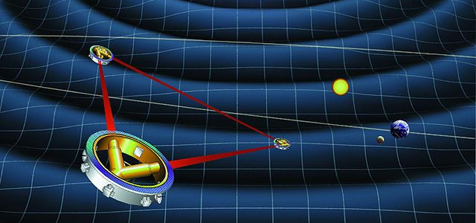
Direct detection of cosmological
Gravitational waves can be achieved
by space-based laser interferometers
Such as eLISA and DECIGO.

Slide 9

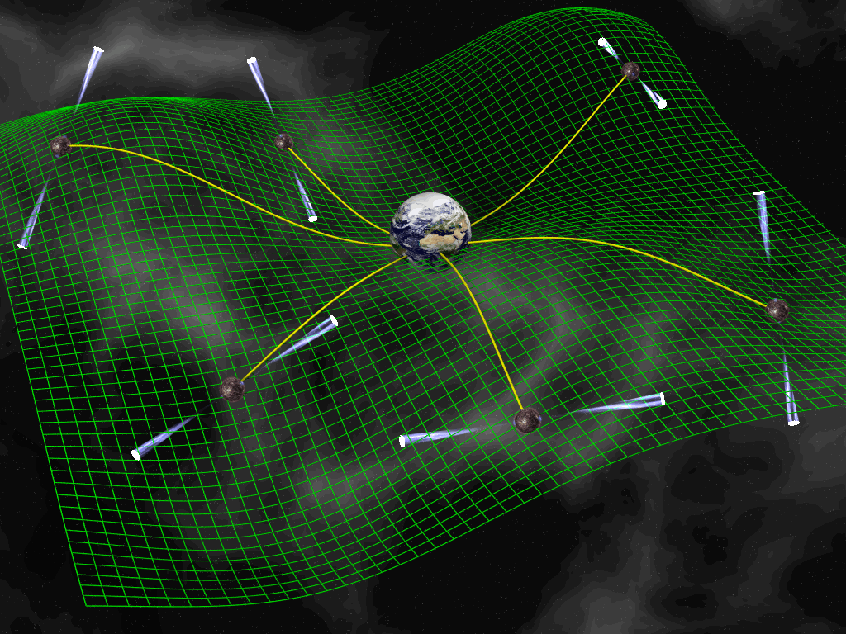
Other means of detection of
Cosmological gravitational waves
B-mode polarization
of Cosmic Microwave
Background (CMB)
Pulsar timing
Breaking news in 2014/3
turned out to be wrong
©David J. Champion

Slide 10
Gravitational
waves provide
new eyes to
see the earliest
Universe.
Today 13.8Gyr
dark energy
Gravitational
waves can probe
up to inflation era.
galaxy formation
We can probe
another tiny dark
age between
inflation and
Big Bang
Nucleosynthesis
Shedding new
“lignt” on this
epoch
first star
Electromagnetic waves can
probe only up to decoupling era.
dark age
decoupling 380kyr
reheating=Big Bang
inflation
multiproduction of universes
m

Slide 11
Sources of gravitational waves
from the early universe
Quantum tensor perturbations from inflation
GWs from second-order scalar perturbations
GWs from bubble collisions after phase transition
GWs from self-ordering scalar fields
GWs from topological defects esp. cosmic strings
….

Slide 12
Sources of gravitational waves
from the early universe
Quantum tensor perturbations from inflation
GWs from second-order scalar perturbations
GWs from bubble collisions after phase transition
GWs from self-ordering scalar fields
GWs from topological defects esp. cosmic strings
and ④: in relation with the thermal history
of the early Universe
③: a negative result related to thermal inflation

Slide 13
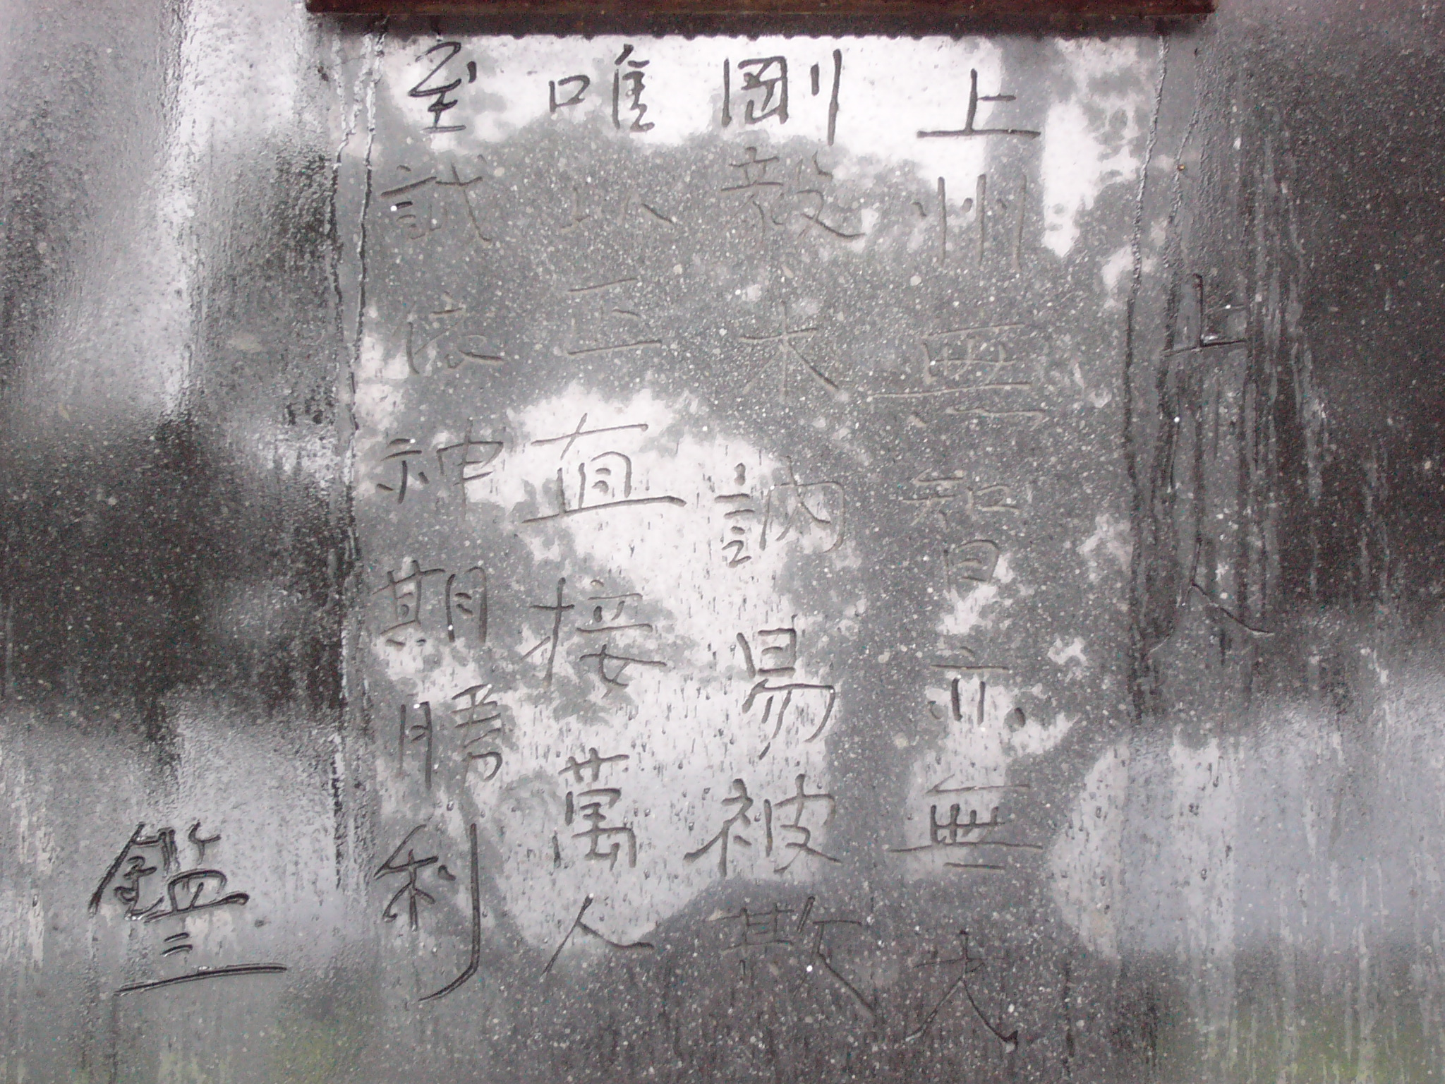
①

Slide 14
Tensor Perturbations (Quantum Gravitational Waves)
transverse
-traceless
They are equivalent with two massless scalar fields.
satisfies massless
Klein-Gordon eqn
Quantization in De Sitter background yields nearly
scale-invariant long-wave perturbations during inflation.
Starobinsky (1979)

Slide 15
Evolution of gravitational waves in the inflationary Universe
scale
Field oscillation
dominant
Radiation
H⁻¹
Hubble horizon
Amplitude of GW is constant
when its wavelength is longer
than the Hubble radius
between and .
Radiation
dominant
a(t)λ
inflation
After entering the Hubble
radius, the amplitude
decreases as
and the energy density as
.
Matter
dominant
H⁻¹
Matter
dominant
time
Reheating
When , the tensor perturbation evolves as

Slide 16
Density parameter in GW per logarithmic frequency interval
When the mode reentered the Hubble horizon at ,
the angular frequency is equal to , so we find

Slide 17
After entering the Hubble horizon,
: equation of state
in the early Universe
Radiation dominated era: constant
Field oscillation dominated era: decreases
High frequency modes which entered the Hubble radius in the
field oscillation regime acquires a suppression .
We may determine the equation of state in the early Universe.
We may determine thermal history of the early Universe.
N. Seto & JY (03), Boyle & Steinhardt (08), Nakayama, Saito, Suwa, JY (08), Kuroyanagi et al (11)…

Slide 18
Thermal History is imprinted on the spectrum of GWs.
Sensitivity curves of various
specifications of DECIGO

Slide 19
Conceptual design of DECIGO
DECihertz Interferometer Gravitational-wave Observatory
N. Seto, S. Kawamura, & T. Nakamura, PRL 87(2001)221103
Now include Fabry-Perot Cavity =Light Resonator
Arm length： L=1000 km
Mirror Diameter： R=0.5 m
Mirror Mass： M=100 kg
Laser Wavelength： λ=532 nm
Laser Power： P=10 W
Finesse： F=10
Original Specifications
Resonator
Average time photons spend
inside the resonator cavity
detector
Resonator
Laser
detector
Drag-Free Spacecraft
© S. Kawamura
Notes:
フィネスはレゾナンスの間隔／半値全幅

Slide 20
Thermal History is imprinted on the spectrum of GWs.
contaminated
by binary
white dwarfs
Sensitivity curves of various
specifications
In order to probe higher
reheating temperature
we need sufficient
sensitivity at higher
frequency.

Slide 21
At the present time, the energy density of GW is given by
Transfer function
depending on
thermal history
Amplitude per
logarithmic
frequency interval
dlnf
Strain power spectrum
with a measure df
This f ³ dependence makes it
very difficult to detect higher
frequency stochastic GWs.

Slide 22
In order to probe higher frequency with the same sensitivity to Ω_{GW},

Slide 23
In order to probe higher frequency with the same sensitivity to Ω_{GW},
Strain sensitivity must be
improved in proportion to f^{—3/2}
Lower thicker curves indicate sensitivity achieved by 3yr correlation analysis

Slide 24
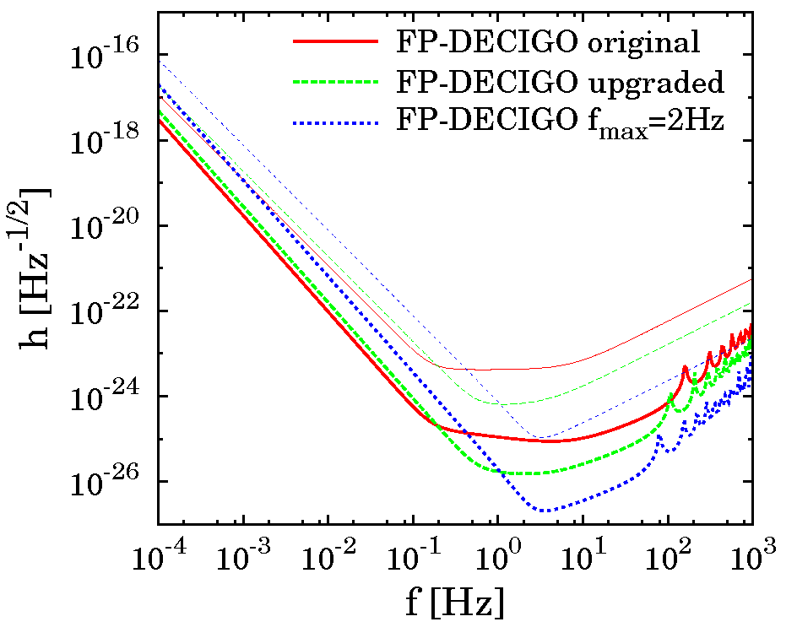
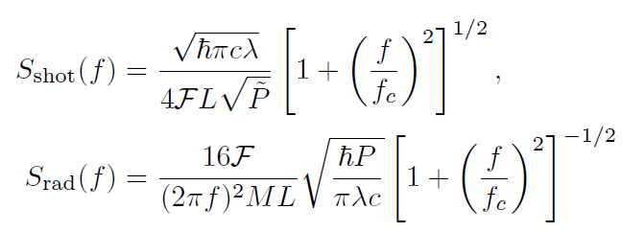
On the basis of recent constraints, we reconsider sensitivity curves
of DECIGO for direct detection of inflationary GW & determination
of the reheating temperature.
Radiation Pressure Noise
Fluctuations in radiation
pressure induces unwanted
motion of the mirror
Shot Noise
Poisson noise due to
quantum nature of laser
Notes:
fcは光子の平均滞在時間に対応する振動数である

Slide 25
In order to achieve sufficient sensitivity at higher frequency, it is
important to suppress shot noise
by .
But would also lowers and the frequency
range of our interest would fall above where we find
Hence we can control the shot noise only by

Slide 26
On the basis of recent constraints, we reconsider sensitivity curves
of DECIGO for direct detection of inflationary GW & determination
of the reheating temperature.

Slide 27
On the basis of recent constraints, we reconsider sensitivity curves
of DECIGO for direct detection of inflationary GW & determination
of the reheating temperature.
Specifications
Original Upgraded
Arm length： L=1000 km 1500km 1500km
Mirror Diameter： R=0.5 m 0.75m
Mirror Mass： M=100 kg
Laser Wavelength： λ=532 nm 157nm
Laser Power： P=10 W 30W 300W
Finesse： F=10

Slide 28
We consider natural inflation
with yielding
as a fiducial model.
(Freese, Frieman, Olinto 90)
cf Current constraint by Planck-BICEP2:
The original DECIGO does not have sufficient sensitivity to
detect the stochastic GW background of this level.
We determine maximum possible reheat temperature DECIGO
can measure by Fisher matrix analysis for upgraded,
and ultimate versions.
noises are assumed to be quantum limited.

Slide 29
Marginalized 1σ uncertainty in T_{R} as a fraction of T_{R} for
natural inflation with
T_{R} can be
determined
within 1σ if

Slide 30
DECIGO can measure the reheat temperature T_{R} if it lies in the
range
The ultimate DECIGO can measure the reheat temperature T_{R}
if it lies in the range
One may naïvely think that high-scale inflation predicts high
reheat temperature, and the upper bound we obtained is too low.
The natural inflation model
for
(Freese, Frieman, Olinto 90)
Good value !
In other high-scale inflation models with field excursion we often introduce symmetries in model building which also constrain coupling of the inflaton and delay reheating.

Slide 31
④

Slide 32




Another source of scale-invariant stochastic GWs:
The self-ordering scalar field
Consider a global phase transition of
an N-component scalar field
High T
Low T
Scalar field is
homogenized
as the universe
expands
GWs are produced
from self ordering
scalar field

Slide 33


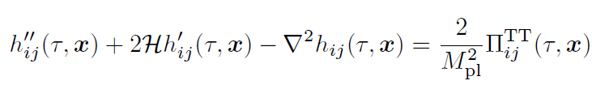

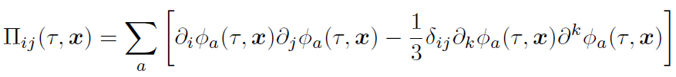
GWs are generated as each Fourier mode enters the
Hubble horizon, in contrast with the inflationary tensor
fluctuations generated when they go out of the horizon.
Krauss(1992), Krauss et al(2010), Dent et al(2014), Durrer et al(2014)

Slide 34
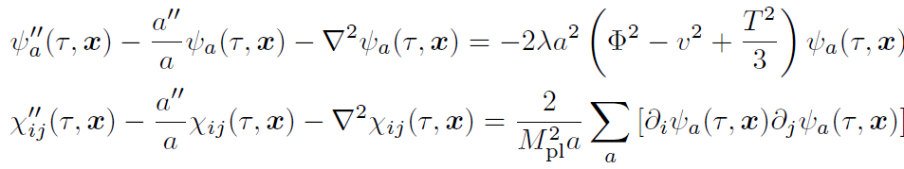



We analyze time evolution of rescaled variables
and on a 3D lattice.
to calculate the energy density of GWs
and
its density parameter per logarithmic frequency interval

Slide 35






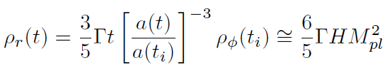
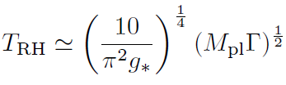
again in the reheating regime after inflation
inflaton radiation
decay rate
inflaton
radiation
matter(inflaton)dominant radiation dominant
time

Slide 36
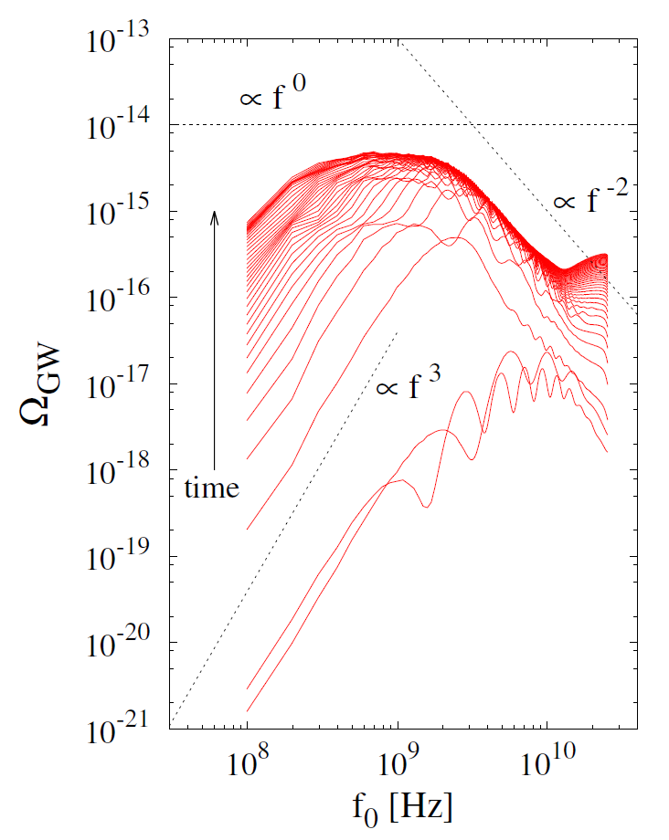
Typical result of 512^3 lattice simulation
This gap would
be filled if we
could follow time
evolution longer.
artifact due to
finite resolution
Lower frequency GWs are
produced at later epochs

Slide 37


Comparison with inflationary tensor perturbations
Transfer functions
B
They give different values of the reheating temperature
by 70 %.
(Kuroyanagi et al 2015)

Slide 38
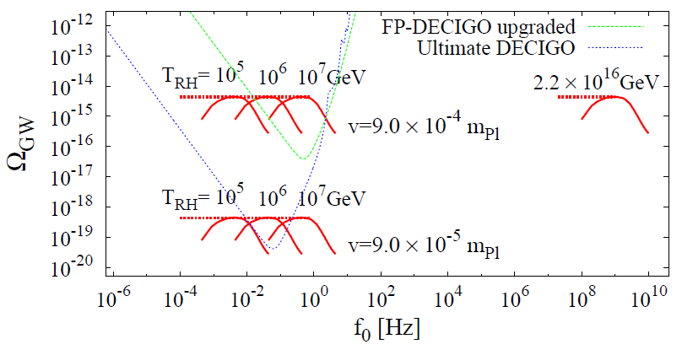
We extrapolate numerical results to more realistic
values of reheating temperature.
from CMB temperature anisotropy
(Ade et al 2014)
from CMB B-mode polarization
(Lizzarraga et al 2014)

Slide 39
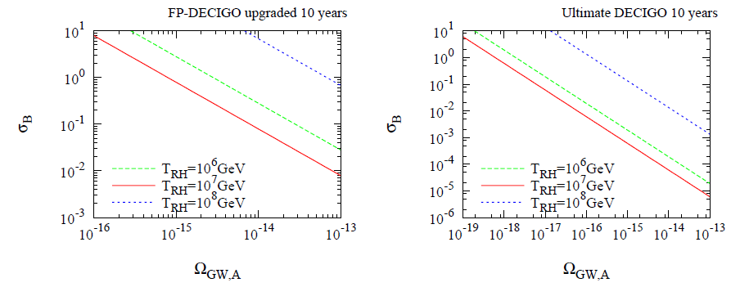
Inflationary tensor perturbations (B=0.22) and
GWs from self-ordering scalar fields (B=0.6) may be
distinguished from the reheating signature if σ_{B}<0.1.
Only ultimate DECIGO may distinguish the difference.
But of course, B-mode polarization of CMB would
tell us a lot more.
(Kuroyanagi et al 2015)

Slide 40
③

Slide 41
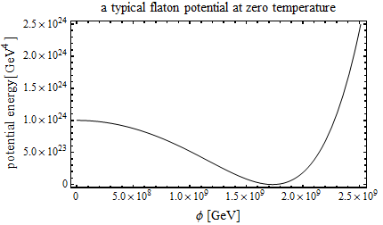
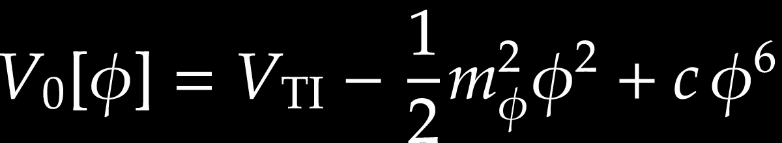
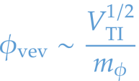


All these high frequency GWs would be diluted away if
there existed entropy production after their horizon
reentry, such as thermal inflation…
Thermal Inflation
Yamamoto (1986), Lyth & stewart (1995)
A short period of inflation driven by a scalar potential
whose symmetry is restored by finite-temperature
effects with a large vacuum energy density there.
flaton: a scalar field
w/ a very flat potential
near the origin
during thermal inflation

Slide 42

For the symmetry is restored.
can be smaller than
THERMAL INFLATION
Inflation supported by thermal correction may
occur for a short period until high temperature
correction becomes ineffective.
Dilutes gravitinos and moduli
Dilutes subhorizon gravitational waves

Slide 43
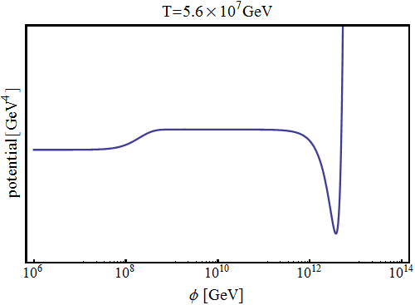
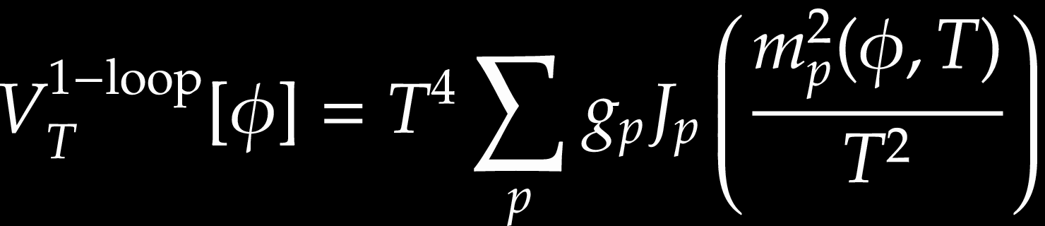
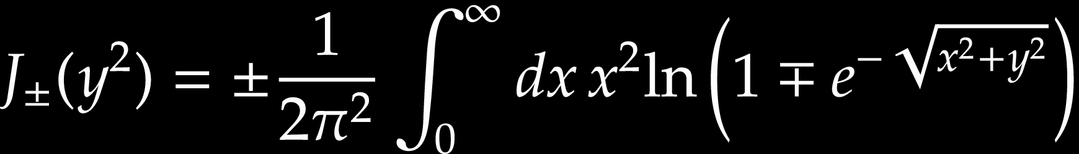
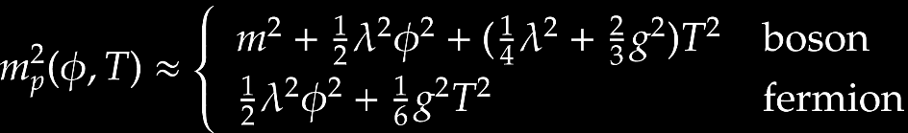



One-loop effective potential predicts a first-order
phase transition
logarithmic scale
enlarge
The potential barrier becomes smaller as T decreases.

Slide 44
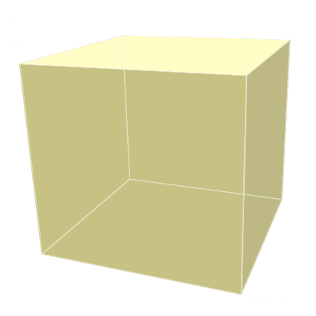
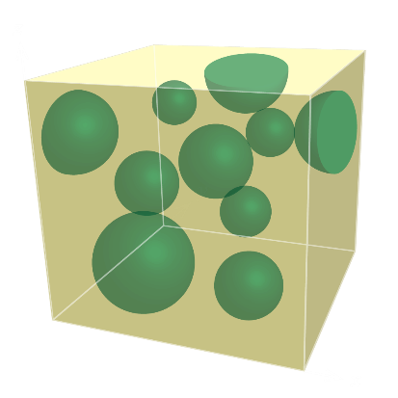
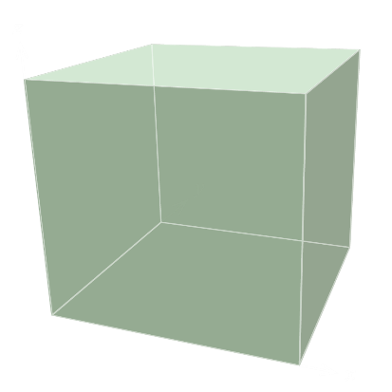



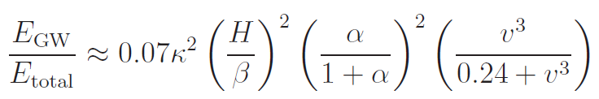
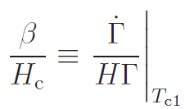
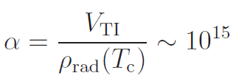
If thermal inflation was terminated by bubble nucleation
and percolation, colliding bubbles would produce GWs.
GW
GW
GW
O
High Temperature
Low Temperature
Time
Kamionkowski et al (1994)

Slide 45

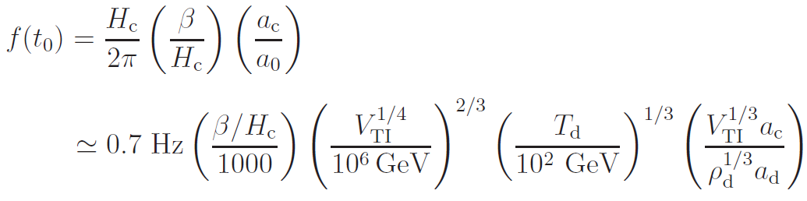
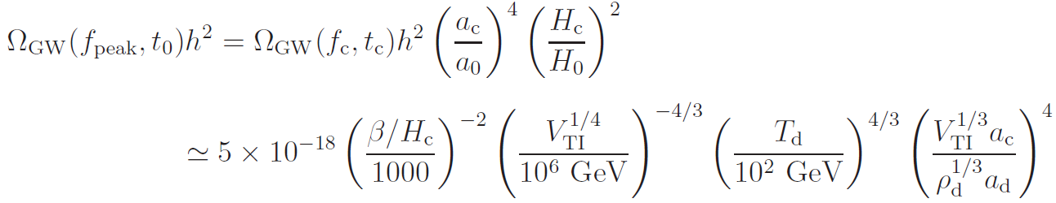
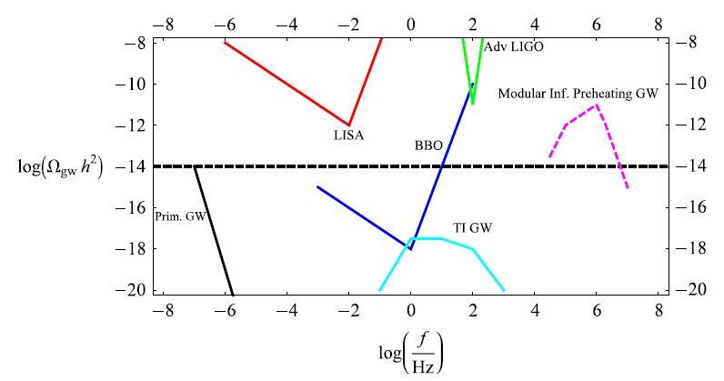
at formation time.
now.
detectable?
Easther et al (2008)

Slide 46
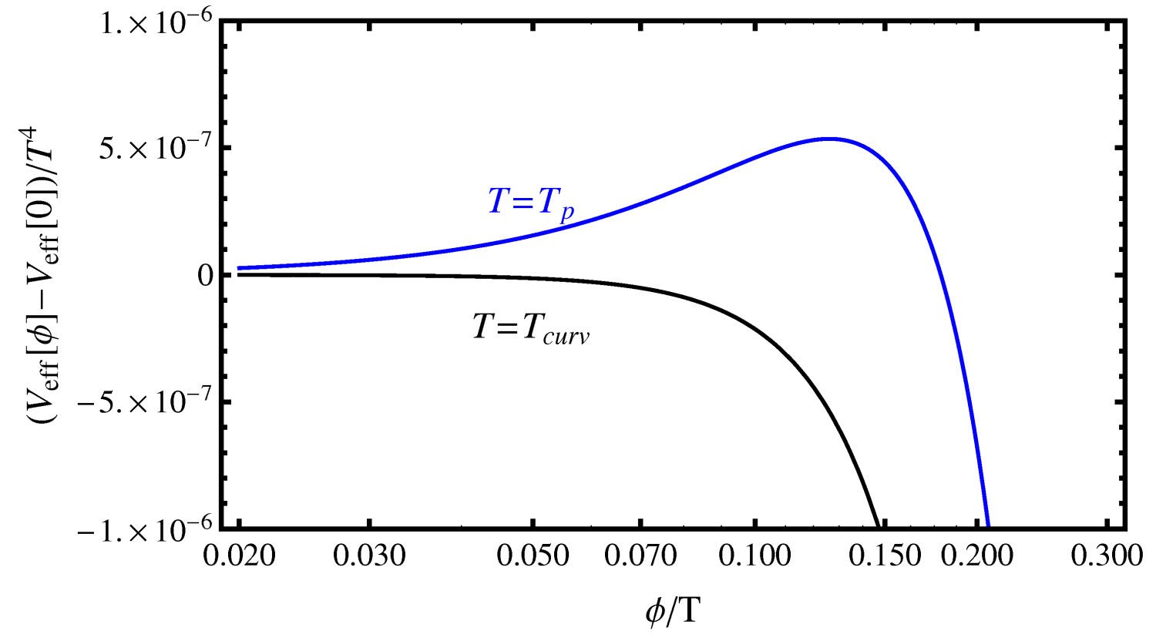
Does Thermal Inflation end with bubble nucleation?
Shape of the effective potential when
the fraction of false vacuum has reached
(percolation temperature).
The height and width of the potential barrier are so small
that we expect phase mixing occurs before nucleation.

Slide 47


In fact, the dynamics of phase transition cannot be
analyzed solely by the effective potential,
but it follows a Langevin equation with thermal
fluctuations and dissipations.
Stochastic thermal noise
Real part of loop diagrams generates effective potential
and dissipation term, while imaginary part gives
correlation function of stochastic thermal noise
effective potential’ dissipation term noise
Fluctuation dissipation theorem
Greiner and Muller (1997), JY(2004)

Slide 48
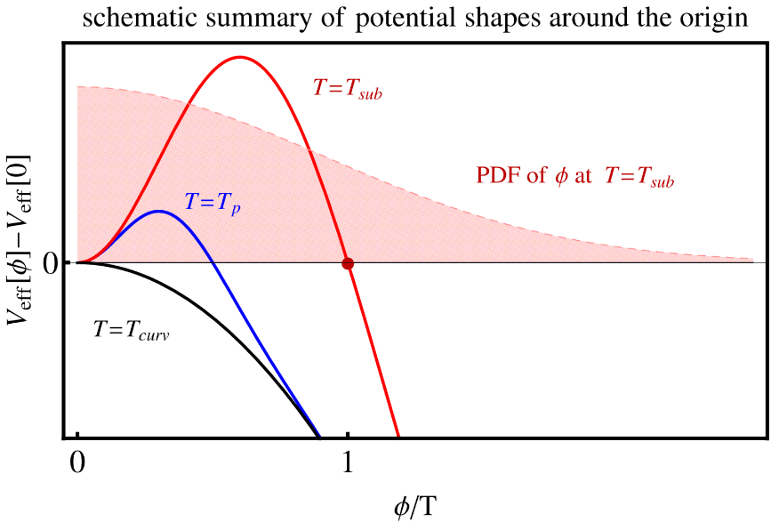
We have solved this Langevin equation on a 3D lattice
for various temperatures, and found that already at
, when the width of the barrier is equal to ,
the universe is in a mixed state of false and true vacua.
The phase transition to terminate thermal inflation is
of cross-over type rather than first-order.
No significant gravitational wave production!
Hiramatsu et al (2015)

Slide 49
Conclusion
Gravitational waves from inflation
or global phase transition may be
useful to probe thermal history of
the early Universe.
If thermal inflation occurred
after inflation, we cannot hope
to detect primordial gravitational
waves at DECIGO band.

