Slide 1
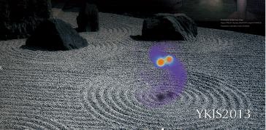
Recent developments in BNS merger in Kyoto group (1)
Binary neutron star merger and r-process
Hot Topics in General Relativity and Gravitation
@ ICISE, Quy Nhon, Vietnam, July 30- Aug. 5, 2017
Yuichiro Sekiguchi（Toho University）
S. Wanajo, N. Nishimura, K. Kyutoku, M. Tanaka, K. Hotokezaka,
K. Kiuchi, M. Shibata, K. Taniguchi

Slide 2
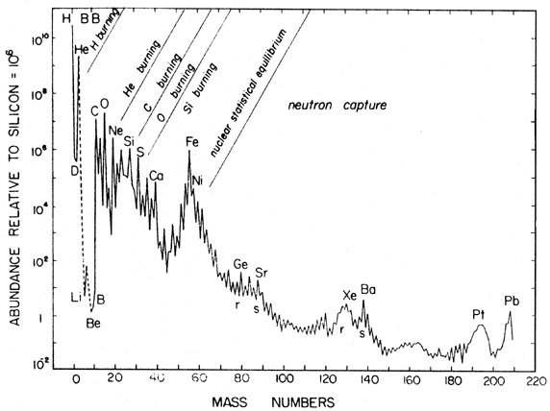
Solar abundance of nuclei
Basic feature : exponential decay with mass number + constant tail
Characteristic features:
Peak in iron-group
Deficient of D, Li, Be, B
Enhancement of α-nuclei (C, O, Ne, Si,..)
Pagel (1997)
Z=N=28
N=50
N=82
N=126
A

Slide 3

Solar abundance of nuclei
Basic feature : exponential decay with mass number + constant tail
Characteristic features:
Peak in iron-group
Deficient of D, Li, Be, B
Enhancement of α-nuclei (C, O, Ne, Si,..)
3 peaks in heavier region associated with n-magic numbers,
made by neutron capture processes
Pagel (1997)
1st peak
2nd peak
3rd peak
Platinum Gold
Z=N=28
N=50
N=82
N=126
A

Slide 4
Neutron capture processes: free from Coulomb barrier
n + (Z,N) ⇒ (Z,N+1)
(Z,N+1) ⇒ (Z+1,N) + e + ν_{e}
n-capture versus β-decay
rapid neutron-capture process
(r-process)
slow neutron-capture process
(s-process)
large neutron densities
Can synthesize all heavy nuclei
moderate neutron densities
does not synthesize all heavy nuclei
terminates at Pb, Bi
Z
Z+1
N
Z+1
N+1
N
: neutron capture
Z
N-1
Z
N
Z
N+1
: β decay

Slide 5
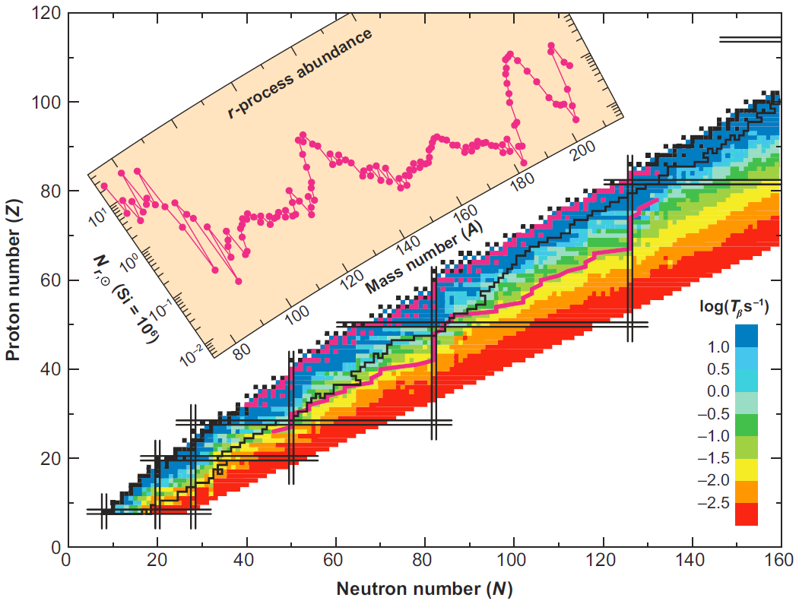

s-process / r-process path
3rd peak
Stable nuclei
2nd peak
1st peak
r-process
Z+1
N
Z+1
N+1
β-decay timescale
s-process
: n-capture
Z
N-1
Z
N
Z
N+1
: β decay

Slide 6
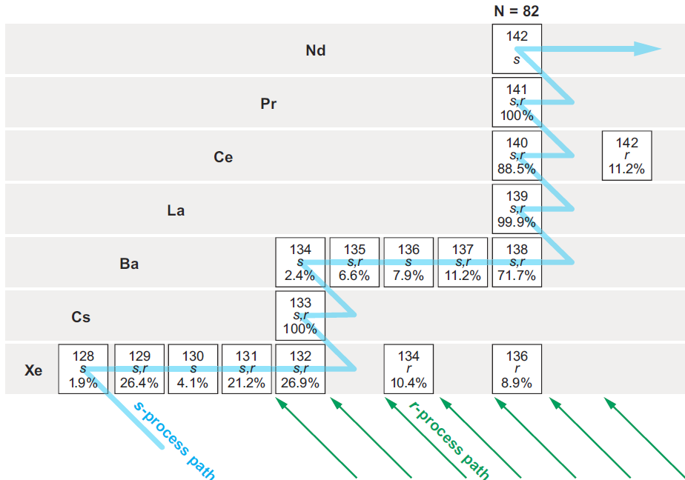
s-process / r-process path
Z : even (more stable)
N : even (more stable)
beta decay

Slide 7
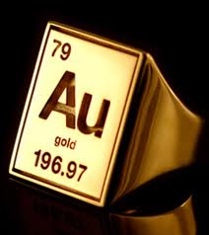
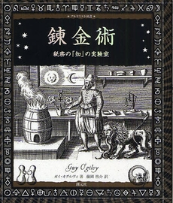
To be an alchemist : recipe to cook gold
Neutron capture : putting neutrons into ‘seed’ nuclei
  Large #neutron/#seed ratio is required
  A(gold) – A (seed) ~ 100
(1) Low electron fraction Ye
  Ye = number of electrons per baryon = # of proton = 1 - # of neutron
  To have a large number of free neutrons
(2) Higher entropy per baryon
  To slow the seed nuclei production
(3) Short expansion timescale
  To freeze seed production with rapid decrease of temperature
n + (Z,N) ⇒ (Z,N+1)

Slide 8
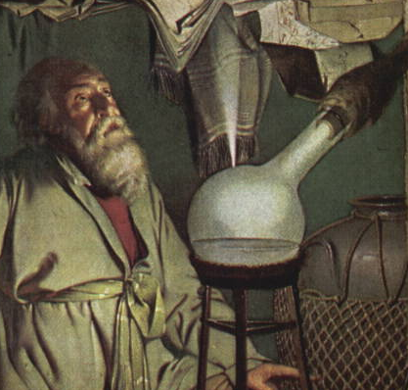
What is the melting pot for r-process ?
Supernova (SN) explosion (+ PNS ν-driven wind) : (Burbidge et al. 1957)
  Textbooks may tell you that SNe are the origin of heavy elements, but ….
  theoretically disfavored (Roberts et al. 2010, 2012)
NS-NS/BH binary merger: (Lattimer & Schramm 1974)
  Too neutron rich ???

Slide 9
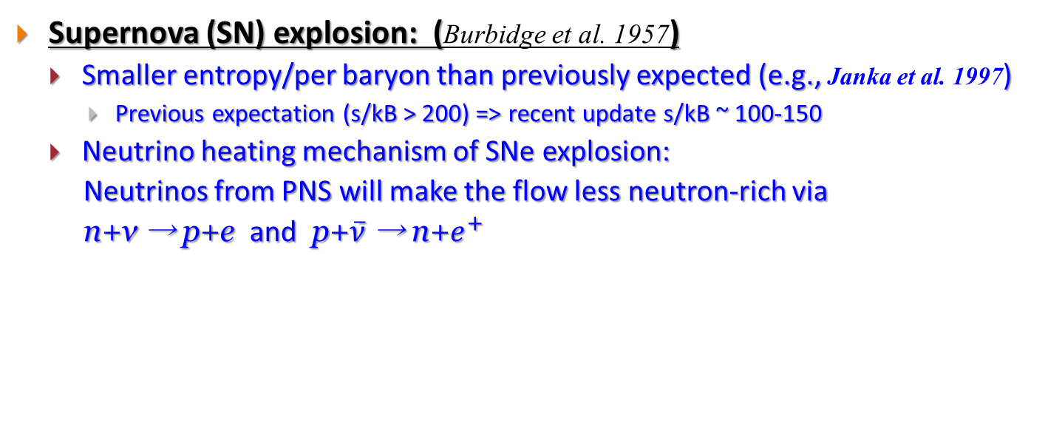
What is the melting pot for r-process ?
Supernova (SN) explosion: (Burbidge et al. 1957)
  Smaller entropy/per baryon than previously expected (e.g., Janka et al. 1997)
    Previous expectation (s/kB > 200) => recent update s/kB ~ 100-150
  Neutrino heating mechanism of SNe explosion:
  Neutrinos from PNS will make the flow less neutron-rich via
  n+ν → p+e and p+$\overline{ν}$ → n+$e^{+}$

Slide 10
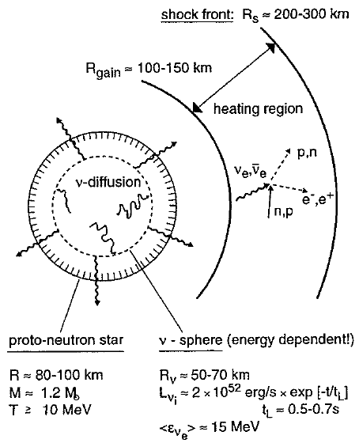
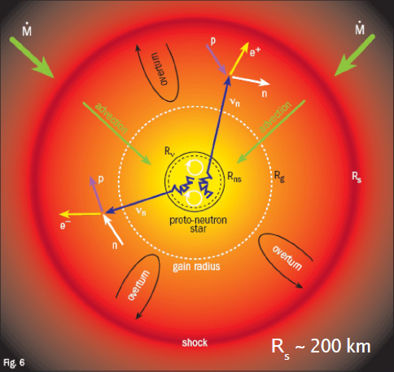
Overall picture of the neutrino heating mechanism
Cartoon by E. Muller (1998)
Cartoon by T. Janka

Slide 11
What is the melting pot for r-process ?
Supernova (SN) explosion (+ PNS ν-driven wind) : (Burbidge et al. 1957)
  Textbooks tell you that SNe are the origin of heavy elements, but ….
  theoretically disfavored (Wanajo 2011, Roberts et al. 2010, 2012)
NS-NS(/BH) binary merger: (Lattimer & Schramm 1974)
  Too neutron rich ???

Slide 12
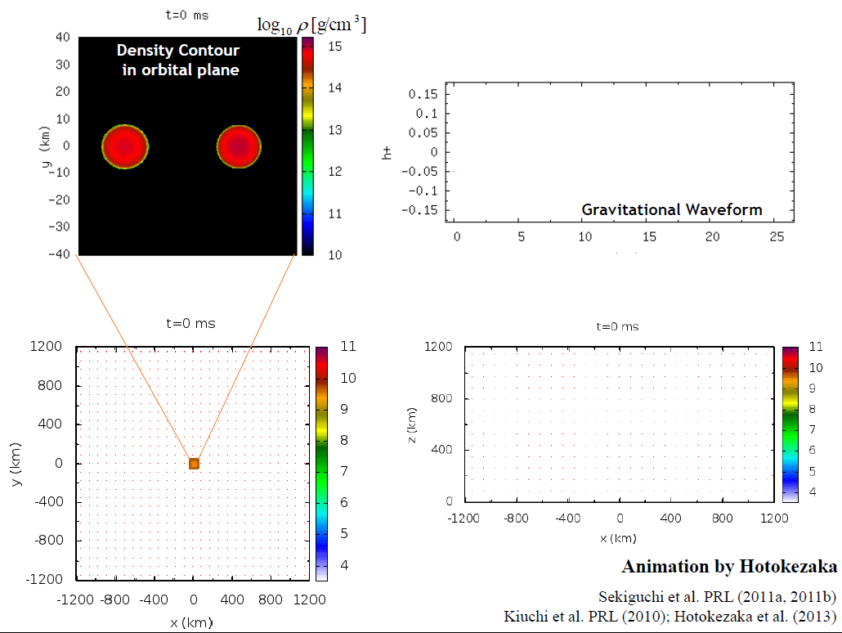
Meridian plane
Orbital plane

Slide 13
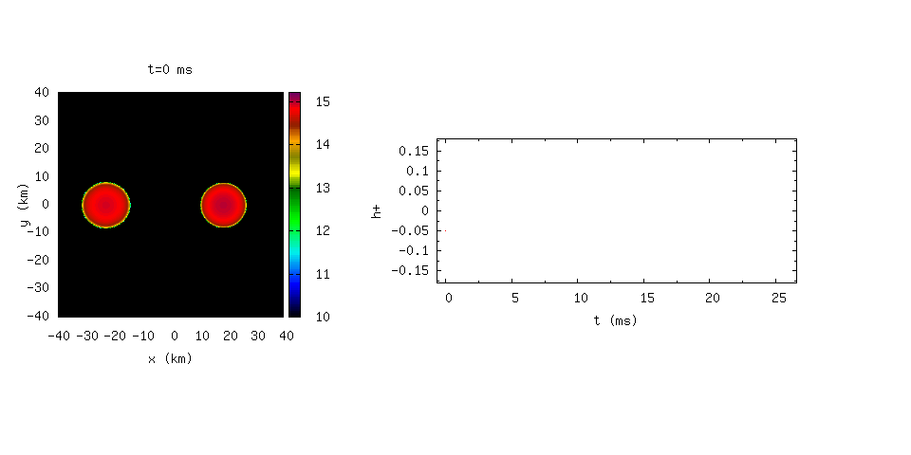
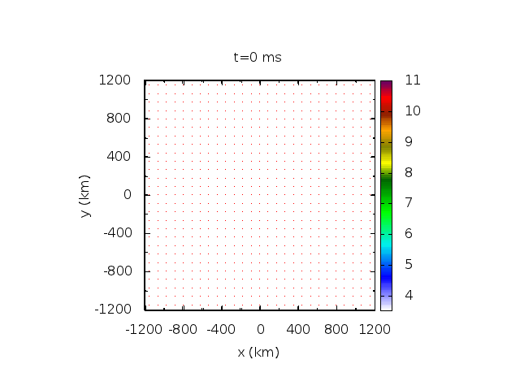
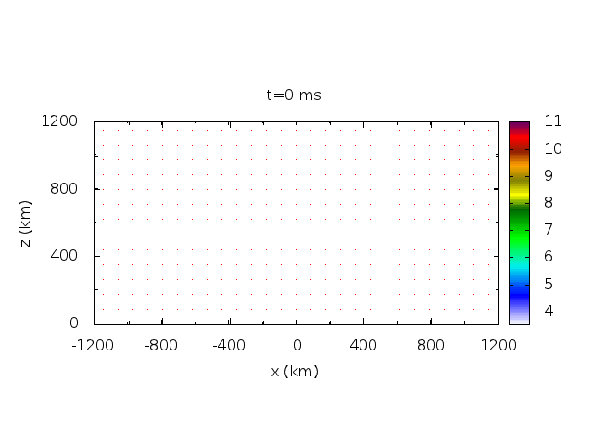
Tidal deformation
Inspiral
Charp signal
Merger
HyperMassive NS
Density Contour
in orbital plane
Gravitational Waveform
Animation by Hotokezaka
Sekiguchi et al. PRL (2011a, 2011b)
Kiuchi et al. PRL (2010); Hotokezaka et al. (2013)

Slide 14
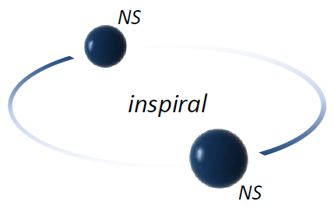

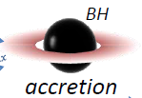
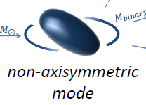

Evolution of NS-NS mergers
Based on Bartos (2013)
Inspiral of NS binary
For canonical-mass binary
Recent measurement of 2Msun NS + NR simulations
NS –NS merger
Dependent on EoS, Mtot
Prompt formation of BH + Torus
Formation of hot, differentially rotating massive NS
Dependent on EoS, Mtot
Delayed collapse to BH + Torus
Rigidly rotating NS

Slide 15
NS-NS merger ejecta: too neutron-rich ?
( ⇔ SNe, ejecta is not sufficiently neutron-rich)
Korobkin et al. 2012; Rosswog et al. 2013 (Newtonian sim. with neutrino); see also Goriely et al. 2011 (Approx. GR sim. without weak interactions)
  Approx. GR simulation: no way to change Ye (ejecta remains n-rich)
  Newtonian SPH simulations: tidal mass ejection of ‘pure’ neutron star matter
  Ejecta is very n-rich with Ye < 0.1

Slide 16
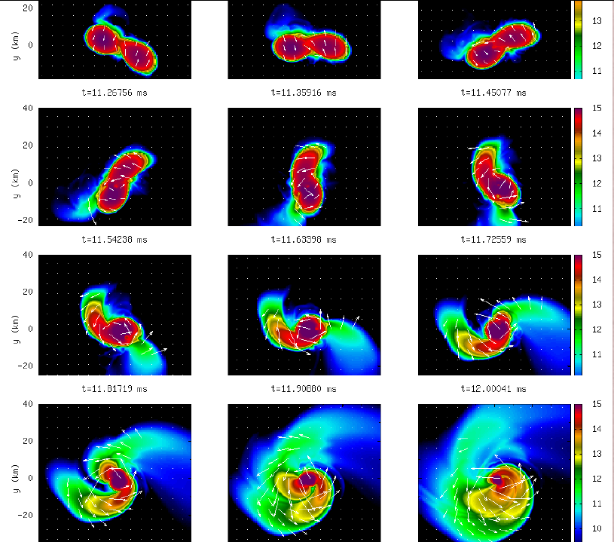
Mass ejection from BNS merger (1) :
Tidal torque + centrifugal force
Hotokezaka et al. (2013)
Less massive NS is tidally deformed
Angular momentum transfer by spiral arm and swing-by
A part of matter is ejected along the orbital plane
  reflects low Ye of cold NS (β-eq. at T~0), no shock heating, rapid expansion (fast T drop), no time to change Ye by weak interactions
Density contour [ log (g/cm³) ]

Slide 17
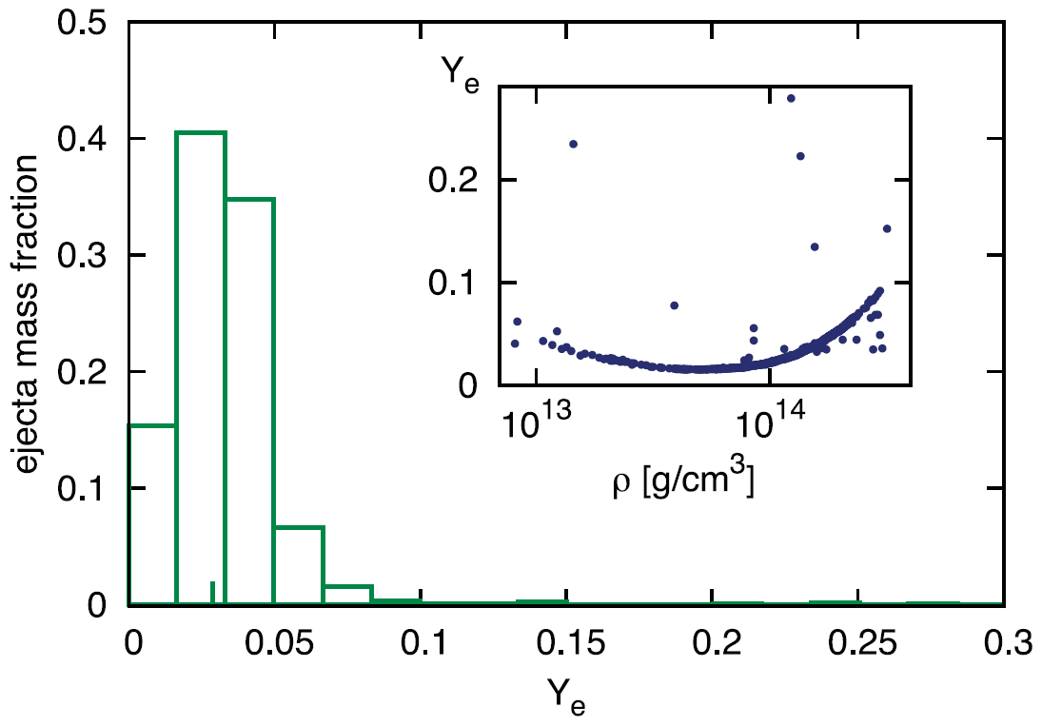
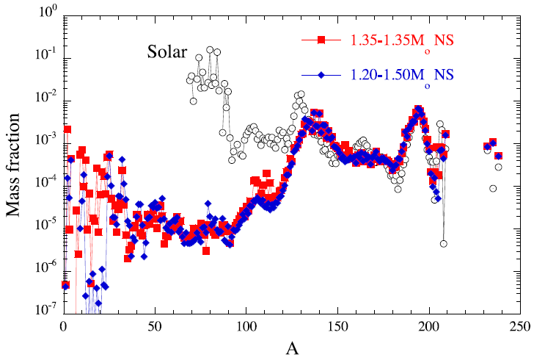

From the ‘Universality’ point of view :
NS-NS merger ejecta: too neutron-rich ?
Korobkin et al. 2012; Rosswog et al. 2013; see also Goriely et al. 2011
  tidal mass ejection of ‘pure’ neutron star matter (very n-rich) with Ye < 0.1
    Ye is that of T=0, β-equilibrium
  strong r-process with fission recycling only 2nd (A~130; N=82) and 3rd (A~195; N=126) peaks are produced (few nuclei in A=90-120)
  the resulting abundance pattern does not reproduce the observed solar pattern
T=0, β-eq.
1st peak
2nd
3rd
Korobkin et al. (2012) MNRAS 426 1940
Goriely et al. (2011) ApJL 738 32

Slide 18
NS-NS merger ejecta: too neutron-rich ?
Korobkin et al. 2012; Rosswog et al. 2013; see also Goriely et al. 2011
  tidal mass ejection of ‘pure’ neutron star matter (very n-rich) with Ye < 0.1
    Ye is that of T=0, β-equilibrium
  strong r-process with fission recycling only 2nd (A~130; N=82) and 3rd (A~195; N=126) peaks are produced (few nuclei in A=90-120)
  the resulting abundance pattern does not reproduce the observed solar pattern
Then BNS mergers are not the origin of the solar r-process elements ?
  No ! If you take into account both neutrino and GR
T=0, β-eq.
1st peak
2nd
3rd
Korobkin et al. (2012) MNRAS 426 1940
Goriely et al. (2011) ApJL 738 32

Slide 19
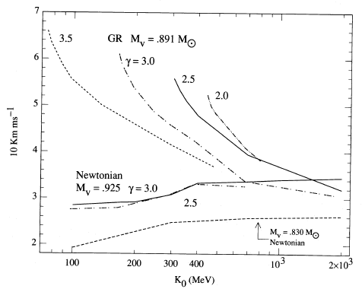

What will change if you include GR and microphysics (1) : Stronger shock in GR
van Riper (1988) ApJ 326 235
realistic ‘stiffness’
e.g., Kolehamainen et al. (1985) NPA 439 535
SN shock velocity @ 300 km (1000km/s)
Shock is stronger in GR
Shock velocity dose not depend on EOS in Newtonian gravity
General relativisitic：
Stronger shock wave formation
Newtonian gravity :
Weaker shock and its independence of EOS
Incompressibility (‘Stiffness’ of EOS) K(sym) (MeV)

Slide 20
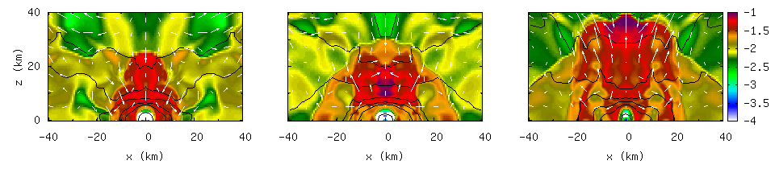
Mass ejection from BNS merger (2):
Shock driven components
Shocks occur due to oscillations of massive NS and collisions of spiral arms
  Isotropic mass ejection, higher temperature (weak interactions set in)
Specific internal energy
x-y
x-z
Hotokezaka et al. (2013)

Slide 21
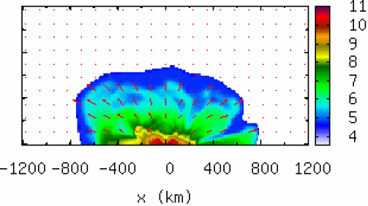
What will change if you include GR and microphysics (2) : Ye can change via weak interaction
  Driven by tidal interactions
    Consists of cold NS matter in β-equilibrium ⇒ low Ye and T
  Driven by shocks
    Consists of shock heated matter higher temperature => Weak interaction can change Ye
x-z

Slide 22
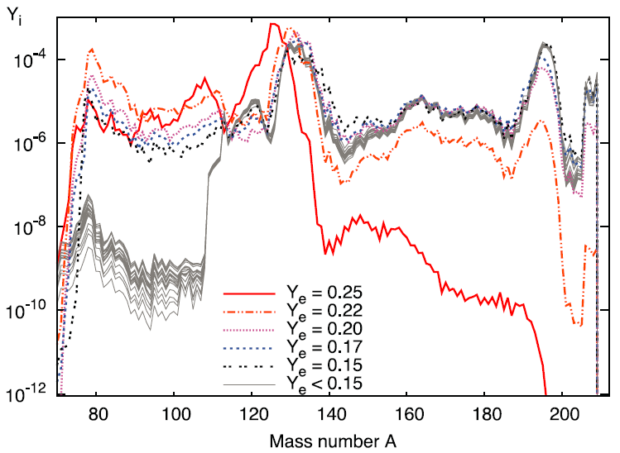
Importance of Ye in the r-process
Electron fraction (Ye) is the key parameter : Ye ~ 0.2 is critical threshold
  Ye < 0.2 : strong r-process ⇒ nuclei with A>130
  Ye > 0.2 : weak r-process ⇒ nuclei with A< 130 (for larger Ye, nuclei with smaller A)
  Different nuclei : different opacity (Smaller opacity for smllaer A? Grossman et al. 2013)
Neutrino-matter interaction
  Ye can be changed
  Two reactions which increase Ye
  Positron capture :
    Important for higher temperature
    ∵ there are more positrons
  Neutrino capture :
    Copious neutrinos are emitted
    NS matter is neutron rich
    Not considered in the previous studies (need neutrino transfer)
Strong Ye dependence
Korobkin et al. 2012

Slide 23
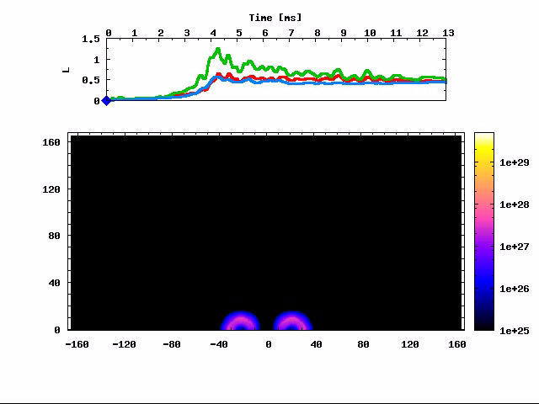
Previous studies and our study
Korobkin et al. 2012 : Newtonian SPH simulations with neutrinos
Bauswein et al. 2013: Relativistic SPH simulations with many EOS but without neutronos
This Study : Full GR, approximate gray radiation hydrodynamics simulation with multiple EOS and neutrinos
Einstein’s equations: Puncture-BSSN/Z4c formalism
GR radiation-hydrodynamics (Sekiguchi 2010; Sekiguchi + in prep.)
  Advection terms : Truncated Moment scheme (Shibata et al. 2011)
    EOS : any tabulated EOS with 3D smooth connection to Timmes EOS
    gray or multi-energy but advection in energy is not included
    Fully covariant and relativistic M-1 closure
  Source terms : two options
    Implicit treatment : Bruenn’s prescription
    Explicit treatment : trapped/streaming ν’s
      e-captures: thermal unblocking/weak magnetism; NSE rate
      Iso-energy scattering : recoil, Coulomb, finite size
      e±annihilation, plasmon decay, bremsstrahlung
      diffusion rate (Rosswog & Liebendoerfer 2004)
      two (beta- and non-beta) EOS method
  Lepton conservation equations
Neutrino energy density
Similar implementation; Radice 2016 ; Lehner et al. 2016, Foucart et al. 2016

Slide 24
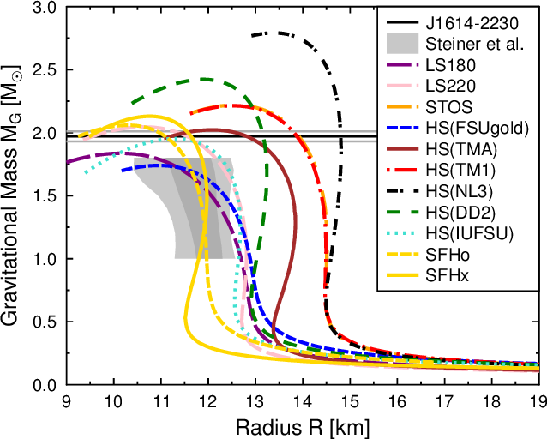
Adopted finite-temperature EOS
Multi-EOS study (Thanks to M. Hempel)
Adopted EOS
  TM1 (Shen EOS)
    TMA
  DD2
    IUFSU
  SFHo
  Consistent with
    NS radius estimation
    Chiral effective theory
  See also, Bauswein et al. (2013); Just et al. (2014)
  © M. Hempel
  DD2
14.5km
TM1
  IUFSU
13.2km
  TMA
11.8km
  SFHo

Slide 25
(Expected) Mass ejection mechanism & EOS
‘Stiffer EOS’
  ⇔ R_{NS} : larger
  TM1, TMA
  Tidal-driven dominant
  Ejecta consist of low T & Ye NS matter
‘Intermediate EOS’
  DD2
‘Softer EOS’
  ⇔ R_{NS} : smaller
  SFHo, IUFSU
  Tidal-driven less dominant
  Shock-driven dominant
  Ye can change via weak processes
  © M. Hempel
  DD2
TM1
  IUFSU
  TMA
  SFHo
  See also, Bauswein et al. (2013); Just et al. (2014)

Slide 26
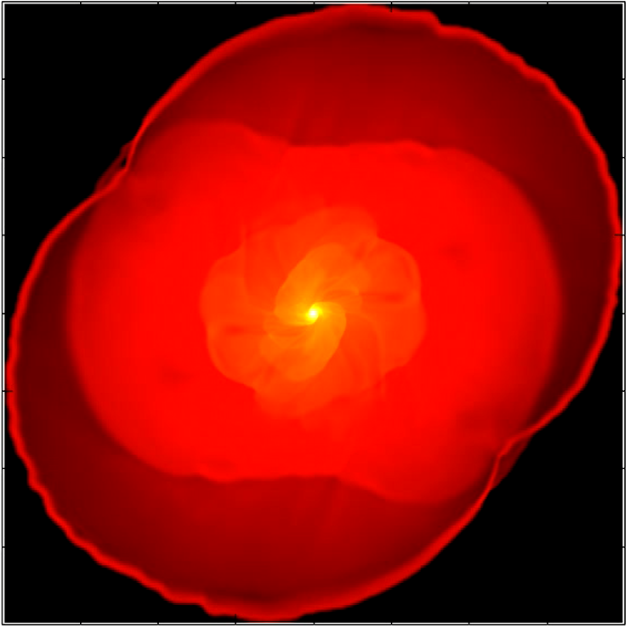
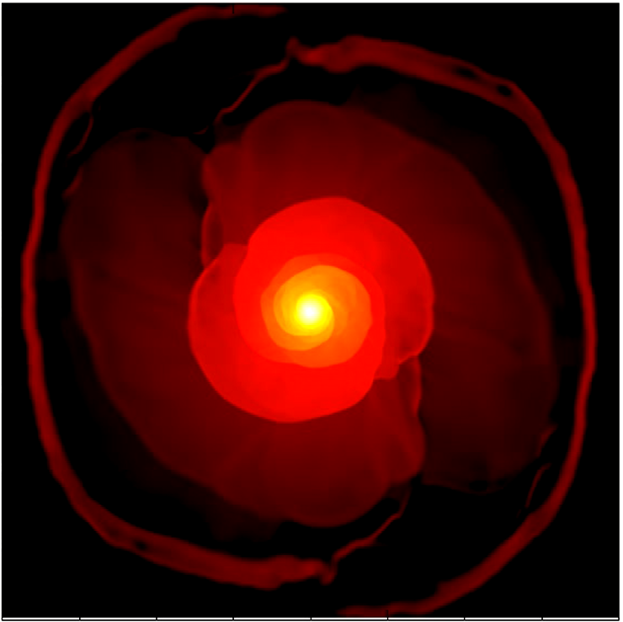

Soft(SFHo) vs. Stiff(TM1): Ejecta temperature
Sekiguchi et al PRD (2015)
Soft (SFHo): temperature of unbound ejecta is higher (as 1MeV) due to the shock heating, and produce copious positrons
Stiff (TM1): temperature is much lower
Soft (SFHo: smaller R_{NS})
1000km
Stiff (TM1: larger R_{NS})
$$n+e^{+}→p+\overline{ν}$$
Higher T : more e⁺
Shock heating
more positron capture
Lower T : less e⁺
Mass ejection mainly
driven by tidal effects

Slide 27
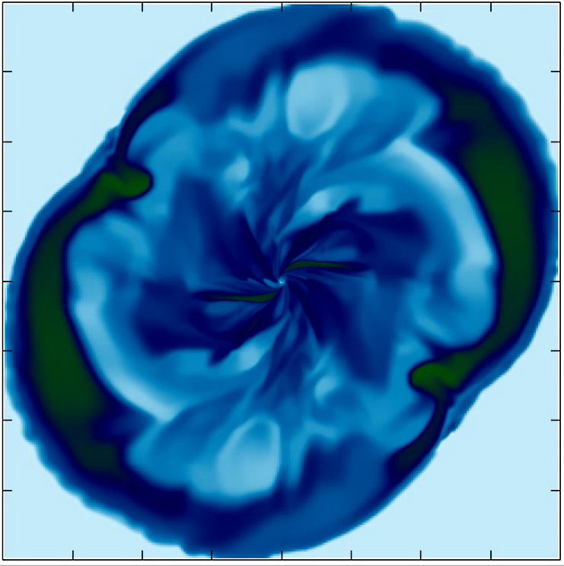
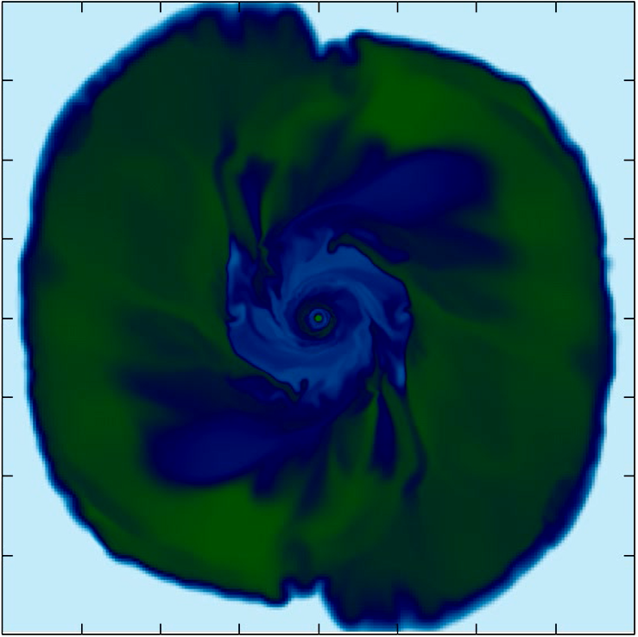
Soft(SFHo) vs. Stiff(TM1): Ejecta Ye = 1- Yn
Sekiguchi et al PRD (2015)
Soft (SFHo): In the shocked regions, Ye >> 0.2 by weak processes
Stiff (TM1): Ye is low as < 0.2 (only strong r-process expected)
Soft (SFHo: smaller R_{NS})
Stiff (TM1: larger R_{NS})
$$n+e^{+}→p+\overline{ν}$$
Higher T : more e⁺
higher Ye > 0.25 region :
less neutron rich
Lower T : less e⁺
smaller Ye < 0.25 :
neutron rich

Slide 28
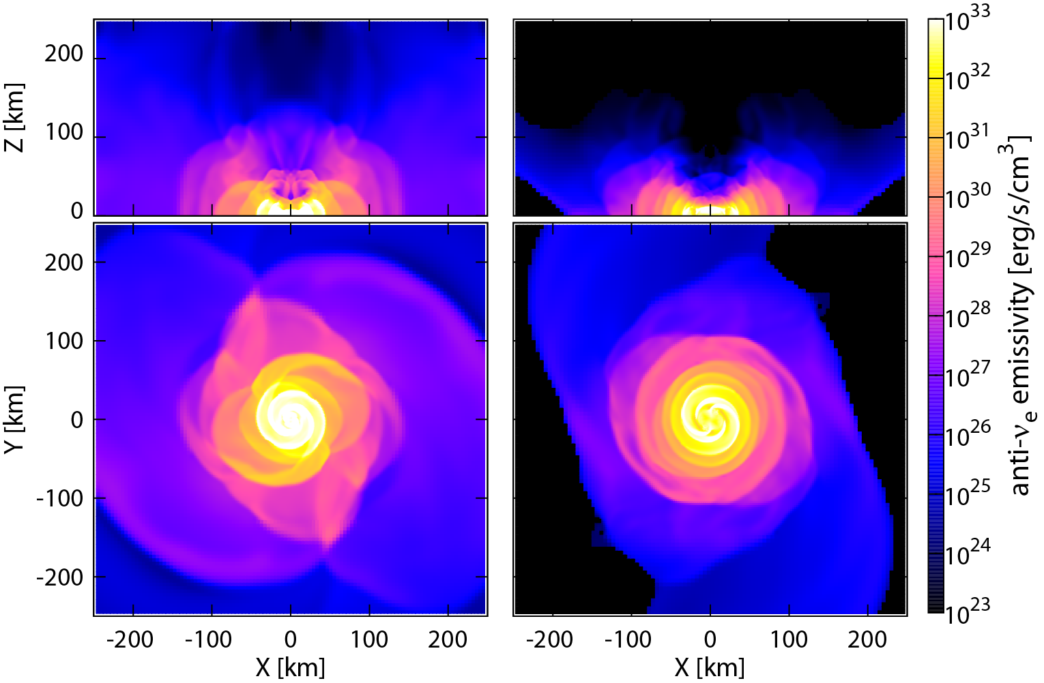
SFHo vs. TM1: νe emissivity
SFHo
TM1
$$n+e^{+}→p+\overline{ν}$$
Higher T : more e⁺
lager $\overline{ν }$emissivity
lower T : less e⁺
smaller $\overline{ν }$emissivity

Slide 29
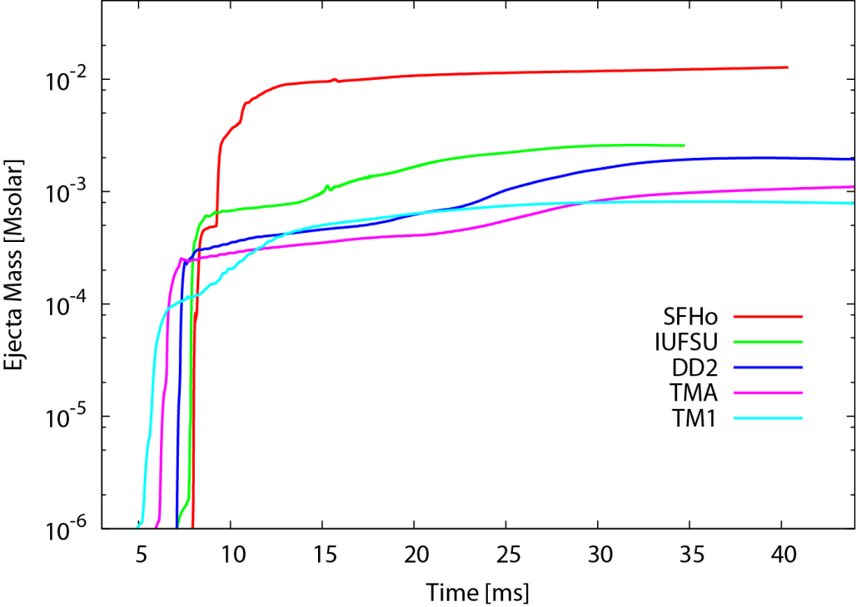
EOS dependence : 1.35-1.35 NS-NS
Sekiguchi et al. 2015; Bauswein et al. 2013; Radice 2016 ; Lehner et al. 2016
  © M. Hempel
Softer EOS
  DD2
TM1
  IUFSU
  TMA
  SFHo
Dynamical ejecta mass
Mej is larger for softer EOS : importance of shock heating and GR
Only SFHo achieves Mej ~ 0.01 Msun : required by the total amount of
r-process elements and flux of the ‘kilonova’ event (GRB 130603B)

Slide 30
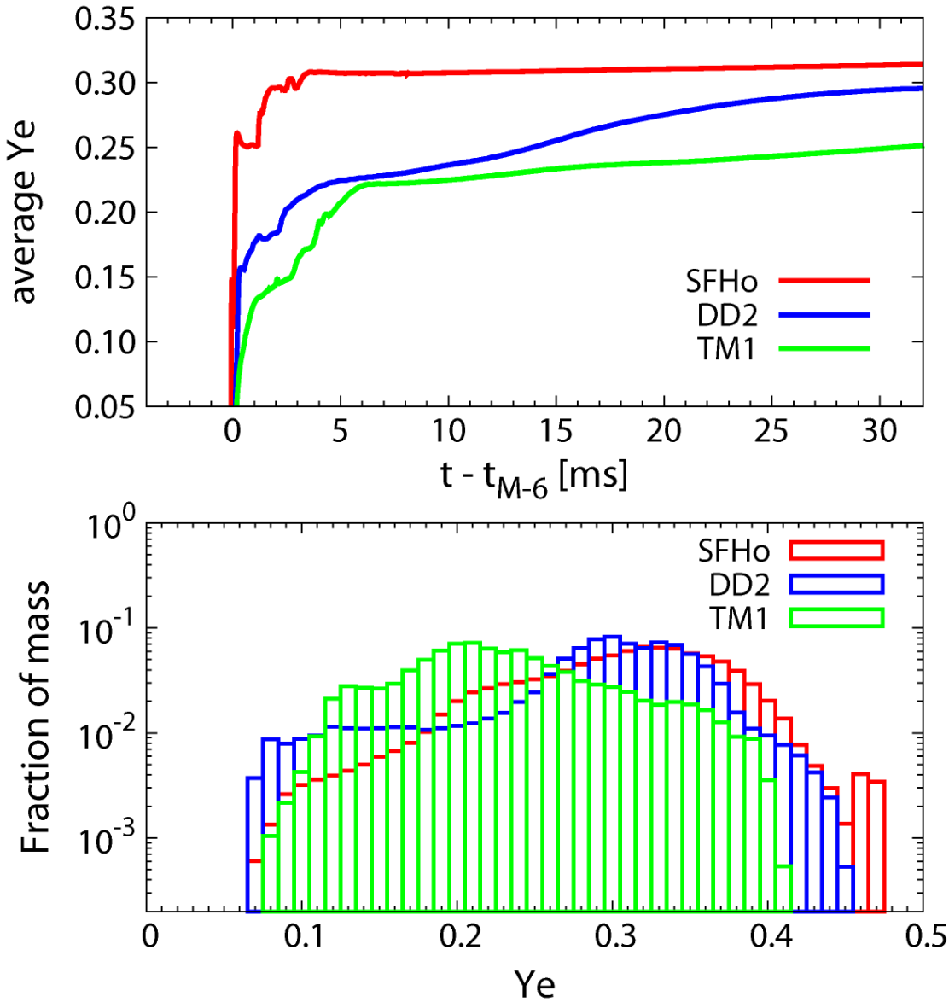
EOS dependence : 1.35-1.35 NS-NS
Sekiguchi et al. 2015; Bauswein et al. 2013; Radice 2016 ; Lehner et al. 2016
Mass averaged Ye of the ejecta is larger for softer EOS
But still neutron rich
Ye distribution of the ejecta is broad irrespective of EOS
There are ejecta components with larger Ye
Softer EOS
Ejecta Ye
Softer EOS
Ye distribution

Slide 31
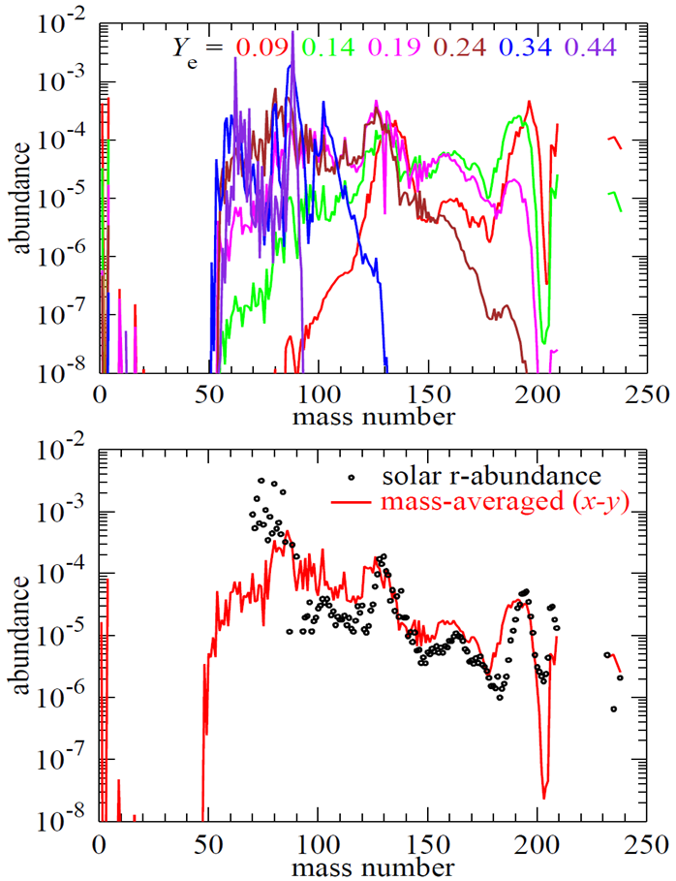
The solar pattern successfully reproduced
(soft EOS (SFHo), equal mass (1.35-1.35))
Wanajo, Sekiguchi et al. ApJL (2014)
The Ye-distribution histogram has a broad, flat structure (Wanajo, Sekiguchi, et al. (2014). )
  Mixture of all Ye gives a good agreement with the solar abundance !

Slide 32
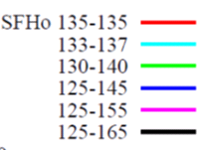
Dependence on mass ratio
Sekiguchi et al. 2016; Bauswein et al. 2013; Lehner et al. 2016
Ye distribution is still wide if mass ratio is not very far from unity
  For mass ratio larger than 1.25-1.45 model, Ye distributes in smaller values

Slide 33

Mass Ejection from Merger Remnant
- a GR viscous simulation with α = 0.01 -
viscous
viscous
non-viscous
Ejecta Mass
non-viscous
Kinetic Energy
Average Velocity
(differential) rotational energy
of NS is released by viscosity !
Fujibayashi et al. in prep.

Slide 34
EM counterpart to GW : r-process nova (Kilonova/Macronova)
Merger ejecta will be very neutron rich: rapid neutron capture (r-process) proceeds (Lattimer & Schramm 1974) : n + (Z,N) ⇒ (Z,N+1)
Competition with the β-decay : (Z,N+1) ⇒ (Z+1,N) + e + ν_{e}
    The r-process is very sensitive to how much neutrons are there, that is, to the electron fraction Ye : this is why we need michrophysics !
Then, EM transients powered by radioactivity of the r-process elements were expected (Li & Paczynski 1998)

Slide 35
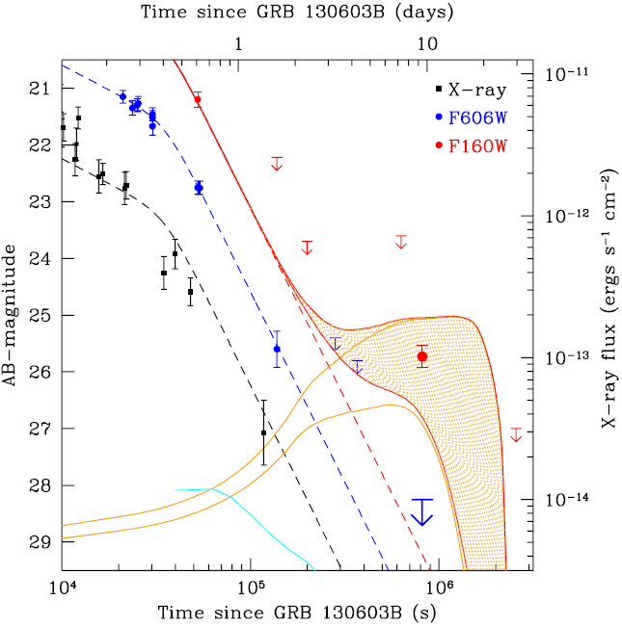
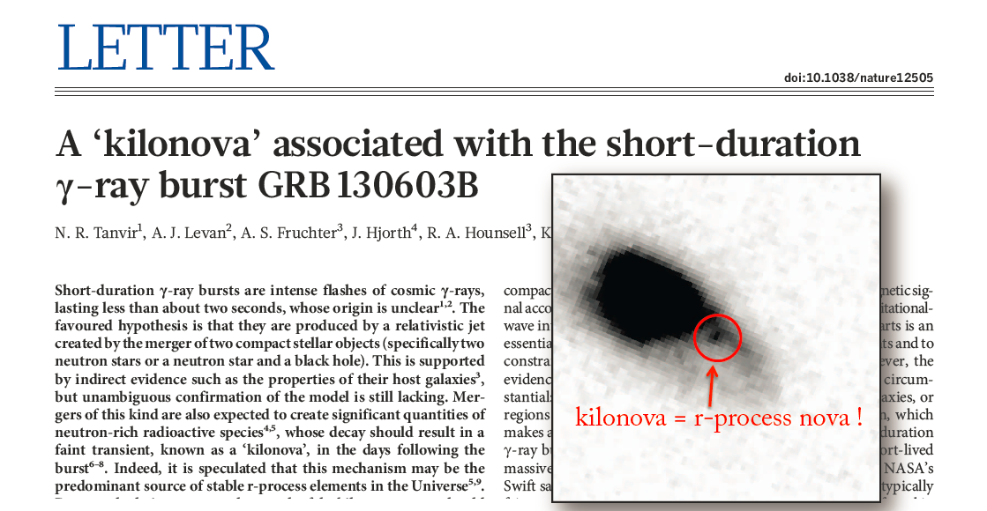
Kilonova/Macronova/r-process nova
Merger ejecta will be very neutron rich: rapid neutron capture (r-process) proceeds (Lattimer & Schramm 1974) : n + (Z,N) ⇒ (Z,N+1)
Competition with the β-decay : (Z,N+1) ⇒ (Z+1,N) + e + ν_{e}
    The r-process is very sensitive to how much neutrons are there, that is, to the electron fraction Ye ( = Yp = 1 – Yn) : we need michrophysics !
Recent critical update : Opacities are dominated by lanthanoids : orders of magnitude (~100) larger (Kasen e al. 2013; Tanaka & Hotokezaka 2013)
Berger et al. (2013)
Tanvir et al. (2013)
1 day ⇒ 10 days
1/10 dimmer
Opt-UV ⇒ NIR

Slide 36
Summary
Full GR neutrino-radiation-viscous hydrodynamics simulations are now feasible !
NS-NS mergers are candidate of r-process nucleosynthesis cite
  The ejecta mass strongly depends on NS matter EOS
  For the dynamical mass ejection, Mej ~0.01 Msun: only for soft EOS like SFHo, APR with Rns ~ 12km
  Ye distribution is wide due to neutrino interactions irrespective of EOS and the so-called universality requirement can be satisfied
  support the hypothesis that BNS mergers are origin of heavy elements
  A long-term viscous driven wind from the merger remnant is expected
The eject will shine by the decay energy of the synthesized r-process elements (kilonova)
  Promising EM counterpart to GW

