Slide 1
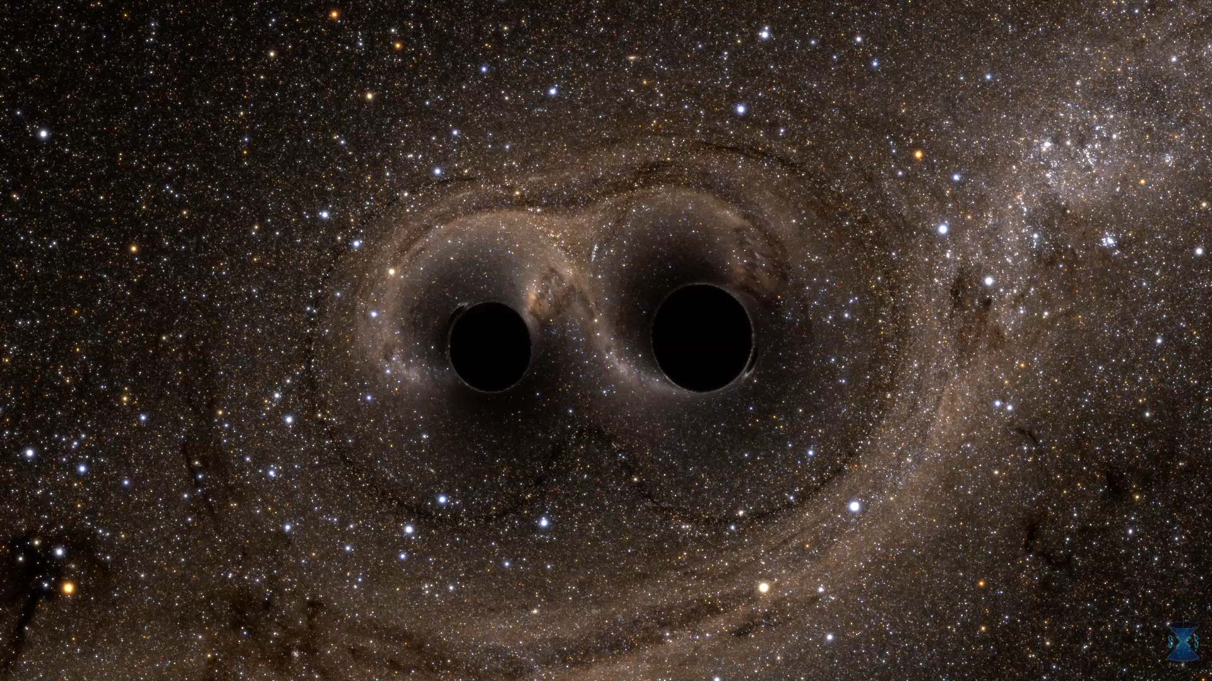
Recent developments in BNS merger in Kyoto group (2)
Gravitational waves and the nuclear equation of state
Yuichiro Sekiguchi (Toho Univ.)
K. Kiuchi, K. Kawaguchi, K. Kyutoku, M.Shibata
Hot Topics in General Relativity and Gravitation
@ ICISE, Quy Nhon, Vietnam, July 30- Aug. 5, 2017
animation © LIGO/SXS

Slide 2
Preface : GW astronomy era comes !
GW150914 : The first direct detection of GWs from BH-BH has opened the era of GW astronomy (it followed by GW151226 and GW170104, and LVT151012)
Abbott et al. (2017)
+ GW170104

Slide 3
Preface : GW astronomy era comes !
An important result from GWs observation from BH-BH mergers :
  The observed GWs (BH-BH: GW150914 + GW151226 + …) are consistent with GR
  No significant deviation from GR prediction
  GR seems to be the (sufficiently) correct theory of gravity even for strong gravity regime like BH-BH mergers
Abbott et al. (2017)
GR predictions
Before merger (NR modelling)
Inspiral (theory + NR)
Merger ringdown (NR modelling)

Slide 4
EoS of NS matter may be the only model
EoS (equation of state : P(ρ)) of NS will be the only ‘model’ for GWs from NS/BH-NS merger
  We could constrain the physics of NS matter by GWs (topic of this talk)

Slide 5
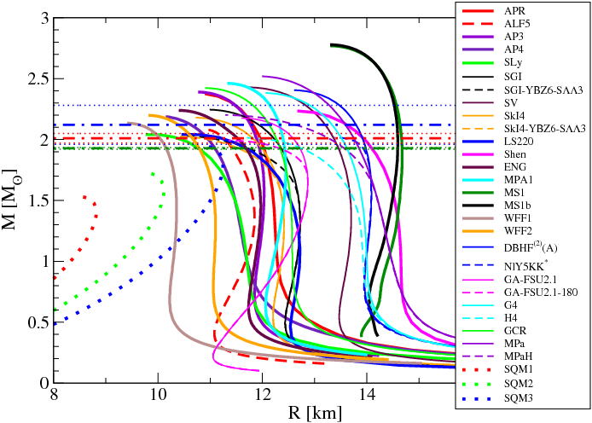
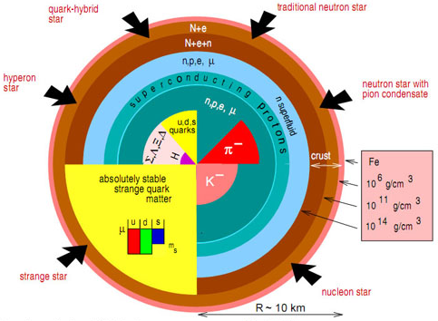
Exploring the interior of NS
Interiors of NS is still poorly known : many theoretical models
  Each model (EOS) uniquely determines NS structure (model (EOS) ⇒ NS structure)
Hybrid star
Neutron star
Yagi & Yunes (2016)
Hyperon star
Pion cond.
We want to solve the inverse problem :
GW observation ⇒ NS structure ⇒ constraining EOS Physics
Quark star
Kaon cond.
Weber (2005)

Slide 6
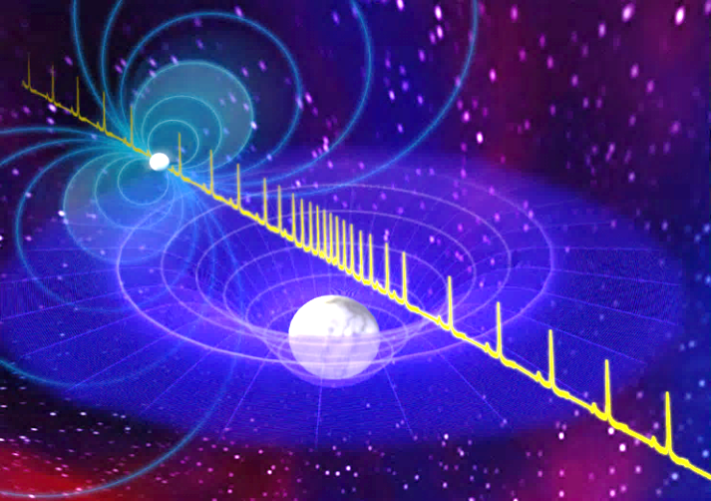
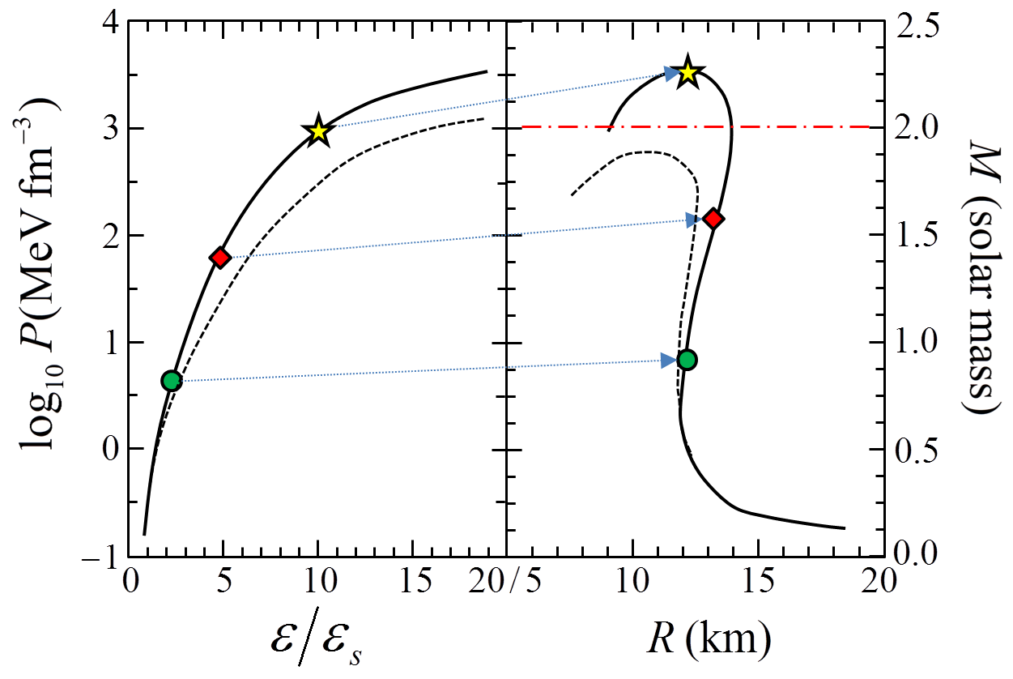
TOV equation : the theoretical basis
Bill Saxton, NRAO/AUI/NSF
Pulses from pulsar
gives one-to-one correspondence between EOS (P-ρ) ⇔ NS M-R relation
  We may in principle reconstruct EOS by NS M-R (Lindblom (1992) ApJ 398 569)
sets maximum mass MEOS,max of NS associated with EOS (model)
  models with MEOS,max not compatible with Mobs, max should be discarded
Impact of PSR J1614-2230 on hadron physics
  M = 1.97±0.04 Msun
  Demorest et al. (2010)
Hyperon Puzzle
WD gravity modifies the pulses ⇒ MWD
Tolman-Oppenheimer-Volkov equations
Demorest et al. 2010

Slide 7

The Hyperon Puzzle
Hyperon potentials based on double hyper nuclei $μ_{n}>m_{hyperon}^{∗}$ inside NS ⇒ (Λ) hyperons should appear ⇒ the Fermi energy is consumed by the hyperon rest mass ⇒ EOS gets softer ⇒ fail to support the 2Msun NS (hyperon puzzle)
Chatterjee & Vidana EPJA 52, 29 (2016)

Slide 8
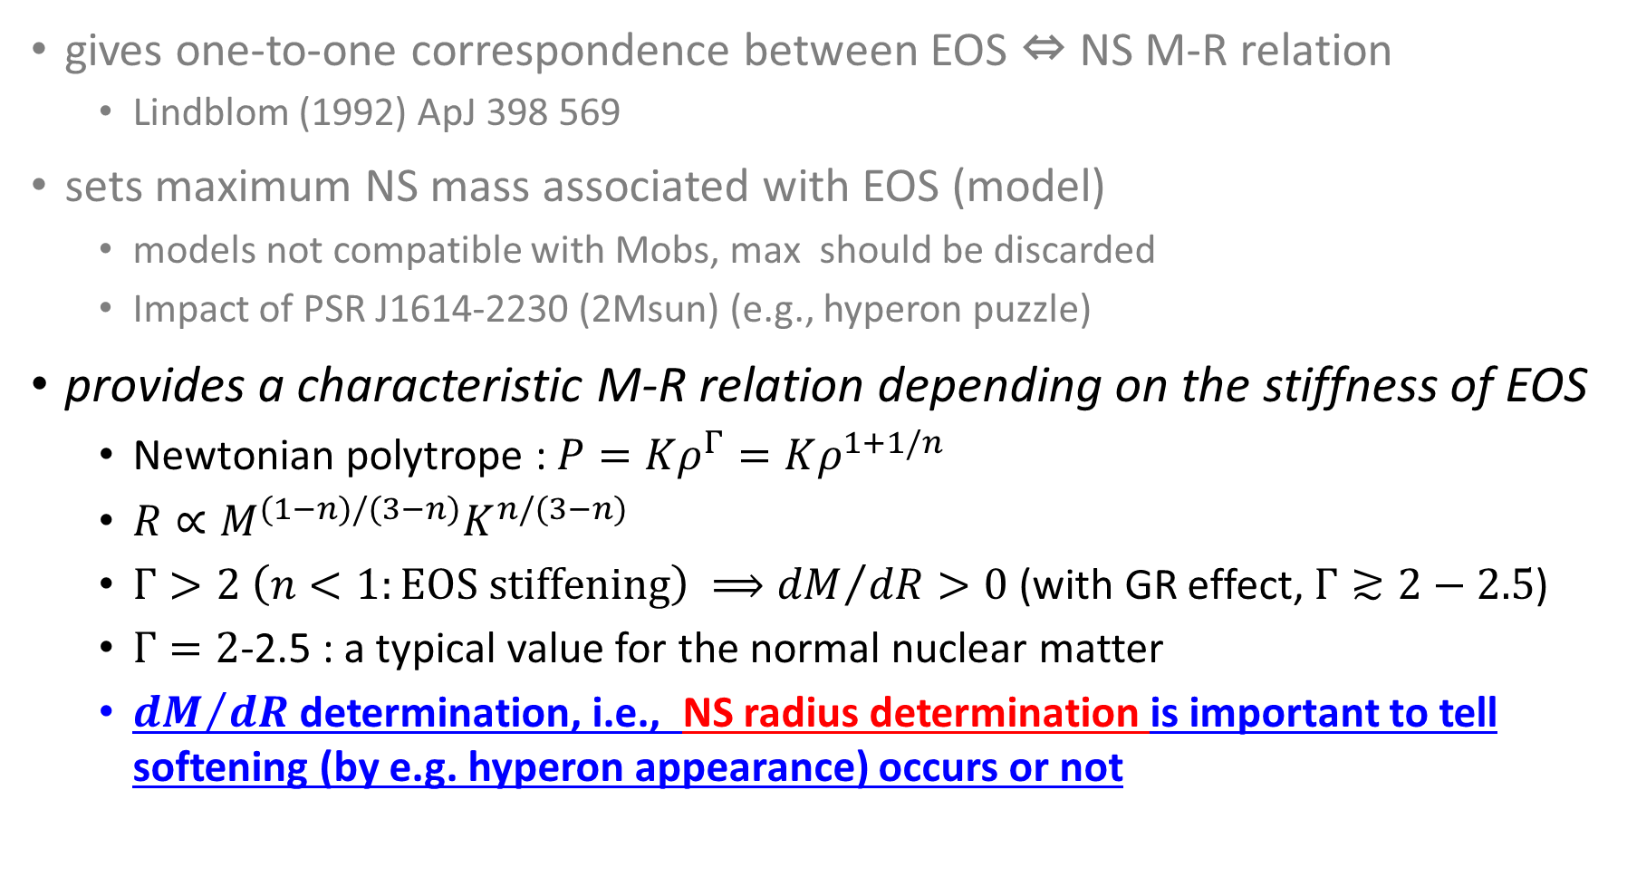
TOV equation : the theoretical basis
gives one-to-one correspondence between EOS ⇔ NS M-R relation
  Lindblom (1992) ApJ 398 569
sets maximum NS mass associated with EOS (model)
  models not compatible with Mobs, max should be discarded
  Impact of PSR J1614-2230 (2Msun) (e.g., hyperon puzzle)
provides a characteristic M-R relation depending on the stiffness of EOS
  Newtonian polytrope : $P=Kρ^{Γ}=Kρ^{1+1/n}$
  $R∝M^{(1−n)/(3−n)}K^{n/(3−n)}$
  $Γ>2 \left(n<1:EOS stiffening\right) ⟹{dM}/{dR}>0$ (with GR effect, $Γ≳2−2.5$)
  $Γ=2$-2.5 : a typical value for the normal nuclear matter
  ${dM}/{dR}$ determination, i.e., NS radius determination is important to tell softening (by e.g. hyperon appearance) occurs or not

Slide 9
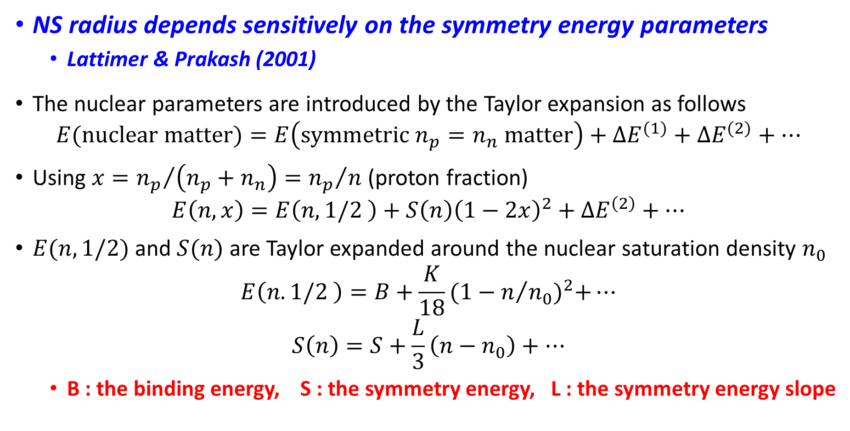
Nuclear EOS and NS radius
NS radius depends sensitively on the symmetry energy parameters
  Lattimer & Prakash (2001)
The nuclear parameters are introduced by the Taylor expansion as follows
$$E(nuclear matter)=E\left(symmetric n_{p}=n_{n} matter\right)+∆E^{(1)}+∆E^{(2)}+…$$
Using $x={n_{p}}/{\left({n_{p}+n}_{n}\right)={n_{p}}/n}$ (proton fraction)
$$E\left(n,x\right)=E\left(n,1/2 \right)+S\left(n\right){\left(1−2x\right)}^{2}+∆E^{\left(2\right)}+…$$
$E(n,1/2)$ and $S(n)$ are Taylor expanded around the nuclear saturation density $n_{0}$
$$E\left(n.1/2 \right)=B+\frac{K}{18}{(1−n/{n_{0}})}^{2}+…$$
$$S\left(n\right)=S+\frac{L}{3}\left(n−n_{0}\right)+…$$
  B : the binding energy, S : the symmetry energy, L : the symmetry energy slope

Slide 10
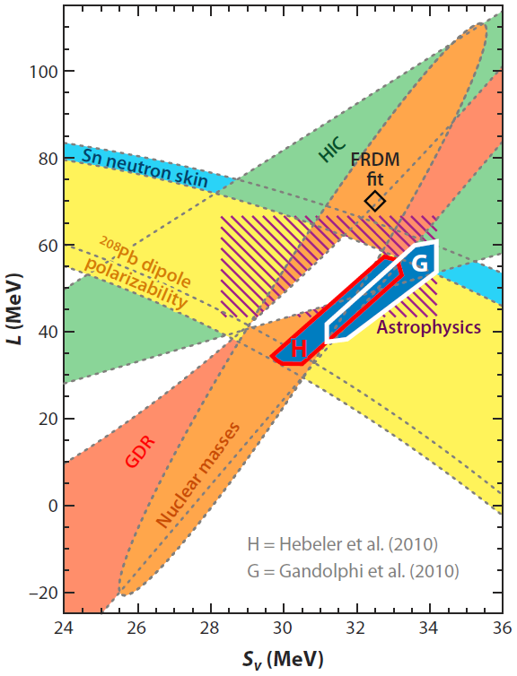
Constraints on the symmetry energy
nuclear mass fitting Kortelainen et al. (2010)
neutron skin thickness of Sn Chen et al. (2010)
²⁰⁸Pb dipole polarizablility Piekarewicz et al. (2012)
giant dipole resonances Trippa et al. (2008)
heavy ion collision Tsang et al. (2009)
NS M-R observations Steiner et al. (2010)
Theoretical calculation
  Chiral effective field theory Hebeler et al. (2010)
  Quantum Monte Carlo Gandolfi et al. (2012)
Lattimer (2012) Annu. Rev. Nucl. Part. Sci. 62 485
Fortin et al. arXiv 1604.01944
S

Slide 11
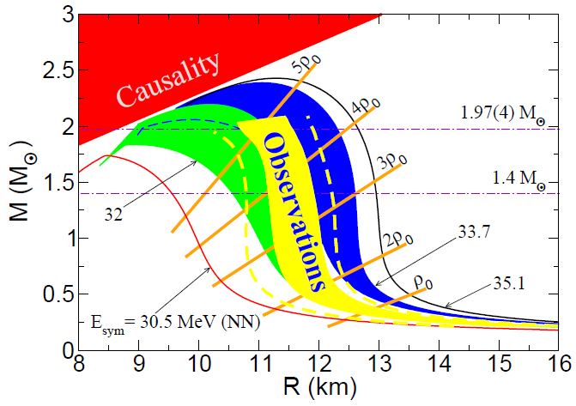
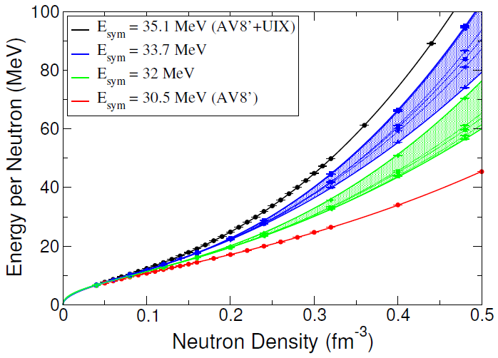
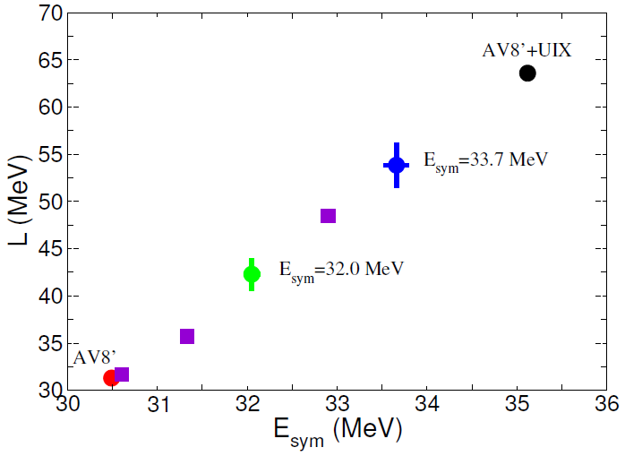
Impact of the symmetry energy on NS radius
Gandolfi et al. (2012) PRC 85 032801(R)

Slide 12
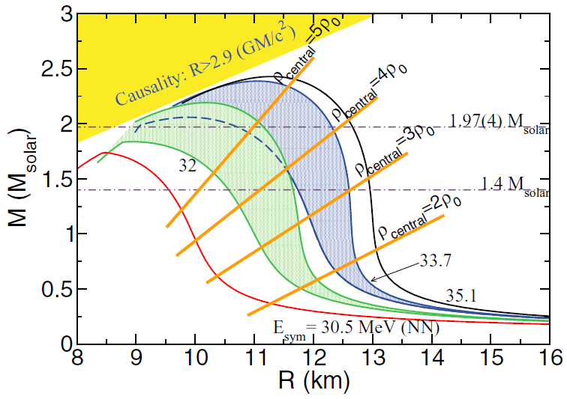
Massive NS is important to explore high density region
core bounce in supernovae
  mass：0.5~0.7Msun
  ρ ~ a few ρ0
canonical neutron stars
  mass： 1.35-1.4Msun
  ρ ~ several ρ0
massive NS ( > 1.6 Msun)
  ρ > 4ρs
massive NSs are necessary to explore higher densities
  Such a massive NS is very rare
  NS-NS : > 2 Msun after the merger

Slide 13
Event rate of NS-NS merger
Event rate is quite uncertain
  Galactic binary pulsar (Kim et al. pulsar)
  NS-NS = SGRB (GRB)
  NS-NS = Origin r-process (r-process)
  NS-NS = kilonova (kilonovae)
  Population synthesis (pop syn)
Merger rate : ~ 10-1000/Gpc³/yr
Detection rate @ design sensitivity : 0.1 – 10 /yr
  D = 200 Mpc (design sensitivity)
  Duty cycle 60%
aLIGO observation schedule
  O1 : 2015-2016 (done)
  O2 : 2016-2017+ (80-120Mpc)
  O3 : 2017-2018+ (120-170 Mpc)
aLIGO detection rate =>
0.1/yr
1/yr
10/yr
O1 : 2015-2016
O2 : 2016-2017+
O3 : 2017-2018+
10
1000
Abbott et al. (2016)

Slide 14
Event rate of NS-NS merger
Event rate is quite uncertain
  Galactic binary pulsar
  SGRB = NS-NS merger
  Origin r-process = NS-NS
  kilonova = NS-NS merger
  Population synthesis
Merger rate : ~ 10-1000/Gpc³/yr
Detection rate @ design sensitivity : 0.1 – 10 /yr
  D = 200 Mpc
  Duty cycle 60%
aLIGO observation schedule
  O1 : 2015-2016 (done)
  O2 : 2016-2017+ (80-120Mpc)
  O3 : 2017-2018+ (120-170 Mpc)
aLIGO detection rate =>
0.1/yr
1/yr
10/yr
GWs from NS-NS may be detected in next few years and might provide us unique information on NS EoS :
      M and R information of NS
          Maximum mass constraints
              Composition of NS interiors
We should prepare for it
O1 : 2015-2016
O2 : 2016-2017+
O3 : 2017-2018+
10
1000
Abbott et al. (2016)

Slide 15
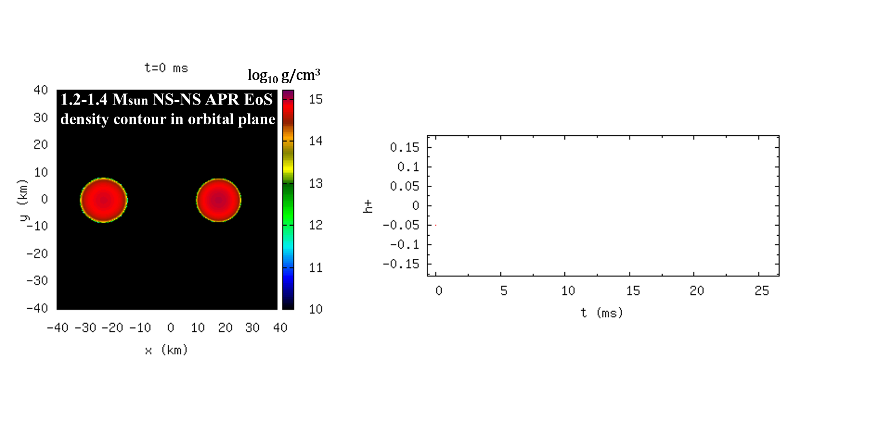
Gravitational waves from NS-NS merger
Gravitational Waveform

Slide 16
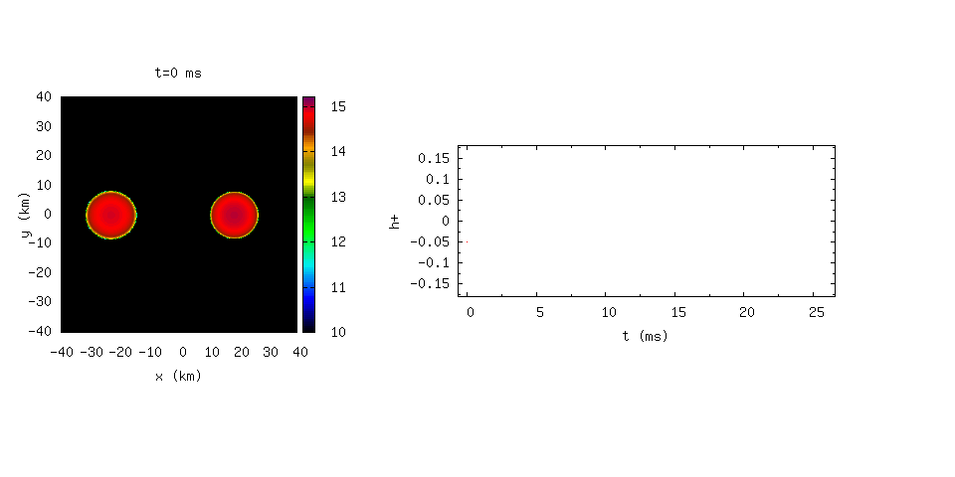
Gravitational waves from NS-NS merger
Tidal
deformation
NS oscillation (BH formation)
log₁₀ g/cm³
Inspiral Chirp signal
1.2-1.4 Msun NS-NS APR EoS
density contour in orbital plane
Gravitational Waveform
Animation: Hotokezaka
Finite size effects appear
tidal deformability
=> radius of cold NS
BH or NS ⇒ Maximum mass
quasi-periodic GW frequency
⇒ radius of hot, massive NS
Point particle approximation
Information of orbits, NS mass

Slide 17
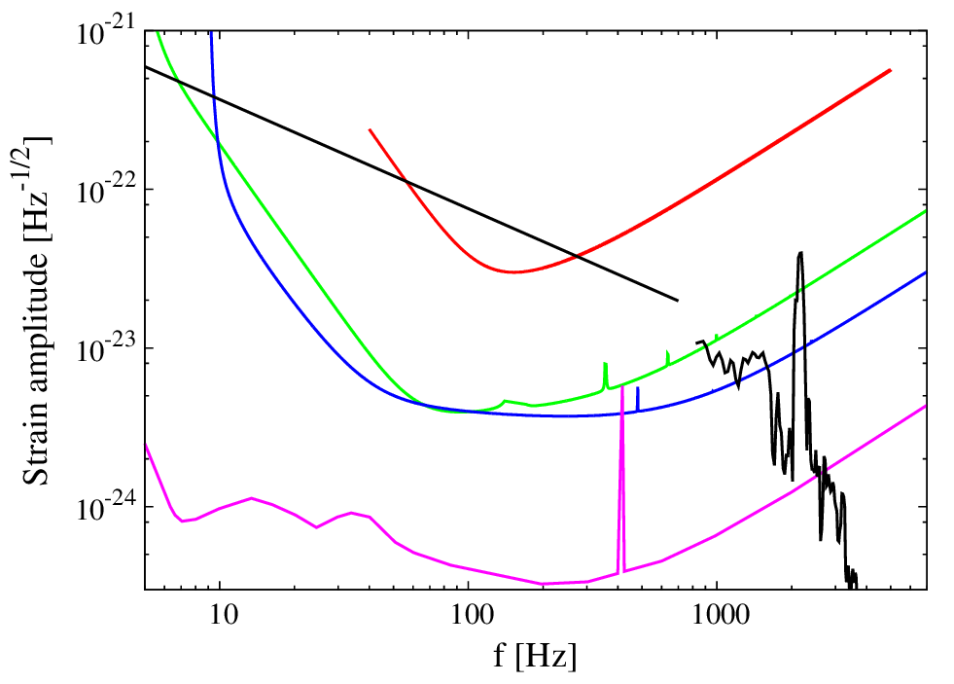
An example of expected GW spectrum：
BNS 1.35-1.35Msolar optimal @ 100Mpc
Initial LIGO
Inspiral charp signal
Mass of each NS
Tidal deformation
Radius of NS
Merger & Oscillation
Mmax,
R of massive NS
KAGRA
Broadband Adv. LIGO
・The event above each sensitivity curve
can be detected.
・Detectability increases as the area above
the sensitivity increases
・Need more nearby event to detect the GW from the merger remnant
Future detector
Einstein Telescope

Slide 18

GWs from NS-NS merger would provide us
Simultaneous determination of mass and radius of NS
  mass from inspiral chirp signal
  radius of cold NS with canonical mass (~1.35Msun) by deviation of GWs from chirp signal due to tidal deformation
    Canonical mass : 1.3-1.4 Msun
    T ~ 0 MeV, ${ ρ}_{0}\sim {(3−4)ρ}_{s}$, Ye = 0.1
  radius of hot merger remnant NS by quasi-periodic GWs frequency
    T ~ 30-60 MeV (larger for softer EoS)
    $ρ_{0}$ ~ 10¹⁵ g/cm³ (larger for softer EoS)
    Ye ~ 0.1
Merger remnant NS for 1.35-1.35
DD2 EoS

Slide 19
GWs from NS-NS and QCD phase diagram
Quasi periodic GWs
Tidal deformation
Ohnishi @ JPS JPARK-HI Sympo.

Slide 20
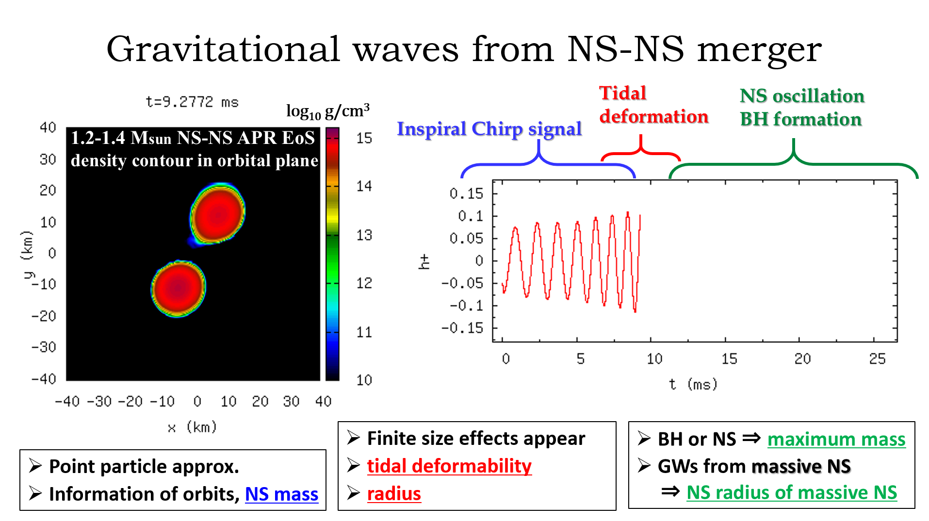

Slide 21
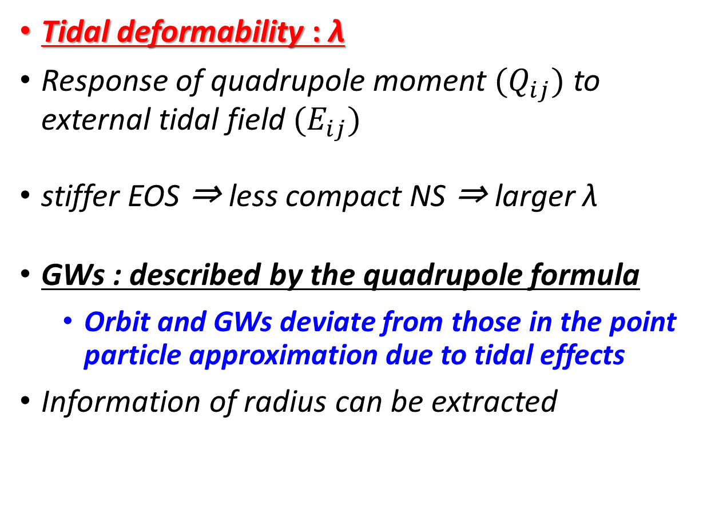
Tidal deformability of NS
Lackey & Wade (2015)
Tidal deformability : λ
Response of quadrupole moment $(Q_{ij})$ to external tidal field $(E_{ij})$
  stiffer EOS ⇒ less compact NS ⇒ larger λ
GWs : described by the quadrupole formula
    Orbit and GWs deviate from those in the point particle approximation due to tidal effects
  Information of radius can be extracted

Slide 22
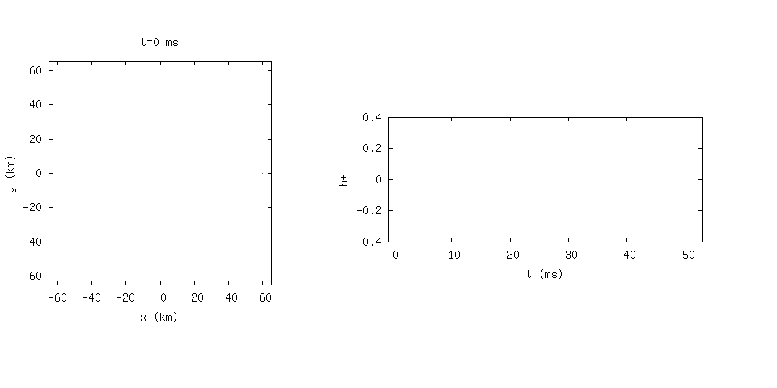
Orbit
Stiff Eos :
MS1 EoS (R1.35 = 14.5km)
  1.35-1.35 Msun NS-NS
Tidal effects are more important
Remarkable deviation of orbit and GWs
GW waveform
Point particle
w/Tidal effect (evolves faster)
Orbit
Soft Eos :
APR EoS (R1.35 = 11.1km)
  1.35-1.35 Msun NS-NS
Tidal effects are less important
Small deviation of orbit and GWs in later phase
GW waveform
Animation: Hotokezaka

Slide 23


Tidal effect in gravitational wave spectra
Hotokezaka et al. (2016)
Sn: detector noise spectrum
Hotokezaka et al. (2016)
APR: R1.35 = 11.1 km
Λ1.35 = 320
distinguishability
  Δh12 = 1 corresponds to 1σ
  D=200Mpc (horizon distance of aLIGO)
See also
  Read et al. (2013); Del Pozzo et al. (2013); Agathos et al. (2015); Lackey & Wade (2015)
SFHo: R1.35 = 11.9 km
Λ1.35 = 420
$2\sqrt{f}|h\left(f\right)|$ @ 100Mpc
TMA:
R1.35 = 13.9 km
Λ1.35 = 1200
DD2: R1.35 = 13.2 km
Λ1.35 = 850
 | APR | SFHo | DD2 | TMA | TM1
APR | ΔR | 0.7 | 2.3 | 3.0 | 3.5
SFHo | 0.8 km | － | 1.9 | 2.7 | 3.3
DD2 | 2.1 km | 1.3 km | － | 1.3 | 2.5
TMA | 2.8 km | 2.0 km | 0.7 km | － | 1.7
TM1 | 3.4 km | 2.6 km | 1.3 km | 0.6 km | Δh12
Point particle
TM1 (Shen) :
R1.35 = 14.5 km
Λ1.35 = 1400
aLIGO design sensitivity
$f$ [kHz]

Slide 24
Tidal effect in gravitational wave spectra
Hotokezaka et al. (2016)
Sn: detector noise spectrum
Hotokezaka et al. (2016)
APR: R1.35 = 11.1 km
Λ1.35 = 320
distinguishability
  Δh12 = 1 corresponds to 1σ
  D=200Mpc (horizon distance of aLIGO)
See also
  Read et al. (2013); Del Pozzo et al. (2013); Agathos et al. (2015); Lackey & Wade (2015)
SFHo: R1.35 = 11.9 km
Λ1.35 = 420
DD2: R1.35 = 13.2 km
Λ1.35 = 850
If the true EoS is stiff and typical radius of NS is > 13km, our analysis suggests that the radius will be constrained within ≈1 km at > 2σ level for an event at 200 Mpc
$2\sqrt{f}|h\left(f\right)|$ @ 100Mpc
TMA:
R1.35 = 13.9 km
Λ1.35 = 1200
 | APR | SFHo | DD2 | TMA | TM1
APR | ΔR | 0.7 | 2.3 | 3.0 | 3.5
SFHo | 0.8 km | － | 1.9 | 2.7 | 3.3
DD2 | 2.1 km | 1.3 km | － | 1.3 | 2.5
TMA | 2.8 km | 2.0 km | 0.7 km | － | 1.7
TM1 | 3.4 km | 2.6 km | 1.3 km | 0.6 km | Δh12
Point particle
TM1 (Shen) :
R1.35 = 14.5 km
Λ1.35 = 1400
aLIGO design sensitivity
$f$ [kHz]

Slide 25
Current NR (numerical relativity) data is not accurate enough
See Kenta’s talk
Origin of orbit and GWs evolution : tidal effect + numerical diffusion
Error in phase is still large (> O(1) rad.) => need more high reso. => continuum limit
R_{1.35}= 13.7 km
R_{1.35}= 12.3 km
Preliminary
R_{1.35}= 11.6 km
R_{1.35}= 11.0 km

Slide 26
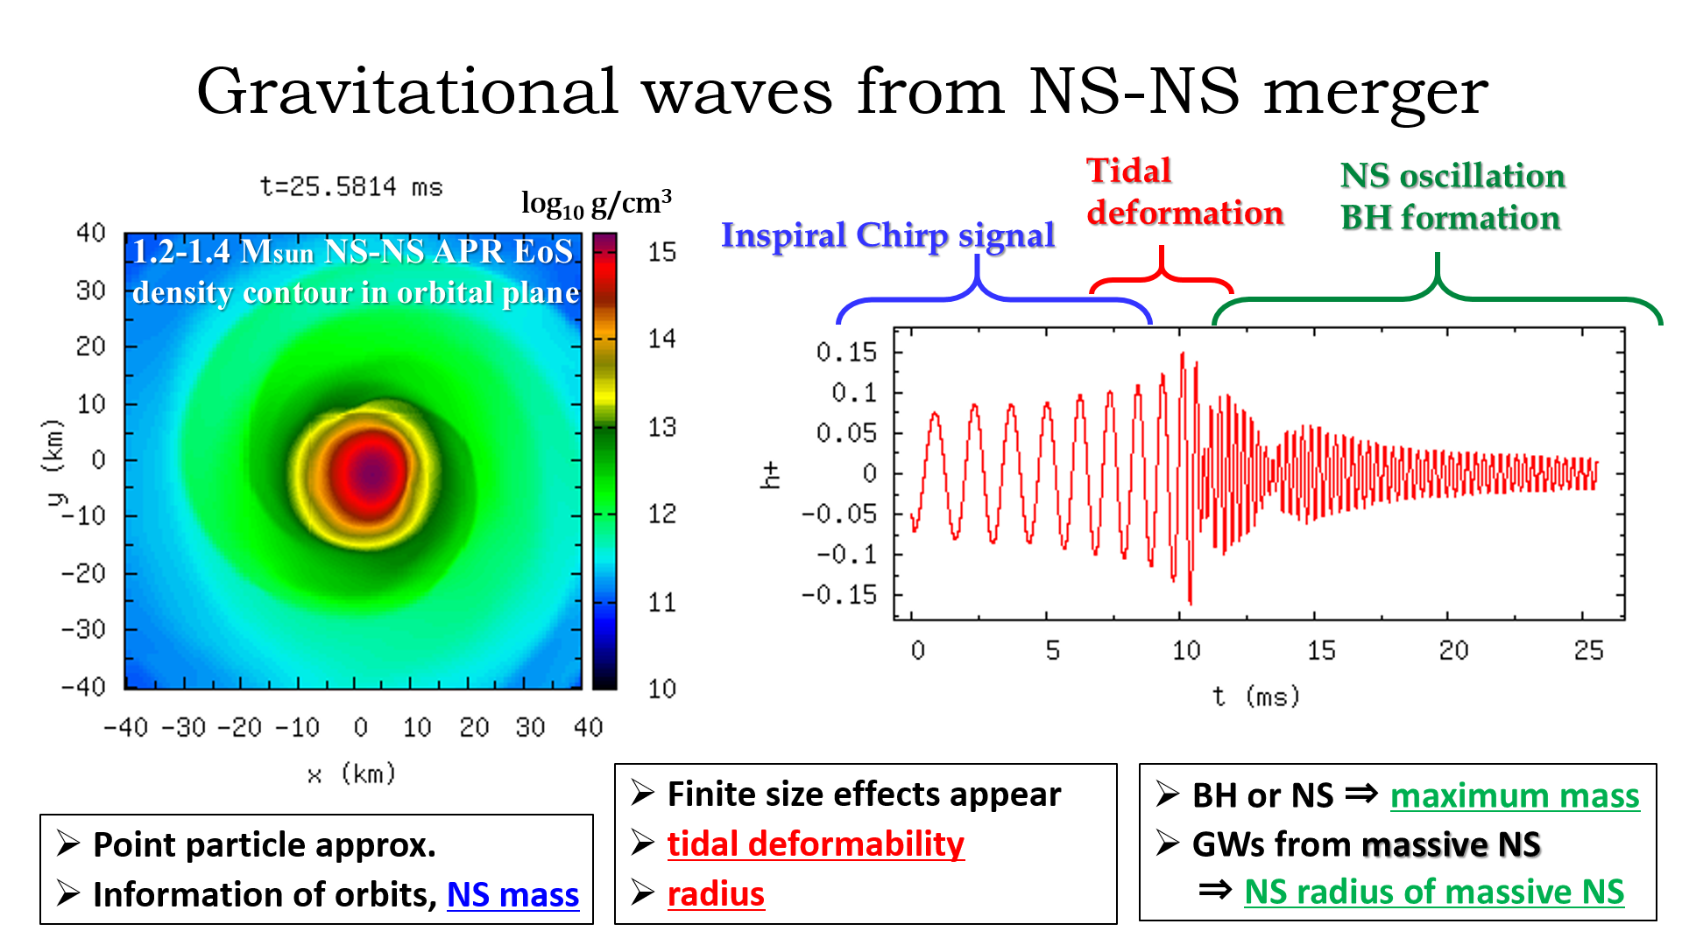
First suggested by Shibata (2005)

Slide 27
Listening GWs : APR EoS (R1.35=11.1km)
3.3 kHz

Slide 28
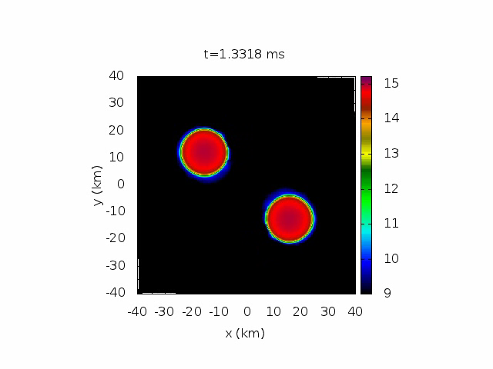
Listening GWs : APR EoS (R1.35=11.1km)
3.3 kHz

Slide 29
Listening GWs : H4 EoS (R1.35=13.6km)
2.7 kHz

Slide 30
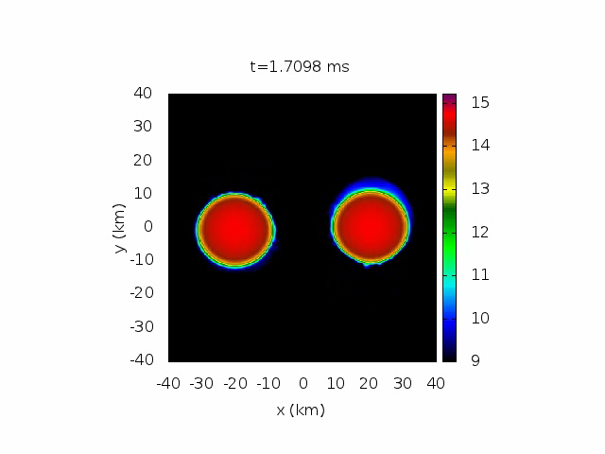
Listening GWs : H4 EoS (R1.35=13.6km)
2.7 kHz

Slide 31
GW spectra and characteristic peak f GW
First suggested by Shibata (2005); Bauswein+ (2012); Hotokezaka+(2013)
APR
11.1 km
DD2
13.2 km
SFHo
11.9 km
TM1
14.5 km
TMA
13.9 km
3.4 kHz
3.3 kHz
2.6 kHz
2.5 kHz
2.3 kHz
Characteristic peak frequency fGW in spectra
Clark et al. (2014)
Quasi periodic GWs from merger remnant NS

Slide 32
GW spectra and characteristic peak f GW
First suggested by Shibata (2005); Bauswein+ (2012); Hotokezaka+(2013)
APR
11.1 km
DD2
13.2 km
SFHo
11.9 km
TM1
14.5 km
TMA
13.9 km
3.4 kHz
3.3 kHz
2.6 kHz
2.5 kHz
2.3 kHz
Peak frequency depends on EoS
stiffer EOS ⇒ larger NS radii, smaller mean density ⇒ lower f _{GW}
softer EOS ⇒ smaller NS radii, larger mean density ⇒ higher f _{GW}
Clark et al. (2014)

Slide 33
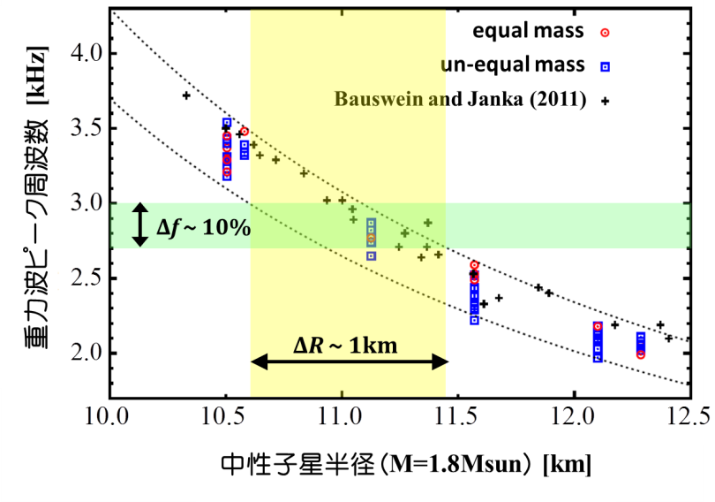
Empirical relation between fGW and RNS
The peak frequency f_{GW} shows good correlation with radius of a massive NS
  Radius of 1.6Msolar NS
    Bauswein et al. (2012)
    approx. GR study
  Radius of 1.8Msolar NS
    Hotokezaka et al. (2013)
    full GR study
Correlation is fairly tight :
  ΔR ~ 0.5 km (Bauswein et al. 2012)
  ΔR ~ 1 km (Hotokezaka et al. 2013)
Further developments and theoretical background => towards the empirical relation
  Takami et al. (2015); Rezzolla et al. (2016)
  Bauswein+ (2014, 2015, 2016)
Hotokezaka et al. (2013)
f_{GW} [kHz]
NS radius

Slide 34
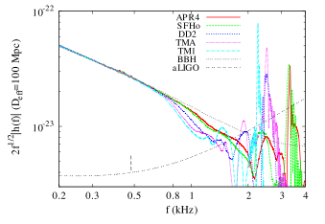
More realistic modeling (MHD viscosity) is necessary
Rotation and oscillation of non-axisymmetric NS formed after merger emits quasi periodic GWs and makes the peak in the GW spectra

Slide 35
More realistic modeling (MHD viscosity) is necessary
Kenta’s talk, Shibata & Kiuchi (2017)
?
Preliminary
Rotation and oscillation of non-axisymmetric NS formed after merger emits quasi periodic GWs and makes the peak in the GW spectra
The NS may become axisymmetric by viscous angular momentum transport
Then GW amplitude and the peak decreases => need further study for MHD viscosity in NS

Slide 36
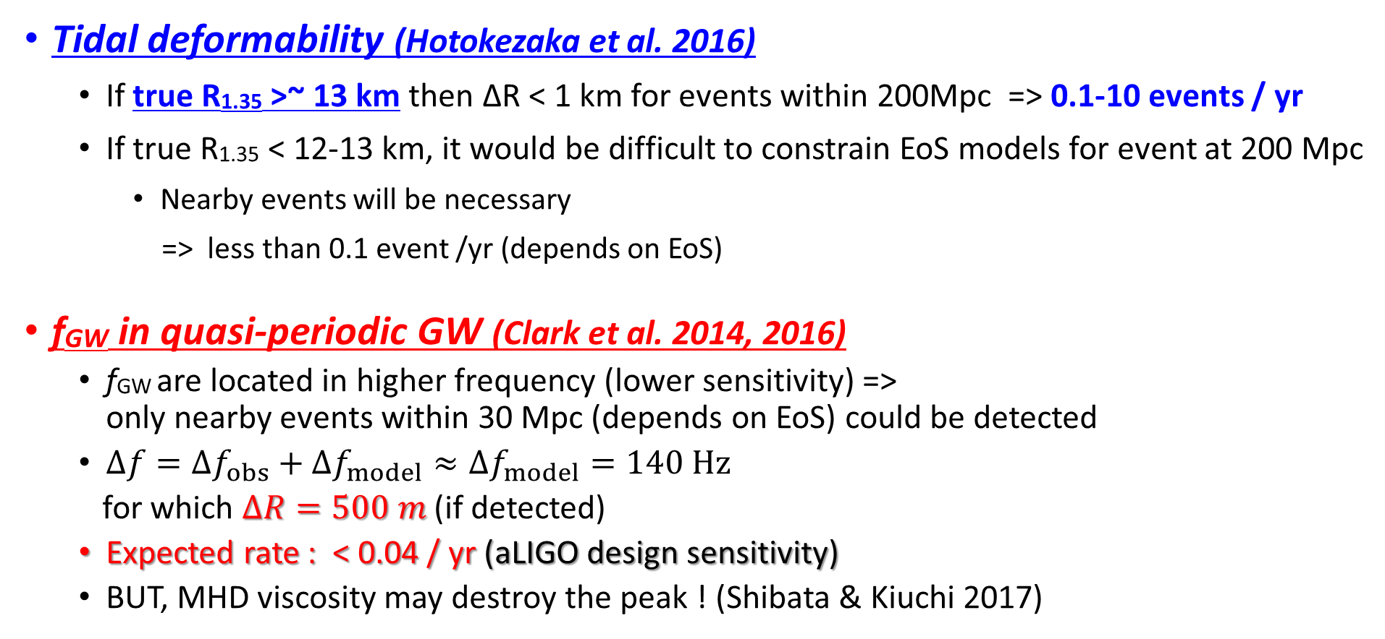
Detectability and event rate (full aLIGO)
Tidal deformability (Hotokezaka et al. 2016)
    If true R1.35 >~ 13 km then ΔR < 1 km for events within 200Mpc => 0.1-10 events / yr
    If true R1.35 < 12-13 km, it would be difficult to constrain EoS models for event at 200 Mpc
      Nearby events will be necessary
      => less than 0.1 event /yr (depends on EoS)
fGW in quasi-periodic GW (Clark et al. 2014, 2016)
  fGW are located in higher frequency (lower sensitivity) => only nearby events within 30 Mpc (depends on EoS) could be detected
  $∆f=∆f_{obs}+∆f_{model}≈∆f_{model}=140 Hz$
  for which $∆R=500 m$ (if detected)
  Expected rate : < 0.04 / yr (aLIGO design sensitivity)
  BUT, MHD viscosity may destroy the peak ! (Shibata & Kiuchi 2017)

Slide 37
Detectability and event rate (full aLIGO)
Tidal deformability (Hotokezaka et al. 2016)
    If true R1.35 >~ 13 km then ΔR < 1 km for events within 200Mpc => 0.1-10 events / yr
    If true R1.35 < 12-13 km, it would be difficult to constrain EoS models for event at 200 Mpc
      Nearby events will be necessary
      => less than 0.1 event /yr (depends on EoS)
fGW in quasi-periodic GW (Clark et al. 2014, 2016)
  fGW are located in higher frequency (lower sensitivity) => only nearby events within 30 Mpc (depends on EoS) could be detected
  $∆f=∆f_{obs}+∆f_{model}≈∆f_{model}=140 Hz$
  for which $∆R=500 m$ (if detected)
  Expected rate : < 0.04 / yr (aLIGO design sensitivity)
  BUT, MHD viscosity may destroy the peak ! (Shibata & Kiuchi 2017)
30Mpc
Uncertainty in Esym (same scale)
70Mpc
100Mpc
200Mpc

Slide 38
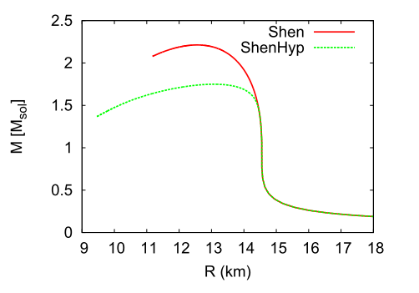
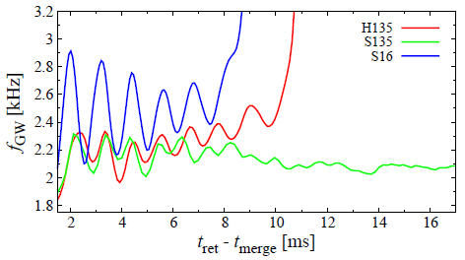
Appearance of hyperons encoded in GWs ?
Sekiguchi et al. (2011)
So far, constraint on EoS is by M-R determination from GWs
It might be possible more directly explore the composition of NS
Hyperons may appear in NS and EOS becomes softer
If this softening is significant, appearance of hyperon may encode in GWs
Hyperonic
Nucleonic
EoS NOT compatible with 2Msun NS
Strong softening

Slide 39
Appearance of hyperons encoded in GWs ?
Sekiguchi et al. (2011)
Nucleonic： NS shrinks by angular momentum loss in a long GW timescale
Hyperonic： GW emission ⇒ NS shrinks ⇒ More Hyperons appear ⇒
  EOS becomes softer ⇒ NS shrinks more ⇒ emits more GWs …
⇒ fGW for hyperonic EOS might increase with time if EoS softening is significant
    Could provide potential way to tell existence of hyperons (exotic phases)
Hyperonic
Nucleonic
EoS NOT compatible with 2Msun NS
Strong softening

Slide 40
Appearance of hyperons encoded in GWs ?
Radice et al. (2017)
Simulation with a hyperon EoS compatible with 2Msun NS
Softening due to hyperon appearance is reduced
Increase of fGW may not be prominent as previously expected
Instead hyperon (exotic phase) appearance may be encoded in GW luminosity

Slide 41
A scenario with a very nearby event
In 20XX, GWs from NS-NS merger are detected
Inspiral chirp signal suggest 1.35-1.35 NS-NS merger @ D = 20Mpc
Extracted tidal deformability parameter suggests R1.35 < 12-12.5km
Many hyperon models which require stiff nucleonic EoS are discarded
Ohnishi @ JPS JPARK-HI Symp.

Slide 42
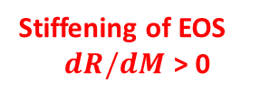
A scenario with a very nearby event
In 20XX, GWs from NS-NS merger are detected
Inspiral chirp signal suggest mass of 1.35-1.35 and D = 20Mpc
Extracted tidal deformability parameter suggests R1.35 < 12-12.5km
Many hyperon models which require stiff nucleonic EoS are discarded
fGW is marginally detected suggesting dM/dR > 0 and stiffening of EoS
Quark crossover model is preferred (other models predicts softening)
A hadron-quark cross over scenario
Stiffening of EOS
$dR/dM$ > 0
Masuda et al. (2013);
Kojo et al. (2015);
Stiffening of EOS
Fukushima & Kojo (2016)

Slide 43
A scenario with a very nearby event
In 20XX, GWs from NS-NS merger are detected
Inspiral chirp signal suggest mass of 1.35-1.35 and D = 20Mpc
Extracted tidal deformability parameter suggests R1.35 = 12-12.5km
Many hyperon models which require stiff nucleonic EoS are discarded
fGW is marginally detected suggesting dM/dR > 0 and stiffening of EoS
Quark crossover model is preferred
Tension between directed flow data by STAR experiments which indicate softening of EoS
Adamczyk et al. (2014)
Nara et al. (2016)

Slide 44
A scenario with a very nearby event
In 20XX, GWs from NS-NS merger are detected
Inspiral chirp signal suggest mass of 1.35-1.35 and D = 20Mpc
Extracted tidal deformability parameter suggests R1.35 = 12-12.5km
Many hyperon models which require stiff nucleonic EoS are discarded
fGW is marginally detected suggesting dM/dR > 0 and stiffening of EoS
Quark crossover model is preferred
Tension between directed flow data by STAR collaboration which indicates softening of EoS
QCD phase boundary should depend (both on T and) isospin chemical potential
=> towards 3 dimensional QCD phase diagram
Quasi periodic GWs
Tidal deformation
Ohnishi @ JPS JPARK-HI Symp.

Slide 45
Summary
GW150914: The first direct detection of GWs from BH-BH
    marks the dawn of GW astronomy era
    GW data consistent with GR prediction
GWs from binary NS mergers and EOS
  Tidal deformation : provides radius of NS before merger
    can constrain EoS with R1.35 > 12.5-13 km
    Need more accurate NR simulations
  Characteristic frequency : provides radius of more massive NS
    can constrain EoS only for nearby event < 30Mpc with aLIGO
    Time dependent analysis : constraint on exotic phase might obtained

