Slide 1
A SHORT HISTORY OF THE COSMOLOGICAL THINKING
Cargese, September 3, 2018
Ugo Moschella
Università dell’Insubria
(Como - Italia)

Slide 2
References
A. Koyre
From the closed world to the infinite universe
John Hopkins Press (1957)
Remi Brague
La Sagesse du monde, Histoire de l’experience humaine de l’univers.
Fayard (1999).
Jurgen Renn
The third way to General Relativity
Einstein and Mach in context. (1994)
Christian Smeenk
Einstein's Role in the Creation of Relativistic Cosmology.
In: The Cambridge Companion to Einstein. M. Janssen and C. Lehner (Eds.) Cambridge University Press (2004)
Michel Janssen
The Einstein-De Sitter Debate and Its Aftermath.
Ibidem
U. Moschella
Breve Histoire de la pensee cosmologique
In Vanhove et al. Dunod (2018)

Slide 3
History of ideas
A. Einstein, Kosmologische Betrachtungen zur allgemeinen Relativitätstheorie. Sitzungsberichte der Königlich Preussischen Akademie der Wissenschaften, VI. Berlin, 1917.
W. de Sitter, On the relativity of inertia. Remarks concerning Einstein's latest hypothesis. Proc. Royal Acad. Amsterdam 19, 1217-25 (1917).
W. de Sitter, Further Remarks on the Solutions of the Field-Equations of Einstein’s Theory of Gravitation. Proc. Royal Acad. Amsterdam 20 II, 1309-12 (1918).
W. de Sitter, On the curvature of space. Proc. Royal Acad. Amsterdam , 20 I, 229-243 (1918)
A. Friedmann Über die Krümmung des Raumes. Zeitschrift für Physik 10 (1): 377–386. (1922)
A. Friedmann, Über die Möglichkeit einer Welt mit konstanter negativer Krümmung des Raumes. Zeitschrift für Physik 21 (1): 326–332. (1924)
Abbé G. Lemaître, Un Univers homogène de masse constante et de rayon croissant rendant compte de la vitesse radiale des nébuleuses extra-galactiques. Annales de la Societe Scientifique de Bruxelles, A47, p. 49-59 (1927) (and its english translation)

Slide 4
news of the World

Slide 5
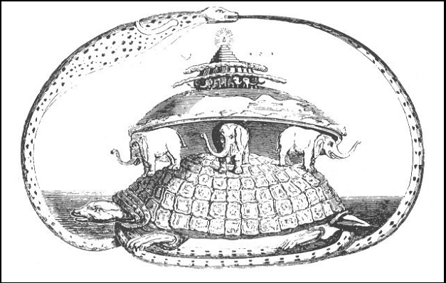
It's turtles all the way down?
The following anecdote is told of William James. [...] After a lecture on cosmology and the structure of the solar system, James was accosted by a little old lady.
"Your theory that the sun is the centre of the solar system, and the earth is a ball which rotates around it has a very convincing ring to it, Mr. James, but it's wrong. I've got a better theory," said the little old lady. - "And what is that, madam?" inquired James politely.
"That we live on a crust of earth which is on the back of a giant turtle.”
Not wishing to demolish this absurd little theory by bringing to bear the masses of scientific evidence he had at his command, James decided to gently dissuade his opponent by making her see some of the inadequacies of her position.
"If your theory is correct, madam," he asked, "what does this turtle stand on?”
"You're a very clever man, Mr. James, and
that's a very good question," replied the little
old lady, "but I have an answer to it. And it's this:
The first turtle stands on the back of a second,
far larger, turtle, who stands directly under him.”
"But what does this second turtle stand on?"
persisted James patiently. To this, the little old lady
crowed triumphantly,
"It's no use, Mr. James — it's turtles all the way down.” Source Wikipedia

Slide 6
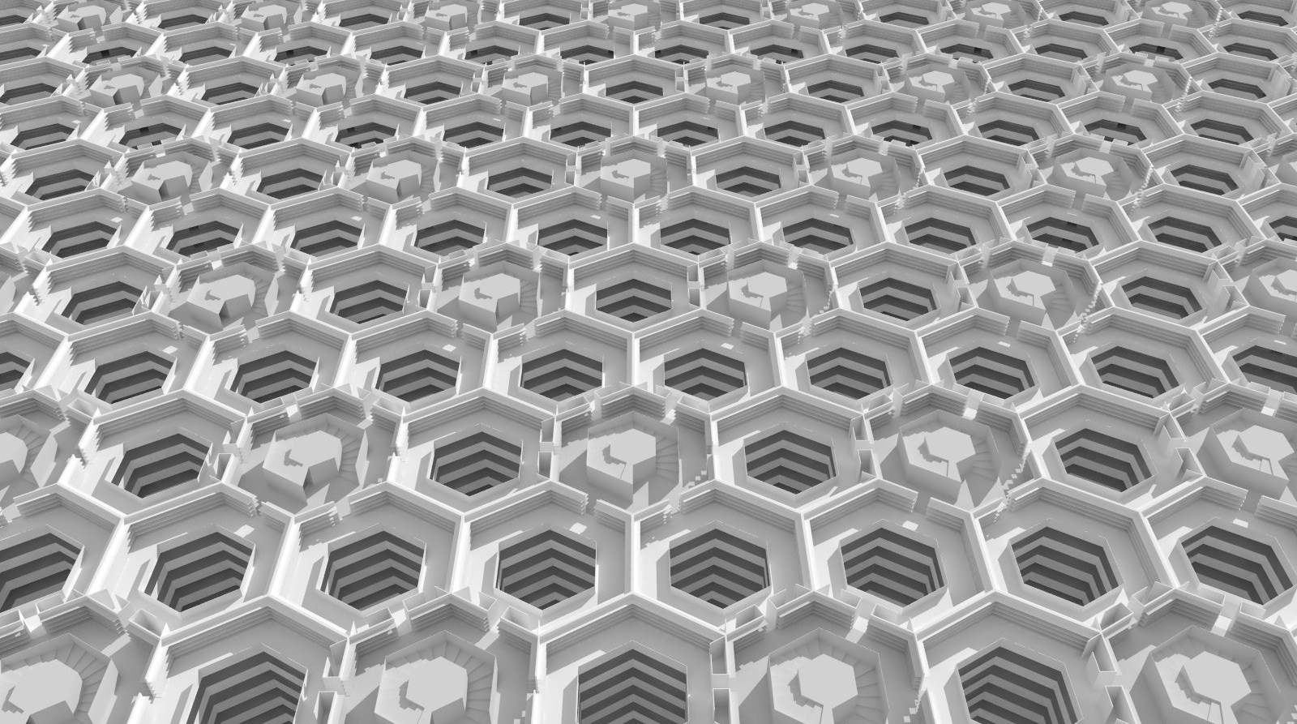
The Library of Babel
The universe (which others call the Library) is composed of an indefinite, perhaps infinite number of hexagonal galleries. In the center of each gallery is a ventilation shaft, bounded by a low railing. From any hexagon one can see the floors above and below - one after another, endlessly. JL Borges

Slide 7
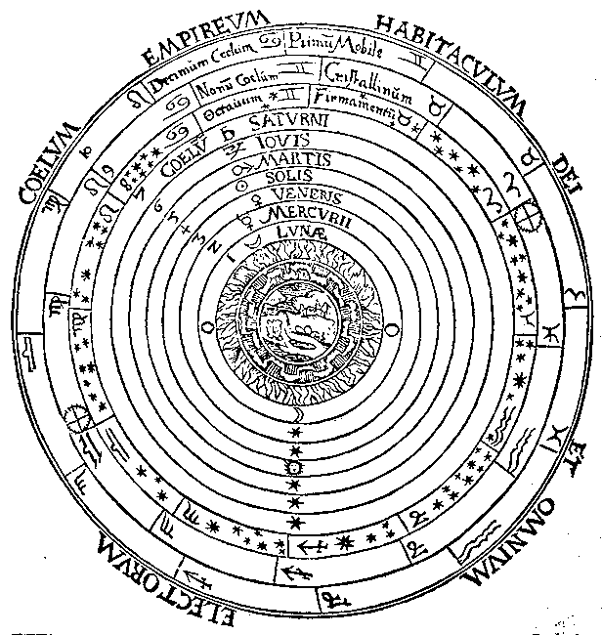
Ptolemy’s Universe

Slide 8
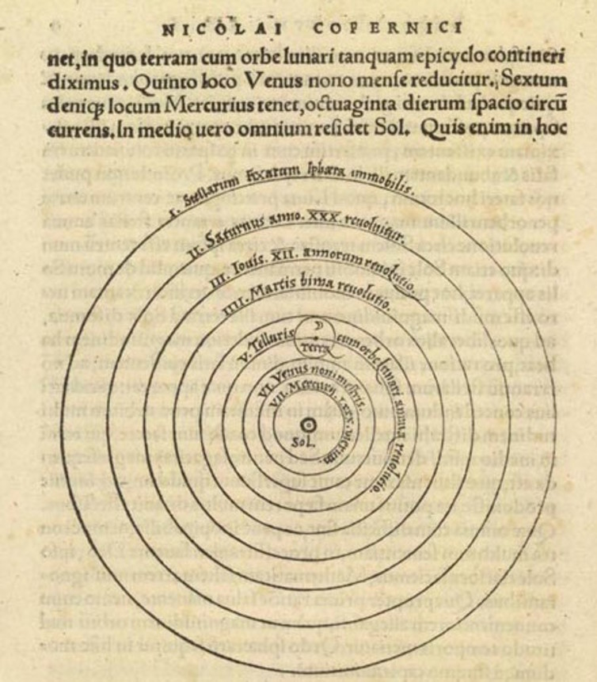
Copernicus Universe (1543)

Slide 9
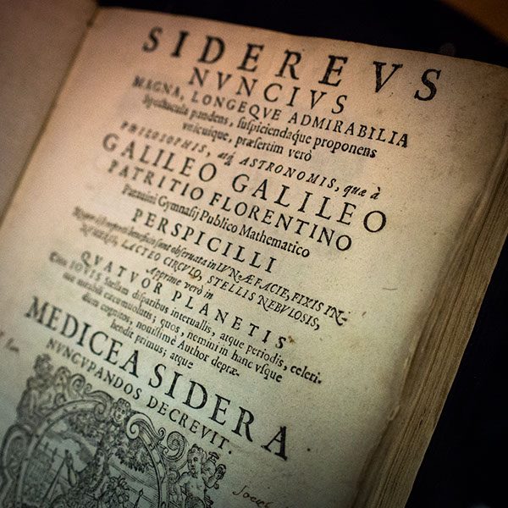
Sidereus Nuncius 1610

Slide 10
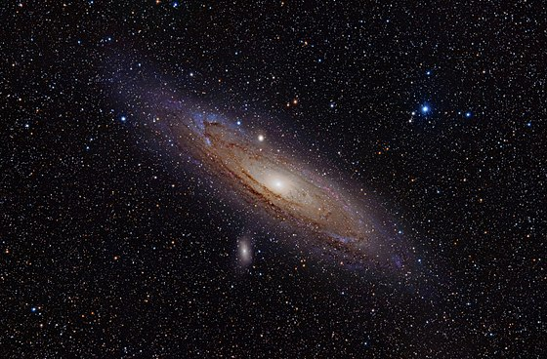
The Universe is wider and expanding (1923 – 1931)

Slide 11
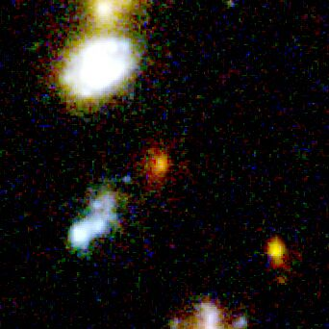
Supernova SN1997 ff
SN 1997 → Sidereus Nuncius 1997

Slide 12
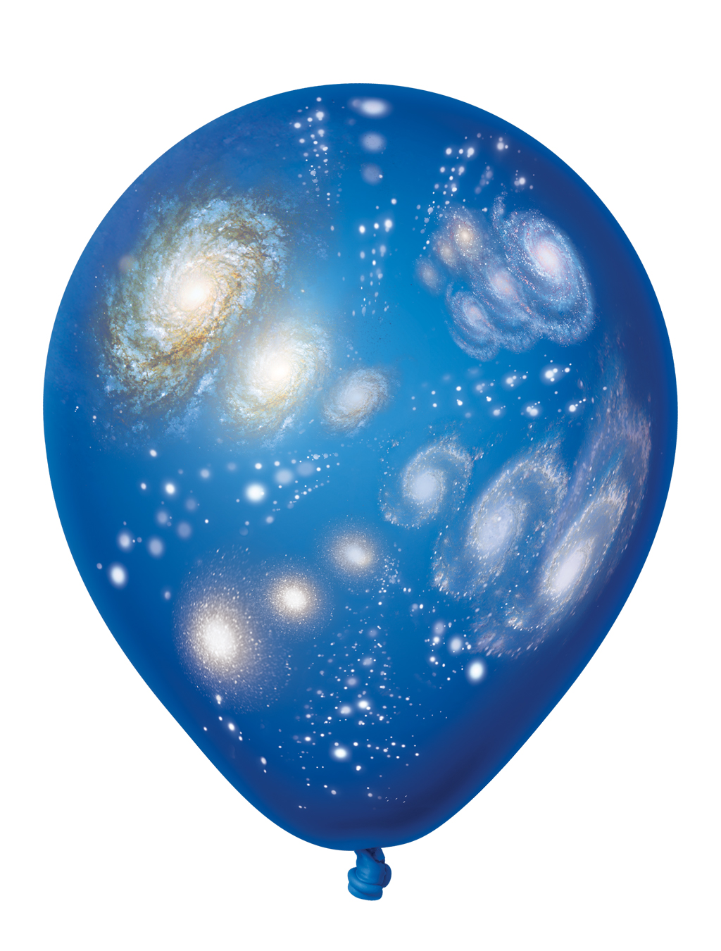
Our Weltanschauung (1997)

Slide 13
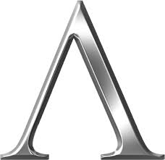
The cosmological constant

Slide 14
The cosmological constant is forever !
C

Slide 15
How did we get here ?

Slide 16
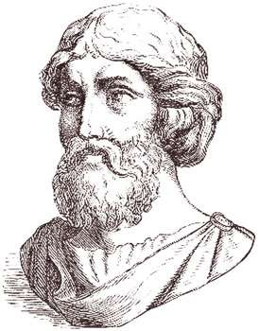
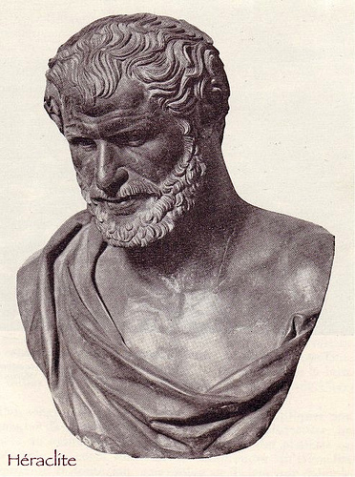
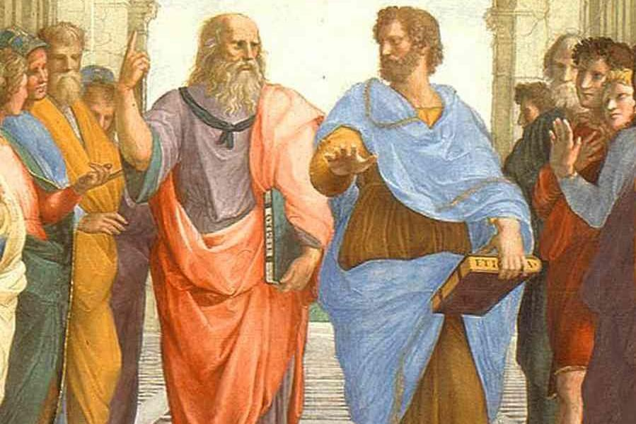
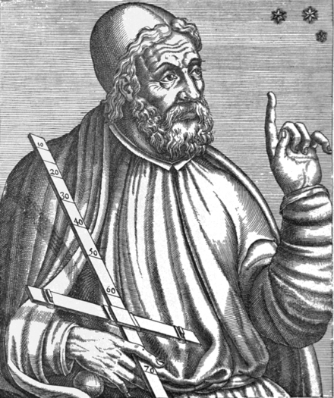
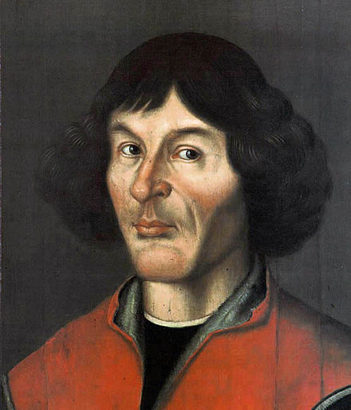
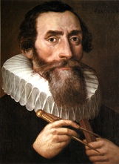
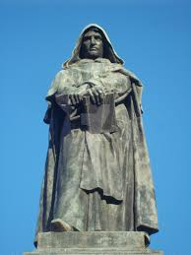
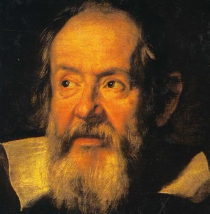
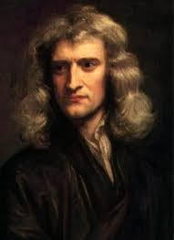
Standing on the sholders of Giants!

Slide 17
«Makers of Universes»

Slide 18
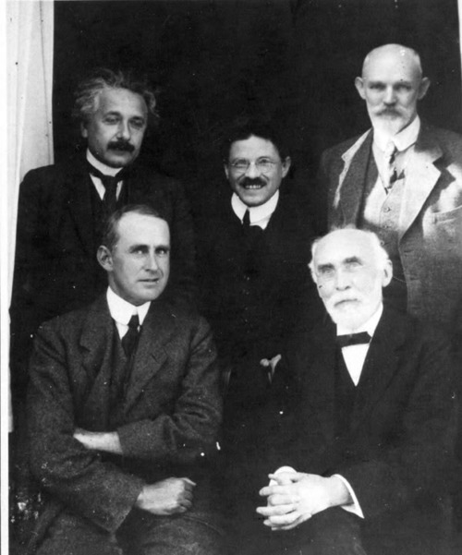
«Makers of Universes»
Leiden, 1923

Slide 19
«Makers of Universes»
Theoreticians

Slide 20
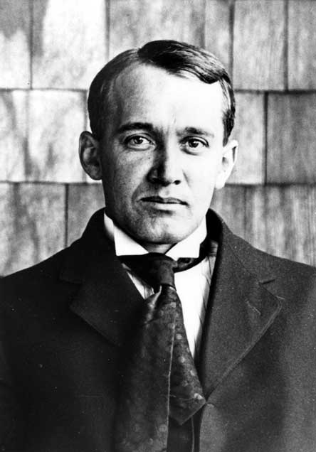
«Makers of Universes»
Astronomers

Slide 21
The natural father and the adoptive Father

Slide 22
The Name is the thing

Slide 23
A missing wor(l)d
The first condition for a cosmology, a reflexive relationship with the « world » or « universe », is that the idea of « world » has become a theme.
The sign of such a thematization is the existence of a word to designate the « world ». The presence of a word does not mean a conceptualization but its absence means at least that the concept has not become a theme.
History begins with the invention of writing, around 3200 B.C. A word capable of designating all of reality in a unified way appeared only around the year 500 B.C.
Humanity was able to do without the idea of « world » (aka « universe ») for half of its history (not to mention the immensity of prehistory).

Slide 24
A missing wor(l)d II
A word for « world » requires that the idea it expresses has reached human consciousness.
And this implies a synthesis between the first two categories of quantity: plurality and unity.
It is necessary that the parts that make the whole are dealt with exhaustively without anything being excluded and that such totality be considered unified.

Slide 25
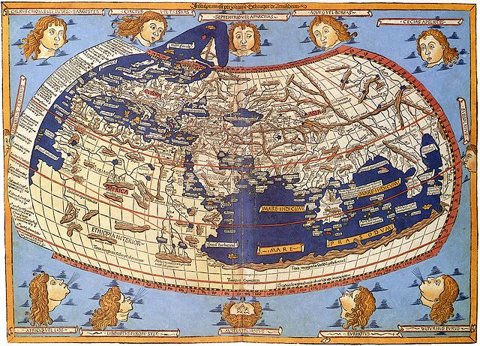
The fluvial civilizations
The great river valley civilizations had a name for the Earth, not of course as a planet, but as oikumené, a common dwelling place for men and animals as opposed to the inaccessible residence of the gods.
But these civilizations did not have a word to designate the world in its entirety, joining together the two components.

Slide 26
Naming the whole
To consider the totality as a whole one possibility was listing everything it contained (the list could be more or less exhaustive)

Slide 27
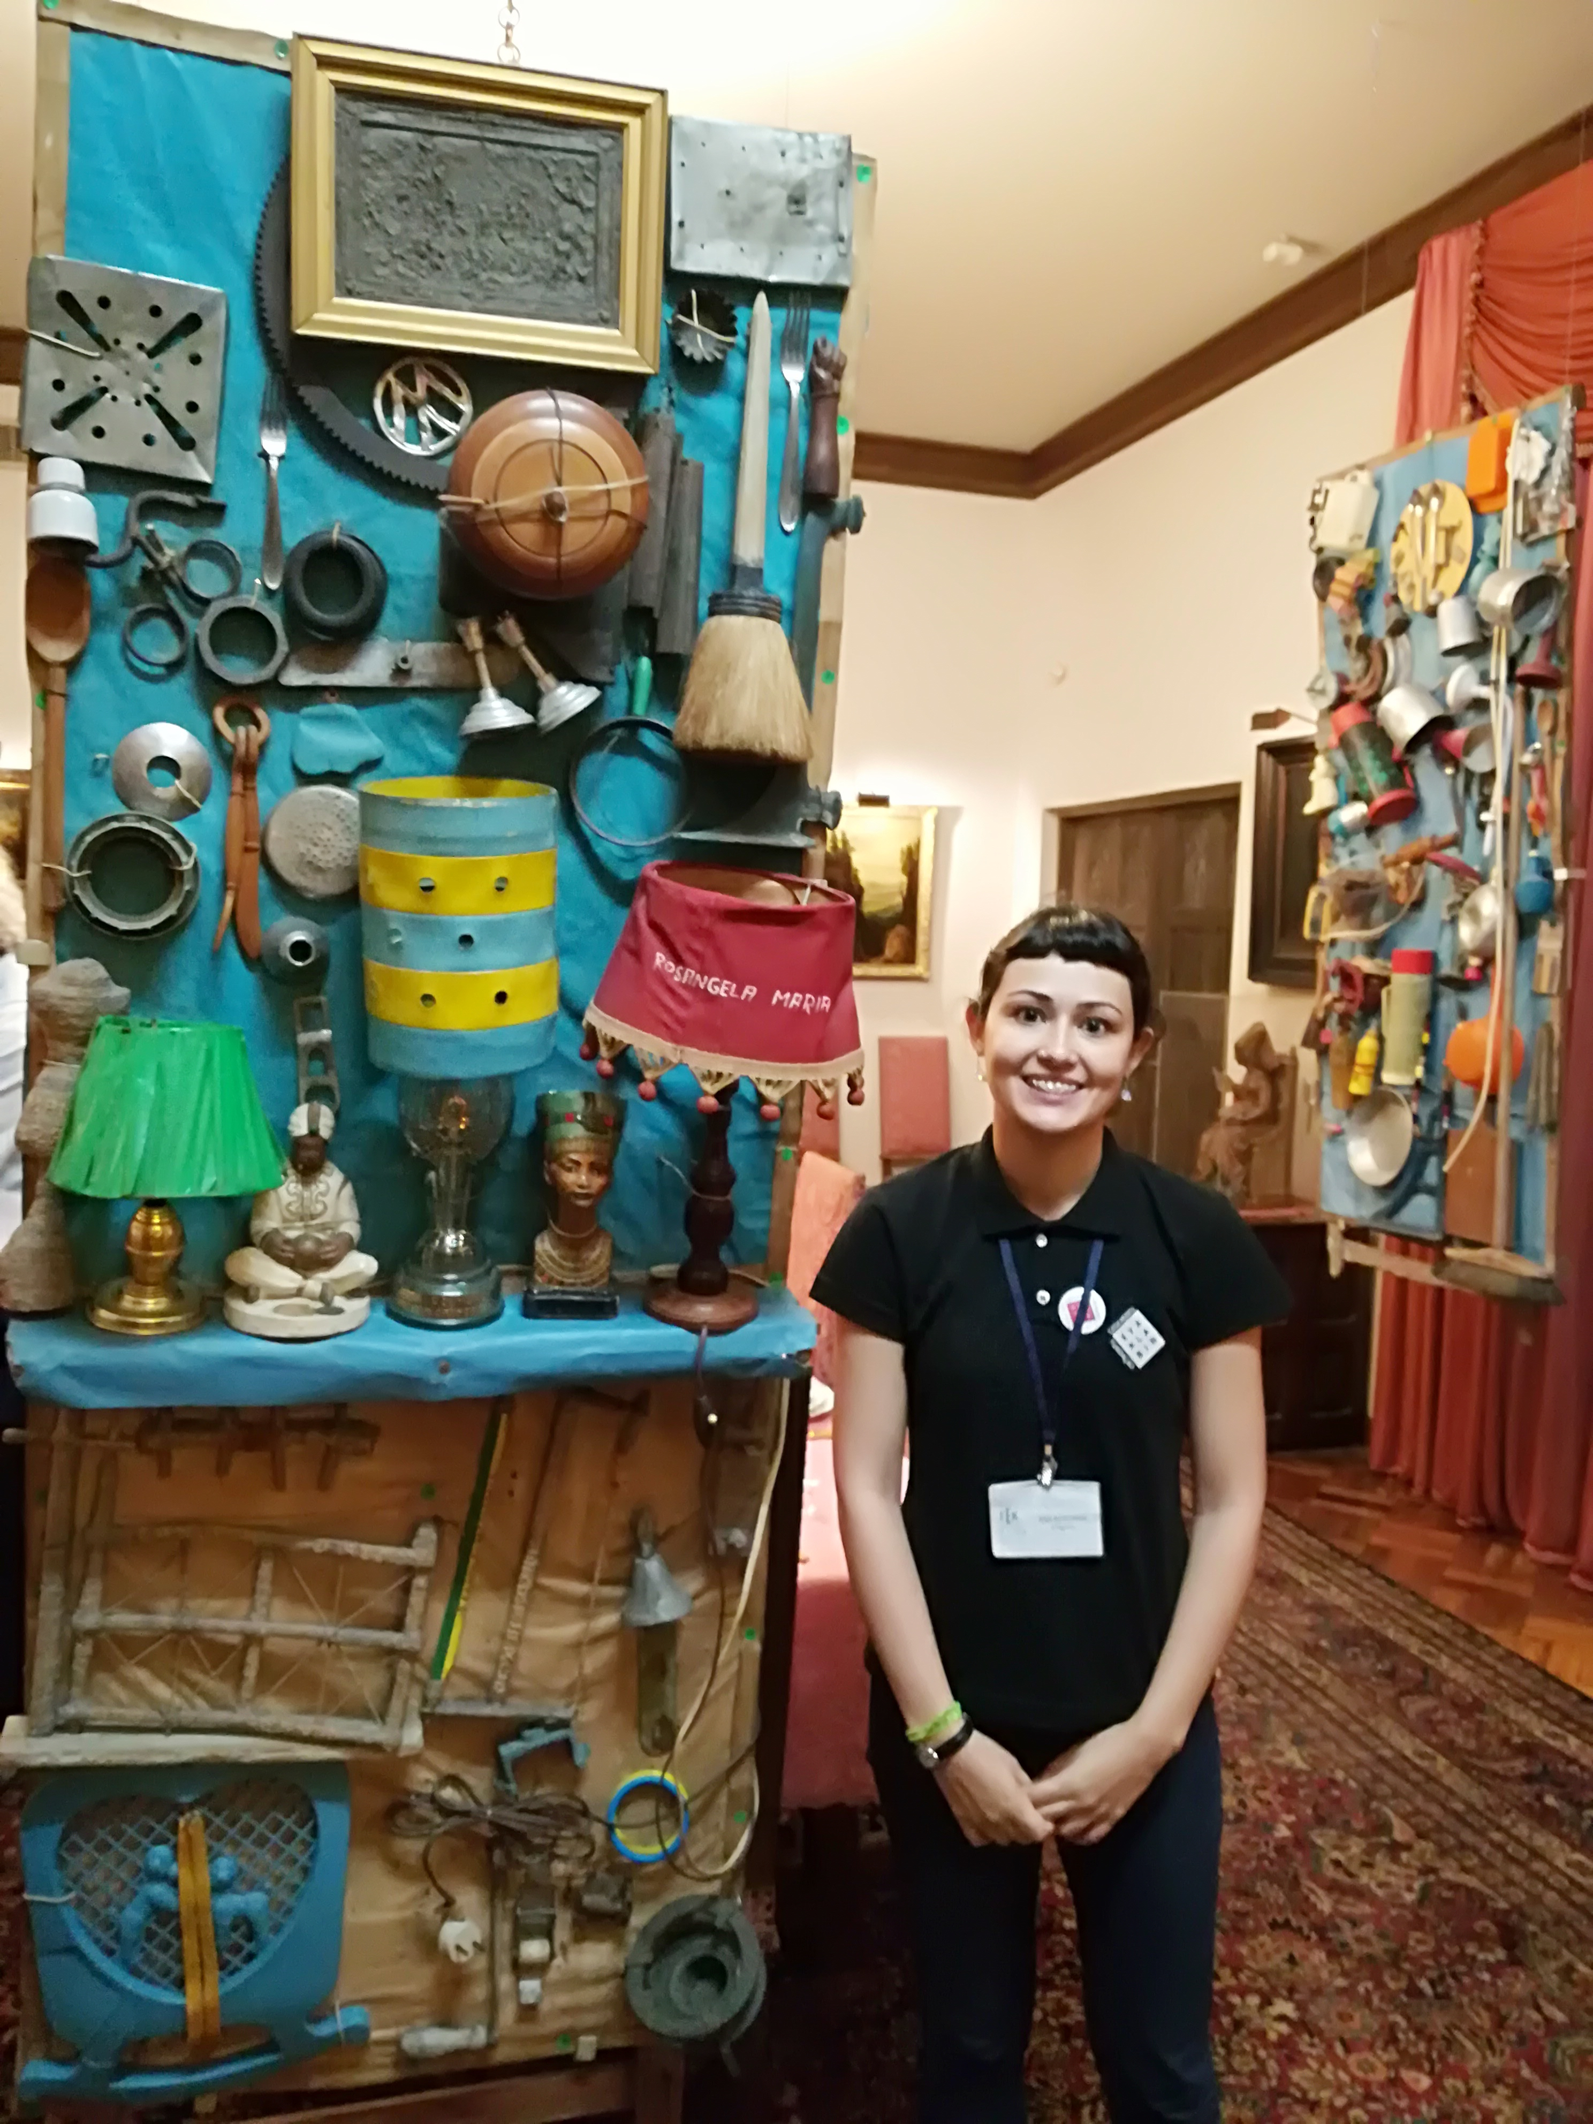
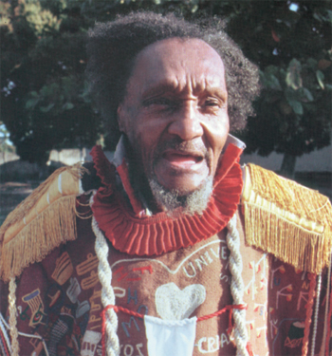
The parts and the Whole
Arthur Bispo’s (an outsider artist diagnosed with schizophrenia) output expressed his experience of the universe. He endlessly listed every single person he met, and his works incorporated every element he came across in his daily life.

Slide 28
Naming the whole
To consider the totality as a whole one possibility was listing everything it contained (the list could be more or less exhaustive)
Or else applying dual opposition following horizontal and vertical axes (terra firma/sea, sky/underground…)
Thus when the Bible names the outcome of creation it names «The Heavens and the Earth».
The biblical and homerical formula is actually older; perhaps the first used to designate the totality. It appears in Egyptian texts of the XXth century BCE.
The fluvial civilizations use also words to designate the idea of totality: tm, tamm, tamam, panta

Slide 29
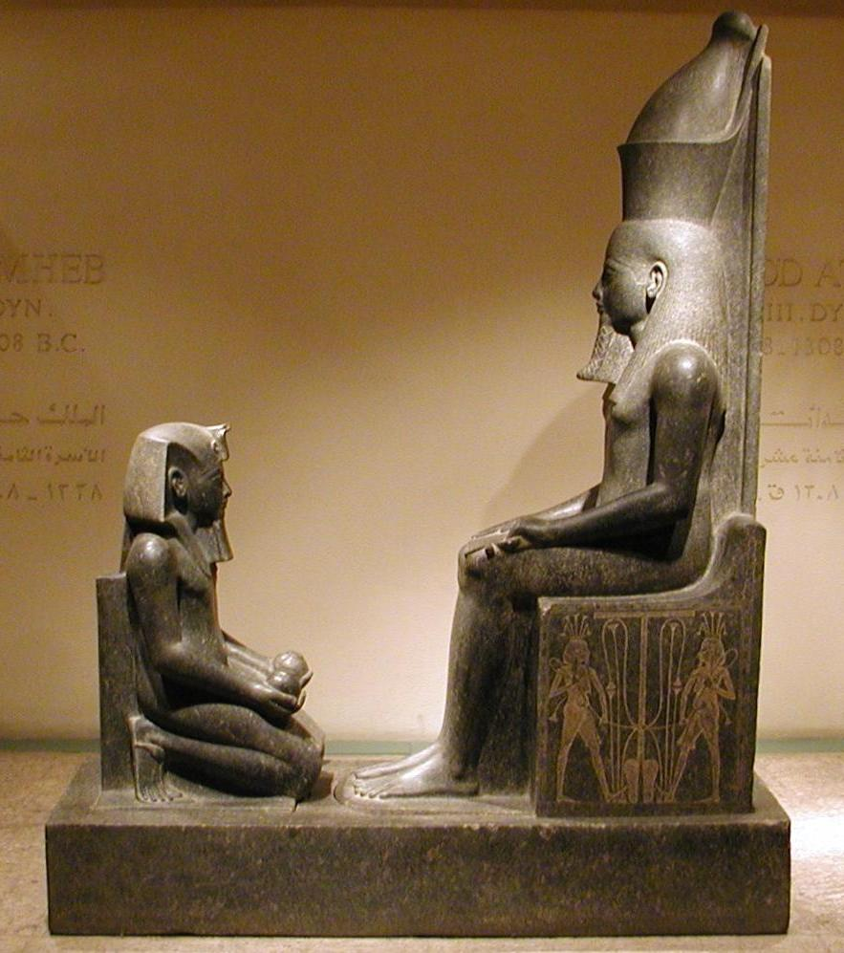
The Egyptians
Egyptian cosmogony: selfgenesis of the god Atum.
What he creates is everything: tm
A dynamical ethical cosmos. The human justice is by no means the imitation of a pre-existent cosmic order. On the contrary it is the role of the human justice to warrant the harmony between the sphere of the gods and that of the mankind, maintaining an unstable dynamical cosmic order.

Slide 30
An adjective is not a wor(l)d
All: tm, tamam, panta → Everything: ta panta (Hesiod, Heraclitus) to pan (Empedocles)
This totality, listed or substantivized into an adjective, is not yet a world.
What it lacks to the unity is, paradoxically, that there are too many things out there.
What prevented the rise of the idea of universe is not the incomplete nature of the list. The ancient civilizations extended the order too widely, encompassing the action of the gods and men.

Slide 31
An anti-anthropic principle
Also the very division of all of reality into the Earth and the Heavens prevents the concept from coming fully into being (although it prepares its emergence)
The implicit criterion behind is human: the Earth and the Heavens are opposed as the things that a man can, at least in principle, grasp and those which completely escape him. The world cannot appear as such until that criterion is put aside.
It is necessary, for the world to appear, that the organic unity linking it to one of its inhabitants be broken. The world as a totality unfolds in face of a subject, and the reality is firmly established as independent of him.
The subject does not belong to the world, but it is a limit of the world. L. Wittgenstein

Slide 32
Summary
The idea of a physical universe specified only by factors that relate to nature is in no way primitive.
Getting that idea took almost three millenaries (of the historic epoch)!

Slide 33
The Proper Name

Slide 34
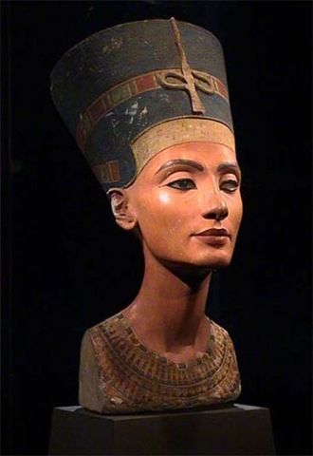
The proper noun: κόσμος
The Greeks gave the world a name in its own: kosmos (order), kata kosmon (in good order).
«Pythagoras was the first to call kosmos the encompassing of all things, because of the order that reigns in it» Aetius, Placita (1st century A.C.).
The Original sense of “woman’s ornament“ is metaphorically turned into order and beauty. More precisely, the beauty resulting from order (cosmetics). The usage was for a long time perceived as a metaphor. The “cosmic” unique usage took centuries to emerge.

Slide 35
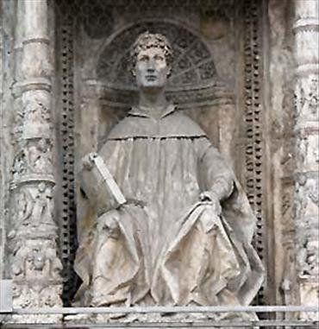
The proper noun: mundus
The cosmological meaning of the Latin word mundus (italian: monile - necklace) comes by by imitation of the Greek kosmos
Graeci nomine ornamenti appellavere eum et nos a perfecta absolutaque elegantia mundum. Caelum quidem haut dubie caelati argumento diximus.
What the Greek call kosmos [ornamenti] we call mundus due to its perfect and faultless elegance
Plinio il Vecchio, Naturalis Historia II, 7

Slide 36
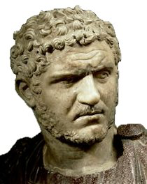
The other name: Universe
Universe comes from the latin universus: unus versus, ad unum vertere
Acre fluit frigus, non primam quamque solemus Particulam venti sentire, et frigoris ejus, sed magis unvorsum : fierique perinde videmus, Corpore tum plagas in nostro, tamquam aliquae res.
Lucrezio De Rerum Natura, Book IV

Slide 37
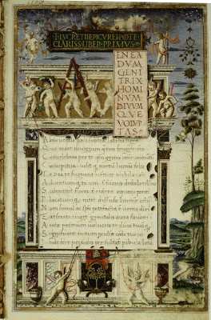
De Rerum Natura (1417)
Carmina sublimis tunc sunt peritura Lucreti, exitio terras cum dabit una dies. Ovidio
«The verses of the sublime Lucretius will perish only when a day will bring the end of the world.»

Slide 38
The other name: Universe
Universe monde (THOMAS DE KENT, Le Roman de toute chevalerie )
Nel suo profondo vidi che s'interna, legato con amore in un volume, ciò che per l'universo si squaderna.
(Dante Par. XXXIII, 85-87)

Slide 39
Emergency of the idea of cosmos The world as a choice
Heraclitus - Fragment 30: κόσμον τόνδε, τὸν αὐτὸν ἁπάντων, οὔτε τις θεῶν οὐτε ἀνθρώπων ἐποίησεν, ἀλλ' ἦν ἀεὶ καὶ ἔστιν καὶ ἔσται πῦρ ἀείζωον, ἁπτόμενον μέτρα καὶ ἀποσβεννύμενον μέτρα
The world, the same for all, neither any god nor any man made; but it was always and is and will be, fire ever-living, kindling in measures and being extinguished in measures.
Idea of a self-sustaining order totality, not requiring the intervention of any external influence. The word kosmos is already a cosmology.

Slide 40
O Guardador de Rebanhos Alberto Caeiro (heteronym of Fernando Pessoa - 1914)
Num dia excessivamente nítido, Dia em que dava a vontade de ter trabalhado muito Para nele não trabalhar nada, Entrevi, como uma estrada por entre as árvores, O que talvez seja o Grande Segredo, Aquele Grande Mistério de que os poetas falsos falam.
Vi que não há́ Natureza, Que Natureza não existe, Que há́ montes, vales, planícies, Que há́ árvores, flores, ervas, Que há́ rios e pedras, Mas que não há́ um todo a que isso pertença, Que um conjunto real e verdadeiro É uma doença das nossas ideias.
A Natureza é partes sem um todo. Isto é talvez o tal mistério de que falam.
Foi isto o que sem pensar nem parar, Acertei que devia ser a verdade Que todos andam a achar e que não acham, E que só́ eu, porque a não fui achar, achei.
On an incredibly clear day, The kind when you wish you'd done lots of work So that you wouldn't have to work that day, I saw – as if spotting a road through the trees – What may well be the Great Secret, That Great Mystery the false poets speak of. I saw that there is no Nature, That Nature doesn't exist, That there are hills, valleys and plains, That there are trees, flowers and grass, That there are rivers and stones, But that there is no whole to which all this belongs, That a true and real ensemble Is a disease of our own ideas.
Nature is parts without a whole. This is perhaps the mystery they speak of. This is what, without thinking or pausing, I realized must be the truth That everyone tries to find but doesn't find And that I alone found, because I didn't try to find it

Slide 41
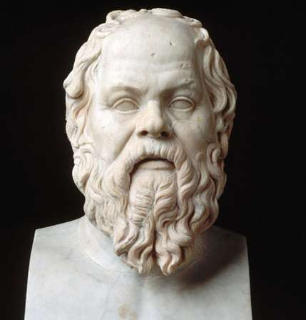
From Socrates…
[1] I have often wondered by what arguments those who drew up the indictment against Socrates could persuade the Athenians that his life was forfeit to the state. The indictment against him was to this effect: Socrates is guilty of rejecting the gods acknowledged by the state and of bringing in strange deities: he is also guilty of corrupting the youth.
[…]
[10] Socrates lived ever in the open: he was talking and anyone might listen. Yet none ever knew him to offend against piety and religion in deed or word.
[11] He did not even discuss that topic so favored by other talkers « the Nature of the Universe » and avoided speculation on the
so-called “Cosmos” of the Professors
(Sophistai)
how it works, and on the laws that govern the phenomena of the heavens: indeed he would argue that to trouble one's mind with such problems is sheer folly.

Slide 42
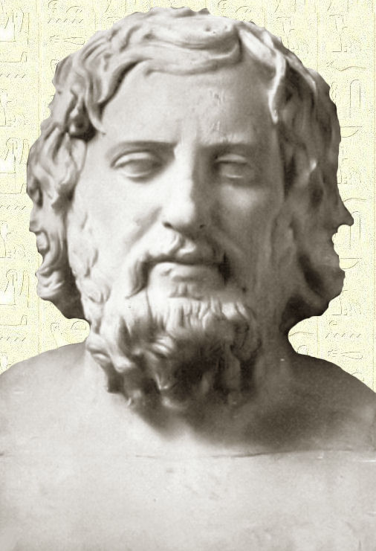
[12] In the first place, he would inquire, did these thinkers suppose that their knowledge of human affairs was so complete that they must seek these new fields for the exercise of their brains; or that it was their duty to neglect human affairs and consider only things divine?
[13] Moreover, he marveled at their blindness in not seeing that man cannot solve these riddles; since even the most conceited talkers on these problems did not agree in their theories, but behaved to one another like madmen.
Xenophon, Memorabilia, Book I (371 BC)

Slide 43
.. To Plato…
The word kosmos takes definitively the cosmic meaning.
Plato’s Timaeus: the first description of reality as forming an ordered whole, both good and beautiful.
«This world (hode ho kosmos) has thus become a visible living creature, embracing all that are visible and an image of the intelligible, a perceptible god, supreme in greatness and excellence, in beauty and perfection, this Heaven single in its kind and one». Conclusion of Timaeus
Kosmos has never designated a neutral description of reality but always translated a judgment of value, either positive or negative
Greek science was not only aware of the kosmos. The use of the very term constructed the kosmos as such, as a kosmos.
The sense of the world must lie outside the world. In the world everything is as it is and happens as it does happen. In it there is no value -- and if there were, it would be of no value. L. Wittgenstein

Slide 44
Theoretical Physics vs Astronomy
The task of the contemplation of nature (theoria phusikè) is to examine the substance of the sky and the stars, the power and the quality of generation and corruption, and, by Zeus! , it is capable of leading demonstrations on the subject of the size the form and the order of things.
As for astronomy (astrologia) it does not undertake to speak of anything like that, but it demonstrates the order (taxis) of celestial things, having declared that the sky (ouranos) is truly a cosmos; it speakes of forms, sizes, distances from the Terre to the Sun and the Moon, eclipses, conjunctions of stars, on the quality and quantity that are shown in their revolutions.
Posidonios, 2nd Century B.C.

Slide 45
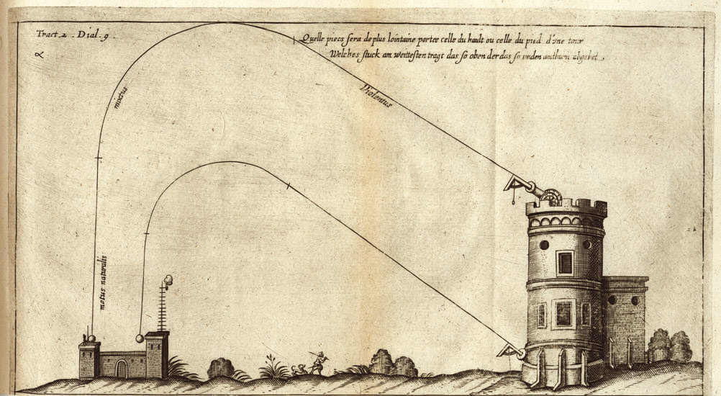
..to Aristotle
The law of falling bodies is at the heath of the organization of the cosmos and to its order.
Diego Ufano, Artillerie, 1628

Slide 46
Ipse dixit
Natural motion: the fall of heavy bodies and the ascent of the light ones is not caused by a strength, but by their tendency to go to their «natural place »
Violent motion: The movement of heavy bodies « against nature » (lifing, dragging..) is caused by a force
Celestial motion: The motion of the stars is neither directed towards a natural place nor caused by forces.

Slide 47
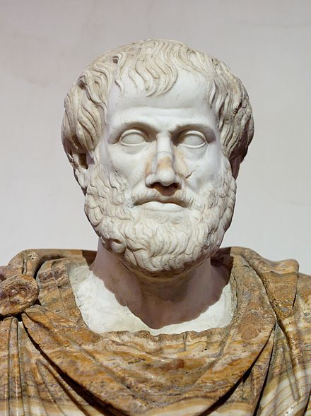
The cosmic order (350 BC- 1543 AD)
Distinction between linear and circular motions
Between the four terrestrial elements and the fifth celestial element (aether)
Between the terrestrial and the celestial spheres.
Negation of the vacuum and of the infinite
Assertion of the finiteness, uniqueness and incorruptibility of the cosmos

Slide 48
A new world
A big jump

Slide 49
1543 : A new cosmic order
…utrum mundus terra stante circumeat an mundo stante terra vertatur… Seneca
For a long time, then, I reflected on this confusion in the astronomical traditions concerning the derivation of the motions of the universe’s spheres. I began to be annoyed that the movements of the world machine, created for our sake by the best and most systematic Artisan of all, were not understood with greater certainty by the philosophers, who otherwise examined so precisely the most insignificant trifles of this world. For this reason I undertook the task of rereading the works of all the philosophers which I could obtain to learn whether anyone had ever proposed other motions of the universe’s spheres than those expounded by the teachers of as- tronomy in the schools. And in fact first I found in Cicero that Hicetas supposed the earth to move. Later I also discovered in Plutarch that certain others were of this opinion. I have decided to set his words down here, so that they may be available to everybody:
« Some think that the Earth remains at rest. But Philolaus the Pythagorean believes that, like the sun and moon, it revolves around the fire in an oblique circle. Heraclides of Pontus and Ecphantus the Pythagorean make the earth move, not in a progressive motion, but like a wheel in a rotation from west to east about its own center. » (Plutarque, De placitis philosophorum, 1. III, cap. 13.)
Copernicus De Revolutionibus

Slide 50
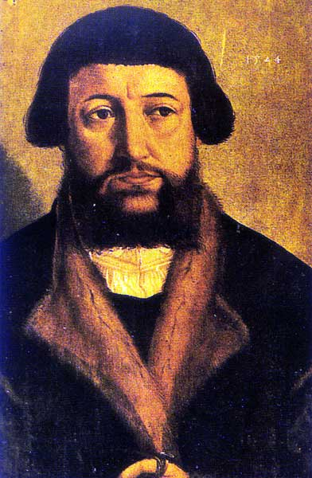
« Sauver les phénomènes »
For it is the duty of an astronomer to compose the history of the celestial motions through careful and expert study. Then he must conceive and devise the causes of these motions or hypotheses about them. Since he cannot in any way attain the true causes, he will adopt whatever suppositions enable the motions to be computed correctly from the principles of geometry for the future as well as the past. The present author has performed both these duties excellently. For these hypotheses need not to be true nor even probable. On the contrary, if they provide a calculus consistent with the observations that is enough Andrea Osiander 1543
Una epistola superliminare attaccata non so da chi asino ignorante e presuntuoso Giordano Bruno La cena delle Ceneri 1584

Slide 51
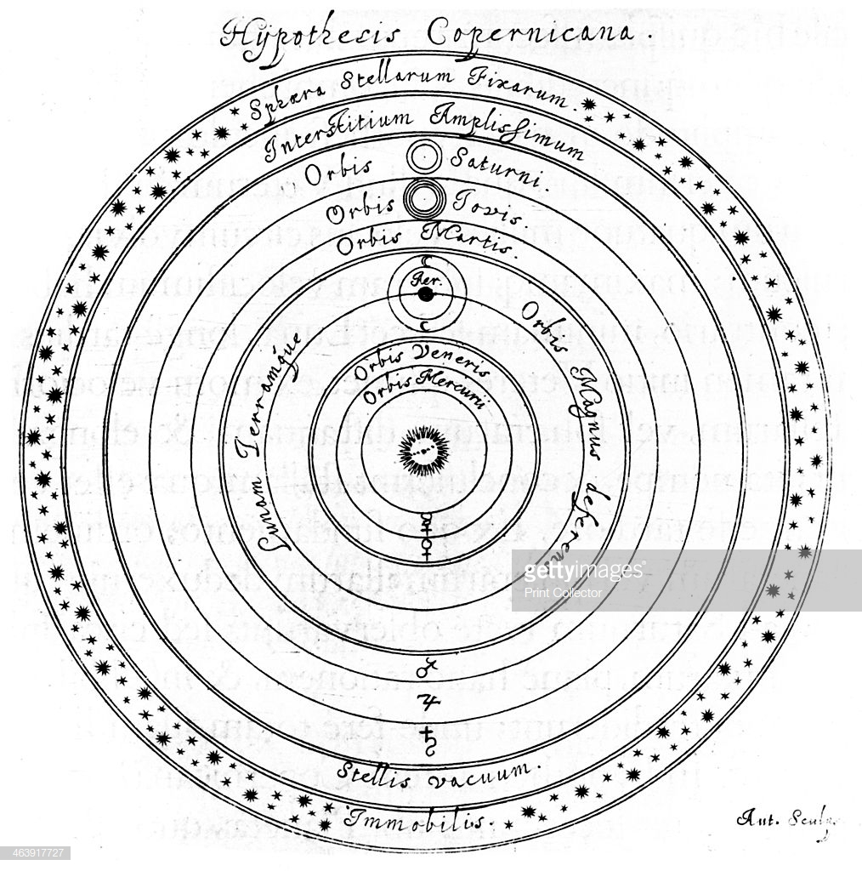
AΓΕΩΜΈΤΡΗΤΟΣ OUDEIΣ ΕΊΣΊΤΩ
Copernicus is neither Copernicannor a modern man.
The dynamics of Copernic has nothing modern.
His Universe is not infinite.
It as much limited as that of Aristotle and Ptolemy
The sun is at the center. Around the Sun are ranged the orbs carrying the planets, solid and real as those of the medieval astronomy.
However an abyss separates him from his contemporaries.
He applies to the Universe an aesthetic point of view: a geometrical aesthetics. Geometry transported the Earth in the Sky

Slide 52
But: new old questions
What is gravity ?
Why bodies fall on the surface of the moving Earth ?
What moves the planets?
Why the stay on their orbits?
How big is the universe?
What is the place of the mankind in nature?
When one touches a key points of a system it may cause the destruction of the whole system. Earth’s motion was one of those key points.

Slide 53
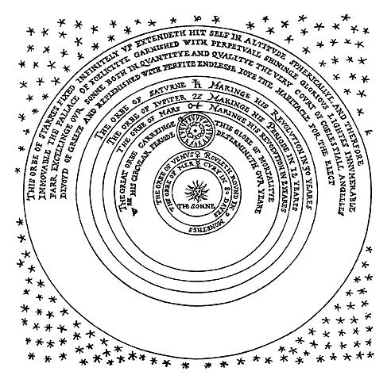
An indefinite universe (Digges)

Slide 54
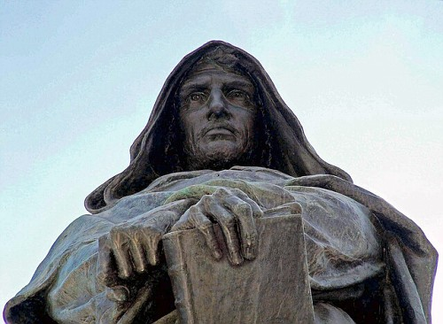
An infinite universe without centre
Questa e’ una filosofia che apre gli sensi, contenta il spirito, magnifica l’intelletto e riduce l’uomo alla vera beatitudine che puo provare come uomo
Giordano Bruno
La Cena delle Ceneri
Or ecco quello, ch'ha varcato l'aria, penetrato il cielo, discorse le stelle, trapassati gli margini del mondo, fatte svanir le fantastiche muraglia de le prime, ottave, none, decime ed altre, che vi s'avesser potuto aggiongere, sfere, per relazione de vani matematici e cieco veder di filosofi volgari…
Giordano Bruno, La Cena delle Ceneri

Slide 55
De l’infinito, universo et mondi (1584)
“Il mondo essere infinito, e però non essere corpo alcuno in quello al quale simplicemente convenga essere nel mezzo o nell’estremo, o fra que’ due termini…
Cotal spacio lo diciamo infinito, perché non v’è raggione, convenienza, possibilità, senso o natura che debba finirlo …(Principle of sufficient reason)
La Terra dunque non è absolutamente in mezzo dell’universo, ma al riguardo di questa nostra regione…
Così si magnifica l’eccellenza di Dio, si manifesta la grandezza dell’imperio suo: non si glorifica in uno, ma in Soli innumerevoli; non in una terra, in un mondo, ma in duecentomila, dico in infiniti".

Slide 56
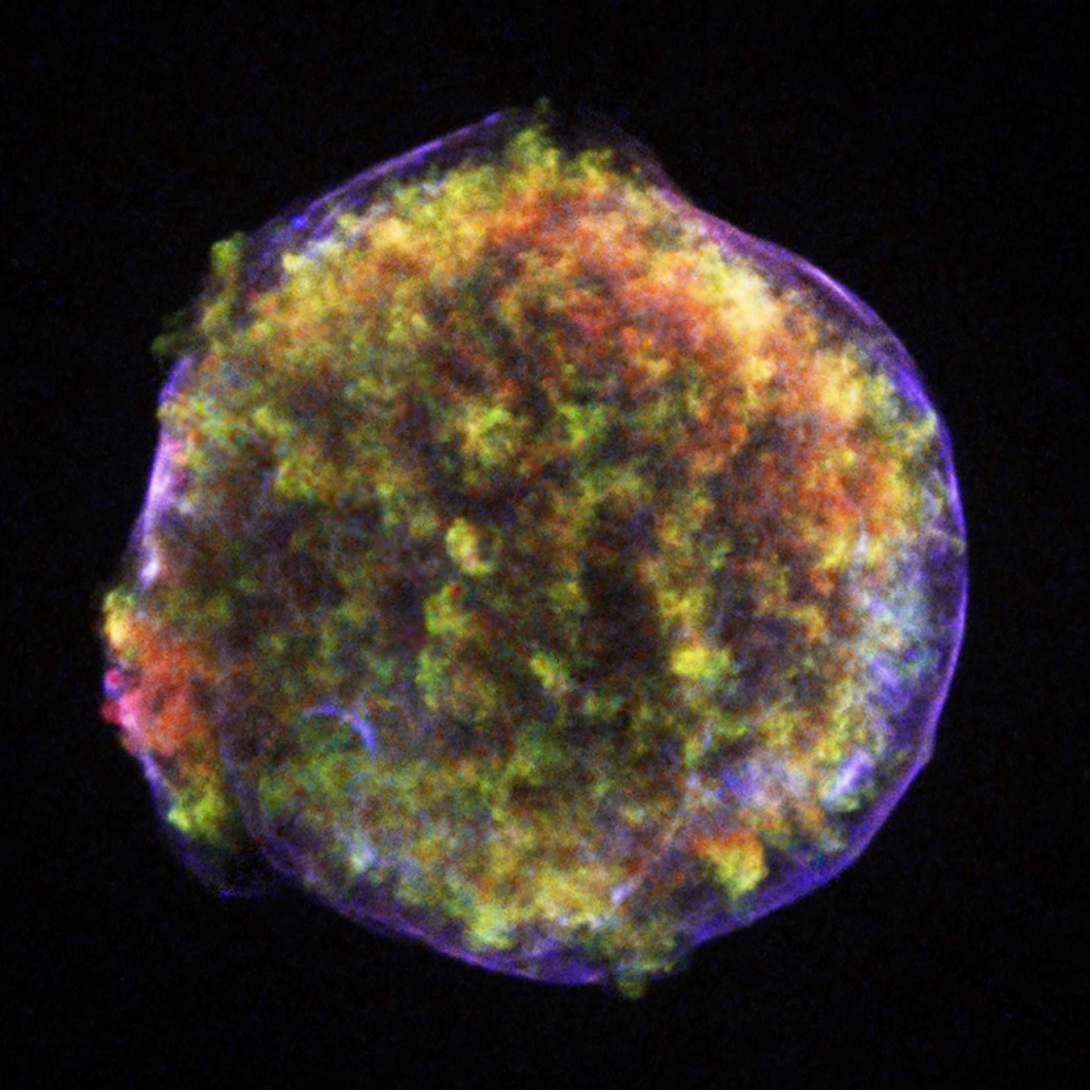
Tycho’s Supernova 1572

Slide 57
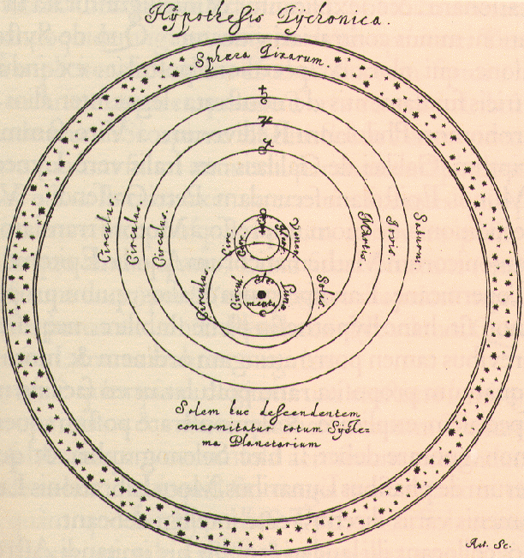
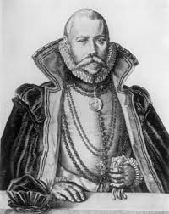
There is no sphere!
The stella nova was not a comet.
Heavens were not unchanging but varying !
All the comets which I have observed move in the ethereal region of the world and never in the sublunary region as Aristotle and his followers wanted us to believe for many centuries!
The reality of all the celestial spheres must be excluded
Comets act in contradiction with them
The spheres do not really exist, the sky is free, open in all the directions, there is no obstacle to the course of the planets

Slide 58
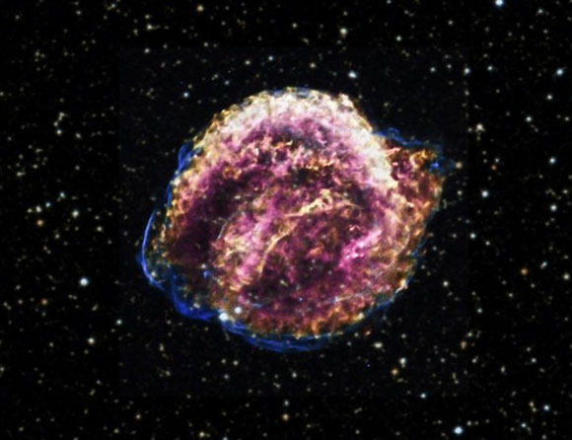
Keplero’s Supernova 1604

Slide 59
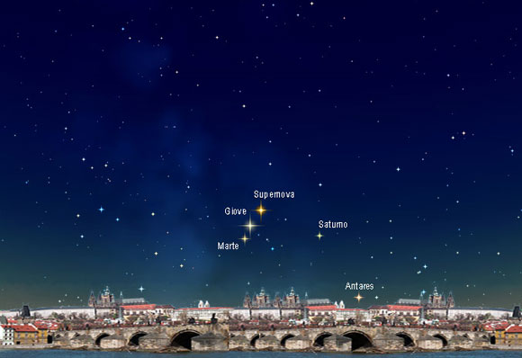
Keplero’s Supernova 1604

Slide 60
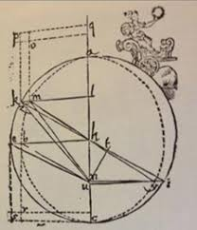
Astronomia nova (1609)
Kepler publishes the study of the orbit of Mars which Tycho had assigned to him in 1601.
The book contains the first two Kepler’s laws.
The Sun (and no imaginary point close to the Sun) occupies a central position causes the motion of the Planets by a quasi-magnetic force.
The orbit is an ellipse and the Sun occupy one of the foyers.
It is the definitive rupture with the Aristotelian system.

Slide 61
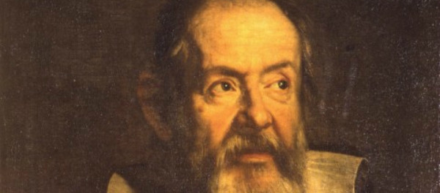
What about the revolution?
1543 -> 1616. Condemnation of Copernicus.
Why this delay?
It was necessary to wait for a new physics (gravitation)
It was necessary to wait for Galileo, the first among the moderns

Slide 62
More geometrico
Aristotle’s physics looks for a rational explanation of the regularities of the sublunary sphere. But geometry is absent in this physics.
The geometry cannot apply to things of the sublunary world. It would be an unacceptable and inconceivable reconciliation between the Earth, place of the corruptible and of the variable, and the perfection of the Skies.
The Copernican revolution operates the decentralization which overturns everything and open possibilities remained invisible for a long time.

Slide 63
In lingua mathematica
«La filosofia è scritta in questo grandissimo libro che continuamente ci sta aperto innanzi a gli occhi (io dico l'universo), ma non si può intendere se prima non s'impara a intender la lingua, e conoscer i caratteri, ne' quali è scritto. Egli è scritto in lingua matematica, e i caratteri son triangoli, cerchi, ed altre figure geometriche, senza i quali mezi è impossibile a intenderne umanamente parola; senza questi è un aggirarsi vanamente per un oscuro laberinto »
Philosophy is written in this grand book — I mean the universe — which stands continually open to our gaze, but it cannot be understood unless one first learns to comprehend the language in which it is written. It is written in the language of mathematics, and its characters are triangles, circles, and other geometric figures, without which it is humanly impossible to understand a single word of it; without these, one is wandering about in a dark labyrinth.

Slide 64
Galileo principle
In the presence of the Grand Duke, Galilee makes the experiment of the falling bodies from the Leaning Tower of Pisa.
Palazzo Pitti, Tempera su muro, 1816.

Slide 65
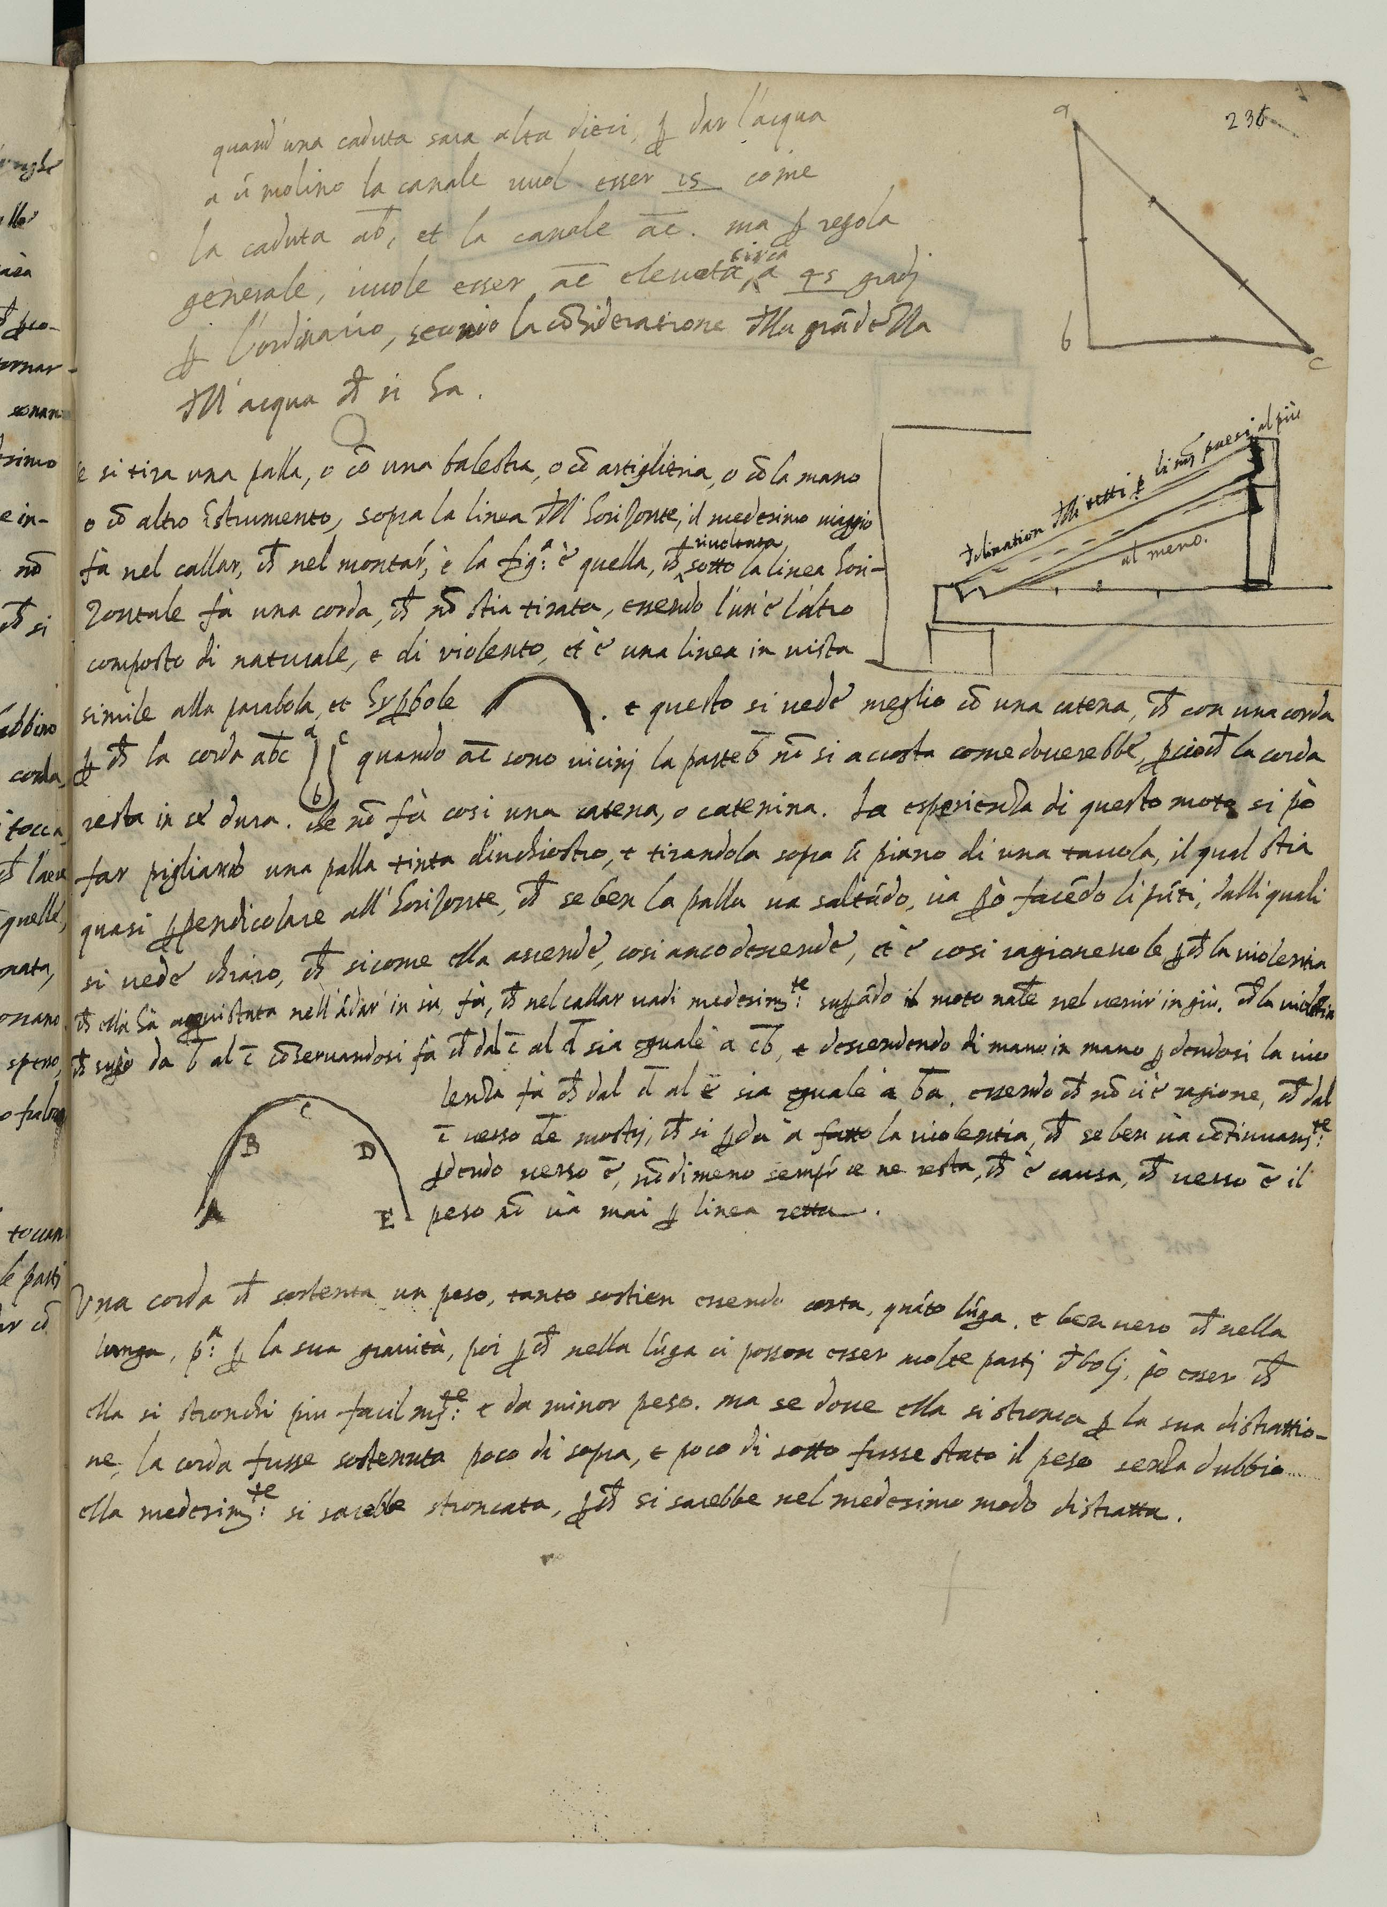
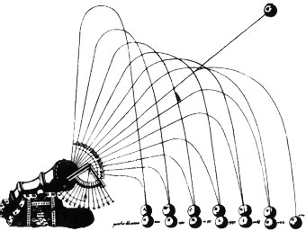
1592
While traveling towards Padua Galileo meets Guidobaldo del Monte. They together make experiments on the motion of projectiles.
The result is a symmetric trajectory looking like a catenary, the shape of a suspended chain, similar to a parabola or a hyperbole.

Slide 66
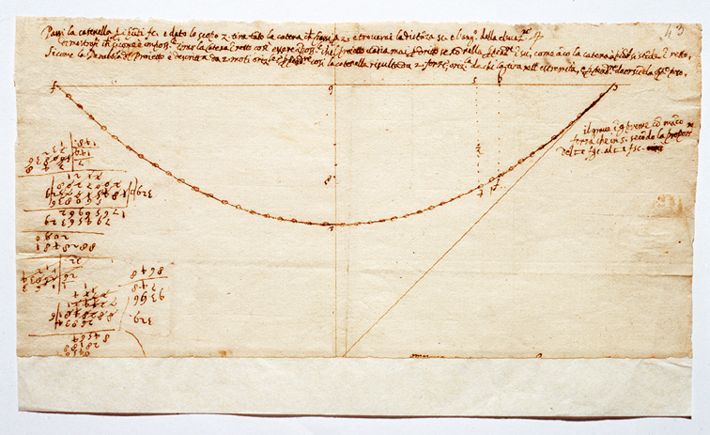
The Heavens on the Earth
Galileo Galilei, Ms Gal 72, f. 43r

Slide 67
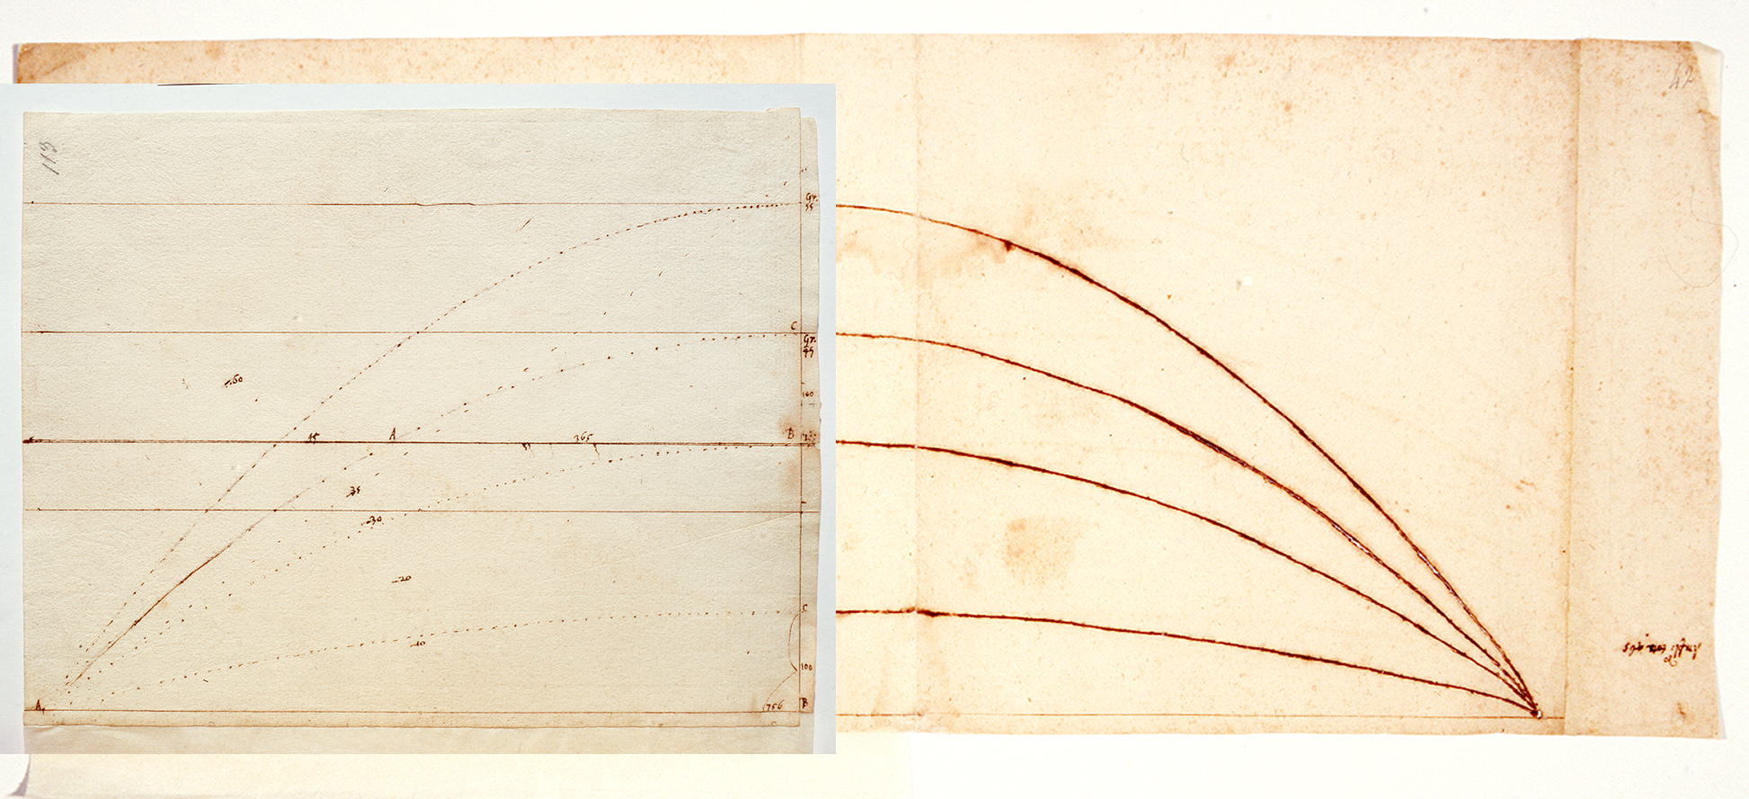
The Heavens on Earth
Curvilinear trajectory of a shot fired from a cannon,
drawn using the trace of a catenary
Galileo Galilei, Ms Gal. 72, f. 113r und 41v/42r

Slide 68
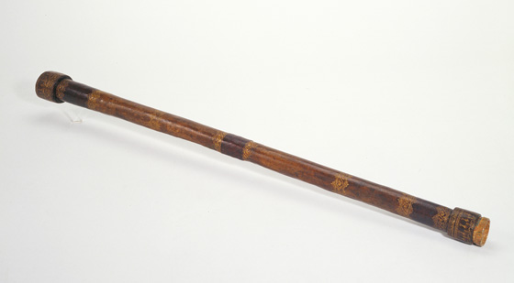
The Earth in the Heavens
Galileo mostra il cannocchiale al Doge di Venezia,
Pisa, Biblioteca Universitaria, olio su tela, 1846.

Slide 69
Things Never Seen Before
January 7, 1610
Galileo sees for the first times
Giove accompagnato da
tre stelle fisse,
totalmente invisibili
per la loro picciolezza.
In the following days Galileo will see that they are not new fixed stars but that they turn around Jupiter
Jupiter and the Astri Medicei.
Photos: Galileo Mission

Slide 70
The back of an envelop
All’Ill.mo Ecc.mo Sig. Galileo Galilei
Matematico di Padova da S. Sagredo (Aleppo)

Slide 71
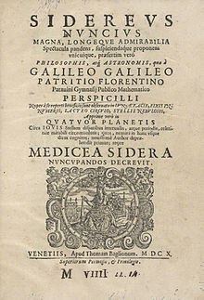
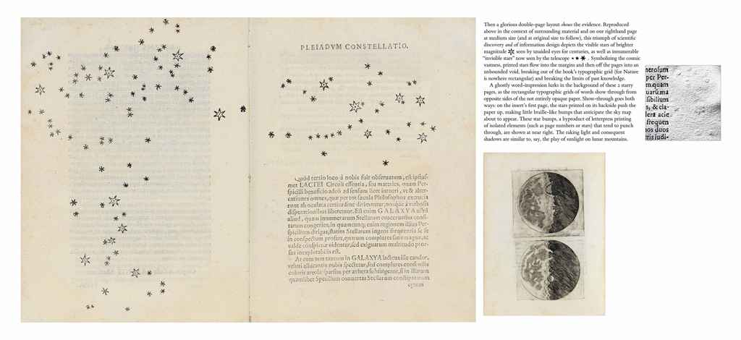
Sidereus Nuncius
CHRISTIE’s
GALILEI, Galileo (1564-1642).
Sidereus nuncius magna,
longeque admirabilia spectacula pandens.
Venice: Tommaso Baglioni, 1610.
Price realised
USD 662,500

Slide 72
Sidereus Nuncius
In this little treatise I am presenting to all students of nature great things to observe and to consider. Great as much because of their intrinsic excellence as of their absolute novelty, and also on account of the instrument by the aid of which they have made themselves accessible to our senses. […]
Any one can know with the certainty of sense-perception that the moon is by no means endowed with a smooth and polished surface, but with a rough and uneven one, and, just like the face of the earth itself, is everywhere full of enormous swellings, deep chasms and sinuosities . […]

Slide 73
The birth of modern science
But what by far surpasses all admiration, and what in the first place moved me to present it to the attention of astronomers and philosophers, is this: namely, that we have discovered four planets, neither known nor observed by any one before us, which have their periods around a certain big star of the number of the previously known ones, like Venus and Mercury around the sun, which sometimes precede it and sometimes follow it, but never depart from it beyond certain limits. All this was discovered and observed a few days ago by means of the perspicilli invented by me through God's grace previously illuminating my mind.

