Slide 1
A SHORT HISTORY
OF THE
COSMOLOGICAL THINKING II
Cargese, September 4, 2018
Ugo Moschella
Università dell’Insubria
(Como - Italia)

Slide 2
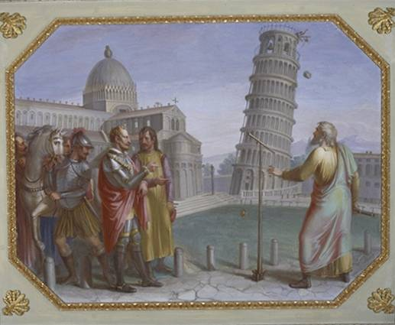
Galileo
Galileo principle
In the presence of the Grand Duke, Galilee makes the experiment of the falling bodies from the Leaning Tower of Pisa.
Palazzo Pitti, Tempera su muro, 1816.

Slide 3
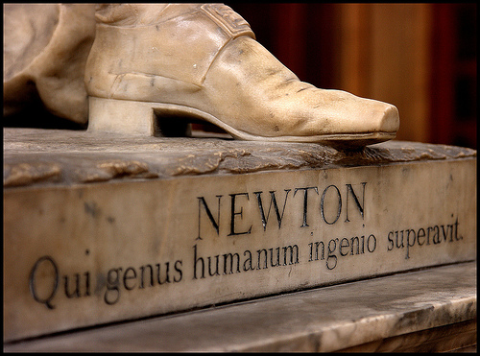
Newton
Louis Francois Roubiliac : Isaac Newton
Cambridge, Trinity College:(1755)

Slide 4
Space and time: Newton
Newton brings the discussion about the nature of space and time inside the philosophia naturalis, the natural science.
The first book of his Philosophiae naturalis principia mathematica, starts with the Definitiones which clarify the notions of the three elements composing the universe:
Space, Matter and Movement.
The discussion is still open!!
(Your idea here – but before you need to know what the great men said about it)

Slide 5
Space and time: Newton
I do not define time, space, place, and motion as being well known to all. Only I must observe that the vulgar conceive those quantities under no other notions but from the relations they bear to sensible objects. And thence arise certain prejudices, for the removing of which, it will be convenient to distinguish them into absolute and relative, true and apparent, mathematical and common.
They could as well be called “intelligible” time and space in contradistinction to “sensible”.
Newton's natural philosophy, stands or falls with the concepts of absolute time and absolute space.

Slide 6
Space and time: Newton
Philosophiae Naturalis Principia Mathematica:
Absolute, true and mathematical time, of itself and from its own nature, flows equably without regard to anything external [. . .] relative, apparent and common time, is some sensible and external (whether accurate or unequable) measure of duration by the means of motion, which is commonly used instead of true time: such as an hour, a day, a month, a year.
Absolute space, in its own nature, without regard to anything external, remains always similar and immovable.
They are not, as Descartes says, something which pertain only to the external material world and which would not exist if there were no such world but something which have their own nature

Slide 7
Philosophical rule III
The qualities of bodies, which admit neither intensification nor remission of degrees, and which are found to belong to all bodies within the reach of our experiments, are to be esteemed the universal qualities of all bodies whatsoever.
That all bodies are movable and endowed with certain powers (which we call the inertia) of persevering in their motion, or in their rest, we only infer from the like properties observed in the bodies which we have seen. […]
Not that I affirm gravity to be essential to bodies; by their vis insita I mean nothing but their inertia. This is immutable. Their gravity is diminished as they recede from the earth.
Consequence: a single body in an otherwise empty universe possesses inertia, a metaphysical claim which plays a crucial role in favor of the existence of absolute space. Only by introducing "absolute space” Newton succeeded in distinguishing between the kinematical and the dynamical aspects of motion.
But there is a disturbing asymmetry : inertial mass is a property that can also be ascribed to a single body in an otherwise empty universe, whereas gravitational mass can only be conceived as a property of a system (in spite of their equality!)

Slide 8
Where is absolute space?
Absolute motion is “very difficult” to be seen.
Space is inaccessible to senses. We perceive things in space, their relative motions, not their absolute motions w.r.t. absolute space.
The status of motion is (as in the fundamental case of uniform, rectilinear, inertial motion) absolutely indistinguishable from the status of rest.
It is indeed a matter of great diffculty to discover and effectively to distinguish the true motions of particular bodies from the apparent, because the parts of that immovable space in which those motions are performed do by no means come under the observation of our senses . […]
The effects which distinguish absolute from relative motion are the forces of receding from the axis of circular motion. For there are no such forces in a circular motion purely relative, but in a true and absolute circular motion they are greater or less, according to the quantity of the motion
Newton, Principia

Slide 9
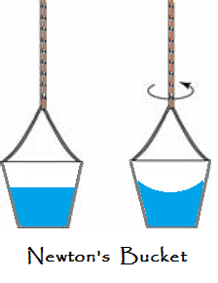
The bucket
If a vessel, hung by a long cord, is so often turned about that the cord is strongly twisted, then filled with water, and held at rest together with the water; after, by the sudden action of another force, it is whirled about in the contrary way, and while the cord is untwisting itself, the vessel continues for some time this motion; the surface of the water will at first be plain, as before the vessel began to move; but the vessel by gradually communicating its motion to the water, will make it begin sensibly to revolve, and recede by little and little, and ascend to the sides of the vessel, forming itself into a concave figure...This ascent of the water shows its endeavour to recede from the axis of its motion; and the true and absolute circular motion of the water, which is here directly contrary to the relative, discovers itself, and may be measured by this endeavour. ... And therefore, this endeavour does not depend upon any translation of the water in respect to ambient bodies, nor can true circular motion be defined by such translation. ...; but relative motions...are altogether destitute of any real effect..
Newton, Principia

Slide 10
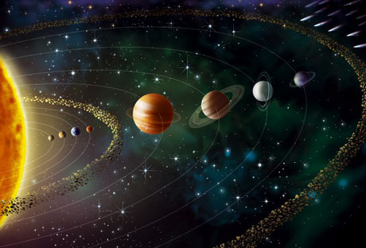
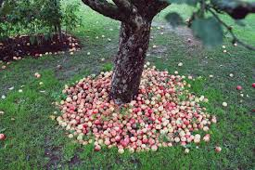
The Earth and the Heavens
In the third book of Principia, Newton expresses the law of universal gravitation. This law applies to the apple which falls on the Earth (and to the Earth which falls on the apple) and to the Moon which falls around the Earth and to the planets to that turn around the Sun. Newton achieves the project of unification of Galileo and abolishes the principle of a substantial difference between Heaven and Earth.
Even better: a single law is enough to account for a wide variety of phenomena.

Slide 11
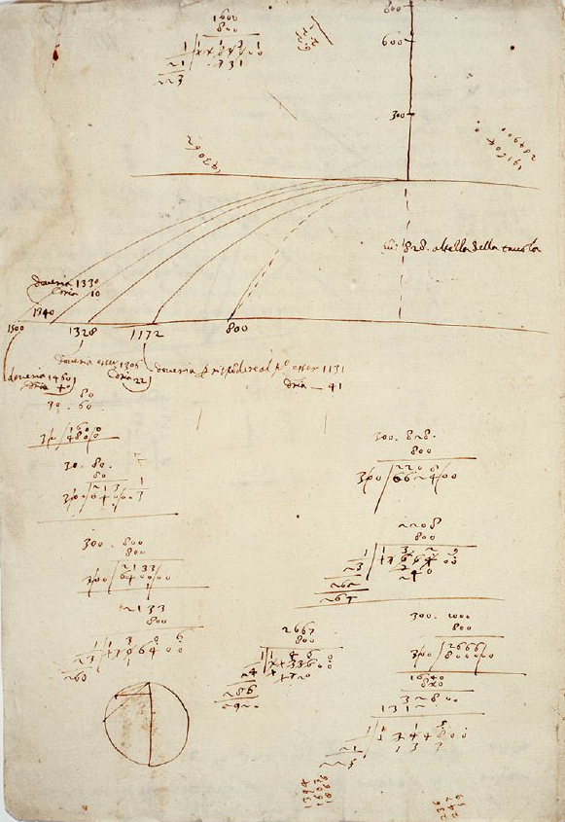
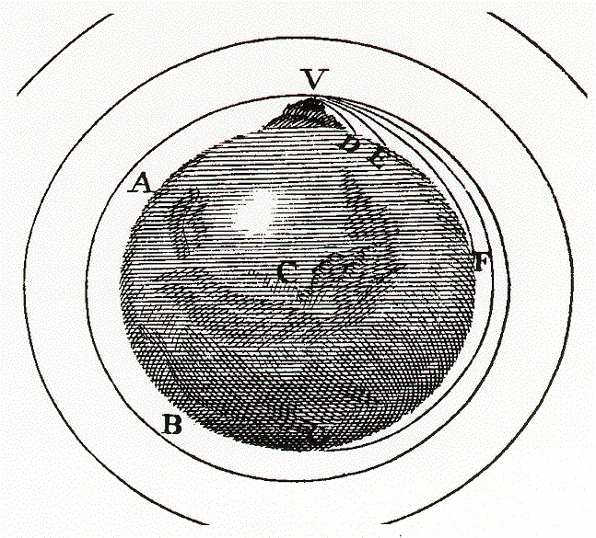
Projectiles and orbits

Slide 12
But, what is gravity?
You sometimes speak of gravity as essential and inherent to matter. Pray do not ascribe that notion to me, for the cause of gravity is what I do not pretend to know and therefore would take more time to consider of it.
It is inconceivable that inanimate brute matter should, without mediation of something else which is not material, operate upon and affect other matter without mutual contact, as it must be if gravitation, in the sense of Epicurus, be essential and inherent in it. And this is one reason why I desired you would not ascribe innate gravity to me. That gravity should be innate, inherent, and essential to matter, so that one body may act upon another at a distance through a vacuum, without the mediation of anything else, by and through which their action and force may be conveyed from one to another, is to me so great an absurdity that I believe no man who has in philosophical matters a competent faculty of thinking can ever fall into it.
Newton. Second letter to Richard Bentley

Slide 13
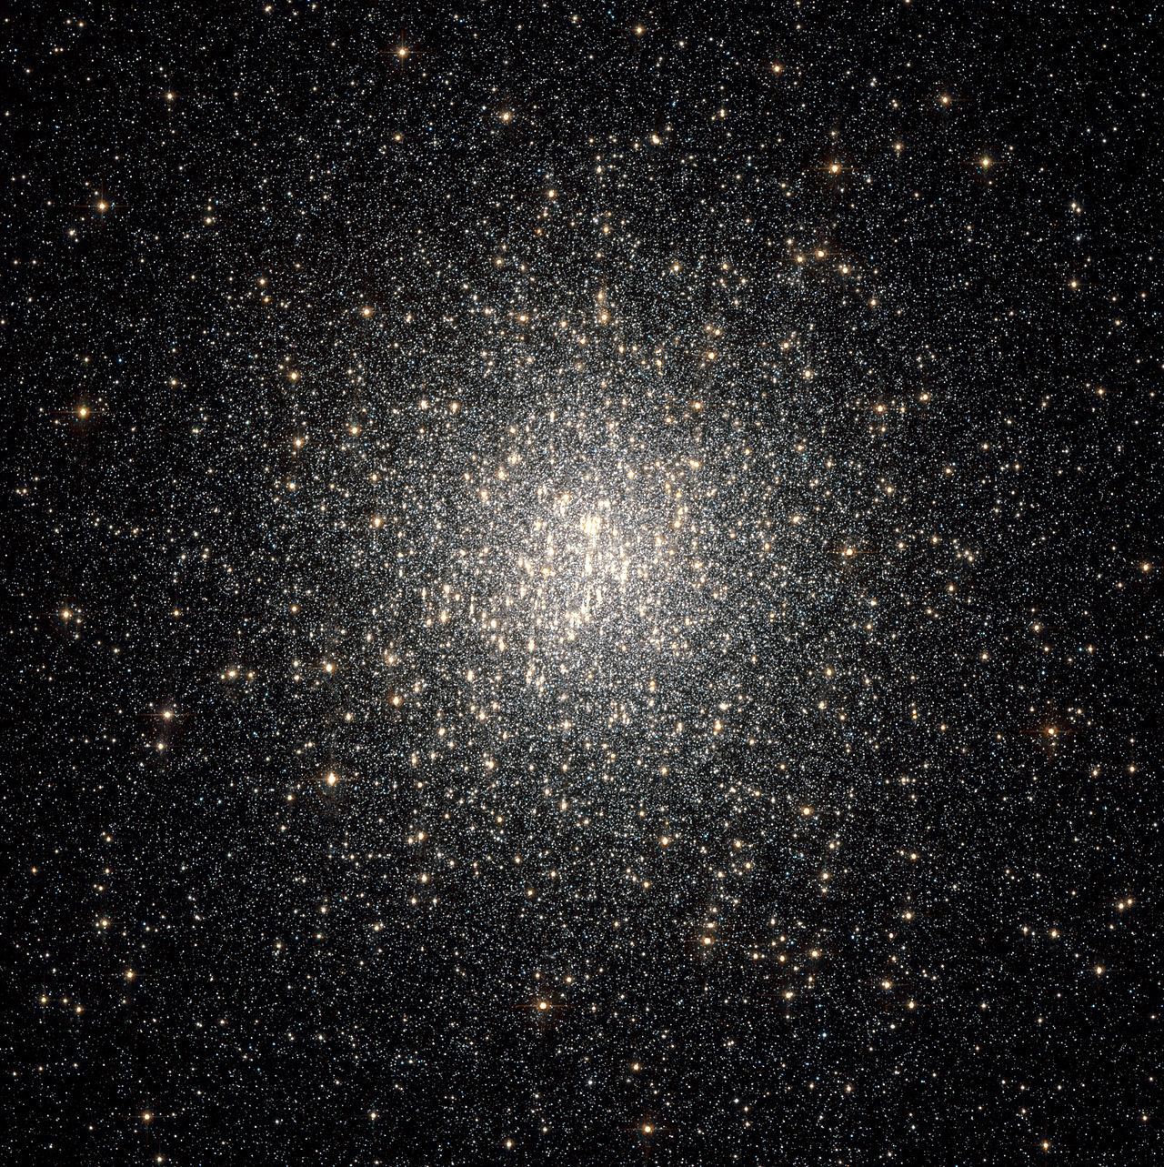
Bentley and Newton’s cosmology
Newton’s law of universal gravitation doesn't succeed in explaining the observed structure of the universe.
A finite Newtonian universe would not escape the gravitational collapse (Letter to Richard Bentley 1756).
The answer of Newton was to postulate an infinite universe in which the gravitational attraction of the stars was annulled by opposite attractions

Slide 14
Newton to Bentley about infinity
As to your first query, it seems to me that if the matter of our sun and planets and all the matter in the universe were evenly scattered throughout all the heavens, and every particle had an innate gravity toward all the rest, and the whole space throughout which this matter was scattered was but finite, the matter on the outside of the space would, by its gravity, tend toward all the matter on the inside, and by consequence, fall down into the middle of the whole space and there compose one great spherical mass. But if the matter was evenly disposed throughout an infinite space, it could never convene into one mass; but some of it would convene into one mass and some into another, so as to make an infinite number of great masses, scattered at great distances from one to another throughout all that infinite space. And thus might the sun and fixed stars be formed, supposing the matter were of a lucid nature

Slide 15
Edmund Halley 1721
A finite system would be surrounded by an “infinite inane.” But if the whole be Infinite, all the parts of it would be nearly in equilibrio, and consequently each fixt Star, being drawn by contrary Powers, would keep its place; or move, till such time, as, from such an equilibrium, it found its resting place; on which account, some, perhaps, may think the Infinity of the Sphere of Fixt Stars no very precarious Postulate.
Halley thought that the equilibrium of an infinite and uniform universe is stable. Newton in his letters to Bentley was under no such illusion: the equilibrium of an infinite and uniform universe is unstable like that of needles standing poised on their points.

Slide 16
A puzzle
Why did Newton change from the Stoic to the Epicurean system? He could have achieved an equilibrium state in the Stoic system by assuming that all stars have motion, thus anticipating the idea of a rotating Milky Way later proposed by Wright.
Newton said that a sidereal system would collapse into its middle were it of finite size. He ignored the possibility of random or systematic motion. Yet the concept of dynamic equilibriumwas not ahead of Newton's time.

Slide 17
De Rerum Natura (again)
Moreover, if all the space in the whole universe were shut in on all sides, and were created with borders determined, and had been bounded, then the store of matter would have flowed together with solid weight from all sides to the bottom, nor could anything be carried on beneath the canopy of the sky, nor would there be sky at all, nor the light of the sun, since in truth all matter would lie idle piled together by sinking down from limitless time. But as it is, no rest, we may be sure, has been granted to the bodies of the first-beginnings because there is no bottom at all whither they may, as it were, flow together and make their resting place. All things are forever carried on in ceaseless movement from all sides, and bodies of matter are stirred up and supplied from beneath out of limitless space.

Slide 18
Galileo about infinity
Many and subtle reasons are given for each of these views but none of them, to my mind, leads to a necessary conclusion so that I remain in doubt about which of the two answers is the true one. There is only one particular argument of mine that inclines me more to the infinite and interminate than to the terminate (note that my imagination is of no help here since I cannot imagine it either finite or infinite) : I feel that my incapacity to comprehend might more properly be referred to incomprehensible infinity, rather than to finiteness, in which no principle of incomprehensibility is required. But this is one of those questions happily inexplicable to human reason, and similar perchance to predestination, free-will and such others in which only Holy Writ and divine revelation can give an answer to our reverent remarks.

Slide 19
Kepler: an infinite prison
(no way to escape)
“A secret horror never felt before: one feels lost in that immensity to which limits and center are denied, to which consequently every determined place is denied”
“If you, Galilei, had discovered any planets revolving around one of the fixed stars there would be now waiting for me chains and a prison amid Bruno’s innumerabilities, I should rahter say, the exile to his infinite space”
Dissertatio cum Nuncio Sidereo (1610)

Slide 21
A lost world
The long use of world (mundus) to mean an object so patterned and unified as the geocentric kosmos went so far as to disqualify it as a name for what we now call “universe”. When once the old model is broken, we become aware that a detailed knowledge of the Region of all regions will be forever unattainable. We now need a word not for some specific and imaginable object but for “ whatever the totality may be ”, and universe is such a word. Furthermore, the same process which broke the old model threw a new meaning on world which, while it lasted, made it impossible, without grave inconveniences, to call the totality the world
C.S Lewis Studies in Words (1960)

Slide 22
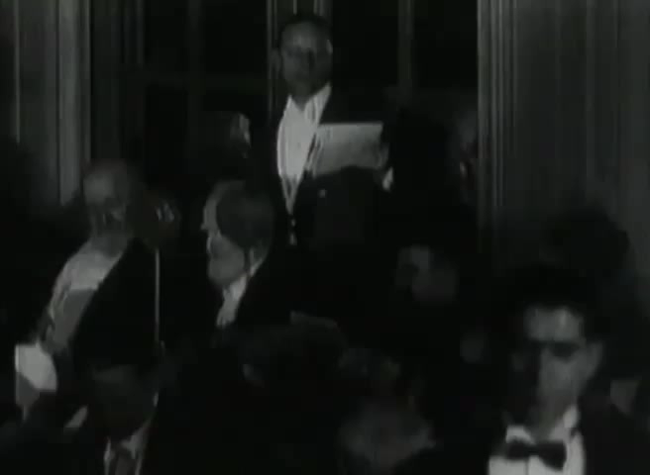

Slide 23
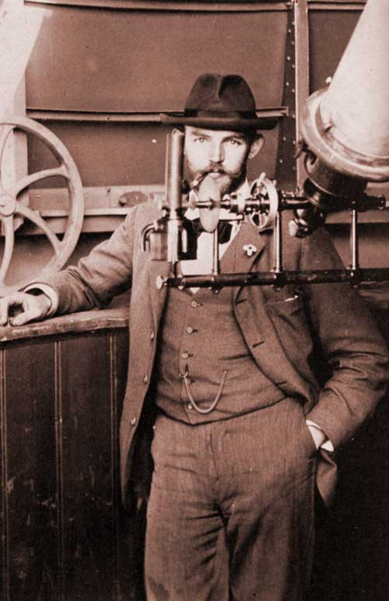
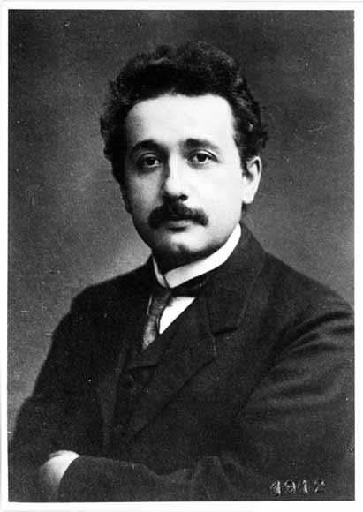
«Makers of Universes (G. B. Shaw) »
Astronomer
Theoretician

Slide 24
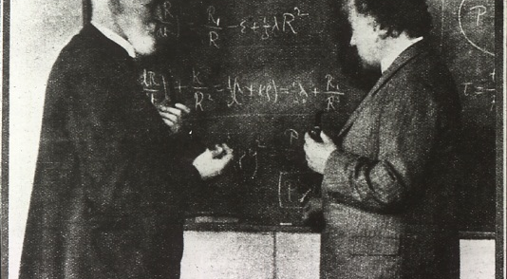
«Makers of Universes»

Slide 25

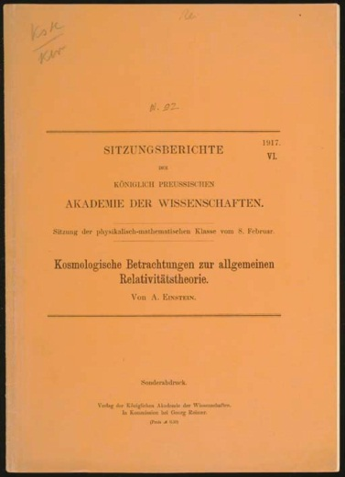
A valuable article
EINSTEIN, Albert.
Kosmologische Betrachtungen
zur allgemeinen Relativitätstheorie.
[Offprint from:]
Sitzungsberichte der Königlich
preussischen Akademie der Wissenschaften,
VI. Berlin, 1917.
Lot 52 / Sale 1677 / 14 June 2006
New York, Rockefeller Plaza
Estimate $1,000 - $1,500
Price Realized at the Auction $5,040

Slide 26
Christie’s lot Description
FIRST EDITION, OFFPRINT ISSUE.
It is in this paper that Einstein introduces an entire field,
general relativistic cosmology,
and introduces a constant - termed the Cosmological Constant - to describe a universe that is ever expanding.
Einstein will later reject this concept as the worst mistake
of his life. Nevertheless, discoveries since the year 2000 suggest that we live in a universe that will always expand, and at an ever-increasing rate.

Slide 27
Leopold Infeld’s Tribute
Speculations about the universe in which men live are as old as human thought and as art; as old as the view of shining star on a clear night. Yet it was general relativity which, only thirty years ago, shifted cosmological problems from poetry or speculative philosophy into physics. We can even fix the year in which modern cosmology was born. It was in 1917, when Einstein’s paper appeared in the Prussian Academy of Science under the title «Cosmological Considerations in General Relativity Theory».

Slide 28
Although is difficult to exaggerate the importance of this paper, and although it created a flood of other papers, Einstein’s original ideas, as viewed from the perspective of our present day are antiquate if not even wrong. I believe Einstein would be the first to admit this.
Yet the appearence of this paper is of great importance in the story of theoretical physics. Indeed it is one more instance showing how a wrong solution of a fundamental problem may be incomparably more important than a correct solution of a trivial, uninteresting problem.
L. Infeld, in Einstein Philosopher-Scientist (1949)

Slide 29
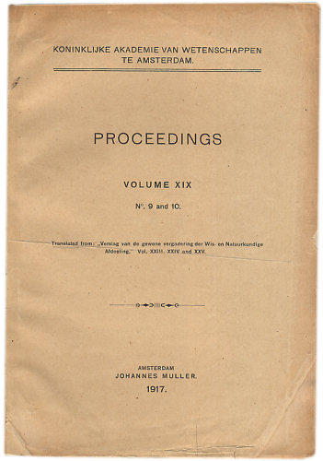
Another valuable article
The Manahattan Rare Book Company
1050 Second Ave, Gallery 50E
New York, NY 10022
DE SITTER, Willem.
On the relativity of inertia.
Remarks concerning Einstein's latest hypothesis. In Proceedings Koninklijke Akademie Van Wetenschappen Te Amsterdampp, vol 19, no. 9 and 10, pp.1217-1225.
First editions in English (translated from the German-language issue of the same journal) of two of cosmology's most important papers: Willem de Sitter's solution to Einstein's field equations, later to become known as the "De Sitter universe", providing a mathematical basis for an expanding universe.
Two complete issues. Octavo, original wrappers neatly rebacked.
$4500.

Slide 30
Lot Description
After studying Einstein's landmark 1916 paper on general relativity, De Sitter began a lengthy correspondence with Einstein concerning the solution to Einstein's provocative gravitational field equations.
De Sitter then published the results of his findings and correspondence first in the Dutch journal Proceedings Koninklijke Akademie Van Wetenschappen Te Amsterdam.
De Sitter "showed that in addition to the solution given by Einstein himself for the Einstein field equation... a second model was possible with systematic motions--particularly the 'expanding universe'--provided the density of matter could be considered negligible" .
Hubble's dramatic discovery in 1929 of the velocity-distance relationship for galaxies confirmed the De Sitter model.
Einstein had included a controversial "cosmological constant" in his field equations to prevent the seemingly absurd conclusion of an expanding universe; Hubble's discoveries later prompted Einstein to famously declare that the cosmological constant was the greatest error of his life.

Slide 31
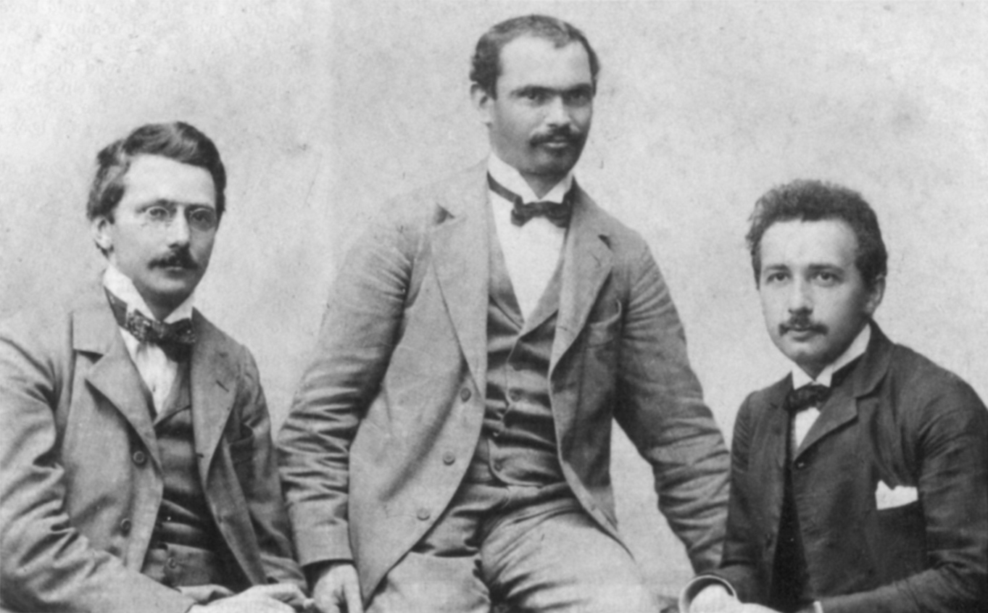
Akademie Olympia

Slide 32
Critical thinking
Nowadays the philosophy of science plays almost no role in the training of physicists or in physics research
Careful reflection on philosophical ideas is rare. Even rarer is systematical instruction
Worse still, publically indulging an interest is often treated as a social blunder
Things were not always so.
Einstein was typical in his generation of physicists in the seriousness and the extent of his early and lasting engagement with philosophy
Einstein’s philosophical forma mentis had to play a fundamental role in his physical thinking and particularly in the invention of cosmology as a science (and ironically also led him to big mistakes)
Source: Albert Einstein as a Philosopher of Science.
D. Howard. Physics Today (2005)

Slide 33
“So many people today—and even professional scientists—seem to me like someone who has seen thousands of trees but has never seen a forest. A knowledge of the historic and philosophical background gives that kind of independence from prejudices of his generation from which most scientists are suffering. This independence created by philosophical insight is—in my opinion—the mark of distinction between a mere artisan or specialist and a real seeker after truth”.
Albert Einstein. Letter to R. Thornton, 1944

Slide 34
“The reciprocal relationship of epistemology and science is of noteworthy kind. They are dependent upon each other. Epistemology without contact with science becomes an empty scheme. Science without epistemology is—insofar as it is thinkable at all— primitive and muddled.”
Albert Einstein 1949.
In Albert Einstein – Philosopher, Scientist

Slide 35
A. Einstein. Obituary for E. Mach,
Phys. Zeitschrift, 17, 101–104, 1917
How does it happen that a properly endowed natural scientist comes to concern himself with epistemology? Is there not some more valuable work to be done in his specialty? That's what I hear many of my colleagues ask, and I sense it from many more. But I cannot share this sentiment.
When I think about the ablest students whom I have encountered in my teaching — that is, those who distinguish themselves by their independence of judgment and not just their quick-wittedness — I can affirm that they had a vigorous interest in epistemology. They happily began discussions about the goals and methods of science, and they showed unequivocally, through tenacious defense of their views, that the subject seemed important to them.

Slide 36
Concepts that have proven useful in ordering things easily achieve such authority over us that we forget their earthly origins and accept them as unalterable givens. Thus they might come to be stamped as "necessities of thought," "a priori givens," etc. The path of scientific progress is often made impassable for a long time by such errors. Therefore it is by no means an idle game if we become practiced in analyzing long-held commonplace concepts and showing the circumstances on which their justification and usefulness depend, and how they have grown up, individually, out of the givens of experience. Thus their excessive authority will be broken. They will be removed if they cannot be properly legitimated, corrected if their correlation with given things be far too superfluous, or replaced if a new system can be established that we prefer for whatever reason.
A. Einstein

Slide 37
Meta-principles of relativity
They are not laws of nature but principles that the laws of physics must satisfy
The epistemological concern leading to General Relativity is explicitly declared at the opening of the founding article:
In classical mechanics and no less in the special theory of relativity there is an inherent epistemological defect which was, perhaps for the first time, clearly elucidated by Ernst Mach….Of course an answer may be satisfactory from the point of view of epistemology and yet unsound physically…

Slide 38
Mach’s principle
In a consistent theory of relativity there can be no inertia relatively to ‘space,’ but only an inertia of masses relatively to one another
A. Einstein, Kosmologische Betrachtungen zur allgemeinen Relativitätstheorie (1917) .
The G-field is completely determined by the masses of bodies. Since mass and energy are identical in accordance with the results of the special theory of relativity and the energy is described formally by means of the symmetric energy tensor (Tμν), the G-field is conditioned and determined (bedingt und bestimmt) by the energy tensor of the matter.
A Einstein, “Prinzipielles zur allgemeinen Relativitätstheorie. (1918)

Slide 39
The Rough and Winding Road to cosmology

Slide 40
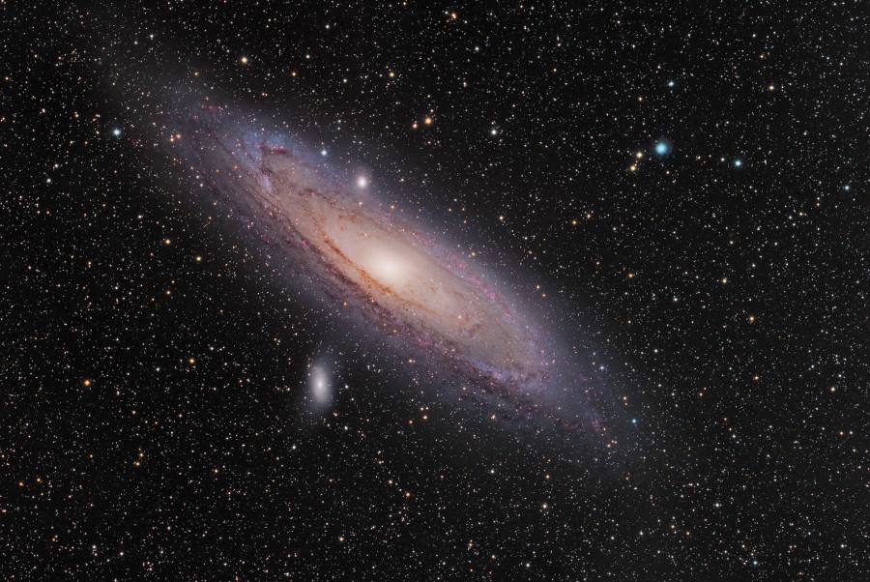
Einstein’s cosmological work was not motivated by the problems of the observational cosmology contemporary to him.
Einstein walks on his rough and winding road towards cosmology following the trail that led him to RG. Relativistic cosmology is the final attempt to guarantee the agreement of his new theory of gravitation with Mach’s ideas

Slide 41
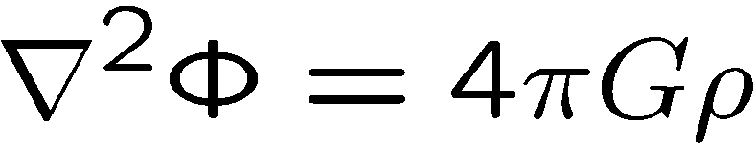
The crucial question
It is well known that Poisson’s Equation
in combination with the equations of motion
of a material point is not a perfect substitute
for Newton’s action at a distance
There is still to be taken into account the condition that at spatial infinity for the potential tends towards a fixed limiting value

Slide 42
The crucial question II
There is an analogous state of things in the theory of gravitation in general relativity.Here too we must supplement the differential equations by limiting conditions at spatial infinity if we conceive the universe as being of infinite spatial extent
In my treatment of the planetary problem I choose the following assumption: it is possible to select a system of reference so at spatial infinity all the gravitational potential g_{μν} become constant
But it is by no means evident a priori that we may lay down the same limiting conditions when we wish to take larger portion of the physical universe under consideration

Slide 43
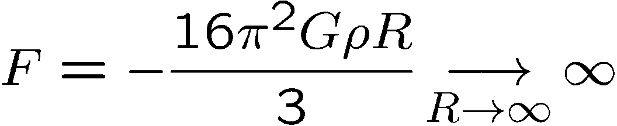
Difficulties of Newton’s cosmology
An embarassing dilemma of Newton’s cosmology:
Gauss law: for a constant mass density the force per unit surface diverges
Impossible!

Slide 44
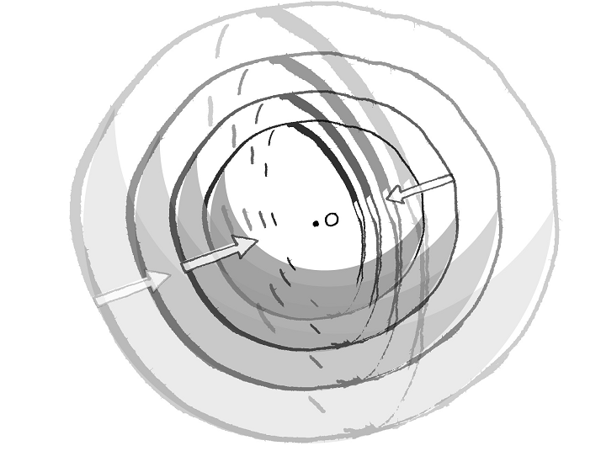
Difficulties with Newton’s cosmology
O
Think of a Newtonian universe uniformly filled with matter.
The total force on the point mass O is given by the sum of forces due to each hemispherical shell. Each half-shell contributes a force of equal magnitude, F = Gπρd, and the sum does not converge (Courtesy: Smeenk, op. cit.).

Slide 45
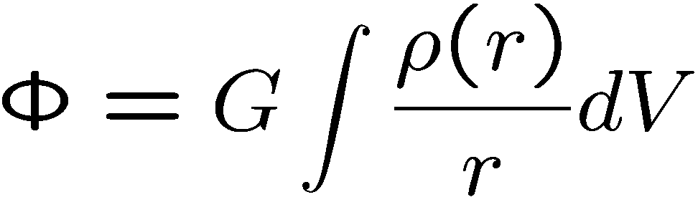
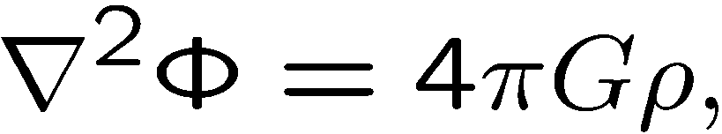
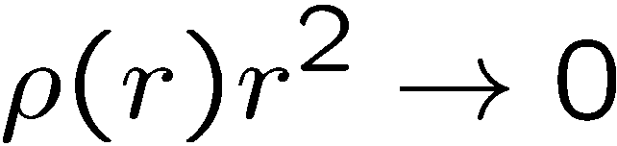
Newton’s Island Univers
An island universe would not be stable. The island would evaporate as long as individual stars acquire enough kinetic energy to escape the gravitational attraction of the other stars.

Slide 46
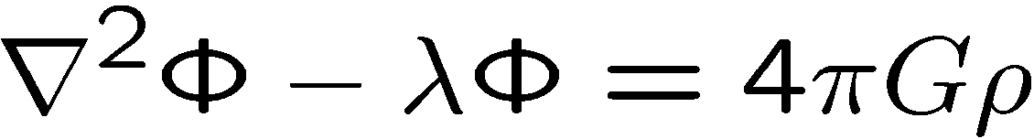
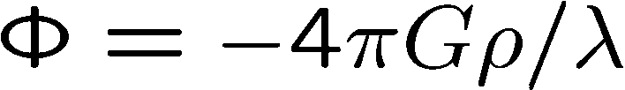
The crucial question
What to do?
Modify Poisson’s equation (not to be taken to seriously, Einstein souligne)
This solution would correspond to the case in which the matter of the fixed stars was distributed uniformly through space, if the density is the actual mean density of matter in the universe…
A universe so constituted would have with respect to its gravitational field, no centre

Slide 47
Mach’s principle reloaded
The opinion which I entertained until recently as to the condition to be laid at spatial infinity took its stand from the following considerations. In a consistent theory of relativity there can be no inertia relatively to ‘space,’ but only an inertia of masses relatively to one another”. If therefore I have a mass at a sufficient distance from all other masses in the universe, its inertia must fall to zero.

Slide 48
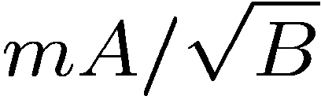
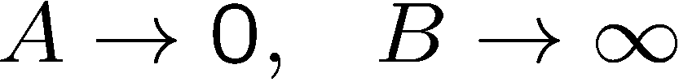
Cosmological principle
In the particularly perspicuous case of the possibility of choosing the system of coordinates so that the gravitational field is at every point spatially isotropic we have more simply
plays the role of the inertial mass. It can vanish only if

Slide 49
Einstein and de Sitter debate
Einstein: the existence of distant masses would provide such degeneracy at infinity and also Minkowskian values at large but finite distances (necessary for explaining planetary motion).
De Sitter: Einstein’s distant masses have to be outside the observable universe. Such explanation is not more satisfactory and is maybe worse than Newton’s absolute space.
«It proved that for the system of the fixed stars no boundary condition of the kind can come into question at all, as was also emphasized by the astronomer de Sitter recently»

Slide 50
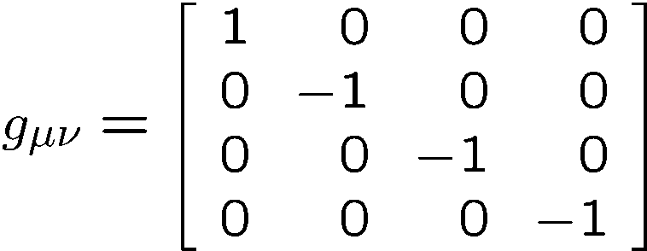
Three possibilities (a)
We may require as in the problem of the planets that the metric in spatial infinity approximate the values
This is unsatisfactory in more respects than one
A definite choice of a SR contrary to spirit of the relativity priciple
Inertia would be influenced but not conditioned by matter present in finite space

Slide 51
Three possibilities (b)
We may refrain entirely from laying down boundary condition at infinity claiming general validity. This holds out no hope of solving the problem and amounts to giving it up. This is an incontestable position which is taken at present time by de Sitter. But I must confess that such a complete resignation in this fundamental question is for me a difficult thing. I should not make up my mind to it until every effort to make headway toward a satisfactory view had proved to be vain.

Slide 52
Three possibilities (c)
I have completely abandoned my views, rightfully contested by you, on the degeneration of the metric. I am curious to hear what you will have to say about the somewhat crazy idea I am considering now.
Letter to W. De Sitter of February 2, 1917
I have again perpetrated something relating to the theory of gravitation that might endanger me of being committed to a madhouse
Letter to P. Ehrenfest, February 4, 1917

Slide 53
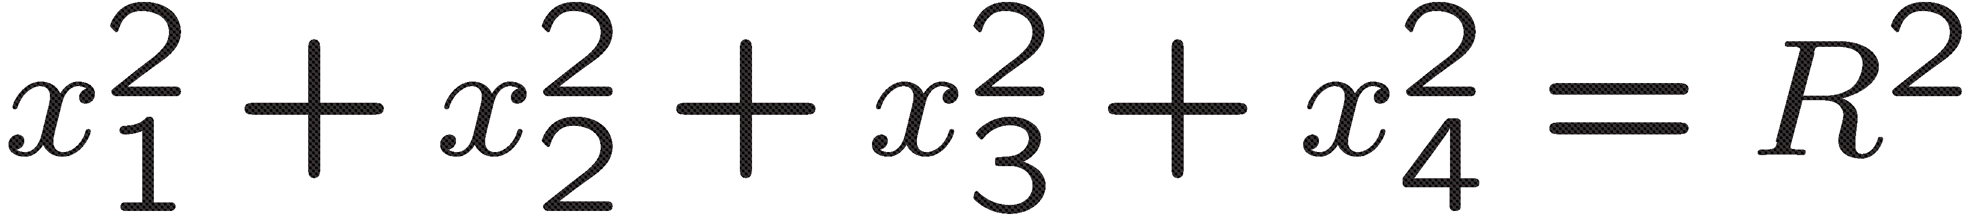
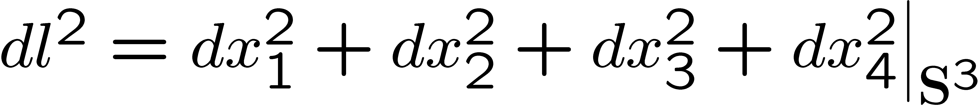
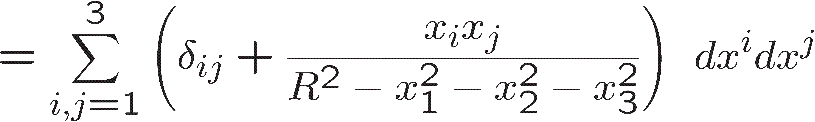
A spherical universe!

Slide 54
Cosmological Principle
The curvature is defined at every point by the matter at that point and the state of matter. On account of the lack of uniformity the metrical structure must be extremely complicated. But if we are concerned with the structure only on a large scale, we may represent matter as being uniformly distributed over enormous space so that the density varies extremely slowly. Our procedure resemble that of a geodesist who by means of an ellipsoid approximates the shape of the Earth which on small scale is extremely complicated

Slide 55
The cosmological constant
(The name is the thing)

Slide 56
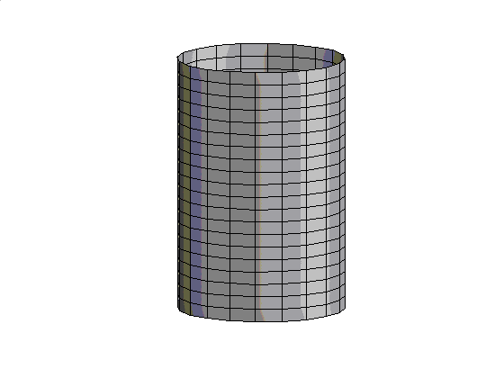
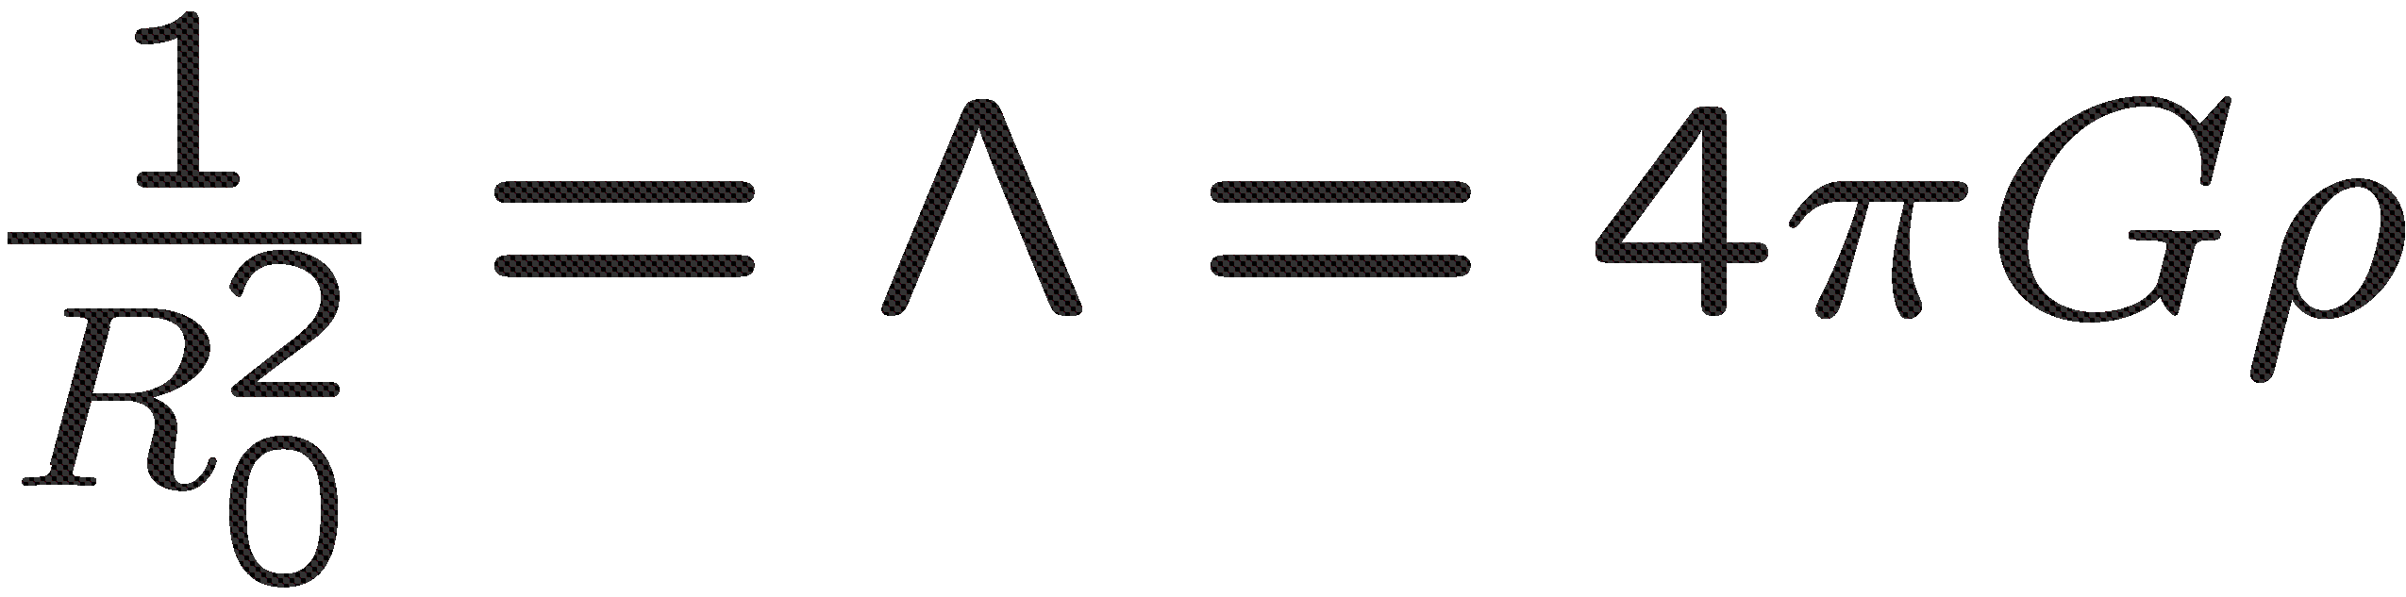
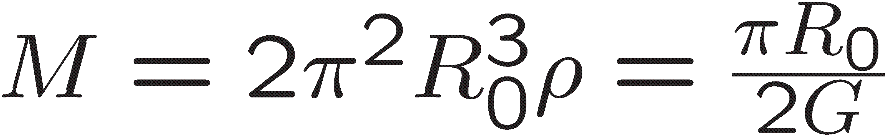
Einstein’s static world
In order to arrive at this view we had to introduce an extension of the field equation that is not justified by our actual knowledge of gravitation. It is to be emphasized that a positive curvature of space is given by our results even if the supplementary term is not introduced. That term is necessary only for the purpose of making possible a quasi static distribution of matter as required by the small velocity of the stars

Slide 57
A spacious castle in the air
de Sitter admired Einstein conception of the cosmos as a contradiction-free chain of reasoning. However he preferred the original GR without the cosmological constant which is “just philosophically and not physically desirable“. Furthermore he criticized the staticity assumption:
We cannot and must not conclude from the fact that we do not see any large changes on this photograph [our observational snapshot of stellar distributions] that everything will always remain as at that instant when the picture was taken de Sitter to Einstein 1916
I have erected but a lofty castle in the air... I compare space to a cloth floating (at rest) in the air, a certain part of which we can observe. This part is slightly curved similarly to a small section of a sphere's surface. ... So let us be satisfied and not expect an answer, and rather see each other again as soon as possible in acceptable health in Leyden.
Einstein to de Sitter, 1916
How the metric tensor is outside our neighborhood we do not know, and any assumption regarding its values is an extrapolation, whose uncertainty increases with the distance (in space, in time, or in both) from the origin. de Sitter 1917

Slide 58
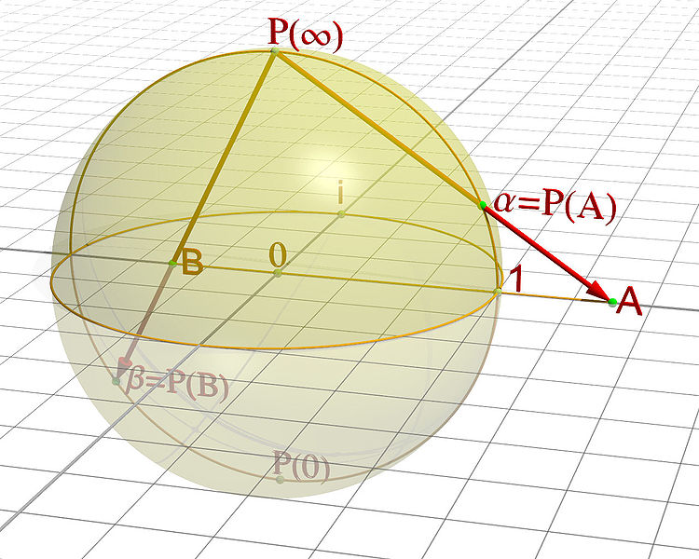
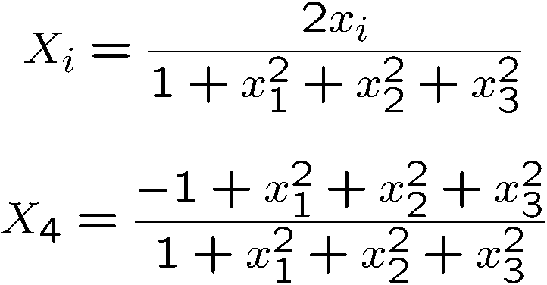
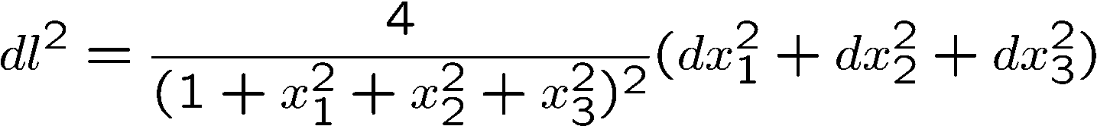
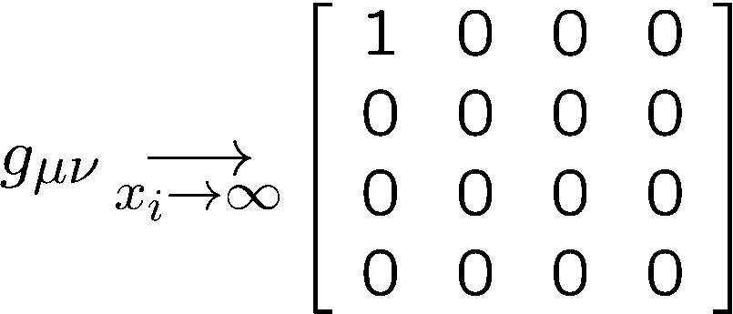
Still a boundary condition remains!

Slide 59
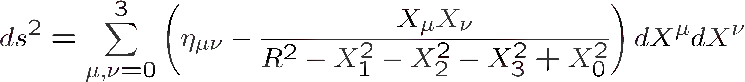
Ehrenfest-de Sitter’s analogy
Einstein’s static model does not solve the
boundary condition problem in an invariant way.
There is a sort of ‘absolute space’ remaining in it.
This discontinuity is however only apparent. The four dimensional world, which we have for the sake of symmetry represented as spherical, is in reality hyperbolical, and consists of two sheets, which are only connected with each other at infinity. de Sitter 1917

Slide 60
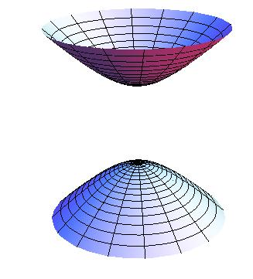

Slide 61
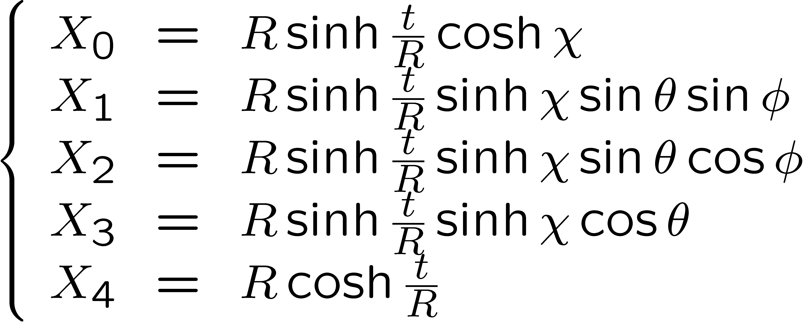
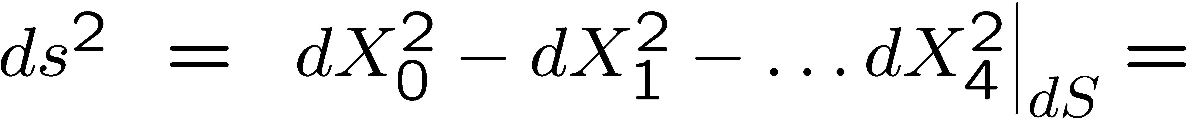
Open FRW model (de Sitter 1917)

Slide 62
A matter of taste
Which of the three systems is to be preferred? From the purely physical point of view, for the description of phenomena in our neighborhood, this question has no importance. The question thus really is: how are we to extrapolate outside our neighborhood?
The choice can thus not be decided by physical arguments, but must depend on metaphysical or philosophical considerations, in which of course personal judgment or predilections will have some influence.
To the question: If all matter is supposed not to exist, with the exception of one material point which is to be used as a test-body has then this test-body inertia or not? The school of Mach requires the answer NO. Our experience however very decidedly gives the answer YES.

Slide 63
Einstein frankly unhappy
It would be unsatisfactory, in my opinion, if a world without matter were possible. Rather, the metric field should be fully determined by matter and not be able to exist without the latter.
This circumstance irritates me.
To admit such possibilities seems senseless.

Slide 64
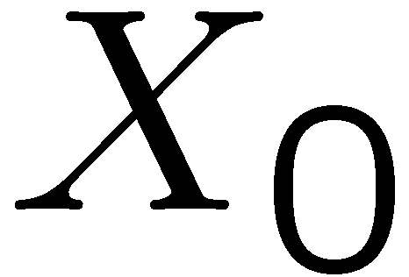
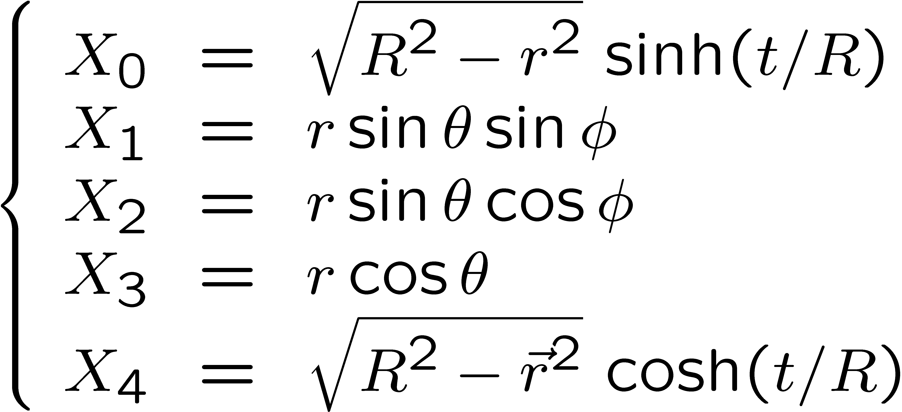
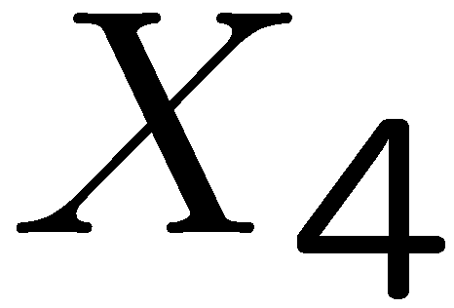
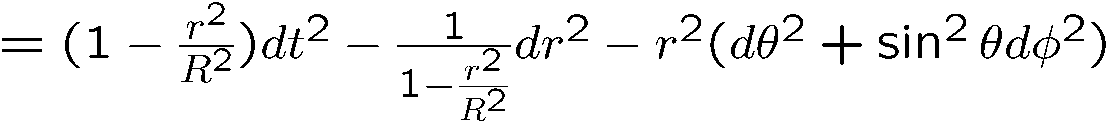
Querelle de“rest”
Static universe (de Sitter 1917

Slide 65
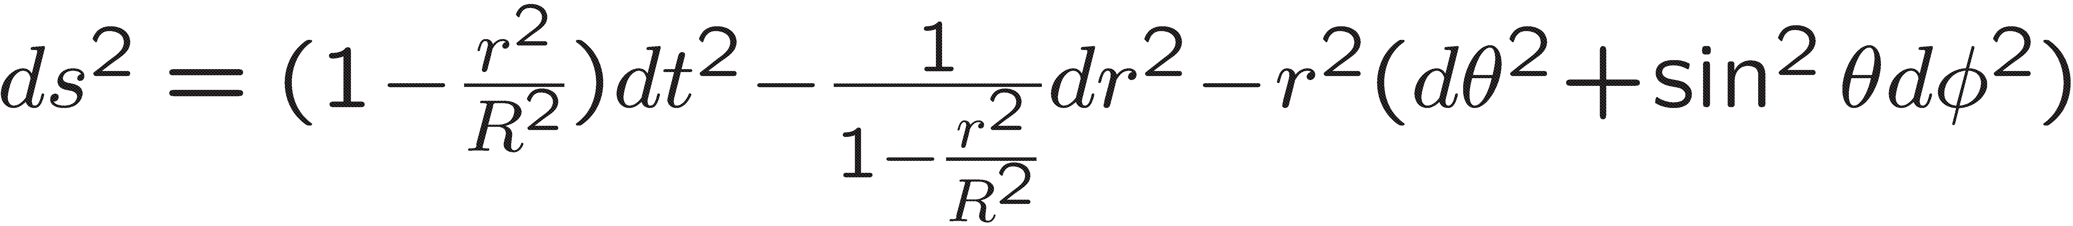
Querelle de“rest”
Static universe (de Sitter 1917)
used.
Einstein liked the new metric
But g_{tt} =0 et g_{rr} = infinity on the equator (mass horizon d’apres Einstein). Such behaviour seemed inacceptable; maybe there was matter on the equator
Einstein convinced himself that the singularity of the metric occurred at a finite proper distance from an arbitrarily chosen point of the space-time and that it was not just an artifact of the coordinates used
The threat that De Sitter’s solution posed to Mach’s principle thus finally seemed to be removed

Slide 66
Then…
Hermann Weyl pieced together a complete solution out of the static de Sitter solution and the solution for an incompressible fluid. The resulting solution has a zone of matter around the equator and the resulting surface layer of matter has a finite mass
This result (1919) seemed to vindicate Einstein’s hunch that the de Sitter solution describes a universe very much like his own cylindrical universe, the difference being that all mass is concentrated on the equator.
In his last letter to de Sitter (of April 15, 1918) Einstein had already announced that Weyl had found a proof for this conjecture.

Slide 67
And then..
On May 19, 1918, Weyl wrote to Einstein that the result of the calculation mentioned above “might meet with your approval.”
Einstein wrote back on May 31 that he was happy that Weyl had finally resolved the “zone issue,” and added: “Now the result of your calculation is just what one had to expect.”

Slide 68
End of the querelle: de Sitter world
In two letters to Einstein (of April 25 and June 16, 1918) Klein solves all the paradoxes by writing the transformation from the pseudo-Cartesian coordinates of the de Sitter hyperboloid in 4+1-dimensional Minkowski space-time to the coordinates used to write the solution in static form.

Slide 69
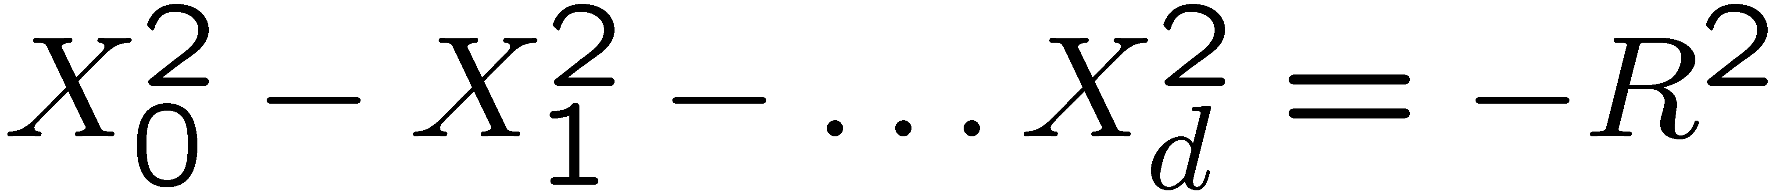
End of the querelle: de Sitter world
Klein explicitly points out that the singularity at the equator is an artifact of the static coordinates.
Einstein’s criticisms were all essentially wrong. But in the end he dismssises the de Sitter universe as unphysical because of its non static character
M^{(d+1)} : η_{μν} = diag(1,-1,……,-1)

Slide 70
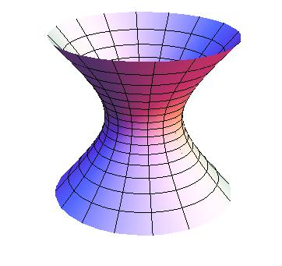
First moral to the story
Einstein admitted that the de Sitter solution is a counterexample to Mach’s principle.
However he rejected as a physically unreasonable model because non-static. A criterion used opportunistically just to rule out De Sitter's anti-Machian solution.
A weakly motivated simplifying assumption in deriving his own model had turned into a substantive constraint that Einstein did not critically examine for the next decade.
If Einstein had stuck to his original field equations of November 1915, he would have predicted that the only way in which his theory allows a spatially closed geometry is through a model in which space-time is expanding. Hubble’s discovery would then have been another triumph for Einstein.
Purely on the strength of his epistemological conviction (Mach’s principle) he would have made the revolutionary prediction that the universe is expanding.

Slide 71
De Sitter COORDINATES AND GEOMETRY
Interlude

Slide 72
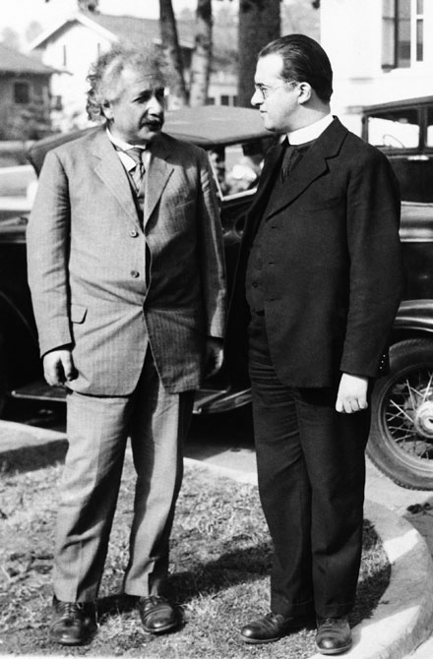
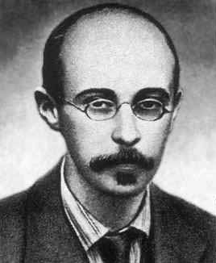
«Makers of Universes»

Slide 73





Cosmological Equations
In comoving
coordinates:
Raychaudhuri Eq.
Friedmann Eq.
Together imply
(for each component):

Slide 74




Spherical Universe

Slide 75
Flat universe

Slide 76

Hyperbolic universe

Slide 77



Hyperbolic Universe (negative curvature)

Slide 78



Spherical model (Lanczos)

Slide 79


Flat model (Lemaître, 1924)

Slide 80
Hyperbolic model (de Sitter 1917)

Slide 81







Λ=0

Slide 82




Λ<0

Slide 83

Asymtototic cone
M^{(d+1)} : η_{μν} = diag(1,-1,……,-1)

Slide 84

Causal structure

Slide 85
Geodesiques

Slide 86



Geodesics

Slide 87

Geodesiques
to be compared with

Slide 88


The asymptotic cone
M⁽⁵⁾ : η_{μν} = diag(1,-1,……,-1)

Slide 89
Causal structure

Slide 90
Geodesics

Slide 91
Geodesics

Slide 92


Stringy coordinate systems
(M. Gaudin & UM 2013)

Slide 93



Finite open strings

Slide 94


Closed (dS) strings

Slide 95
Epilogue II
Up to the beginning of the ‘30 everybody believed in a static universe
The fundamental papers by Friedmann - 1922 and 1924 – and the independent work by Lemaître en 1927 were largely ignored
Einstein even published a note claiming a mistake in Friedmann’s work.
Once more he was wrong.
In his retractation he said (sentence suppressed in the final vesion) Friedmann's paper while mathematically correct is hardly of anyphysical significance
« Vos calculs sont corrects, mais votre physique est abominable » Einstein to Lemaitre, 1927

Slide 96


Epilogue 3: Lemaitre’s discovers Hubble’s law

Slide 97
Lemaitre’s discovers
Lemaitre-Hubble’s law
1922 Vesto Slipher measures the redshifts for 41 galaxies.
1923, Arthur Eddington : “The great preponderance of positive [receding] velocities is very striking; but the lack of observations of southern nebulae is unfortunate, and forbids a final conclusion.”
1927, the Belgian priest and cosmologist Georges Lemaître published a paper (in French in the relatively obscure Annals of the Scientific Society of Brussels) whose title read (in its English translation): “A Homogeneous Universe of Constant Mass and Increasing Radius Accounting for the Radial Velocity of Extra-Galactic Nebulae.”
Lemaitre started out by considering an Einstein universe "where the radius of space or of the universe is allowed to vary in an arbitrary way”.
He found differential equations for the time-dependent space curvature R(t) that were the same as Friedmann's except that Lemaitre included the radiation pressure. Lemaitre rediscovered what Friedmann had discovered five years earlier.
Yet,to say that Lemaitre simply rediscovered Friedmann's solution of an expanding universe is to miss the important difference between the two works.
Although quite similar in their mathematics, when it comes to physics the two papers are strikingly different.
Lemaitre pointed out in clear language that his model universe was expanding and that the velocity of recession was to be understood as "the apparent Doppler effect due to the variation of the radius of the universe".

Slide 98
He was not interested in any kind of variation of R(t) allowed by the equations, but only in the expanding solution that seemed to correspond to the redshift data
This is reflected in his manuscript version, where the term variable was replaced in the proof with croissant (increasing).
Lemaître thus first discovers what is now known as “Hubble’s Law”—the fact that the velocity of recession is linearly proportional to the distance.
But Lemaître went beyond mere theoretical calculations. He actually used the velocities of the galaxies as measured by Slipher and the distances as determined from brightness measurements by Hubble in 1926, to determine the rate of expansion of the universe.
For the numerical value of that rate, today called the Hubble constant, Lemaître obtained 625 km/s/Mpc. Recall that Hubble obtained a value of about 500 in 1929.
Lemaître also discussed the fact that the accuracy of the distance estimates available at the time seemed to him to be insufficient to assess the validity of the linear relation he discovered.

Slide 99
Who did the cosmic censorship?
The English translation of Lemaître’s 1927 paper was published in the Monthly Notices of the Royal Astronomical Society in March 1931.11 However, a few paragraphs from the original French version were deleted! In particular, the paragraph that described “Hubble’s Law” and in which Lemaître used the 42 galaxies for which he had distances and velocities to derive a value for the Hubble Constant of 625 km/s/Mpc, was missing.
Also missing were one paragraph in which Lemaître discussed the possible errors in the distance estimates, and footnotes, in one of which he remarked on the interpretation of the proportionality between the velocity and distance, as resulting from a relativistic expansion. In the same footnote, Lemaître also calculated two possible values for the Hubble Constant, of 575 and 670, depending on how the data were grouped.

Slide 100


Slide 101

M Livio solves the Hubble-Lemaitre affaire

Slide 102
Two years later
Hubble explains the redshifts of the nebulae by using the de Sitter model, as suggested by Eddington. He ignored Lemaître (Eddington too, but not Einstein)

Slide 103
Epilogue III
The introduction of such a constant implies a considerable renunciation of the logical simplicity of the theory... Since I introduced this term, I had always a bad conscience... I am unable to believe that such an ugly thing should be realized in nature
—Einstein to Lemaître, 1947
The history of science provides many instances of discoveries which have been made for reasons which are no longer considered satisfactory. It may be that the discovery of the cosmological constant is such a case.
—Lemaître to Einstein, 1949

Slide 104
Epilogue IV
(in case you think you understood what space is.)
If I let all things disappear from the world, then, according to Newton, the Galilean inertial space remains, while according to my view, nothing is left. Albert Einstein, 9 January 1916
Space, brought to light by the corporeal object, made a physical reality by Newton, has in the last few decades swallowed ether and time and seems about to swallow also the field and the corpuscles, so that it remains as the sole medium of reality. Albert Einstein, 1930

Slide 105
Final Wor(l)d
Die Welt ist alles was der Fall ist
L. Wittgenstein
The world is everything that happens
The world is the fall
The world is everything that falls

