Slide 1
Hot topics in Modern Cosmology
Cargèse - 10 Mai 2011

Slide 2
General Relativity and Weyl frames
Carlos Romero
Notes:
2

Slide 3
The Principle of General Covariance
The form of the physical laws must be invariant under arbitrary coordinate transformations
This principle was used by Einstein as a guide in the formulation of General Relativity
Notes:
3

Slide 4
One question: is there another kind of invariance of the equations of General Relativity?
One kind of invariance that has attracted the attention of theoreticians in other branches of physics is the so-called conformal invariance
This concept first arose with H. Weyl, in 1919, in his attempt to unify gravitation and electromagnetism

Slide 5
Conformal transformation
Interest in this new form of invariance
has led to the investigation of conformal gravity theories
One of the simplest examples is Weyl conformal gravity:
Notes:
5

Slide 6
Weyl conformal gravity leads to fourth order derivative in the field equations
All these gravitational theories are fundamentally different from general relativity and give predictions that are not consistent with the observational facts
Notes:
6

Slide 7
An interesting fact is that…
if we
change the geometric description of space-time
Riemann Weyl
We have a new fundamental group of transformations
Notes:
7

Slide 8
These are called Weyl transformations
They include the conformal group as a subgroup
What is Weyl geometry ?

Slide 9
Riemannian geometry
In Weyl geometry, the manifold is
endowed with a global 1-form

Slide 10
A particular case is
Weyl integrable geometry
We have a global scalar field defined on the
embedding manifold, such that

Slide 11
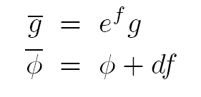
We can relate the Weyl affine connection
with the Riemannian metric connection
Consider the transformations
The interesting fact here is that...

Slide 12
...geodesics are invariant under Weyl transformations !
The concept of frames in Weyl
geometry
The Riemann frame
General Relativity is formulated in
a Riemann frame, i.e. in which
there is no Weyl field

Slide 13
Riemann frame
First question: Can we formulate General Relativity in an arbitrary frame?
Second question: Is it possible to
rewrite GR in a formalism invariant
under arbitrary Weyl transformations?

Slide 14
The answer is... Yes!
The new formalism is built through the following steps:
First step: assume that the space-time
manifold which represents the arena of physical phenomena may be described by a Weyl integrable geometry

Slide 15
We need two basic geometric
fields: a metric and a scalar field
Second step: Construct an action S that
be invariant under changes of frames
Third step: S must be chosen such
that there exists a unique frame in
which it reduces to the Einstein-Hilbert action

Slide 16
Fourth step: Extend Einstein’s geodesic
postulate to arbitrary frames. In the Riemann frame it should reproduce particle motion predicted by GR
Fifth step: Define proper time in an
arbitrary frame. This definition should
be invariant under Weyl transformations
and coincide with GR’s proper time in the
Riemann frame

Slide 17
The simplest action that satisfies
all previous requisites is
Riemann frame
GR action

Slide 18
In n-dimensions the action has the form
What happens if we express S in
Riemannian terms ?

Slide 19
For n=4

Slide 20
In the vacuum case and vanishing
cosmological constant this reduces
to Brans-Dicke for w=-3/2
However the analogy is not perfect
because test particles move along
Riemannian geodesics only in the
Riemann frame

Slide 21
Proper time: we need a definition
invariant under Weyl transformations
In an arbitrary frame it should depend
not only on the metric, but also on the
Weyl field
The extension is straightforward:

Slide 22
Consequences:
Under change of frames null curves are mapped into null curves
The light cone structure is preserved
Causality is preserved under Weyl
transformations

Slide 23
This change of perspective leads, in some cases, to new insights in the description of gravitational phenomena
Gravity in the Weyl frame

Slide 24
Variation Principles
In an arbitrary Weyl frame variations
shoud be done independently with
respect to the metric and the scalar field
In four dimensions this leads to
This is General Relativity in disguise!

Slide 25
In this scenario the gravitational field is not associated only with the metric tensor, but with the combination of both the metric and the geometrical scalar field
We can get some insight on the amount of physical information carried by the scalar field by investigating its behaviour conformal solutions of general relativity

Slide 26
Consider, for instance, homogeneous
and isotropic cosmological models
These have a conformally flat geometry
There is a frame in which the
Geometry becomes flat (Minkowski)
In the Riemann frame the manifold M is endowed with a metric that leads to Riemannian curvature, while in the Weyl frame space-time is flat.

Slide 27
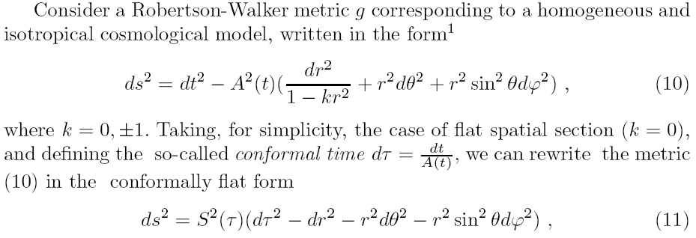
This leads to quite a different picture.
For instance
The Weyl field will be given by

Slide 28
Another simple example is given
by some Brans-Dicke solution.
For instance, consider O`Hanlon-Tupper
cosmological model and set w=-3/2
It is equivalent to Minkowski
spacetime in the Riemann
frame.

Slide 29
Conclusions:
There is no unique geometrical
formulation of General Relativity
As far as physical observations are concerned all frames are completely equivalent
Is this kind of invariance just a
mathematical curiosity or should
We look for a “hidden symmetry”?

Slide 30
Thank you

