Slide 1

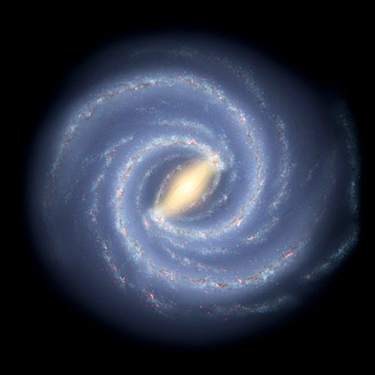

Massive Gravity and Cosmology
Claudia de Rham
May 9th 2012

Slide 2
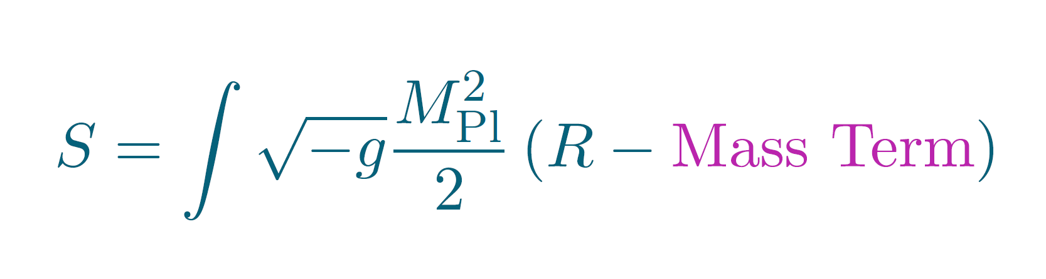
Massive Gravity

Slide 3
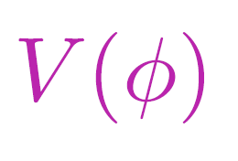
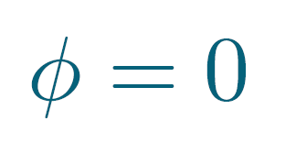

Massive Gravity
The notion of mass requires a reference !
Flat Metric
Metric

Slide 4
Massive Gravity
The notion of mass requires a reference !
Having the flat Metric as a Reference breaks Covariance !!! (Coordinate transformation invariance)

Slide 5
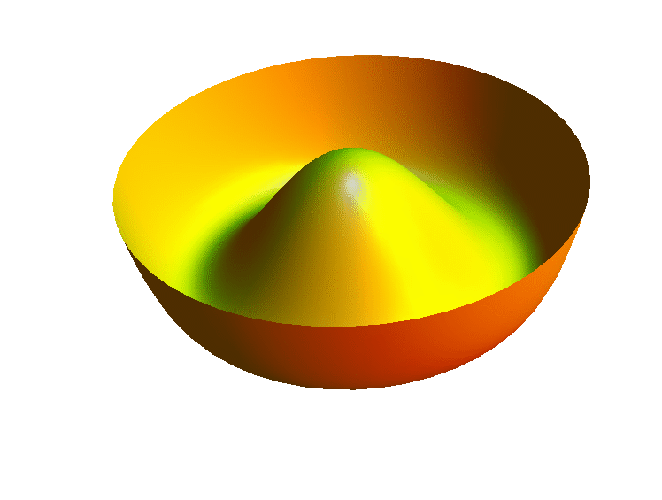
Massive Gravity
The notion of mass requires a reference !
Having the flat Metric as a Reference breaks Covariance !!! (Coordinate transformation invariance)
The loss in symmetry generates new dof

Slide 6
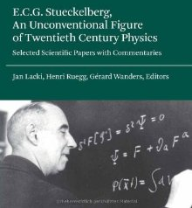
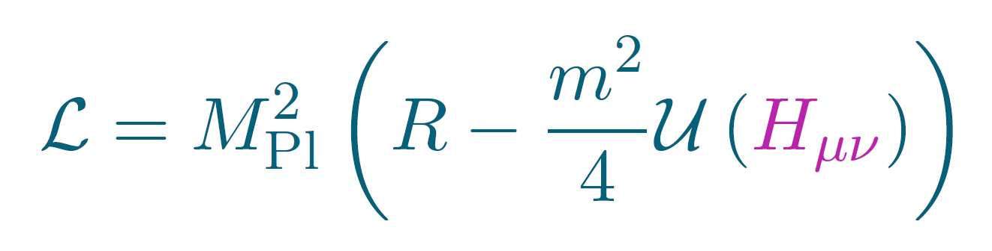
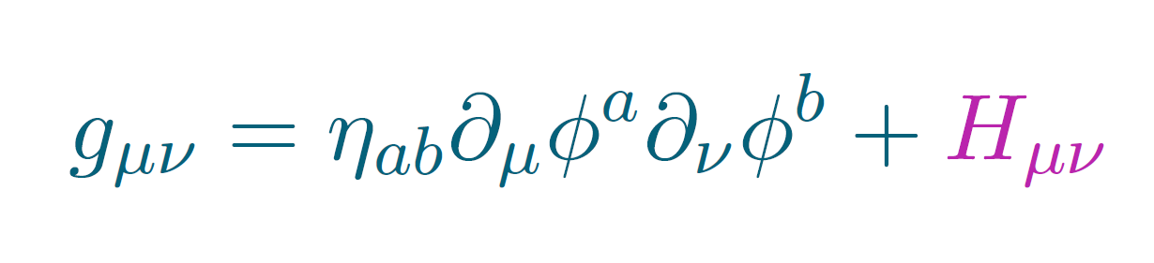
Stückelberg language
Consider potential interactions for the Graviton
Where covariance is manifest after introduction of four Stückelberg fields

Slide 7
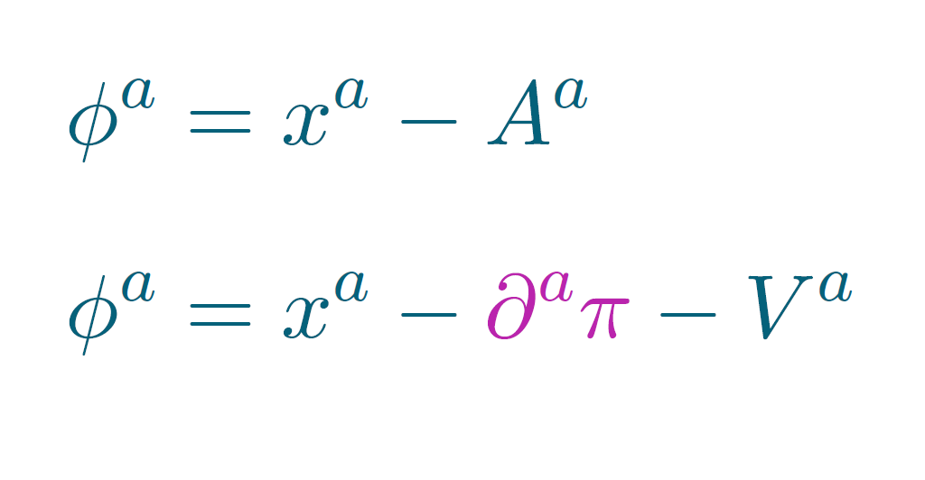
Stückelberg language
Consider potential interactions for the Graviton
Where covariance is manifest after introduction of four Stückelberg fields

Slide 8
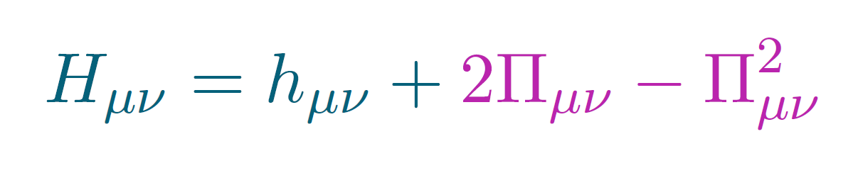
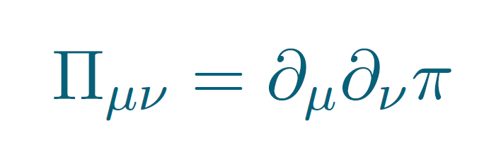
Stückelberg language
Consider potential interactions for the Graviton
Where covariance is manifest after introduction of four Stückelberg fields

Slide 9
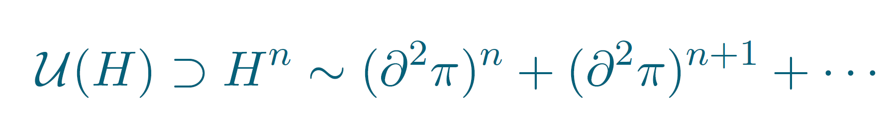
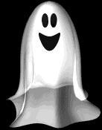
Stückelberg language
The potential typically has higher derivatives
ghost ...

Slide 10
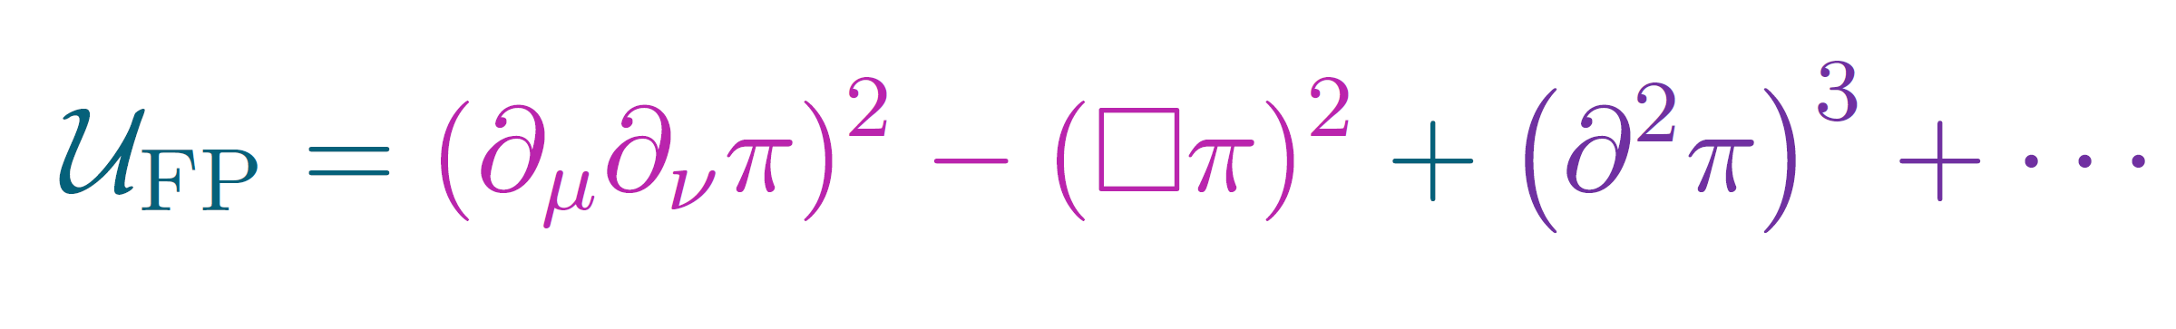
Stückelberg language
The potential typically has higher derivatives
The Fierz-Pauli mass term is special at quadratic order,
ghost ...
Total derivative

Slide 11
Stückelberg language
The potential typically has higher derivatives
The Fierz-Pauli mass term is special at quadratic order,
ghost ...
Just need to keep going
to all orders…
Total derivative

Slide 12
Decoupling limit
Problem arises from non-linearities in helicity-0

Slide 13
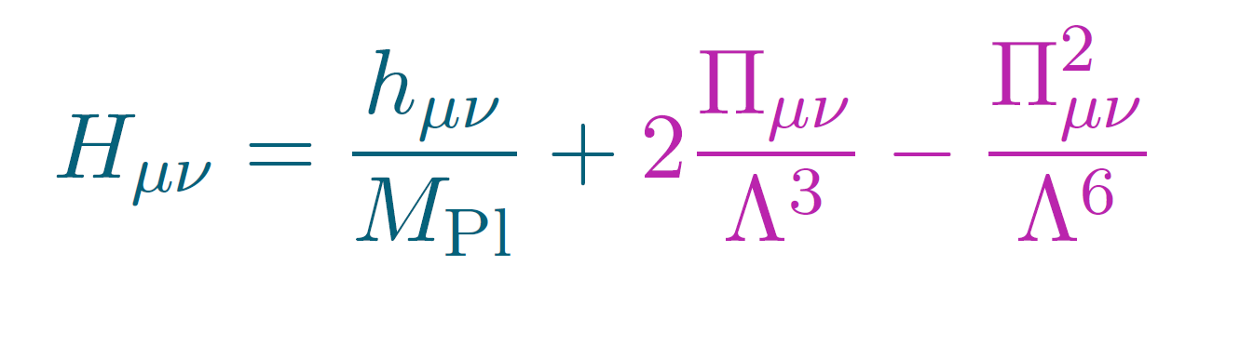
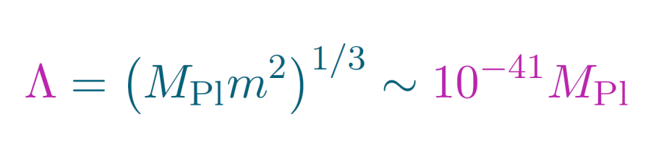
Decoupling limit
Problem arises from non-linearities in helicity-0

Slide 14
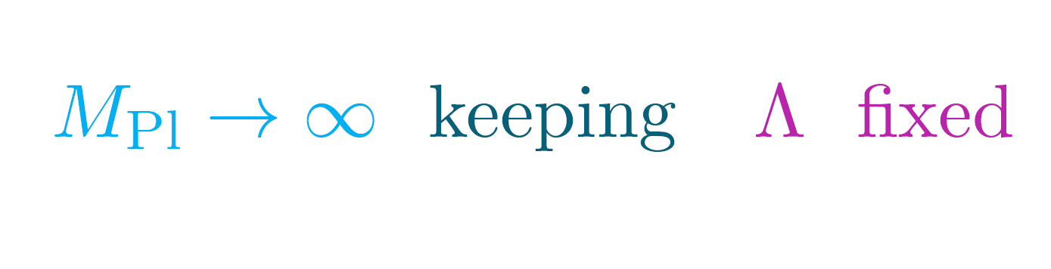
Decoupling limit
Problem arises from non-linearities in helicity-0
To focus on the relevant interactions, we can take the limit

Slide 15
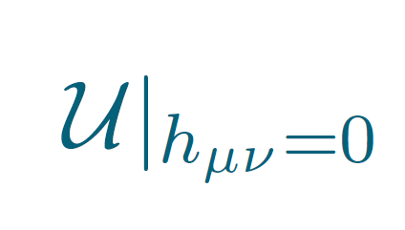
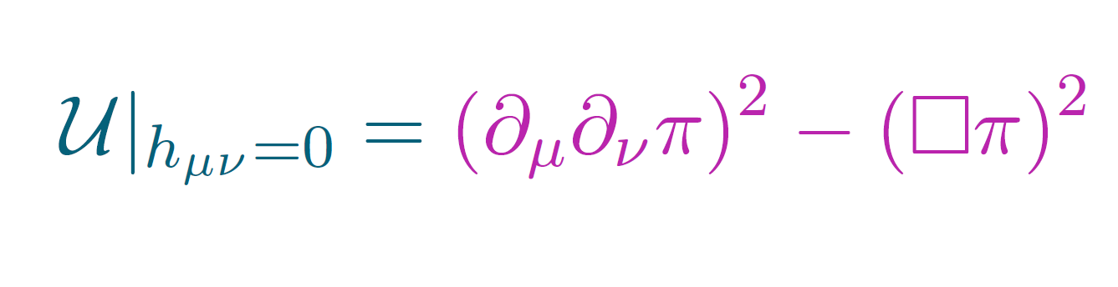
Decoupling limit
is a total derivative, for instance if

Slide 16
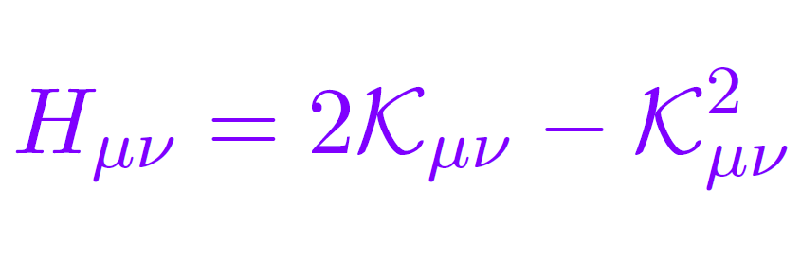
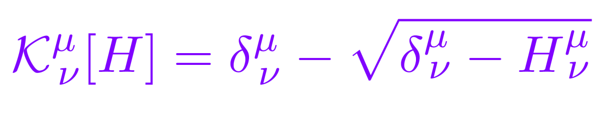
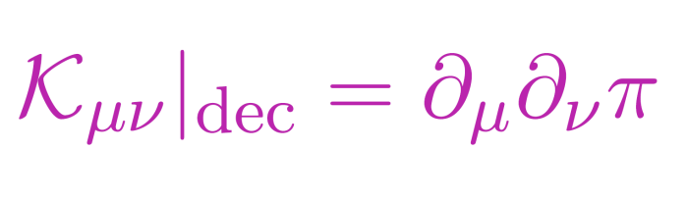
Decoupling limit
is a total derivative, for instance if
Defining ie.
Then in the decoupling limit,

Slide 17
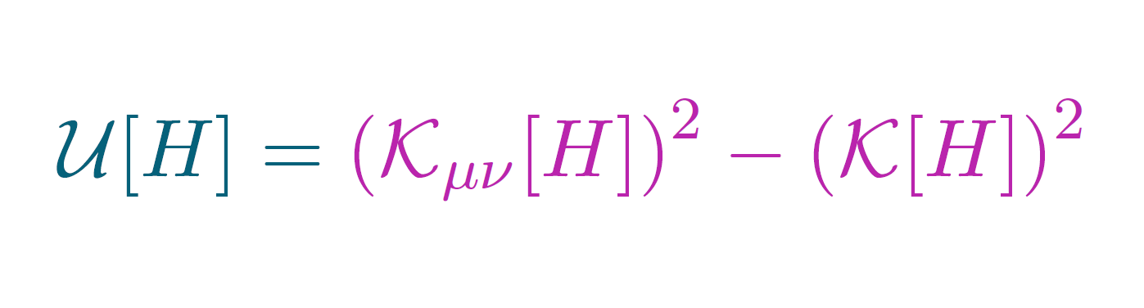
Decoupling limit
is a total derivative, for instance if
Defining ie.
Then in the decoupling limit,

Slide 18
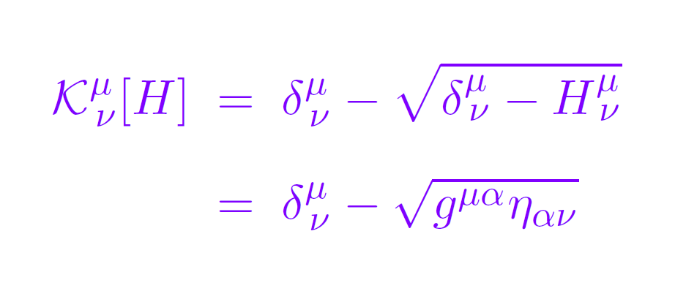
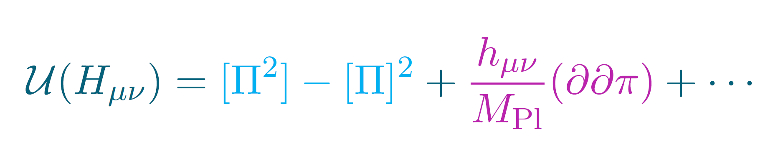
Ghost-free theory
The mass term
with
Has no ghosts to leading order in the decoupling limit
CdR, Gabadadze, Tolley, 1011.1232

Slide 19
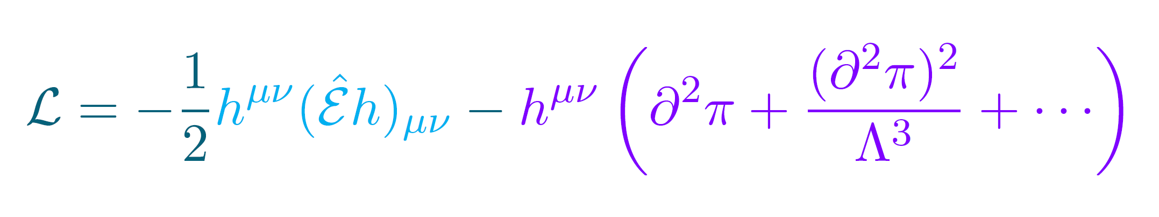
Ghost-free decoupling limit
In the decoupling limit (keeping )
CdR, Gabadadze, 1007.0443

Slide 20
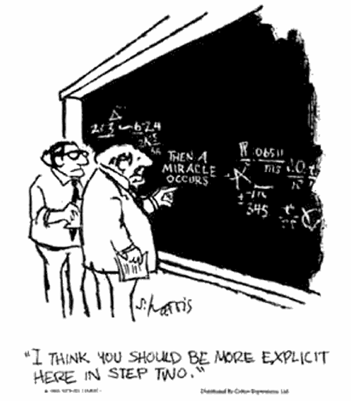
Ghost-free decoupling limit
In the decoupling limit (keeping )

Slide 21
Ghost-free decoupling limit
In the decoupling limit (keeping )
Only a finite number of interactions survive in the DL
CdR, Gabadadze, 1007.0443

Slide 22
Ghost-free decoupling limit
In the decoupling limit (keeping )
Only a finite number of interactions survive in the DL
The surviving interactions have the VERY specific structure
which prevents any ghost...
CdR, Gabadadze, 1007.0443

Slide 23
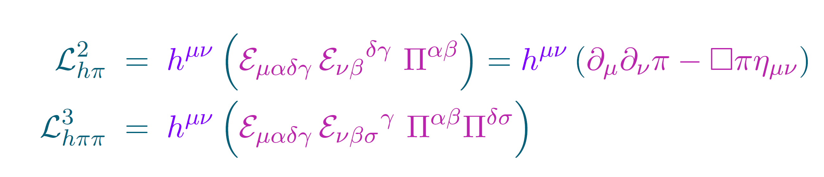
Ghost-free decoupling limit
In the decoupling limit (keeping )
CdR, Gabadadze, 1007.0443

Slide 24
Ghost-free decoupling limit
In the decoupling limit (keeping )
Only a finite number of interactions survive in the DL
The surviving interactions have the VERY specific structure
which prevents any ghost...
CdR, Gabadadze, 1007.0443
CdR, Gabadadze, Tolley, 1011.1232
Hassan & Rosen, 1106.3344
CdR, Gabadadze, Tolley, 1107.3820
CdR, Gabadadze, Tolley, 1108.4521
Hassan & Rosen, 1111.2070
Hassan, Schmidt-May & von Strauss, 1203.5283
The absence of ghosts can be
shown to all orders
beyond the decoupling limit

Slide 25
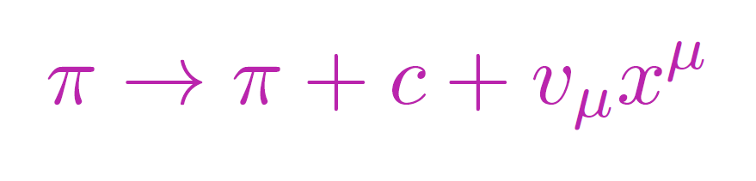
Ghost-free decoupling limit
In the decoupling limit (keeping )
Only a finite number of interactions survive in the DL
The surviving interactions have the VERY specific structure
which prevents any ghost...
CdR, Gabadadze, 1007.0443
CdR, Gabadadze, Tolley, 1011.1232
Hassan & Rosen, 1106.3344
CdR, Gabadadze, Tolley, 1107.3820
CdR, Gabadadze, Tolley, 1108.4521
Hassan & Rosen, 1111.2070
Hassan, Schmidt-May & von Strauss, 1203.5283
The absence of ghosts can be
shown to all orders
beyond the decoupling limit
The theory is invariant under the symmetry

Slide 26

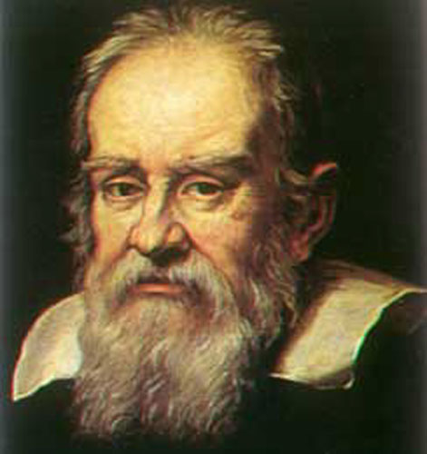

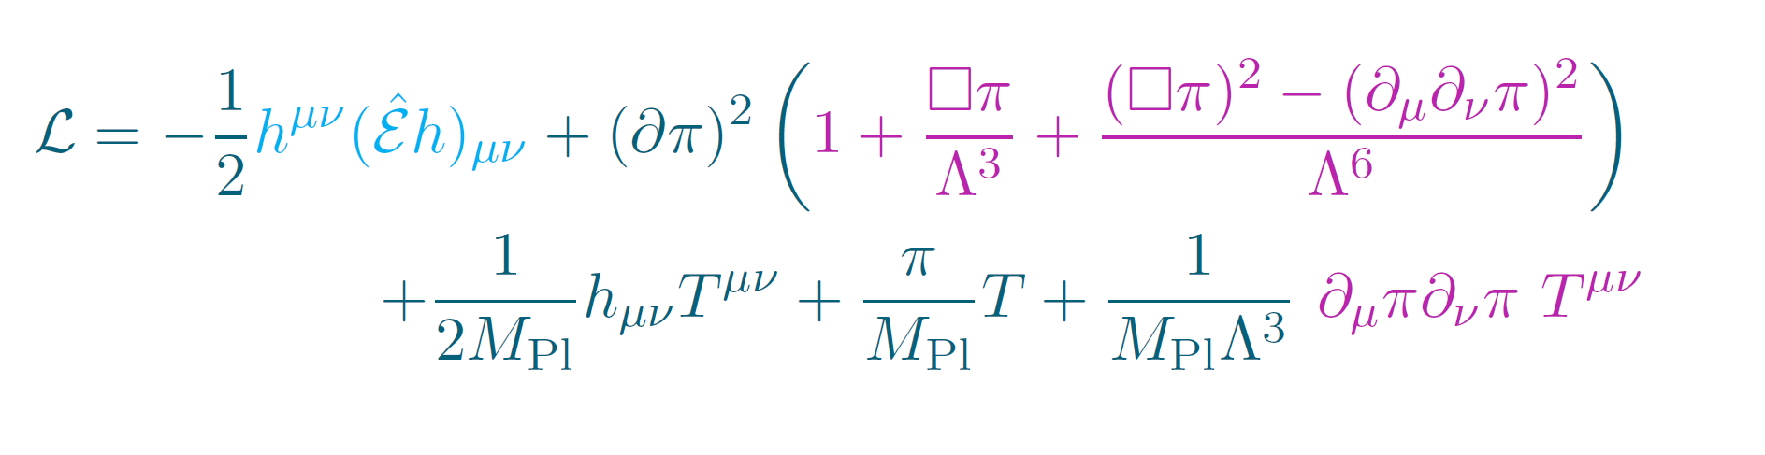
Ghost-free decoupling limit
In the decoupling limit (keeping )
After diagonalization, we are left with nothing else but the Galileon type of interactions
Only a finite number of interactions survive in the DL
The surviving interactions have the VERY specific structure
which prevents any ghost....
The theory is invariant under the symmetry
CdR, Gabadadze, 1007.0443

Slide 27

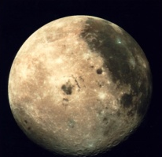
Playing Hide & Seek
Helicity - 2
Helicity - 0
But interactions for the helicity-0 mode are
already relevant at the scale

Slide 28
Playing Hide & Seek
Helicity - 2
Helicity - 0
Helicity-0 mode is strongly coupled to itself
Makes it weakly coupled to external sources

Slide 29
EFT and relevant operators
Higher derivative interactions are essential for the viability of this class of models.
Within the solar system, π reaches the scale Λ …
Vainshtein, Phys. Lett. B 39 (1972) 393
Babichev, Deffayet & Ziour, 0901.0393
Luty, Porrati, Rattazzi hep-th/0303116
Nicolis & Rattazzi, hep-th/0404159

Slide 30
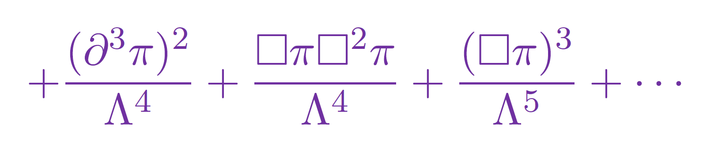
EFT and relevant operators
Higher derivative interactions are essential for the viability of this class of models.
Within the solar system, π reaches the scale Λ …
+ quantum corrections
Vainshtein, Phys. Lett. B 39 (1972) 393
Babichev, Deffayet & Ziour, 0901.0393
Luty, Porrati, Rattazzi hep-th/0303116
Nicolis & Rattazzi, hep-th/0404159

Slide 31
EFT and relevant operators
Higher derivative interactions are essential for the viability of this class of models.
Within the solar system, π reaches the scale Λ …
How can we trust the EFT at that scale ???

Slide 32
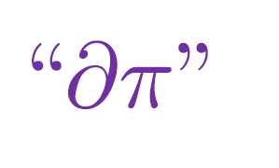
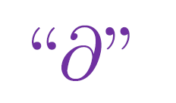
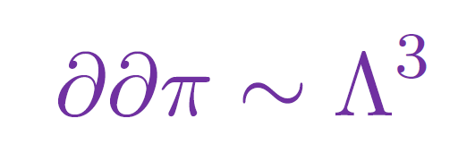
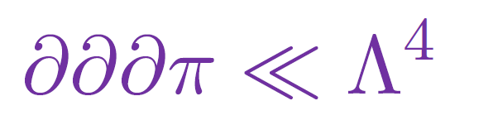
EFT and relevant operators
Higher derivative interactions are essential for the viability of this class of models.
Within the solar system, π reaches the scale Λ …
How can we trust the EFT at that scale ???
The breakdown of the EFT is not measured by the standard operator but instead by
We can trust a regime where
as long as
Luty, Porrati, Rattazzi hep-th/0303116
Nicolis & Rattazzi, hep-th/0404159

Slide 33
EFT and relevant operators
Higher derivative interactions are essential for the viability of this class of models.
Within the solar system, π reaches the scale Λ …
Luty, Porrati, Rattazzi hep-th/0303116
Nicolis & Rattazzi, hep-th/0404159

Slide 34
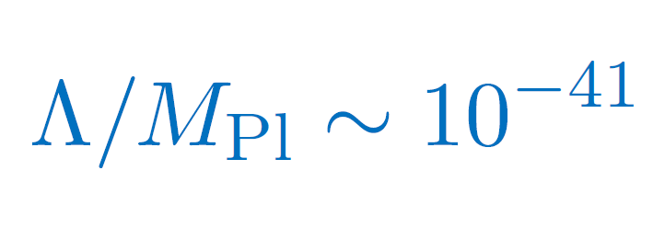
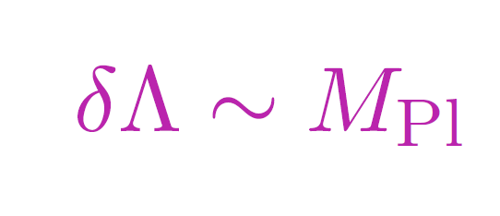
Tuning...
The Vainshtein mechanism relies on a large hierarchy of scales,
Naively we expect quantum corrections to destroy that tuning .

Slide 35
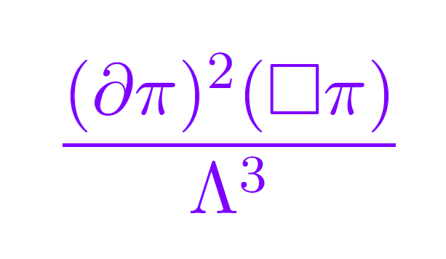
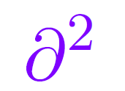
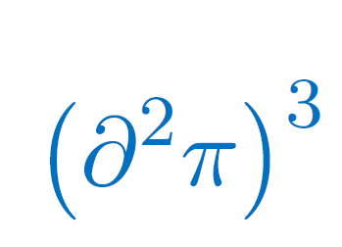
Tuning...
The Vainshtein mechanism relies on a large hierarchy of scales,
Naively we expect quantum corrections to destroy that tuning . eg. interaction
Renormalizes an
irrelevant operator

Slide 36
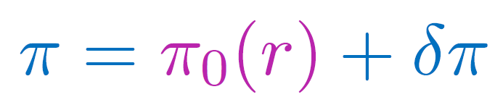
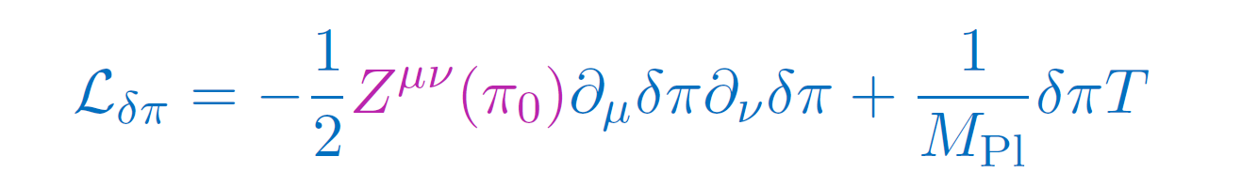
Non-renormalization theorem
The Vainshtein mechanism relies on a large classical background
h_{μν} remains linear within solar system but not π.
Which creates a new effective kinetic term for

Slide 37
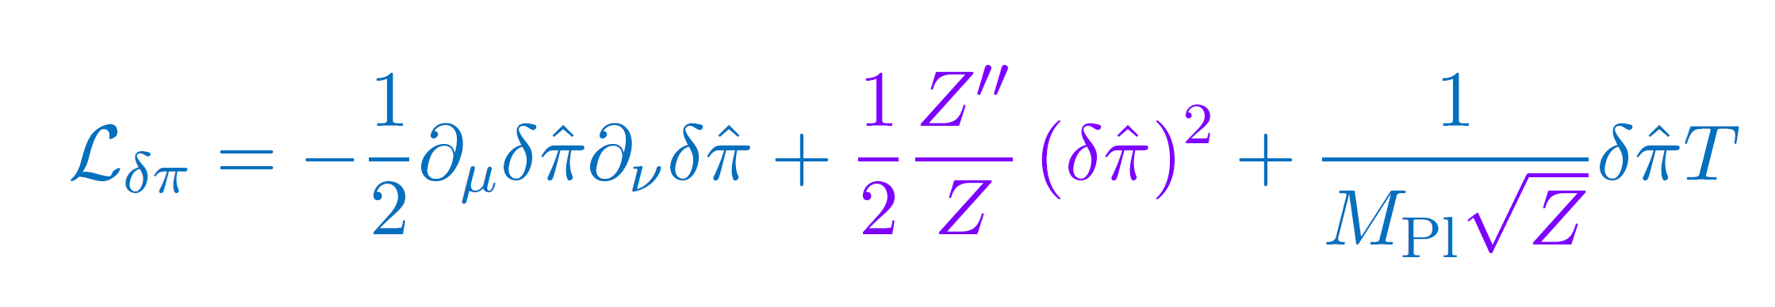
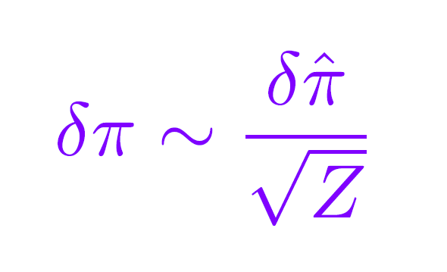
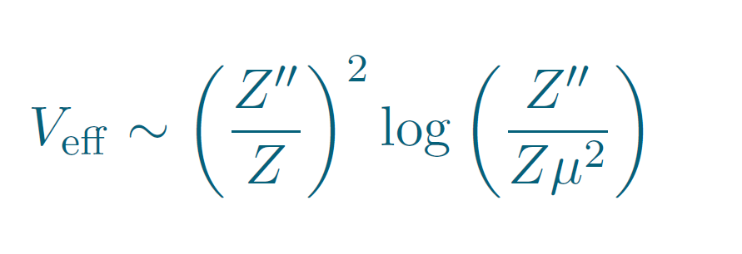
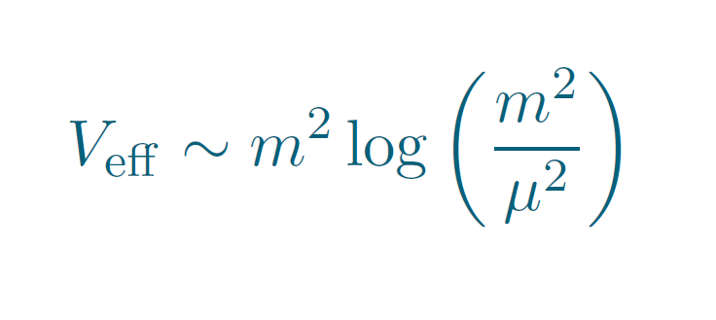
Non-renormalization theorem
The Vainshtein mechanism relies on a large classical background
h_{μν} remains linear within solar system but not π.
Which creates a new effective kinetic term for
The field should be properly canonical normalized
The coupling to matter is suppressed
The field acquires an effective mass
Associated Coleman-Weinberg effective potential

Slide 38
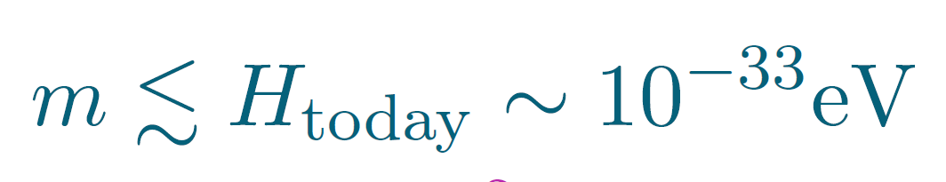
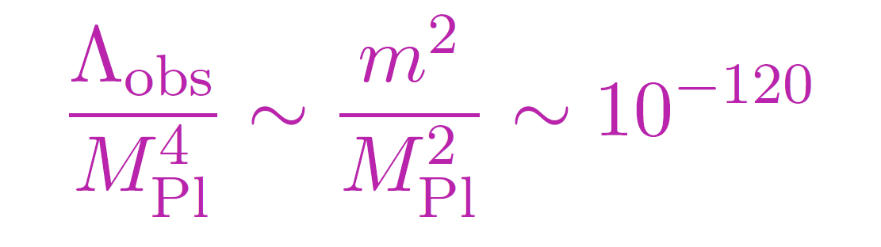
Tuning
To be consistent with observations, the graviton mass ought to be tuned,
Which is the same tuning as the vacuum energy,
Notes:
To see that, we can simply look at the linearized Einstein equation.
If I omit the tensor structure for a second, the Einstein equation looks like

Slide 39
Tuning
To be consistent with observations, the graviton mass ought to be tuned,
Which is the same tuning as the vacuum energy,
One expects the graviton mass to be protected against quantum corrections
Notes:
To see that, we can simply look at the linearized Einstein equation.
If I omit the tensor structure for a second, the Einstein equation looks like

Slide 40

Tuning / Fine-Tuning
Mass renormalization
Notes:
To see that, we can simply look at the linearized Einstein equation.
If I omit the tensor structure for a second, the Einstein equation looks like

Slide 41
Tuning / Fine-Tuning
Mass renormalization
Corrections from new degrees of Freedom
They come protected by a
non-renormalization theorem
( Galileon types of interactions )
CdR & Heisenberg, to appear soon
Notes:
To see that, we can simply look at the linearized Einstein equation.
If I omit the tensor structure for a second, the Einstein equation looks like

Slide 42

Now that we’ve modified gravity...

Slide 43

Implications for our current Universe
New polarizations
of graviton could be
Dark Energy !

Slide 44

Implications for our current Universe
New polarizations
of graviton could be
Dark Energy !
Not yet again another new model for dark energy...

Slide 45
Implications for our current Universe
New polarizations
of graviton could be
Dark Energy !
Graviton mass could
alleviate the
cosmological constant
problem !

Slide 46

Vacuum Energy from Particle Physics
Could the rough estimate from particle physics be correct ?
Is there a way to hide such
a huge Cosmological
Constant ???

Slide 47
Vacuum Energy from Particle Physics
Could the rough estimate from particle physics be correct ?
Is there a way to hide such
a huge Cosmological
Constant ???
NO !!! (not in GR)
But maybe in
Massive gravity ???

Slide 48
General Relativity
Λ
Phase transition
time
time
H²
time
time
Notes:
To see that, we can simply look at the linearized Einstein equation.
If I omit the tensor structure for a second, the Einstein equation looks like

Slide 49
Relaxation mechanism in MG
Λ
Phase transition
time
time
H²
1/m
time
time
Notes:
To see that, we can simply look at the linearized Einstein equation.
If I omit the tensor structure for a second, the Einstein equation looks like

Slide 50

Cosmology in Massive Gravity
Massive Gravity has flat space-time as a reference

Slide 51

Cosmology in Massive Gravity
Massive Gravity has flat space-time as a reference
Which has a fundamentally different
topology than dS
there is NO spatially flat
homogeneous FRW solutions.

Slide 52

Cosmology in Massive Gravity
Massive Gravity has flat space-time as a reference
Which has a fundamentally different
topology than dS
there is NO spatially flat
homogeneous FRW solutions.

Slide 53

Inhomogeneous Cosmology
Could our Universe be composed of Inhomogeneous
patches ???
A priori we don’t
expect our Universe
to be homogeneous on
distances larger than the
Hubble length !
D’Amico, CdR, Dubovsky, Gabadadze, Pirtskhalava & Tolley, Phys.Rev. D84 (2011) 124046

Slide 54


Inhomogeneous Cosmology
Could our Universe be composed of Inhomogeneous
patches ???
At high densities,
Vainshtein mechanism
at work to “hide” the
additional helicity-0
modes
Locally, each patch is essentially FRW

Slide 55


Inhomogeneous Cosmology
As the Universe cools down,
the new dof acquire their own
dynamics
At late time the cosmology
differs significantly
from GR
Gives a bound on the graviton mass

Slide 56


Observational Signatures
The new dofs only manifests themselves in low-energy environment
- Structure formation
- Weak Lensing
Mark Wyman, Phys.Rev.Lett. 106 (2011) 201102
Khoury & Wyman, Phys.Rev. D80 (2009) 064023

Slide 57




Observational Signatures
The new dofs only manifests themselves in low-energy environment
- Structure formation
- Weak Lensing
- Through precision tests in
the Solar System
- Via Binary Pulsar Timing
CdR, Matas, Tolley, Wesley, in progress

Slide 58
Observational Signatures
All manifestations of the
helicity-0 (scalar) mode !
The new dofs only manifests themselves in low-energy environment
- Structure formation
- Weak Lensing
- Through precision tests in
the Solar System
- Via Binary Pulsar Timing
CdR, Matas, Tolley, Wesley, in progress

Slide 59



Massless Limit of Gravity
+ 2
+ 2
+ 1
+ 1
0
0
- 1
- 1
- 2
- 2
General covariance 4 Symmetries only 2 dof

Slide 60

Partially Massless Limit of Gravity
Deser & Waldron, 2001
+ 2
+ 2
+ 1
+ 1
0
0
- 1
- 1
- 2
- 2
Other Limit Other Symmetry 4 dof
keep graviton massive

Slide 61
Change of Ref. metric
The notion of mass requires a reference !
dS Metric
Metric
Hassan & Rosen, 2011

Slide 62






Massive Gravity in de Sitter
Healthy scalar field
How about at exactly
See Matteo Fasiello’s talk for everything you
always dreamt to know about the Higuchi ghost
...and never dare to ask

Slide 63


(Partially) massless limit
Massless limit
GR + mass term
Recover 4d diff invariance
GR
2 dof (helicity 2)

Slide 64


(Partially) massless limit
Massless limit
Partially Massless limit
GR + mass term
GR + mass term
Recover 4d diff invariance
Recover 1 symmetry
GR
Massive GR
2 dof (helicity 2)
4 dof (helicity 2 &1)

Slide 65
CdR & Sébastien Renaux-Petel, to appear soon
GR + mass term
Vainshtein mechanism
Helicity-0 mode is
strongly coupled
in the
partially massless limit
Recover 1 symmetry
Partially Massive gravity
4 dof (helicity 2 &1)

Slide 66


Symmetries in DL around Minkowski
In the decoupling limit,
with
fixed
Linearized diff invariance
2 Accidental Global Symmetries
Covariance
Space-time
Global Lorentz Invariance
Internal
Global Lorentz Invariance
Notes:
To see that, we can simply look at the linearized Einstein equation.
If I omit the tensor structure for a second, the Einstein equation looks like

Slide 67


Symmetries in DL around Minkowski
If we work in the representation of the single group
with
fixed
behaves as a vector under this Global Symmetry
Covariance
Space-time
Global Lorentz Invariance
Internal
Global Lorentz Invariance
AND
Notes:
To see that, we can simply look at the linearized Einstein equation.
If I omit the tensor structure for a second, the Einstein equation looks like

Slide 68


Symmetries in DL around Minkowski
If we work in the representation of the single group
with
fixed
behaves as a vector under this Global Symmetry
Covariance
It makes sense to use a SVT decomposition
under this representation
  behaves as a scalar in the dec. limit and captures the physics of the helicity-0 mode
Notes:
To see that, we can simply look at the linearized Einstein equation.
If I omit the tensor structure for a second, the Einstein equation looks like

Slide 69
Symmetries in DL around Minkowski
This is no longer true if we use
another reference metric ...
If we work in the representation of the single group
with
fixed
behaves as a vector under this Global Symmetry
Covariance
It makes sense to use a SVT decomposition
under this representation
  behaves as a scalar in the dec. limit and captures the physics of the helicity-0 mode
Notes:
To see that, we can simply look at the linearized Einstein equation.
If I omit the tensor structure for a second, the Einstein equation looks like

Slide 70

Helicity-0 on dS
CdR & Sébastien Renaux-Petel, to appear soon
To identify the helicity-0 mode on de Sitter, we copy the procedure on Minkowski.
Can embed 4d dS into 5d Minkowski:
Notes:
To see that, we can simply look at the linearized Einstein equation.
If I omit the tensor structure for a second, the Einstein equation looks like

Slide 71


Helicity-0 on dS
CdR & Sébastien Renaux-Petel, to appear soon
To identify the helicity-0 mode on de Sitter, we copy the procedure on Minkowski.
Can embed 4d dS into 5d Minkowski:
  behaves as a scalar in the dec. limit and captures the physics of the helicity-0 mode
Notes:
To see that, we can simply look at the linearized Einstein equation.
If I omit the tensor structure for a second, the Einstein equation looks like

Slide 72

Decoupling limit on dS
CdR & Sébastien Renaux-Petel, to appear soon
Using the properly identified helicity-0 mode, we can derive the decoupling limit on dS
Since we need to satisfy the Higuchi bound,
Notes:
To see that, we can simply look at the linearized Einstein equation.
If I omit the tensor structure for a second, the Einstein equation looks like

Slide 73

Decoupling limit on dS
CdR & Sébastien Renaux-Petel, to appear soon
Using the properly identified helicity-0 mode, we can derive the decoupling limit on dS
Since we need to satisfy the Higuchi bound,
The resulting DL resembles a Galileon
Notes:
To see that, we can simply look at the linearized Einstein equation.
If I omit the tensor structure for a second, the Einstein equation looks like

Slide 74

Decoupling limit on dS
CdR & Sébastien Renaux-Petel, to appear soon
Using the properly identified helicity-0 mode, we can derive the decoupling limit on dS
Since we need to satisfy the Higuchi bound,
The resulting DL resembles a Galileon
The Vainshtein mechanism that decouples π works in the DL in the limit
Notes:
To see that, we can simply look at the linearized Einstein equation.
If I omit the tensor structure for a second, the Einstein equation looks like

Slide 75
To conclude…
6 = 5+1
5=2+2+1
5= 4+1

Slide 76
To conclude…
6 = 5+1
5=2+2+1
5= 4+1
GW could in principle have up to 6 polarizations,
one of them being a ghost

Slide 77
To conclude…
6 = 5+1
5=2+2+1
5= 4+1
GW could in principle have up to 6 polarizations,
one of them being a ghost
Massive Gravity has 5 polarizations

Slide 78
To conclude…
6 = 5+1
5=2+2+1
5= 4+1
GW could in principle have up to 6 polarizations,
one of them being a ghost
Massive Gravity has 5 polarizations
3 of them decouple in the
massless limit

Slide 79
To conclude…
6 = 5+1
5=2+2+1
5= 4+1
GW could in principle have up to 6 polarizations,
one of them being a ghost
Massive Gravity has 5 polarizations
3 of them decouple in the
massless limit
1 of them decouples in the
partially massless limit

