Slide 1
The Cosmology of
Massive (Bi)gravity
Adam R. Solomon
Center for Particle Cosmology,
University of Pennsylvania
Spontaneous Workshop X
Cargèse
May 9th, 2016

Slide 2

Collaborators:
Heidelberg:
Yashar Akrami
Luca Amendola
Frank Könnig
Geneva:
Mariele Motta
Stockholm/Nordita:
Jonas Enander
Fawad Hassan
Tomi Koivisto
Edvard Mörtsell
Zürich:
Angnis Schmidt-May
Based on:
1404.4061 ARS, Akrami, & Koivisto (JCAP)
1407.4331 Könnig, Amendola, Akrami, Motta, & ARS (PRD)
1409.2860 Enander, ARS, Akrami, & Mörtsell (JCAP)
1409.8300 ARS, Enander, et al. (JCAP)
1503.07521 Akrami, Hassan, Könnig, Schmidt-May, & ARS (PLB)

Slide 3
Why a massive graviton?
GR is an important theory – its boundaries need to be pushed!
  Tests of gravity improve by the year
Field theory – how to construct spin-2 interactions?
Cosmology – the accelerating Universe

Slide 4
Why bimetric gravity?
Old CC problem: why isn’t Λ huge?
New CC problem: why is Λ nonzero?
Try modifying GR
Conceptually simple modification:
give the graviton a small mass
This leads naturally to a theory with two metrics
Also: field theory motivation:
how to construct interacting spin-2 fields?

Slide 5
Dark energy or modified gravity?
Einstein’s equation + the Standard Model + dark matter predict a decelerating universe, but this contradicts observations. The expansion of the Universe is accelerating!
What went wrong?? Two possibilities:
Dark energy: Do we need to include new “stuff” on the RHS?
Modified gravity: Are we using the wrong equation to describe gravity at cosmological distances?

Slide 6
Cosmic acceleration has theoretical problems which modified gravity might solve
Technically natural self-acceleration (new problem): Late-time acceleration due to modified gravity may not get destabilized by quantum corrections.
  THE major problem with a simple cosmological constant
Degravitation (old problem): Perhaps an IR modification of gravity makes a large CC invisible to gravity

Slide 7
What would gravity be beyond GR?
Some famous examples
Brans-Dicke (1961): make Newton’s constant dynamical:
G_{N} = 1/ϕ, gravity couples non-minimally to ϕ
f(R) (2000s): replace Einstein-Hilbert term with a general function f(R) of the Ricci scalar

Slide 8
What would gravity be beyond GR?
These theories are generally not simple
  Even f(R) looks elegant in the action, but from a degrees of freedom standpoint it is a theory of a scalar field non-minimally coupled to the metric, just like Brans-Dicke, Galileons, Horndeski, etc.

Slide 9
How can we do gravity beyond GR?
Most attempts at modifying GR are guided by Lovelock’s theorem (Lovelock, 1971):
The game of modifying gravity is usually played by breaking one or more of these assumptions
GR is the unique theory of gravity which
Only involves a rank-2 tensor
Has second-order equations of motion
Is in 4D
Is local and Lorentz invariant

Slide 11
Another path: degrees of freedom
(or, Lovelock or Weinberg?)
GR is unique.
But instead of thinking about that uniqueness through Lovelock’s theorem, we can also remember that (Weinberg, others, 1960s)…
GR = massless spin-2
A natural way to modify GR: give the graviton mass!

Slide 12
Some (hand-wavy, historical) motivation
Technical naturalness: small graviton mass expected to be natural because diff invariance restored in limit m→0
Degravitation: Yukawa force may weaken response to long-wavelength sources (e.g., Λ) à la high-pass filter
Cosmic acceleration: weaker gravity at large distances may lead to late-time acceleration

Slide 13
How to build a massive graviton
Step 1: Go linear
Consider a linearized metric
The Einstein-Hilbert action at quadratic order is
with the Lichnerowicz operator defined by
This action is invariant under linearized diffeomorphisms

Slide 14
How to build a massive graviton
Step 1: Go linear
Unique healthy (ghost-free) mass term
(Fierz and Pauli, 1939):
This massive graviton contains five polarizations:
  2 x tensor
  2 x vector
  1 x scalar
Fierz-Pauli tuning: Any other coefficient between and leads to a ghostly sixth degree of freedom

Slide 15
How to build a massive graviton
Step 2: Go nonlinear
Gravity can’t be described by a linear theory
  Stress-energy conservation broken by matter-graviton coupling
Q: What is nonlinear completion of Fierz-Pauli?
  Analogous to how GR completes linearized massless gravity
Problem: ghosts!
  Boulware-Deser ghost: Fierz-Pauli tuning generally fails at cubic and higher orders
Ghost-free nonlinear completion only found in 2010
(de Rham, Gabadadze, Tolley – dRGT)

Slide 16
dRGT Massive Gravity in a Nutshell
The unique non-linear action for a single massive spin-2 graviton is
where f_{μν} is a reference metric which must be chosen at the start
β_{n} are the free parameters; the graviton mass is ~m²β_{n}
The e_{n} are elementary symmetric polynomials given by…

Slide 17
For a matrix X, the elementary symmetric polynomials are ([] = trace)

Slide 18
Much ado about a reference metric?
There is a simple (heuristic) reason that massive gravity needs a second metric: you can’t construct a non-trivial interaction term from one metric alone:
We need to introduce a second metric to construct interaction terms.
Can be Minkowski, (A)dS, FRW, etc., or even dynamical
This points the way to a large family of theories with a massive graviton

Slide 19
Theories of a massive graviton
Examples of this family of massive gravity theories:
g_{μν}, f_{μν} dynamical: bigravity (Hassan, Rosen: 1109.3515)
  One massive graviton, one massless
g_{μν}, f_{1,μν}, f_{2,μν}, …, f_{n,μν}, with various pairs coupling à la dRGT: multigravity (Hinterbichler, Rosen: 1203.5783)
  One massive graviton, n massless
Massive graviton coupled to a scalar (e.g., quasidilaton, mass-varying)

Slide 20
The search for viable massive cosmologies
No stable FLRW solutions in dRGT massive gravity
Way out #1: large-scale inhomogeneites
Way out #2: generalize dRGT
  Break translation invariance (de Rham+: 1410.0960)
  Generalize matter coupling (de Rham+: 1408.1678)
Way out #3: new degrees of freedom
  Scalar (mass-varying, f(R), quasidilaton, etc.)
  Tensor (bi/multigravity) (Hassan/Rosen: 1109.3515)

Slide 21
Cosmology in bigravity: the situation to date
Self-accelerating solutions exist, agree with background observations (SNe, BAO, CMB)
  Akrami, Koivisto, & Sandstad 1209.0457 (JHEP)
But, they are plagued by instabilities!
  Crisostomi, Comelli, & Pilo 1202.1986 (JHEP)
  Könnig, Akrami, Amendola, Motta, & ARS 1407.4331 (PRD)
  Lagos and Ferreira 1410.0207 (JCAP)
Is all lost? (Spoiler alert: Maybe not!)

Slide 22
Bigravity in a nutshell
The action for bigravity for metrics g_{μν} and f_{μν} is
V: interaction potential built out of the matrix
m: interaction scale/”graviton mass”
M_{pl}, M_{f}: Planck masses for g_{μν} and f_{μν}
g_{μν}: physical (spacetime) metric; f_{μν}: modifies gravity

Slide 23
Three things to keep in mind…
V has restricted form to avoid ghosts
de Rham, Gabadadze, and Tolley
Hassan and Rosen
Self-acceleration requires m ~ H₀ ~ 10⁻³³ eV
Diffeomorphism invariance broken by g⁻¹f
Recovered when m=0
Small m – protected from quantum corrections
(Contrast this with Λ!)

Slide 24
For a matrix X, the elementary symmetric polynomials are ([] = trace)
Cosmological constant for g_{μν}
Cosmological constant for f_{μν}

Slide 25
The elementary symmetric polynomials can be nicely rewritten as

Slide 26
Or, in terms of vielbeins

Slide 27
Massive bigravity has self-accelerating cosmologies
Consider FRW solutions
NB: g = physical metric (matter couples to it)
Bianchi identity fixes X
New dynamics are entirely controlled by y = Y/a

Slide 28
Massive bigravity has self-accelerating cosmologies
The Friedmann equation for g is
The Friedmann equation for f becomes algebraic after applying the Bianchi constraint:

Slide 29
Massive bigravity has self-accelerating cosmologies
At late times, ρ → 0 and so y → const.
The mass term in the Friedmann equation approaches a constant – dynamical dark energy

Slide 30
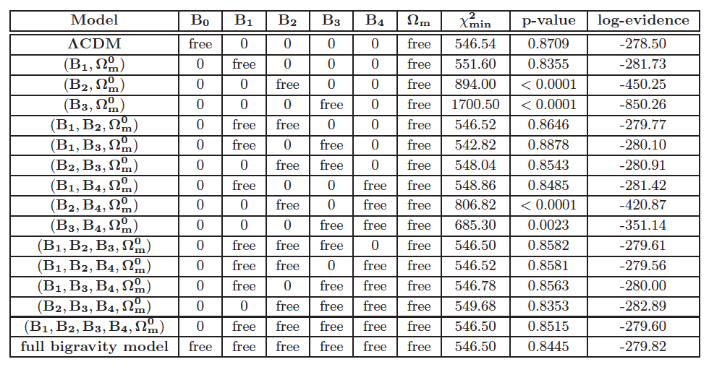
Massive bigravity vs. ΛCDM
Y. Akrami, T. Koivisto, and M. Sandstad [arXiv:1209.0457]
See also F. Könnig, A. Patil, and L. Amendola [arXiv:1312.3208];
ARS, Y. Akrami, and T. Koivisto [arXiv:1404.4061]

Slide 31
Beyond the background
Cosmological perturbation theory in massive bigravity is a huge cottage industry and the source of many PhD degrees (yay). See:
Cristosomi, Comelli, and Pilo, 1202.1986
ARS, Akrami, and Koivisto, 1404.4061
Könnig, Akrami, Amendola, Motta, and ARS, 1407.4331
Könnig and Amendola, 1402.1988
Lagos and Ferreira, 1410.0207
Cusin, Durrer, Guarato, and Motta, 1412.5979
and many more for more general matter couplings!

Slide 32
Scalar perturbations in massive bigravity
Approach of ARS and friends (esp. Frank Könnig):
1407.4331 and 1404.4061
Linearize metrics around FRW backgrounds, restrict to scalar perturbations {E_{g,f}, A_{g,f}, F_{g,f}, and B_{g,f}}:
Full linearized Einstein equations (in cosmic or conformal time) can be found in ARS, Akrami, and Koivisto, arXiv:1404.4061

Slide 33
Scalar fluctuations can suffer from instabilities
Usual story: solve perturbed Einstein equations in subhorizon, quasistatic limit:
This is valid only if perturbations vary on Hubble timescales
Cannot trust quasistatic limit if perturbations are unstable
Check for instability by solving full system of perturbation equations

Slide 34
Scalar fluctuations can suffer from instabilities
Degree of freedom count: nine total variables
  Four g_{μν} perturbations: E_{g}, A_{g}, B_{g}, F_{g}
  Four f_{μν} perturbations: E_{f}, A_{f}, B_{f}, F_{f}
  One perfect fluid perturbation: χ
Seven are redundant:
  Four of these are nondynamical/auxiliary (E_{g}, F_{g}, E_{f}, F_{f})
  Two can be gauged away
  After integrating out auxiliary variables, one of the dynamical variables becomes auxiliary – related to absence of ghost!
End result: only two independent degrees of freedom
NB: This story is deeply indebted to Lagos and Ferreira

Slide 35
Scalar fluctuations can suffer from instabilities
Choose g-metric Bardeen variables:
Then entire system of 10 perturbed Einstein/fluid equations can be reduced to two coupled equations:
where

Slide 36
Scalar fluctuations can suffer from instabilities
Ten perturbed Einstein/fluid equations can be reduced to two coupled equations:
where
Under assumption (WKB) that F_{ij}, S_{ij} vary slowly, this is solved by
with N = ln a

Slide 37
Scalar fluctuations can suffer from instabilities
B₁-only model – simplest allowed by background
Unstable for small y (early times)
NB: Gradient instability

Slide 38
A = -\[Beta]1 + 3/\[Beta]1;y[a_] := (1/6) a^-3 (-A + Sqrt[12 a^6 + A^2])ParametricPlot[{1/a - 1, y[a]} /. \[Beta]1 -> 1.38, {a, 1/6, 1}, AspectRatio -> .8, PlotTheme -> "Detailed", FrameLabel -> {z, y}, PlotLegends -> None, ImageSize -> Large, LabelStyle -> {FontFamily -> "Latin Modern Roman", FontSize -> 20, FontColor -> RGBColor[0, 0.01, 0]}]

Slide 39
Scalar fluctuations can suffer from instabilities
B₁-only model – simplest allowed by background
Unstable for small y (early times)
For realistic parameters, model is only (linearly) stable for z <~ 0.5

Slide 40
No good models?
Every single bigravity model (i.e., parameter choice) has at least one of:
  Gradient instability
  Ghost instability
  Nonviable background evolution

Slide 41
Gradient instability does not rule models out
Instability → breakdown of linear perturbation theory
  Nothing more
  Nothing less
Cannot take quasistatic limit for unstable models
Need nonlinear techniques to make structure formation predictions
  See me if you’re interested!
Simplest model (β₁) has no Higuchi ghost!
Fasiello and Tolley, 1308.1647

Slide 42
Do nonlinearities save us?
Helicity-0 mode of the massive graviton has nonlinear derivative terms (cf. galileons)
Linear perturbation theory misses these
Some evidence that the gradient instability is cured by these nonlinearities! (Aoki, Maeda, Namba 1506.04543)
  Morally related to the Vainshtein mechanism
Deeper look into this (status of instability, predictions for structure formation) in progress!

Slide 43
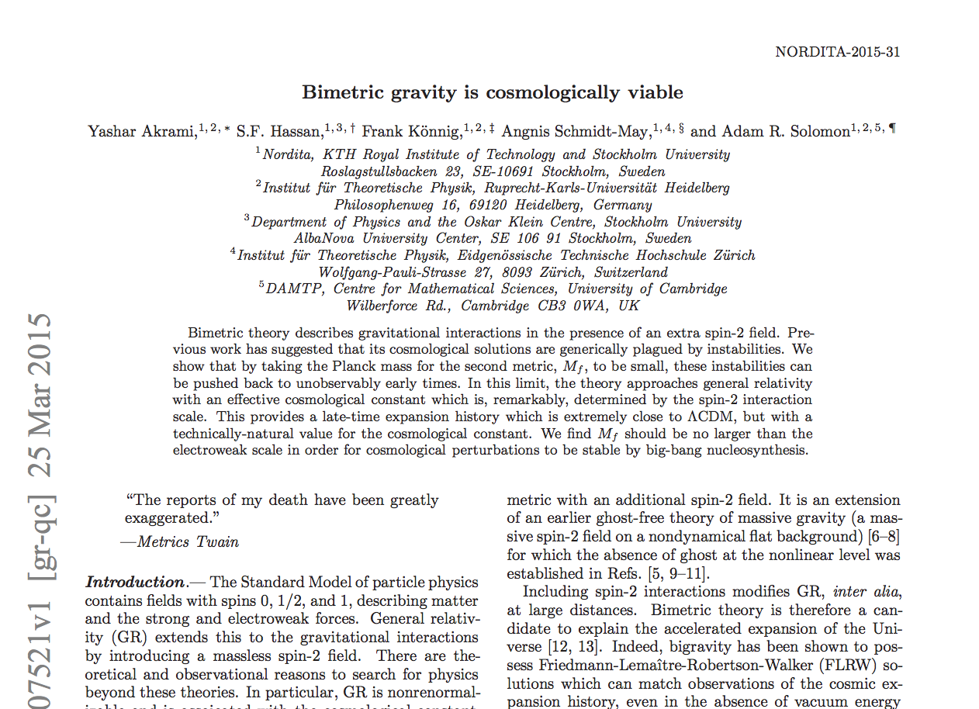
A way out? arXiv:1503.07521

Slide 44
There is nothing stable in the world; uproar's your only music.
John Keats
Most FLRW solutions have gradient instability
Subhorizon scalar perturbations grow exponentially from t=0 until recently (~acceleration era)
  Until z~0.5 in the simplest model
  Our goal: push back instability without losing acceleration
Big Bang
z=0.5
z=0
z

Slide 45
The GR limit of bigravity
The field equations are
Limit M_{f} → 0: bigravity becomes GR
  f equation: fixes f in terms of g algebraically
  This implies
  The metric interactions leave behind an effective cosmological constant!
NB In this limit, fluctuations of g become massless

Slide 46
Exorcising the instability
Question: what happens to the instability in the GR limit?
Answer: it never vanishes, but ends at earlier and earlier times
By making f-metric Planck mass very small, instability can be unobservable or beyond cutoff of the EFT
Perturbations stable after H = H★, with
Ex: instability absent after BBN requires M_{f} ~ 100 GeV

Slide 47
Doesn’t the GR limit make the theory boring?
Don’t we lose self-acceleration?
No!
Consider (example) the interaction potential
The effective cosmological constant is
We still have self-acceleration and automatic consistency with observations!

Slide 48
Taking M_{f} / M_{pl} small (<~10⁻¹⁷) we find
Bigravity = GR+ O(M_{f}²/M_{pl}²)
Bad news: difficult to distinguish from GR
Good news: small CC is technically natural
HUGE improvement over standard ΛCDM
(More good news: agrees with observations as well as GR does)

Slide 49
How was this missed?
M_{f} is usually seen as a redundant parameter. The rescaling
leaves the action unchanged.
Common practice in bigravity: set M_{f} = M_{pl} from the start!
In this language, the GR limit is
β₁ ~ 10¹⁷
β₂ ~ 10³⁴
etc.
which looks weird and highly unnatural!
Also: need more than one β_{n} nonzero

Slide 50
A way forward?
By taking second-metric Planck mass to be small, bigravity cosmologies become stable
  Instability still exists, but at unobservably early times
Cosmologies extremely close to ΛCDM at late times
GR limit only valid when
This is also the condition for absence of instability!
→ Possible early-time tests

Slide 51

http://espressoontherocks.deviantart.com/art/1265-Massive-Gravity-503189237

Slide 52
Summary
Massive gravity is a promising approach to solving cosmic acceleration
Bimetric massive gravity has cosmological backgrounds competitive with ΛCDM
These models have linear instabilities
Is the gradient instability cured nonlinearly?
Another option: take small f-metric Planck mass

Slide 53
Collaborators:
Heidelberg:
Yashar Akrami
Luca Amendola
Frank Könnig
Geneva:
Mariele Motta
Stockholm/Nordita:
Jonas Enander
Fawad Hassan
Tomi Koivisto
Edvard Mörtsell
Zürich:
Angnis Schmidt-May
Based on:
1404.4061 ARS, Akrami, & Koivisto (JCAP)
1407.4331 Könnig, Amendola, Akrami, Motta, & ARS (PRD)
1409.2860 Enander, ARS, Akrami, & Mörtsell (JCAP)
1409.8300 ARS, Enander, et al. (JCAP)
1503.07521 Akrami, Hassan, Könnig, Schmidt-May, & ARS (PLB)

Slide 54
Small M_{f}: is there a strong-coupling problem?
m << M_{f} << M_{pl}
Do perturbations of f_{μν} become strongly-coupled for k~M_{f}?
  This ignores potential: when M_{f} = 0, f_{μν} is set by g_{μν}
  All relevant cosmological perturbations satisfy k/M_{f} << 1
Doesn’t this lower the massive-gravity cutoff Λ₃=(m²M_{pl})^{1/3}?
  The analogous scale is not (m²M_{f})^{1/3} but actually (m²M_{pl}²/M_{f})^{1/3}
  Raises the cutoff, rather than lowering it!
  This is because we are working with the GR limit of bigravity, which is not like massive gravity

