Slide 1
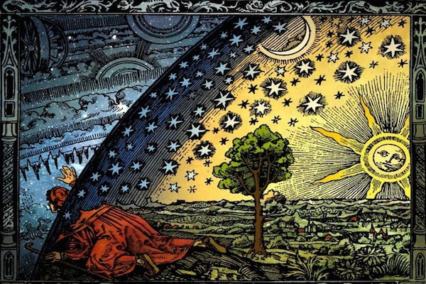
Non-Abelian S-term dark energy and inflation
Based on Physics of the Dark Universe 19 (2018) 129
Andrés A. Navarro
Yeinzon Rodríguez
Notes:
Good morning, mi name is Andres navarro, I am phd student in the universidad industrial de Santander. Today, I will talk about my doctoral research.

Slide 2
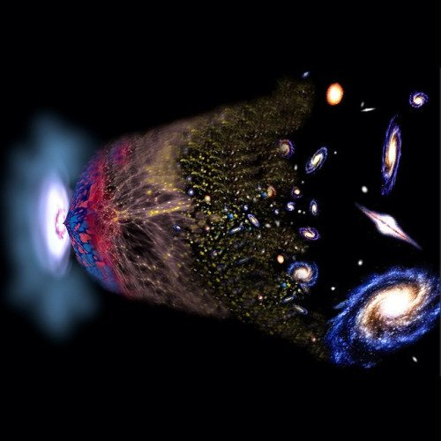
let's start with the next question:
Did Nature have any option at defining the action that describes the natural phenomena?
Notes:
let me start with the next question:
Did Nature have any option at defining the action that describes the natural phenomena?

Slide 3
The answer is yes, but it is quite limited:
Define the field content.
Define the symmetries enjoyed by the action.
Be sure, please, that the Hamiltonian is bounded from below! Otherwise…
Notes:
Why is limited, well:
we need to define the content of fields.
it is also necessary to define symmetries associated with the action.
Is really important that the Hamiltonian is bounded from below

Slide 4
You will end up suffering!!:
Unstable at the classical and quantum level.
This is the Ostrogradski’s instability.
Notes:
You will end up suffering:
Your theory will be severely unstable at the classical level and even more at the quantum level! .
This is the Ostrogradski’s instability.

Slide 5
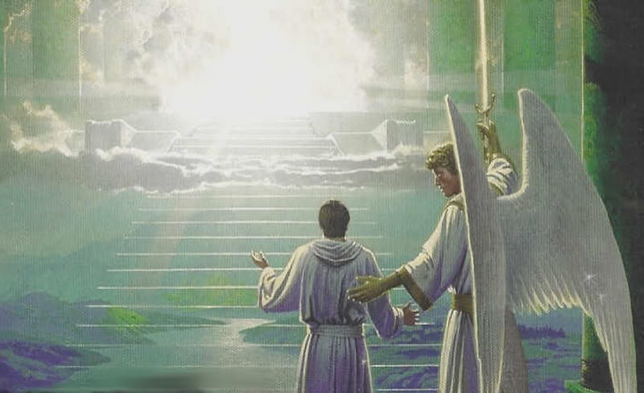
And how can we avoid these problems?
The equations of evolution second order.
This is not enough but it is a necessary condition.
The road to heaven is the Galileon/Horndeski theories.
Notes:
The equations of evolution must be, at most, second order in space-time derivatives.
This is not enough but it is a necessary condition.
One possibility to avoid these problems is the study of Horndeski theories

Slide 6
Road to heaven (leading to, at most, second-order field equations)
Horndeski (Int. J. Theor. Phys. 1974): scalar field + gravity.
Horndeski (J. Math. Phys. 1976): vector field + gravity.
Nicolis et. al., Phys. Rev. D 2009; Deffayet et. al., several Phys. Rev. D within 2009-2011.
Notes:
how is the road to this theory:
Horndeski in 1974 built the most general scalar-tensor theory
and 2 year after built the most general vector-tensor theory with an Abelian gauge symmetry
Horndeski theories were rediscovered 33 years later and called Galileon theories

Slide 7
The road to heaven (leading to, at most, second-order field equations)
Heisenberg (JCAP 2014) and Tasinato (JHEP 2014): vector Galileon theory.
Allys et. al. (JCAP 2016) and Heisenberg et. al. (Phys. Lett. B 2016) formulate the complete vector Galileon theory.
Allys et. al. (Phys. Rev. D 2016): Generalized SU(2) Proca theory.
Notes:
Heisenberg (JCAP 2014) and Tasinato (JHEP 2014) built the most general vector-tensor theory without gauge invariance, we found the generalized Proca action for an Abelian vector field or vector Galileon theory.
READ
But, Allys built the vector Galileon theory with a global SU(2) symmetry, that is, found the generalized SU(2) Proca theory.

Slide 8
The road to heaven (leading to, at most, second-order field equations)
What’s the purpose of involving global symmetries??
Applications in particle physics!
Applications in cosmology!
Notes:
READ
U(1) global symmetry in the context of what is called “the Peccei-Quinn mechanism” solves the strong CP problem.
one vector field generates too much anisotropy; however, a triad of vector fields under SU(2) can be consistent with a homogenous and isotropic universe.

Slide 9
The recipe to build scalar Galileons
Lorentz-invariant terms.
Group Lorentz-invariant terms
Establish relations.
Add counter-terms.
Notes:
Identify all the possible Lorentz-invariant terms built from contractions of first-order and second-order space-time derivatives with metric tensors.
Group together all these Lorentz-invariant terms in general linear combinations.
Establish relations between these coefficients in the linear combinations so that the higher than second-order contributions produced in the Euler-Lagrange equations vanish.
Generalize the obtained action to curved spacetime and add the necessary counter-terms to maintain the order of the evolution equations.

Slide 10
The scalar Galileon action
Notes:
Finally, make previous steps, we found:

Slide 11
The recipe to build non-Abelian vector Galileons
Identify all the possible Lorentz-invariant terms built from contractions of vector fields.
Group together all these Lorentz-SU(2) invariant term.
Establish relations.
The scalar limit.
Generalizde to curved spacetime.
Notes:
Identify all the possible Lorentz-invariant terms built from contractions of vector fields (without SU(2) group indices) and first-order space-time derivatives with the primitive invariants of the Lorentz group (SO(3,1)): metric tensors and, at most, one Levi-Civita tensor.
Group together all these Lorentz-SU(2) invariant terms in general linear combinations.
Establish relations among the coefficients in the linear combinations so that no more than three degrees of freedom propagate.
Go to the scalar limit case and remove all those terms whose resultant action does not correspond to that of multi-scalar Galileons in the three-dimensional representation of SU(2).
Generalize the obtained action to curved spacetime and add the necessary counterterms to keep the order of the evolution equations.

Slide 12
What have we learned?
Theories are built from the gauge field strength tensor its Hodge dual or
Theories that don’t invoke gauge symmetries cam be built from the symmetric version of the gauge field strength tensor:
Notes:
Theories invariant under continuous local transformations, Abelian or non Abelian, are built from the gauge field strength tensor F_{\mu\nu} , its Hodge dual tilde{F_{\mu\nu}}, and (if the symmetry is spontaneously broken) from the gauge field A_{\mu}.
Theories that don’t invoke gauge symmetries cam be built from the symmetric version S_{\mu\nu} of the gauge field strength tensor:

Slide 13
The non-Abelian vector Galileon action
up to six contracted Lorentz indices

Slide 14
The non-Abelian vector Galileon action
up to six contracted Lorentz indices
T
h
e
S
t
e
r
m
s

Slide 15
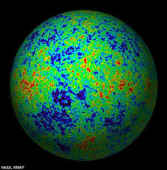
Cosmological implications?
The cosmological implications of , , and had been well investigated.
But nobody had studied the cosmological implications of !!
Notes:
For example, gauge-flation and chromo natural inflation.
But nobody had studied the cosmological implications of S-term.

Slide 16
The model to study: the S term in

Slide 17
A novel mechanism to explain the dark energy
Two components: one corresponding to the Yang-Mills term and the other corresponding to the S term.
What would happen if: ?
That means a singularity in the energy-momentum tensor should be avoided.
How?: so that . Fine tuning? Yes, but the system could “self tune”.
Notes:
Let’s split artificially our vector field fluid into two components: one corresponding to the Yang-Mills term and the other corresponding to the S term.
What would happen if:
That means a singularity in the energy-momentum tensor should be avoided.
How

Slide 18
A novel mechanism to explain the dark energy
What about the pressure?: Since , we have again a singularity in the energy-momentum tensor unless , i.e., .
The S-term fluid behaves as radiation: .
Notes:
READ
The only possible consistent way to do this is if the S-term fluid behaves as radiation. This means that, the S-term behaves like a radiation fluid with negative energy density and pressure.

Slide 19
A novel mechanism to explain the dark energy
If the two fluids behave as radiation, could we say that the actual total fluid also behaves as radiation?
No. 0 divided by 0 could be anything:
A realization of this scenario, with and self tuning will be presented in the following.
Notes:
READ
The actual value of the equation of state parameter depends on the specificities of the model.

Slide 20
The ingredients of the model
We want to describe our observable universe. Therefore, we employ the Friedmann-Lemaitre-Robertson-Walker metric at the background level.
This is only possible if the field configuration is a “cosmic triad”:
This configuration is invariant both under SU(2), for the field space, and SO(3), for the physical space, in agreement with the homomorphism between the two groups.
Notes:
We want to describe our observable universe. Therefore, we employ the Friedmann-Lemaitre-Robertson-Walker metric at the background level.
this means that, that each vector is oriented in a spatial direction and have the same magnitude.
READ

Slide 21
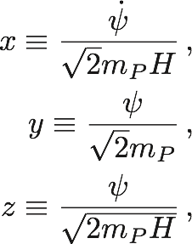
The autonomous dynamical system
Main dimensionless variables:
Notes:
The autonomous system is defined from these dimensionless variables

Slide 22
The autonomous dynamical system
Constraint (Friedmann) equation:
Field equations:
Auxiliary dimensionless quantities:
Notes:
In this way, the field equations of this models are:
in term of the dimensionless variables

Slide 23
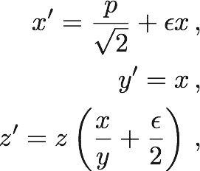
The autonomous dynamical system
Evolution equations for the main dimensionless quantities:
The time evolution will be parametrized by the number of e-folds:
Notes:
finally, these are the equations that define the autonomous dynamic system

Slide 24
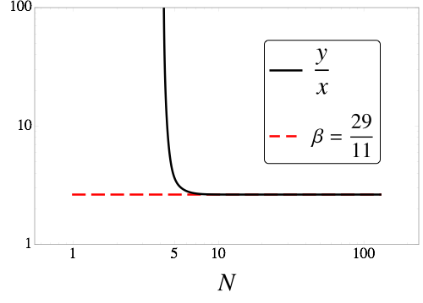
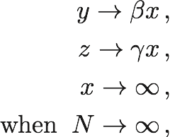
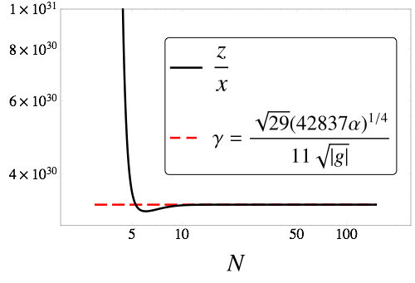
Asymptotic behaviour
Notes:
This dynamical system exhibits an interesting asymptotic behaviour for an ample spectrum of initial conditions:

Slide 25
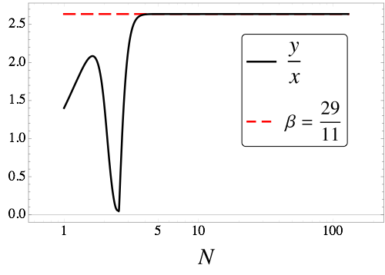
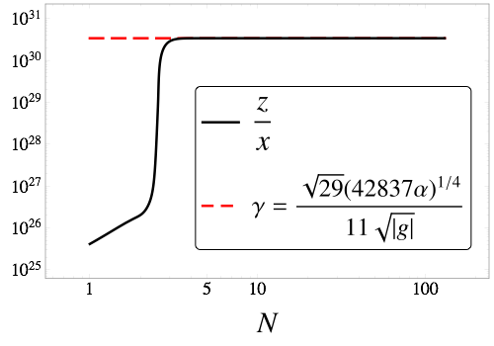
Asymptotic behaviour
Notes:
Same as before but with a second set of initial conditions.
Negative values of alpha do not give place to the asymptotic behaviour. In contrast, positive and negative values for g are allowed.

Slide 26
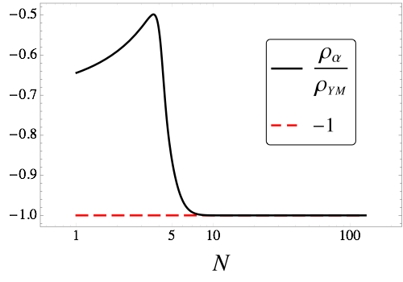
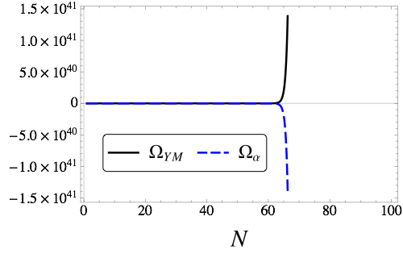
Asymptotic behaviour
In the asymptotic limit,
However, while in an exponential way. Dynamical fine-tuning mechanism in action!!

Slide 27
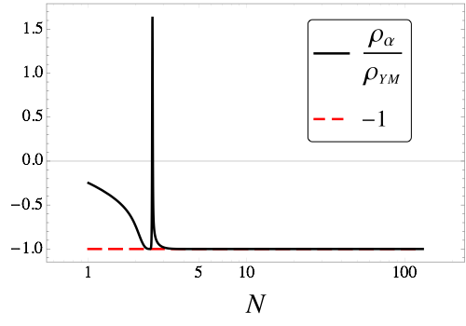
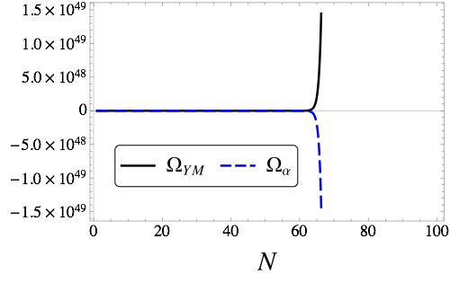
Asymptotic behaviour
Same as before with the second set of initial conditions.

Slide 28
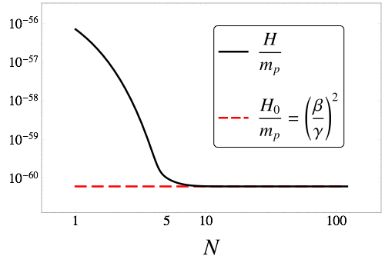
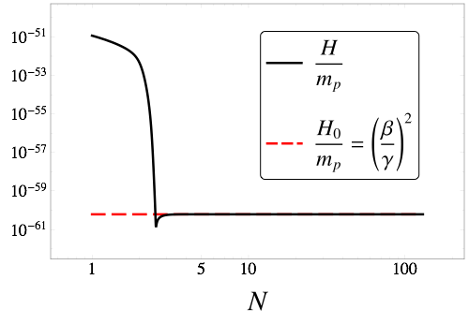
Asymptotic behaviour
The total energy density keeps finite and under control (the Hubble parameter it's much smaller the Planck mass).
The plots presented correspond to the two sets of initial conditions.
The free parameters in the action, and , can be chosen so that the asymptotic value of the Hubble parameter corresponds to its present observable value.
Notes:
What is the consequence of this asymptotic behavior?. As observed in the figures, the apparent breakdown of the classical regime due to the exponential growth of the absolute values of the energy densities is disproved by the good behaviour of H

Slide 29
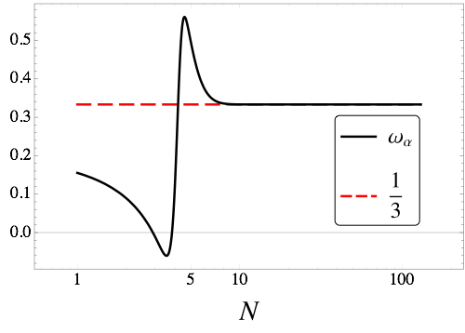
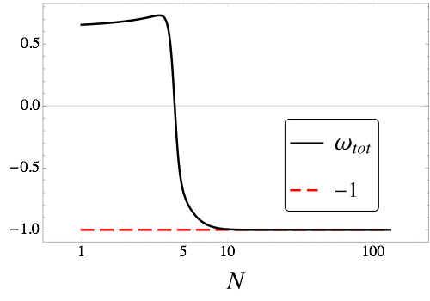
Asymptotic behaviour
Notes:
As expected, the equation of state parameter for the S-term fluid is that of a radiation fluid.
In contrast, the equation of state parameter for the whole fluid, Yang-Mills plus S term, is that of a cosmological constant. This model is an excellent candidate to explain the dark energy!

Slide 30
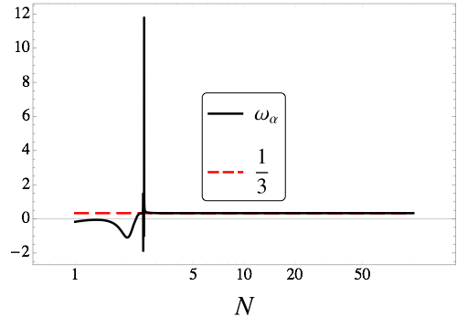
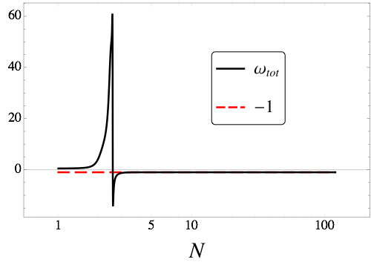
Asymptotic behaviour
Same as before but with the second set of initial conditions.

Slide 31
Primordial inflation
There exists 112 critical points of the autonomous dynamical system.
51 of them are unrealistic as they correspond either to complex values for y or z or to real values for the same variables but with different signs.
Other 38 lead to .
Other 6 lead to .
The other 17 lead to .

Slide 32
Primordial inflation
Among the 17 survivals, 8 are unrealistic too because the inflationary period is given only for .
From the remaining 9 points, only 1 gives long enough inflation.
Notes:
This is a saddle point, which means the inflationary period has an end. Indeed, the S-term fluid becomes negligible and the inflationary period ends with a transition to the radiation dominated epoch (Yang-Mills fluid dominating).

Slide 33
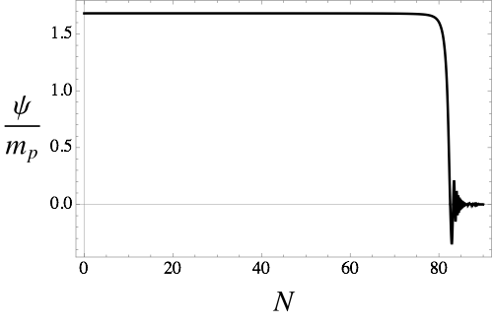
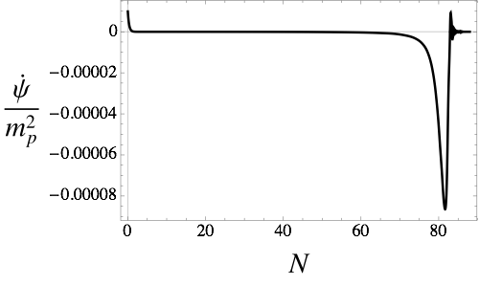
Primordial inflation
Notes:
As observed in the plots, the inflationary period is of the slow-roll variety and is long enough to solve the classical problems of the standard cosmology.

Slide 34
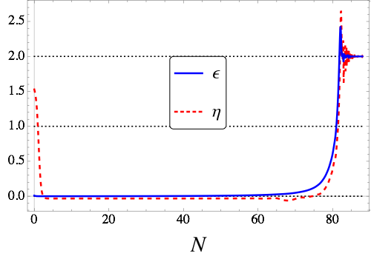
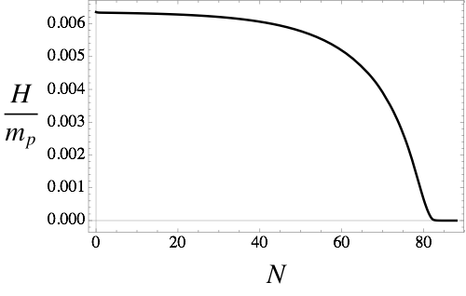
Primordial inflation
Notes:
As observed in the plots, implying a period of slow-roll inflation long enough to solve the classical problems of the standard cosmology;.

Slide 35
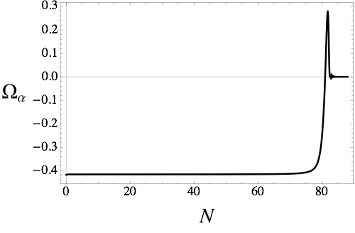
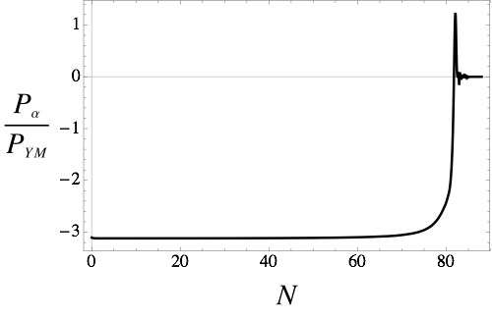
Primordial inflation
Notes:
During inflation, the S-term contributes with a negative energy density which is neither dominating nor negligible; but, becomes negligible by the end of this period.
However, the S term contributes with a dominating negative pressure during inflation that becomes negligible by the end of this period. This lets the Yang-Mills term dominate and produce the radiation dominated epoch.

Slide 36
Primordial inflation
Unfortunately, and in contrast to the dark energy scenario, the primordial inflation in this model is strongly sensitive to the initial conditions and coupling constant .

Slide 37
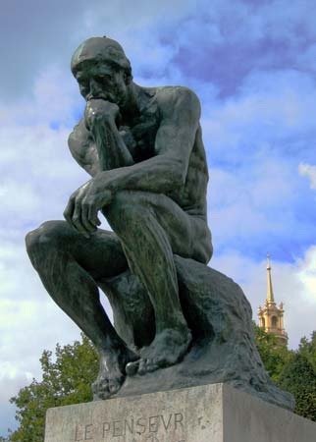
Further exploration of the model
To investigate whether the Hamiltonian is actually bounded from below.
Establish if the model does not have Laplacian and phantom instabilities..
To check the perturbative stability of the isotropic solution.
To calculate the sound speed which is a distinctive feature of any dark energy model.
To investigate the possible attractor nature of the triad configuration in a more general anisotropic background.

Slide 38
Further exploration of the model
is, apparently, ruled out by the detection of the gravitational wave signal GW170817 and its electromagnetic counterpart GRB 170817A. It, apparently, produces an anomalous gravity waves speed.
Urgent and necessary: to investigate whether the addition of can evade these strong gravity waves speed constraints.
There are some hints that indicate that the non-minimal coupling to the Riemann tensor in could be the salvation.

Slide 39
Thanks a lot

Slide 40
“You don’t know the power of the dark side.”
–Darth Vader

