Slide 1


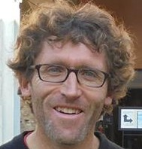


Direct detection of dark energy?
Collaboration with S. Vagnozzi, L. Visinelli,
A. Davis and J. Sakstein.
Based on 2103.15834
Philippe Brax
Institut de Physique Théorique
Université Paris-Saclay

Slide 2
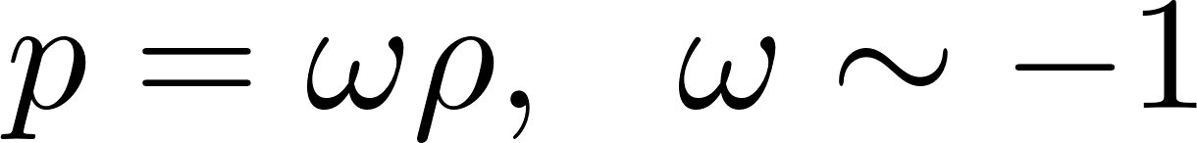
Relatively strong evidence in favour of acceleration of expansion:
Phenomenologically described by a fluid of pressure:
Hubble diagram
Equation of state vs matter fraction

Slide 3
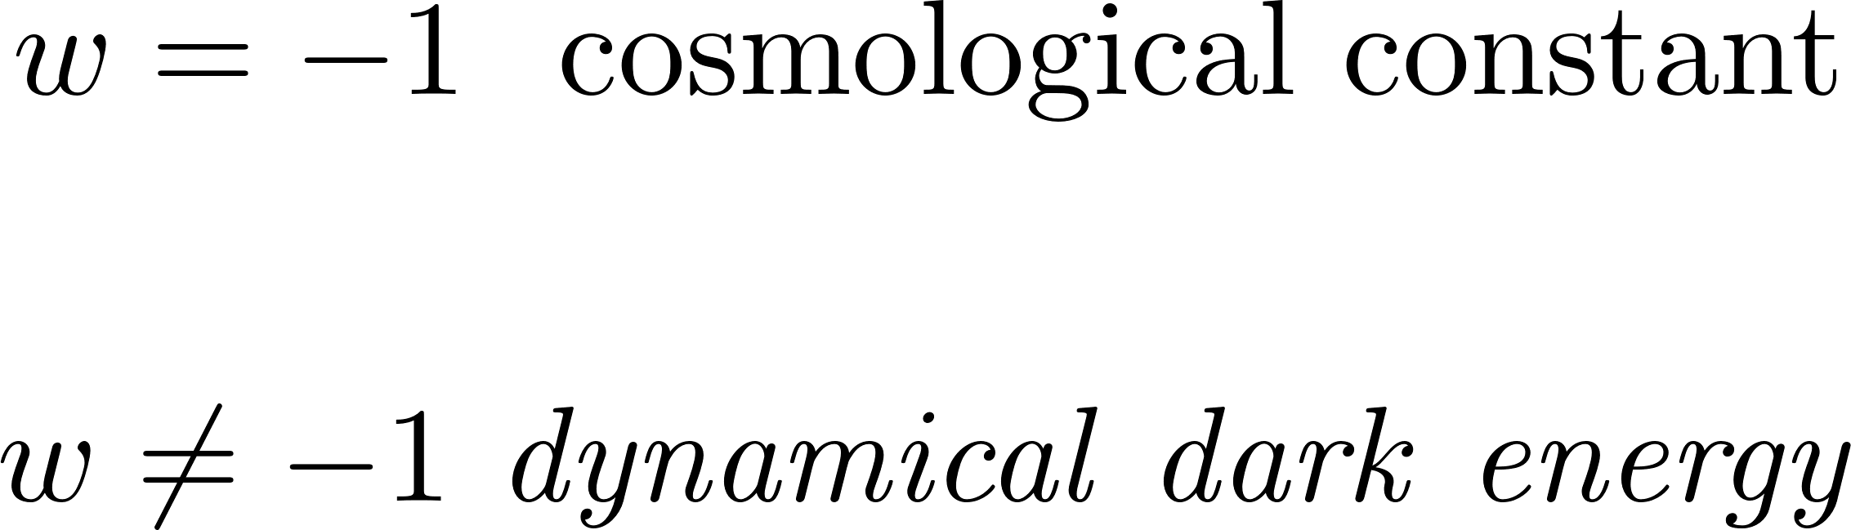
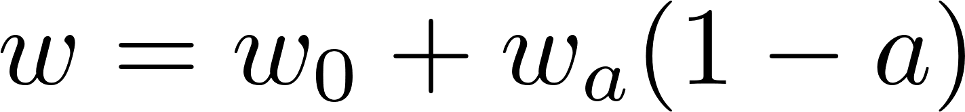
Future large scale galaxy surveys will test the evolution of the background cosmology.
LSST collaboration
2% level

Slide 4
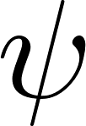
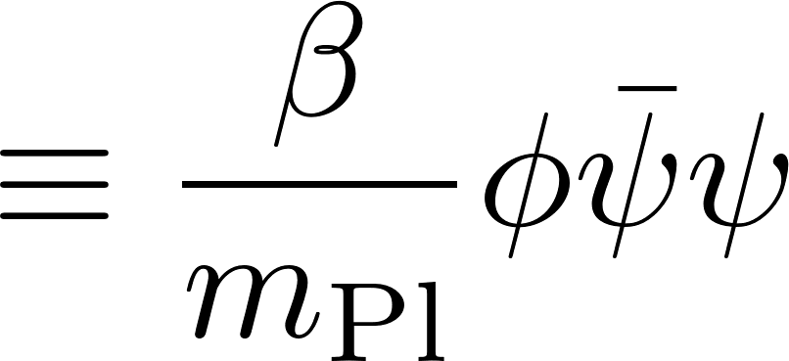

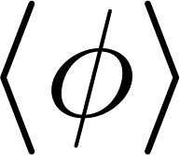
The dark energy recipe book:
Long range field
Coupled to matter
Coupling strength β

Slide 5
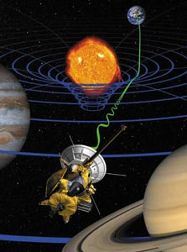
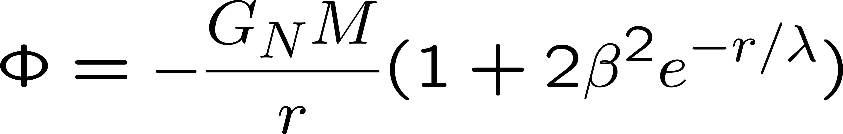
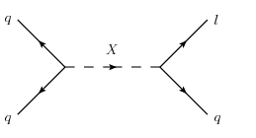
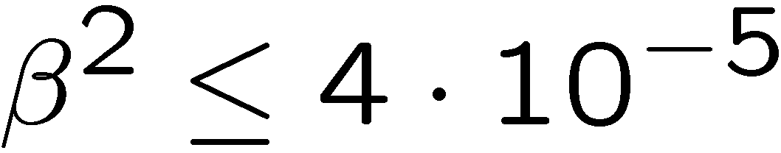
Solar system tests of gravity:
Deviations from Newton’s law are parametrised by:
For long range forces with large λ, the tightest constraint on the coupling β comes from the Cassini probe measuring the Shapiro effect (time delay):
Bertotti et al. (2004)
β
β
Fine tuning issue?

Slide 6
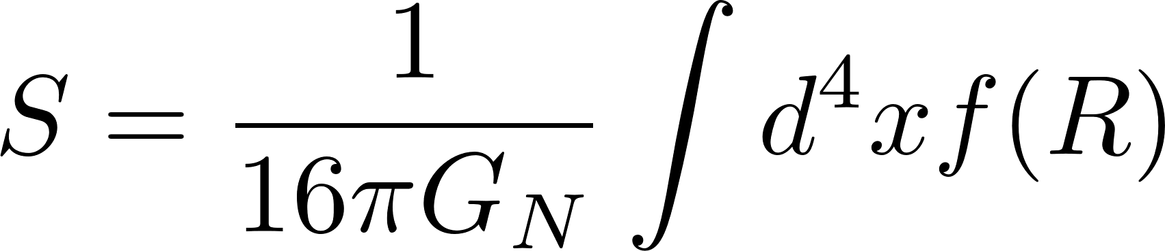
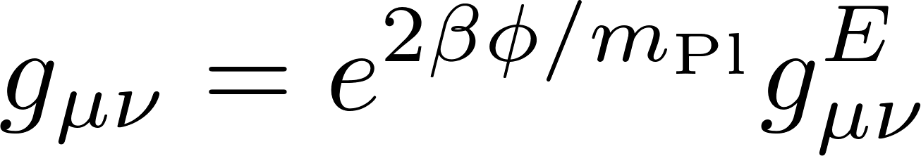
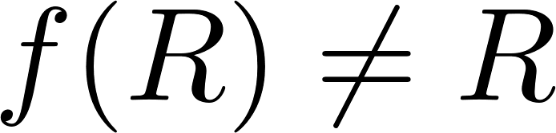
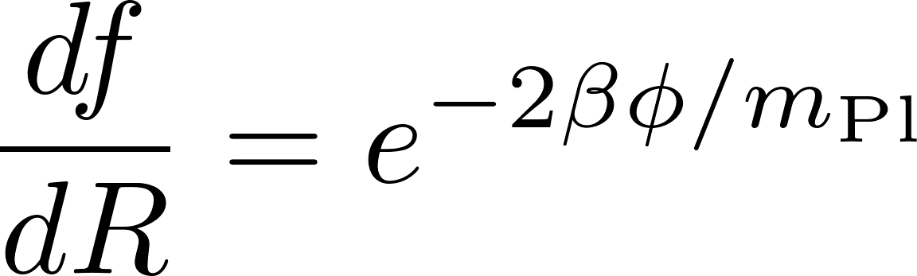
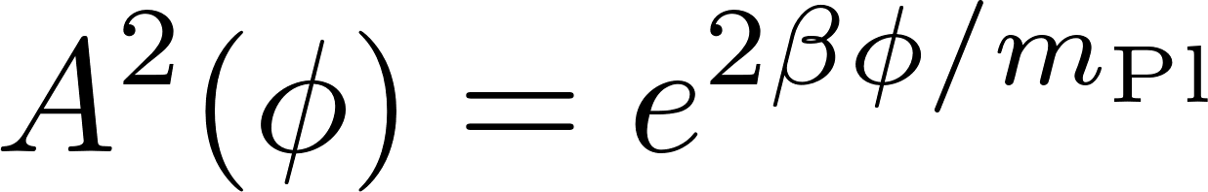
The archetypical example: f(R) gravity
Metric in the Einstein frame
Models with the action
modify gravity when
Jordan metric coupled to matter
These models are equivalent to scalar-tensor models using the mapping
Links the curvature to the scalar
The scalar tensor model is determined by the coupling function:

Slide 7
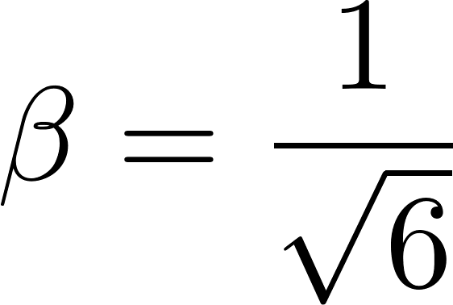
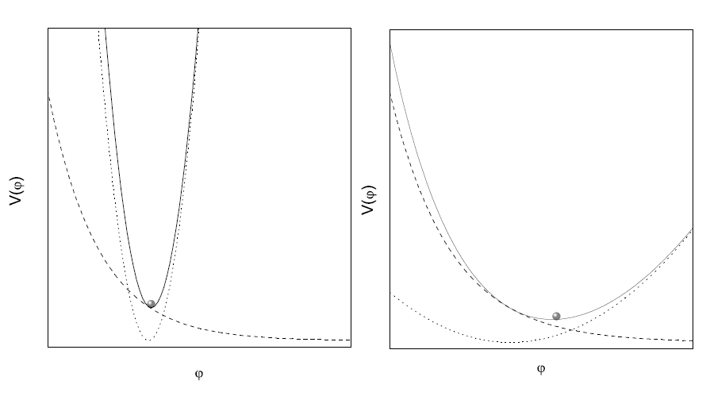
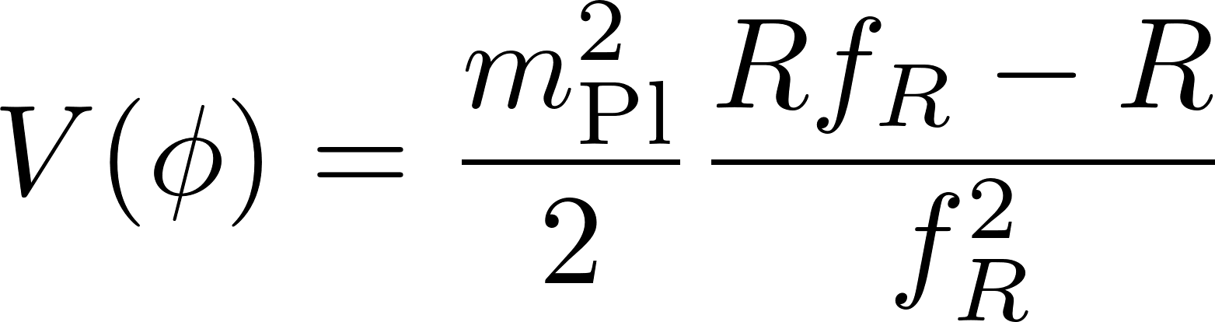
The coupling between the scalar and matter is fixed and equal to:
Effective minimum
PROBLEM: too big!! Would be excluded by Cassini experiment.
Solution: Chameleon screening
Effective potential

Slide 8
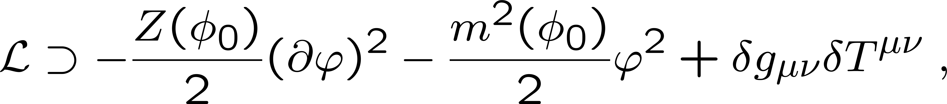
SCREENING:
Crucial coupling between scalar and matter.
For a recent review: 2201.10817
conformal
disformal
Vainshtein for Galileons
K-mouflage
Vainshtein for massive gravity

Slide 9
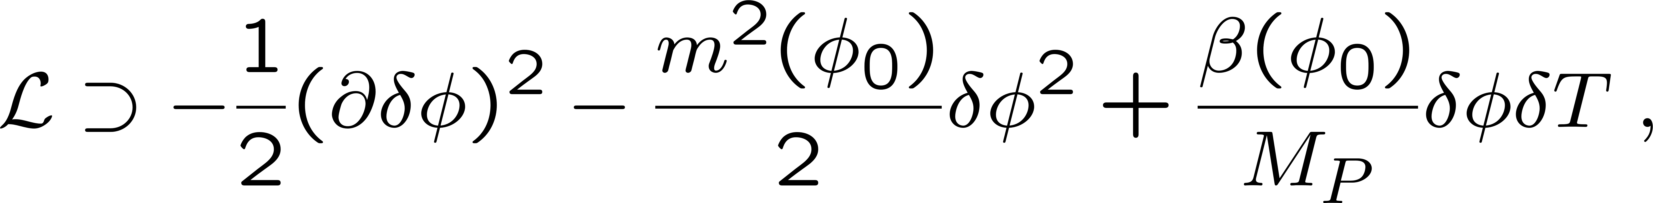
Chameleon Screening:
The chameleon mechanism increases the scalar mass in dense environments.

Slide 10
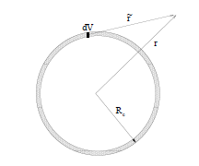
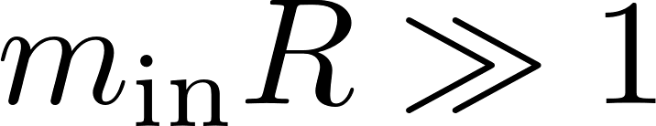
Chameleon Screening
When coupled to matter, scalar fields have a matter dependent effective potential
Environment dependent minimum
Large mass inside object
The field generated from deep inside is Yukawa suppressed. Only a thin shell radiates outside the body. Hence suppressed scalar contribution to the fifth force.

Slide 11
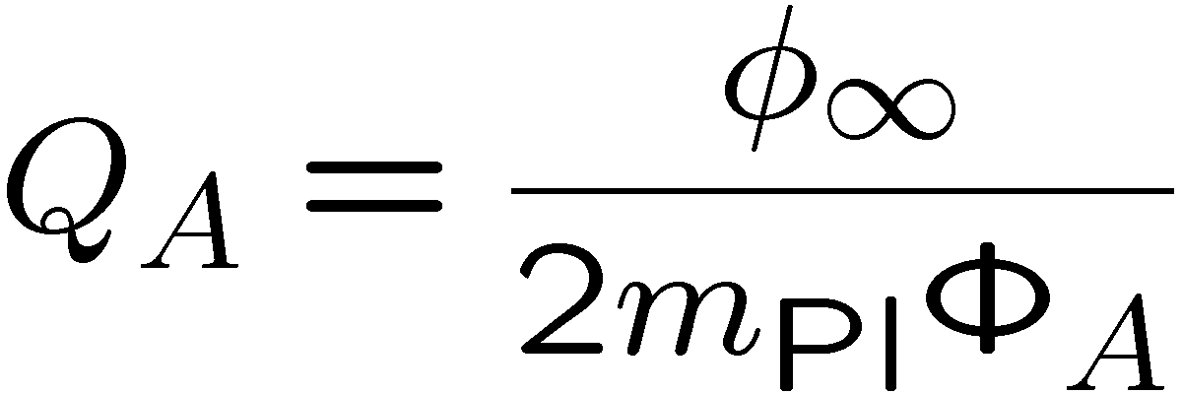

Due to the scalar interaction, within the Compton wavelength of the scalar field, the inertial and gravitational masses differ for screened objects:
Interaction rate depending on the objects
Gravity + scalar force
A
B
Value of the field far away
Screening criterion for compact objects
Newtonian potential at the surface of the body.
Massive bodies with differ scalar charges fall differently. Hence a violation of the strong equivalence principle.

Slide 12
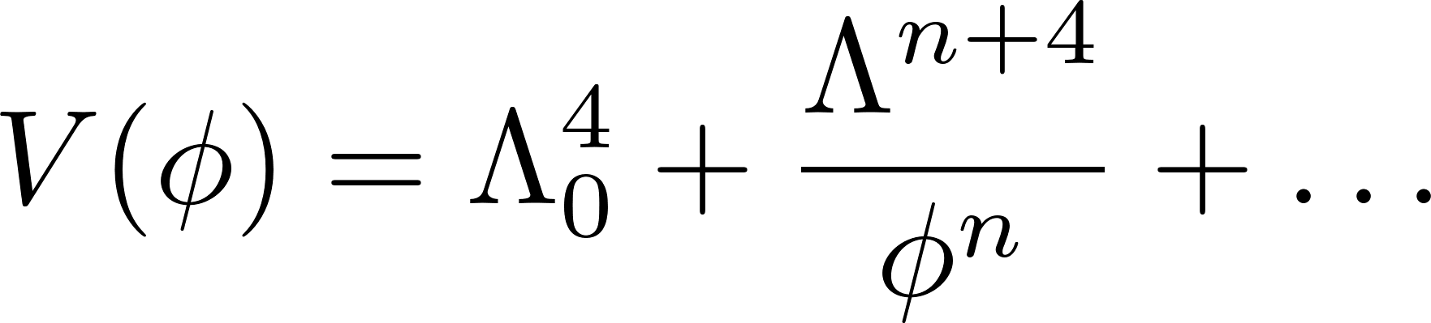
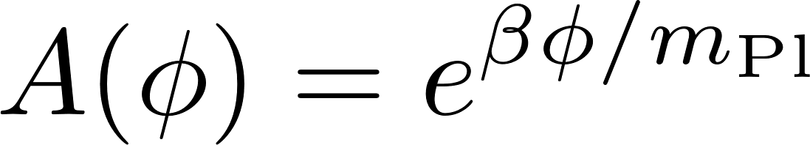
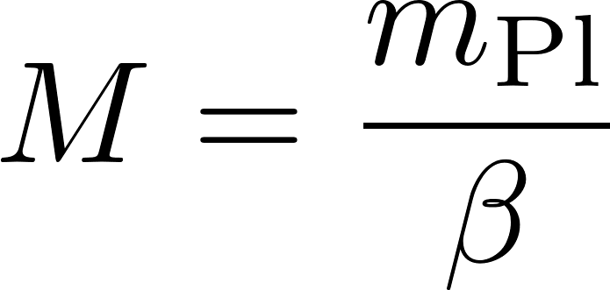
A typical example: the Ratra Peebles chameleon
In these models the cosmic acceleration is mostly due to the constant term in the potential and the environmental dependence is via the inverse power law.

Slide 13
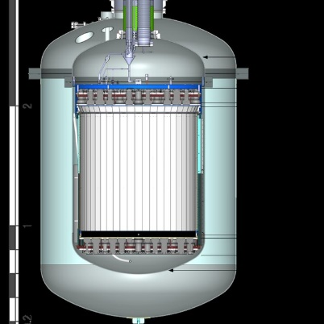

The chameleon field is associated to a particle:
Could we detect the effects of a chameleon particle?
Questions:
Where could it be produced and how?
How could it be detected?
Dark matter detector
Sun

Slide 14
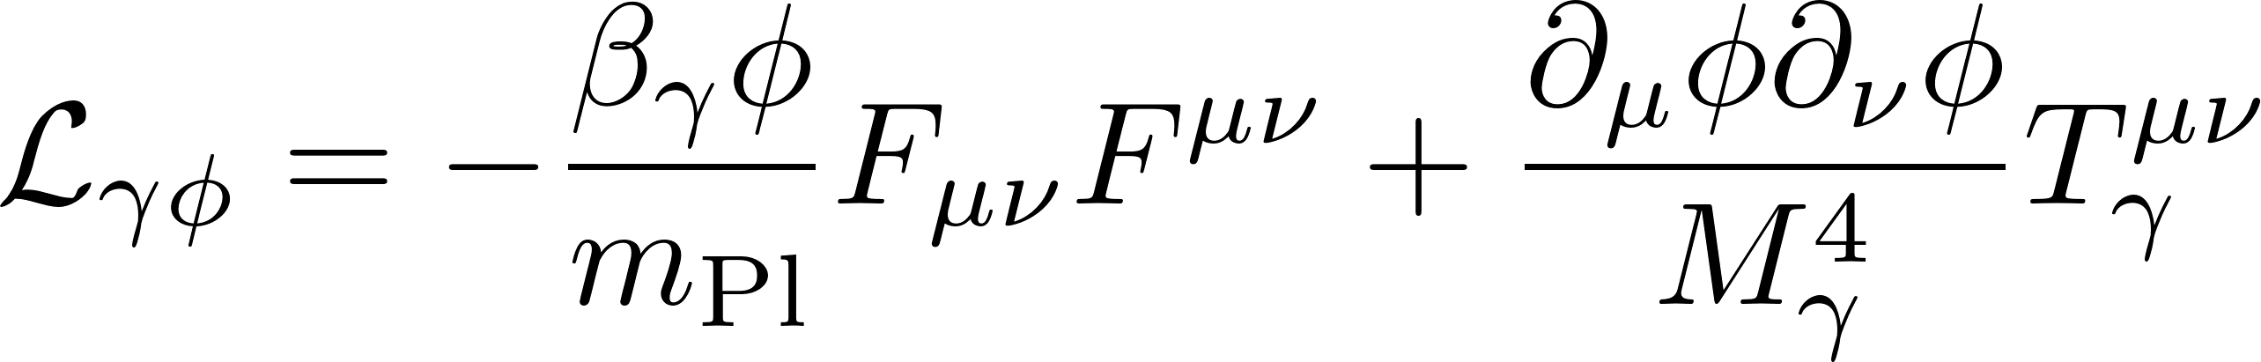

Chameleon production:
Quantum processes induce a coupling to photons
Flux of chameleons received on Earth from Sun
Chameleons are produced in the strong magnetic field of the tachocline B=30T.

Slide 15
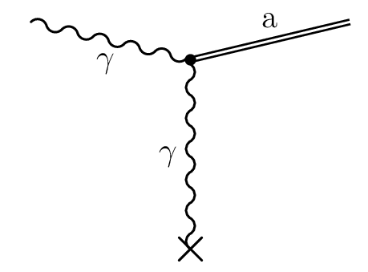
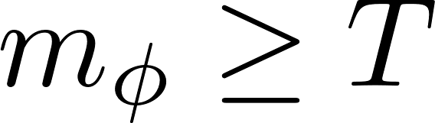
Screened production:
In dense regions, contrary to axions, chameleon production is kinematically forbidden:
Chameleon are coupled to photons in a way similar to axions

Slide 16
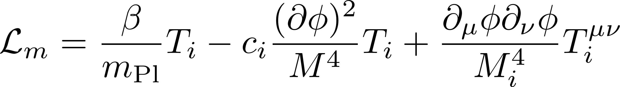
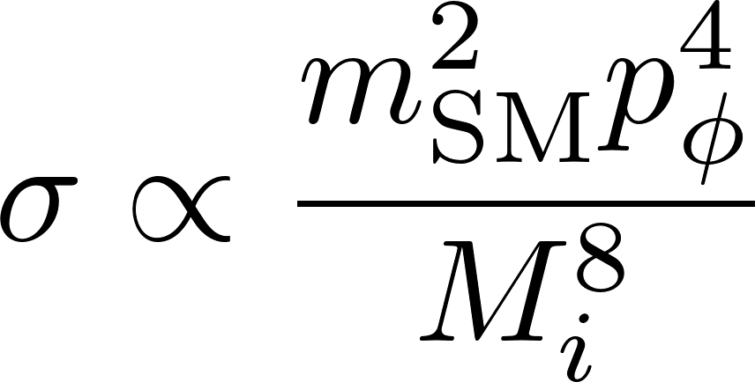
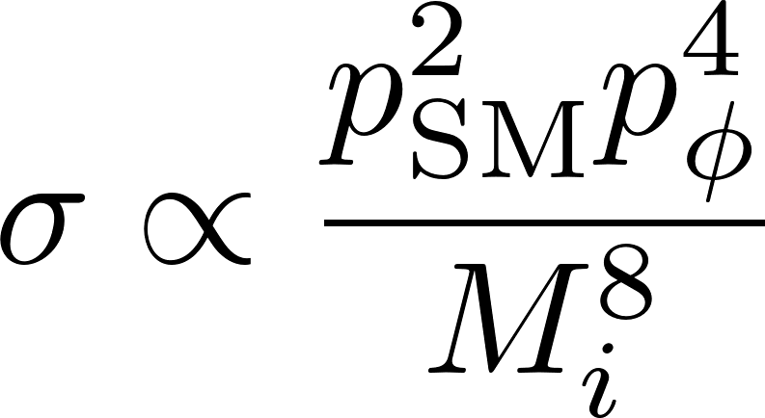
Chameleon detection:
Chameleons interact with matter as:
Chameleon interaction with bound electrons.
Dominated by disformal interaction

Slide 17
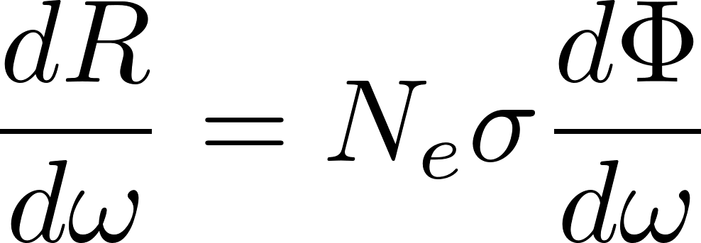
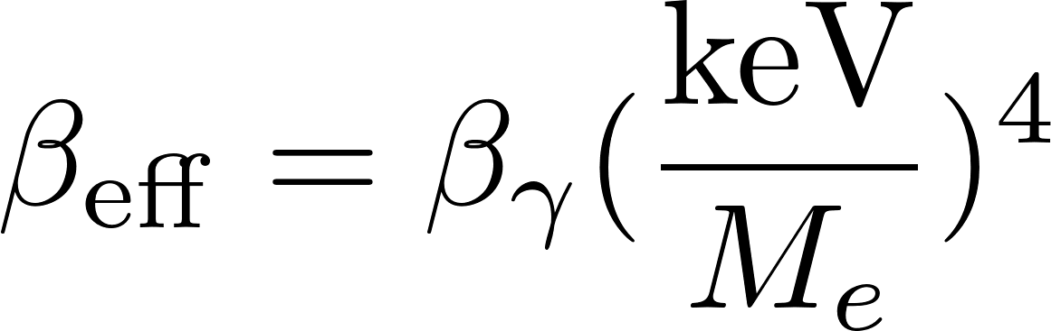

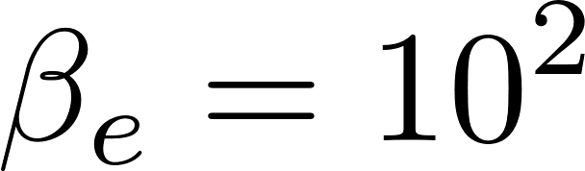
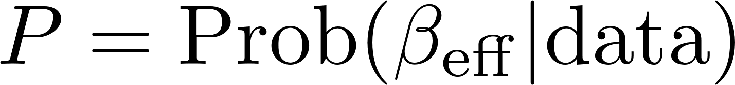
Number of electrons
The event rate in the detector is given by:
Chameleon flux
The effective parameter:
Peaked around -4.5
Template:
Posterior distribution
Preferred at 2σ over background.

Slide 18
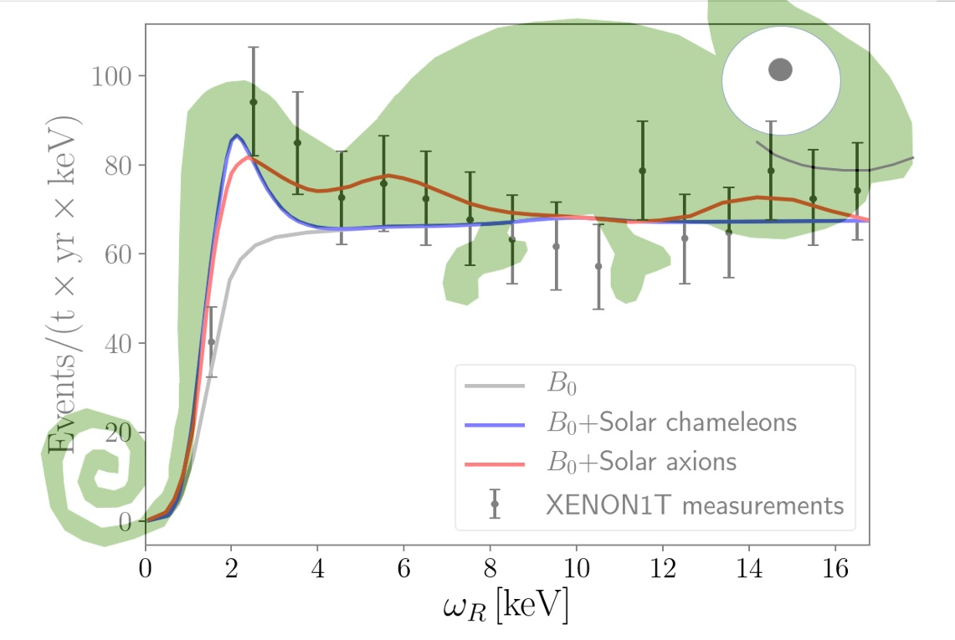

Slide 19
Forecast for future experiments:

Slide 20
Conclusion:
Screened dark energy has many features:
Acts on cosmic scales but hardly locally
Tiny effects can be tested in the laboratory
Can be produced in the Sun and detected on Earth
Testable by future direct detection experiments

