Slide 1
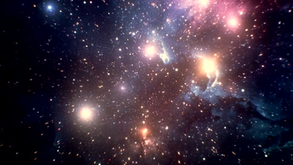
Beyond Relativistic Zel'dovich Approximation: a new method for structure formation
Spontaneous Workshop XIV
May 8th – 14th, 2022, IESC Cargese, France
Ismael Delgado Gaspar, NCBJ

Slide 2
Beyond Relativistic Zel'dovich Approximation [and Exact Solutions of Einstein's Field Equations]
: a new method for structure formation
Ismael Delgado Gaspar, NCBJ
Notes:
I had to shorten the title because of the character limit, but a more precise title must contain the phrase 'exact solutions.'

Slide 3
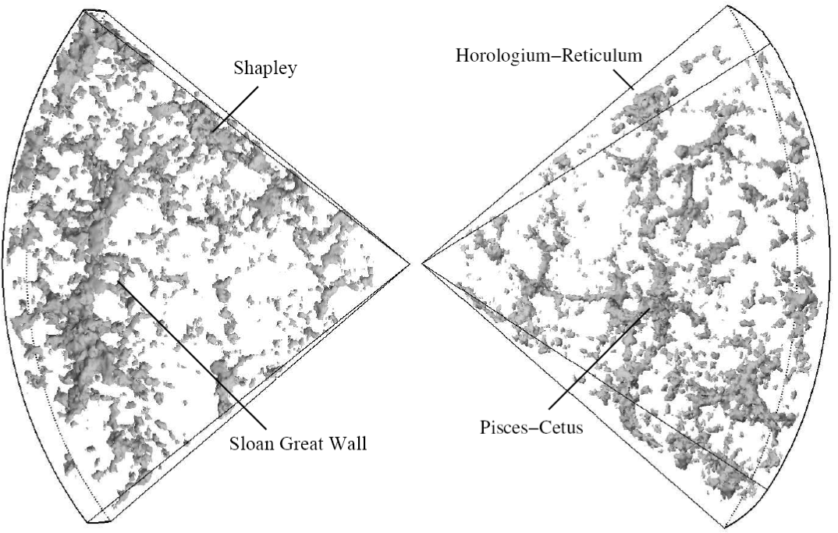
Introduction
The current era of “Precision Cosmology” has produced a large amount of high-quality observational data at all astrophysical and cosmic scales whose theoretical interpretation requires robust modeling of self-gravitating systems.
The analysis of these observations by means of analytic or numerical solutions of Einstein’s equations has been less favored due to their non-linear complexity.
Self-gravitational systems at galactic and galactic cluster scales
Newtonian gravity
linear perturbations on a ΛCDM background
Large cosmic scale dynamics

Slide 4
Gauge Invariant
Perturbative Approach
Exact Solutions
1+3 splitting of EEs
(Ex. silent solutions)
Relativistic Cosmology
(some formalisms to examine the structure formation)
Relativistic Numerical Cosmology
(BSSN formalism)
Post-Newtonian Corrections
RZA

Slide 5
Inhomogeneous cosmological models
“We define ICMs as those exact solutions of EEs that contain at least a subclass of non-vacuum and non-static FLRW solutions as a limit.”
K. Bolejko, MN Célérier, A Krasiński, Class. Quantum Gravity (2011).
Gen. Solutions
Szekeres-Szafron
Dust
+
Lambda [or p(t)]
Class I
Class II
Delgado Gaspar et al EPJC (2021)
LTB
KS
A. Krasinski, Inhomogeneous Cosmological Models (1997).
FLRW

Slide 6
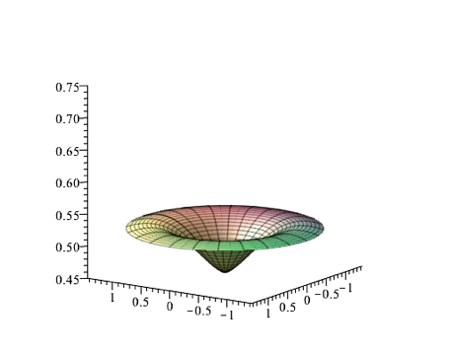
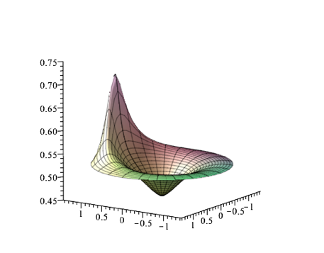
Szekeres models
To model structures using Szekeres models we associate the spatial minima and maxima of the density matter with “structures”:
Regions surrounding the spatial maxima of the matter density
Over-densities
Regions surrounding the spatial minima of the matter density
Voids
NO Angular maximum or minimum
Angular maximum
Radial extrema

Slide 7
Szekeres models
NO Angular maxima or minima
Angular maximum
Radial extrema
Silent universes: Each worldline evolves independently of the others.
Shell crossings: These singularities occur when two shells of dust collide leading to infinite values of the density.

Slide 8
Goode & Wainwright parametrization
Goode & Wainwright, PRD (1982)
In the Goode and Wainwright representation, the Szekeres line-element reads:
Friedmann-like equation
(associated background)
Growing & Decaying modes
(necessary and sufficient conditions for the RW limit )
The energy-density:
Class I
The form of the
vary depending on the class.
Class II

Slide 9
Modeling cosmic structures
Considering the quasi-spherical models of class-I:
The information about the spatial foliation is contained in
W=0
Szekeres dipole (spherical coordinates):
The “angular extrema” of the scalars coincide with the angular extrema of W.
Solution 1
RA Sussman, I Delgado Gaspar, PRD (2015).

Slide 10
Modeling cosmic structures
Soln. 1
Soln. 2
+
Soln. 1
Soln. 4
Soln. 3
Soln. 1

Slide 11
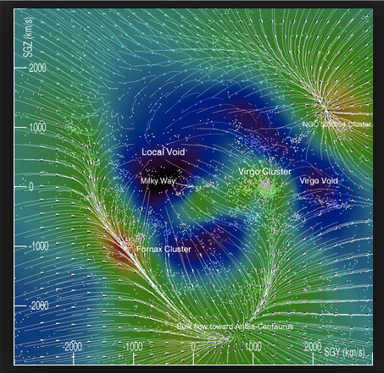
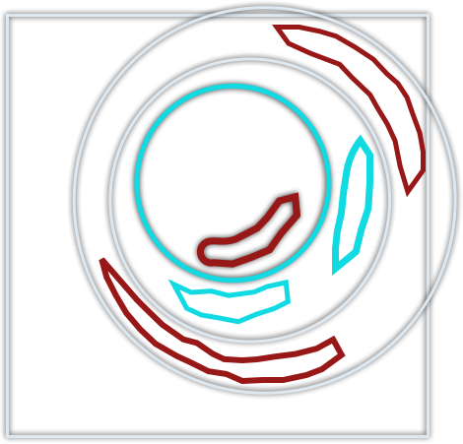
Inhomogeneous cosmological models
Equatorial projection of the density contrast at initial time (left panel) and at present cosmic time (right panel).
We identify the density maxima with over-densities and the density minima with cosmic voids, and smoothly superpose multiple solutions.
R. Brent Tully et al, Nature 513, 71–73 (2014), “The Laniakea supercluster of galaxies”.
I Delgado Gaspar, JC Hidalgo, RA Sussman, EPJC (2019).
RA Sussman, JC Hidalgo, I Delgado Gaspar, G German, PRD (2017).
RA Sussman , I Delgado Gaspar, JC Hidalgo, JCAP (2016).

Slide 12
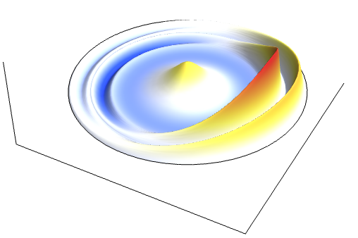
Inhomogeneous models
Szekeres
Gravitational collapse of multiple non-spherical structures, modeled by the smooth matching of LTB/Szekeres regions embedded in a Schwarzschild exterior solution.
ShXs are interpreted as the onset of the virialization process. Or we can hide them inside the AH, remaining undetectable to observers in the exterior Schwarzschild spacetime.
LTB
I Delgado Gaspar, JC Hidalgo, RA Sussman, I Quiros, PRD (2018).
Schwarzschild
T.A.
Inhomogeous and anisotropic generalization of SCM:
FLRW
--> Sze
J.J. Ostrowski & I. Delgado Gaspar, JCAP (2022)

Slide 13
Exact solutions & RZA
Lagrangian theory of structure formation in relativistic cosmology
Buchert and Ostermann, PRD (2012)
Buchert, Nayet and Wiegand, PRD (2013)
Alles, Buchert, Al Roumi and Wiegand, PRD (2015)
Al Roumi, Buchert and Wiegand, PRD (2017)
Li, Mourier, Buchert and Wiltshire, PRD (2018)

Slide 14
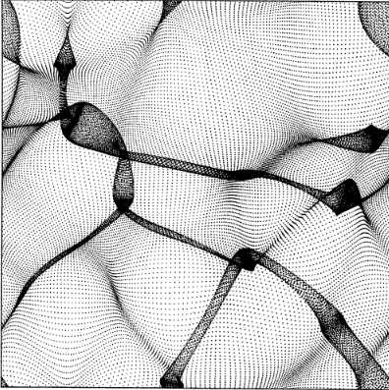
The Zel’dovich Approximation
Zel’dovich A&A (1970)
The ZA approximation is used to describe the gravitational evolution in the mildly non-linear regime. We follow the motion of the fluid elements using the Lagrangian approach to hydrodynamics.
Eulerian coordinates
Lagrangian coordinates
Displacement with respect to the initial (Lagrangian) position
In an expanding homogeneous and isotropic medium:
Trajectory
In a pressureless and viscosity-free, medium without gravitational interaction:
Background scale factor
Growing rate of linear fluctuations
Mass conservation:
Notes:
In the so-called Zeldovich approximation we follow the motion of a fluid element using the Lagrangian approach to the equations of hydrodynamics. In this approach, the initial matter distribution is considered to be homogeneous and collisionless. If the unperturbed (initial) Lagrangian coordinates of the particles are denoted by X, then the Eulerian coordinates of the particles at any time are given by this relation. Here $a(t)$ is the cosmic expansion factor and $b(t)$ the growing rate of linear fluctuations.
Let’s discuss a bit about the physical meaning of each term in it.
First, note that s(X) is a perturbation of the Lagrangian coordinates. If s(X) is zero, the transformation is given by this equation which is nothing more that the homogeneous expansion of the universe. to better visualize the meaning of this transformation, let us consider a pressureless medium without gravitational interaction. For this system, the Eulerian positions of the particles are related to the Lagrangian positions by this linear relation, being v the initial velocity.
So, with these relations we can understand the Zeldovich approximation. This term accounts for the background cosmic expansion, and this other accounts for the presence of gravity, giving particles a deceleration along the trajectories.
We can use the mass conservation to find that the density. The density is related to its value at the initial time (background density) by the Jacobian of the transformation. Here, a,b, and g are the eigenvalues of the tensor defined by the derivatives of the displacement (deformation tensor).
If the eigenvalues are ordered in such a way that a>b>g, then, as b(t) grows, the first singularity occurs in the direction where alpha attains its maximum positive value, at X. This corresponds to the formation of a pancake structures, by contraction along one of the principal axes. For this reason, Zeldovich argued that pancakes are the first structures formed by gravitational clustering. Other structures like filaments and knots come from simultaneous contractions along two and three axes, respectively.
To wrap up, in the Newtonian framework, the trajectory field is the only dynamical variable. The Lagrangian coordinates, comoving with the fluid, can be defined to coincide with the Eulerian ones at some initial time. Then the trajectory field measures the deviation of a fluid element’s position, and its Lagrangian gradient measures its volume deformation. In this way, finding the trajectory field, we implicitly solve the Eulerian evolution equations, for instance, the velocity, acceleration, and the density field. This trajectory is assumed to be a superposition of a homogeneous and isotropic background deformation and an inhomogeneous deformation field. Then, the evolution equations for the deformation field are linear, while the density and other fields are evaluated as functionals of the linearized perturbation, providing nonlinear expressions as an extrapolation into the mildly nonlinear regime.

Slide 15
Newtonian Solution (briefly)
General Relativistic Case
In the transition from the Eulerian to the Lagrangian picture, the trajectory field is the only dynamical field variable
The Lagrangian deformation gradient of Newtonian cosmology meets its generalization in the coframe field
measures the deviation of a fluid element’s position at some time from its initial one
measures the volume deformation of fluid elements
Restricting the matter model to irrotational dust, and considering a flow-orthogonal foliation of the spacetime,
In coframe basis:
We implicitly solve the Eulerian evolution Eqns.
Gram’s matrix:
We assume:
Through the 3+1 formalism EEs are transformed into a system of 9+4 evolution equations:
In this splitting:
Determinant of the 3×3 coframe matrix.
Notes:
In the Newtonian framework, the trajectory field is the only dynamical variable. Here capital X denotes the Lagrangian coordinates, comoving with the fluid, which is defined to coincide with the Eulerian ones at some initial instant of time.
Note that the trajectory field measures the deviation of a fluid element’s position at some time from its initial one, and its Lagrangian gradient measures the volume deformation of the fluid elements. In this way, finding the trajectory field, we implicitly solve the Eulerian evolution equations, for instance, the velocity, acceleration, and the density field, where J denotes the Jacobian determinant of the transformation from Eulerian to Lagrangian coordinates.
Next, the trajectory is assumed to be a superposition of a homogeneous and isotropic background deformation (a(t) is the Friedmanian scale factor) and an inhomogeneous deformation field. Then, the evolution equations for the deformation field (longitudinal and transverse parts) are linearized, while the density and other fields are evaluated as functionals of the linearized perturbation, providing nonlinear expressions as an extrapolation into the mildly nonlinear regime.
----------
In the general relativistic case, the Lagrangian deformation gradient of Newtonian cosmology meets its generalization in the coframe field —with the proviso that the deformation of fluid elements is no longer integrable.
Restricting the matter model to irrotational dust and considering a flow-orthogonal foliation of the spacetime, the metric has this form (equation). Where the spatial metric is expressed in terms of the coframe basis, and the initial metric coefficients are encoded into Gram’s matrix (so that it absorbs all the initial non-trivial deviations):
In this representation, using the 3+1 formalism, Einstein’s equations are transformed into a system of 9+4 evolution equations, where now J is the determinant of the coframe matrix, a 3 x 3 matrix.

Slide 16
RZA
RZA considers the coframe coefficients as the only variables: we linearly perturb the trivial coframe set associated with a homogeneous and isotropic spacetime
Final approximation: (i) considers the linearized solution for these coefficients; (ii) exactly evaluates any other field as a functional of this solution (without performing further approximations or truncations).
To have a more transparent representation, the deformation is decomposed into the trace, trace-free symmetric, and antisymmetric parts,
Focusing on the trace part of the solution, the time-dependence is determined from Raychaudhuri’s equation:
Functional evaluation:
Metric
Jacobian
Density field
Notes:
The RZA considers the 9 coframe coefficient as the only independent variables; we then linearly perturb the trivial coframe set associated with a homogeneous and isotropic spacetime with an inhomogeneous deformation. Here, a(t) is the FLRW scale factor.
As in the Newtonian case, we linearize the solution for the deformation coefficients. And the final approximation consists in evaluating any other field as a functional of the linearized solution without further approximations or truncations. I mean, as in the Newtonian case, the evolution equations are linear but the functional evaluation of all the relevant quantities is exact.
Since the initial spatial metric is encoded in the Gram's matrix, the deformation field vanishes at some initial time. Here, H is the Hubble function of the background, and Ua and Wa are the relativistic generalizations of the initial Newtonian peculiar-velocity and peculiar- acceleration gradients.
To have a more transparent representation, the deformation is decomposed into the trace, trace-free symmetric, and antisymmetric parts.
If we focus on the trace part of the solution, the time-dependence is determined from Raychaudhuri's equation, leading to an equation similar to the Newtonian one. This equation is critical to connecting this approach with the Szekeres models.
Note that in this approximation, the line element takes a quadratic bilinear form. We also exploit this expression to compare with the Szekeres solutions.
Furthermore, the nonlinear density field is evaluated through the exact integral of the continuity equation; the same applies to the Jacobian where J1, J2, J3 are the principal scalar invariants of the perturbation matrix.
Click
Similarly, the three-dimensional spatial curvature and the gravitoelectric and gravitomagnetic parts of the Weyl tensor can be obtained from the nonlinear expressions coming from their functional in terms of the coframes. Here, I'm just showing these relations to illustrate how we can compute all the relevant physical quantities from the solutions for the deformation.

Slide 17
Class II & RZA
Delgado Gaspar & Buchert, PRD (2021)
Szekeres
RZA contains the class II of the Szekeres exact solution as a particular case with deformation field and Gram’s matrix given by
All quantities are linear in the deformation (P), but the sol is intrinsically non-linear:
Class I & RZA?
The class I can be interpreted as a (constrained) superposition of non-intersecting world lines, satisfying RZA’s equations.
Class II
Given an arbitrary world line (t,z,x,y)
Reference (background) model
Class I
Scale function:
Initial density:

Slide 18
RZA & Szekeres class I
Although RZA cannot reproduce the class I of Szekeres models, both solutions are governed by the same set of evolution equations. Their difference relies on the constraint equations.
This is a characteristic feature of the silent class of exact solutions, where several well-known models have a common set of evolution eqns.
FLRW
Kantowski-Sachs, Bianchi I, Bianchi VI
(…)
(…)
LTB
It is precisely the constraints that make them different.
Szekeres-Szafron
Notes:
Although RZA cannot reproduce the class I of Szekeres models, both solutions are governed by the same set of evolution equations. Their difference purely relies on the constraint equations.

Slide 19

Generalized RZA (GRZA)
We propose a generalization of RZA with as minimal modifications as possible to contain Szekeres class I, while still retaining the mathematical structure of the Lagrangian perturbation theory: GRZA
The coframe set of RZA finds its generalization in the following expressions:
P ^{i} _{a}
P ^{i} _{a}
with
The non-existence of a background is reflected in the absence of a conformal Friedmann scale factor.
RM
RM
And so, the line-element keeps the bilinear quadratic mathematical structure on the deformation field
Delgado Gaspar, Buchert & Ostrowski (in preparation)
Notes:
This connection motivates the development of a new approach. Note that if we consider the Szekeres models, there are many possible ways to extend the solution to the approximate regimen. Likewise, we can think of a number of ways to extend RZA. However, the relationship we have found paves the way to a physical generalization of both Szekeres and RZA.
This new approach relies on retaining the same extrapolation spirit employed to develop RZA, but without assuming a global background. The non-existence of a background is reflected in the absence of a conformal Friedmann scale factor.
Instead, the conformal scale factor will also depend on the spatial coordinates and obey a Friedmann-like equation as in the Szekeres models of class-I. Then, we will work within the relativistic Lagrangian framework.
Well, our first step is to generalize the coframe set to include such a spatial dependent scale factor. So that the metric keeps its bilinear form. Note this metric contains the Szekeres case in the limit when the deformation field is locally one-dimensional.

Slide 20
GRZA
Lagrange-Einstein system
3 + 1 relativistic Lagrangian framework
The approach consists of obtaining evolution eqns for deviation fields, linearizing them, and injecting the formal solution into the exact nonlinear functional.
Delgado Gaspar, Buchert and Ostrowski (in preparation)
Notes:
The subsequent approach consists of obtaining evolution equations for deviation fields, linearizing them, and then injecting the formal solution into the exact nonlinear functional expressions.
So we substitute our new coframe set into the Einstein-Lagrange system, linearize the evolution equations in the local deformation field. Then, we substitute this solution in the exact functionals in terms of the coframes, that is, in terms of the conformal scale factor and the local deformation field.
Note that this scheme retains the original Zel'dovich's extrapolation idea and generalizes RZA to include the whole family of Szekeres models. That's the reason why we call this approach Generalized Relativistic Zel'dovich Approximation.

Slide 21
Delgado Gaspar,
Buchert & Ostrowski
(in preparation)
GRZA
(background)
Sze-I
RZA
SS limit
LTB
Sze-II

Slide 22
GRZA: Numerical Example
We explore the numerical solutions of a family of locally 1-d models, containing Szekeres as a particular case.
These models retain the spatial foliation of the hypersurfaces by non-concentric two-spheres, but generalize Szekeres in the form the 2-spheres are arranged.
Snapshots of the density contrast at the present cosmic time for the solution with α = 0 (Szekeres case), 5.0 × 10⁻³, 7.2 × 10⁻³.
Notes:
A key aspect of these models is
that they retain the spatial foliation of the hypersurfaces
by non-concentric two-spheres, a characteristic feature of
the quasi-spherical Szekeres models, but generalize Szek-
eres in the form the 2-spheres are arranged.
Writing out the line-element (28), one can check that
the metric of the surfaces {t = const., ξ = const.} coin-
cides with its equivalent in the exact solution, and then
it can be transformed into that of a 2-sphere with radius
A(t, ξ)χ(ξ) (by the transformation (B8)). The departure
from the exact solution comes from the metric coefficient
gξξ , which is generalized to resemble the usual approx-
imation where the growing (decaying) mode is coupled
to a non-trivial function of the spatial coordinates. In
this way, the models retain the characteristic foliation
by non-concentric 2-spheres of Szekeres; the term δβ+f+
leads to more general arrangements of the 2-spheres.

Slide 23
GRZA: Numerical Example
The violation of the Hamiltonian constraint can be used to estimate the error of the approach. Taking into account that the fluid flow velocity is the vector normal to our spatial hypersurfaces, we define
H as a function of r for different values of the polar angle for the case α = 7.2 × 10−3. While for the other cases the error remains smaller, being negligible (purely numerical) for α = 0 (exact solution).

Slide 24
Final remarks
We have shown that the full dynamical freedom of the exact solutions allows for the description of elaborated 3-dimensional networks of cold dark matter structures (overdensities and/or density voids) providing a coarse-grained description of the cosmic structure.
We have examined the relation between the Szekeres models and the Relativistic Zel’dovich Approximation:
RZA
Szekeres
a consistent framework to generalize the Szekeres to more general scenarios
It is a non-linear relativistic approach which paraphrases the Newtonian theory of structure formation. Connection with N-body simulations is straightforward.
Sze. paves the way of a strategy to arrive at a more general form of RZA without a presumed background
Most general exact solution of EEs applicable to matter/dark energy dominated era.

Slide 25


