Slide 1



Explaining the Hubble tension
and dark energy from α-attractors
Konstantinos Dimopoulos
Lancaster University
Work in progress with
Lucy Brissenden and Samuel Sánchez López

Slide 2
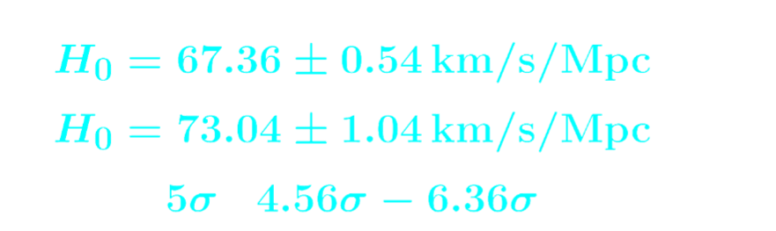

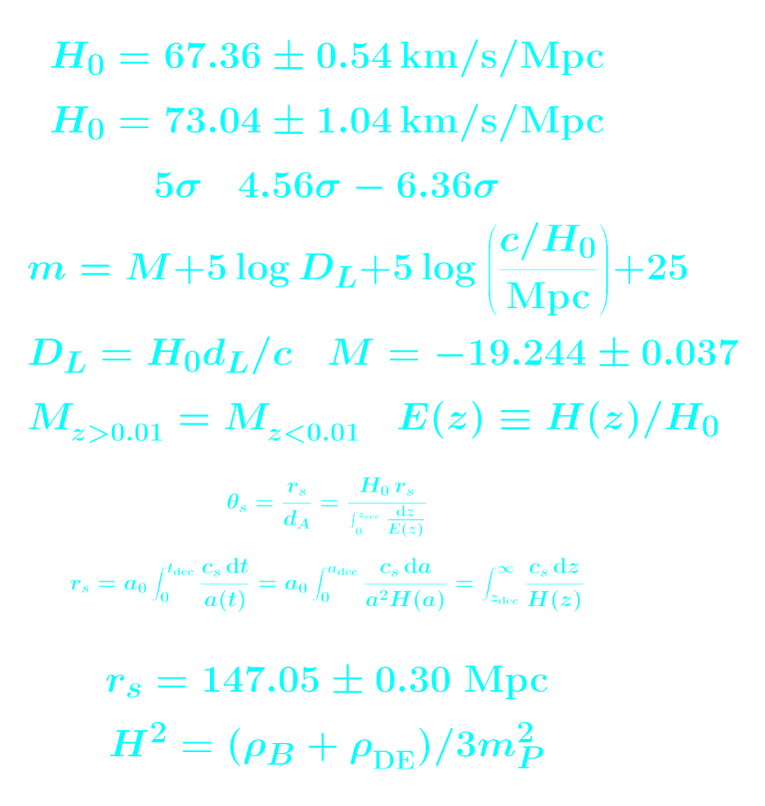
Hubble tension
ΛCDM suffers from a number of challenges
The most important of which is the Hubble tension
Hubble tension: A disagreement in the estimate of H₀ as inferred by
the CMB and by the SNe observations
► CMB:
► SNe:
This difference is about ( )

Slide 3
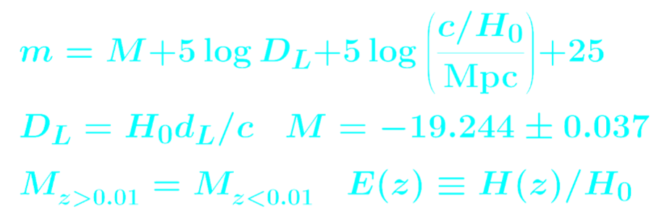
SNe estimates
Observations estimate:
Apparent magnitude of SNe
Dimensionless luminosity distance
SN absolute magnitude
Estimated when z < 0.01
► Crucial assumption:
If M at large z were smaller so must be for H₀

Slide 4
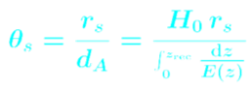
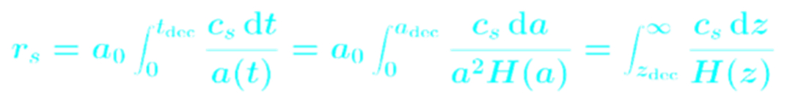
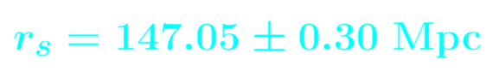
CMB estimates
Observations estimate:
Angle subtended by sound horizon at decoupling
Sound horizon:
Planck 2018
If r_{s} were smaller then H₀ must be larger
Early Dark Energy is a prominent way to decrease r_{s}

Slide 5
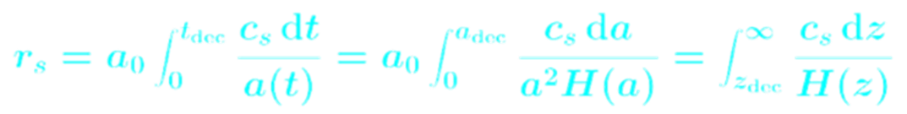
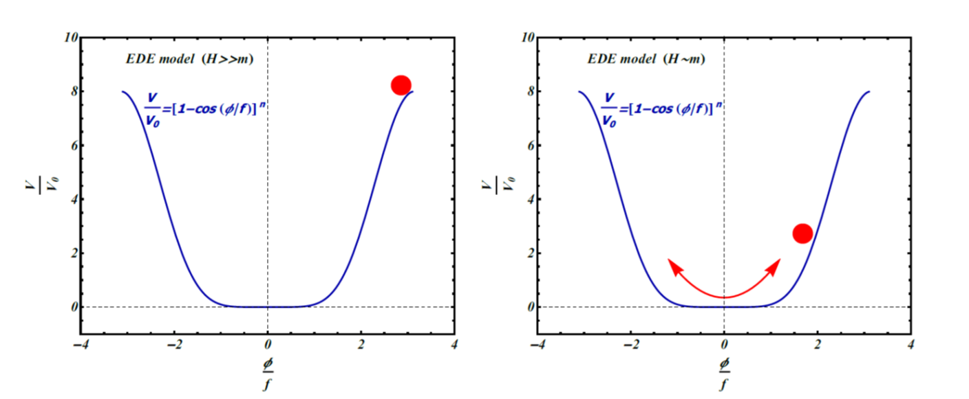
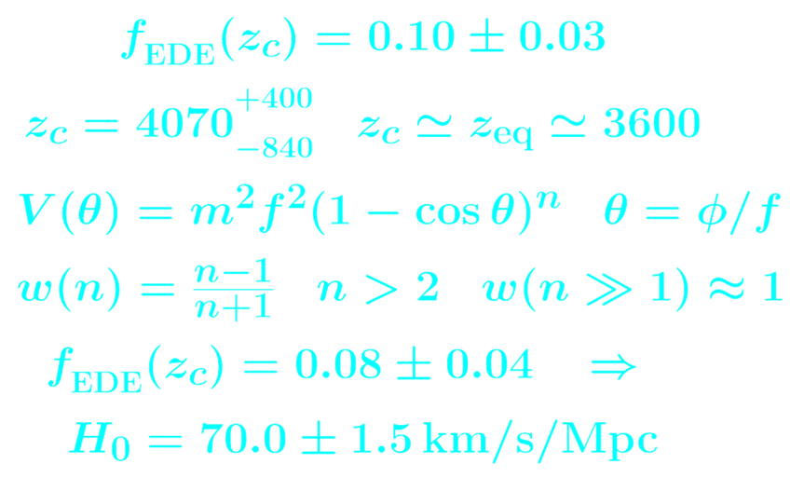


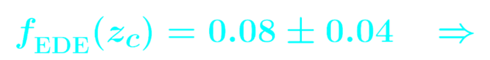
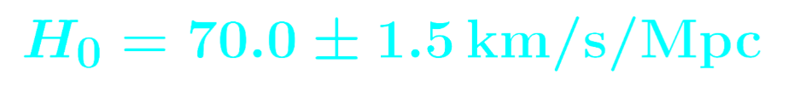

Early Dark Energy (EDE)
Early Dark Energy: Momentary importance of Dark Energy near equality
Friedman Eq:
fractional energy density
EDE is about 10% of total near equality
► Prototype:
Poulin, Smith, Karval & Kamionkowski 2019
√
EDE density has to decrease faster than radiation after equality

Slide 6
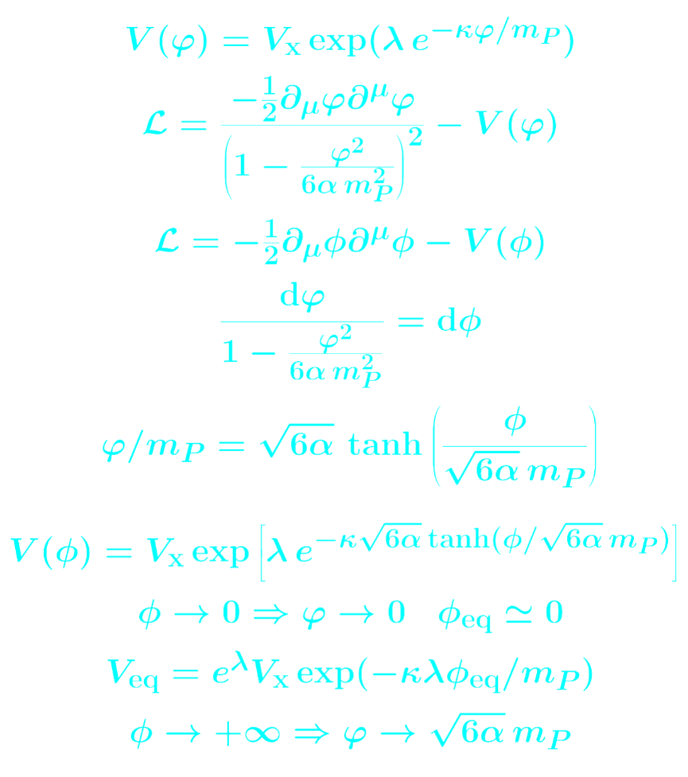
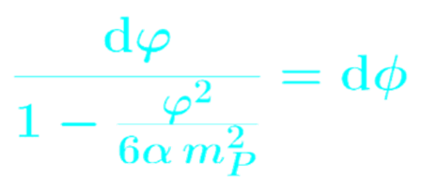

EDE + α-attractors
α-attractors are possible in the framework of CFT or SUGRA
The hope is to construct realistic EDE in this framework
Non-canonical
kinetric term:
Define canonical field:

Slide 7
Unified EDE + LDE from α-attractors
Attempt to unify EDE with late DE (LDE) in the context of α-attactors
Braglia, Emond, Finelli, Gümrükçüoğlu & Koyama 2020
As with original EDE, EDE first thawing then oscillating
Potential not realistic:
New attempt where EDE not oscillating at the end

Slide 8
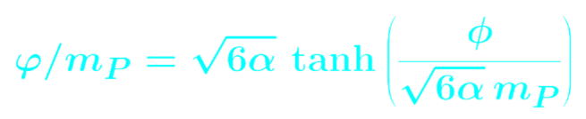
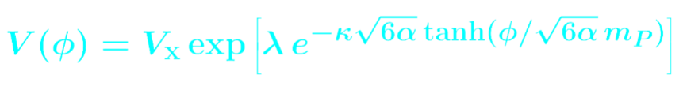

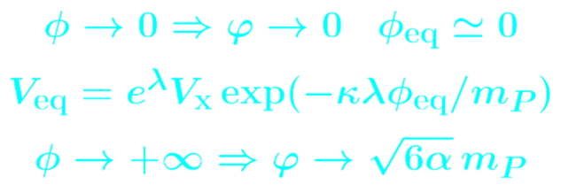
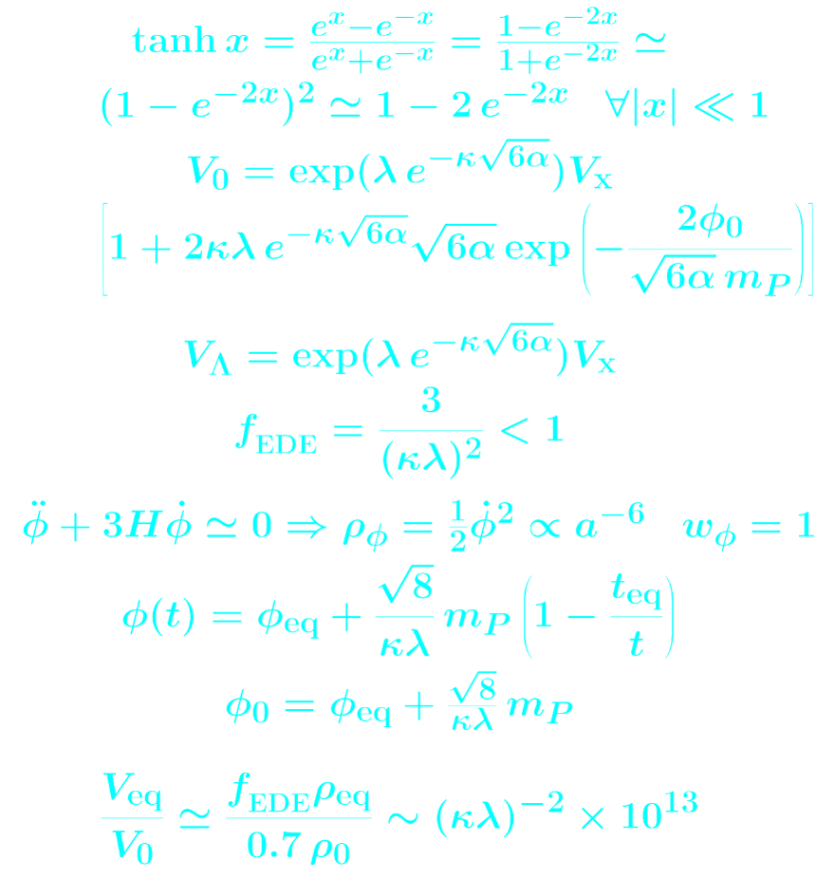

Model
We are interested in two limits: equality and today
At equality we consider:
Today we consider:

Slide 9

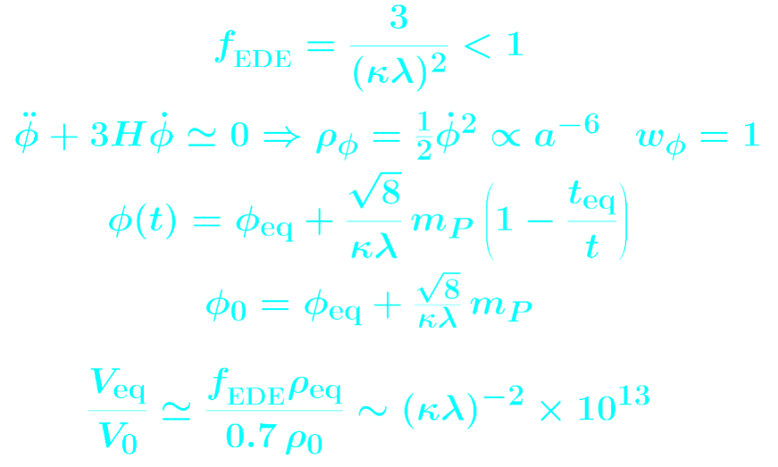
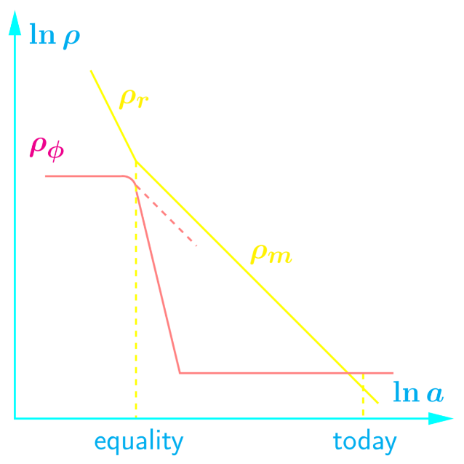
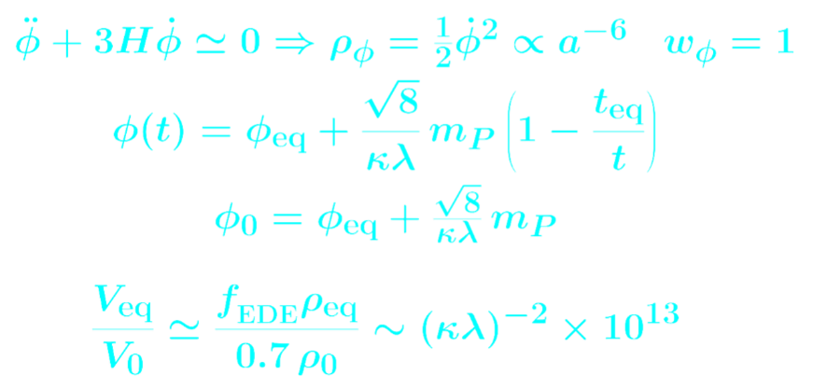
EDE
The field thaws at equality following the subdominant exponential attractor, which mimics the background density
Exponential approximation allows us to estimate when the field thaws
Soon afterwards the field experiences the full exp(exp) potential and free falls
Freezes at:

Slide 10
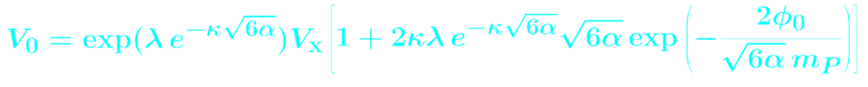
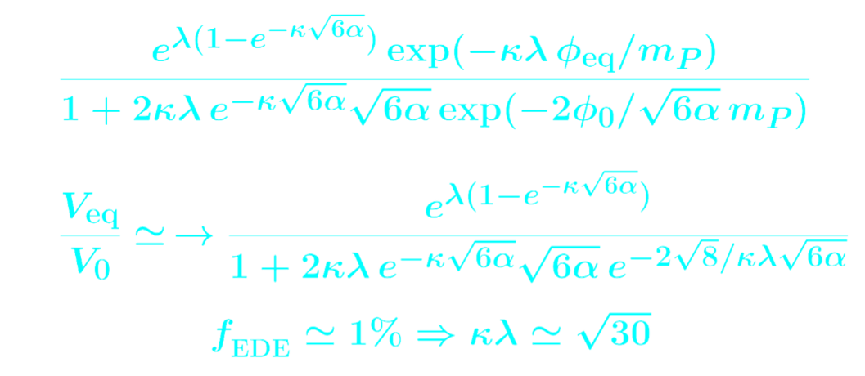
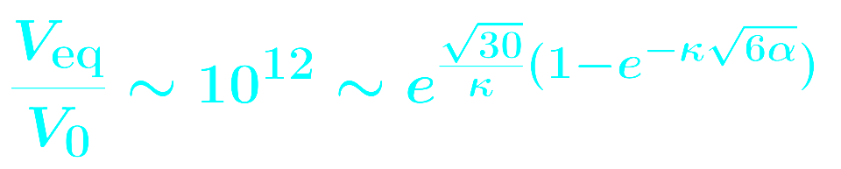
LDE

Slide 11
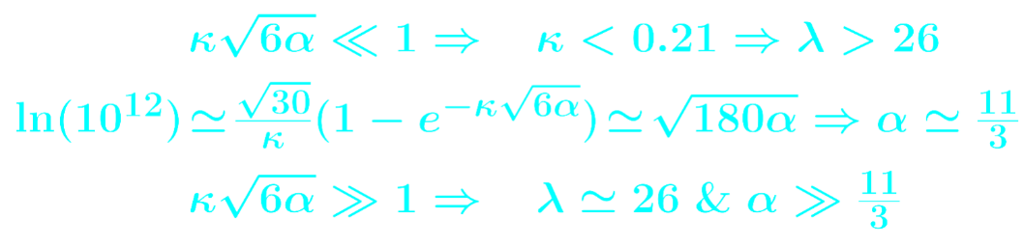
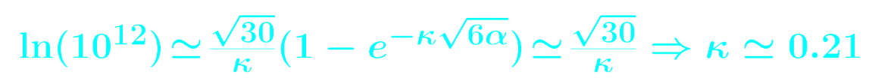
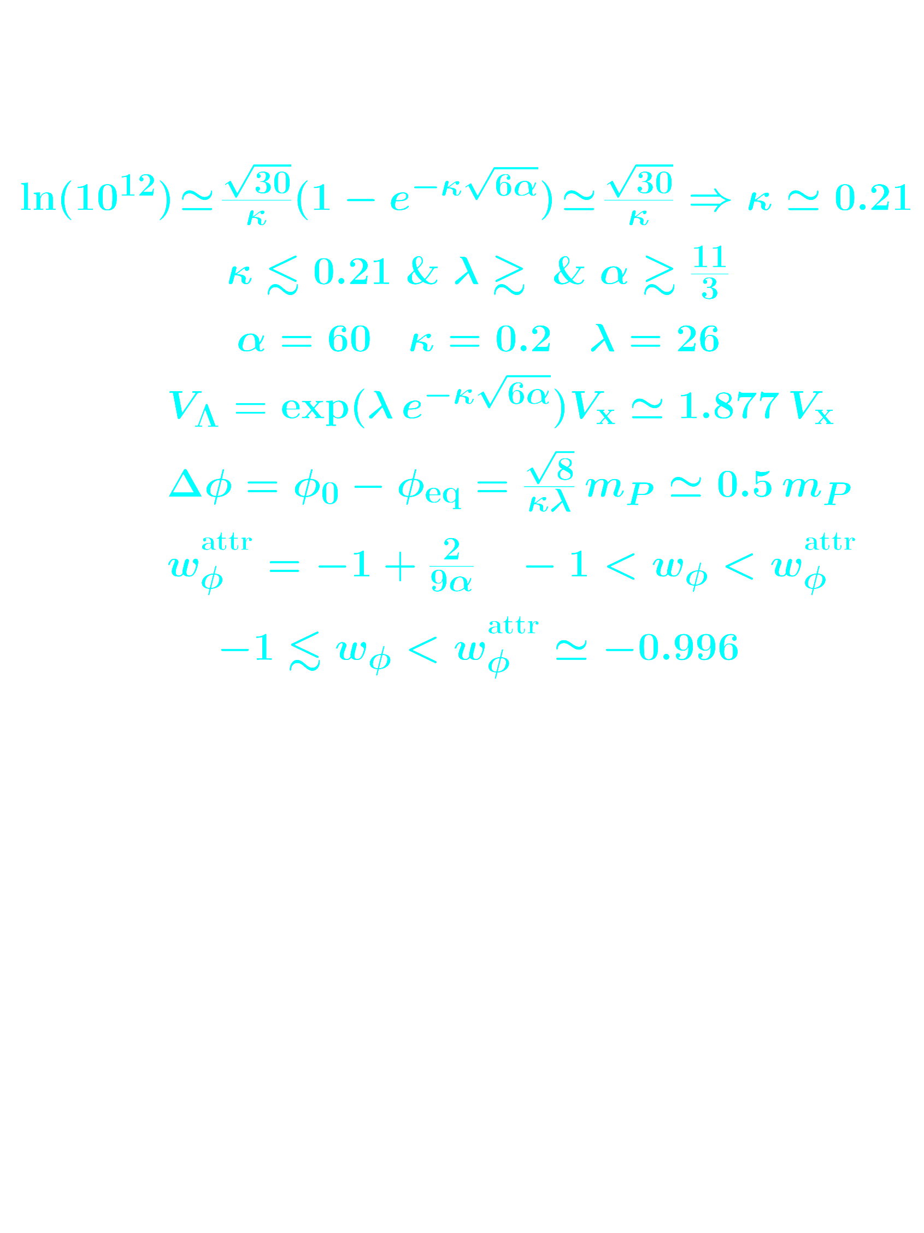

Model parameters
► When
► When
Same fine-tuning with ΛCDM

Slide 12
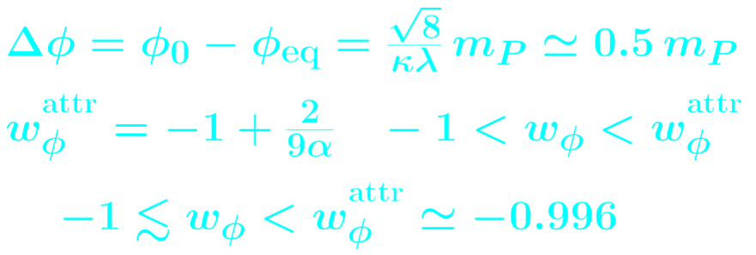

Barotropic parameter and total excursion
For dominant exponential attractor (ignoring V_{Λ} ):
Thawing
With V_{Λ}
Planck 2018: w_{φ}< - 0.95
√
Total excursion:
Sub-Planckian
√
A sub-Planckian total excursion implies that the 5th force is suppressed

Slide 13
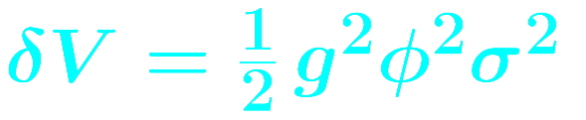
Trapping at the origin
The origin can be an Enhanced Symmetry Point:
Original kinetic energy of φ is depleted due to particle production of σ-particles because their mass gφ changes non-adiabatically near the origin
Produced particles give rise to linear effective potential V_{eff} ~ gn_{σ}|φ|, which halts the roll of φ and reverses its variation
Linde 2006
More particles are created when φ crosses the origin again, which results to steeper V_{eff} that reverses the variation of φ again
Trapping at φ = 0 provided σ-particles do not decay at maximum Δφ : ( Γ_{σ} ∝ m_{σ} ~ gφ )
After trapping, σ-particles are massless → radiation reheats the Universe

Slide 14
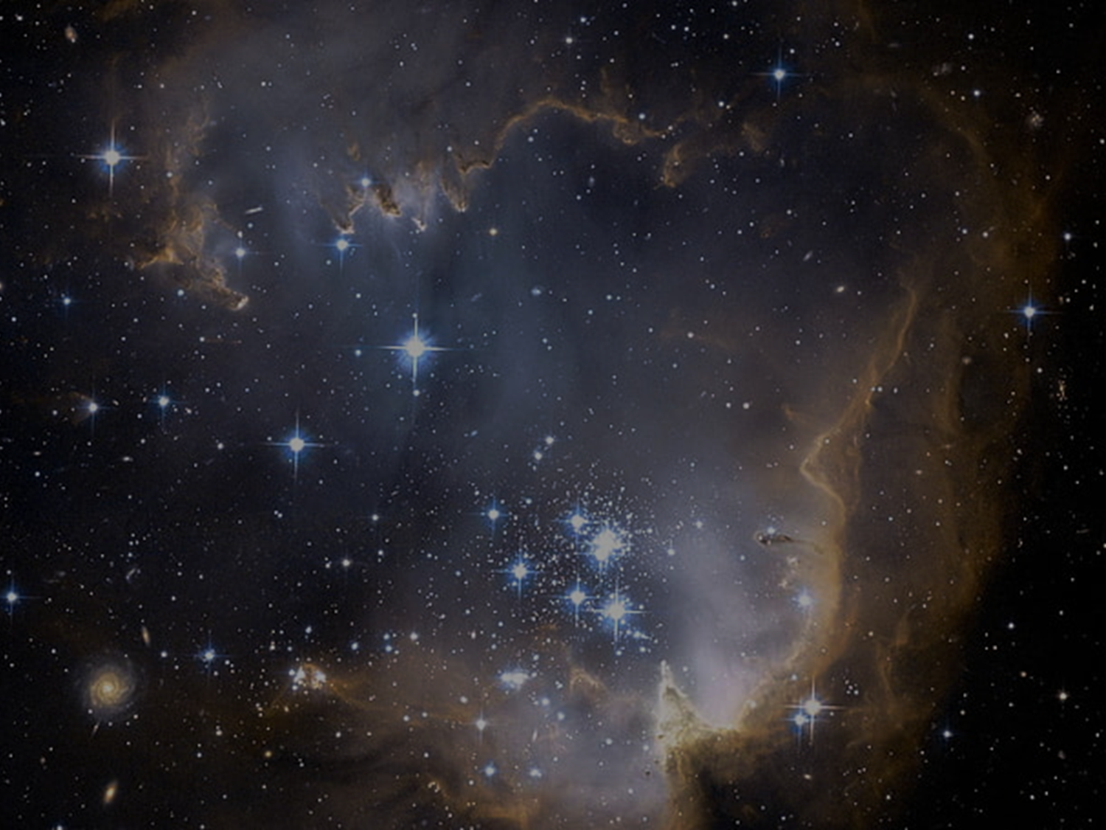
Conclusions
Concordance model (ΛCDM) suffers from Hubble tension at 5σ
Prominent solution is Early Dark Energy
EDE amounts to Dark Energy which momentarily becomes about 10% of total near equality, but decays faster than radiation afterwards
EDE with α-attractors can unify EDE and Late DE without more fine-tuning than ΛCDM
EDE with exp(exp) potential thaws at equality, then free-falls and eventually freezes until today, when it becomes LDE
The model seems to work with natural values of the parameters
It produces a barotropic parameter in excellent agreement with Planck 2018
It does not suffer from a 5th force problem
A thorough numerical investigation is pending to overcome the problem of oversimplifying assumptions, explore the parameter space and result in firm predictions

Slide 15
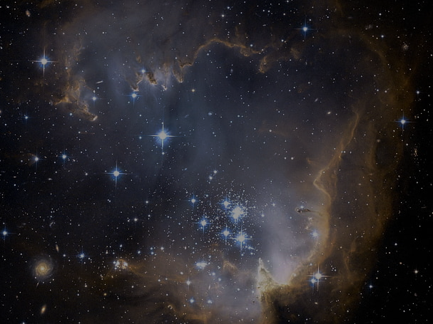
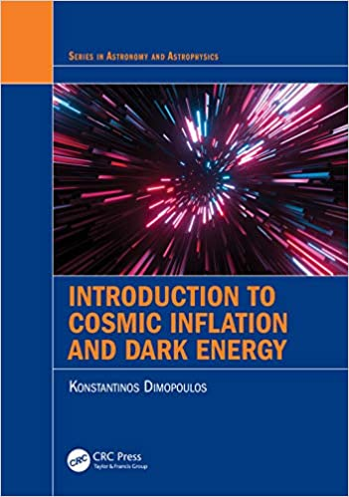
My book!

