Slide 1
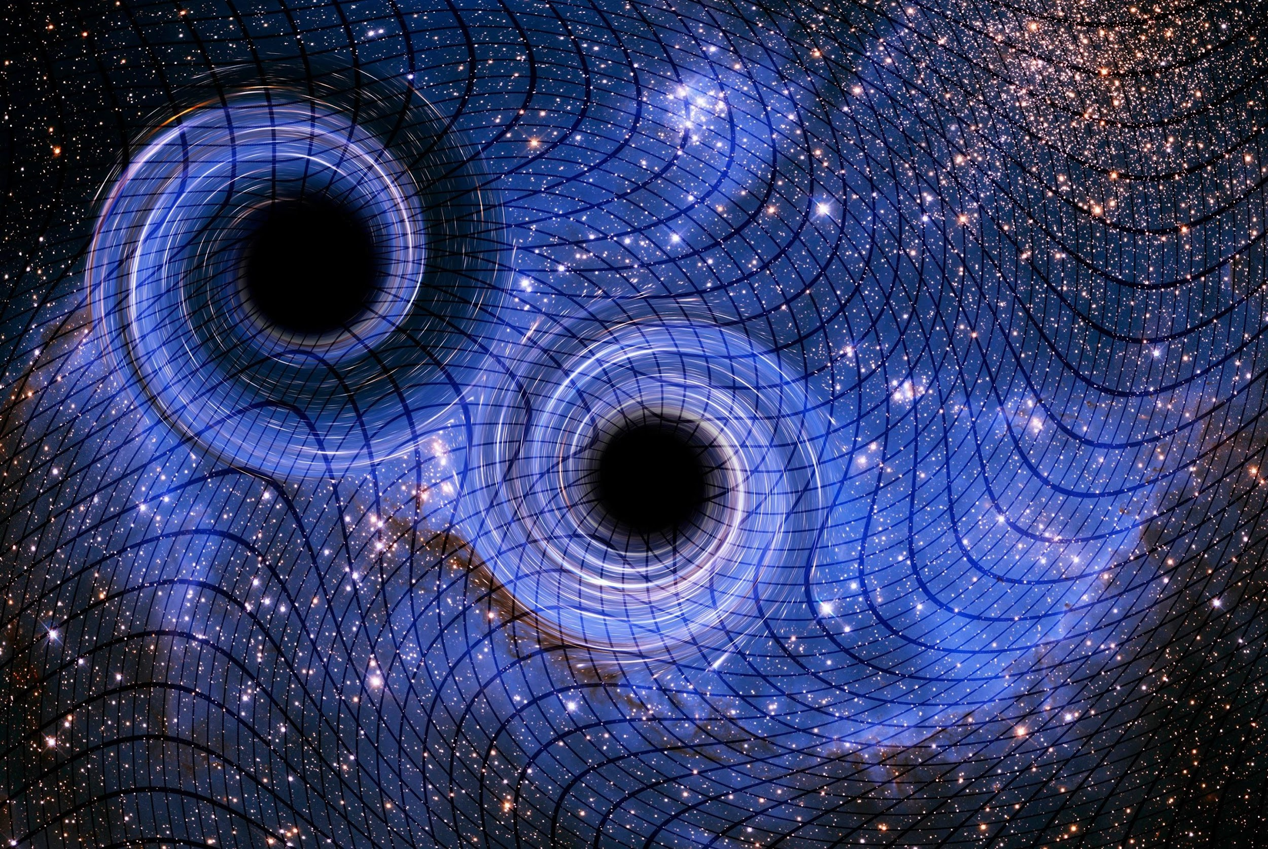

Probing Dark energy with gravitational waves distances
SW14 Cargese
10/05/2022
Alice Garoffolo
Instituut Lorentz - Leiden University
garoffolo@lorentz.leidenuniv.nl

Slide 2
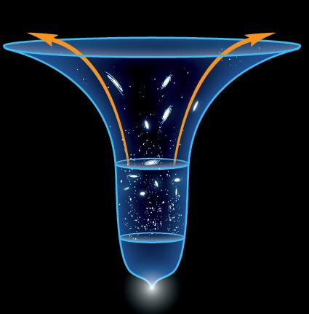
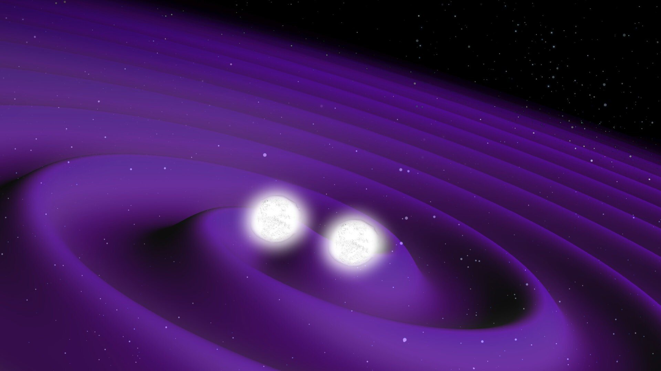
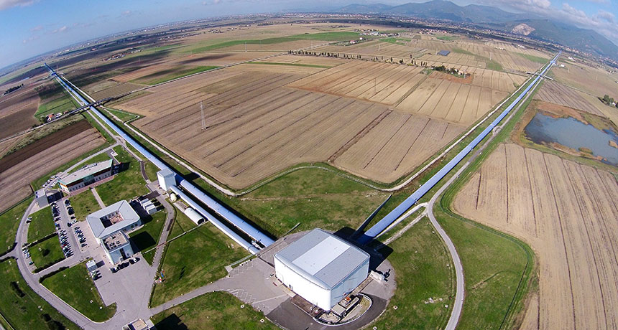
«GWs distances» to test GR+Λ against alternative theories
  Modiﬁed propagation of GW in scalar-tensor theories → 1912.08093
  Luminosity distance ﬂuctuations: DE clustering detection → 2007.13722
  Angular diameter distance: DDR and time delay → 2103.00155
  Screening and detectability of extra polarizations → 2110.14689
  AG, A. Silvestri, M. Raveri, S. Matarrese, G. Tasinato, D. Bertacca, C. Carbone, O.Contigiani
1/9

Slide 3
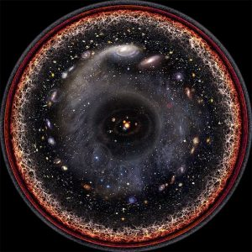
Geometrical vs physical distances: «how» we measure
$$d=f(A)$$
We always observe SIGNALS, either in the form of photons or gravitational waves.
It’s important the DYNAMICS of messenger
2/9

Slide 4
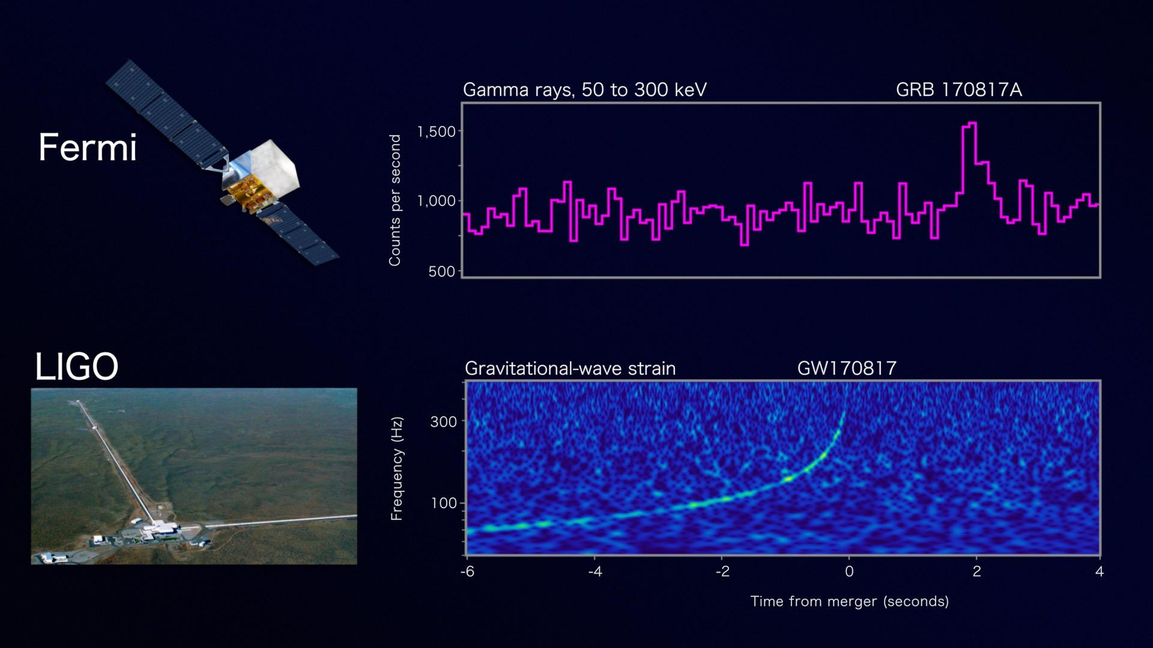

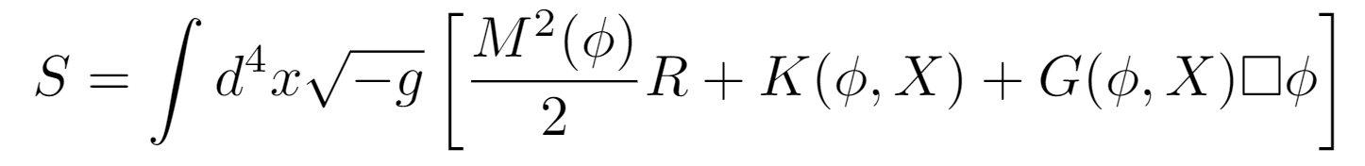
Scalar-tensor theories of gravity
DE is scalar field coupled to metric in every possible way provided that stability and symmetry requirements are met
17/08/17:
GW propagate at the speed of light! *
LIGO & Virgo collaboration ‘17
Baker et al. ‘17, Creminelli et al. ‘17, Ezquiaga et al. ‘17
3/9

Slide 5
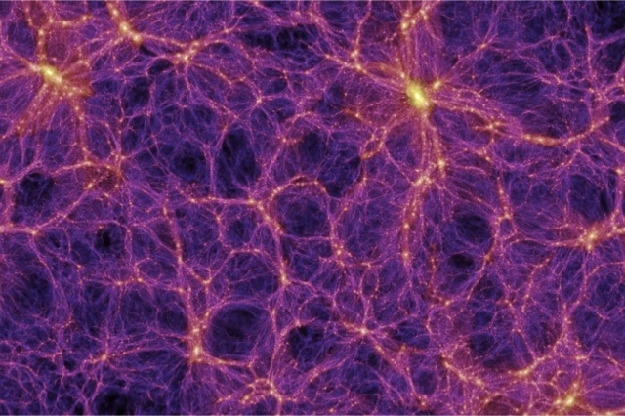


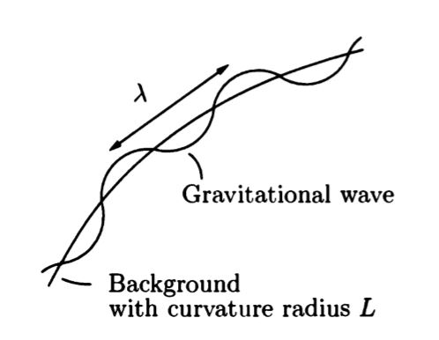
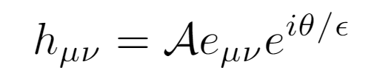

GW propagation equation in ST theories
FRW + LSS background:
«DE clustering»
Propagation equation:
AG et al ‘19,
G. Tasinato, AG et al ‘21
Solution: GO ansatz, use high frequency character
LSS affects distance estimates. Lensing for LISA 5-10%.
Belgacem et al. ‘18, Holz et al. ’15, Tamanini et al. ‘17
4/9

Slide 6
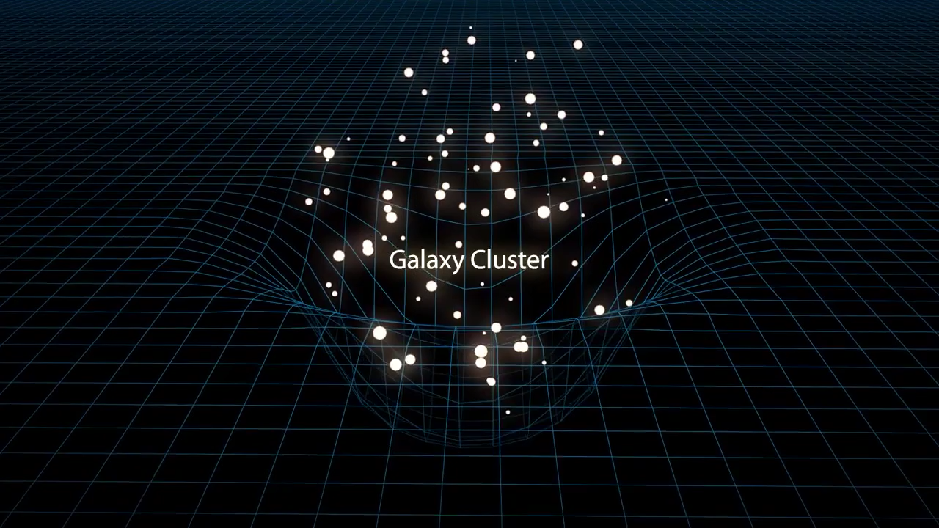
LSS effects on wave’s amplitude
Disclaimer:
Photon = GW
5/9

Slide 7
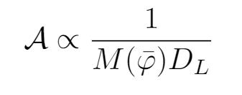
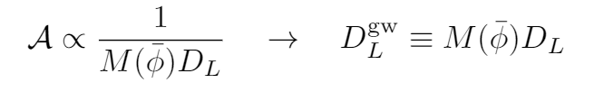
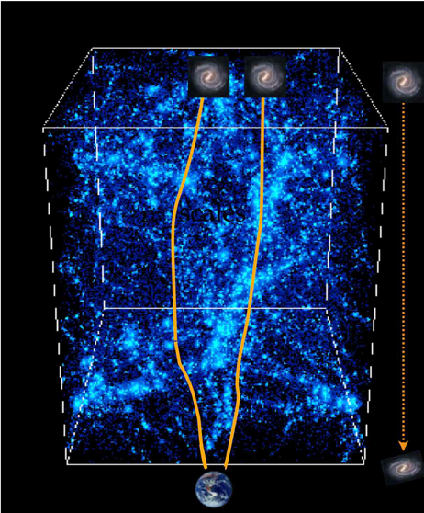
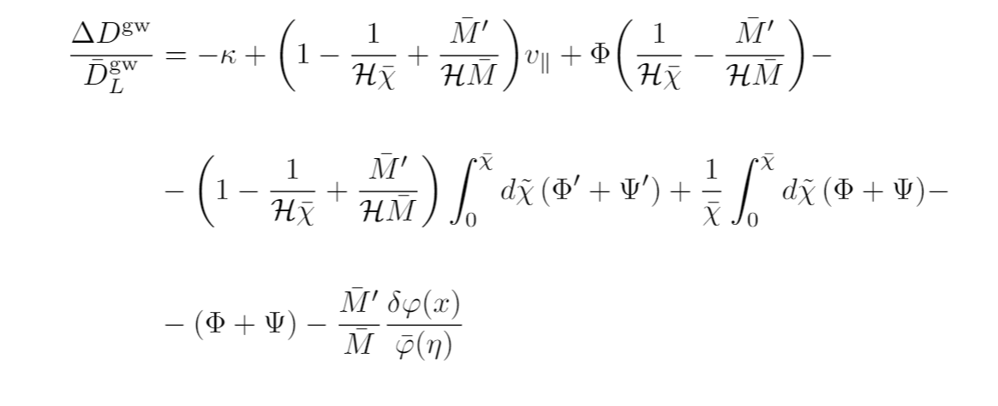

GW luminosity distance fluctuations
AG et al ‘19, AG et al ‘20
“Standard Sirens”:
Compare EM and GW
luminosity distance
FRW background:
Including LSS:
Lensing
SW
Doppler
ISW
Shapiro time delay
Volume
DE clustering
LSS induce correlation between GW observed events.
Can use this both to correct D_{L} or as signal to detect DE clustering.
5/9

Slide 8
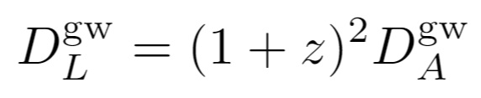

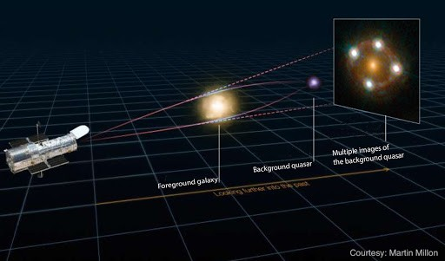
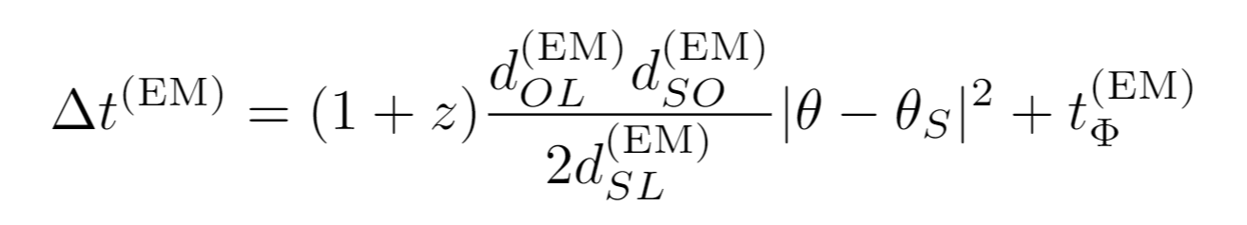
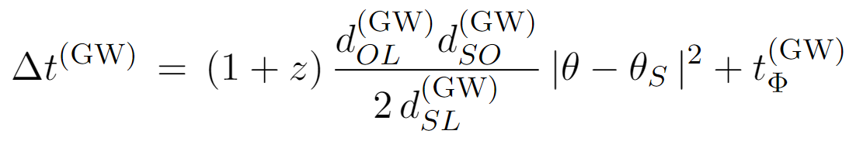
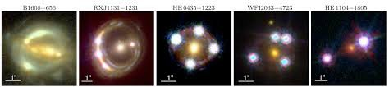
GW angular diameter distance and distance duality relation
G. Tasinato, AG et al ‘21
Propagation of particles along null geodesics
Conservation of particles number
Also $d_{A}^{GW}$ is modified:
H0liCOW
However $Δt^{GW}=Δt^{EM}$ because $c_{t}^{2}=1$.
6/9

Slide 9

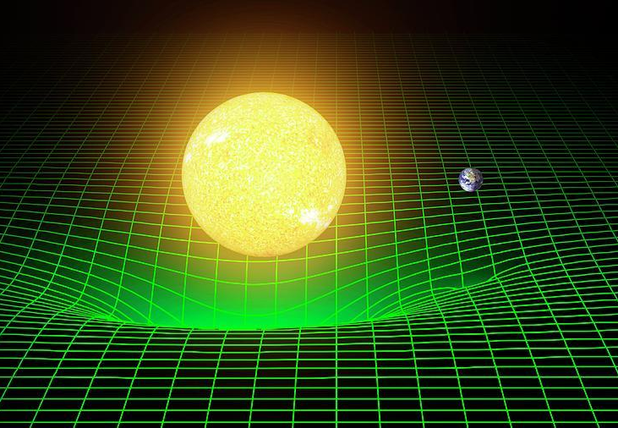
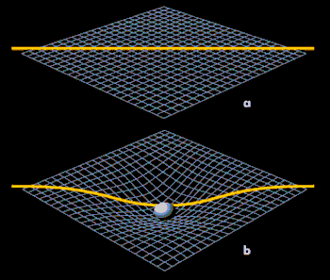
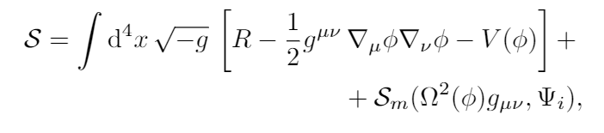
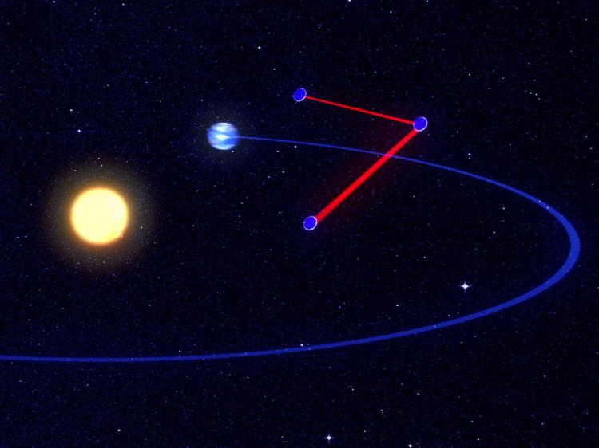
Fifth force and screening
AG et al. ‘21
s
To pass local test of GR, viable ST theory must be endowed of screening mechanisms to suppress 5° force.
Action in Einstein Frame*
Conformal factor
Matter fields
7/9

Slide 10
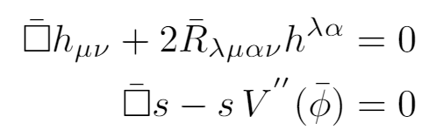



Screening of high frequency waves?
AG et al. ‘21
Equations of motion:
GO ansatz
Conservation equation
No «mass»!
p.e. Chameleon:
5° force is Yukawa with environment dependent «mass»
Neglect mass term: Can we detect high frequency scalar wave?
8/9

Slide 11

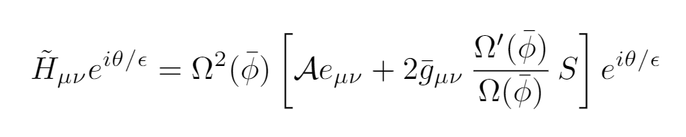
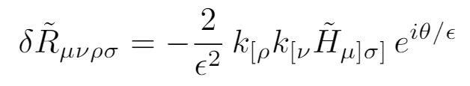
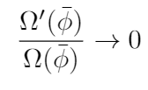
Detectability of scalar wave
AG et al. ‘21
The relative acceleration between two nearby geodesics given by
«electric components of the Riemann tensor» in Jordan frame
Metric perturbation in Jordan frame
Chamaleon and symmetron:
Khoury et al. ‘04, Burrage et al. ‘18, Hinterbichler et al. ‘11
Screening suppresses the interaction with matter.
We predict that SW should NOT be detected.
9/9

Slide 12
Summary and conclusion
Standard Sirens
Luminosity distance fluctuations
1. If know z: use distance-redshift relation
Accurate DL measurements
Direct DE clustering detection
Angular diameter distance
Polarization test
DDR holds
$Δt^{GW}=Δt^{EM}$ because $c_{t}^{2}=1$.
SW is screened in chameleon and symmetron
Thank you!

