Slide 1
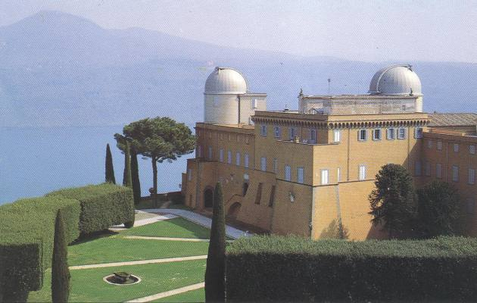
JORDAN AND EINSTEIN FRAMES FROM THE PERSPECTIVE
OF HAMILTONIAN BRANS-DICKE THEORY
Gabriele Gionti, S.J.
HOT TOPIC IN MODERN COSMOLOGY, SPONTANEOUS WORKSHOP 14, CARGESE-FRANCE, May 8-14, 2022
partially in collaboration with Matteo Galaverni and based on arXiv:2003.04304 Phys. Rev. D 103 024022 (2021) , arXiv:2110.12222 Phys. Rev. D 105 084008 (2022), arXiv:2112.02098 Universe 8 (2021).

Slide 2
Outline
Jordan and Einstein frame. Scalar-Tensor theory with (GHY)-boundary term and Weyl (conformal) transformations from Jordan to Einstein Frame.
Hamiltonian (canonical) analysis of Brans-Dicke theory with GHY-boundary term (case $ω≠−\frac{3}{2} ).$
Hamiltonian transformations from Jordan to the Einstein Frame. “Vexata Questio”: are these transformations canonical? “Anti-Newtonian”transformations as Hamiltonian canonical transformations.
Canonical analysis of BD theory in the case $ω=−\frac{3}{2}$ in the Jordan Frame
BD theory for $ω=−\frac{3}{2}$ in the Einstein Frame
The inequivalence of the Dirac constraints’ algebra of BD theory for $ω=−\frac{3}{2}$ in the Jordan
shows the transformations from Jordan to Einstein frame are not canonical.
Brans- Dicke FLRW flat, k=0, case as finite dimensional example.
Conclusions.

Slide 3
Jordan-Einstein Frames
Old paper: Dicke (Phys. Rev. (1962) 125, 6 2163-2167)
Suppose the proton mass is in mass units and, in “natural units”, we scale the unit of measurement by a factor (length)⁻¹
. In the new unit the proton mass .
Confronting the measurement of the proton mass in the two mass units
(Faraoni and Nadeau 2006)

Slide 4
Jordan-Einstein Frames
Since and , then the covariant metric functions scales as
Invariance under rescaling of unit of measurement implies Weyl (conformal invariance) of the metric tensor
The starting frame is called “Jordan” frame and the conformal transformed the “Einstein Frame. One observable can be computed in both frames. Its measure, obviously different in the two frames, is related by conformal rescaling according to the observable’s dimensions.(e.g. ).

Slide 5
Jordan-Einstein Frames
Dimensional analysis shows the following trasformation rules between Jordan and Einstein frame

Slide 6
Scalar-Tensor Theory
In general, one starts from a scalar-tensor theory, with GHY-like boundary term, in the Jordan Frame
and passes to the Einstein Frame with the transformation
therefore the action becomes

Slide 7
Scalar-Tensor Theory
where
One is looking for solutions of the equation of motions such that if
is solution in the Jordan Frame,
is solution in the Einstein frame

Slide 8
Brans-Dicke Theory
Brans-Dicke, with GHY boundary term, is a particular case of Scalar Tensor theory
We studied the 3+1 ADM (Hamiltonian) decomposition
The ADM Lagrangian is

Slide 9
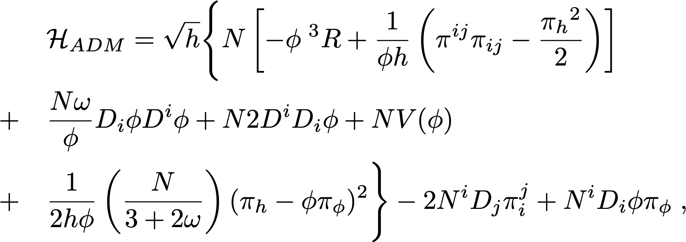
Brans-Dicke Theory
We can define the canonical momenta
And the ADM-Hamiltonian

Slide 10
Brans-Dicke Theory
Therefore is the sum of the Hamiltonian constraint and the momentum constraint
The constraint algebra is like Einstein’s Geometrodynamics

Slide 11
Brans-Dicke Theory-Einstein Frame
Implementing the Weyl (conformal) transformation, we get the following ADM metric in the Einstein Frame
Now we recall that in the Brans-Dicke case

Slide 12
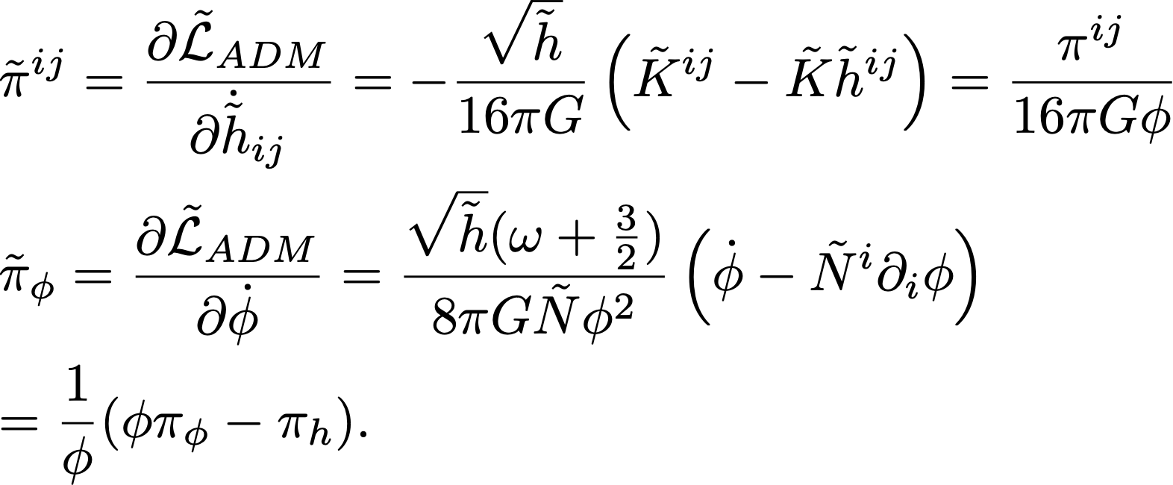
Brans-Dicke Theory-Einstein Frame
Canonical momenta ( is ADM-Lagrangiam demsiti in the E-F)
The ADM Hamiltonian density in the E-F is

Slide 14
Canonical Transformations
In Hamiltonian theory a transformation of variables among the canonical variables and is a canonical transformation if the symplectic two form is invariant, that is, in the new coordinates, . This is equivalent to the following condition on the Poisson Brackets
Transformations from the Jordan to the Einstein frame are the followings

Slide 15
Canonical Transformations
Here, for simplicity, we repeat the transformations from the Jordan to the Einstein Frame in Hamiltonian formalism
One can check they are not Hamiltonian Canonical Transformations
Therefore it is meaningless to perform the Dirac’s constraint analysis in the Einstein Frame and show that the constraint algebra, for Brans-Dicke, closes in this frame

Slide 16
Main criticism to this non-canonicity argument
In litterature, people object N, N^{i} are mere Lagrangian multipliers and canonicity should be checked on the true physical degrees of freedom.
This could be misleading. Lapse and Shifts cannot be eliminated ❝ad hoc❞, they are still canonical variables
The only way we can ❝safely❞ treat them is by making a gauge fixing (ex. N$≈$c₁ , N^{i} $≈$c^{i} so that $π≈0$, $π_{i}≈0$ becomes second class constraints).
N, N^{i} $, π$, $π_{i}$ are then eliminated defining Dirac’s brackets.

Slide 17
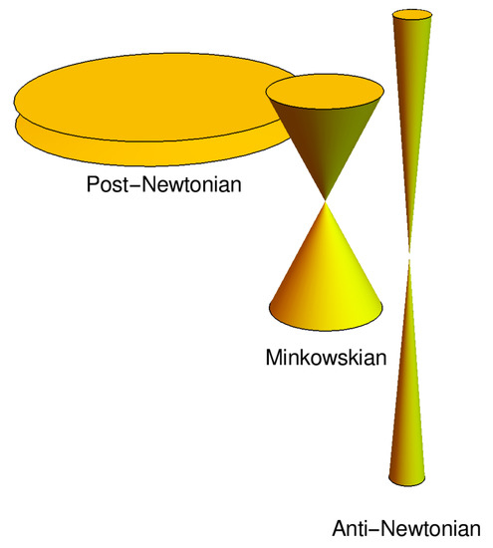
Canonical Transformations
There exist Hamiltonian Canonical Transformations (Anti-Gravity transformations)
(in two dim. )
In this case the ADM Hamiltonian
Since this theory is canonically equivalent to B-D, the constraint algebra of secondary first class constraints ( , ) is like B-D’s one.
Carrolian Gravity,
G$→∞ , c→$0
M. Niedermaier 2019

Slide 18
BRANS-DICKE PARTICULAR CASE $ω=−\frac{3}{2}$
The B-D action for $ω=−\frac{3}{2}$ is (for consistency reasons here U($φ$)=$αφ^{2}$ $α$ is a constant)
It is invariant under this conformal transformations
The ADM Hamiltonian in this particular case is

Slide 19
BRANS-DICKE PARTICULAR CASE $ω=−\frac{3}{2}$
Clearly the Hamiltonian and momenta constraints are
We also have a further primary constraint due to conformal invariance
All the constraints (shown through lengthy and technically complicated calculations) are first class .

Slide 20
BRANS-DICKE PARTICULAR CASE $ω=−\frac{3}{2}$
Momentum and Hamiltonian constraints have the same algebra as Einstein geometro-dynamics.
The constraint algebra of the primary constraint $C_{φ}$ the momentum and Hamiltonian constraint is
The Poisson Bracket of the Hamiltonian-Hamiltonian constraint results to be
Notice the extra term is generated by the diffeomorphisms for conformal invariance

Slide 21
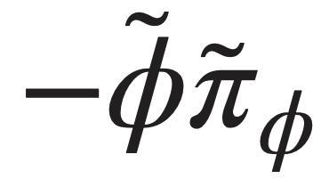
BD PARTICULAR CASE EINSTEIN FRAME
The B-D action for $ω=−\frac{3}{2}$ in the Einstein Frame is nothing else but (the potential is now a constant function)
Notice that the theory is just Einstein GR and is not (Weyl)-Conformal invariant
The relative ADM Hamiltonian
The Dirac primary constraint $C_{φ}$ $≈0$ becomes $≈$0. The other Dirac’s constraints are the same as Einstein’s GR.

Slide 22
BD PARTICULAR CASE IN EINSTEIN FRAME
The constraint algebra among momentum and Hamiltonian constraints are like Einstein geometro-dynamics
The remaining constraint algebra is
Very clearly the algebra of the Dirac’s constraints of the BD theory in the Einstein Frame is completely different respect to the Jordan frame. Therefore, we continue to remark, the transformation between the two frames results not to be canonical.

Slide 24
Finite Dimensional Example
We can apply these considerations on a finite dimensional example: FLRW case with k=0
If we put this metric in the B-D action, we obtain the following finite dimensional Lagrangian
The canonical momenta are

Slide 25
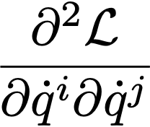
FLAT FLRW B-D THEORY LAGRANGIAN
The determinant of the Hessian matrix
is zero. Moreover, the determinant of the submatrix associate to the variables ($\dot{a,}\dot{φ}$) is
Therefore, we have two cases, as we already know, $ω≠−\frac{3}{2}$ and , $ω=−\frac{3}{2}$

Slide 26
HAMILTONIANS IN THE JORDAN FRAME
The canonical Hamiltonian for $ω≠−\frac{3}{2}$ is
The canonical Hamiltonian for $ω=−\frac{3}{2}$ is
with a further secondary first class conformal constraint
The total Hamiltonians are ( H and$H^{(−3/2)}$ are, respectively, the Hamiltonian constraints)

Slide 27
Transformations from the Jordan to the Einstein Frame
JF-EF transformations
They are not Hamiltonian canonical
The followings are canonical transformations (as we have seen above)

Slide 28
Equivalence (and non-equivalence) of the Equations of Motions

Slide 29
Conclusions
We have analyzed the Hamiltonian formalism of Brans-Dicke theory in the Jordan Frame
with GHY boundary term both in the general case $ω≠−\frac{3}{2} ,$and $ω=−\frac{3}{2}$.
Using the Poisson brackets defined on the extended phase space, where the Dirac’s constraints are not zero, we have shown that the Weyl (conformal) transformations, in the Hamiltonian formalism, from Jordan to Einstein frame are not canonical transformations.
$A$ set of true canonical transformations have been found (Anti-Gravity or Anti-Newtonian transformations). In the case $ω=−\frac{3}{2}$ , the inequivalence is straightforward confronting and contrasting the Dirac’s constraint algebra in the two frames.
The question remains whether on the reduced phase, where the Dirac’s constraints are null, there could be a way to show Hamiltonian equivalence between the Jordan and Einstein frame.

Slide 30
This Hamiltonian canonical inequivalence addresses a new question: is it feasible to reduce the degrees of
freedom, through a gauge fixing for example, in such a way to recover Hamiltonian
equivalence (of course in the case $ω≠−\frac{3}{2}$).?

Slide 31
Jordan-Einstein Frames
Dimensional analysis shows the following trasformation rules between Jordan and Einstein frame
The confontation of the physical observables in the two frames has to take into account these transformation fomulas, for example the red-shift (adimensional).

