Slide 1
New features of
K-essential cosmologies
Ugo Moschella
Università dell’Insubria
Como

Slide 2
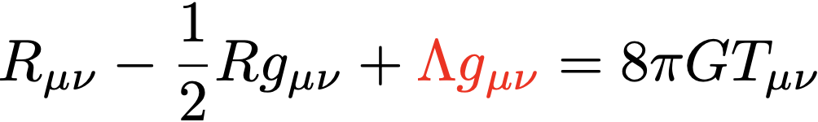
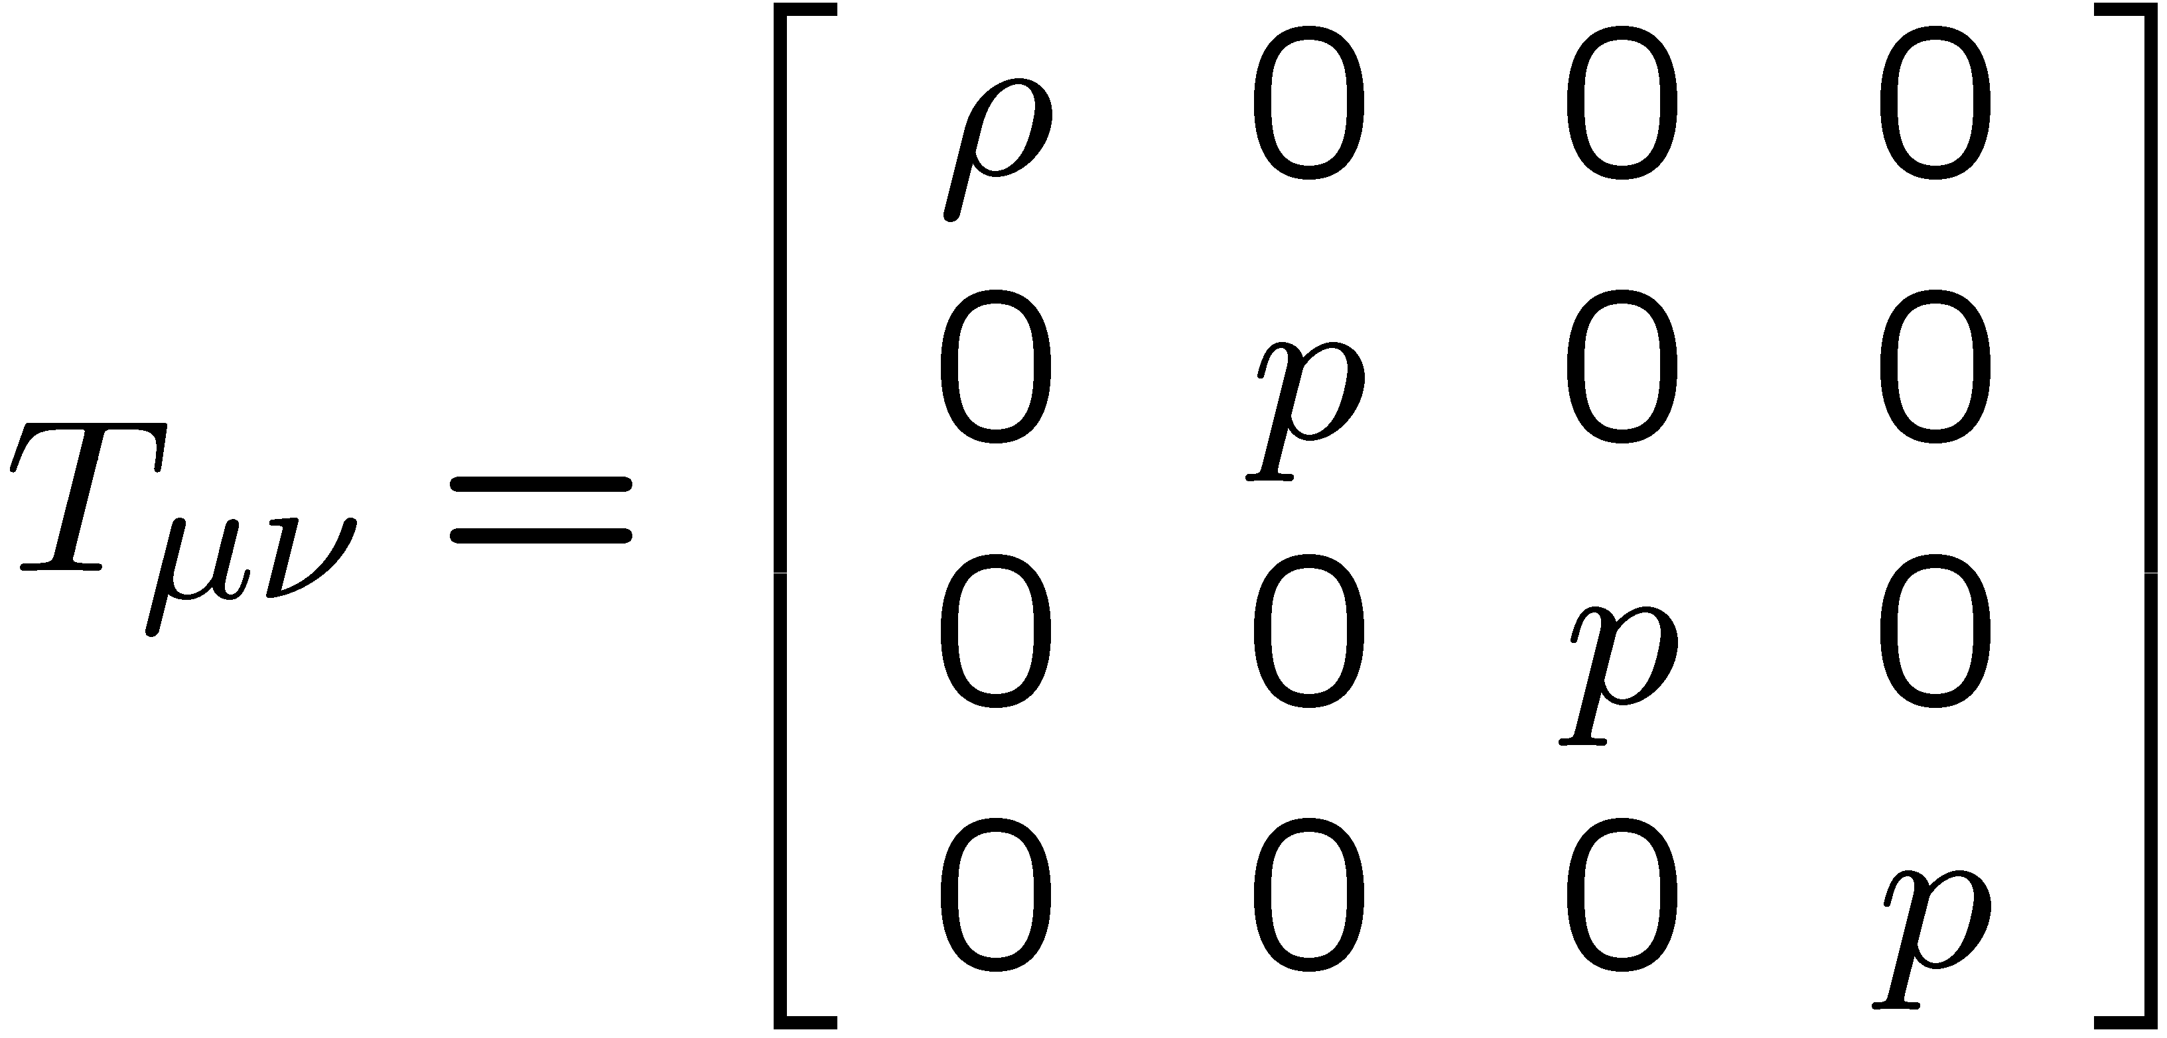
Einstein’s (Cosmological) Equations
In comoving
coordinates:

Slide 3
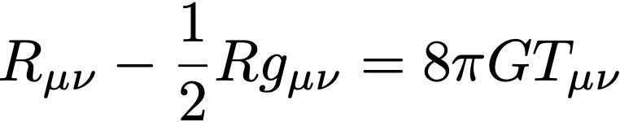
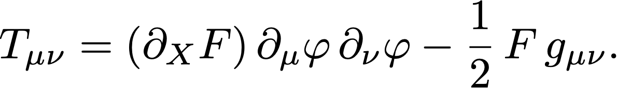
Pure k-essence models

Slide 4
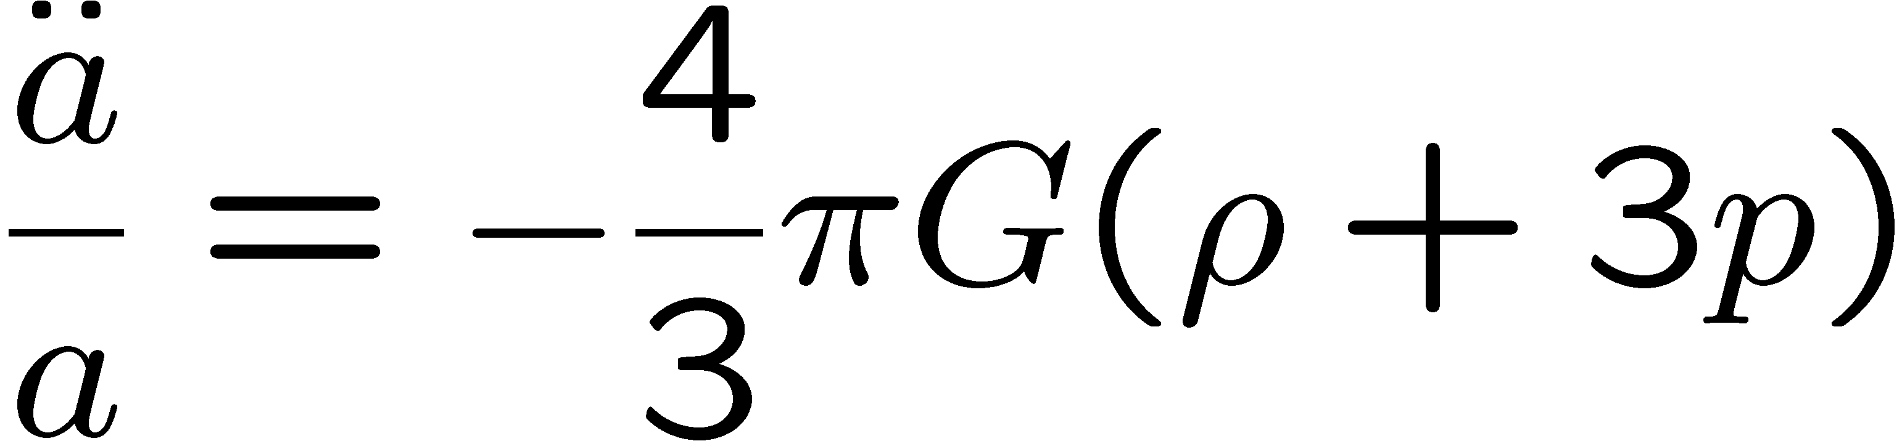
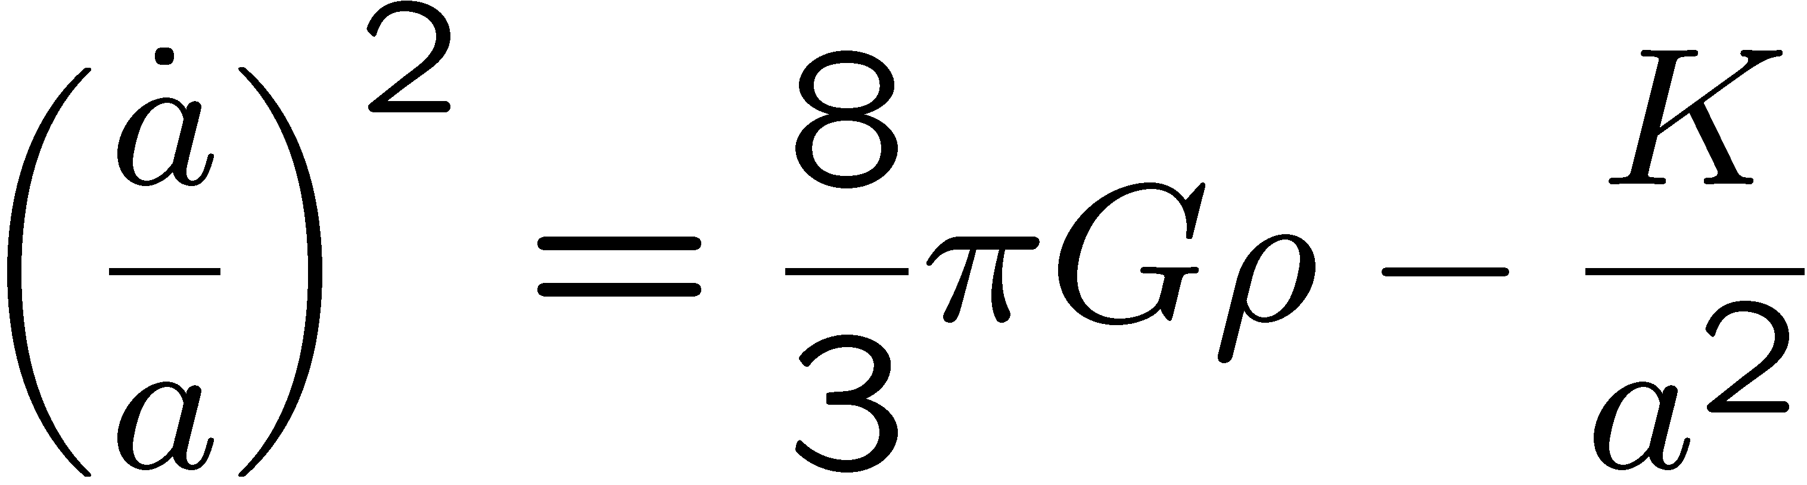
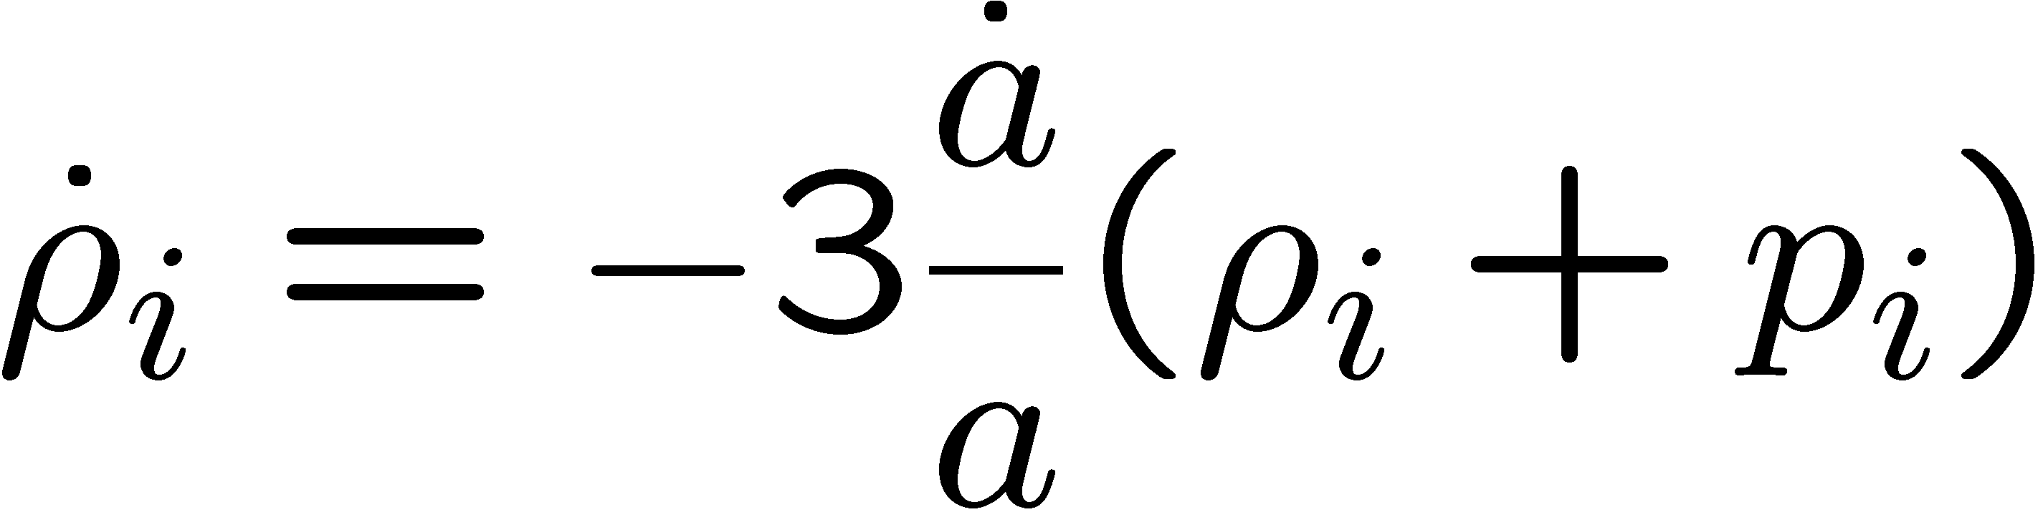
Cosmological Equations
Raychaudhuri Eq.
Friedmann Eq.
Together imply
(for each component):

Slide 5

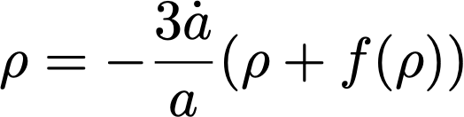


Equation of state
Linear case:

Slide 6
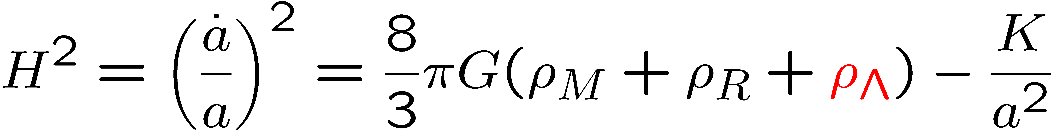
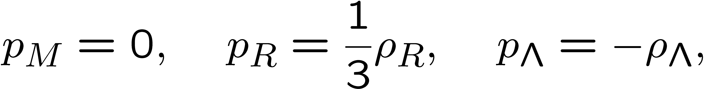
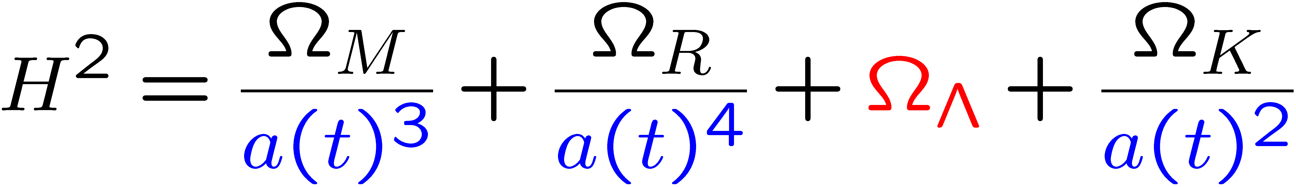
Lambda forever

Slide 7
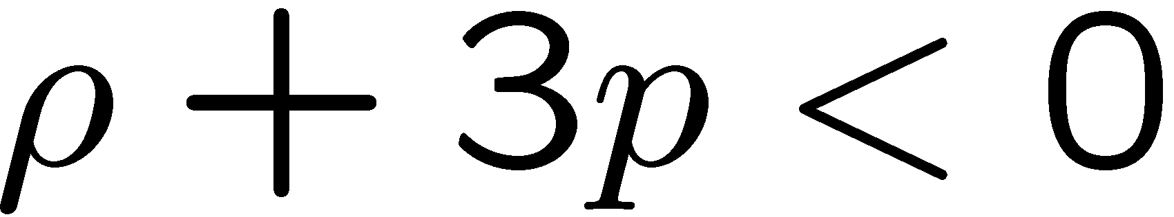


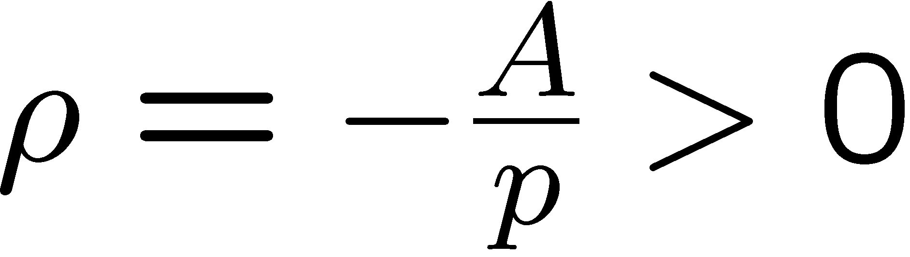

Simple Dark Energy Models
Cosmic Acceleration
1) A perfect fluid
2) Cosmological Constant
3) Chaplygin Gas
4) Dynamical scalar fields: Quintessence, k-essence,
tachyons, f(R),…….

Slide 8
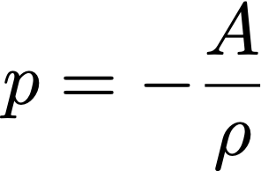
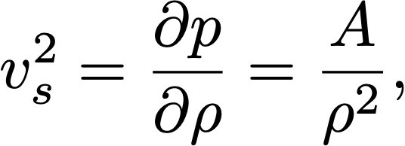
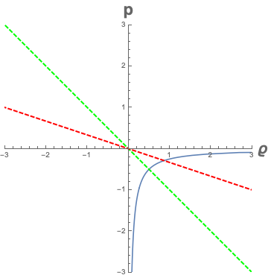
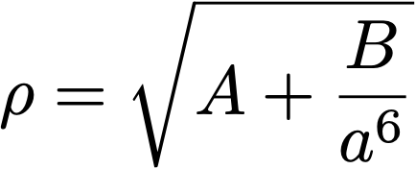
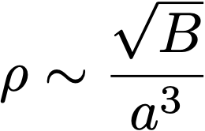

Chaplygin gas

Slide 9


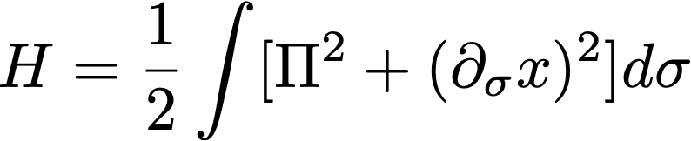

A string in three dimensions
x is a transverse coordinate in the light-cone gauge

Slide 10
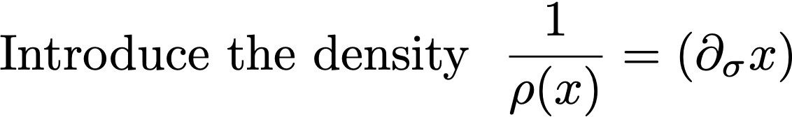


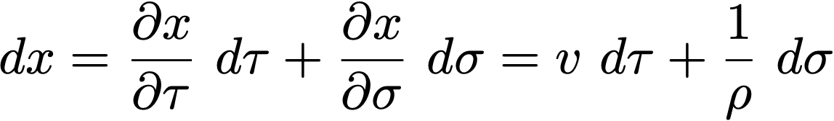
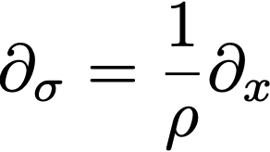
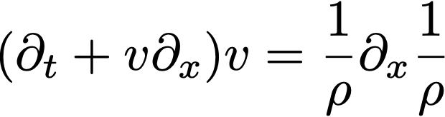

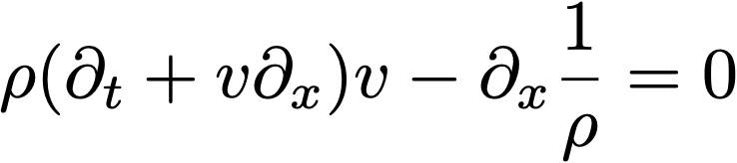
Integrability: hodograph transformation

Slide 11

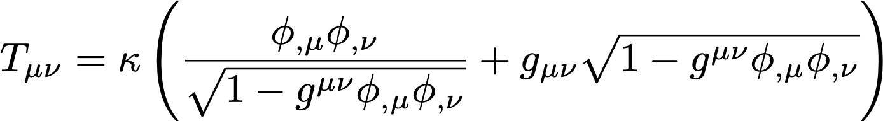

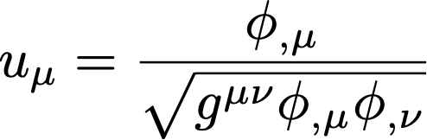
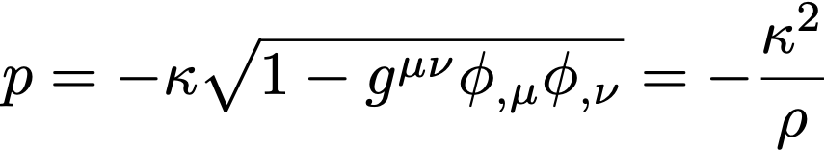
Braneworld

Slide 12



Pure k-essence models. One scalar field

Slide 13

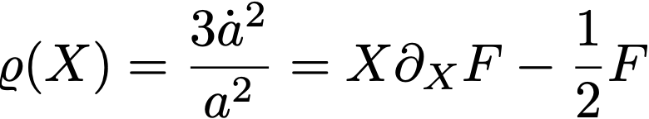
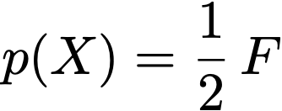
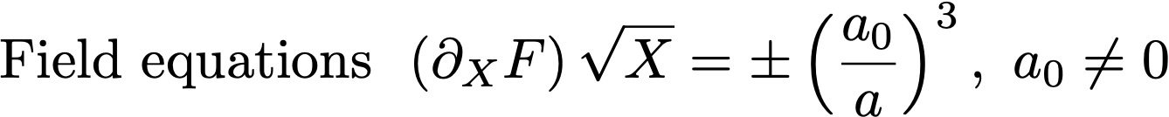
Flat k-essence: cosmological equations

Slide 14
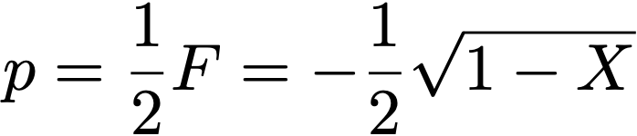
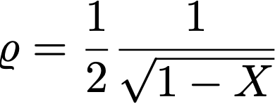
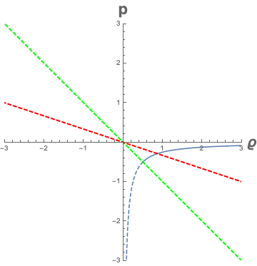
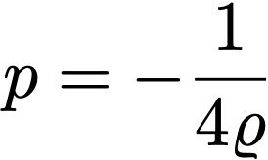

The Chaplygin Gas again

Slide 15
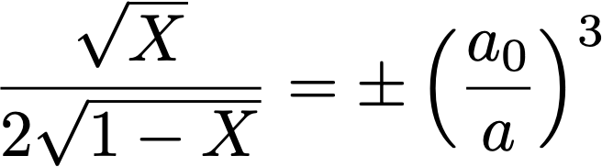
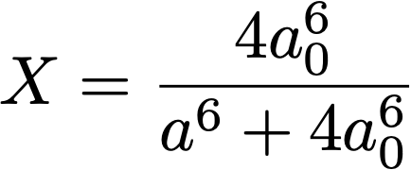
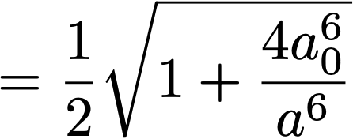
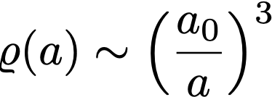
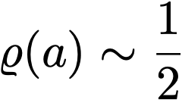
Solving the FE : the Chaplygin Gas

Slide 16
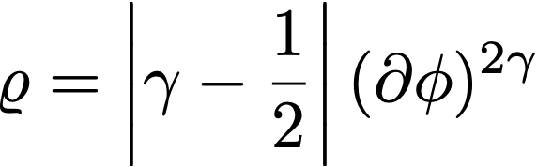
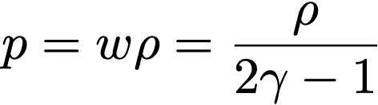
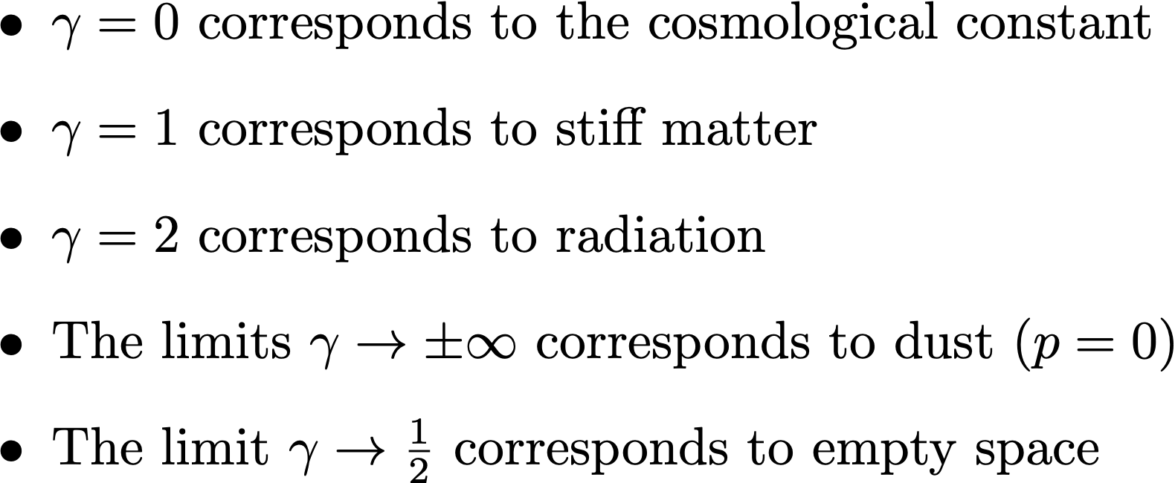
Barotropic fluids

Slide 17
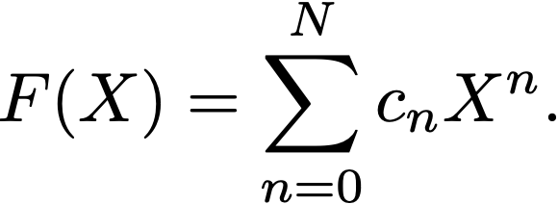
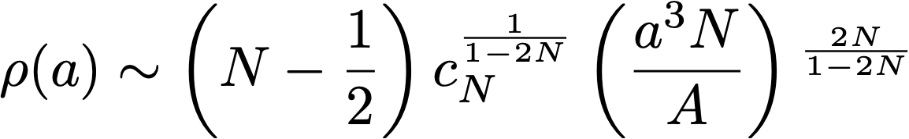
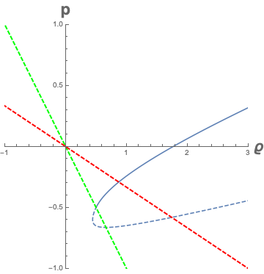
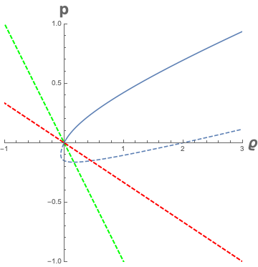
Polynomial interactions: standard case

Slide 18
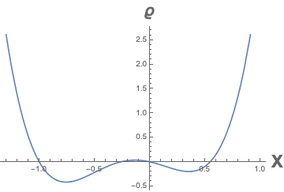
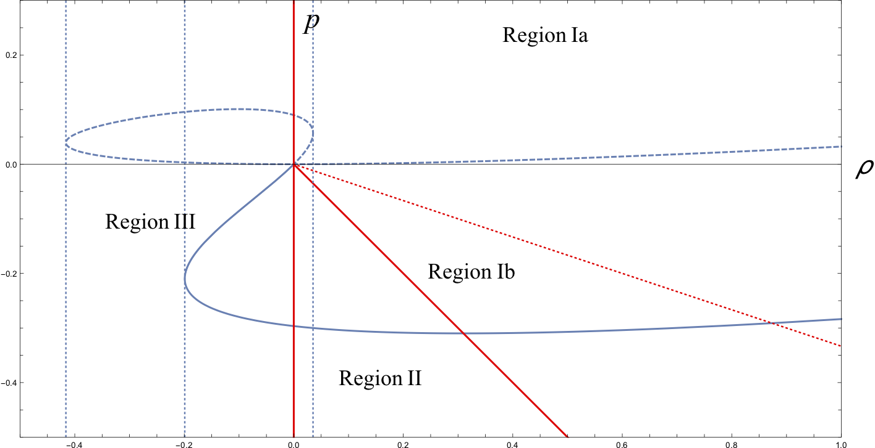

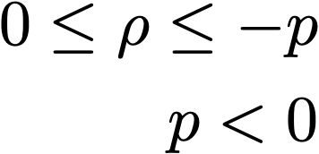

Polynomial interactions: general case

Slide 19

A completely soluble model: lessons form the quartic self-interaction

Slide 20

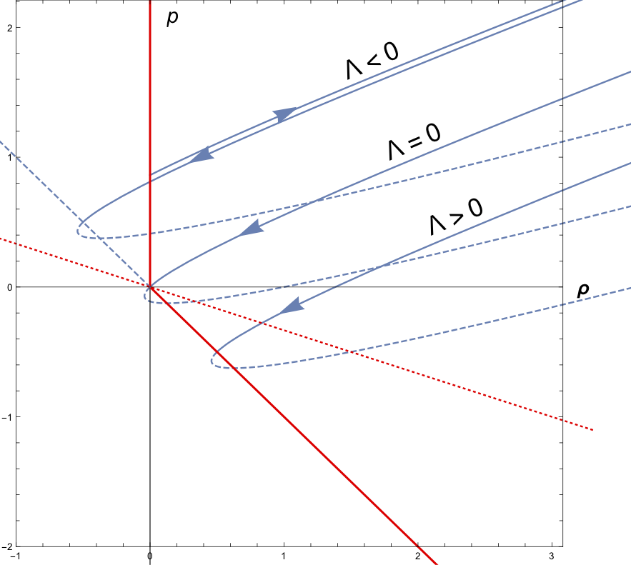

K-essence with a cosmological constant

Slide 21






K-essence with a cosmological constant

Slide 22






With the cosmological constant

Slide 23




Only Λ<0

Slide 24








Without the cosmological constant

Slide 25



Slide 26






Slide 27







Vacuum Cosmological Equations

Slide 28




Spherical de Sitter model

Slide 29


Flat de Sitter model (Lemaître, 1924)

Slide 30

Open de Sitter model (de Sitter 1917)

Slide 31




Slide 32




Mimicking a negative cosmological constant

Slide 33





Phenomenology of a branching point

Slide 34

Phenomenology of a branching point

Slide 35

Phenomenology of a branching point

Slide 36



Phenomenology of a branching point

Slide 37



Phenomenology of a branching point

Slide 38
So what happens at the branching point?

Slide 39


First scenario

Slide 40

First interpretation
When the field gets at the critical point the density reaches a maximum and the universe cannot shrink anymore. Like in the elastic collision the sign of the velocity is reverted. The expansion following the collision keeps decelerating as the acceleration in this model is always negative.

Slide 41



Second interpretation

Slide 42
Second interpretation
The ramification point in the equation of state is encountered twice during the time evolution. When the universe gets at the ramification point the time starts flowing backward till the universe gets again to the ramification point, when the usual forward orientation of time is recovered. The phenomenology is essentially the same as in the previous conservative description but the inversion of the velocity is caused by an inversion of the sense of the flow of time, inversion that is short-lived.
Borrowing from relativistic quantum mechanics ideas it is tempting to say that a universe pair is annihilated when the ramification point is first encountered; a pair of universes is created when the ramification point is encountered a second time.
There is only one possible difference. Since the time runs backward the instability due to the negative squared velocity of sound needs to be reconsidered.

Slide 43


General models (non pure)

Slide 44
General models (non pure)

