Slide 1
Inhomogeneous extra dimensions
Sergey Rubin, Polina Petriakova
SW14 - 2022, May

Slide 2
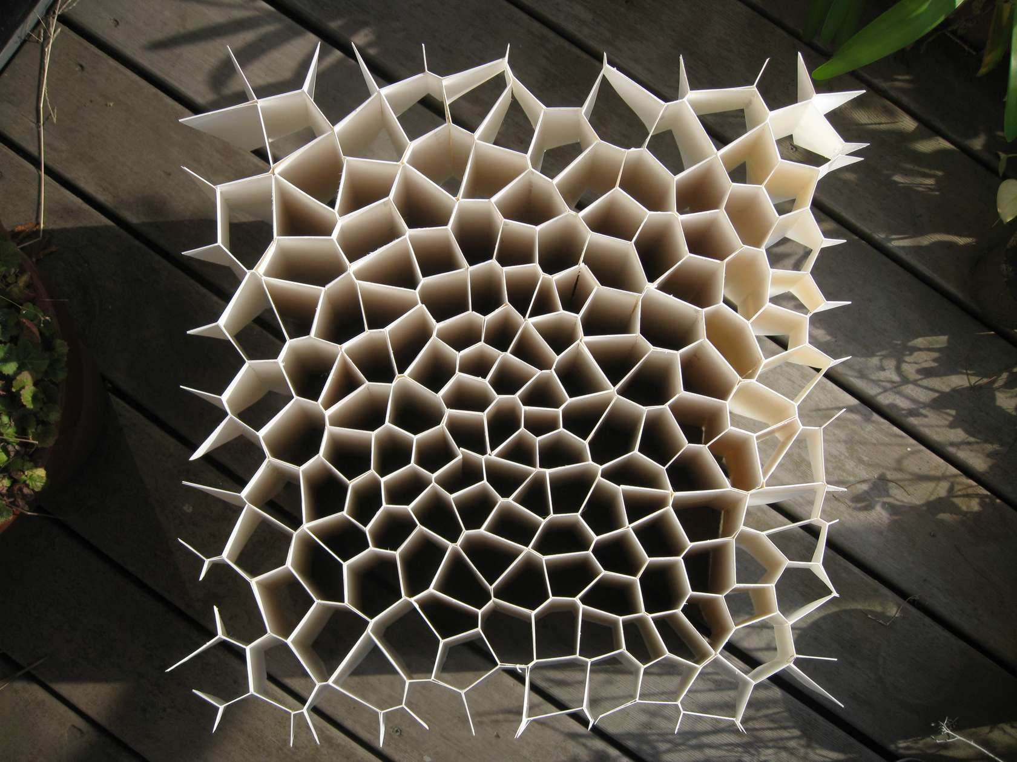
Short introduction
Assumption (looks realistic):
our space-time was nucleated at the (sub-)Planck energy scale together with the physical laws
All quantities are of the Planck scale - the horizon size and the Lagrangian parameters
Problems:
Hierarchy
How the space and the Lagrangian parameters have evolved to the present values?
Why the observed parameters are so small as compared to those at high energies?
Fine tuning
Low energy parameters are strongly adjusted to each other to allow the intelligent life.
Multiverse?
Physical parameters are different in
different causally disconnected volumes (pocket universes)!?
There is no reliable tool responsible for this difference
Inhomogeneous extra dimensions

Slide 3
How to shift high energy parameters to small energies (main idea)
m_{D} = 1
Assume that our space was nucleated being D-dimensional manifold.
We are living in 4 dimensions now, therefore extra D-4 coordinates should be excluded
- effective parameters depend on initial parameters and extra space metric
Equations to be solved:
Hierarchy
Strategy N1 - fix extra metric and find the Lagrangian parameters p_{D} -
We come back to the previous difficulty with p_{D} instead of p₄ . -
There is no tool responsible for substantional set of p_{D}
Strategy N2 - fix the Lagrangian parameters and find extra metric -
There IS tool responsible for a set of g_{extra}
Quantum fluctuations produce continuum set of various metrics
Inhomogeneous extra metrics form a wide set of the metrics caused by quantum fluctuations
Maximally symmetric extra metric?

Slide 4
Maximally symmetric extra space
Evolution from high to low energies
classiсal equations

Slide 5
Asymptotic:

Slide 6
Maximally symmetric extra space leads to unacceptable final states at low energies.
Final stage is described by de Sitter 4-dim metric.
The space expansion and fluctuations of the metric and/or scalar field can last for an arbitrarily long time.
Their scale quickly overcomes the present horizon.
Number of pocket universes (causally disconnected domains under horizon) tends to $∞$
The fluctuations within the extra space are of most interest.
Some of them can deform the extra metric significantly and in different way in each pocket universe.
initial coditions in
pocket universes
differ each other
extra space metric in
pocket universes
differ each other
Disturbed extra metrics evolve to different static inhomogeneous extra metrics (if they exist).

Slide 7
Inhomogeneous static extra dimensions. Do they exist?
Differential equations need
additional conditions (continuum set)
to choose a particular solution
Cosmological (x-homogeneous) solutions

Slide 8
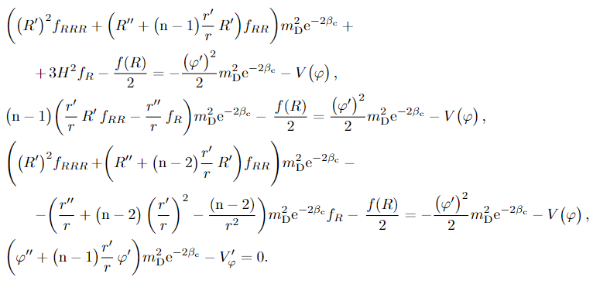
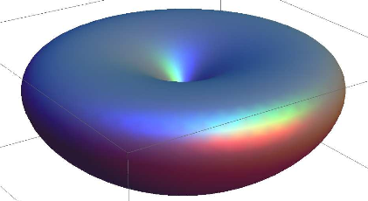
Inhomogeneous static extra dimensions in de Sitter space
The search of static metrics.
continuum set of solutions
Each metric function r(u) and scalar field (u) relates to specific auxilliary conditions
Each pocket universe is characterized by unique extra metric

Slide 9
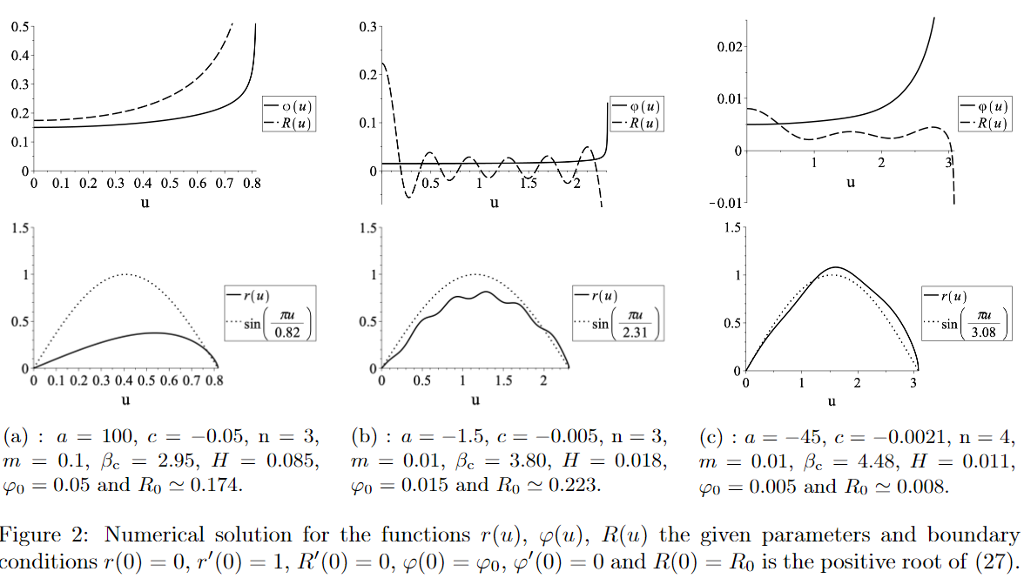
Continuous set of metrics of extra dimensions

Slide 10
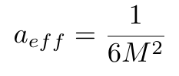
Application of inhomogeneous extra metrics. Specific example.
(**)
The Starobinsky model
10⁹
10⁻¹²³
4-dim Planck units
Start with the same action at high energies:
(*)
~ 1
~ 1
D-dim Planck units
p₄ =?
Choose parameter values a,c
Solve classical equations to obtain r(u), $φ(u)$
Substitute solution into (*)
Compare with (**)

Slide 11
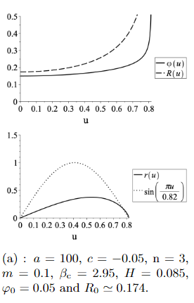
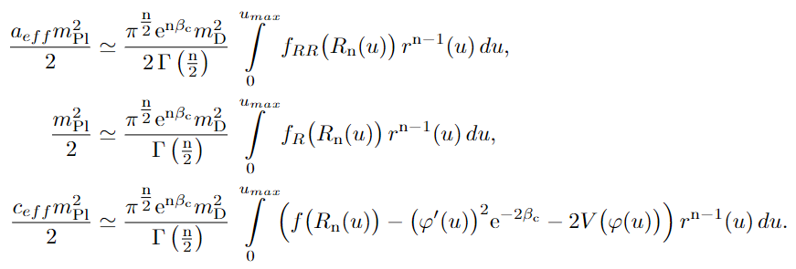
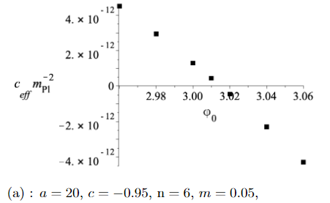
Observable inflation. Self-tuning
These relations can be treated as equations for
It is the extra metric that is responsible for variation of low-energy parameters

Slide 12
Initial parameters (energy scale ~ 10¹⁴ GeV)
We have continuum set of extra metrics
marked by values
Parameters are not very large/small
a,c are the same in each
pocket universe. Metric is different
observable parameters (energy scale ~ 10¹³GeV)

Slide 13
For Future
Inhomogeneous extra metric
depends on initial fluctuations
system of equations
for low-energy parameters:
Hierarchi
~10¹⁴⁻¹⁹ GeV
0 ~ 100 GeV

Slide 14
CONCLUSION
-A continuum set of static inhomogeneous extra dimensionional metrics
appears due to quantum fluctuatons
- Each pocket universe of the Multiverse is endowed by specific extra metric
- Some of pocket universes contain observable 4-dim physics because the low energy parameters depend on extra metric.
All these looks like the reasonable idea. If YES, then we need:
-Much more complex extra metric (to involve the Standard Model)
-Supergravity (to insert fermions)
- Renormalization (parameters depend on energy)
- Stability

Slide 15
Remark on charge generation and its consevation
Baryon asymmetry leads to conflicting requirements:
-charge should be generated (in the beginning)
and
-charge is conserved (at the present times).
This contradiction is naturally dissolved if we admit that
quantum fluctuations produce deformed metrics
Entropy of extra space tends to minimum due to
its outflow into main space.
Entropy is decreasing hence the process
of symmetrization takes place.
Hence, asymptotic metrics aquires the Killing vectors
This metric is
invariant under
rotation
A. A. Kirillov, A. A. Korotkevich, S.G. Rubin, Emergence of symmetries, Physics Letters B 718
(2012) 237-240, arXiv:1205.1108 [gr-qc].
(momentum along the Killing vector)
Application to the baryon asymmetry in our Universe
looks promissing
Formation of conserved charges and deformed extra space,
Sergey G. Rubin, Antonio Troisi,
International Journal of Modern Physics D, Vol. 27 (2018) 1841007

Slide 16
Remark on Quantum corrections to the cosmological constant
Equation for the extra metric g_{n}
?
Quantum correction should be compared
with initial parameters
but not with observational valued
!
$$c,g_{n}→c+δс, g_{n}+ δg_{n}$$

Slide 17
Thank you

